Slide 1

DIVINE GRACE COLLEGE OF ARTS, SCIENCE AND TECHNOLOGY
(DGCAST) — GAROUA | GEOGRAPHY DEPARTMENT
FORM 2 TECHNICAL — LESSON 2 (PART 2)
The Tropical Grassland Region: Characteristics (Soils and Vegetation)
Mr KAMDEM EMMANUEL
Geography Teacher — PLEG
Academic Year 2026 / 2027
Notes:
Good morning, class. Today we study The Tropical Grassland Region, part 2: Characteristics (Soils and Vegetation).

Slide 2
ECO. GEOGRAPHY — FORM 2 TECH
CLASS INFO
Class, Chapter & Duration
Class | Form 2 Technical
Chapter | Economic Geography — Natural Regions: 2. The Tropical Grassland Region
Duration | 2 periods (2 × 50 minutes)
2026 / 2027
DGCAST GAROUA — GEOGRAPHY DEPARTMENT
Mr KAMDEM E. | 2

Slide 3
ECO. GEOGRAPHY — FORM 2 TECH
IDENTIFICATION
Lesson Identification
Topic | Man in His Environment
Sub-topic | Natural Regions
Lesson | Lesson 2: The Tropical Grassland Region — Part 2: Characteristics (Soils and Vegetation)
Notions / Concepts | Savanna, deciduous, xerophyte, ferruginous soil, laterite, black cotton soil.
Syllabus focus | Characteristics of the soils and vegetation of the Tropical Grassland region.
Competence | Learners are able to recognise the trees and soils of the savanna around them and explain why some trees lose their leaves in the dry season.
2026 / 2027
DGCAST GAROUA — GEOGRAPHY DEPARTMENT
Mr KAMDEM E. | 3

Slide 4
ECO. GEOGRAPHY — FORM 2 TECH
OBJECTIVES
Learning Objectives
By the end of the lesson, the learner should be able to:
Describe the vegetation of the Tropical Grassland region.
Explain how savanna plants are adapted to the dry season and to bush fires.
Describe the main soils of the Tropical Grassland region.
2026 / 2027
DGCAST GAROUA — GEOGRAPHY DEPARTMENT
Mr KAMDEM E. | 4

Slide 5
ECO. GEOGRAPHY — FORM 2 TECH
RECALL
Recall
The Tropical Grassland lies between 5° and 15° north and south of the Equator.
It has a wet season and a dry season, with 500 to 1,500 mm of rain.
Garoua has a dry season from November to March.
2026 / 2027
DGCAST GAROUA — GEOGRAPHY DEPARTMENT
Mr KAMDEM E. | 5
Notes:
Check the homework: which trees keep or lose their leaves in the dry season?

Slide 6
ECO. GEOGRAPHY — FORM 2 TECH
REAL-LIFE SITUATION
Real-Life Situation
In January, Hawa travels from Garoua to Ngaoundéré. The grass is dry and yellow, and many trees have no leaves. But one big tree, the shea tree, still has leaves, and its bark is not burnt.
2026 / 2027
DGCAST GAROUA — GEOGRAPHY DEPARTMENT
Mr KAMDEM E. | 6
Notes:
Read the situation slowly, twice.

Slide 7
ECO. GEOGRAPHY — FORM 2 TECH
REAL-LIFE SITUATION
Situation — Question 1
What is the problem in the situation?
2026 / 2027
DGCAST GAROUA — GEOGRAPHY DEPARTMENT
Mr KAMDEM E. | 7

Slide 8
ECO. GEOGRAPHY — FORM 2 TECH
REAL-LIFE SITUATION
Answer
Hawa does not know how savanna plants survive the dry season.
2026 / 2027
DGCAST GAROUA — GEOGRAPHY DEPARTMENT
Mr KAMDEM E. | 8

Slide 9
ECO. GEOGRAPHY — FORM 2 TECH
REAL-LIFE SITUATION
Situation — Question 2
What did Hawa see?
2026 / 2027
DGCAST GAROUA — GEOGRAPHY DEPARTMENT
Mr KAMDEM E. | 9

Slide 10
ECO. GEOGRAPHY — FORM 2 TECH
REAL-LIFE SITUATION
Answer
Dry grass and trees without leaves.
2026 / 2027
DGCAST GAROUA — GEOGRAPHY DEPARTMENT
Mr KAMDEM E. | 10

Slide 11
ECO. GEOGRAPHY — FORM 2 TECH
REAL-LIFE SITUATION
Situation — Question 3
How can we protect the trees from fire?
2026 / 2027
DGCAST GAROUA — GEOGRAPHY DEPARTMENT
Mr KAMDEM E. | 11

Slide 12
ECO. GEOGRAPHY — FORM 2 TECH
REAL-LIFE SITUATION
Possible Answer
We can avoid bush fires and make firebreaks.
2026 / 2027
DGCAST GAROUA — GEOGRAPHY DEPARTMENT
Mr KAMDEM E. | 12

Slide 13
ECO. GEOGRAPHY — FORM 2 TECH
JUSTIFICATION
Justification of the Lesson
This lesson helps us to know the plants and soils around us.
2026 / 2027
DGCAST GAROUA — GEOGRAPHY DEPARTMENT
Mr KAMDEM E. | 13

Slide 14
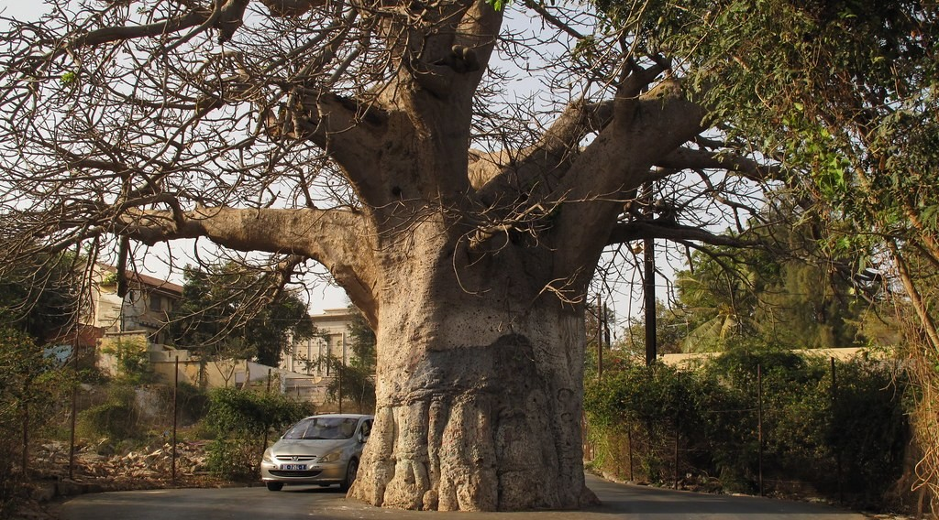
ECO. GEOGRAPHY — FORM 2 TECH
I. VEGETATION
Activity 1
A baobab tree.
2026 / 2027
DGCAST GAROUA — GEOGRAPHY DEPARTMENT
Mr KAMDEM E. | 14
Notes:
Without the projector: ask learners where they have seen a baobab.

Slide 15
ECO. GEOGRAPHY — FORM 2 TECH
I. VEGETATION
Activity 1: Question
Look at the trunk of the baobab. How does it help the tree in the dry season?
2026 / 2027
DGCAST GAROUA — GEOGRAPHY DEPARTMENT
Mr KAMDEM E. | 15

Slide 16
ECO. GEOGRAPHY — FORM 2 TECH
I. VEGETATION
Answer
The big trunk keeps water for the dry season.
2026 / 2027
DGCAST GAROUA — GEOGRAPHY DEPARTMENT
Mr KAMDEM E. | 16

Slide 17
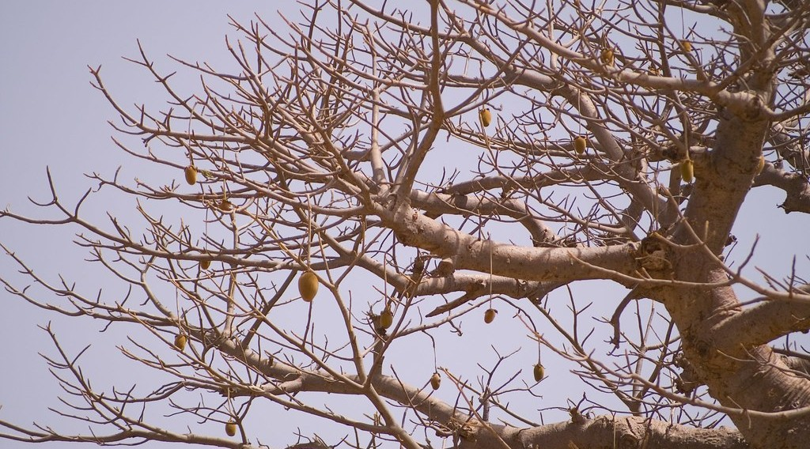
ECO. GEOGRAPHY — FORM 2 TECH
I. VEGETATION
Activity 2
A tree without leaves in the dry season.
2026 / 2027
DGCAST GAROUA — GEOGRAPHY DEPARTMENT
Mr KAMDEM E. | 17
Notes:
Without the projector: ask learners which trees near their home lose their leaves.

Slide 18
ECO. GEOGRAPHY — FORM 2 TECH
I. VEGETATION
Activity 2: Question
Why do many savanna trees lose their leaves in the dry season?
2026 / 2027
DGCAST GAROUA — GEOGRAPHY DEPARTMENT
Mr KAMDEM E. | 18

Slide 19
ECO. GEOGRAPHY — FORM 2 TECH
I. VEGETATION
Answer
To lose less water when there is no rain.
2026 / 2027
DGCAST GAROUA — GEOGRAPHY DEPARTMENT
Mr KAMDEM E. | 19

Slide 20

ECO. GEOGRAPHY — FORM 2 TECH
I. VEGETATION
Activity 3
A shea tree (karité).
2026 / 2027
DGCAST GAROUA — GEOGRAPHY DEPARTMENT
Mr KAMDEM E. | 20
Notes:
Without the projector: bring a piece of shea bark or shea butter to class.

Slide 21
ECO. GEOGRAPHY — FORM 2 TECH
I. VEGETATION
Activity 3: Question
The shea tree has a thick bark. How does it help the tree?
2026 / 2027
DGCAST GAROUA — GEOGRAPHY DEPARTMENT
Mr KAMDEM E. | 21

Slide 22
ECO. GEOGRAPHY — FORM 2 TECH
I. VEGETATION
Answer
The thick bark protects the tree from bush fires.
2026 / 2027
DGCAST GAROUA — GEOGRAPHY DEPARTMENT
Mr KAMDEM E. | 22

Slide 23

ECO. GEOGRAPHY — FORM 2 TECH
II. SOILS
Activity 4
Bricks cut from red laterite.
2026 / 2027
DGCAST GAROUA — GEOGRAPHY DEPARTMENT
Mr KAMDEM E. | 23
Notes:
Without the projector: ask learners the colour of the soil of the school yard.

Slide 24
ECO. GEOGRAPHY — FORM 2 TECH
II. SOILS
Activity 4: Question
This red soil becomes very hard when it dries. What is it called? What do we use it for?
2026 / 2027
DGCAST GAROUA — GEOGRAPHY DEPARTMENT
Mr KAMDEM E. | 24

Slide 25
ECO. GEOGRAPHY — FORM 2 TECH
II. SOILS
Answer
It is laterite. We use it for roads and bricks.
2026 / 2027
DGCAST GAROUA — GEOGRAPHY DEPARTMENT
Mr KAMDEM E. | 25

Slide 26

ECO. GEOGRAPHY — FORM 2 TECH
II. SOILS
Activity 5
Clay soil with big cracks in the dry season.
2026 / 2027
DGCAST GAROUA — GEOGRAPHY DEPARTMENT
Mr KAMDEM E. | 26
Notes:
Without the projector: describe the black soils (karal) of the Far North.

Slide 27
ECO. GEOGRAPHY — FORM 2 TECH
II. SOILS
Activity 5: Question
Black cotton soils are clay soils that crack when dry. Why do farmers like them?
2026 / 2027
DGCAST GAROUA — GEOGRAPHY DEPARTMENT
Mr KAMDEM E. | 27

Slide 28
ECO. GEOGRAPHY — FORM 2 TECH
II. SOILS
Answer
It is fertile and keeps water. It is good for cotton and sorghum.
2026 / 2027
DGCAST GAROUA — GEOGRAPHY DEPARTMENT
Mr KAMDEM E. | 28

Slide 29
ECO. GEOGRAPHY — FORM 2 TECH
BOARD SUMMARY
The Tropical Grassland Region
Topic: Man in His Environment
Sub-topic: Natural Regions
Lesson 2: The Tropical Grassland Region — Part 2: Characteristics (Soils and Vegetation)
2026 / 2027
DGCAST GAROUA — GEOGRAPHY DEPARTMENT
Mr KAMDEM E. | 29
Notes:
Learners copy the board summary now. Give them enough time for each slide.

Slide 30
ECO. GEOGRAPHY — FORM 2 TECH
BOARD SUMMARY
I. Definitions
Deciduous tree: It is a tree that loses its leaves in the dry season.
Laterite: It is a hard, red layer in the soil.
Leaching: It is the washing of plant food deep into the soil.
2026 / 2027
DGCAST GAROUA — GEOGRAPHY DEPARTMENT
Mr KAMDEM E. | 30

Slide 31
ECO. GEOGRAPHY — FORM 2 TECH
BOARD SUMMARY
II. Vegetation (1/2)
The vegetation of the savanna is:
A. Grass: Tall grass grows up to 3 metres high.
B. Trees: Baobab, acacia and shea trees grow far apart.
C. Adaptation: Many trees lose their leaves in the dry season.
2026 / 2027
DGCAST GAROUA — GEOGRAPHY DEPARTMENT
Mr KAMDEM E. | 31

Slide 32
ECO. GEOGRAPHY — FORM 2 TECH
BOARD SUMMARY
II. Vegetation (2/2)
D. Thick bark: It protects trees from bush fires.
2026 / 2027
DGCAST GAROUA — GEOGRAPHY DEPARTMENT
Mr KAMDEM E. | 32

Slide 33
ECO. GEOGRAPHY — FORM 2 TECH
BOARD SUMMARY
III. Soils
The soils of the savanna are:
A. Red soils: They are only fairly fertile.
B. Laterite: It is used for roads and bricks.
C. Black cotton soils: They are fertile and keep water.
D. Little humus: Bush fires burn the dead plants.
2026 / 2027
DGCAST GAROUA — GEOGRAPHY DEPARTMENT
Mr KAMDEM E. | 33

Slide 34
ECO. GEOGRAPHY — FORM 2 TECH
FORMATIVE EVALUATION
Formative Evaluation 1
Give two ways savanna trees survive the dry season.
2026 / 2027
DGCAST GAROUA — GEOGRAPHY DEPARTMENT
Mr KAMDEM E. | 34

Slide 35
ECO. GEOGRAPHY — FORM 2 TECH
FORMATIVE EVALUATION
Expected Answer
They lose their leaves; the baobab keeps water in its trunk.
2026 / 2027
DGCAST GAROUA — GEOGRAPHY DEPARTMENT
Mr KAMDEM E. | 35

Slide 36
ECO. GEOGRAPHY — FORM 2 TECH
FORMATIVE EVALUATION
Formative Evaluation 2
What is laterite used for?
2026 / 2027
DGCAST GAROUA — GEOGRAPHY DEPARTMENT
Mr KAMDEM E. | 36

Slide 37
ECO. GEOGRAPHY — FORM 2 TECH
FORMATIVE EVALUATION
Expected Answer
For roads and bricks.
2026 / 2027
DGCAST GAROUA — GEOGRAPHY DEPARTMENT
Mr KAMDEM E. | 37

Slide 38
ECO. GEOGRAPHY — FORM 2 TECH
REMEDIATION
Remediation
Fill in the blanks:
Trees that lose their leaves are ______ trees.
The tree that keeps water in its trunk is the ______.
The hard red layer in the soil is ______.
2026 / 2027
DGCAST GAROUA — GEOGRAPHY DEPARTMENT
Mr KAMDEM E. | 38
Notes:
Answers: 1. deciduous 2. baobab 3. laterite

Slide 39
ECO. GEOGRAPHY — FORM 2 TECH
HOMEWORK
Homework
List three things that people in your family get from the savanna around Garoua, for example food, wood or animals.
This prepares Part 3: Types of Resources and Methods of Exploitation.
2026 / 2027
DGCAST GAROUA — GEOGRAPHY DEPARTMENT
Mr KAMDEM E. | 39
Notes:
This homework prepares the next lesson.

Slide 40
ECO. GEOGRAPHY — FORM 2 TECH
BILINGUAL GAME
Bilingual Game (Jeu Bilingue)
English | Français
Savanna | La savane
Grass | L'herbe
Deciduous tree | L'arbre à feuilles caduques
Bush fire | Le feu de brousse
Shea tree | Le karité
Baobab | Le baobab
Laterite | La latérite
Leaching | Le lessivage
2026 / 2027
DGCAST GAROUA — GEOGRAPHY DEPARTMENT
Mr KAMDEM E. | 40
Notes:
Say the English word; learners give the French word, then the reverse.

Slide 41
ECO. GEOGRAPHY — FORM 2 TECH
LOGBOOK
Official Logbook (1/2)
Module / Topic | Man in His Environment
Lesson Title | Lesson 2: The Tropical Grassland Region — Part 2: Characteristics (Soils and Vegetation)
Expected Learning Outcomes | Describe the vegetation of the Tropical Grassland region. Explain how savanna plants are adapted to the dry season and to bush fires. Describe the main soils of the Tropical Grassland region.
Competence | Learners are able to recognise the trees and soils of the savanna around them and explain why some trees lose their leaves in the dry season.
2026 / 2027
DGCAST GAROUA — GEOGRAPHY DEPARTMENT
Mr KAMDEM E. | 41

Slide 42
ECO. GEOGRAPHY — FORM 2 TECH
LOGBOOK
Official Logbook (2/2)
Matter Taught | I. Definitions: Deciduous tree, Laterite, Leaching; II. Vegetation: Grass, Trees, Adaptation, Thick bark; III. Soils: Red soils, Laterite, Black cotton soils, Little humus.
Evaluation | Formative evaluation (3 questions) and remediation exercise.
Homework | List three things that people in your family get from the savanna around Garoua, for example food, wood or animals.
Enrolment / Present / Absent | ____ / ____ / ____
Achievement | To be completed by the teacher after the lesson.
2026 / 2027
DGCAST GAROUA — GEOGRAPHY DEPARTMENT
Mr KAMDEM E. | 42

Slide 43
ECO. GEOGRAPHY — FORM 2 TECH
TEACHER'S NOTE
Teacher's Note
Timing: Set-up, recall 8 min | Situation 8 min | 5 activities 25 min | Board summary (copying) 30 min | Evaluation, remediation 10 min | Homework 4 min | Logbook 10 min | Spare 5 min
2026 / 2027
DGCAST GAROUA — GEOGRAPHY DEPARTMENT
Mr KAMDEM E. | 43

Slide 44
ECO. GEOGRAPHY — FORM 2 TECH
REFERENCES
References
Harmonised Progression Sheet, Economic Geography (5051), Form 2.
Class textbook: The major biomes of the world (tropical grassland).
Photo, Activity 1: “What happens if you let weeds grow in centre of road, Dakar, Senegal” by ambabheg, CC BY 2.0, via Flickr (https://www.flickr.com/photos/31518985@N04/5627872663)
Photo, Activity 2: “'Pain de singe' (monkey's bread) in a baobab, Senegal” by Milamber's portfolio, CC BY-NC-ND 2.0, via Flickr (https://www.flickr.com/photos/90956808@N00/420120264)
Photo, Activity 3: “Female shea tree (Vitellaria paradoxa) in full flower” by Joel Abroad, CC BY-NC-SA 2.0, via Flickr (https://www.flickr.com/photos/40295335@N00/5603751456)
Photo, Activity 4: “Laterite soil bricks in Richard Rebello's farm” by India Water Portal, CC BY-NC-SA 2.0, via Flickr (https://www.flickr.com/photos/21623815@N03/10720461943)
Photo, Activity 5: “Cracked Earth” by Aleatoric Consonance, CC BY 2.0, via Flickr (https://www.flickr.com/photos/93921318@N00/3772011444)
Diagrams and animations: drawn for this lesson (DGCAST Geography Department).
2026 / 2027
DGCAST GAROUA — GEOGRAPHY DEPARTMENT
Mr KAMDEM E. | 44

