Slide 1

DIVINE GRACE COLLEGE OF ARTS, SCIENCE AND TECHNOLOGY
(DGCAST) — GAROUA | GEOGRAPHY DEPARTMENT
FORM 2 TECHNICAL — LESSON 2 (PART 4)
The Tropical Grassland Region: Human Activities
Mr KAMDEM EMMANUEL
Geography Teacher — PLEG
Academic Year 2026 / 2027
Notes:
Good morning, class. Today we study The Tropical Grassland Region, part 4: Human Activities.

Slide 2
ECO. GEOGRAPHY — FORM 2 TECH
CLASS INFO
Class, Chapter & Duration
Class | Form 2 Technical
Chapter | Economic Geography — Natural Regions: 2. The Tropical Grassland Region
Duration | 2 periods (2 × 50 minutes)
2026 / 2027
DGCAST GAROUA — GEOGRAPHY DEPARTMENT
Mr KAMDEM E. | 2

Slide 3
ECO. GEOGRAPHY — FORM 2 TECH
IDENTIFICATION
Lesson Identification
Topic | Man in His Environment
Sub-topic | Natural Regions
Lesson | Lesson 2: The Tropical Grassland Region — Part 4: Human Activities
Notions / Concepts | Crop farming, cash crop, food crop, livestock rearing, nomadic pastoralism, transhumance, hunting.
Syllabus focus | Human activities of the Tropical Grassland region: farming, livestock rearing, hunting, lumbering and others.
Competence | Learners are able to describe the work of farmers and herders around them and explain why herders move with their animals.
2026 / 2027
DGCAST GAROUA — GEOGRAPHY DEPARTMENT
Mr KAMDEM E. | 3

Slide 4
ECO. GEOGRAPHY — FORM 2 TECH
OBJECTIVES
Learning Objectives
By the end of the lesson, the learner should be able to:
Describe crop farming in the Tropical Grassland region.
Describe livestock rearing, including nomadic pastoralism and transhumance.
Describe hunting, fishing and wood cutting in the Tropical Grassland region.
2026 / 2027
DGCAST GAROUA — GEOGRAPHY DEPARTMENT
Mr KAMDEM E. | 4

Slide 5
ECO. GEOGRAPHY — FORM 2 TECH
RECALL
Recall
The resources of the savanna are pasture, farmland, wildlife, water and trees.
People exploit them by farming, livestock rearing, tourism, fishing and cutting trees.
2026 / 2027
DGCAST GAROUA — GEOGRAPHY DEPARTMENT
Mr KAMDEM E. | 5
Notes:
Check the homework: what did learners find out from farmers or herders?

Slide 6
ECO. GEOGRAPHY — FORM 2 TECH
REAL-LIFE SITUATION
Real-Life Situation
Every year in November, Adamou, a Fulani herder, leaves his village near Garoua with his cattle. He walks south for weeks and comes back when the rains return. His classmate Paul thinks Adamou is lost.
2026 / 2027
DGCAST GAROUA — GEOGRAPHY DEPARTMENT
Mr KAMDEM E. | 6
Notes:
Read the situation slowly, twice.

Slide 7
ECO. GEOGRAPHY — FORM 2 TECH
REAL-LIFE SITUATION
Situation — Question 1
What is the problem in the situation?
2026 / 2027
DGCAST GAROUA — GEOGRAPHY DEPARTMENT
Mr KAMDEM E. | 7

Slide 8
ECO. GEOGRAPHY — FORM 2 TECH
REAL-LIFE SITUATION
Answer
Paul does not understand why Adamou moves every year.
2026 / 2027
DGCAST GAROUA — GEOGRAPHY DEPARTMENT
Mr KAMDEM E. | 8

Slide 9
ECO. GEOGRAPHY — FORM 2 TECH
REAL-LIFE SITUATION
Situation — Question 2
When does Adamou leave, and when does he come back?
2026 / 2027
DGCAST GAROUA — GEOGRAPHY DEPARTMENT
Mr KAMDEM E. | 9

Slide 10
ECO. GEOGRAPHY — FORM 2 TECH
REAL-LIFE SITUATION
Answer
He leaves in November and comes back when the rains return.
2026 / 2027
DGCAST GAROUA — GEOGRAPHY DEPARTMENT
Mr KAMDEM E. | 10

Slide 11
ECO. GEOGRAPHY — FORM 2 TECH
REAL-LIFE SITUATION
Situation — Question 3
Why does he move?
2026 / 2027
DGCAST GAROUA — GEOGRAPHY DEPARTMENT
Mr KAMDEM E. | 11

Slide 12
ECO. GEOGRAPHY — FORM 2 TECH
REAL-LIFE SITUATION
Possible Answer
To find grass and water for his cattle.
2026 / 2027
DGCAST GAROUA — GEOGRAPHY DEPARTMENT
Mr KAMDEM E. | 12

Slide 13
ECO. GEOGRAPHY — FORM 2 TECH
JUSTIFICATION
Justification of the Lesson
This lesson helps us to know the work of the people of the savanna.
2026 / 2027
DGCAST GAROUA — GEOGRAPHY DEPARTMENT
Mr KAMDEM E. | 13

Slide 14

ECO. GEOGRAPHY — FORM 2 TECH
I. CROP FARMING
Activity 1
Farmers harvest cotton.
2026 / 2027
DGCAST GAROUA — GEOGRAPHY DEPARTMENT
Mr KAMDEM E. | 14
Notes:
Without the projector: ask learners which crops their family sells.

Slide 15
ECO. GEOGRAPHY — FORM 2 TECH
I. CROP FARMING
Activity 1: Question
Do farmers grow cotton to eat it or to sell it? What do we call this type of crop?
2026 / 2027
DGCAST GAROUA — GEOGRAPHY DEPARTMENT
Mr KAMDEM E. | 15

Slide 16
ECO. GEOGRAPHY — FORM 2 TECH
I. CROP FARMING
Answer
To sell it. It is a cash crop.
2026 / 2027
DGCAST GAROUA — GEOGRAPHY DEPARTMENT
Mr KAMDEM E. | 16

Slide 17

ECO. GEOGRAPHY — FORM 2 TECH
I. CROP FARMING
Activity 2
A rice field with water.
2026 / 2027
DGCAST GAROUA — GEOGRAPHY DEPARTMENT
Mr KAMDEM E. | 17
Notes:
Without the projector: mention the rice fields of Lagdo and Yagoua (SEMRY).

Slide 18
ECO. GEOGRAPHY — FORM 2 TECH
I. CROP FARMING
Activity 2: Question
Rice needs a lot of water. How do farmers get water in the dry savanna?
2026 / 2027
DGCAST GAROUA — GEOGRAPHY DEPARTMENT
Mr KAMDEM E. | 18

Slide 19
ECO. GEOGRAPHY — FORM 2 TECH
I. CROP FARMING
Answer
They bring water from rivers and dams to the fields: irrigation.
2026 / 2027
DGCAST GAROUA — GEOGRAPHY DEPARTMENT
Mr KAMDEM E. | 19

Slide 20
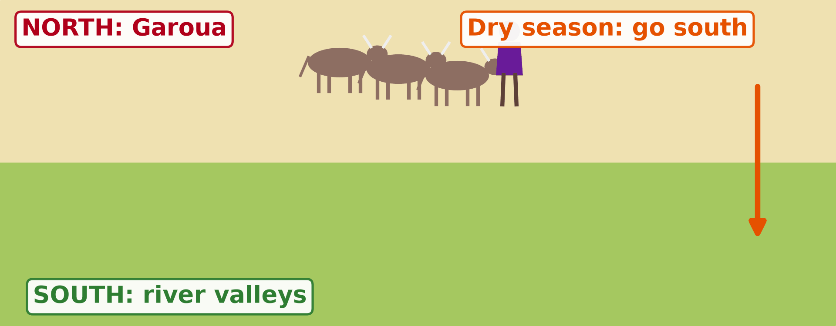
ECO. GEOGRAPHY — FORM 2 TECH
II. LIVESTOCK REARING
Activity 3
Animation: the herder moves with his cattle.
2026 / 2027
DGCAST GAROUA — GEOGRAPHY DEPARTMENT
Mr KAMDEM E. | 20
Notes:
Without the projector: draw an arrow going south and an arrow going north on the board.

Slide 21
ECO. GEOGRAPHY — FORM 2 TECH
II. LIVESTOCK REARING
Activity 3: Question
Where does the herder go in the dry season? And in the rainy season?
2026 / 2027
DGCAST GAROUA — GEOGRAPHY DEPARTMENT
Mr KAMDEM E. | 21

Slide 22
ECO. GEOGRAPHY — FORM 2 TECH
II. LIVESTOCK REARING
Answer
South in the dry season; back north in the rainy season.
2026 / 2027
DGCAST GAROUA — GEOGRAPHY DEPARTMENT
Mr KAMDEM E. | 22

Slide 23
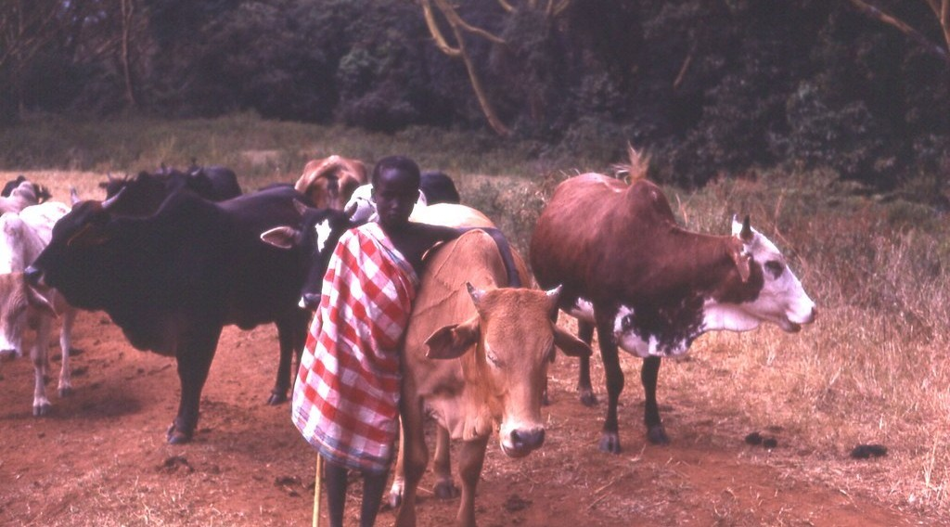
ECO. GEOGRAPHY — FORM 2 TECH
II. LIVESTOCK REARING
Activity 4
Maasai herders with their cattle in East Africa.
2026 / 2027
DGCAST GAROUA — GEOGRAPHY DEPARTMENT
Mr KAMDEM E. | 23
Notes:
Without the projector: compare with the Fulani of North Cameroon.

Slide 24
ECO. GEOGRAPHY — FORM 2 TECH
II. LIVESTOCK REARING
Activity 4: Question
Why are cattle important for these herders?
2026 / 2027
DGCAST GAROUA — GEOGRAPHY DEPARTMENT
Mr KAMDEM E. | 24

Slide 25
ECO. GEOGRAPHY — FORM 2 TECH
II. LIVESTOCK REARING
Answer
Cattle give milk, meat and money. They show that a man is rich.
2026 / 2027
DGCAST GAROUA — GEOGRAPHY DEPARTMENT
Mr KAMDEM E. | 25

Slide 26

ECO. GEOGRAPHY — FORM 2 TECH
III. OTHER ACTIVITIES
Activity 5
Fishermen in a canoe on a river.
2026 / 2027
DGCAST GAROUA — GEOGRAPHY DEPARTMENT
Mr KAMDEM E. | 26
Notes:
Without the projector: ask learners what work their parents do.

Slide 27
ECO. GEOGRAPHY — FORM 2 TECH
III. OTHER ACTIVITIES
Activity 5: Question
Give two other activities of the people of the savanna.
2026 / 2027
DGCAST GAROUA — GEOGRAPHY DEPARTMENT
Mr KAMDEM E. | 27

Slide 28
ECO. GEOGRAPHY — FORM 2 TECH
III. OTHER ACTIVITIES
Answer
Fishing and tourism. Also hunting and cutting wood.
2026 / 2027
DGCAST GAROUA — GEOGRAPHY DEPARTMENT
Mr KAMDEM E. | 28

Slide 29
ECO. GEOGRAPHY — FORM 2 TECH
BOARD SUMMARY
The Tropical Grassland Region
Topic: Man in His Environment
Sub-topic: Natural Regions
Lesson 2: The Tropical Grassland Region — Part 4: Human Activities
2026 / 2027
DGCAST GAROUA — GEOGRAPHY DEPARTMENT
Mr KAMDEM E. | 29
Notes:
Learners copy the board summary now. Give them enough time for each slide.

Slide 30
ECO. GEOGRAPHY — FORM 2 TECH
BOARD SUMMARY
I. Definitions
Cash crop: It is a crop grown to be sold.
Food crop: It is a crop grown to feed the family.
Transhumance: It is the movement of herders with their animals between seasons.
Irrigation: It is bringing water to the fields.
2026 / 2027
DGCAST GAROUA — GEOGRAPHY DEPARTMENT
Mr KAMDEM E. | 30

Slide 31
ECO. GEOGRAPHY — FORM 2 TECH
BOARD SUMMARY
II. Crop Farming
Crop farming in the savanna:
A. Food crops: Farmers grow sorghum, millet and maize.
B. Cash crops: Farmers grow cotton and sell it to SODECOTON.
C. Irrigated farming: Rice is grown at Lagdo and Yagoua.
2026 / 2027
DGCAST GAROUA — GEOGRAPHY DEPARTMENT
Mr KAMDEM E. | 31

Slide 32
ECO. GEOGRAPHY — FORM 2 TECH
BOARD SUMMARY
III. Livestock Rearing
Herders rear animals in three ways:
A. Nomadic herding: Herders move from place to place.
B. Transhumance: Herders go south in the dry season.
C. Ranching: Cattle are kept on the Adamawa plateau.
2026 / 2027
DGCAST GAROUA — GEOGRAPHY DEPARTMENT
Mr KAMDEM E. | 32

Slide 33
ECO. GEOGRAPHY — FORM 2 TECH
BOARD SUMMARY
IV. Other Activities
A. Fishing: People fish in the Lagdo lake and the Benue.
B. Tourism: Tourists visit the national parks.
C. Hunting: People hunt in hunting zones.
2026 / 2027
DGCAST GAROUA — GEOGRAPHY DEPARTMENT
Mr KAMDEM E. | 33

Slide 34
ECO. GEOGRAPHY — FORM 2 TECH
FORMATIVE EVALUATION
Formative Evaluation 1
What is the difference between a food crop and a cash crop?
2026 / 2027
DGCAST GAROUA — GEOGRAPHY DEPARTMENT
Mr KAMDEM E. | 34

Slide 35
ECO. GEOGRAPHY — FORM 2 TECH
FORMATIVE EVALUATION
Expected Answer
A food crop feeds the family; a cash crop is sold.
2026 / 2027
DGCAST GAROUA — GEOGRAPHY DEPARTMENT
Mr KAMDEM E. | 35

Slide 36
ECO. GEOGRAPHY — FORM 2 TECH
FORMATIVE EVALUATION
Formative Evaluation 2
What is transhumance?
2026 / 2027
DGCAST GAROUA — GEOGRAPHY DEPARTMENT
Mr KAMDEM E. | 36

Slide 37
ECO. GEOGRAPHY — FORM 2 TECH
FORMATIVE EVALUATION
Expected Answer
The movement of herders with their animals between seasons.
2026 / 2027
DGCAST GAROUA — GEOGRAPHY DEPARTMENT
Mr KAMDEM E. | 37

Slide 38
ECO. GEOGRAPHY — FORM 2 TECH
REMEDIATION
Remediation
Fill in the blanks:
Cotton is a ______ crop.
The movement of herders between seasons is called ______.
Bringing water to the fields is called ______.
2026 / 2027
DGCAST GAROUA — GEOGRAPHY DEPARTMENT
Mr KAMDEM E. | 38
Notes:
Answers: 1. cash 2. transhumance 3. irrigation

Slide 39
ECO. GEOGRAPHY — FORM 2 TECH
HOMEWORK
Homework
Write down two problems that farmers or herders around Garoua face, for example with rain, fires or pests.
This prepares Part 5: Problems Faced and Attempted Solutions.
2026 / 2027
DGCAST GAROUA — GEOGRAPHY DEPARTMENT
Mr KAMDEM E. | 39
Notes:
This homework prepares the next lesson.

Slide 40
ECO. GEOGRAPHY — FORM 2 TECH
BILINGUAL GAME
Bilingual Game (Jeu Bilingue)
English | Français
Cash crop | La culture de rente
Food crop | La culture vivrière
Herder | L'éleveur
Cattle | Les bovins
Transhumance | La transhumance
Nomadic | Nomade
Hunting | La chasse
Firewood | Le bois de chauffe
2026 / 2027
DGCAST GAROUA — GEOGRAPHY DEPARTMENT
Mr KAMDEM E. | 40
Notes:
Say the English word; learners give the French word, then the reverse.

Slide 41
ECO. GEOGRAPHY — FORM 2 TECH
LOGBOOK
Official Logbook (1/2)
Module / Topic | Man in His Environment
Lesson Title | Lesson 2: The Tropical Grassland Region — Part 4: Human Activities
Expected Learning Outcomes | Describe crop farming in the Tropical Grassland region. Describe livestock rearing, including nomadic pastoralism and transhumance. Describe hunting, fishing and wood cutting in the Tropical Grassland region.
Competence | Learners are able to describe the work of farmers and herders around them and explain why herders move with their animals.
2026 / 2027
DGCAST GAROUA — GEOGRAPHY DEPARTMENT
Mr KAMDEM E. | 41

Slide 42
ECO. GEOGRAPHY — FORM 2 TECH
LOGBOOK
Official Logbook (2/2)
Matter Taught | I. Definitions: Cash crop, Food crop, Transhumance, Irrigation; II. Crop Farming: Food crops, Cash crops, Irrigated farming; III. Livestock Rearing: Nomadic herding, Transhumance, Ranching; IV. Other Activities: Fishing, Tourism, Hunting.
Evaluation | Formative evaluation (3 questions) and remediation exercise.
Homework | Write down two problems that farmers or herders around Garoua face, for example with rain, fires or pests.
Enrolment / Present / Absent | ____ / ____ / ____
Achievement | To be completed by the teacher after the lesson.
2026 / 2027
DGCAST GAROUA — GEOGRAPHY DEPARTMENT
Mr KAMDEM E. | 42

Slide 43
ECO. GEOGRAPHY — FORM 2 TECH
TEACHER'S NOTE
Teacher's Note
Timing: Set-up, recall 8 min | Situation 8 min | 5 activities 25 min | Board summary (copying) 30 min | Evaluation, remediation 10 min | Homework 4 min | Logbook 10 min | Spare 5 min
SODECOTON buys the cotton of North Cameroon; SEMRY manages the irrigated rice fields of Yagoua.
Activity 3 is an animation (GIF): it plays automatically in slide-show mode.
2026 / 2027
DGCAST GAROUA — GEOGRAPHY DEPARTMENT
Mr KAMDEM E. | 43

Slide 44
ECO. GEOGRAPHY — FORM 2 TECH
REFERENCES
References
Harmonised Progression Sheet, Economic Geography (5051), Form 2.
Class textbook: The major biomes of the world (tropical grassland).
Photo, Activity 1: “Cotton harvest” by CIFOR, CC BY-NC-ND 2.0, via Flickr (https://www.flickr.com/photos/45423546@N07/35706862552)
Photo, Activity 2: “Irrigated rice fields in Sefula, Zambia. Photo by Kate Longley, 2013.” by WorldFish, CC BY-NC-ND 2.0, via Flickr (https://www.flickr.com/photos/61545321@N06/8608804590)
Photo, Activity 4: “Young Maasai herder, Kenya, 1979” by gbaku, CC BY-SA 2.0, via Flickr (https://www.flickr.com/photos/72105154@N00/482990998)
Photo, Activity 5: “Fishermen, Lake Tana” by A.Davey, CC BY 2.0, via Flickr (https://www.flickr.com/photos/40595948@N00/2260748777)
Diagrams and animations: drawn for this lesson (DGCAST Geography Department).
2026 / 2027
DGCAST GAROUA — GEOGRAPHY DEPARTMENT
Mr KAMDEM E. | 44

