Slide 1

DIVINE GRACE COLLEGE OF ARTS, SCIENCE AND TECHNOLOGY
(DGCAST) — GAROUA | GEOGRAPHY DEPARTMENT
FORM 2 TECHNICAL — LESSON 3 (PART 2)
The Desert Regions: Characteristics (Climate)
Mr KAMDEM EMMANUEL
Geography Teacher — PLEG
Academic Year 2026 / 2027
Notes:
Good morning, class. Today we study The Desert Regions, part 2: Characteristics (Climate).

Slide 2
ECO. GEOGRAPHY — FORM 2 TECH
CLASS INFO
Class, Chapter & Duration
Class | Form 2 Technical
Chapter | Economic Geography — Natural Regions: 3. Desert Regions
Duration | 2 periods (2 × 50 minutes)
2026 / 2027
DGCAST GAROUA — GEOGRAPHY DEPARTMENT
Mr KAMDEM E. | 2

Slide 3
ECO. GEOGRAPHY — FORM 2 TECH
IDENTIFICATION
Lesson Identification
Topic | Man in His Environment
Sub-topic | Natural Regions
Lesson | Lesson 3: The Desert Regions — Part 2: Characteristics (Climate)
Notions / Concepts | Aridity, diurnal temperature range, relative humidity, sandstorm, Harmattan, Sirocco, Khamsin.
Syllabus focus | Characteristics of the climate of hot deserts, with the example of Aswan (Egypt).
Competence | Learners are able to protect themselves from extreme heat and dust, and to explain why desert nights are cold.
2026 / 2027
DGCAST GAROUA — GEOGRAPHY DEPARTMENT
Mr KAMDEM E. | 3

Slide 4
ECO. GEOGRAPHY — FORM 2 TECH
OBJECTIVES
Learning Objectives
By the end of the lesson, the learner should be able to:
Describe the rainfall of hot deserts.
Describe the temperatures of hot deserts and explain the large daily range.
Describe the winds and humidity of hot deserts.
2026 / 2027
DGCAST GAROUA — GEOGRAPHY DEPARTMENT
Mr KAMDEM E. | 4

Slide 5
ECO. GEOGRAPHY — FORM 2 TECH
RECALL
Recall
Hot deserts lie between 15° and 30° north and south of the Equator.
They are caused by dry trade winds, cold ocean currents, distance from the sea and rain shadow.
There are sandy (erg), stony (reg) and rocky (hamada) deserts.
2026 / 2027
DGCAST GAROUA — GEOGRAPHY DEPARTMENT
Mr KAMDEM E. | 5
Notes:
Check the homework: day and night temperatures in Garoua in March.

Slide 6
ECO. GEOGRAPHY — FORM 2 TECH
REAL-LIFE SITUATION
Real-Life Situation
Oumarou, a lorry driver from Garoua, crosses the Sahara. In the day, the metal of his lorry is too hot to touch. But at night, he is so cold that he needs a blanket.
2026 / 2027
DGCAST GAROUA — GEOGRAPHY DEPARTMENT
Mr KAMDEM E. | 6
Notes:
Read the situation slowly, twice.

Slide 7
ECO. GEOGRAPHY — FORM 2 TECH
REAL-LIFE SITUATION
Situation — Question 1
What is the problem in the situation?
2026 / 2027
DGCAST GAROUA — GEOGRAPHY DEPARTMENT
Mr KAMDEM E. | 7

Slide 8
ECO. GEOGRAPHY — FORM 2 TECH
REAL-LIFE SITUATION
Answer
Oumarou does not understand why the desert is hot by day and cold at night.
2026 / 2027
DGCAST GAROUA — GEOGRAPHY DEPARTMENT
Mr KAMDEM E. | 8

Slide 9
ECO. GEOGRAPHY — FORM 2 TECH
REAL-LIFE SITUATION
Situation — Question 2
How is the desert in the day and at night?
2026 / 2027
DGCAST GAROUA — GEOGRAPHY DEPARTMENT
Mr KAMDEM E. | 9

Slide 10
ECO. GEOGRAPHY — FORM 2 TECH
REAL-LIFE SITUATION
Answer
Very hot in the day and cold at night.
2026 / 2027
DGCAST GAROUA — GEOGRAPHY DEPARTMENT
Mr KAMDEM E. | 10

Slide 11
ECO. GEOGRAPHY — FORM 2 TECH
REAL-LIFE SITUATION
Situation — Question 3
What should he take with him?
2026 / 2027
DGCAST GAROUA — GEOGRAPHY DEPARTMENT
Mr KAMDEM E. | 11

Slide 12
ECO. GEOGRAPHY — FORM 2 TECH
REAL-LIFE SITUATION
Possible Answer
Water, light clothes for the day and a blanket for the night.
2026 / 2027
DGCAST GAROUA — GEOGRAPHY DEPARTMENT
Mr KAMDEM E. | 12

Slide 13
ECO. GEOGRAPHY — FORM 2 TECH
JUSTIFICATION
Justification of the Lesson
This lesson helps us to understand the climate of the desert.
2026 / 2027
DGCAST GAROUA — GEOGRAPHY DEPARTMENT
Mr KAMDEM E. | 13

Slide 14

ECO. GEOGRAPHY — FORM 2 TECH
I. RAINFALL
Activity 1
Rain per year in Douala, Garoua and Aswan (Egypt).
2026 / 2027
DGCAST GAROUA — GEOGRAPHY DEPARTMENT
Mr KAMDEM E. | 14
Notes:
Without the projector: write the three numbers on the board.

Slide 15
ECO. GEOGRAPHY — FORM 2 TECH
I. RAINFALL
Activity 1: Question
Compare the rain of Aswan with the rain of Garoua.
2026 / 2027
DGCAST GAROUA — GEOGRAPHY DEPARTMENT
Mr KAMDEM E. | 15

Slide 16
ECO. GEOGRAPHY — FORM 2 TECH
I. RAINFALL
Answer
Aswan gets only 2 mm. Garoua gets 1,000 mm, 500 times more.
2026 / 2027
DGCAST GAROUA — GEOGRAPHY DEPARTMENT
Mr KAMDEM E. | 16

Slide 17
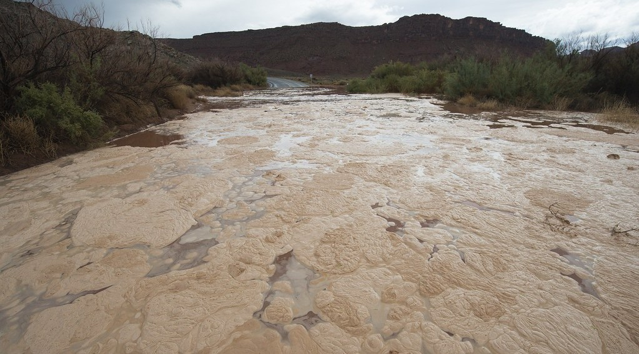
ECO. GEOGRAPHY — FORM 2 TECH
I. RAINFALL
Activity 2
A sudden flood in a dry desert valley.
2026 / 2027
DGCAST GAROUA — GEOGRAPHY DEPARTMENT
Mr KAMDEM E. | 17
Notes:
Without the projector: describe a desert valley that is dry for years and suddenly full of water.

Slide 18
ECO. GEOGRAPHY — FORM 2 TECH
I. RAINFALL
Activity 2: Question
In the desert, rain can stop for years, then a storm brings a flood. What does this show?
2026 / 2027
DGCAST GAROUA — GEOGRAPHY DEPARTMENT
Mr KAMDEM E. | 18

Slide 19
ECO. GEOGRAPHY — FORM 2 TECH
I. RAINFALL
Answer
The rain is rare and irregular.
2026 / 2027
DGCAST GAROUA — GEOGRAPHY DEPARTMENT
Mr KAMDEM E. | 19

Slide 20
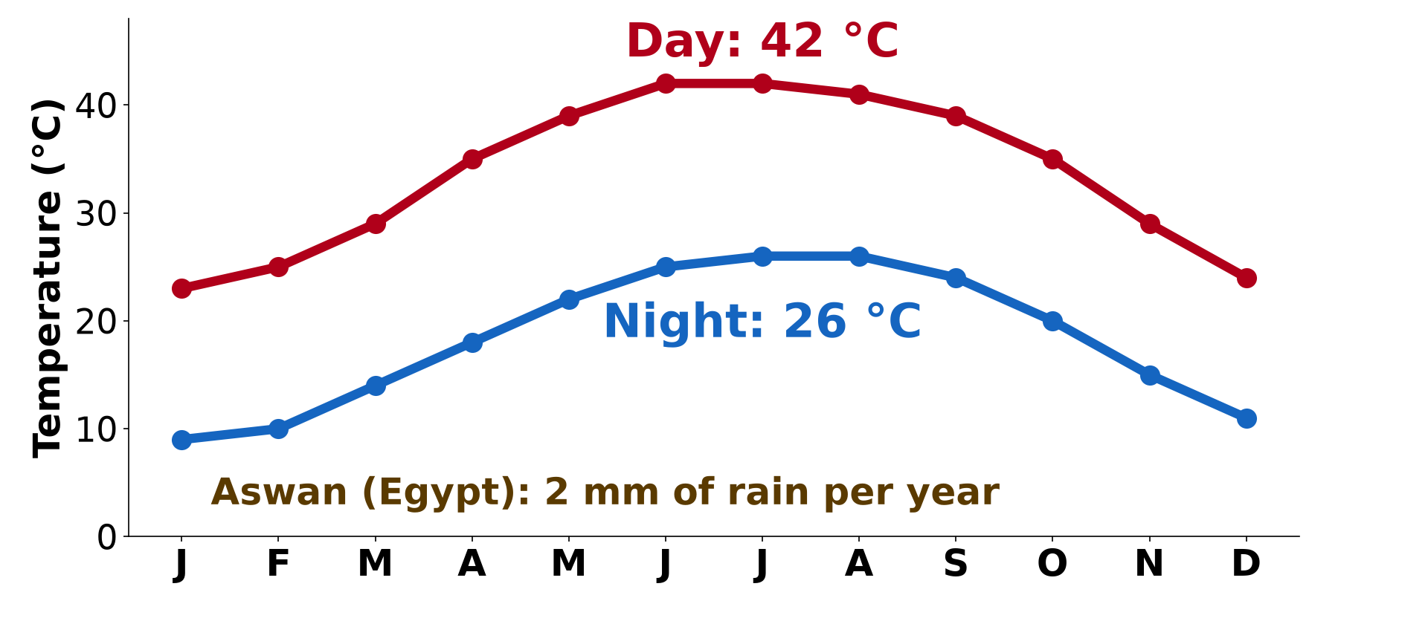
ECO. GEOGRAPHY — FORM 2 TECH
II. TEMPERATURES
Activity 3
Aswan (Egypt): temperature in the day (red) and at night (blue).
2026 / 2027
DGCAST GAROUA — GEOGRAPHY DEPARTMENT
Mr KAMDEM E. | 20
Notes:
Without the projector: write 42 °C and 26 °C on the board and subtract.

Slide 21
ECO. GEOGRAPHY — FORM 2 TECH
II. TEMPERATURES
Activity 3: Question
What is the temperature in July in the day and at night? What is the difference?
2026 / 2027
DGCAST GAROUA — GEOGRAPHY DEPARTMENT
Mr KAMDEM E. | 21

Slide 22
ECO. GEOGRAPHY — FORM 2 TECH
II. TEMPERATURES
Answer
Day 42 °C, night 26 °C. The difference is 16 °C.
2026 / 2027
DGCAST GAROUA — GEOGRAPHY DEPARTMENT
Mr KAMDEM E. | 22

Slide 23
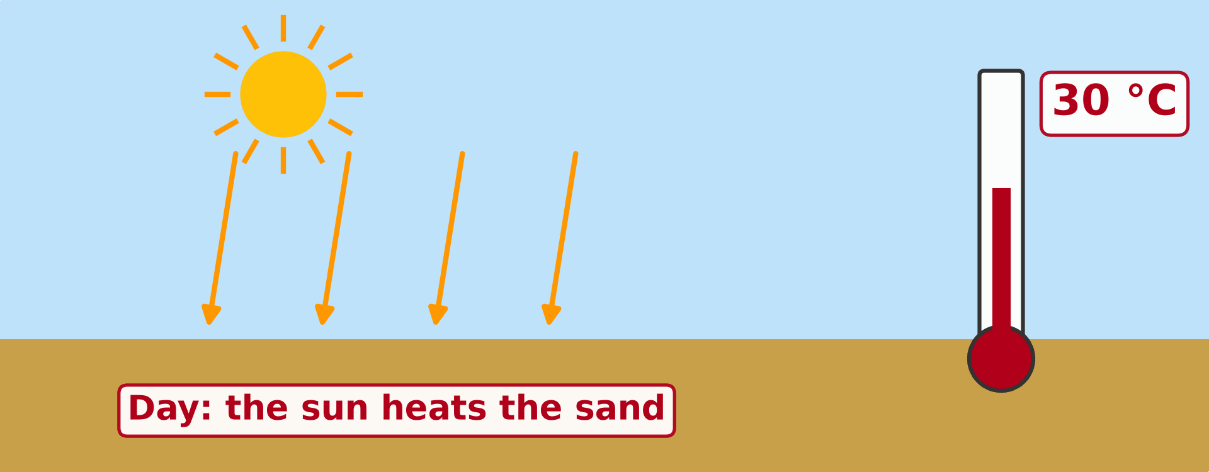
ECO. GEOGRAPHY — FORM 2 TECH
II. TEMPERATURES
Activity 4
Animation: the desert by day and at night.
2026 / 2027
DGCAST GAROUA — GEOGRAPHY DEPARTMENT
Mr KAMDEM E. | 23
Notes:
Without the projector: compare a cloudy night and a clear night in December in Garoua.

Slide 24
ECO. GEOGRAPHY — FORM 2 TECH
II. TEMPERATURES
Activity 4: Question
Why does the desert become cold at night?
2026 / 2027
DGCAST GAROUA — GEOGRAPHY DEPARTMENT
Mr KAMDEM E. | 24

Slide 25
ECO. GEOGRAPHY — FORM 2 TECH
II. TEMPERATURES
Answer
There are no clouds, so the heat escapes into the sky.
2026 / 2027
DGCAST GAROUA — GEOGRAPHY DEPARTMENT
Mr KAMDEM E. | 25

Slide 26

ECO. GEOGRAPHY — FORM 2 TECH
III. WINDS
Activity 5
A sandstorm arrives.
2026 / 2027
DGCAST GAROUA — GEOGRAPHY DEPARTMENT
Mr KAMDEM E. | 26
Notes:
Without the projector: compare with a very dusty Harmattan day.

Slide 27
ECO. GEOGRAPHY — FORM 2 TECH
III. WINDS
Activity 5: Question
What is this? Give one danger.
2026 / 2027
DGCAST GAROUA — GEOGRAPHY DEPARTMENT
Mr KAMDEM E. | 27

Slide 28
ECO. GEOGRAPHY — FORM 2 TECH
III. WINDS
Answer
A sandstorm. People cannot see, and it hurts the eyes and lungs.
2026 / 2027
DGCAST GAROUA — GEOGRAPHY DEPARTMENT
Mr KAMDEM E. | 28

Slide 29
ECO. GEOGRAPHY — FORM 2 TECH
BOARD SUMMARY
The Desert Regions
Topic: Man in His Environment
Sub-topic: Natural Regions
Lesson 3: The Desert Regions — Part 2: Characteristics (Climate)
2026 / 2027
DGCAST GAROUA — GEOGRAPHY DEPARTMENT
Mr KAMDEM E. | 29
Notes:
Learners copy the board summary now. Give them enough time for each slide.

Slide 30
ECO. GEOGRAPHY — FORM 2 TECH
BOARD SUMMARY
I. Definitions
Daily temperature range: It is the difference between the day and the night temperature.
Sandstorm: It is a strong wind that lifts sand into the air.
2026 / 2027
DGCAST GAROUA — GEOGRAPHY DEPARTMENT
Mr KAMDEM E. | 30

Slide 31
ECO. GEOGRAPHY — FORM 2 TECH
BOARD SUMMARY
II. Rainfall
A. Very little rain: Less than 250 mm per year.
B. Irregular rain: It can stop for years.
C. Clear skies: There are almost no clouds.
2026 / 2027
DGCAST GAROUA — GEOGRAPHY DEPARTMENT
Mr KAMDEM E. | 31

Slide 32
ECO. GEOGRAPHY — FORM 2 TECH
BOARD SUMMARY
III. Temperatures (1/2)
A. Hot days: Often more than 40 °C.
B. Cold nights: The heat escapes at night.
C. Large range: It can be 15 °C or more.
2026 / 2027
DGCAST GAROUA — GEOGRAPHY DEPARTMENT
Mr KAMDEM E. | 32

Slide 33
ECO. GEOGRAPHY — FORM 2 TECH
BOARD SUMMARY
III. Temperatures (2/2)
Copy the two lines: day and night.
2026 / 2027
DGCAST GAROUA — GEOGRAPHY DEPARTMENT
Mr KAMDEM E. | 33

Slide 34
ECO. GEOGRAPHY — FORM 2 TECH
BOARD SUMMARY
IV. Winds
A. Hot, dry winds: The Harmattan and the Sirocco.
B. Sandstorms: They damage crops, roads and machines.
2026 / 2027
DGCAST GAROUA — GEOGRAPHY DEPARTMENT
Mr KAMDEM E. | 34

Slide 35
ECO. GEOGRAPHY — FORM 2 TECH
FORMATIVE EVALUATION
Formative Evaluation 1
Why is the desert cold at night?
2026 / 2027
DGCAST GAROUA — GEOGRAPHY DEPARTMENT
Mr KAMDEM E. | 35

Slide 36
ECO. GEOGRAPHY — FORM 2 TECH
FORMATIVE EVALUATION
Expected Answer
There are no clouds, so the heat escapes.
2026 / 2027
DGCAST GAROUA — GEOGRAPHY DEPARTMENT
Mr KAMDEM E. | 36

Slide 37
ECO. GEOGRAPHY — FORM 2 TECH
FORMATIVE EVALUATION
Formative Evaluation 2
Name one hot, dry wind from the Sahara.
2026 / 2027
DGCAST GAROUA — GEOGRAPHY DEPARTMENT
Mr KAMDEM E. | 37

Slide 38
ECO. GEOGRAPHY — FORM 2 TECH
FORMATIVE EVALUATION
Expected Answer
The Harmattan (or the Sirocco).
2026 / 2027
DGCAST GAROUA — GEOGRAPHY DEPARTMENT
Mr KAMDEM E. | 38

Slide 39
ECO. GEOGRAPHY — FORM 2 TECH
REMEDIATION
Remediation
Fill in the blanks:
Hot deserts get less than ______ mm of rain per year.
The difference between day and night temperature is the daily temperature ______.
A strong wind full of sand is a ______.
2026 / 2027
DGCAST GAROUA — GEOGRAPHY DEPARTMENT
Mr KAMDEM E. | 39
Notes:
Answers: 1. 250 2. range 3. sandstorm

Slide 40
ECO. GEOGRAPHY — FORM 2 TECH
HOMEWORK
Homework
Look at a cactus, an acacia or a date palm near your home or in a picture. Write down one way in which it is adapted to lack of water.
This prepares Part 3: Soils and Vegetation of Hot Deserts.
2026 / 2027
DGCAST GAROUA — GEOGRAPHY DEPARTMENT
Mr KAMDEM E. | 40
Notes:
This homework prepares the next lesson.

Slide 41
ECO. GEOGRAPHY — FORM 2 TECH
BILINGUAL GAME
Bilingual Game (Jeu Bilingue)
English | Français
Rainfall | Les précipitations
Humidity | L'humidité
Temperature range | L'amplitude thermique
Day | Le jour
Night | La nuit
Sandstorm | La tempête de sable
Dry | Sec
Heat | La chaleur
2026 / 2027
DGCAST GAROUA — GEOGRAPHY DEPARTMENT
Mr KAMDEM E. | 41
Notes:
Say the English word; learners give the French word, then the reverse.

Slide 42
ECO. GEOGRAPHY — FORM 2 TECH
LOGBOOK
Official Logbook (1/2)
Module / Topic | Man in His Environment
Lesson Title | Lesson 3: The Desert Regions — Part 2: Characteristics (Climate)
Expected Learning Outcomes | Describe the rainfall of hot deserts. Describe the temperatures of hot deserts and explain the large daily range. Describe the winds and humidity of hot deserts.
Competence | Learners are able to protect themselves from extreme heat and dust, and to explain why desert nights are cold.
2026 / 2027
DGCAST GAROUA — GEOGRAPHY DEPARTMENT
Mr KAMDEM E. | 42

Slide 43
ECO. GEOGRAPHY — FORM 2 TECH
LOGBOOK
Official Logbook (2/2)
Matter Taught | I. Definitions: Daily temperature range, Sandstorm; II. Rainfall: Very little rain, Irregular rain, Clear skies; III. Temperatures: Hot days, Cold nights, Large range; IV. Winds: Hot, dry winds, Sandstorms.
Evaluation | Formative evaluation (3 questions) and remediation exercise.
Homework | Look at a cactus, an acacia or a date palm near your home or in a picture. Write down one way in which it is adapted to lack of water.
Enrolment / Present / Absent | ____ / ____ / ____
Achievement | To be completed by the teacher after the lesson.
2026 / 2027
DGCAST GAROUA — GEOGRAPHY DEPARTMENT
Mr KAMDEM E. | 43

Slide 44
ECO. GEOGRAPHY — FORM 2 TECH
TEACHER'S NOTE
Teacher's Note
Timing: Set-up, recall 8 min | Situation 8 min | 5 activities 25 min | Board summary (copying) 30 min | Evaluation, remediation 10 min | Homework 4 min | Logbook 10 min | Spare 5 min
Aswan data (approximate normals): July day 42 °C, night 26 °C; January day 23 °C, night 9 °C; rainfall about 1–2 mm per year.
Activity 4 is an animation (GIF): it plays automatically in slide-show mode.
2026 / 2027
DGCAST GAROUA — GEOGRAPHY DEPARTMENT
Mr KAMDEM E. | 44

Slide 45
ECO. GEOGRAPHY — FORM 2 TECH
REFERENCES
References
Harmonised Progression Sheet, Economic Geography (5051), Form 2.
Class textbook: The major biomes of the world (hot deserts).
Aswan climate normals: NOAA 1991–2020 (via Wikipedia, "Aswan").
Photo, Activity 2: “Flooding on the road to Delicate Arch Overlook” by ArchesNPS, Public domain 1.0, via Flickr (https://www.flickr.com/photos/72578886@N08/8083724580)
Photo, Activity 5: “Sandstorm at Camp Bastion, Afghanistan” by Defence Images, CC BY-NC 2.0, via Flickr (https://www.flickr.com/photos/48399297@N04/10343833885)
Diagrams and animations: drawn for this lesson (DGCAST Geography Department).
2026 / 2027
DGCAST GAROUA — GEOGRAPHY DEPARTMENT
Mr KAMDEM E. | 45

