Slide 1

DIVINE GRACE COLLEGE OF ARTS, SCIENCE AND TECHNOLOGY
(DGCAST) — GAROUA | GEOGRAPHY DEPARTMENT
FORM 2 TECHNICAL — LESSON 3 (PART 4)
The Desert Regions: Problems Faced and Adaptations
Mr KAMDEM EMMANUEL
Geography Teacher — PLEG
Academic Year 2026 / 2027
Notes:
Good morning, class. Today we study The Desert Regions, part 4: Problems Faced and Adaptations.

Slide 2
ECO. GEOGRAPHY — FORM 2 TECH
CLASS INFO
Class, Chapter & Duration
Class | Form 2 Technical
Chapter | Economic Geography — Natural Regions: 3. Desert Regions
Duration | 2 periods (2 × 50 minutes)
2026 / 2027
DGCAST GAROUA — GEOGRAPHY DEPARTMENT
Mr KAMDEM E. | 2

Slide 3
ECO. GEOGRAPHY — FORM 2 TECH
IDENTIFICATION
Lesson Identification
Topic | Man in His Environment
Sub-topic | Natural Regions
Lesson | Lesson 3: The Desert Regions — Part 4: Problems Faced and Adaptations
Notions / Concepts | Aridity, nomadism, adaptation, foggara, desalination, camel.
Syllabus focus | Problems faced by people in hot deserts and their adaptations.
Competence | Learners are able to save water and protect themselves from heat and dust, as desert people do.
2026 / 2027
DGCAST GAROUA — GEOGRAPHY DEPARTMENT
Mr KAMDEM E. | 3

Slide 4
ECO. GEOGRAPHY — FORM 2 TECH
OBJECTIVES
Learning Objectives
By the end of the lesson, the learner should be able to:
Identify the problems faced by people living in hot deserts.
Describe the traditional adaptations of desert people.
Describe the modern adaptations used in deserts.
2026 / 2027
DGCAST GAROUA — GEOGRAPHY DEPARTMENT
Mr KAMDEM E. | 4

Slide 5
ECO. GEOGRAPHY — FORM 2 TECH
RECALL
Recall
Desert vegetation is scarce: cacti, thorny bushes and date palms in oases.
Plants store water, reduce water loss and have long roots.
Desert soils are sandy or stony, salty and poor in humus.
2026 / 2027
DGCAST GAROUA — GEOGRAPHY DEPARTMENT
Mr KAMDEM E. | 5
Notes:
Check the homework: problems of a week in the Sahara.

Slide 6
ECO. GEOGRAPHY — FORM 2 TECH
REAL-LIFE SITUATION
Real-Life Situation
A Tuareg family lives in the Sahara, in Niger. Their well is dry, and there is no grass for their camels and goats. The father must decide what to do.
2026 / 2027
DGCAST GAROUA — GEOGRAPHY DEPARTMENT
Mr KAMDEM E. | 6
Notes:
Read the situation slowly, twice.

Slide 7
ECO. GEOGRAPHY — FORM 2 TECH
REAL-LIFE SITUATION
Situation — Question 1
What is the problem in the situation?
2026 / 2027
DGCAST GAROUA — GEOGRAPHY DEPARTMENT
Mr KAMDEM E. | 7

Slide 8
ECO. GEOGRAPHY — FORM 2 TECH
REAL-LIFE SITUATION
Answer
The family has no water and no grass for the animals.
2026 / 2027
DGCAST GAROUA — GEOGRAPHY DEPARTMENT
Mr KAMDEM E. | 8

Slide 9
ECO. GEOGRAPHY — FORM 2 TECH
REAL-LIFE SITUATION
Situation — Question 2
What can the father do?
2026 / 2027
DGCAST GAROUA — GEOGRAPHY DEPARTMENT
Mr KAMDEM E. | 9

Slide 10
ECO. GEOGRAPHY — FORM 2 TECH
REAL-LIFE SITUATION
Answer
He can move with his animals to another well.
2026 / 2027
DGCAST GAROUA — GEOGRAPHY DEPARTMENT
Mr KAMDEM E. | 10

Slide 11
ECO. GEOGRAPHY — FORM 2 TECH
REAL-LIFE SITUATION
Situation — Question 3
Which animal can help them to travel?
2026 / 2027
DGCAST GAROUA — GEOGRAPHY DEPARTMENT
Mr KAMDEM E. | 11

Slide 12
ECO. GEOGRAPHY — FORM 2 TECH
REAL-LIFE SITUATION
Possible Answer
The camel.
2026 / 2027
DGCAST GAROUA — GEOGRAPHY DEPARTMENT
Mr KAMDEM E. | 12

Slide 13
ECO. GEOGRAPHY — FORM 2 TECH
JUSTIFICATION
Justification of the Lesson
This lesson helps us to know the problems of desert people and how they live.
2026 / 2027
DGCAST GAROUA — GEOGRAPHY DEPARTMENT
Mr KAMDEM E. | 13

Slide 14

ECO. GEOGRAPHY — FORM 2 TECH
I. PROBLEMS FACED
Activity 1
People take water from a well in the desert.
2026 / 2027
DGCAST GAROUA — GEOGRAPHY DEPARTMENT
Mr KAMDEM E. | 14
Notes:
Without the projector: ask learners how far their family goes to get water.

Slide 15
ECO. GEOGRAPHY — FORM 2 TECH
I. PROBLEMS FACED
Activity 1: Question
What is the biggest problem in the desert?
2026 / 2027
DGCAST GAROUA — GEOGRAPHY DEPARTMENT
Mr KAMDEM E. | 15

Slide 16
ECO. GEOGRAPHY — FORM 2 TECH
I. PROBLEMS FACED
Answer
The lack of water.
2026 / 2027
DGCAST GAROUA — GEOGRAPHY DEPARTMENT
Mr KAMDEM E. | 16

Slide 17
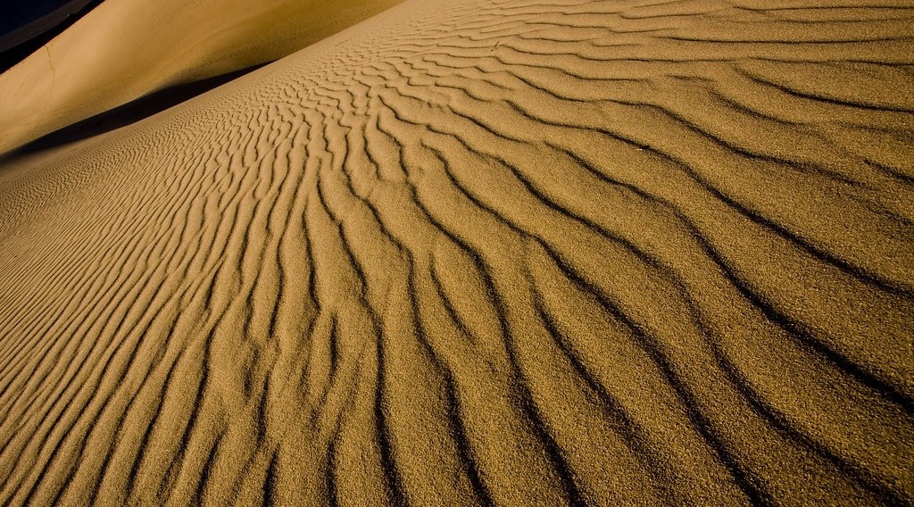
ECO. GEOGRAPHY — FORM 2 TECH
I. PROBLEMS FACED
Activity 2
Sand moved by the wind.
2026 / 2027
DGCAST GAROUA — GEOGRAPHY DEPARTMENT
Mr KAMDEM E. | 17
Notes:
Without the projector: describe a road covered with sand after a sandstorm.

Slide 18
ECO. GEOGRAPHY — FORM 2 TECH
I. PROBLEMS FACED
Activity 2: Question
The wind moves this sand. What can it cover?
2026 / 2027
DGCAST GAROUA — GEOGRAPHY DEPARTMENT
Mr KAMDEM E. | 18

Slide 19
ECO. GEOGRAPHY — FORM 2 TECH
I. PROBLEMS FACED
Answer
Roads, wells and fields.
2026 / 2027
DGCAST GAROUA — GEOGRAPHY DEPARTMENT
Mr KAMDEM E. | 19

Slide 20
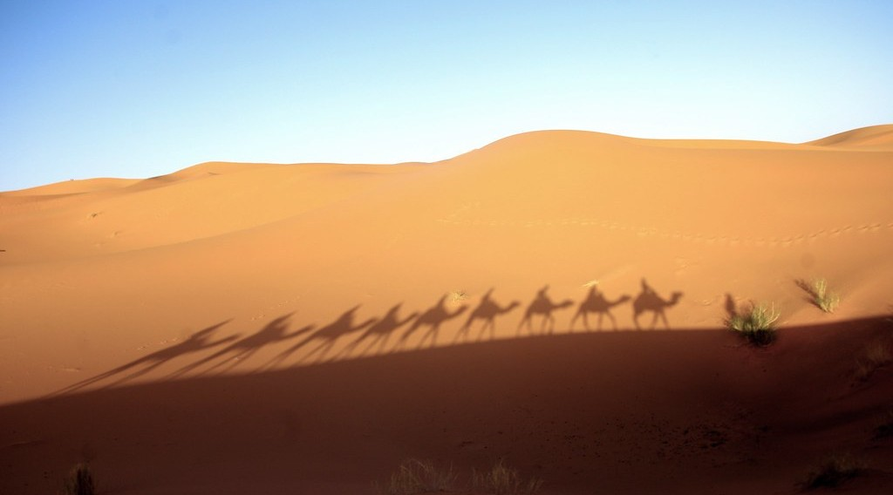
ECO. GEOGRAPHY — FORM 2 TECH
II. ADAPTATIONS
Activity 3
A camel caravan in the Sahara.
2026 / 2027
DGCAST GAROUA — GEOGRAPHY DEPARTMENT
Mr KAMDEM E. | 20
Notes:
Without the projector: ask learners where they have seen camels (Far North).

Slide 21
ECO. GEOGRAPHY — FORM 2 TECH
II. ADAPTATIONS
Activity 3: Question
Why is the camel called the "ship of the desert"?
2026 / 2027
DGCAST GAROUA — GEOGRAPHY DEPARTMENT
Mr KAMDEM E. | 21

Slide 22
ECO. GEOGRAPHY — FORM 2 TECH
II. ADAPTATIONS
Answer
It can walk for days without water and carry heavy loads on sand.
2026 / 2027
DGCAST GAROUA — GEOGRAPHY DEPARTMENT
Mr KAMDEM E. | 22

Slide 23
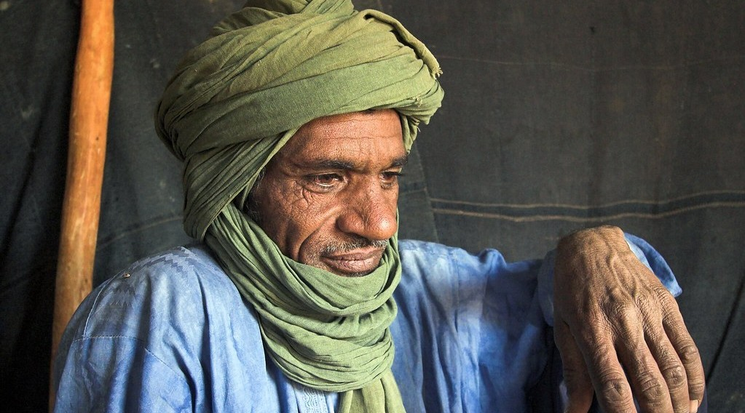
ECO. GEOGRAPHY — FORM 2 TECH
II. ADAPTATIONS
Activity 4
A Tuareg man with a long turban.
2026 / 2027
DGCAST GAROUA — GEOGRAPHY DEPARTMENT
Mr KAMDEM E. | 23
Notes:
Without the projector: compare with the clothes worn in Garoua in the dry season.

Slide 24
ECO. GEOGRAPHY — FORM 2 TECH
II. ADAPTATIONS
Activity 4: Question
Why do desert people wear long, loose clothes and a turban?
2026 / 2027
DGCAST GAROUA — GEOGRAPHY DEPARTMENT
Mr KAMDEM E. | 24

Slide 25
ECO. GEOGRAPHY — FORM 2 TECH
II. ADAPTATIONS
Answer
They protect the body from the sun and the sand.
2026 / 2027
DGCAST GAROUA — GEOGRAPHY DEPARTMENT
Mr KAMDEM E. | 25

Slide 26
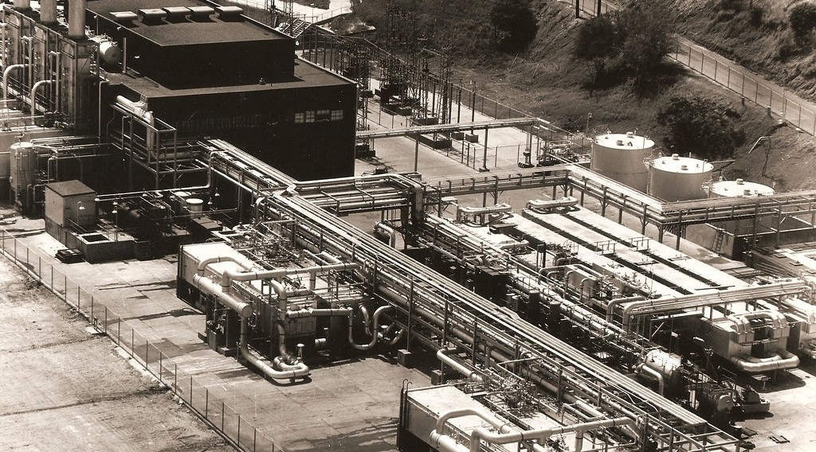
ECO. GEOGRAPHY — FORM 2 TECH
II. ADAPTATIONS
Activity 5
A factory that makes fresh water from sea water.
2026 / 2027
DGCAST GAROUA — GEOGRAPHY DEPARTMENT
Mr KAMDEM E. | 26
Notes:
Without the projector: explain that sea water is boiled or filtered to remove the salt.

Slide 27
ECO. GEOGRAPHY — FORM 2 TECH
II. ADAPTATIONS
Activity 5: Question
Rich desert countries have little fresh water. How do they get drinking water?
2026 / 2027
DGCAST GAROUA — GEOGRAPHY DEPARTMENT
Mr KAMDEM E. | 27

Slide 28
ECO. GEOGRAPHY — FORM 2 TECH
II. ADAPTATIONS
Answer
They remove the salt from sea water.
2026 / 2027
DGCAST GAROUA — GEOGRAPHY DEPARTMENT
Mr KAMDEM E. | 28

Slide 29
ECO. GEOGRAPHY — FORM 2 TECH
BOARD SUMMARY
The Desert Regions
Topic: Man in His Environment
Sub-topic: Natural Regions
Lesson 3: The Desert Regions — Part 4: Problems Faced and Adaptations
2026 / 2027
DGCAST GAROUA — GEOGRAPHY DEPARTMENT
Mr KAMDEM E. | 29
Notes:
Learners copy the board summary now. Give them enough time for each slide.

Slide 30
ECO. GEOGRAPHY — FORM 2 TECH
BOARD SUMMARY
I. Definitions
Nomad: It is a person who moves from place to place with animals.
Desalination: It is the removal of salt from sea water.
2026 / 2027
DGCAST GAROUA — GEOGRAPHY DEPARTMENT
Mr KAMDEM E. | 30

Slide 31
ECO. GEOGRAPHY — FORM 2 TECH
BOARD SUMMARY
II. Problems Faced
The main problems are:
A. Lack of water: Wells dry up.
B. Heat and cold: Hot days and cold nights.
C. Sandstorms: They hurt the eyes and cover roads.
D. Poor soils: Farming is difficult.
2026 / 2027
DGCAST GAROUA — GEOGRAPHY DEPARTMENT
Mr KAMDEM E. | 31

Slide 32
ECO. GEOGRAPHY — FORM 2 TECH
BOARD SUMMARY
III. Adaptations
People adapt in these ways:
A. Nomadism: The Tuareg move with their animals.
B. The camel: It travels for days without water.
C. Clothes and houses: Long clothes and thick mud walls.
D. Water supply: Wells and desalination.
2026 / 2027
DGCAST GAROUA — GEOGRAPHY DEPARTMENT
Mr KAMDEM E. | 32

Slide 33
ECO. GEOGRAPHY — FORM 2 TECH
FORMATIVE EVALUATION
Formative Evaluation 1
Give two problems of desert people.
2026 / 2027
DGCAST GAROUA — GEOGRAPHY DEPARTMENT
Mr KAMDEM E. | 33

Slide 34
ECO. GEOGRAPHY — FORM 2 TECH
FORMATIVE EVALUATION
Expected Answer
Lack of water and sandstorms.
2026 / 2027
DGCAST GAROUA — GEOGRAPHY DEPARTMENT
Mr KAMDEM E. | 34

Slide 35
ECO. GEOGRAPHY — FORM 2 TECH
FORMATIVE EVALUATION
Formative Evaluation 2
Why is the camel useful in the desert?
2026 / 2027
DGCAST GAROUA — GEOGRAPHY DEPARTMENT
Mr KAMDEM E. | 35

Slide 36
ECO. GEOGRAPHY — FORM 2 TECH
FORMATIVE EVALUATION
Expected Answer
It walks for days without water and carries heavy loads.
2026 / 2027
DGCAST GAROUA — GEOGRAPHY DEPARTMENT
Mr KAMDEM E. | 36

Slide 37
ECO. GEOGRAPHY — FORM 2 TECH
REMEDIATION
Remediation
Fill in the blanks:
A person who moves with his animals is a ______.
The "ship of the desert" is the ______.
Removing salt from sea water is called ______.
2026 / 2027
DGCAST GAROUA — GEOGRAPHY DEPARTMENT
Mr KAMDEM E. | 37
Notes:
Answers: 1. nomad 2. camel 3. desalination

Slide 38
ECO. GEOGRAPHY — FORM 2 TECH
HOMEWORK
Homework
Find in your textbook or atlas the name of one oasis in the Sahara, and write the name of the country where it is found.
This prepares Part 5: Human Activities (Farming around Oases).
2026 / 2027
DGCAST GAROUA — GEOGRAPHY DEPARTMENT
Mr KAMDEM E. | 38
Notes:
This homework prepares the next lesson.

Slide 39
ECO. GEOGRAPHY — FORM 2 TECH
BILINGUAL GAME
Bilingual Game (Jeu Bilingue)
English | Français
Water | L'eau
Well | Le puits
Camel | Le dromadaire
Nomad | Le nomade
Adaptation | L'adaptation
Turban | Le turban
Desalination | Le dessalement
Heatstroke | Le coup de chaleur
2026 / 2027
DGCAST GAROUA — GEOGRAPHY DEPARTMENT
Mr KAMDEM E. | 39
Notes:
Say the English word; learners give the French word, then the reverse.

Slide 40
ECO. GEOGRAPHY — FORM 2 TECH
LOGBOOK
Official Logbook (1/2)
Module / Topic | Man in His Environment
Lesson Title | Lesson 3: The Desert Regions — Part 4: Problems Faced and Adaptations
Expected Learning Outcomes | Identify the problems faced by people living in hot deserts. Describe the traditional adaptations of desert people. Describe the modern adaptations used in deserts.
Competence | Learners are able to save water and protect themselves from heat and dust, as desert people do.
2026 / 2027
DGCAST GAROUA — GEOGRAPHY DEPARTMENT
Mr KAMDEM E. | 40

Slide 41
ECO. GEOGRAPHY — FORM 2 TECH
LOGBOOK
Official Logbook (2/2)
Matter Taught | I. Definitions: Nomad, Desalination; II. Problems Faced: Lack of water, Heat and cold, Sandstorms, Poor soils; III. Adaptations: Nomadism, The camel, Clothes and houses, Water supply.
Evaluation | Formative evaluation (3 questions) and remediation exercise.
Homework | Find in your textbook or atlas the name of one oasis in the Sahara, and write the name of the country where it is found.
Enrolment / Present / Absent | ____ / ____ / ____
Achievement | To be completed by the teacher after the lesson.
2026 / 2027
DGCAST GAROUA — GEOGRAPHY DEPARTMENT
Mr KAMDEM E. | 41

Slide 42
ECO. GEOGRAPHY — FORM 2 TECH
TEACHER'S NOTE
Teacher's Note
Timing: Set-up, recall 8 min | Situation 8 min | 5 activities 25 min | Board summary (copying) 30 min | Evaluation, remediation 10 min | Homework 4 min | Logbook 10 min | Spare 5 min
2026 / 2027
DGCAST GAROUA — GEOGRAPHY DEPARTMENT
Mr KAMDEM E. | 42

Slide 43
ECO. GEOGRAPHY — FORM 2 TECH
REFERENCES
References
Harmonised Progression Sheet, Economic Geography (5051), Form 2.
Class textbook: The major biomes of the world (hot deserts).
Photo, Activity 1: “Well in the desert” by Focx Photography, CC BY-SA 2.0, via Flickr (https://www.flickr.com/photos/30780900@N02/4117141154)
Photo, Activity 2: “Mesquite Flat Dunes at Sunrise, Death Valley National Park, California” by Raj Hanchanahal Photography, CC BY-NC-ND 2.0, via Flickr (https://www.flickr.com/photos/32684709@N03/3873091107)
Photo, Activity 3: “Merzouga desert, Morocco” by Mycroyance, CC BY-ND 2.0, via Flickr (https://www.flickr.com/photos/91155980@N07/13157027505)
Photo, Activity 4: “my neighbor” by Emilia Tjernström [Arriving at the horizon], CC BY-NC-SA 2.0, via Flickr (https://www.flickr.com/photos/60614633@N00/502315074)
Photo, Activity 5: “Desalinization plant at Guantanamo Bay, Cuba” by U.S. Navy Seabee Museum, CC BY 2.0, via Flickr (https://www.flickr.com/photos/60248384@N05/6847412393)
Diagrams and animations: drawn for this lesson (DGCAST Geography Department).
2026 / 2027
DGCAST GAROUA — GEOGRAPHY DEPARTMENT
Mr KAMDEM E. | 43

