Slide 1

DIVINE GRACE COLLEGE OF ARTS, SCIENCE AND TECHNOLOGY
(DGCAST) — GAROUA | GEOGRAPHY DEPARTMENT
FORM 2 TECHNICAL — LESSON 5 (PART 1)
The Sectors of the Economy: Introduction, Definitions and Key Concepts
Mr KAMDEM EMMANUEL
Geography Teacher — PLEG
Academic Year 2026 / 2027
Notes:
Good morning, class. Today we study The Sectors of the Economy, part 1: Introduction, Definitions and Key Concepts.

Slide 2
ECO. GEOGRAPHY — FORM 2 TECH
CLASS INFO
Class, Chapter & Duration
Class | Form 2 Technical
Chapter | Economic Geography — Sectors of the Economy
Duration | 2 periods (2 × 50 minutes)
2026 / 2027
DGCAST GAROUA — GEOGRAPHY DEPARTMENT
Mr KAMDEM E. | 2

Slide 3
ECO. GEOGRAPHY — FORM 2 TECH
IDENTIFICATION
Lesson Identification
Topic | Economic Activities
Sub-topic | Sectors of the Economy
Lesson | Lesson 5: The Sectors of the Economy — Part 1: Introduction, Definitions and Key Concepts
Notions / Concepts | Economy, economic activity, goods, services, raw material, production, sector of the economy.
Syllabus focus | Introduction to the sectors of the economy; definitions of terms; key concepts (activities and examples).
Competence | Learners are able to classify the jobs of people around them into the four sectors of the economy.
2026 / 2027
DGCAST GAROUA — GEOGRAPHY DEPARTMENT
Mr KAMDEM E. | 3

Slide 4
ECO. GEOGRAPHY — FORM 2 TECH
OBJECTIVES
Learning Objectives
By the end of the lesson, the learner should be able to:
Define economy, economic activity, goods and services.
Define a sector of the economy.
Name the four sectors of the economy and give an example of each.
2026 / 2027
DGCAST GAROUA — GEOGRAPHY DEPARTMENT
Mr KAMDEM E. | 4

Slide 5
ECO. GEOGRAPHY — FORM 2 TECH
RECALL
Recall
In Lessons 1 to 4, we studied the natural regions of the world.
In each region, people carry out activities such as farming, rearing, mining and tourism.
These activities help them to earn a living.
2026 / 2027
DGCAST GAROUA — GEOGRAPHY DEPARTMENT
Mr KAMDEM E. | 5
Notes:
Check the homework: five jobs done in the family or neighbourhood.

Slide 6
ECO. GEOGRAPHY — FORM 2 TECH
REAL-LIFE SITUATION
Real-Life Situation
Ahmadou's father grows cotton near Garoua. His uncle works in the CICAM factory, where cotton becomes cloth. His aunt sells cloth in the market. His cousin looks for better cotton seeds in a research centre.
2026 / 2027
DGCAST GAROUA — GEOGRAPHY DEPARTMENT
Mr KAMDEM E. | 6
Notes:
Read the situation slowly, twice.

Slide 7
ECO. GEOGRAPHY — FORM 2 TECH
REAL-LIFE SITUATION
Situation — Question 1
What is the problem in the situation?
2026 / 2027
DGCAST GAROUA — GEOGRAPHY DEPARTMENT
Mr KAMDEM E. | 7

Slide 8
ECO. GEOGRAPHY — FORM 2 TECH
REAL-LIFE SITUATION
Answer
Ahmadou does not know how to group the jobs of his family.
2026 / 2027
DGCAST GAROUA — GEOGRAPHY DEPARTMENT
Mr KAMDEM E. | 8

Slide 9
ECO. GEOGRAPHY — FORM 2 TECH
REAL-LIFE SITUATION
Situation — Question 2
Who works with cotton first?
2026 / 2027
DGCAST GAROUA — GEOGRAPHY DEPARTMENT
Mr KAMDEM E. | 9

Slide 10
ECO. GEOGRAPHY — FORM 2 TECH
REAL-LIFE SITUATION
Answer
His father, who grows it.
2026 / 2027
DGCAST GAROUA — GEOGRAPHY DEPARTMENT
Mr KAMDEM E. | 10

Slide 11
ECO. GEOGRAPHY — FORM 2 TECH
REAL-LIFE SITUATION
Situation — Question 3
What links all these jobs?
2026 / 2027
DGCAST GAROUA — GEOGRAPHY DEPARTMENT
Mr KAMDEM E. | 11

Slide 12
ECO. GEOGRAPHY — FORM 2 TECH
REAL-LIFE SITUATION
Possible Answer
They all work with cotton, one after the other.
2026 / 2027
DGCAST GAROUA — GEOGRAPHY DEPARTMENT
Mr KAMDEM E. | 12

Slide 13
ECO. GEOGRAPHY — FORM 2 TECH
JUSTIFICATION
Justification of the Lesson
This lesson helps us to know the main groups of jobs in a country.
2026 / 2027
DGCAST GAROUA — GEOGRAPHY DEPARTMENT
Mr KAMDEM E. | 13

Slide 14
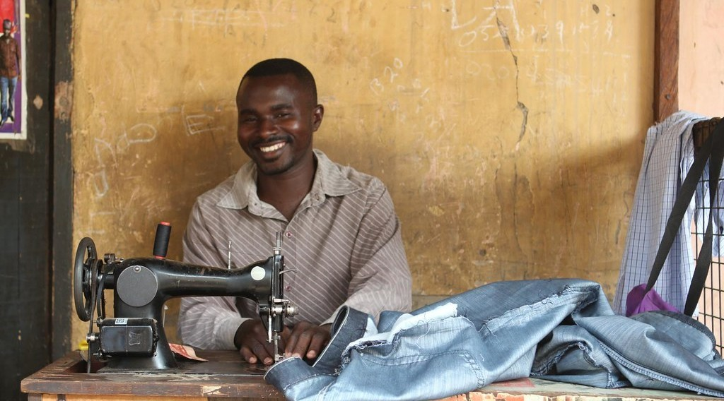
ECO. GEOGRAPHY — FORM 2 TECH
I. DEFINITIONS
Activity 1
A tailor at work.
2026 / 2027
DGCAST GAROUA — GEOGRAPHY DEPARTMENT
Mr KAMDEM E. | 14
Notes:
Without the projector: show a piece of cloth or a pen: things we can touch are goods.

Slide 15
ECO. GEOGRAPHY — FORM 2 TECH
I. DEFINITIONS
Activity 1: Question
The tailor makes a dress. Can we touch it? Is it a good or a service?
2026 / 2027
DGCAST GAROUA — GEOGRAPHY DEPARTMENT
Mr KAMDEM E. | 15

Slide 16
ECO. GEOGRAPHY — FORM 2 TECH
I. DEFINITIONS
Answer
Yes, we can touch it. It is a good.
2026 / 2027
DGCAST GAROUA — GEOGRAPHY DEPARTMENT
Mr KAMDEM E. | 16

Slide 17

ECO. GEOGRAPHY — FORM 2 TECH
I. DEFINITIONS
Activity 2
A health worker with a patient.
2026 / 2027
DGCAST GAROUA — GEOGRAPHY DEPARTMENT
Mr KAMDEM E. | 17
Notes:
Without the projector: ask learners to name people who give services in Garoua.

Slide 18
ECO. GEOGRAPHY — FORM 2 TECH
I. DEFINITIONS
Activity 2: Question
The doctor treats a patient. Is this a good or a service?
2026 / 2027
DGCAST GAROUA — GEOGRAPHY DEPARTMENT
Mr KAMDEM E. | 18

Slide 19
ECO. GEOGRAPHY — FORM 2 TECH
I. DEFINITIONS
Answer
A service: work done for other people.
2026 / 2027
DGCAST GAROUA — GEOGRAPHY DEPARTMENT
Mr KAMDEM E. | 19

Slide 20
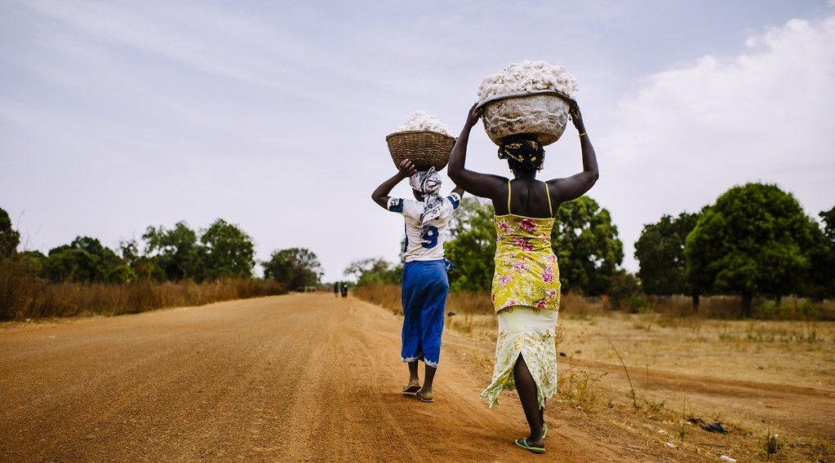
ECO. GEOGRAPHY — FORM 2 TECH
I. DEFINITIONS
Activity 3
Raw cotton after the harvest.
2026 / 2027
DGCAST GAROUA — GEOGRAPHY DEPARTMENT
Mr KAMDEM E. | 20
Notes:
Without the projector: bring raw cotton and a piece of cloth.

Slide 21
ECO. GEOGRAPHY — FORM 2 TECH
I. DEFINITIONS
Activity 3: Question
Cotton is used to make cloth. What do we call it?
2026 / 2027
DGCAST GAROUA — GEOGRAPHY DEPARTMENT
Mr KAMDEM E. | 21

Slide 22
ECO. GEOGRAPHY — FORM 2 TECH
I. DEFINITIONS
Answer
A raw material.
2026 / 2027
DGCAST GAROUA — GEOGRAPHY DEPARTMENT
Mr KAMDEM E. | 22

Slide 23
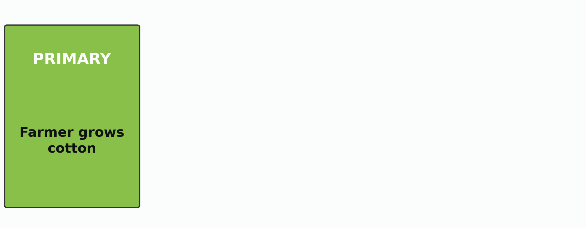
ECO. GEOGRAPHY — FORM 2 TECH
II. THE FOUR SECTORS
Activity 4
Animation: the journey of cotton.
2026 / 2027
DGCAST GAROUA — GEOGRAPHY DEPARTMENT
Mr KAMDEM E. | 23
Notes:
Without the projector: draw four boxes on the board: farmer, factory, trader, researcher.

Slide 24
ECO. GEOGRAPHY — FORM 2 TECH
II. THE FOUR SECTORS
Activity 4: Question
Name the four sectors in the order of the journey of cotton.
2026 / 2027
DGCAST GAROUA — GEOGRAPHY DEPARTMENT
Mr KAMDEM E. | 24

Slide 25
ECO. GEOGRAPHY — FORM 2 TECH
II. THE FOUR SECTORS
Answer
Primary, secondary, tertiary and quaternary.
2026 / 2027
DGCAST GAROUA — GEOGRAPHY DEPARTMENT
Mr KAMDEM E. | 25

Slide 26
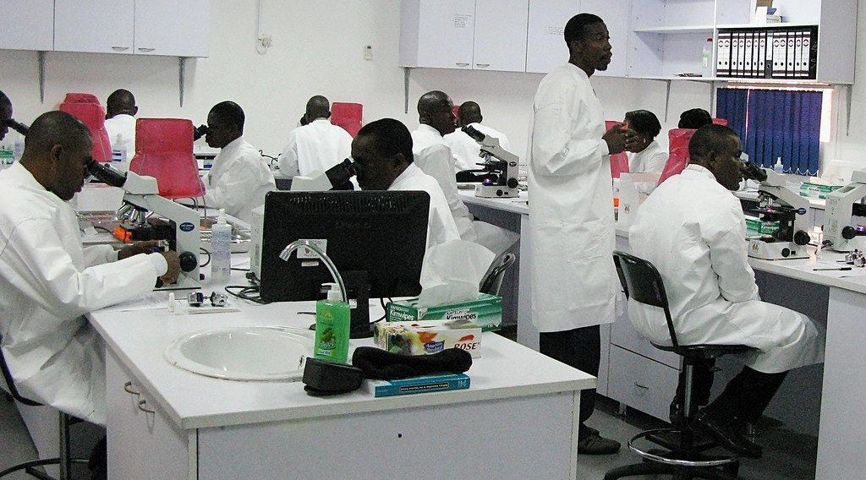
ECO. GEOGRAPHY — FORM 2 TECH
II. THE FOUR SECTORS
Activity 5
A scientist in a laboratory.
2026 / 2027
DGCAST GAROUA — GEOGRAPHY DEPARTMENT
Mr KAMDEM E. | 26
Notes:
Without the projector: ask learners what a researcher does.

Slide 27
ECO. GEOGRAPHY — FORM 2 TECH
II. THE FOUR SECTORS
Activity 5: Question
Ahmadou's cousin looks for better seeds. In which sector does she work?
2026 / 2027
DGCAST GAROUA — GEOGRAPHY DEPARTMENT
Mr KAMDEM E. | 27

Slide 28
ECO. GEOGRAPHY — FORM 2 TECH
II. THE FOUR SECTORS
Answer
In the quaternary sector.
2026 / 2027
DGCAST GAROUA — GEOGRAPHY DEPARTMENT
Mr KAMDEM E. | 28

Slide 29
ECO. GEOGRAPHY — FORM 2 TECH
BOARD SUMMARY
The Sectors of the Economy
Topic: Economic Activities
Sub-topic: Sectors of the Economy
Lesson 5: The Sectors of the Economy — Part 1: Introduction, Definitions and Key Concepts
2026 / 2027
DGCAST GAROUA — GEOGRAPHY DEPARTMENT
Mr KAMDEM E. | 29
Notes:
Learners copy the board summary now. Give them enough time for each slide.

Slide 30
ECO. GEOGRAPHY — FORM 2 TECH
BOARD SUMMARY
I. Definitions (1/2)
Economy: It is all the work people do to produce, sell and buy.
Goods: They are things we can touch, like food.
Services: They are work done for others, like teaching.
2026 / 2027
DGCAST GAROUA — GEOGRAPHY DEPARTMENT
Mr KAMDEM E. | 30

Slide 31
ECO. GEOGRAPHY — FORM 2 TECH
BOARD SUMMARY
I. Definitions (2/2)
Raw material: It is a natural product used to make goods.
Sector: It is a group of jobs of the same kind.
2026 / 2027
DGCAST GAROUA — GEOGRAPHY DEPARTMENT
Mr KAMDEM E. | 31

Slide 32
ECO. GEOGRAPHY — FORM 2 TECH
BOARD SUMMARY
II. The Four Sectors (1/2)
A. Primary: It takes products from nature.
B. Secondary: It makes goods in factories.
C. Tertiary: It gives services.
D. Quaternary: It creates knowledge.
2026 / 2027
DGCAST GAROUA — GEOGRAPHY DEPARTMENT
Mr KAMDEM E. | 32

Slide 33
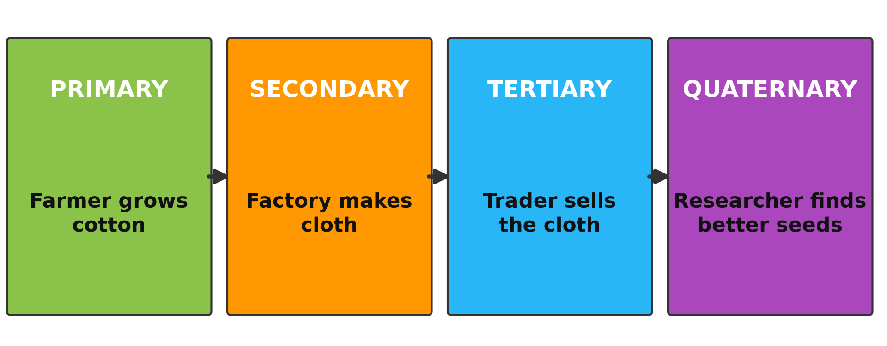
ECO. GEOGRAPHY — FORM 2 TECH
BOARD SUMMARY
II. The Four Sectors (2/2)
Copy the journey of cotton.
2026 / 2027
DGCAST GAROUA — GEOGRAPHY DEPARTMENT
Mr KAMDEM E. | 33

Slide 34
ECO. GEOGRAPHY — FORM 2 TECH
FORMATIVE EVALUATION
Formative Evaluation 1
What is the difference between a good and a service?
2026 / 2027
DGCAST GAROUA — GEOGRAPHY DEPARTMENT
Mr KAMDEM E. | 34

Slide 35
ECO. GEOGRAPHY — FORM 2 TECH
FORMATIVE EVALUATION
Expected Answer
A good can be touched; a service is work done for others.
2026 / 2027
DGCAST GAROUA — GEOGRAPHY DEPARTMENT
Mr KAMDEM E. | 35

Slide 36
ECO. GEOGRAPHY — FORM 2 TECH
FORMATIVE EVALUATION
Formative Evaluation 2
Name the four sectors of the economy.
2026 / 2027
DGCAST GAROUA — GEOGRAPHY DEPARTMENT
Mr KAMDEM E. | 36

Slide 37
ECO. GEOGRAPHY — FORM 2 TECH
FORMATIVE EVALUATION
Expected Answer
Primary, secondary, tertiary and quaternary.
2026 / 2027
DGCAST GAROUA — GEOGRAPHY DEPARTMENT
Mr KAMDEM E. | 37

Slide 38
ECO. GEOGRAPHY — FORM 2 TECH
REMEDIATION
Remediation
Fill in the blanks:
Things that we can touch are ______.
A natural product used to make goods is a ______ material.
The sector that makes goods in factories is the ______ sector.
2026 / 2027
DGCAST GAROUA — GEOGRAPHY DEPARTMENT
Mr KAMDEM E. | 38
Notes:
Answers: 1. goods 2. raw 3. secondary

Slide 39
ECO. GEOGRAPHY — FORM 2 TECH
HOMEWORK
Homework
Observe two workers in your area: one who works for a registered company and one who works alone in the street (for example a moto-taxi driver). Write one difference between them.
This prepares Part 2: The Formal and Informal Sectors of the Economy.
2026 / 2027
DGCAST GAROUA — GEOGRAPHY DEPARTMENT
Mr KAMDEM E. | 39
Notes:
This homework prepares the next lesson.

Slide 40
ECO. GEOGRAPHY — FORM 2 TECH
BILINGUAL GAME
Bilingual Game (Jeu Bilingue)
English | Français
Economy | L'économie
Goods | Les biens
Services | Les services
Raw material | La matière première
Primary sector | Le secteur primaire
Secondary sector | Le secteur secondaire
Tertiary sector | Le secteur tertiaire
Quaternary sector | Le secteur quaternaire
2026 / 2027
DGCAST GAROUA — GEOGRAPHY DEPARTMENT
Mr KAMDEM E. | 40
Notes:
Say the English word; learners give the French word, then the reverse.

Slide 41
ECO. GEOGRAPHY — FORM 2 TECH
LOGBOOK
Official Logbook (1/2)
Module / Topic | Economic Activities
Lesson Title | Lesson 5: The Sectors of the Economy — Part 1: Introduction, Definitions and Key Concepts
Expected Learning Outcomes | Define economy, economic activity, goods and services. Define a sector of the economy. Name the four sectors of the economy and give an example of each.
Competence | Learners are able to classify the jobs of people around them into the four sectors of the economy.
2026 / 2027
DGCAST GAROUA — GEOGRAPHY DEPARTMENT
Mr KAMDEM E. | 41

Slide 42
ECO. GEOGRAPHY — FORM 2 TECH
LOGBOOK
Official Logbook (2/2)
Matter Taught | I. Definitions: Economy, Goods, Services, Raw material, Sector; II. The Four Sectors: Primary, Secondary, Tertiary, Quaternary.
Evaluation | Formative evaluation (3 questions) and remediation exercise.
Homework | Observe two workers in your area: one who works for a registered company and one who works alone in the street (for example a moto-taxi driver). Write one difference between them.
Enrolment / Present / Absent | ____ / ____ / ____
Achievement | To be completed by the teacher after the lesson.
2026 / 2027
DGCAST GAROUA — GEOGRAPHY DEPARTMENT
Mr KAMDEM E. | 42

Slide 43
ECO. GEOGRAPHY — FORM 2 TECH
TEACHER'S NOTE
Teacher's Note
Timing: Set-up, recall 8 min | Situation 8 min | 5 activities 25 min | Board summary (copying) 30 min | Evaluation, remediation 10 min | Homework 4 min | Logbook 10 min | Spare 5 min
CICAM (Cotonnière Industrielle du Cameroun) spins and weaves cotton in Garoua.
Activity 4 is an animation (GIF): it plays automatically in slide-show mode.
2026 / 2027
DGCAST GAROUA — GEOGRAPHY DEPARTMENT
Mr KAMDEM E. | 43

Slide 44
ECO. GEOGRAPHY — FORM 2 TECH
REFERENCES
References
Harmonised Progression Sheet, Economic Geography (5051), Form 2.
Photo, Activity 1: “A tailor of Wa” by 10b travelling / Carsten ten Brink, CC BY-NC-ND 2.0, via Flickr (https://www.flickr.com/photos/77334245@N00/8154947468)
Photo, Activity 2: “Medical Readiness and Training Exercise 15-3” by US Army Africa, CC BY 2.0, via Flickr (https://www.flickr.com/photos/36281822@N08/16958932197)
Photo, Activity 3: “Women carrying cotton” by CIFOR, CC BY-NC-ND 2.0, via Flickr (https://www.flickr.com/photos/45423546@N07/35706852432)
Photo, Activity 5: “USAMRUK Malaria Diagnostics and Control Center of Excellence microscop” by US Army Africa, CC BY 2.0, via Flickr (https://www.flickr.com/photos/36281822@N08/4077018383)
Diagrams and animations: drawn for this lesson (DGCAST Geography Department).
2026 / 2027
DGCAST GAROUA — GEOGRAPHY DEPARTMENT
Mr KAMDEM E. | 44

