Slide 1

DIVINE GRACE COLLEGE OF ARTS, SCIENCE AND TECHNOLOGY
(DGCAST) — GAROUA | GEOGRAPHY DEPARTMENT
FORM 2 TECHNICAL — LESSON 5 (PART 4)
The Sectors of the Economy: The Secondary Sector (Definition and Examples)
Mr KAMDEM EMMANUEL
Geography Teacher — PLEG
Academic Year 2026 / 2027
Notes:
Good morning, class. Today we study The Sectors of the Economy, part 4: The Secondary Sector (Definition and Examples).

Slide 2
ECO. GEOGRAPHY — FORM 2 TECH
CLASS INFO
Class, Chapter & Duration
Class | Form 2 Technical
Chapter | Economic Geography — Sectors of the Economy
Duration | 2 periods (2 × 50 minutes)
2026 / 2027
DGCAST GAROUA — GEOGRAPHY DEPARTMENT
Mr KAMDEM E. | 2

Slide 3
ECO. GEOGRAPHY — FORM 2 TECH
IDENTIFICATION
Lesson Identification
Topic | Economic Activities
Sub-topic | Sectors of the Economy
Lesson | Lesson 5: The Sectors of the Economy — Part 4: The Secondary Sector (Definition and Examples)
Notions / Concepts | Secondary sector, industry, manufacturing, processing, construction, energy production.
Syllabus focus | Definition and examples of the secondary sector, with examples from Cameroon.
Competence | Learners are able to recognise the products of Cameroonian factories and explain why transforming raw materials creates jobs and wealth.
2026 / 2027
DGCAST GAROUA — GEOGRAPHY DEPARTMENT
Mr KAMDEM E. | 3

Slide 4
ECO. GEOGRAPHY — FORM 2 TECH
OBJECTIVES
Learning Objectives
By the end of the lesson, the learner should be able to:
Define the secondary sector.
Name the main secondary activities.
Give examples of industries in Cameroon and explain their importance.
2026 / 2027
DGCAST GAROUA — GEOGRAPHY DEPARTMENT
Mr KAMDEM E. | 4

Slide 5
ECO. GEOGRAPHY — FORM 2 TECH
RECALL
Recall
The primary sector takes raw materials from nature.
Its activities are agriculture, livestock rearing, fishing, forestry and mining.
2026 / 2027
DGCAST GAROUA — GEOGRAPHY DEPARTMENT
Mr KAMDEM E. | 5
Notes:
Check the homework: two factories in Cameroon and their products.

Slide 6
ECO. GEOGRAPHY — FORM 2 TECH
REAL-LIFE SITUATION
Real-Life Situation
Cameroon sells raw cotton and cocoa beans at low prices. Later, it buys back clothes and chocolate made from them at high prices. Djibrilla wonders why.
2026 / 2027
DGCAST GAROUA — GEOGRAPHY DEPARTMENT
Mr KAMDEM E. | 6
Notes:
Read the situation slowly, twice.

Slide 7
ECO. GEOGRAPHY — FORM 2 TECH
REAL-LIFE SITUATION
Situation — Question 1
What is the problem in the situation?
2026 / 2027
DGCAST GAROUA — GEOGRAPHY DEPARTMENT
Mr KAMDEM E. | 7

Slide 8
ECO. GEOGRAPHY — FORM 2 TECH
REAL-LIFE SITUATION
Answer
Cameroon sells raw products cheaply and buys finished goods at high prices.
2026 / 2027
DGCAST GAROUA — GEOGRAPHY DEPARTMENT
Mr KAMDEM E. | 8

Slide 9
ECO. GEOGRAPHY — FORM 2 TECH
REAL-LIFE SITUATION
Situation — Question 2
What are clothes and chocolate made from?
2026 / 2027
DGCAST GAROUA — GEOGRAPHY DEPARTMENT
Mr KAMDEM E. | 9

Slide 10
ECO. GEOGRAPHY — FORM 2 TECH
REAL-LIFE SITUATION
Answer
Cotton and cocoa.
2026 / 2027
DGCAST GAROUA — GEOGRAPHY DEPARTMENT
Mr KAMDEM E. | 10

Slide 11
ECO. GEOGRAPHY — FORM 2 TECH
REAL-LIFE SITUATION
Situation — Question 3
What can Cameroon do?
2026 / 2027
DGCAST GAROUA — GEOGRAPHY DEPARTMENT
Mr KAMDEM E. | 11

Slide 12
ECO. GEOGRAPHY — FORM 2 TECH
REAL-LIFE SITUATION
Possible Answer
Build more factories to make the goods here.
2026 / 2027
DGCAST GAROUA — GEOGRAPHY DEPARTMENT
Mr KAMDEM E. | 12

Slide 13
ECO. GEOGRAPHY — FORM 2 TECH
JUSTIFICATION
Justification of the Lesson
This lesson helps us to know the jobs that make goods.
2026 / 2027
DGCAST GAROUA — GEOGRAPHY DEPARTMENT
Mr KAMDEM E. | 13

Slide 14

ECO. GEOGRAPHY — FORM 2 TECH
I. DEFINITION
Activity 1
Machines that weave cloth in a factory.
2026 / 2027
DGCAST GAROUA — GEOGRAPHY DEPARTMENT
Mr KAMDEM E. | 14
Notes:
Without the projector: show raw cotton and a piece of cloth.

Slide 15
ECO. GEOGRAPHY — FORM 2 TECH
I. DEFINITION
Activity 1: Question
This factory turns cotton into cloth. Which sector is this?
2026 / 2027
DGCAST GAROUA — GEOGRAPHY DEPARTMENT
Mr KAMDEM E. | 15

Slide 16
ECO. GEOGRAPHY — FORM 2 TECH
I. DEFINITION
Answer
The secondary sector.
2026 / 2027
DGCAST GAROUA — GEOGRAPHY DEPARTMENT
Mr KAMDEM E. | 16

Slide 17

ECO. GEOGRAPHY — FORM 2 TECH
II. EXAMPLES
Activity 2
Machines fill bottles in a drinks factory.
2026 / 2027
DGCAST GAROUA — GEOGRAPHY DEPARTMENT
Mr KAMDEM E. | 17
Notes:
Without the projector: ask learners which products are made in Garoua.

Slide 18
ECO. GEOGRAPHY — FORM 2 TECH
II. EXAMPLES
Activity 2: Question
Name two factories of North Cameroon and what they make.
2026 / 2027
DGCAST GAROUA — GEOGRAPHY DEPARTMENT
Mr KAMDEM E. | 18

Slide 19
ECO. GEOGRAPHY — FORM 2 TECH
II. EXAMPLES
Answer
CICAM (cloth) and SODECOTON (cotton oil). Also drinks factories.
2026 / 2027
DGCAST GAROUA — GEOGRAPHY DEPARTMENT
Mr KAMDEM E. | 19

Slide 20
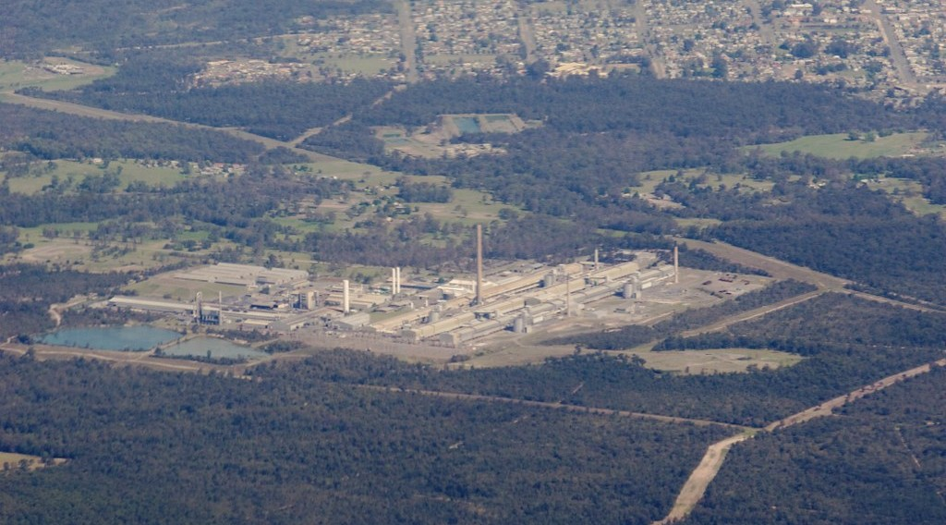
ECO. GEOGRAPHY — FORM 2 TECH
II. EXAMPLES
Activity 3
An aluminium factory seen from the sky.
2026 / 2027
DGCAST GAROUA — GEOGRAPHY DEPARTMENT
Mr KAMDEM E. | 20
Notes:
Without the projector: show a cooking pot made of aluminium.

Slide 21
ECO. GEOGRAPHY — FORM 2 TECH
II. EXAMPLES
Activity 3: Question
Alucam at Edéa makes aluminium. What type of industry is this?
2026 / 2027
DGCAST GAROUA — GEOGRAPHY DEPARTMENT
Mr KAMDEM E. | 21

Slide 22
ECO. GEOGRAPHY — FORM 2 TECH
II. EXAMPLES
Answer
A heavy industry: it transforms minerals.
2026 / 2027
DGCAST GAROUA — GEOGRAPHY DEPARTMENT
Mr KAMDEM E. | 22

Slide 23

ECO. GEOGRAPHY — FORM 2 TECH
II. EXAMPLES
Activity 4
Workers build a house.
2026 / 2027
DGCAST GAROUA — GEOGRAPHY DEPARTMENT
Mr KAMDEM E. | 23
Notes:
Without the projector: ask learners to name buildings under construction in Garoua.

Slide 24
ECO. GEOGRAPHY — FORM 2 TECH
II. EXAMPLES
Activity 4: Question
Is building houses and roads part of the secondary sector? Why?
2026 / 2027
DGCAST GAROUA — GEOGRAPHY DEPARTMENT
Mr KAMDEM E. | 24

Slide 25
ECO. GEOGRAPHY — FORM 2 TECH
II. EXAMPLES
Answer
Yes. Builders make new things from sand, cement and iron.
2026 / 2027
DGCAST GAROUA — GEOGRAPHY DEPARTMENT
Mr KAMDEM E. | 25

Slide 26
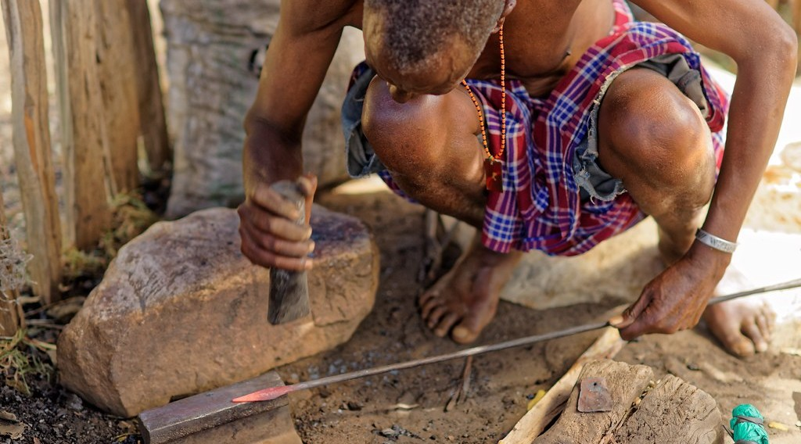
ECO. GEOGRAPHY — FORM 2 TECH
II. EXAMPLES
Activity 5
A blacksmith makes tools.
2026 / 2027
DGCAST GAROUA — GEOGRAPHY DEPARTMENT
Mr KAMDEM E. | 26
Notes:
Without the projector: ask learners to name craftsmen: tailors, potters, carpenters.

Slide 27
ECO. GEOGRAPHY — FORM 2 TECH
II. EXAMPLES
Activity 5: Question
The blacksmith makes tools by hand. What do we call this work?
2026 / 2027
DGCAST GAROUA — GEOGRAPHY DEPARTMENT
Mr KAMDEM E. | 27

Slide 28
ECO. GEOGRAPHY — FORM 2 TECH
II. EXAMPLES
Answer
Crafts (handicraft).
2026 / 2027
DGCAST GAROUA — GEOGRAPHY DEPARTMENT
Mr KAMDEM E. | 28

Slide 29
ECO. GEOGRAPHY — FORM 2 TECH
BOARD SUMMARY
The Sectors of the Economy
Topic: Economic Activities
Sub-topic: Sectors of the Economy
Lesson 5: The Sectors of the Economy — Part 4: The Secondary Sector (Definition and Examples)
2026 / 2027
DGCAST GAROUA — GEOGRAPHY DEPARTMENT
Mr KAMDEM E. | 29
Notes:
Learners copy the board summary now. Give them enough time for each slide.

Slide 30
ECO. GEOGRAPHY — FORM 2 TECH
BOARD SUMMARY
I. Definitions
Secondary sector: It is the sector that turns raw materials into goods.
Industry: It is a factory or group of factories.
Craft: It is making goods by hand.
2026 / 2027
DGCAST GAROUA — GEOGRAPHY DEPARTMENT
Mr KAMDEM E. | 30

Slide 31
ECO. GEOGRAPHY — FORM 2 TECH
BOARD SUMMARY
II. Examples
A. Agro-industries: CICAM makes cloth from cotton.
B. Heavy industries: Alucam makes aluminium.
C. Construction: Building houses, roads and bridges.
D. Energy: The Lagdo and Edéa dams make electricity.
E. Crafts: Tailors, blacksmiths and potters.
2026 / 2027
DGCAST GAROUA — GEOGRAPHY DEPARTMENT
Mr KAMDEM E. | 31

Slide 32
ECO. GEOGRAPHY — FORM 2 TECH
FORMATIVE EVALUATION
Formative Evaluation 1
What is the secondary sector?
2026 / 2027
DGCAST GAROUA — GEOGRAPHY DEPARTMENT
Mr KAMDEM E. | 32

Slide 33
ECO. GEOGRAPHY — FORM 2 TECH
FORMATIVE EVALUATION
Expected Answer
The sector that turns raw materials into goods.
2026 / 2027
DGCAST GAROUA — GEOGRAPHY DEPARTMENT
Mr KAMDEM E. | 33

Slide 34
ECO. GEOGRAPHY — FORM 2 TECH
FORMATIVE EVALUATION
Formative Evaluation 2
Give two examples of industries in Cameroon.
2026 / 2027
DGCAST GAROUA — GEOGRAPHY DEPARTMENT
Mr KAMDEM E. | 34

Slide 35
ECO. GEOGRAPHY — FORM 2 TECH
FORMATIVE EVALUATION
Expected Answer
CICAM (cloth) and Alucam (aluminium).
2026 / 2027
DGCAST GAROUA — GEOGRAPHY DEPARTMENT
Mr KAMDEM E. | 35

Slide 36
ECO. GEOGRAPHY — FORM 2 TECH
REMEDIATION
Remediation
Fill in the blanks:
Turning raw materials into goods is the ______ sector.
CICAM turns cotton into ______.
Alucam at Edéa makes ______.
2026 / 2027
DGCAST GAROUA — GEOGRAPHY DEPARTMENT
Mr KAMDEM E. | 36
Notes:
Answers: 1. secondary 2. cloth 3. aluminium

Slide 37
ECO. GEOGRAPHY — FORM 2 TECH
HOMEWORK
Homework
List four services that your family uses every week, for example transport, school, hospital, market or mobile money.
This prepares Part 5: The Tertiary Sector.
2026 / 2027
DGCAST GAROUA — GEOGRAPHY DEPARTMENT
Mr KAMDEM E. | 37
Notes:
This homework prepares the next lesson.

Slide 38
ECO. GEOGRAPHY — FORM 2 TECH
BILINGUAL GAME
Bilingual Game (Jeu Bilingue)
English | Français
Industry | L'industrie
Factory | L'usine
Finished good | Le produit fini
Construction | Le bâtiment (la construction)
Energy | L'énergie
Refinery | La raffinerie
Craftsman | L'artisan
Cement | Le ciment
2026 / 2027
DGCAST GAROUA — GEOGRAPHY DEPARTMENT
Mr KAMDEM E. | 38
Notes:
Say the English word; learners give the French word, then the reverse.

Slide 39
ECO. GEOGRAPHY — FORM 2 TECH
LOGBOOK
Official Logbook (1/2)
Module / Topic | Economic Activities
Lesson Title | Lesson 5: The Sectors of the Economy — Part 4: The Secondary Sector (Definition and Examples)
Expected Learning Outcomes | Define the secondary sector. Name the main secondary activities. Give examples of industries in Cameroon and explain their importance.
Competence | Learners are able to recognise the products of Cameroonian factories and explain why transforming raw materials creates jobs and wealth.
2026 / 2027
DGCAST GAROUA — GEOGRAPHY DEPARTMENT
Mr KAMDEM E. | 39

Slide 40
ECO. GEOGRAPHY — FORM 2 TECH
LOGBOOK
Official Logbook (2/2)
Matter Taught | I. Definitions: Secondary sector, Industry, Craft; II. Examples: Agro-industries, Heavy industries, Construction, Energy, Crafts.
Evaluation | Formative evaluation (3 questions) and remediation exercise.
Homework | List four services that your family uses every week, for example transport, school, hospital, market or mobile money.
Enrolment / Present / Absent | ____ / ____ / ____
Achievement | To be completed by the teacher after the lesson.
2026 / 2027
DGCAST GAROUA — GEOGRAPHY DEPARTMENT
Mr KAMDEM E. | 40

Slide 41
ECO. GEOGRAPHY — FORM 2 TECH
TEACHER'S NOTE
Teacher's Note
Timing: Set-up, recall 8 min | Situation 8 min | 5 activities 25 min | Board summary (copying) 30 min | Evaluation, remediation 10 min | Homework 4 min | Logbook 10 min | Spare 5 min
2026 / 2027
DGCAST GAROUA — GEOGRAPHY DEPARTMENT
Mr KAMDEM E. | 41

Slide 42
ECO. GEOGRAPHY — FORM 2 TECH
REFERENCES
References
Harmonised Progression Sheet, Economic Geography (5051), Form 2.
Photo, Activity 1: “Lowell Massachusetts - Boott Cotton Mills Museum Weave Room” by Onasill ~ Bill- 81M views, CC BY-NC-SA 2.0, via Flickr (https://www.flickr.com/photos/7156765@N05/43677799854)
Photo, Activity 2: “Interior of Winston-Salem Chero-Cola Bottling Company, Winston-Salem, ” by unclibraries_commons, Public domain 1.0, via Flickr (https://www.flickr.com/photos/122654055@N06/22680169228)
Photo, Activity 3: “Kurri Kurri aluminium” by yewenyi, CC BY-NC 2.0, via Flickr (https://www.flickr.com/photos/30265340@N00/2971223932)
Photo, Activity 4: “Cementing Ethiopia's progress” by DFID - UK Department for International Development, CC BY 2.0, via Flickr (https://www.flickr.com/photos/14214150@N02/8757865770)
Photo, Activity 5: “Forging a new spear tip” by www.j-pics.info, CC BY-NC-SA 2.0, via Flickr (https://www.flickr.com/photos/33979630@N07/16024814824)
Diagrams and animations: drawn for this lesson (DGCAST Geography Department).
2026 / 2027
DGCAST GAROUA — GEOGRAPHY DEPARTMENT
Mr KAMDEM E. | 42

