Slide 1

DIVINE GRACE COLLEGE OF ARTS, SCIENCE AND TECHNOLOGY
(DGCAST) — GAROUA | GEOGRAPHY DEPARTMENT
FORM 4 GEOGRAPHY — LESSON 1
Our Planet, the Earth: Size, Shape and Proofs
Mr KAMDEM EMMANUEL
Geography Teacher — PLEG
Academic Year 2026 / 2027
Notes:
Good morning, class, and welcome to Form 4 Geography. Our first lesson is about our planet, the Earth: its size, its shape and the proofs of its shape.

Slide 2
GEOGRAPHY — FORM 4
CLASS INFO
Class, Chapter & Duration
Class | Form 4
Chapter | The Earth as a Planet in the Solar System — The Earth as a Planet of the Solar System
Duration | 50 minutes
2026 / 2027
DGCAST GAROUA — GEOGRAPHY DEPARTMENT
Mr KAMDEM E. | 2

Slide 3
GEOGRAPHY — FORM 4
IDENTIFICATION
Lesson Identification
Topic | The Earth as a Planet in the Solar System
Sub-topic | The Earth as a Planet of the Solar System
Lesson | Lesson 1: Our Planet, the Earth: Size, Shape and Proofs
Notions / Concepts | Sphere, oblate spheroid, circumference, diameter, horizon.
Syllabus focus | Size of the Earth; shape of the Earth; proofs of the shape of the Earth.
Competence | Learners are able to explain, with everyday observations, why the Earth is round and to give its main measurements.
2026 / 2027
DGCAST GAROUA — GEOGRAPHY DEPARTMENT
Mr KAMDEM E. | 3

Slide 4
GEOGRAPHY — FORM 4
OBJECTIVES
Learning Objectives
By the end of the lesson, the learner should be able to:
Give the size of the Earth: its circumferences and diameters.
Describe the true shape of the Earth (an oblate spheroid).
Explain at least four proofs that the Earth is round.
2026 / 2027
DGCAST GAROUA — GEOGRAPHY DEPARTMENT
Mr KAMDEM E. | 4

Slide 5
GEOGRAPHY — FORM 4
RECALL
Recall
The Earth is one of the eight planets of the solar system.
The Earth moves around the Sun.
We live on the surface of the Earth, which is made of land and water.
2026 / 2027
DGCAST GAROUA — GEOGRAPHY DEPARTMENT
Mr KAMDEM E. | 5
Notes:
Ask learners what they learned about the Earth in Form 1.

Slide 6
GEOGRAPHY — FORM 4
REAL-LIFE SITUATION
Real-Life Situation
On a long, straight road, Aïcha sees a lorry coming from far away. First, she sees only the top of the lorry. Then she sees the whole lorry. Her brother says, "The Earth is flat."
2026 / 2027
DGCAST GAROUA — GEOGRAPHY DEPARTMENT
Mr KAMDEM E. | 6
Notes:
Read the situation slowly, twice.

Slide 7
GEOGRAPHY — FORM 4
REAL-LIFE SITUATION
Situation — Question 1
What is the problem in the situation?
2026 / 2027
DGCAST GAROUA — GEOGRAPHY DEPARTMENT
Mr KAMDEM E. | 7

Slide 8
GEOGRAPHY — FORM 4
REAL-LIFE SITUATION
Answer
Aïcha cannot explain why she saw the top of the lorry first.
2026 / 2027
DGCAST GAROUA — GEOGRAPHY DEPARTMENT
Mr KAMDEM E. | 8

Slide 9
GEOGRAPHY — FORM 4
REAL-LIFE SITUATION
Situation — Question 2
Which part of the lorry did she see first?
2026 / 2027
DGCAST GAROUA — GEOGRAPHY DEPARTMENT
Mr KAMDEM E. | 9

Slide 10
GEOGRAPHY — FORM 4
REAL-LIFE SITUATION
Answer
She saw the top of the lorry first.
2026 / 2027
DGCAST GAROUA — GEOGRAPHY DEPARTMENT
Mr KAMDEM E. | 10

Slide 11
GEOGRAPHY — FORM 4
REAL-LIFE SITUATION
Situation — Question 3
How can she show her brother that the Earth is round?
2026 / 2027
DGCAST GAROUA — GEOGRAPHY DEPARTMENT
Mr KAMDEM E. | 11

Slide 12
GEOGRAPHY — FORM 4
REAL-LIFE SITUATION
Possible Answer
She can show him a globe and photos of the Earth from space.
2026 / 2027
DGCAST GAROUA — GEOGRAPHY DEPARTMENT
Mr KAMDEM E. | 12

Slide 13
GEOGRAPHY — FORM 4
JUSTIFICATION
Justification of the Lesson
This lesson helps us to know the size and the shape of our planet.
2026 / 2027
DGCAST GAROUA — GEOGRAPHY DEPARTMENT
Mr KAMDEM E. | 13

Slide 14

GEOGRAPHY — FORM 4
SHAPE OF THE EARTH
Activity 1
The Earth seen from space.
2026 / 2027
DGCAST GAROUA — GEOGRAPHY DEPARTMENT
Mr KAMDEM E. | 14
Notes:
Without the projector: show a globe or a ball.

Slide 15
GEOGRAPHY — FORM 4
SHAPE OF THE EARTH
Activity 1: Question
Look at the photo. What is the shape of the Earth?
2026 / 2027
DGCAST GAROUA — GEOGRAPHY DEPARTMENT
Mr KAMDEM E. | 15

Slide 16
GEOGRAPHY — FORM 4
SHAPE OF THE EARTH
Answer
The Earth is round, like a ball.
2026 / 2027
DGCAST GAROUA — GEOGRAPHY DEPARTMENT
Mr KAMDEM E. | 16

Slide 17
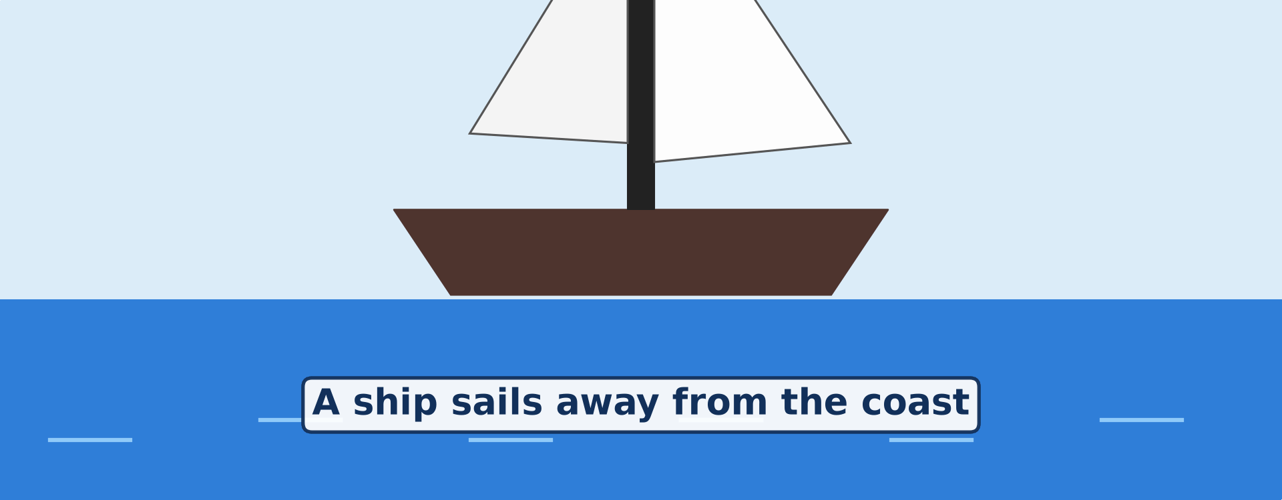
GEOGRAPHY — FORM 4
PROOFS
Activity 2
Animation: a ship sails away from the coast.
2026 / 2027
DGCAST GAROUA — GEOGRAPHY DEPARTMENT
Mr KAMDEM E. | 17
Notes:
Without the projector: draw three ships going down behind a curved line and ask the question.

Slide 18
GEOGRAPHY — FORM 4
PROOFS
Activity 2: Question
Which part of the ship disappears first? Why?
2026 / 2027
DGCAST GAROUA — GEOGRAPHY DEPARTMENT
Mr KAMDEM E. | 18

Slide 19
GEOGRAPHY — FORM 4
PROOFS
Answer
The bottom of the ship disappears first, because the ship goes over the curve of the Earth.
2026 / 2027
DGCAST GAROUA — GEOGRAPHY DEPARTMENT
Mr KAMDEM E. | 19

Slide 20
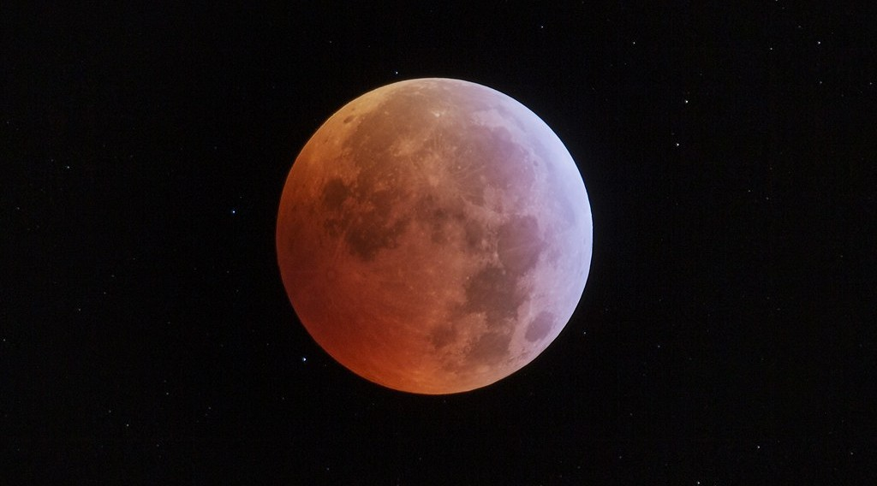
GEOGRAPHY — FORM 4
PROOFS
Activity 3
An eclipse of the Moon: the Moon is inside the shadow of the Earth.
2026 / 2027
DGCAST GAROUA — GEOGRAPHY DEPARTMENT
Mr KAMDEM E. | 20
Notes:
Without the projector: hold a ball in front of a torch: its shadow on the wall is round.

Slide 21
GEOGRAPHY — FORM 4
PROOFS
Activity 3: Question
During an eclipse, the edge of the shadow of the Earth on the Moon is always curved. What does this prove?
2026 / 2027
DGCAST GAROUA — GEOGRAPHY DEPARTMENT
Mr KAMDEM E. | 21

Slide 22
GEOGRAPHY — FORM 4
PROOFS
Answer
The Earth is round. Only a round object gives a round shadow.
2026 / 2027
DGCAST GAROUA — GEOGRAPHY DEPARTMENT
Mr KAMDEM E. | 22

Slide 23
GEOGRAPHY — FORM 4
BOARD SUMMARY
Our Planet, the Earth: Size, Shape and Proofs
Topic: The Earth as a Planet in the Solar System
Sub-topic: The Earth as a Planet of the Solar System
Lesson 1: Our Planet, the Earth: Size, Shape and Proofs
2026 / 2027
DGCAST GAROUA — GEOGRAPHY DEPARTMENT
Mr KAMDEM E. | 23
Notes:
Learners copy the board summary now. Give them enough time for each slide.

Slide 24
GEOGRAPHY — FORM 4
BOARD SUMMARY
I. Definitions
Planet: It is a large body that moves around the Sun.
Oblate spheroid: It is a ball that is flat at the poles and wider at the Equator.
2026 / 2027
DGCAST GAROUA — GEOGRAPHY DEPARTMENT
Mr KAMDEM E. | 24

Slide 25
GEOGRAPHY — FORM 4
BOARD SUMMARY
II. Size of the Earth
The main measurements of the Earth are:
A. Distance around the Equator: about 40,075 km.
B. Distance around the poles: about 40,008 km.
C. Diameter at the Equator: about 12,756 km.
2026 / 2027
DGCAST GAROUA — GEOGRAPHY DEPARTMENT
Mr KAMDEM E. | 25

Slide 26
GEOGRAPHY — FORM 4
BOARD SUMMARY
III. Shape of the Earth (1/2)
Shape: The Earth is an oblate spheroid.
2026 / 2027
DGCAST GAROUA — GEOGRAPHY DEPARTMENT
Mr KAMDEM E. | 26

Slide 27
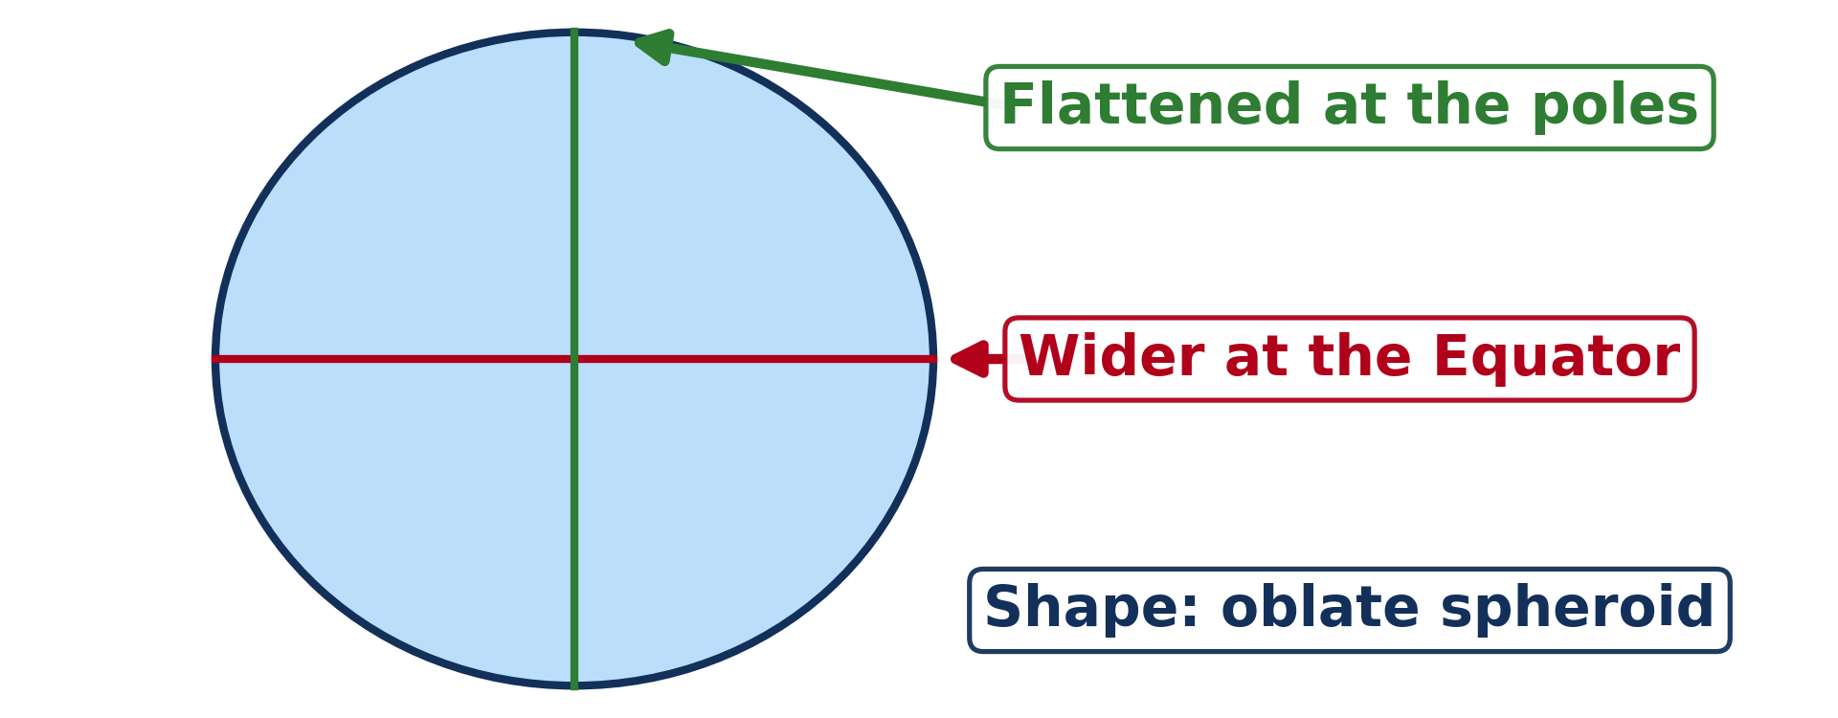
GEOGRAPHY — FORM 4
BOARD SUMMARY
III. Shape of the Earth (2/2)
Copy this simple drawing.
2026 / 2027
DGCAST GAROUA — GEOGRAPHY DEPARTMENT
Mr KAMDEM E. | 27

Slide 28
GEOGRAPHY — FORM 4
BOARD SUMMARY
IV. Proofs of the Shape
The main proofs are:
A. The ship: Its bottom disappears first.
B. The eclipse of the Moon: The shadow of the Earth is round.
C. Photos from space: They show a round Earth.
D. Travel around the world: We come back to the start.
2026 / 2027
DGCAST GAROUA — GEOGRAPHY DEPARTMENT
Mr KAMDEM E. | 28

Slide 29
GEOGRAPHY — FORM 4
FORMATIVE EVALUATION
Formative Evaluation 1
What is the shape of the Earth?
2026 / 2027
DGCAST GAROUA — GEOGRAPHY DEPARTMENT
Mr KAMDEM E. | 29

Slide 30
GEOGRAPHY — FORM 4
FORMATIVE EVALUATION
Expected Answer
It is an oblate spheroid.
2026 / 2027
DGCAST GAROUA — GEOGRAPHY DEPARTMENT
Mr KAMDEM E. | 30

Slide 31
GEOGRAPHY — FORM 4
FORMATIVE EVALUATION
Formative Evaluation 2
Give two proofs that the Earth is round.
2026 / 2027
DGCAST GAROUA — GEOGRAPHY DEPARTMENT
Mr KAMDEM E. | 31

Slide 32
GEOGRAPHY — FORM 4
FORMATIVE EVALUATION
Expected Answer
The ship at sea and the round shadow of the Earth on the Moon.
2026 / 2027
DGCAST GAROUA — GEOGRAPHY DEPARTMENT
Mr KAMDEM E. | 32

Slide 33
GEOGRAPHY — FORM 4
REMEDIATION
Remediation
Fill in the blanks:
The Earth is flat at the ______.
The Earth is wider at the ______.
The shadow of the Earth on the Moon is ______.
2026 / 2027
DGCAST GAROUA — GEOGRAPHY DEPARTMENT
Mr KAMDEM E. | 33
Notes:
Answers: 1. poles 2. Equator 3. round

Slide 34
GEOGRAPHY — FORM 4
HOMEWORK
Homework
Look at the Moon on three different evenings this week. Draw its shape each time and write the date under each drawing.
This prepares Further Study 1: The Universe and the Moon.
2026 / 2027
DGCAST GAROUA — GEOGRAPHY DEPARTMENT
Mr KAMDEM E. | 34
Notes:
This homework prepares the next lesson.

Slide 35
GEOGRAPHY — FORM 4
BILINGUAL GAME
Bilingual Game (Jeu Bilingue)
English | Français
Planet | La planète
Shape | La forme
Size | La taille
Sphere | La sphère
Circumference | La circonférence
Diameter | Le diamètre
Horizon | L'horizon
Proof | La preuve
2026 / 2027
DGCAST GAROUA — GEOGRAPHY DEPARTMENT
Mr KAMDEM E. | 35
Notes:
Say the English word; learners give the French word, then the reverse.

Slide 36
GEOGRAPHY — FORM 4
LOGBOOK
Official Logbook (1/2)
Module / Topic | The Earth as a Planet in the Solar System
Lesson Title | Lesson 1: Our Planet, the Earth: Size, Shape and Proofs
Expected Learning Outcomes | Give the size of the Earth: its circumferences and diameters. Describe the true shape of the Earth (an oblate spheroid). Explain at least four proofs that the Earth is round.
Competence | Learners are able to explain, with everyday observations, why the Earth is round and to give its main measurements.
2026 / 2027
DGCAST GAROUA — GEOGRAPHY DEPARTMENT
Mr KAMDEM E. | 36

Slide 37
GEOGRAPHY — FORM 4
LOGBOOK
Official Logbook (2/2)
Matter Taught | I. Definitions: Planet, Oblate spheroid; II. Size of the Earth: Distance around the Equator, Distance around the poles, Diameter at the Equator; III. Shape of the Earth: Shape; IV. Proofs of the Shape: The ship, The eclipse of the Moon, Photos from space, Travel around the world.
Evaluation | Formative evaluation (3 questions) and remediation exercise.
Homework | Look at the Moon on three different evenings this week. Draw its shape each time and write the date under each drawing.
Enrolment / Present / Absent | ____ / ____ / ____
Achievement | To be completed by the teacher after the lesson.
2026 / 2027
DGCAST GAROUA — GEOGRAPHY DEPARTMENT
Mr KAMDEM E. | 37

Slide 38
GEOGRAPHY — FORM 4
TEACHER'S NOTE
Teacher's Note
Timing: Set-up, recall 5 min | Situation 5 min | 3 activities 12 min | Board summary (copying) 15 min | Evaluation, homework 5 min | Logbook 5 min | Spare 3 min
Figures: equatorial circumference 40,075 km; polar 40,008 km; equatorial diameter 12,756 km; polar 12,714 km.
Activity 2 is an animation (GIF): it plays automatically in slide-show mode.
2026 / 2027
DGCAST GAROUA — GEOGRAPHY DEPARTMENT
Mr KAMDEM E. | 38

Slide 39
GEOGRAPHY — FORM 4
REFERENCES
References
National Geography Syllabus (MINESEC), Form 4 — The Earth as a Planet in the Solar System.
Teacher's lesson notes (Form 4), checked and corrected where necessary.
Photo, Activity 1: “Blue Marble, Eastern Hemisphere March 2014” by NASA Goddard Photo and Video, CC BY 2.0, via nasa (https://www.flickr.com/photos/24662369@N07/14990033062)
Photo, Activity 3: “Medio de la totalidad eclipse Luna 21 enero 2019” by StarryEarth, CC BY-NC 2.0, via Flickr (https://www.flickr.com/photos/65131760@N06/46777562672)
Diagrams and animations: drawn for this lesson (DGCAST Geography Department).
2026 / 2027
DGCAST GAROUA — GEOGRAPHY DEPARTMENT
Mr KAMDEM E. | 39

