Slide 1

DIVINE GRACE COLLEGE OF ARTS, SCIENCE AND TECHNOLOGY
(DGCAST) — GAROUA | GEOGRAPHY DEPARTMENT
FORM 4 GEOGRAPHY — LESSON 9
The Theory of Continental Drift
Mr KAMDEM EMMANUEL
Geography Teacher — PLEG
Academic Year 2026 / 2027
Notes:
Good morning, class. Today we study Lesson 9: The Theory of Continental Drift.

Slide 2
GEOGRAPHY — FORM 4
CLASS INFO
Class, Chapter & Duration
Class | Form 4
Chapter | The Structure of the Earth: Building Processes and Impacts on Man — Internal Structure of the Earth
Duration | 50 minutes
2026 / 2027
DGCAST GAROUA — GEOGRAPHY DEPARTMENT
Mr KAMDEM E. | 2

Slide 3
GEOGRAPHY — FORM 4
IDENTIFICATION
Lesson Identification
Topic | The Structure of the Earth: Building Processes and Impacts on Man
Sub-topic | Internal Structure of the Earth
Lesson | Lesson 9: The Theory of Continental Drift
Notions / Concepts | Continental drift, Pangaea, Laurasia, Gondwanaland.
Syllabus focus | The theory of continental drift: main idea, illustration and evidence.
Competence | Learners are able to explain, with map evidence, that the continents have moved, and to read the shape of the continents on a world map.
2026 / 2027
DGCAST GAROUA — GEOGRAPHY DEPARTMENT
Mr KAMDEM E. | 3

Slide 4
GEOGRAPHY — FORM 4
OBJECTIVES
Learning Objectives
By the end of the lesson, the learner should be able to:
State the theory of continental drift.
Describe the break-up of Pangaea.
Explain the evidence for continental drift.
2026 / 2027
DGCAST GAROUA — GEOGRAPHY DEPARTMENT
Mr KAMDEM E. | 4

Slide 5
GEOGRAPHY — FORM 4
RECALL
Recall
The crust is broken and lies on the very hot mantle.
The mantle flows very slowly.
Fossils are found mainly in sedimentary rocks.
2026 / 2027
DGCAST GAROUA — GEOGRAPHY DEPARTMENT
Mr KAMDEM E. | 5
Notes:
Check the homework: the fit of Africa and South America.

Slide 6
GEOGRAPHY — FORM 4
REAL-LIFE SITUATION
Real-Life Situation
Djibrilla looks at a map. The coast of Africa and the coast of South America look like two pieces of a puzzle. He wonders if they were once joined.
2026 / 2027
DGCAST GAROUA — GEOGRAPHY DEPARTMENT
Mr KAMDEM E. | 6
Notes:
Read the situation slowly, twice.

Slide 7
GEOGRAPHY — FORM 4
REAL-LIFE SITUATION
Situation — Question 1
What is the problem in the situation?
2026 / 2027
DGCAST GAROUA — GEOGRAPHY DEPARTMENT
Mr KAMDEM E. | 7

Slide 8
GEOGRAPHY — FORM 4
REAL-LIFE SITUATION
Answer
Djibrilla wonders if Africa and South America were once joined.
2026 / 2027
DGCAST GAROUA — GEOGRAPHY DEPARTMENT
Mr KAMDEM E. | 8

Slide 9
GEOGRAPHY — FORM 4
REAL-LIFE SITUATION
Situation — Question 2
What does he notice?
2026 / 2027
DGCAST GAROUA — GEOGRAPHY DEPARTMENT
Mr KAMDEM E. | 9

Slide 10
GEOGRAPHY — FORM 4
REAL-LIFE SITUATION
Answer
The two coasts fit like a puzzle.
2026 / 2027
DGCAST GAROUA — GEOGRAPHY DEPARTMENT
Mr KAMDEM E. | 10

Slide 11
GEOGRAPHY — FORM 4
REAL-LIFE SITUATION
Situation — Question 3
Who first explained this?
2026 / 2027
DGCAST GAROUA — GEOGRAPHY DEPARTMENT
Mr KAMDEM E. | 11

Slide 12
GEOGRAPHY — FORM 4
REAL-LIFE SITUATION
Possible Answer
Alfred Wegener, in 1912.
2026 / 2027
DGCAST GAROUA — GEOGRAPHY DEPARTMENT
Mr KAMDEM E. | 12

Slide 13
GEOGRAPHY — FORM 4
JUSTIFICATION
Justification of the Lesson
This lesson helps us to understand that the continents move.
2026 / 2027
DGCAST GAROUA — GEOGRAPHY DEPARTMENT
Mr KAMDEM E. | 13

Slide 14

GEOGRAPHY — FORM 4
I. THE THEORY
Activity 1
Animation: closing the Atlantic Ocean.
2026 / 2027
DGCAST GAROUA — GEOGRAPHY DEPARTMENT
Mr KAMDEM E. | 14
Notes:
Without the projector: cut a paper map of the two continents and fit them.

Slide 15
GEOGRAPHY — FORM 4
I. THE THEORY
Activity 1: Question
What happens when we bring South America near Africa?
2026 / 2027
DGCAST GAROUA — GEOGRAPHY DEPARTMENT
Mr KAMDEM E. | 15

Slide 16
GEOGRAPHY — FORM 4
I. THE THEORY
Answer
The two coasts fit together like a puzzle.
2026 / 2027
DGCAST GAROUA — GEOGRAPHY DEPARTMENT
Mr KAMDEM E. | 16

Slide 17
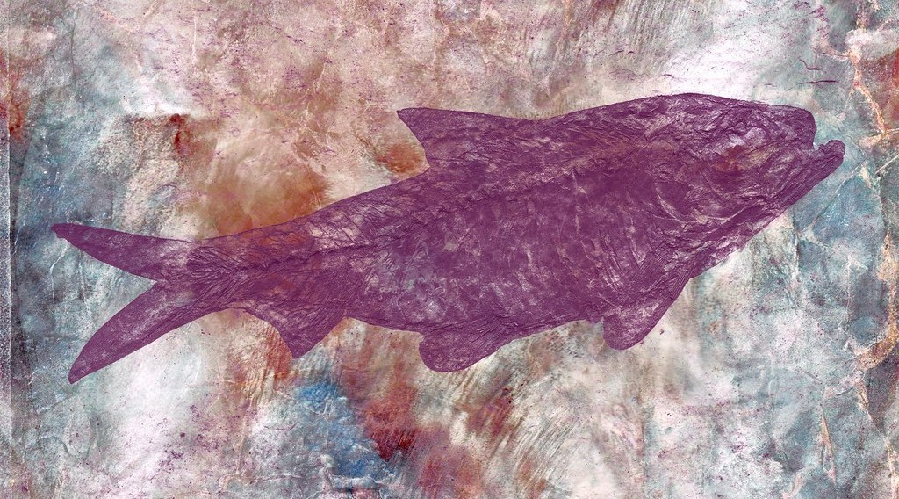
GEOGRAPHY — FORM 4
II. EVIDENCE
Activity 2
A fossil of a fish in rock.
2026 / 2027
DGCAST GAROUA — GEOGRAPHY DEPARTMENT
Mr KAMDEM E. | 17
Notes:
The photo shows a fossil fish; Mesosaurus fossils look similar and are found on both sides of the Atlantic.
Without the projector: explain: this small animal could not swim across the ocean.

Slide 18
GEOGRAPHY — FORM 4
II. EVIDENCE
Activity 2: Question
The fossils of the same small reptile (Mesosaurus) are found in Brazil and in southern Africa. What does it prove?
2026 / 2027
DGCAST GAROUA — GEOGRAPHY DEPARTMENT
Mr KAMDEM E. | 18

Slide 19
GEOGRAPHY — FORM 4
II. EVIDENCE
Answer
The two continents were once joined.
2026 / 2027
DGCAST GAROUA — GEOGRAPHY DEPARTMENT
Mr KAMDEM E. | 19

Slide 20

GEOGRAPHY — FORM 4
II. EVIDENCE
Activity 3
A crack in the ground in Iceland, where two plates move apart.
2026 / 2027
DGCAST GAROUA — GEOGRAPHY DEPARTMENT
Mr KAMDEM E. | 20
Notes:
Without the projector: push two books apart slowly on the table.

Slide 21
GEOGRAPHY — FORM 4
II. EVIDENCE
Activity 3: Question
The ground here opens a little every year. What does it show?
2026 / 2027
DGCAST GAROUA — GEOGRAPHY DEPARTMENT
Mr KAMDEM E. | 21

Slide 22
GEOGRAPHY — FORM 4
II. EVIDENCE
Answer
The land (the continents) is moving.
2026 / 2027
DGCAST GAROUA — GEOGRAPHY DEPARTMENT
Mr KAMDEM E. | 22

Slide 23
GEOGRAPHY — FORM 4
BOARD SUMMARY
The Theory of Continental Drift
Topic: The Structure of the Earth: Building Processes and Impacts on Man
Sub-topic: Internal Structure of the Earth
Lesson 9: The Theory of Continental Drift
2026 / 2027
DGCAST GAROUA — GEOGRAPHY DEPARTMENT
Mr KAMDEM E. | 23
Notes:
Learners copy the board summary now. Give them enough time for each slide.

Slide 24
GEOGRAPHY — FORM 4
BOARD SUMMARY
I. Definitions
Continental drift: It is the slow movement of the continents.
Pangaea: It is the single big continent of long ago.
2026 / 2027
DGCAST GAROUA — GEOGRAPHY DEPARTMENT
Mr KAMDEM E. | 24

Slide 25
GEOGRAPHY — FORM 4
BOARD SUMMARY
II. The Theory
A. Author: Alfred Wegener (1912).
B. Idea: All continents were once one: Pangaea.
C. Break-up: Pangaea broke into pieces that moved apart.
2026 / 2027
DGCAST GAROUA — GEOGRAPHY DEPARTMENT
Mr KAMDEM E. | 25

Slide 26
GEOGRAPHY — FORM 4
BOARD SUMMARY
III. Evidence (1/2)
A. Jigsaw fit: Africa and South America fit together.
B. Fossils: The same fossils are on both sides.
C. Rocks: The same rocks are on both sides.
D. Old ice: Marks of ice are found in hot lands.
2026 / 2027
DGCAST GAROUA — GEOGRAPHY DEPARTMENT
Mr KAMDEM E. | 26

Slide 27
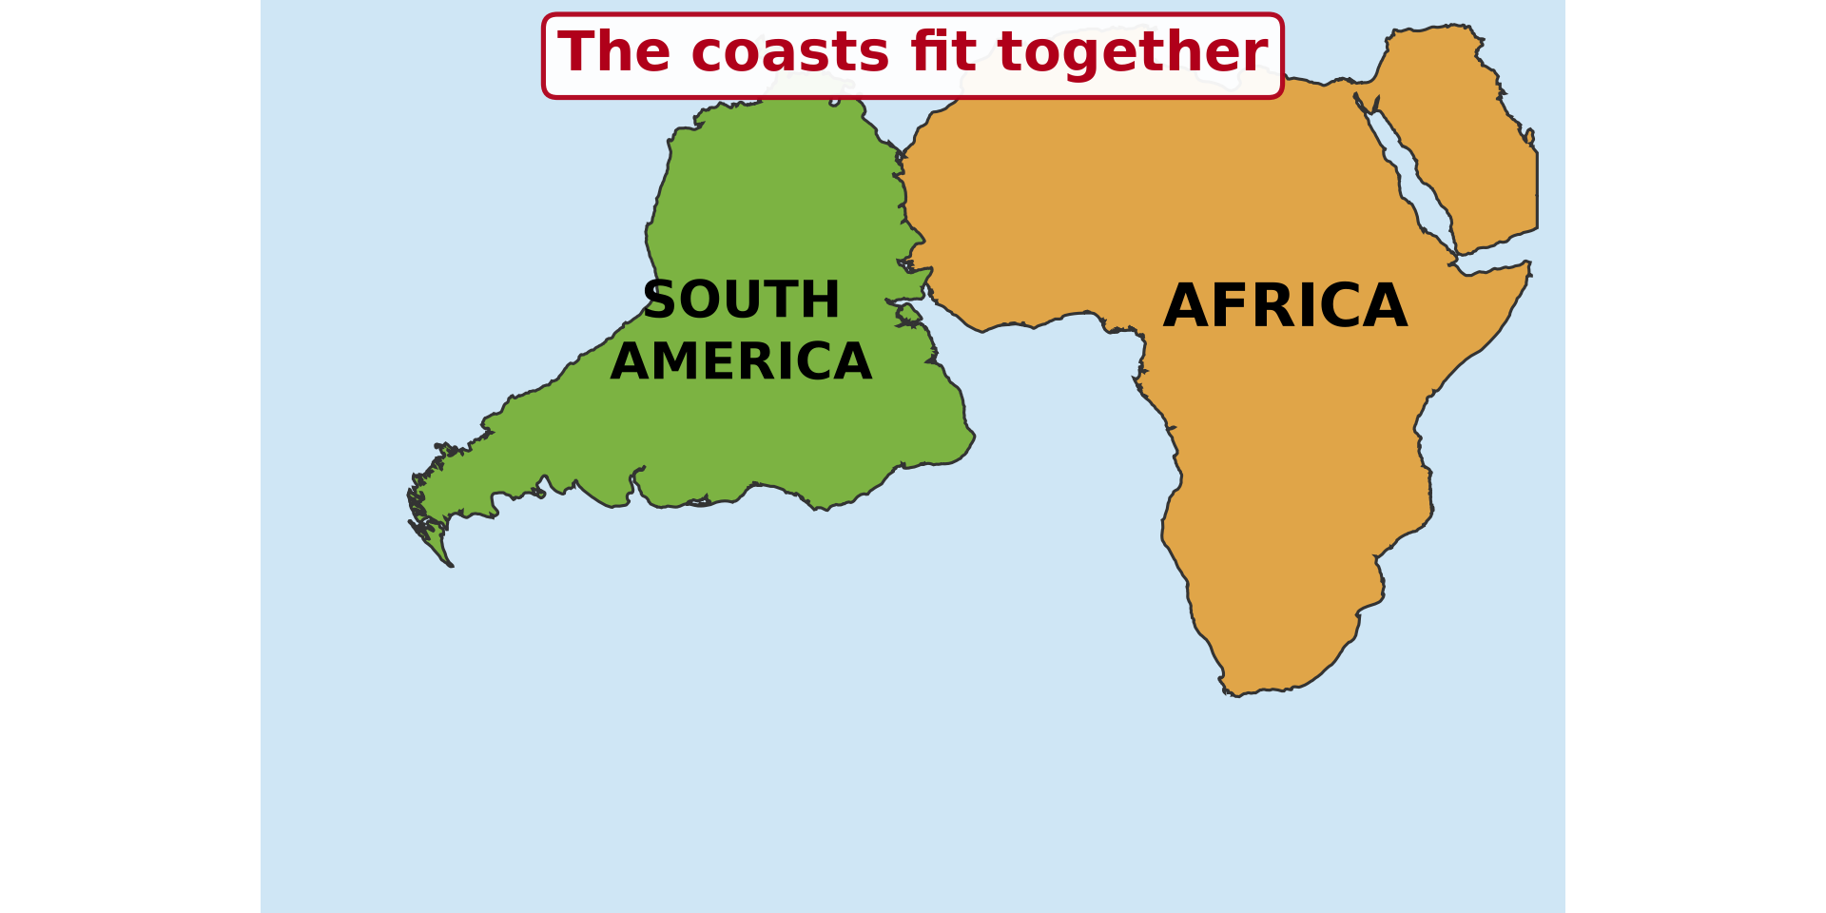
GEOGRAPHY — FORM 4
BOARD SUMMARY
III. Evidence (2/2)
Copy the fit of the two continents.
2026 / 2027
DGCAST GAROUA — GEOGRAPHY DEPARTMENT
Mr KAMDEM E. | 27

Slide 28
GEOGRAPHY — FORM 4
FORMATIVE EVALUATION
Formative Evaluation 1
What is Pangaea?
2026 / 2027
DGCAST GAROUA — GEOGRAPHY DEPARTMENT
Mr KAMDEM E. | 28

Slide 29
GEOGRAPHY — FORM 4
FORMATIVE EVALUATION
Expected Answer
The single big continent of long ago.
2026 / 2027
DGCAST GAROUA — GEOGRAPHY DEPARTMENT
Mr KAMDEM E. | 29

Slide 30
GEOGRAPHY — FORM 4
FORMATIVE EVALUATION
Formative Evaluation 2
Give two pieces of evidence for continental drift.
2026 / 2027
DGCAST GAROUA — GEOGRAPHY DEPARTMENT
Mr KAMDEM E. | 30

Slide 31
GEOGRAPHY — FORM 4
FORMATIVE EVALUATION
Expected Answer
The jigsaw fit and the same fossils on both continents.
2026 / 2027
DGCAST GAROUA — GEOGRAPHY DEPARTMENT
Mr KAMDEM E. | 31

Slide 32
GEOGRAPHY — FORM 4
REMEDIATION
Remediation
Fill in the blanks:
The theory of continental drift was given by ______.
The single big continent was called ______.
Africa and South America fit like a ______.
2026 / 2027
DGCAST GAROUA — GEOGRAPHY DEPARTMENT
Mr KAMDEM E. | 32
Notes:
Answers: 1. Wegener 2. Pangaea 3. puzzle (jigsaw)

Slide 33
GEOGRAPHY — FORM 4
HOMEWORK
Homework
Listen to the news or ask an adult about a recent earthquake or volcanic eruption in the world. Write the name of the country and what happened.
This prepares Lesson 10: The Theory of Plate Tectonics.
2026 / 2027
DGCAST GAROUA — GEOGRAPHY DEPARTMENT
Mr KAMDEM E. | 33
Notes:
This homework prepares the next lesson.

Slide 34
GEOGRAPHY — FORM 4
BILINGUAL GAME
Bilingual Game (Jeu Bilingue)
English | Français
Continental drift | La dérive des continents
Continent | Le continent
Evidence | La preuve
Fossil | Le fossile
Coast | La côte
Ice sheet | L'inlandsis / la calotte glaciaire
Puzzle | Le puzzle
To move apart | S'éloigner
2026 / 2027
DGCAST GAROUA — GEOGRAPHY DEPARTMENT
Mr KAMDEM E. | 34
Notes:
Say the English word; learners give the French word, then the reverse.

Slide 35
GEOGRAPHY — FORM 4
LOGBOOK
Official Logbook (1/2)
Module / Topic | The Structure of the Earth: Building Processes and Impacts on Man
Lesson Title | Lesson 9: The Theory of Continental Drift
Expected Learning Outcomes | State the theory of continental drift. Describe the break-up of Pangaea. Explain the evidence for continental drift.
Competence | Learners are able to explain, with map evidence, that the continents have moved, and to read the shape of the continents on a world map.
2026 / 2027
DGCAST GAROUA — GEOGRAPHY DEPARTMENT
Mr KAMDEM E. | 35

Slide 36
GEOGRAPHY — FORM 4
LOGBOOK
Official Logbook (2/2)
Matter Taught | I. Definitions: Continental drift, Pangaea; II. The Theory: Author, Idea, Break-up; III. Evidence: Jigsaw fit, Fossils, Rocks, Old ice.
Evaluation | Formative evaluation (3 questions) and remediation exercise.
Homework | Listen to the news or ask an adult about a recent earthquake or volcanic eruption in the world. Write the name of the country and what happened.
Enrolment / Present / Absent | ____ / ____ / ____
Achievement | To be completed by the teacher after the lesson.
2026 / 2027
DGCAST GAROUA — GEOGRAPHY DEPARTMENT
Mr KAMDEM E. | 36

Slide 37
GEOGRAPHY — FORM 4
TEACHER'S NOTE
Teacher's Note
Timing: Set-up, recall 5 min | Situation 5 min | 3 activities 12 min | Board summary (copying) 15 min | Evaluation, homework 5 min | Logbook 5 min | Spare 3 min
Activity 1 is an animation (GIF): it plays automatically in slide-show mode.
2026 / 2027
DGCAST GAROUA — GEOGRAPHY DEPARTMENT
Mr KAMDEM E. | 37

Slide 38
GEOGRAPHY — FORM 4
REFERENCES
References
National Geography Syllabus (MINESEC), Form 4 — The Structure of the Earth: Building Processes and Impacts on Man.
Teacher's lesson notes (Form 4), checked and corrected where necessary.
Photo, Activity 2: “Marble Skin Fish Fossil” by Bold Frontiers, CC BY 2.0, via Flickr (https://www.flickr.com/photos/82955120@N05/14091612527)
Photo, Activity 3: “Silfra Fissure” by Daveography.ca, CC BY-NC-SA 2.0, via Flickr (https://www.flickr.com/photos/71482738@N00/32857247053)
Diagrams and animations: drawn for this lesson (DGCAST Geography Department).
2026 / 2027
DGCAST GAROUA — GEOGRAPHY DEPARTMENT
Mr KAMDEM E. | 38

