Slide 1

DIVINE GRACE COLLEGE OF ARTS, SCIENCE AND TECHNOLOGY
(DGCAST) — GAROUA | GEOGRAPHY DEPARTMENT
FORM 4 GEOGRAPHY — LESSON 15
Weathering
Mr KAMDEM EMMANUEL
Geography Teacher — PLEG
Academic Year 2026 / 2027
Notes:
Good morning, class. Today we study Lesson 15: Weathering.

Slide 2
GEOGRAPHY — FORM 4
CLASS INFO
Class, Chapter & Duration
Class | Form 4
Chapter | Denudation Processes, Landforms and Impacts on Man — Weathering Processes and Impacts on Man
Duration | 50 minutes
2026 / 2027
DGCAST GAROUA — GEOGRAPHY DEPARTMENT
Mr KAMDEM E. | 2

Slide 3
GEOGRAPHY — FORM 4
IDENTIFICATION
Lesson Identification
Topic | Denudation Processes, Landforms and Impacts on Man
Sub-topic | Weathering Processes and Impacts on Man
Lesson | Lesson 15: Weathering
Notions / Concepts | Weathering, in situ, physical weathering, chemical weathering.
Syllabus focus | Definition; types (physical and chemical); general factors of weathering in brief (climate, rock characteristics, vegetation, time, human activities).
Competence | Learners are able to explain why rocks, walls and buildings slowly break down, and to choose materials and actions that slow this down.
2026 / 2027
DGCAST GAROUA — GEOGRAPHY DEPARTMENT
Mr KAMDEM E. | 3

Slide 4
GEOGRAPHY — FORM 4
OBJECTIVES
Learning Objectives
By the end of the lesson, the learner should be able to:
Define weathering.
Distinguish physical and chemical weathering.
Explain briefly the factors of weathering.
2026 / 2027
DGCAST GAROUA — GEOGRAPHY DEPARTMENT
Mr KAMDEM E. | 4

Slide 5
GEOGRAPHY — FORM 4
RECALL
Recall
Denudation includes weathering, erosion and transportation.
Weathering happens in place, without movement.
The main agents are running water, wind and waves.
2026 / 2027
DGCAST GAROUA — GEOGRAPHY DEPARTMENT
Mr KAMDEM E. | 5
Notes:
Check the homework: the old wall and the new wall.

Slide 6
GEOGRAPHY — FORM 4
REAL-LIFE SITUATION
Real-Life Situation
In Sadou's compound, an old wall is cracked. Its stones break into sandy pieces at the bottom. A new wall with the same stones still looks strong.
2026 / 2027
DGCAST GAROUA — GEOGRAPHY DEPARTMENT
Mr KAMDEM E. | 6
Notes:
Read the situation slowly, twice.

Slide 7
GEOGRAPHY — FORM 4
REAL-LIFE SITUATION
Situation — Question 1
What is the problem in the situation?
2026 / 2027
DGCAST GAROUA — GEOGRAPHY DEPARTMENT
Mr KAMDEM E. | 7

Slide 8
GEOGRAPHY — FORM 4
REAL-LIFE SITUATION
Answer
The old wall breaks into pieces.
2026 / 2027
DGCAST GAROUA — GEOGRAPHY DEPARTMENT
Mr KAMDEM E. | 8

Slide 9
GEOGRAPHY — FORM 4
REAL-LIFE SITUATION
Situation — Question 2
Why is the old wall weaker than the new one?
2026 / 2027
DGCAST GAROUA — GEOGRAPHY DEPARTMENT
Mr KAMDEM E. | 9

Slide 10
GEOGRAPHY — FORM 4
REAL-LIFE SITUATION
Answer
It has been in the sun and rain for many years.
2026 / 2027
DGCAST GAROUA — GEOGRAPHY DEPARTMENT
Mr KAMDEM E. | 10

Slide 11
GEOGRAPHY — FORM 4
REAL-LIFE SITUATION
Situation — Question 3
What do we call this slow breaking of rock?
2026 / 2027
DGCAST GAROUA — GEOGRAPHY DEPARTMENT
Mr KAMDEM E. | 11

Slide 12
GEOGRAPHY — FORM 4
REAL-LIFE SITUATION
Possible Answer
Weathering.
2026 / 2027
DGCAST GAROUA — GEOGRAPHY DEPARTMENT
Mr KAMDEM E. | 12

Slide 13
GEOGRAPHY — FORM 4
JUSTIFICATION
Justification of the Lesson
This lesson helps us to know how rocks break down.
2026 / 2027
DGCAST GAROUA — GEOGRAPHY DEPARTMENT
Mr KAMDEM E. | 13

Slide 14
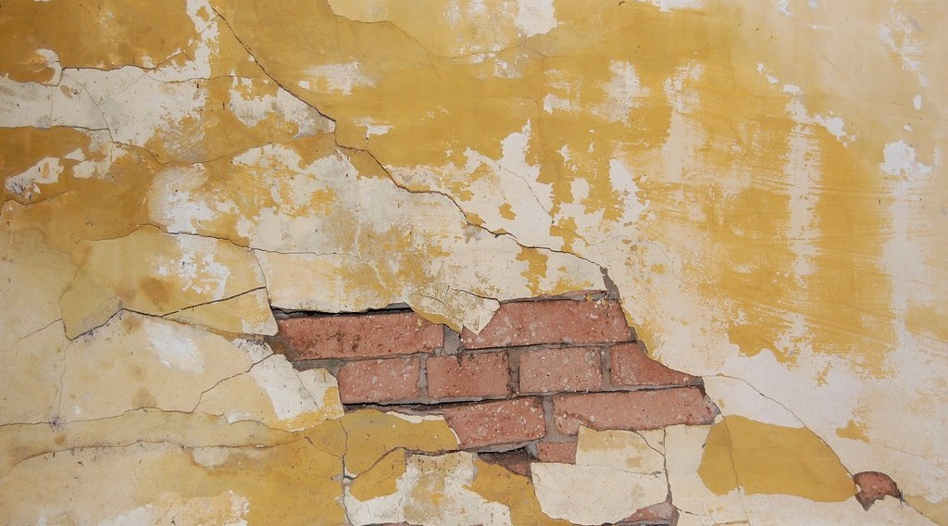
GEOGRAPHY — FORM 4
I. DEFINITION
Activity 1
An old wall that is breaking.
2026 / 2027
DGCAST GAROUA — GEOGRAPHY DEPARTMENT
Mr KAMDEM E. | 14
Notes:
Without the projector: show an old wall of the school.

Slide 15
GEOGRAPHY — FORM 4
I. DEFINITION
Activity 1: Question
What makes this old wall break slowly?
2026 / 2027
DGCAST GAROUA — GEOGRAPHY DEPARTMENT
Mr KAMDEM E. | 15

Slide 16
GEOGRAPHY — FORM 4
I. DEFINITION
Answer
Sun, rain and air: weathering.
2026 / 2027
DGCAST GAROUA — GEOGRAPHY DEPARTMENT
Mr KAMDEM E. | 16

Slide 17

GEOGRAPHY — FORM 4
II. TYPES
Activity 2
A rusty piece of metal.
2026 / 2027
DGCAST GAROUA — GEOGRAPHY DEPARTMENT
Mr KAMDEM E. | 17
Notes:
Without the projector: show a rusty nail.

Slide 18
GEOGRAPHY — FORM 4
II. TYPES
Activity 2: Question
Rain and air make iron red and weak. Which type of weathering is similar?
2026 / 2027
DGCAST GAROUA — GEOGRAPHY DEPARTMENT
Mr KAMDEM E. | 18

Slide 19
GEOGRAPHY — FORM 4
II. TYPES
Answer
Chemical weathering.
2026 / 2027
DGCAST GAROUA — GEOGRAPHY DEPARTMENT
Mr KAMDEM E. | 19

Slide 20

GEOGRAPHY — FORM 4
III. FACTORS
Activity 3
Tree roots break a rock.
2026 / 2027
DGCAST GAROUA — GEOGRAPHY DEPARTMENT
Mr KAMDEM E. | 20
Notes:
Without the projector: show a tree root in a cracked wall or road.

Slide 21
GEOGRAPHY — FORM 4
III. FACTORS
Activity 3: Question
How can plants break rocks?
2026 / 2027
DGCAST GAROUA — GEOGRAPHY DEPARTMENT
Mr KAMDEM E. | 21

Slide 22
GEOGRAPHY — FORM 4
III. FACTORS
Answer
Their roots grow in cracks and open them.
2026 / 2027
DGCAST GAROUA — GEOGRAPHY DEPARTMENT
Mr KAMDEM E. | 22

Slide 23
GEOGRAPHY — FORM 4
BOARD SUMMARY
Weathering
Topic: Denudation Processes, Landforms and Impacts on Man
Sub-topic: Weathering Processes and Impacts on Man
Lesson 15: Weathering
2026 / 2027
DGCAST GAROUA — GEOGRAPHY DEPARTMENT
Mr KAMDEM E. | 23
Notes:
Learners copy the board summary now. Give them enough time for each slide.

Slide 24
GEOGRAPHY — FORM 4
BOARD SUMMARY
I. Definitions
Weathering: It is the breaking down of rocks in their place.
Physical weathering: Rocks break into pieces but do not change.
Chemical weathering: The minerals of the rock change.
2026 / 2027
DGCAST GAROUA — GEOGRAPHY DEPARTMENT
Mr KAMDEM E. | 24

Slide 25
GEOGRAPHY — FORM 4
BOARD SUMMARY
II. Types of Weathering (1/2)
A. Physical: Heat, cold and roots break rocks.
B. Chemical: Rain and air make rocks rot.
2026 / 2027
DGCAST GAROUA — GEOGRAPHY DEPARTMENT
Mr KAMDEM E. | 25

Slide 26
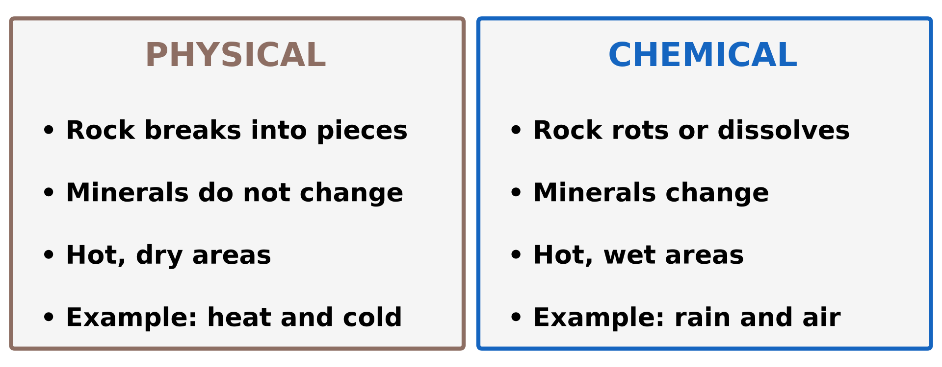
GEOGRAPHY — FORM 4
BOARD SUMMARY
II. Types of Weathering (2/2)
Copy the table.
2026 / 2027
DGCAST GAROUA — GEOGRAPHY DEPARTMENT
Mr KAMDEM E. | 26

Slide 27
GEOGRAPHY — FORM 4
BOARD SUMMARY
III. Factors
A. Climate: Hot, wet areas favour chemical weathering.
B. Type of rock: Soft rocks break faster.
C. Plants and animals: Roots and animals break rocks.
D. People: Roads and quarries expose rocks.
2026 / 2027
DGCAST GAROUA — GEOGRAPHY DEPARTMENT
Mr KAMDEM E. | 27

Slide 28
GEOGRAPHY — FORM 4
FORMATIVE EVALUATION
Formative Evaluation 1
What is weathering?
2026 / 2027
DGCAST GAROUA — GEOGRAPHY DEPARTMENT
Mr KAMDEM E. | 28

Slide 29
GEOGRAPHY — FORM 4
FORMATIVE EVALUATION
Expected Answer
The breaking down of rocks in their place.
2026 / 2027
DGCAST GAROUA — GEOGRAPHY DEPARTMENT
Mr KAMDEM E. | 29

Slide 30
GEOGRAPHY — FORM 4
FORMATIVE EVALUATION
Formative Evaluation 2
Give the two types of weathering.
2026 / 2027
DGCAST GAROUA — GEOGRAPHY DEPARTMENT
Mr KAMDEM E. | 30

Slide 31
GEOGRAPHY — FORM 4
FORMATIVE EVALUATION
Expected Answer
Physical and chemical weathering.
2026 / 2027
DGCAST GAROUA — GEOGRAPHY DEPARTMENT
Mr KAMDEM E. | 31

Slide 32
GEOGRAPHY — FORM 4
REMEDIATION
Remediation
Fill in the blanks:
Rocks breaking into pieces without changing is ______ weathering.
Rain and air change the minerals: ______ weathering.
Tree ______ can break rocks.
2026 / 2027
DGCAST GAROUA — GEOGRAPHY DEPARTMENT
Mr KAMDEM E. | 32
Notes:
Answers: 1. physical 2. chemical 3. roots

Slide 33
GEOGRAPHY — FORM 4
HOMEWORK
Homework
Touch a big rock or a cement wall at 1 p.m. and again at 7 p.m. Write what you feel, and why this could break the rock after many years.
This prepares Lesson 16: Physical Weathering Processes and Products.
2026 / 2027
DGCAST GAROUA — GEOGRAPHY DEPARTMENT
Mr KAMDEM E. | 33
Notes:
This homework prepares the next lesson.

Slide 34
GEOGRAPHY — FORM 4
BILINGUAL GAME
Bilingual Game (Jeu Bilingue)
English | Français
Weathering | L'altération
Physical weathering | L'altération physique / mécanique
Chemical weathering | L'altération chimique
Joint | La diaclase / fissure
Climate | Le climat
Vegetation | La végétation
In situ | Sur place
To crumble | S'effriter
2026 / 2027
DGCAST GAROUA — GEOGRAPHY DEPARTMENT
Mr KAMDEM E. | 34
Notes:
Say the English word; learners give the French word, then the reverse.

Slide 35
GEOGRAPHY — FORM 4
LOGBOOK
Official Logbook (1/2)
Module / Topic | Denudation Processes, Landforms and Impacts on Man
Lesson Title | Lesson 15: Weathering
Expected Learning Outcomes | Define weathering. Distinguish physical and chemical weathering. Explain briefly the factors of weathering.
Competence | Learners are able to explain why rocks, walls and buildings slowly break down, and to choose materials and actions that slow this down.
2026 / 2027
DGCAST GAROUA — GEOGRAPHY DEPARTMENT
Mr KAMDEM E. | 35

Slide 36
GEOGRAPHY — FORM 4
LOGBOOK
Official Logbook (2/2)
Matter Taught | I. Definitions: Weathering, Physical weathering, Chemical weathering; II. Types of Weathering: Physical, Chemical; III. Factors: Climate, Type of rock, Plants and animals, People.
Evaluation | Formative evaluation (3 questions) and remediation exercise.
Homework | Touch a big rock or a cement wall at 1 p.m. and again at 7 p.m. Write what you feel, and why this could break the rock after many years.
Enrolment / Present / Absent | ____ / ____ / ____
Achievement | To be completed by the teacher after the lesson.
2026 / 2027
DGCAST GAROUA — GEOGRAPHY DEPARTMENT
Mr KAMDEM E. | 36

Slide 37
GEOGRAPHY — FORM 4
TEACHER'S NOTE
Teacher's Note
Timing: Set-up, recall 5 min | Situation 5 min | 3 activities 12 min | Board summary (copying) 15 min | Evaluation, homework 5 min | Logbook 5 min | Spare 3 min
2026 / 2027
DGCAST GAROUA — GEOGRAPHY DEPARTMENT
Mr KAMDEM E. | 37

Slide 38
GEOGRAPHY — FORM 4
REFERENCES
References
National Geography Syllabus (MINESEC), Form 4 — Denudation Processes, Landforms and Impacts on Man.
Teacher's lesson notes (Form 4), checked and corrected where necessary.
Photo, Activity 1: “Cracked wall” by árticotropical, CC BY 2.0, via Flickr (https://www.flickr.com/photos/8581973@N02/521943309)
Photo, Activity 2: “Lock down!” by ViNo Gv, CC BY 2.0, via Flickr (https://www.flickr.com/photos/38217093@N03/20143584561)
Photo, Activity 3: “Stones 'n' Roots” by erix!, CC BY 2.0, via Flickr (https://www.flickr.com/photos/68387408@N00/55692423)
Diagrams and animations: drawn for this lesson (DGCAST Geography Department).
2026 / 2027
DGCAST GAROUA — GEOGRAPHY DEPARTMENT
Mr KAMDEM E. | 38

