Slide 1

DIVINE GRACE COLLEGE OF ARTS, SCIENCE AND TECHNOLOGY
(DGCAST) — GAROUA | GEOGRAPHY DEPARTMENT
FORM 4 GEOGRAPHY — LESSON 17
Chemical Weathering Processes and Products
Mr KAMDEM EMMANUEL
Geography Teacher — PLEG
Academic Year 2026 / 2027
Notes:
Good morning, class. Today we study Lesson 17: Chemical Weathering Processes and Products.

Slide 2
GEOGRAPHY — FORM 4
CLASS INFO
Class, Chapter & Duration
Class | Form 4
Chapter | Denudation Processes, Landforms and Impacts on Man — Weathering Processes: The Products and Impacts on Man
Duration | 50 minutes
2026 / 2027
DGCAST GAROUA — GEOGRAPHY DEPARTMENT
Mr KAMDEM E. | 2

Slide 3
GEOGRAPHY — FORM 4
IDENTIFICATION
Lesson Identification
Topic | Denudation Processes, Landforms and Impacts on Man
Sub-topic | Weathering Processes: The Products and Impacts on Man
Lesson | Lesson 17: Chemical Weathering Processes and Products
Notions / Concepts | Solution, carbonation, hydrolysis, oxidation, hydration, chemically induced biological weathering.
Syllabus focus | Processes and products of chemical weathering: solution, carbonation, hydrolysis, oxidation, hydration and chemically induced biological weathering.
Competence | Learners are able to explain why rocks rot and soils become red or clayey, and to protect metal and cement from the effects of water and air.
2026 / 2027
DGCAST GAROUA — GEOGRAPHY DEPARTMENT
Mr KAMDEM E. | 3

Slide 4
GEOGRAPHY — FORM 4
OBJECTIVES
Learning Objectives
By the end of the lesson, the learner should be able to:
Define chemical weathering.
Explain the main processes of chemical weathering.
Name the products of each process.
2026 / 2027
DGCAST GAROUA — GEOGRAPHY DEPARTMENT
Mr KAMDEM E. | 4

Slide 5
GEOGRAPHY — FORM 4
RECALL
Recall
Physical weathering breaks rocks without changing their minerals.
Thermal shattering is common in hot, dry areas.
Chemical weathering is fastest in hot, wet climates.
2026 / 2027
DGCAST GAROUA — GEOGRAPHY DEPARTMENT
Mr KAMDEM E. | 5
Notes:
Check the homework: the rusty gate or roofing sheet.

Slide 6
GEOGRAPHY — FORM 4
REAL-LIFE SITUATION
Real-Life Situation
In the rainy season, Kaltouma sees that the old metal gate of her compound is reddish-brown. It flakes and crumbles. A new gate still shines.
2026 / 2027
DGCAST GAROUA — GEOGRAPHY DEPARTMENT
Mr KAMDEM E. | 6
Notes:
Read the situation slowly, twice.

Slide 7
GEOGRAPHY — FORM 4
REAL-LIFE SITUATION
Situation — Question 1
What is the problem in the situation?
2026 / 2027
DGCAST GAROUA — GEOGRAPHY DEPARTMENT
Mr KAMDEM E. | 7

Slide 8
GEOGRAPHY — FORM 4
REAL-LIFE SITUATION
Answer
The old gate is rusting and breaking.
2026 / 2027
DGCAST GAROUA — GEOGRAPHY DEPARTMENT
Mr KAMDEM E. | 8

Slide 9
GEOGRAPHY — FORM 4
REAL-LIFE SITUATION
Situation — Question 2
What makes it rust?
2026 / 2027
DGCAST GAROUA — GEOGRAPHY DEPARTMENT
Mr KAMDEM E. | 9

Slide 10
GEOGRAPHY — FORM 4
REAL-LIFE SITUATION
Answer
Rain and the air (oxygen).
2026 / 2027
DGCAST GAROUA — GEOGRAPHY DEPARTMENT
Mr KAMDEM E. | 10

Slide 11
GEOGRAPHY — FORM 4
REAL-LIFE SITUATION
Situation — Question 3
Can rocks also rust?
2026 / 2027
DGCAST GAROUA — GEOGRAPHY DEPARTMENT
Mr KAMDEM E. | 11

Slide 12
GEOGRAPHY — FORM 4
REAL-LIFE SITUATION
Possible Answer
Yes, rocks with iron become red: oxidation.
2026 / 2027
DGCAST GAROUA — GEOGRAPHY DEPARTMENT
Mr KAMDEM E. | 12

Slide 13
GEOGRAPHY — FORM 4
JUSTIFICATION
Justification of the Lesson
This lesson helps us to know how rain and air change rocks.
2026 / 2027
DGCAST GAROUA — GEOGRAPHY DEPARTMENT
Mr KAMDEM E. | 13

Slide 14

GEOGRAPHY — FORM 4
I. OXIDATION
Activity 1
Rusty metal.
2026 / 2027
DGCAST GAROUA — GEOGRAPHY DEPARTMENT
Mr KAMDEM E. | 14
Notes:
Without the projector: show a rusty nail and a new nail.

Slide 15
GEOGRAPHY — FORM 4
I. OXIDATION
Activity 1: Question
Rain and air make iron red. What is this process?
2026 / 2027
DGCAST GAROUA — GEOGRAPHY DEPARTMENT
Mr KAMDEM E. | 15

Slide 16
GEOGRAPHY — FORM 4
I. OXIDATION
Answer
Oxidation.
2026 / 2027
DGCAST GAROUA — GEOGRAPHY DEPARTMENT
Mr KAMDEM E. | 16

Slide 17

GEOGRAPHY — FORM 4
II. OXIDATION
Activity 2
Red soil in a dry area.
2026 / 2027
DGCAST GAROUA — GEOGRAPHY DEPARTMENT
Mr KAMDEM E. | 17
Notes:
Without the projector: show red soil from the school yard.

Slide 18
GEOGRAPHY — FORM 4
II. OXIDATION
Activity 2: Question
Why are many soils around Garoua red?
2026 / 2027
DGCAST GAROUA — GEOGRAPHY DEPARTMENT
Mr KAMDEM E. | 18

Slide 19
GEOGRAPHY — FORM 4
II. OXIDATION
Answer
The iron in the soil is oxidised (rusted).
2026 / 2027
DGCAST GAROUA — GEOGRAPHY DEPARTMENT
Mr KAMDEM E. | 19

Slide 20
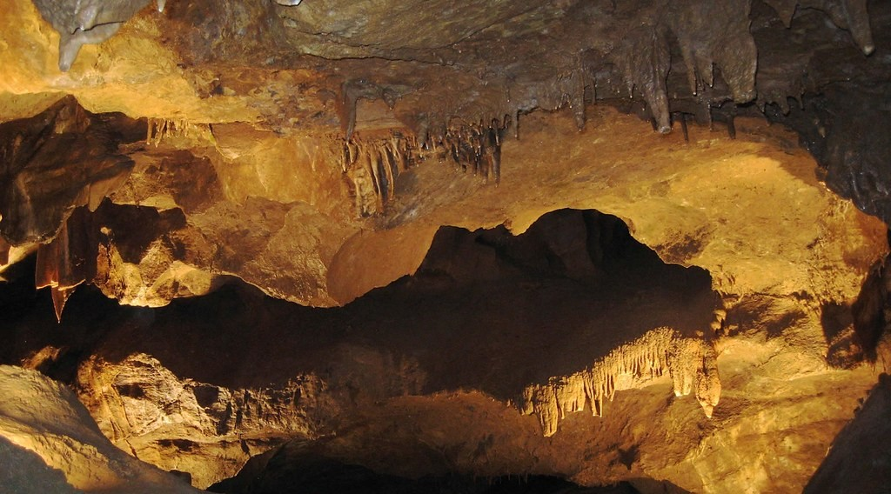
GEOGRAPHY — FORM 4
III. CARBONATION
Activity 3
A cave in limestone.
2026 / 2027
DGCAST GAROUA — GEOGRAPHY DEPARTMENT
Mr KAMDEM E. | 20
Notes:
Without the projector: drop a piece of chalk in vinegar: it slowly dissolves.

Slide 21
GEOGRAPHY — FORM 4
III. CARBONATION
Activity 3: Question
Rain water dissolves limestone. What forms after a long time?
2026 / 2027
DGCAST GAROUA — GEOGRAPHY DEPARTMENT
Mr KAMDEM E. | 21

Slide 22
GEOGRAPHY — FORM 4
III. CARBONATION
Answer
Caves (with stalactites).
2026 / 2027
DGCAST GAROUA — GEOGRAPHY DEPARTMENT
Mr KAMDEM E. | 22

Slide 23
GEOGRAPHY — FORM 4
BOARD SUMMARY
Chemical Weathering Processes and Products
Topic: Denudation Processes, Landforms and Impacts on Man
Sub-topic: Weathering Processes: The Products and Impacts on Man
Lesson 17: Chemical Weathering Processes and Products
2026 / 2027
DGCAST GAROUA — GEOGRAPHY DEPARTMENT
Mr KAMDEM E. | 23
Notes:
Learners copy the board summary now. Give them enough time for each slide.

Slide 24
GEOGRAPHY — FORM 4
BOARD SUMMARY
I. Definitions
Chemical weathering: It is the change of the minerals of a rock.
Oxidation: It is the rusting of iron in rocks.
Carbonation: It is when rain water dissolves limestone.
2026 / 2027
DGCAST GAROUA — GEOGRAPHY DEPARTMENT
Mr KAMDEM E. | 24

Slide 25
GEOGRAPHY — FORM 4
BOARD SUMMARY
II. Processes and Products
A. Solution: Water dissolves salts.
B. Carbonation: Limestone forms caves.
C. Oxidation: Iron makes soils red.
D. Hydrolysis: Granite becomes clay.
E. Hydration: Rocks take water and swell.
2026 / 2027
DGCAST GAROUA — GEOGRAPHY DEPARTMENT
Mr KAMDEM E. | 25

Slide 26
GEOGRAPHY — FORM 4
FORMATIVE EVALUATION
Formative Evaluation 1
Why are the soils of Garoua red?
2026 / 2027
DGCAST GAROUA — GEOGRAPHY DEPARTMENT
Mr KAMDEM E. | 26

Slide 27
GEOGRAPHY — FORM 4
FORMATIVE EVALUATION
Expected Answer
The iron in them is oxidised.
2026 / 2027
DGCAST GAROUA — GEOGRAPHY DEPARTMENT
Mr KAMDEM E. | 27

Slide 28
GEOGRAPHY — FORM 4
FORMATIVE EVALUATION
Formative Evaluation 2
What does carbonation produce in limestone?
2026 / 2027
DGCAST GAROUA — GEOGRAPHY DEPARTMENT
Mr KAMDEM E. | 28

Slide 29
GEOGRAPHY — FORM 4
FORMATIVE EVALUATION
Expected Answer
Caves.
2026 / 2027
DGCAST GAROUA — GEOGRAPHY DEPARTMENT
Mr KAMDEM E. | 29

Slide 30
GEOGRAPHY — FORM 4
REMEDIATION
Remediation
Fill in the blanks:
The rusting of iron in rocks is ______.
Rain water dissolves limestone by ______.
Granite changes into clay by ______.
2026 / 2027
DGCAST GAROUA — GEOGRAPHY DEPARTMENT
Mr KAMDEM E. | 30
Notes:
Answers: 1. oxidation 2. carbonation 3. hydrolysis

Slide 31
GEOGRAPHY — FORM 4
HOMEWORK
Homework
Ask a farmer in your family where the soil of his farm comes from, and ask if he has seen rocks fall or roads blocked after heavy rain. Write his answers.
This prepares Further Study 2: The Impact of Weathering on the Environment.
2026 / 2027
DGCAST GAROUA — GEOGRAPHY DEPARTMENT
Mr KAMDEM E. | 31
Notes:
This homework prepares the next lesson.

Slide 32
GEOGRAPHY — FORM 4
BILINGUAL GAME
Bilingual Game (Jeu Bilingue)
English | Français
Solution | La dissolution
Oxidation | L'oxydation
Carbonation | La carbonatation
Hydrolysis | L'hydrolyse
Hydration | L'hydratation
Rust | La rouille
Clay | L'argile
Limestone | Le calcaire
2026 / 2027
DGCAST GAROUA — GEOGRAPHY DEPARTMENT
Mr KAMDEM E. | 32
Notes:
Say the English word; learners give the French word, then the reverse.

Slide 33
GEOGRAPHY — FORM 4
LOGBOOK
Official Logbook (1/2)
Module / Topic | Denudation Processes, Landforms and Impacts on Man
Lesson Title | Lesson 17: Chemical Weathering Processes and Products
Expected Learning Outcomes | Define chemical weathering. Explain the main processes of chemical weathering. Name the products of each process.
Competence | Learners are able to explain why rocks rot and soils become red or clayey, and to protect metal and cement from the effects of water and air.
2026 / 2027
DGCAST GAROUA — GEOGRAPHY DEPARTMENT
Mr KAMDEM E. | 33

Slide 34
GEOGRAPHY — FORM 4
LOGBOOK
Official Logbook (2/2)
Matter Taught | I. Definitions: Chemical weathering, Oxidation, Carbonation; II. Processes and Products: Solution, Carbonation, Oxidation, Hydrolysis, Hydration.
Evaluation | Formative evaluation (3 questions) and remediation exercise.
Homework | Ask a farmer in your family where the soil of his farm comes from, and ask if he has seen rocks fall or roads blocked after heavy rain. Write his answers.
Enrolment / Present / Absent | ____ / ____ / ____
Achievement | To be completed by the teacher after the lesson.
2026 / 2027
DGCAST GAROUA — GEOGRAPHY DEPARTMENT
Mr KAMDEM E. | 34

Slide 35
GEOGRAPHY — FORM 4
TEACHER'S NOTE
Teacher's Note
Timing: Set-up, recall 5 min | Situation 5 min | 3 activities 12 min | Board summary (copying) 15 min | Evaluation, homework 5 min | Logbook 5 min | Spare 3 min
2026 / 2027
DGCAST GAROUA — GEOGRAPHY DEPARTMENT
Mr KAMDEM E. | 35

Slide 36
GEOGRAPHY — FORM 4
REFERENCES
References
National Geography Syllabus (MINESEC), Form 4 — Denudation Processes, Landforms and Impacts on Man.
Teacher's lesson notes (Form 4), checked and corrected where necessary.
Photo, Activity 1: “Lock down!” by ViNo Gv, CC BY 2.0, via Flickr (https://www.flickr.com/photos/38217093@N03/20143584561)
Photo, Activity 2: “in the middle of nowhere, morocco” by mariusz kluzniak, CC BY-NC-ND 2.0, via Flickr (https://www.flickr.com/photos/39997856@N03/8398997251)
Photo, Activity 3: “Songam Cave” by D-Stanley, CC BY 2.0, via Flickr (https://www.flickr.com/photos/79721788@N00/5063216873)
Diagrams and animations: drawn for this lesson (DGCAST Geography Department).
2026 / 2027
DGCAST GAROUA — GEOGRAPHY DEPARTMENT
Mr KAMDEM E. | 36

