Slide 1

DIVINE GRACE COLLEGE OF ARTS, SCIENCE AND TECHNOLOGY
(DGCAST) — GAROUA | GEOGRAPHY DEPARTMENT
FORM 4 GEOGRAPHY — LESSON 19
The Upper Course of a River
Mr KAMDEM EMMANUEL
Geography Teacher — PLEG
Academic Year 2026 / 2027
Notes:
Good morning, class. Today we study Lesson 19: The Upper Course of a River.

Slide 2
GEOGRAPHY — FORM 4
CLASS INFO
Class, Chapter & Duration
Class | Form 4
Chapter | Denudation Processes, Landforms and Impacts on Man — The Work of Rivers on the Landscape and Impacts on Man
Duration | 50 minutes
2026 / 2027
DGCAST GAROUA — GEOGRAPHY DEPARTMENT
Mr KAMDEM E. | 2

Slide 3
GEOGRAPHY — FORM 4
IDENTIFICATION
Lesson Identification
Topic | Denudation Processes, Landforms and Impacts on Man
Sub-topic | The Work of Rivers on the Landscape and Impacts on Man
Lesson | Lesson 19: The Upper Course of a River
Notions / Concepts | V-shaped valley, waterfalls, rapids, cataracts, potholes.
Syllabus focus | Main characteristics and processes of the upper course; landforms of the upper course.
Competence | Learners are able to recognise the landforms of the upper course, such as waterfalls and gorges, and to explain their value and dangers.
2026 / 2027
DGCAST GAROUA — GEOGRAPHY DEPARTMENT
Mr KAMDEM E. | 3

Slide 4
GEOGRAPHY — FORM 4
OBJECTIVES
Learning Objectives
By the end of the lesson, the learner should be able to:
Describe the main characteristics and processes of the upper course.
Explain the formation of the landforms of the upper course.
Give examples of these landforms in Cameroon.
2026 / 2027
DGCAST GAROUA — GEOGRAPHY DEPARTMENT
Mr KAMDEM E. | 4

Slide 5
GEOGRAPHY — FORM 4
RECALL
Recall
The long profile is steep near the source.
Vertical erosion is dominant in the upper course.
Rivers erode by hydraulic action, abrasion, attrition and solution.
2026 / 2027
DGCAST GAROUA — GEOGRAPHY DEPARTMENT
Mr KAMDEM E. | 5
Notes:
Check the homework: descriptions of the Vina Falls, Tello Falls or Kola Gorges.

Slide 6
GEOGRAPHY — FORM 4
REAL-LIFE SITUATION
Real-Life Situation
Near Ngaoundéré, the Vina River falls over a cliff of hard rock. The water is fast and noisy, and the valley sides are steep. Bouba compares it with the slow Benue at Garoua.
2026 / 2027
DGCAST GAROUA — GEOGRAPHY DEPARTMENT
Mr KAMDEM E. | 6
Notes:
Read the situation slowly, twice.

Slide 7
GEOGRAPHY — FORM 4
REAL-LIFE SITUATION
Situation — Question 1
What is the problem in the situation?
2026 / 2027
DGCAST GAROUA — GEOGRAPHY DEPARTMENT
Mr KAMDEM E. | 7

Slide 8
GEOGRAPHY — FORM 4
REAL-LIFE SITUATION
Answer
Bouba does not know why the river is so different in two places.
2026 / 2027
DGCAST GAROUA — GEOGRAPHY DEPARTMENT
Mr KAMDEM E. | 8

Slide 9
GEOGRAPHY — FORM 4
REAL-LIFE SITUATION
Situation — Question 2
Describe the Vina near Ngaoundéré.
2026 / 2027
DGCAST GAROUA — GEOGRAPHY DEPARTMENT
Mr KAMDEM E. | 9

Slide 10
GEOGRAPHY — FORM 4
REAL-LIFE SITUATION
Answer
Fast, noisy, with a waterfall and steep sides.
2026 / 2027
DGCAST GAROUA — GEOGRAPHY DEPARTMENT
Mr KAMDEM E. | 10

Slide 11
GEOGRAPHY — FORM 4
REAL-LIFE SITUATION
Situation — Question 3
Which course of the river is this?
2026 / 2027
DGCAST GAROUA — GEOGRAPHY DEPARTMENT
Mr KAMDEM E. | 11

Slide 12
GEOGRAPHY — FORM 4
REAL-LIFE SITUATION
Possible Answer
The upper course.
2026 / 2027
DGCAST GAROUA — GEOGRAPHY DEPARTMENT
Mr KAMDEM E. | 12

Slide 13
GEOGRAPHY — FORM 4
JUSTIFICATION
Justification of the Lesson
This lesson helps us to know the landforms of the upper course.
2026 / 2027
DGCAST GAROUA — GEOGRAPHY DEPARTMENT
Mr KAMDEM E. | 13

Slide 14
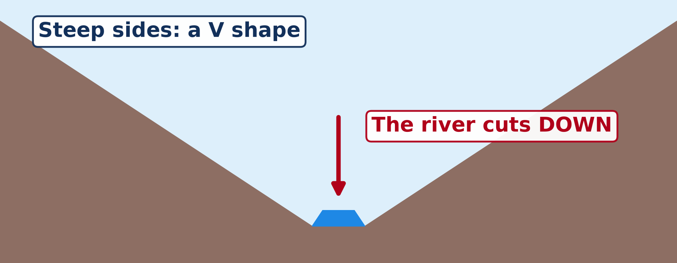
GEOGRAPHY — FORM 4
I. V-SHAPED VALLEY
Activity 1
A cross-section of a valley in the upper course.
2026 / 2027
DGCAST GAROUA — GEOGRAPHY DEPARTMENT
Mr KAMDEM E. | 14
Notes:
Without the projector: draw a V on the board.

Slide 15
GEOGRAPHY — FORM 4
I. V-SHAPED VALLEY
Activity 1: Question
What is the shape of this valley? Why?
2026 / 2027
DGCAST GAROUA — GEOGRAPHY DEPARTMENT
Mr KAMDEM E. | 15

Slide 16
GEOGRAPHY — FORM 4
I. V-SHAPED VALLEY
Answer
A V shape. The river cuts down into its bed.
2026 / 2027
DGCAST GAROUA — GEOGRAPHY DEPARTMENT
Mr KAMDEM E. | 16

Slide 17
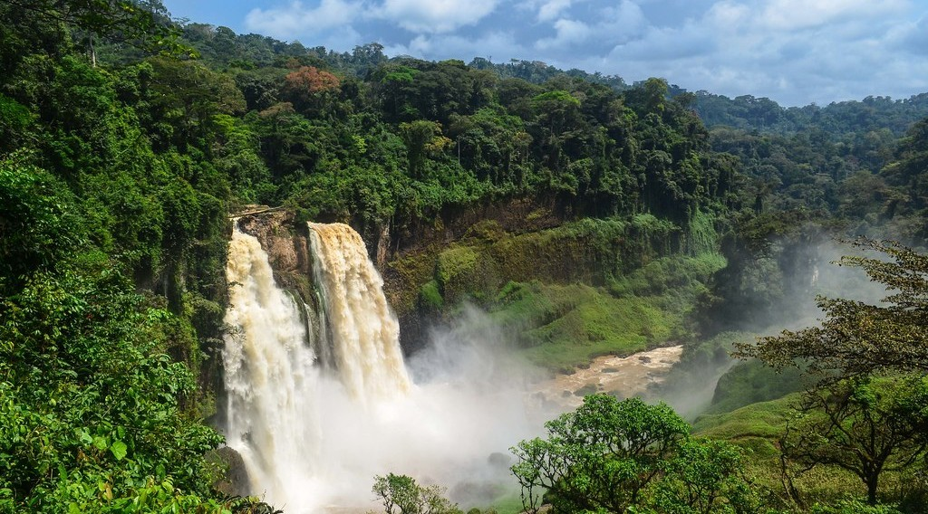
GEOGRAPHY — FORM 4
II. WATERFALL
Activity 2
A waterfall.
2026 / 2027
DGCAST GAROUA — GEOGRAPHY DEPARTMENT
Mr KAMDEM E. | 17
Notes:
Without the projector: describe the Vina Falls near Ngaoundéré.

Slide 18
GEOGRAPHY — FORM 4
II. WATERFALL
Activity 2: Question
Why does a waterfall form?
2026 / 2027
DGCAST GAROUA — GEOGRAPHY DEPARTMENT
Mr KAMDEM E. | 18

Slide 19
GEOGRAPHY — FORM 4
II. WATERFALL
Answer
The river flows from hard rock onto soft rock that wears away faster.
2026 / 2027
DGCAST GAROUA — GEOGRAPHY DEPARTMENT
Mr KAMDEM E. | 19

Slide 20
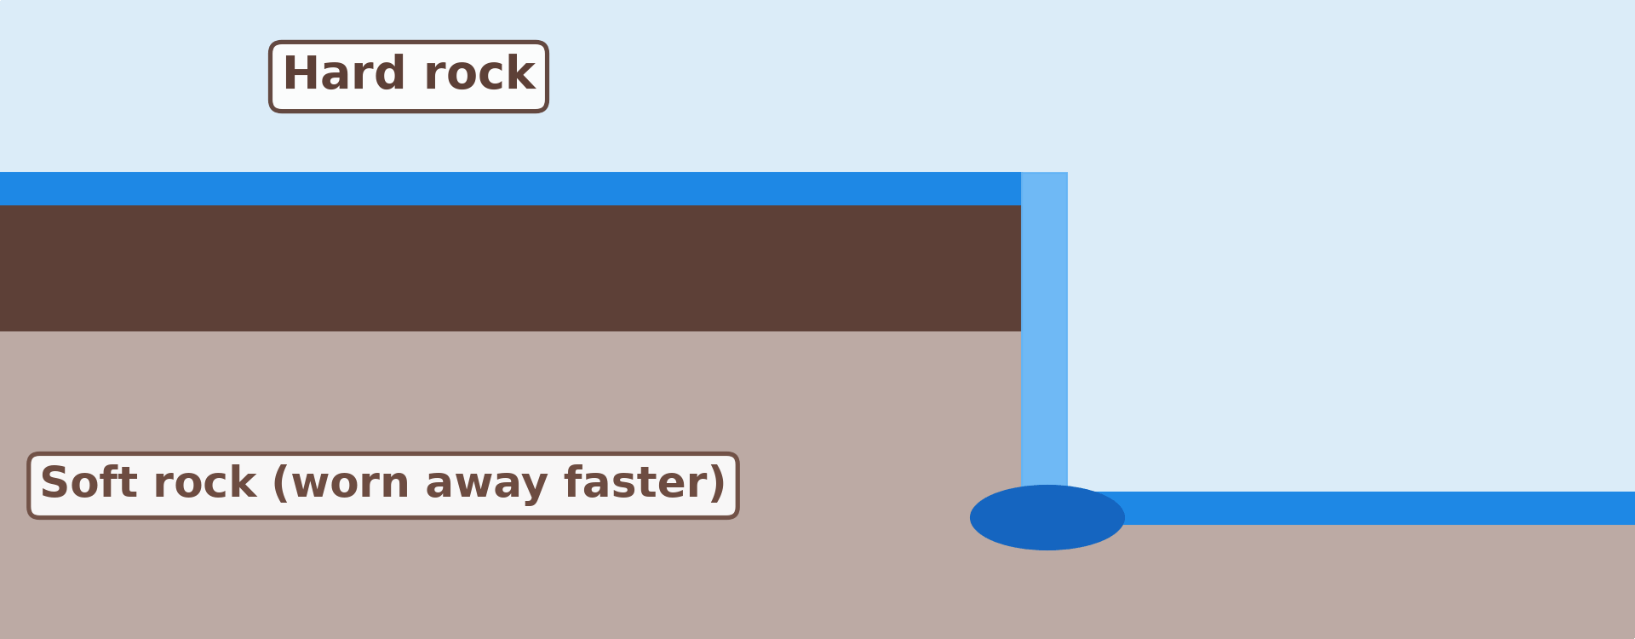
GEOGRAPHY — FORM 4
II. WATERFALL
Activity 3
Animation: a waterfall moves back and makes a gorge.
2026 / 2027
DGCAST GAROUA — GEOGRAPHY DEPARTMENT
Mr KAMDEM E. | 20
Notes:
Without the projector: draw the hard rock on top of soft rock.

Slide 21
GEOGRAPHY — FORM 4
II. WATERFALL
Activity 3: Question
What happens to the waterfall over many years?
2026 / 2027
DGCAST GAROUA — GEOGRAPHY DEPARTMENT
Mr KAMDEM E. | 21

Slide 22
GEOGRAPHY — FORM 4
II. WATERFALL
Answer
It moves back and leaves a gorge.
2026 / 2027
DGCAST GAROUA — GEOGRAPHY DEPARTMENT
Mr KAMDEM E. | 22

Slide 23
GEOGRAPHY — FORM 4
BOARD SUMMARY
The Upper Course of a River
Topic: Denudation Processes, Landforms and Impacts on Man
Sub-topic: The Work of Rivers on the Landscape and Impacts on Man
Lesson 19: The Upper Course of a River
2026 / 2027
DGCAST GAROUA — GEOGRAPHY DEPARTMENT
Mr KAMDEM E. | 23
Notes:
Learners copy the board summary now. Give them enough time for each slide.

Slide 24
GEOGRAPHY — FORM 4
BOARD SUMMARY
I. Definitions
Upper course: It is the steep part of a river near its source.
Waterfall: It is a place where a river falls over a cliff.
Gorge: It is a deep, narrow valley below a waterfall.
2026 / 2027
DGCAST GAROUA — GEOGRAPHY DEPARTMENT
Mr KAMDEM E. | 24

Slide 25
GEOGRAPHY — FORM 4
BOARD SUMMARY
II. Characteristics
A. Slope: Steep.
B. Water: Fast and noisy.
C. Main work: The river cuts down (vertical erosion).
2026 / 2027
DGCAST GAROUA — GEOGRAPHY DEPARTMENT
Mr KAMDEM E. | 25

Slide 26
GEOGRAPHY — FORM 4
BOARD SUMMARY
III. Landforms (1/2)
A. V-shaped valley: Narrow with steep sides.
B. Interlocking spurs: Hills the river winds around.
C. Waterfall and gorge: Hard rock on soft rock.
D. Rapids and potholes: Fast water on rocks.
2026 / 2027
DGCAST GAROUA — GEOGRAPHY DEPARTMENT
Mr KAMDEM E. | 26

Slide 27
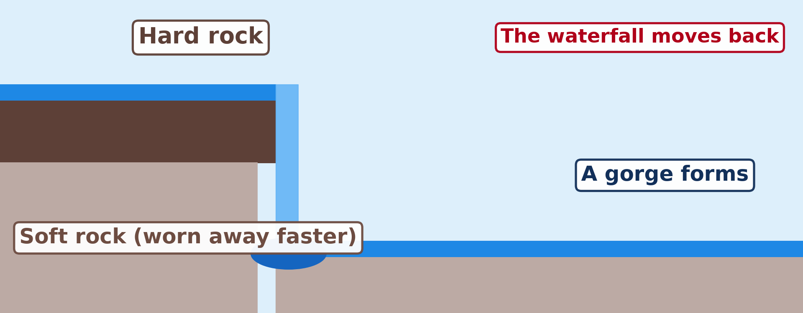
GEOGRAPHY — FORM 4
BOARD SUMMARY
III. Landforms (2/2)
Copy the waterfall.
2026 / 2027
DGCAST GAROUA — GEOGRAPHY DEPARTMENT
Mr KAMDEM E. | 27

Slide 28
GEOGRAPHY — FORM 4
FORMATIVE EVALUATION
Formative Evaluation 1
What is the main work of a river in its upper course?
2026 / 2027
DGCAST GAROUA — GEOGRAPHY DEPARTMENT
Mr KAMDEM E. | 28

Slide 29
GEOGRAPHY — FORM 4
FORMATIVE EVALUATION
Expected Answer
It cuts down (vertical erosion).
2026 / 2027
DGCAST GAROUA — GEOGRAPHY DEPARTMENT
Mr KAMDEM E. | 29

Slide 30
GEOGRAPHY — FORM 4
FORMATIVE EVALUATION
Formative Evaluation 2
How does a gorge form?
2026 / 2027
DGCAST GAROUA — GEOGRAPHY DEPARTMENT
Mr KAMDEM E. | 30

Slide 31
GEOGRAPHY — FORM 4
FORMATIVE EVALUATION
Expected Answer
The waterfall moves back and leaves a deep, narrow valley.
2026 / 2027
DGCAST GAROUA — GEOGRAPHY DEPARTMENT
Mr KAMDEM E. | 31

Slide 32
GEOGRAPHY — FORM 4
REMEDIATION
Remediation
Fill in the blanks:
In the upper course, the valley is ______-shaped.
A river falling over a cliff forms a ______.
The deep valley below a waterfall is a ______.
2026 / 2027
DGCAST GAROUA — GEOGRAPHY DEPARTMENT
Mr KAMDEM E. | 32
Notes:
Answers: 1. V 2. waterfall 3. gorge

Slide 33
GEOGRAPHY — FORM 4
HOMEWORK
Homework
Stand on the Benue Bridge in Garoua or look at a photo of it. Draw the river and its bends, and mark where the water seems fastest.
This prepares Lesson 20: The Middle Course of a River.
2026 / 2027
DGCAST GAROUA — GEOGRAPHY DEPARTMENT
Mr KAMDEM E. | 33
Notes:
This homework prepares the next lesson.

Slide 34
GEOGRAPHY — FORM 4
BILINGUAL GAME
Bilingual Game (Jeu Bilingue)
English | Français
Waterfall | La chute d'eau / la cascade
Gorge | La gorge
Rapids | Les rapides
Pothole | La marmite de géant
Spur | L'éperon
V-shaped valley | La vallée en V
Plunge pool | La fosse de plongée
Hard rock | La roche dure
2026 / 2027
DGCAST GAROUA — GEOGRAPHY DEPARTMENT
Mr KAMDEM E. | 34
Notes:
Say the English word; learners give the French word, then the reverse.

Slide 35
GEOGRAPHY — FORM 4
LOGBOOK
Official Logbook (1/2)
Module / Topic | Denudation Processes, Landforms and Impacts on Man
Lesson Title | Lesson 19: The Upper Course of a River
Expected Learning Outcomes | Describe the main characteristics and processes of the upper course. Explain the formation of the landforms of the upper course. Give examples of these landforms in Cameroon.
Competence | Learners are able to recognise the landforms of the upper course, such as waterfalls and gorges, and to explain their value and dangers.
2026 / 2027
DGCAST GAROUA — GEOGRAPHY DEPARTMENT
Mr KAMDEM E. | 35

Slide 36
GEOGRAPHY — FORM 4
LOGBOOK
Official Logbook (2/2)
Matter Taught | I. Definitions: Upper course, Waterfall, Gorge; II. Characteristics: Slope, Water, Main work; III. Landforms: V-shaped valley, Interlocking spurs, Waterfall and gorge, Rapids and potholes.
Evaluation | Formative evaluation (3 questions) and remediation exercise.
Homework | Stand on the Benue Bridge in Garoua or look at a photo of it. Draw the river and its bends, and mark where the water seems fastest.
Enrolment / Present / Absent | ____ / ____ / ____
Achievement | To be completed by the teacher after the lesson.
2026 / 2027
DGCAST GAROUA — GEOGRAPHY DEPARTMENT
Mr KAMDEM E. | 36

Slide 37
GEOGRAPHY — FORM 4
TEACHER'S NOTE
Teacher's Note
Timing: Set-up, recall 5 min | Situation 5 min | 3 activities 12 min | Board summary (copying) 15 min | Evaluation, homework 5 min | Logbook 5 min | Spare 3 min
Activity 3 is an animation (GIF): it plays automatically in slide-show mode.
2026 / 2027
DGCAST GAROUA — GEOGRAPHY DEPARTMENT
Mr KAMDEM E. | 37

Slide 38
GEOGRAPHY — FORM 4
REFERENCES
References
National Geography Syllabus (MINESEC), Form 4 — Denudation Processes, Landforms and Impacts on Man.
Teacher's lesson notes (Form 4), checked and corrected where necessary.
Photo, Activity 2: “Ekom-Nkam waterfall” by jbdodane, CC BY-NC 2.0, via Flickr (https://www.flickr.com/photos/27998473@N02/11291226526)
Diagrams and animations: drawn for this lesson (DGCAST Geography Department).
2026 / 2027
DGCAST GAROUA — GEOGRAPHY DEPARTMENT
Mr KAMDEM E. | 38

