Slide 1

DIVINE GRACE COLLEGE OF ARTS, SCIENCE AND TECHNOLOGY
(DGCAST) — GAROUA | GEOGRAPHY DEPARTMENT
FORM 4 GEOGRAPHY — LESSON 20
The Middle Course of a River
Mr KAMDEM EMMANUEL
Geography Teacher — PLEG
Academic Year 2026 / 2027
Notes:
Good morning, class. Today we study Lesson 20: The Middle Course of a River.

Slide 2
GEOGRAPHY — FORM 4
CLASS INFO
Class, Chapter & Duration
Class | Form 4
Chapter | Denudation Processes, Landforms and Impacts on Man — The Work of Rivers on the Landscape and Impacts on Man
Duration | 50 minutes
2026 / 2027
DGCAST GAROUA — GEOGRAPHY DEPARTMENT
Mr KAMDEM E. | 2

Slide 3
GEOGRAPHY — FORM 4
IDENTIFICATION
Lesson Identification
Topic | Denudation Processes, Landforms and Impacts on Man
Sub-topic | The Work of Rivers on the Landscape and Impacts on Man
Lesson | Lesson 20: The Middle Course of a River
Notions / Concepts | Open V-shaped valley, meanders, river cliffs, slip-off slopes.
Syllabus focus | Main characteristics and processes of the middle course; landforms of the middle course.
Competence | Learners are able to recognise the landforms of the middle course and to choose safe places to build or farm along a winding river.
2026 / 2027
DGCAST GAROUA — GEOGRAPHY DEPARTMENT
Mr KAMDEM E. | 3

Slide 4
GEOGRAPHY — FORM 4
OBJECTIVES
Learning Objectives
By the end of the lesson, the learner should be able to:
Describe the main characteristics and processes of the middle course.
Explain how a river transports its load.
Explain the formation of meanders, river cliffs and slip-off slopes.
2026 / 2027
DGCAST GAROUA — GEOGRAPHY DEPARTMENT
Mr KAMDEM E. | 4

Slide 5
GEOGRAPHY — FORM 4
RECALL
Recall
The upper course has steep slopes and vertical erosion.
Waterfalls form where hard rock lies on soft rock.
In the middle course, the gradient is gentler.
2026 / 2027
DGCAST GAROUA — GEOGRAPHY DEPARTMENT
Mr KAMDEM E. | 5
Notes:
Check the homework: drawings of the Benue from the bridge.

Slide 6
GEOGRAPHY — FORM 4
REAL-LIFE SITUATION
Real-Life Situation
From the Benue Bridge in Garoua, Adama sees that the river bends. On the outside of the bend, the bank is steep. On the inside, there is a gentle beach of sand.
2026 / 2027
DGCAST GAROUA — GEOGRAPHY DEPARTMENT
Mr KAMDEM E. | 6
Notes:
Read the situation slowly, twice.

Slide 7
GEOGRAPHY — FORM 4
REAL-LIFE SITUATION
Situation — Question 1
What is the problem in the situation?
2026 / 2027
DGCAST GAROUA — GEOGRAPHY DEPARTMENT
Mr KAMDEM E. | 7

Slide 8
GEOGRAPHY — FORM 4
REAL-LIFE SITUATION
Answer
Adama does not know why the two banks are different.
2026 / 2027
DGCAST GAROUA — GEOGRAPHY DEPARTMENT
Mr KAMDEM E. | 8

Slide 9
GEOGRAPHY — FORM 4
REAL-LIFE SITUATION
Situation — Question 2
Describe the two banks.
2026 / 2027
DGCAST GAROUA — GEOGRAPHY DEPARTMENT
Mr KAMDEM E. | 9

Slide 10
GEOGRAPHY — FORM 4
REAL-LIFE SITUATION
Answer
Steep outside; gentle and sandy inside.
2026 / 2027
DGCAST GAROUA — GEOGRAPHY DEPARTMENT
Mr KAMDEM E. | 10

Slide 11
GEOGRAPHY — FORM 4
REAL-LIFE SITUATION
Situation — Question 3
What do we call a big bend in a river?
2026 / 2027
DGCAST GAROUA — GEOGRAPHY DEPARTMENT
Mr KAMDEM E. | 11

Slide 12
GEOGRAPHY — FORM 4
REAL-LIFE SITUATION
Possible Answer
A meander.
2026 / 2027
DGCAST GAROUA — GEOGRAPHY DEPARTMENT
Mr KAMDEM E. | 12

Slide 13
GEOGRAPHY — FORM 4
JUSTIFICATION
Justification of the Lesson
This lesson helps us to know the landforms of the middle course.
2026 / 2027
DGCAST GAROUA — GEOGRAPHY DEPARTMENT
Mr KAMDEM E. | 13

Slide 14

GEOGRAPHY — FORM 4
I. MEANDERS
Activity 1
A river with big bends, seen from the sky.
2026 / 2027
DGCAST GAROUA — GEOGRAPHY DEPARTMENT
Mr KAMDEM E. | 14
Notes:
Without the projector: draw a snake-like river on the board.

Slide 15
GEOGRAPHY — FORM 4
I. MEANDERS
Activity 1: Question
What do we call these big bends?
2026 / 2027
DGCAST GAROUA — GEOGRAPHY DEPARTMENT
Mr KAMDEM E. | 15

Slide 16
GEOGRAPHY — FORM 4
I. MEANDERS
Answer
Meanders.
2026 / 2027
DGCAST GAROUA — GEOGRAPHY DEPARTMENT
Mr KAMDEM E. | 16

Slide 17
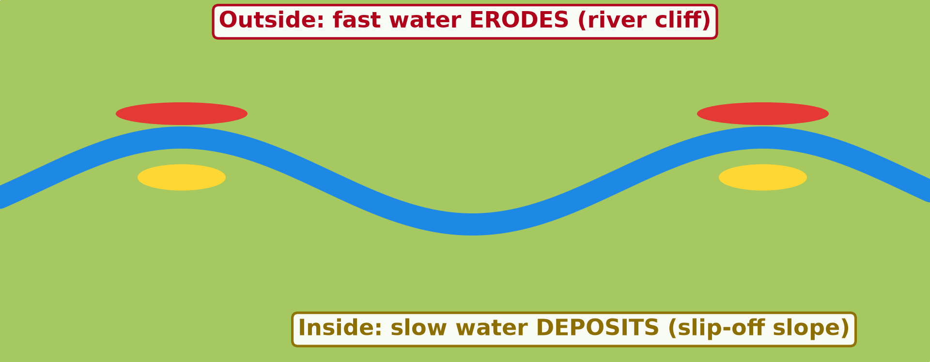
GEOGRAPHY — FORM 4
I. MEANDERS
Activity 2
Animation: a meander grows.
2026 / 2027
DGCAST GAROUA — GEOGRAPHY DEPARTMENT
Mr KAMDEM E. | 17
Notes:
Without the projector: draw a bend and mark the outside and the inside.

Slide 18
GEOGRAPHY — FORM 4
I. MEANDERS
Activity 2: Question
Where does the water erode? Where does it deposit?
2026 / 2027
DGCAST GAROUA — GEOGRAPHY DEPARTMENT
Mr KAMDEM E. | 18

Slide 19
GEOGRAPHY — FORM 4
I. MEANDERS
Answer
It erodes the outside of the bend and deposits on the inside.
2026 / 2027
DGCAST GAROUA — GEOGRAPHY DEPARTMENT
Mr KAMDEM E. | 19

Slide 20
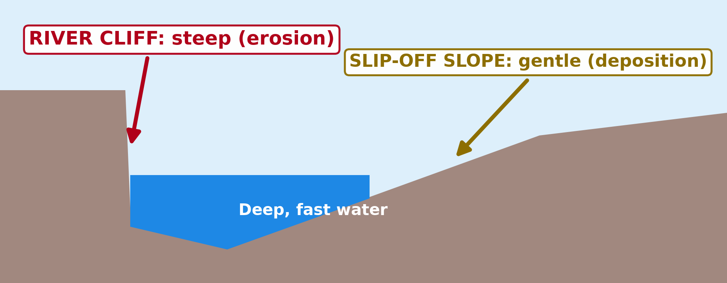
GEOGRAPHY — FORM 4
II. RIVER CLIFF
Activity 3
A cross-section of a meander.
2026 / 2027
DGCAST GAROUA — GEOGRAPHY DEPARTMENT
Mr KAMDEM E. | 20
Notes:
Without the projector: describe the banks of the Benue at Garoua.

Slide 21
GEOGRAPHY — FORM 4
II. RIVER CLIFF
Activity 3: Question
What is the steep bank on the outside of the bend called?
2026 / 2027
DGCAST GAROUA — GEOGRAPHY DEPARTMENT
Mr KAMDEM E. | 21

Slide 22
GEOGRAPHY — FORM 4
II. RIVER CLIFF
Answer
A river cliff.
2026 / 2027
DGCAST GAROUA — GEOGRAPHY DEPARTMENT
Mr KAMDEM E. | 22

Slide 23
GEOGRAPHY — FORM 4
BOARD SUMMARY
The Middle Course of a River
Topic: Denudation Processes, Landforms and Impacts on Man
Sub-topic: The Work of Rivers on the Landscape and Impacts on Man
Lesson 20: The Middle Course of a River
2026 / 2027
DGCAST GAROUA — GEOGRAPHY DEPARTMENT
Mr KAMDEM E. | 23
Notes:
Learners copy the board summary now. Give them enough time for each slide.

Slide 24
GEOGRAPHY — FORM 4
BOARD SUMMARY
I. Definitions (1/2)
Middle course: It is the part of a river with a gentle slope.
Meander: It is a big bend in a river.
River cliff: It is a steep bank on the outside of a bend.
2026 / 2027
DGCAST GAROUA — GEOGRAPHY DEPARTMENT
Mr KAMDEM E. | 24

Slide 25
GEOGRAPHY — FORM 4
BOARD SUMMARY
I. Definitions (2/2)
Slip-off slope: It is a gentle bank on the inside of a bend.
2026 / 2027
DGCAST GAROUA — GEOGRAPHY DEPARTMENT
Mr KAMDEM E. | 25

Slide 26
GEOGRAPHY — FORM 4
BOARD SUMMARY
II. Characteristics
A. Slope: Gentle.
B. Valley: Wider, with a flat floor.
C. Main work: The river cuts sideways.
2026 / 2027
DGCAST GAROUA — GEOGRAPHY DEPARTMENT
Mr KAMDEM E. | 26

Slide 27
GEOGRAPHY — FORM 4
BOARD SUMMARY
III. Landforms (1/2)
A. Meanders: Big bends.
B. River cliff: Erosion on the outside.
C. Slip-off slope: Deposition on the inside.
2026 / 2027
DGCAST GAROUA — GEOGRAPHY DEPARTMENT
Mr KAMDEM E. | 27

Slide 28
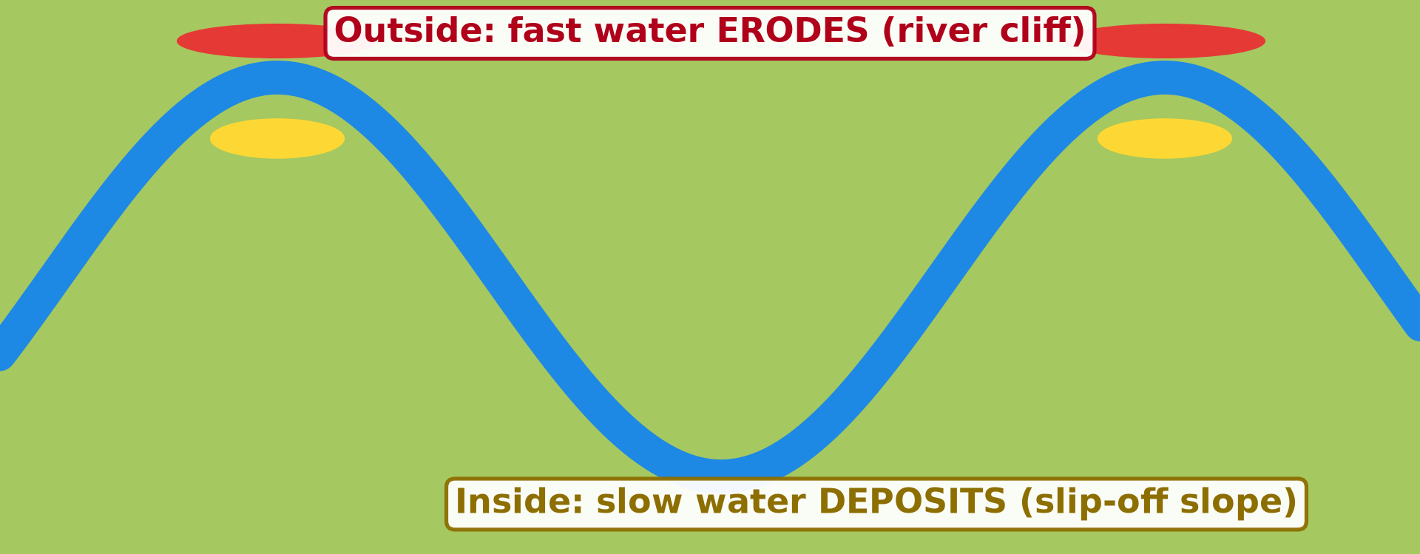
GEOGRAPHY — FORM 4
BOARD SUMMARY
III. Landforms (2/2)
Copy the meander.
2026 / 2027
DGCAST GAROUA — GEOGRAPHY DEPARTMENT
Mr KAMDEM E. | 28

Slide 29
GEOGRAPHY — FORM 4
FORMATIVE EVALUATION
Formative Evaluation 1
What is a meander?
2026 / 2027
DGCAST GAROUA — GEOGRAPHY DEPARTMENT
Mr KAMDEM E. | 29

Slide 30
GEOGRAPHY — FORM 4
FORMATIVE EVALUATION
Expected Answer
A big bend in a river.
2026 / 2027
DGCAST GAROUA — GEOGRAPHY DEPARTMENT
Mr KAMDEM E. | 30

Slide 31
GEOGRAPHY — FORM 4
FORMATIVE EVALUATION
Formative Evaluation 2
Why is the outside of a bend steep?
2026 / 2027
DGCAST GAROUA — GEOGRAPHY DEPARTMENT
Mr KAMDEM E. | 31

Slide 32
GEOGRAPHY — FORM 4
FORMATIVE EVALUATION
Expected Answer
The fast water erodes it.
2026 / 2027
DGCAST GAROUA — GEOGRAPHY DEPARTMENT
Mr KAMDEM E. | 32

Slide 33
GEOGRAPHY — FORM 4
REMEDIATION
Remediation
Fill in the blanks:
A big bend in a river is a ______.
The steep bank on the outside is a river ______.
The gentle bank on the inside is a slip-off ______.
2026 / 2027
DGCAST GAROUA — GEOGRAPHY DEPARTMENT
Mr KAMDEM E. | 33
Notes:
Answers: 1. meander 2. cliff 3. slope

Slide 34
GEOGRAPHY — FORM 4
HOMEWORK
Homework
Look at a map of the Niger Delta or the Nile Delta in your atlas. Draw its shape and name the sea it reaches.
This prepares Lesson 21: The Lower Course of a River.
2026 / 2027
DGCAST GAROUA — GEOGRAPHY DEPARTMENT
Mr KAMDEM E. | 34
Notes:
This homework prepares the next lesson.

Slide 35
GEOGRAPHY — FORM 4
BILINGUAL GAME
Bilingual Game (Jeu Bilingue)
English | Français
Meander | Le méandre
River cliff | La rive concave / falaise de méandre
Slip-off slope | La rive convexe
Lateral erosion | L'érosion latérale
Suspension | La suspension
Saltation | La saltation
Traction | Le charriage / la traction
Sandbank | Le banc de sable
2026 / 2027
DGCAST GAROUA — GEOGRAPHY DEPARTMENT
Mr KAMDEM E. | 35
Notes:
Say the English word; learners give the French word, then the reverse.

Slide 36
GEOGRAPHY — FORM 4
LOGBOOK
Official Logbook (1/2)
Module / Topic | Denudation Processes, Landforms and Impacts on Man
Lesson Title | Lesson 20: The Middle Course of a River
Expected Learning Outcomes | Describe the main characteristics and processes of the middle course. Explain how a river transports its load. Explain the formation of meanders, river cliffs and slip-off slopes.
Competence | Learners are able to recognise the landforms of the middle course and to choose safe places to build or farm along a winding river.
2026 / 2027
DGCAST GAROUA — GEOGRAPHY DEPARTMENT
Mr KAMDEM E. | 36

Slide 37
GEOGRAPHY — FORM 4
LOGBOOK
Official Logbook (2/2)
Matter Taught | I. Definitions: Middle course, Meander, River cliff, Slip-off slope; II. Characteristics: Slope, Valley, Main work; III. Landforms: Meanders, River cliff, Slip-off slope.
Evaluation | Formative evaluation (3 questions) and remediation exercise.
Homework | Look at a map of the Niger Delta or the Nile Delta in your atlas. Draw its shape and name the sea it reaches.
Enrolment / Present / Absent | ____ / ____ / ____
Achievement | To be completed by the teacher after the lesson.
2026 / 2027
DGCAST GAROUA — GEOGRAPHY DEPARTMENT
Mr KAMDEM E. | 37

Slide 38
GEOGRAPHY — FORM 4
TEACHER'S NOTE
Teacher's Note
Timing: Set-up, recall 5 min | Situation 5 min | 3 activities 12 min | Board summary (copying) 15 min | Evaluation, homework 5 min | Logbook 5 min | Spare 3 min
Activity 2 is an animation (GIF): it plays automatically in slide-show mode.
2026 / 2027
DGCAST GAROUA — GEOGRAPHY DEPARTMENT
Mr KAMDEM E. | 38

Slide 39
GEOGRAPHY — FORM 4
REFERENCES
References
National Geography Syllabus (MINESEC), Form 4 — Denudation Processes, Landforms and Impacts on Man.
Teacher's lesson notes (Form 4), checked and corrected where necessary.
Photo, Activity 1: “Ox-bow” by colinjackson1972, CC BY-NC 2.0, via Flickr (https://www.flickr.com/photos/8253719@N04/2329293239)
Diagrams and animations: drawn for this lesson (DGCAST Geography Department).
2026 / 2027
DGCAST GAROUA — GEOGRAPHY DEPARTMENT
Mr KAMDEM E. | 39

