Slide 1

DIVINE GRACE COLLEGE OF ARTS, SCIENCE AND TECHNOLOGY
(DGCAST) — GAROUA | GEOGRAPHY DEPARTMENT
FORM 4 GEOGRAPHY — LESSON 23
Wave Action in Coastal Areas
Mr KAMDEM EMMANUEL
Geography Teacher — PLEG
Academic Year 2026 / 2027
Notes:
Good morning, class. Today we start a new sub-topic: wave action along the coast. Lesson 23 is about waves in coastal areas.

Slide 2
GEOGRAPHY — FORM 4
CLASS INFO
Class, Chapter & Duration
Class | Form 4
Chapter | Denudation Processes, Landforms and Impacts on Man — Wave Action along the Coast and Impacts on Man
Duration | 50 minutes
2026 / 2027
DGCAST GAROUA — GEOGRAPHY DEPARTMENT
Mr KAMDEM E. | 2

Slide 3
GEOGRAPHY — FORM 4
IDENTIFICATION
Lesson Identification
Topic | Denudation Processes, Landforms and Impacts on Man
Sub-topic | Wave Action along the Coast and Impacts on Man
Lesson | Lesson 23: Wave Action in Coastal Areas
Notions / Concepts | Wave, fetch, swash, backwash, longshore drift.
Syllabus focus | Meaning of waves; types of waves (constructive and destructive).
Competence | Learners are able to explain how waves form and to recognise dangerous waves on a beach, for example at Kribi or Limbe.
2026 / 2027
DGCAST GAROUA — GEOGRAPHY DEPARTMENT
Mr KAMDEM E. | 3

Slide 4
GEOGRAPHY — FORM 4
OBJECTIVES
Learning Objectives
By the end of the lesson, the learner should be able to:
Define a wave and explain its cause.
Explain the factors of the strength of waves.
Distinguish constructive and destructive waves.
2026 / 2027
DGCAST GAROUA — GEOGRAPHY DEPARTMENT
Mr KAMDEM E. | 4

Slide 5
GEOGRAPHY — FORM 4
RECALL
Recall
Rivers erode, transport and deposit.
Rivers drop their load where they lose energy.
Waves are an agent of denudation along the coast.
2026 / 2027
DGCAST GAROUA — GEOGRAPHY DEPARTMENT
Mr KAMDEM E. | 5
Notes:
Check the homework: observations of waves made by the wind.

Slide 6
GEOGRAPHY — FORM 4
REAL-LIFE SITUATION
Real-Life Situation
On a windy day, Moussa sees small waves on the Benue. His cousin in Kribi says that the waves of the Atlantic Ocean are much bigger and stronger.
2026 / 2027
DGCAST GAROUA — GEOGRAPHY DEPARTMENT
Mr KAMDEM E. | 6
Notes:
Read the situation slowly, twice.

Slide 7
GEOGRAPHY — FORM 4
REAL-LIFE SITUATION
Situation — Question 1
What is the problem in the situation?
2026 / 2027
DGCAST GAROUA — GEOGRAPHY DEPARTMENT
Mr KAMDEM E. | 7

Slide 8
GEOGRAPHY — FORM 4
REAL-LIFE SITUATION
Answer
Moussa does not know why some waves are bigger than others.
2026 / 2027
DGCAST GAROUA — GEOGRAPHY DEPARTMENT
Mr KAMDEM E. | 8

Slide 9
GEOGRAPHY — FORM 4
REAL-LIFE SITUATION
Situation — Question 2
What makes the waves?
2026 / 2027
DGCAST GAROUA — GEOGRAPHY DEPARTMENT
Mr KAMDEM E. | 9

Slide 10
GEOGRAPHY — FORM 4
REAL-LIFE SITUATION
Answer
The wind blowing on the water.
2026 / 2027
DGCAST GAROUA — GEOGRAPHY DEPARTMENT
Mr KAMDEM E. | 10

Slide 11
GEOGRAPHY — FORM 4
REAL-LIFE SITUATION
Situation — Question 3
Why are sea waves bigger?
2026 / 2027
DGCAST GAROUA — GEOGRAPHY DEPARTMENT
Mr KAMDEM E. | 11

Slide 12
GEOGRAPHY — FORM 4
REAL-LIFE SITUATION
Possible Answer
The wind blows longer over a very large area of water.
2026 / 2027
DGCAST GAROUA — GEOGRAPHY DEPARTMENT
Mr KAMDEM E. | 12

Slide 13
GEOGRAPHY — FORM 4
JUSTIFICATION
Justification of the Lesson
This lesson helps us to understand waves and their work on the coast.
2026 / 2027
DGCAST GAROUA — GEOGRAPHY DEPARTMENT
Mr KAMDEM E. | 13

Slide 14

GEOGRAPHY — FORM 4
I. MEANING OF WAVES
Activity 1
Waves on the coast.
2026 / 2027
DGCAST GAROUA — GEOGRAPHY DEPARTMENT
Mr KAMDEM E. | 14
Notes:
Without the projector: blow on a plate of water.

Slide 15
GEOGRAPHY — FORM 4
I. MEANING OF WAVES
Activity 1: Question
What causes most waves?
2026 / 2027
DGCAST GAROUA — GEOGRAPHY DEPARTMENT
Mr KAMDEM E. | 15

Slide 16
GEOGRAPHY — FORM 4
I. MEANING OF WAVES
Answer
The wind blowing on the sea.
2026 / 2027
DGCAST GAROUA — GEOGRAPHY DEPARTMENT
Mr KAMDEM E. | 16

Slide 17
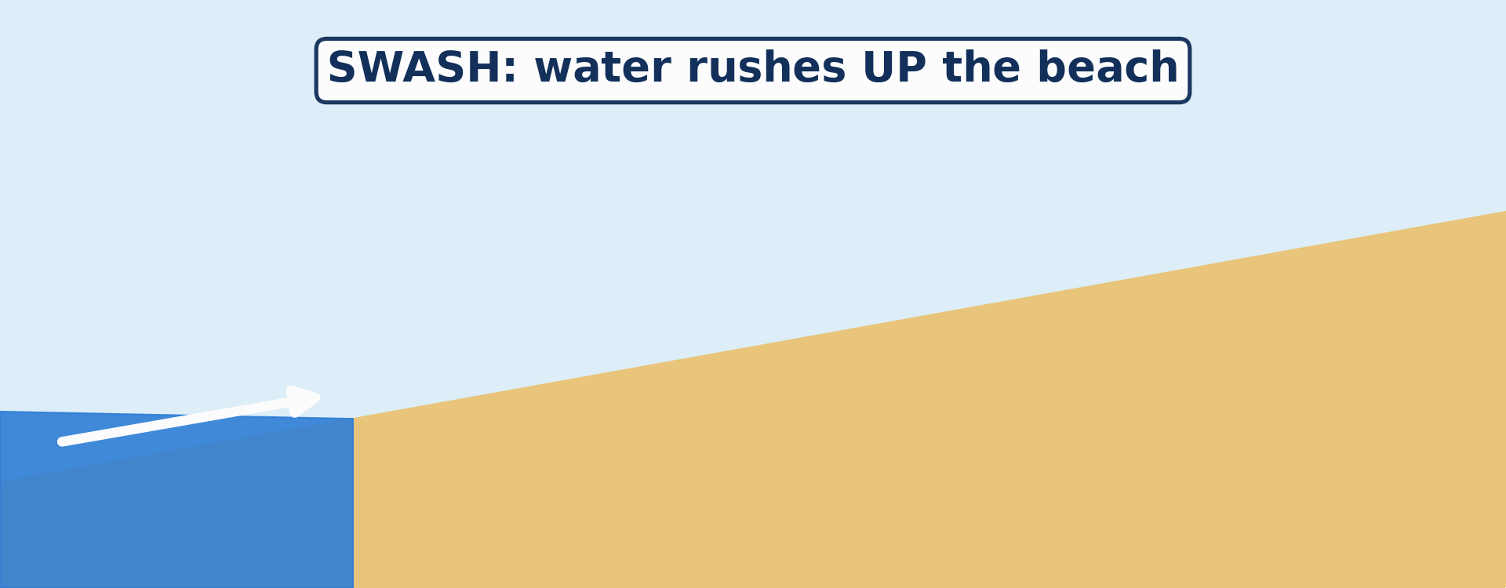
GEOGRAPHY — FORM 4
I. MEANING OF WAVES
Activity 2
Animation: the water goes up the beach and comes back.
2026 / 2027
DGCAST GAROUA — GEOGRAPHY DEPARTMENT
Mr KAMDEM E. | 17
Notes:
Without the projector: draw a beach with an arrow up and an arrow down.

Slide 18
GEOGRAPHY — FORM 4
I. MEANING OF WAVES
Activity 2: Question
What do we call the water going up the beach? And coming back?
2026 / 2027
DGCAST GAROUA — GEOGRAPHY DEPARTMENT
Mr KAMDEM E. | 18

Slide 19
GEOGRAPHY — FORM 4
I. MEANING OF WAVES
Answer
Up: the swash. Back: the backwash.
2026 / 2027
DGCAST GAROUA — GEOGRAPHY DEPARTMENT
Mr KAMDEM E. | 19

Slide 20

GEOGRAPHY — FORM 4
II. TYPES OF WAVES
Activity 3
Big waves in a storm.
2026 / 2027
DGCAST GAROUA — GEOGRAPHY DEPARTMENT
Mr KAMDEM E. | 20
Notes:
Without the projector: compare a calm day and a stormy day at the beach.

Slide 21
GEOGRAPHY — FORM 4
II. TYPES OF WAVES
Activity 3: Question
These high waves take sand away from the beach. What type of waves are they?
2026 / 2027
DGCAST GAROUA — GEOGRAPHY DEPARTMENT
Mr KAMDEM E. | 21

Slide 22
GEOGRAPHY — FORM 4
II. TYPES OF WAVES
Answer
Destructive waves.
2026 / 2027
DGCAST GAROUA — GEOGRAPHY DEPARTMENT
Mr KAMDEM E. | 22

Slide 23
GEOGRAPHY — FORM 4
BOARD SUMMARY
Wave Action in Coastal Areas
Topic: Denudation Processes, Landforms and Impacts on Man
Sub-topic: Wave Action along the Coast and Impacts on Man
Lesson 23: Wave Action in Coastal Areas
2026 / 2027
DGCAST GAROUA — GEOGRAPHY DEPARTMENT
Mr KAMDEM E. | 23
Notes:
Learners copy the board summary now. Give them enough time for each slide.

Slide 24
GEOGRAPHY — FORM 4
BOARD SUMMARY
I. Definitions
Wave: It is a movement of the water of the sea.
Swash: It is the water that goes up the beach.
Backwash: It is the water that goes back to the sea.
Fetch: It is the distance of sea over which the wind blows.
2026 / 2027
DGCAST GAROUA — GEOGRAPHY DEPARTMENT
Mr KAMDEM E. | 24

Slide 25
GEOGRAPHY — FORM 4
BOARD SUMMARY
II. Strength of Waves
A. Wind: A stronger wind makes bigger waves.
B. Time: The longer it blows, the bigger the waves.
C. Fetch: A long fetch makes big waves.
2026 / 2027
DGCAST GAROUA — GEOGRAPHY DEPARTMENT
Mr KAMDEM E. | 25

Slide 26
GEOGRAPHY — FORM 4
BOARD SUMMARY
III. Types of Waves (1/2)
A. Constructive: Low waves; strong swash; they build beaches.
B. Destructive: High waves; strong backwash; they destroy beaches.
2026 / 2027
DGCAST GAROUA — GEOGRAPHY DEPARTMENT
Mr KAMDEM E. | 26

Slide 27
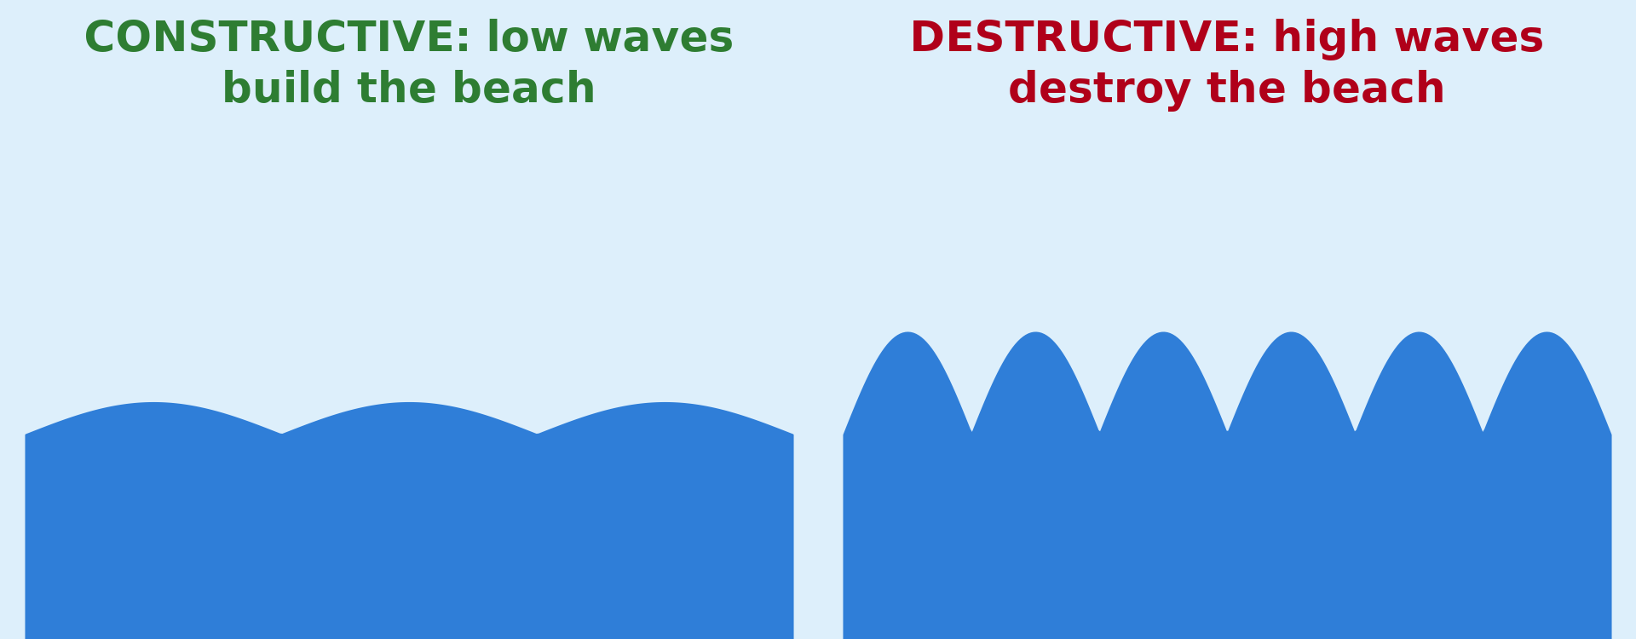
GEOGRAPHY — FORM 4
BOARD SUMMARY
III. Types of Waves (2/2)
Copy the two types of waves.
2026 / 2027
DGCAST GAROUA — GEOGRAPHY DEPARTMENT
Mr KAMDEM E. | 27

Slide 28
GEOGRAPHY — FORM 4
FORMATIVE EVALUATION
Formative Evaluation 1
What is the swash?
2026 / 2027
DGCAST GAROUA — GEOGRAPHY DEPARTMENT
Mr KAMDEM E. | 28

Slide 29
GEOGRAPHY — FORM 4
FORMATIVE EVALUATION
Expected Answer
The water that goes up the beach.
2026 / 2027
DGCAST GAROUA — GEOGRAPHY DEPARTMENT
Mr KAMDEM E. | 29

Slide 30
GEOGRAPHY — FORM 4
FORMATIVE EVALUATION
Formative Evaluation 2
Give one difference between constructive and destructive waves.
2026 / 2027
DGCAST GAROUA — GEOGRAPHY DEPARTMENT
Mr KAMDEM E. | 30

Slide 31
GEOGRAPHY — FORM 4
FORMATIVE EVALUATION
Expected Answer
Constructive waves build the beach; destructive waves destroy it.
2026 / 2027
DGCAST GAROUA — GEOGRAPHY DEPARTMENT
Mr KAMDEM E. | 31

Slide 32
GEOGRAPHY — FORM 4
REMEDIATION
Remediation
Fill in the blanks:
Most waves are caused by the ______.
Water going back to the sea is the ______.
High waves that destroy the beach are ______ waves.
2026 / 2027
DGCAST GAROUA — GEOGRAPHY DEPARTMENT
Mr KAMDEM E. | 32
Notes:
Answers: 1. wind 2. backwash 3. destructive

Slide 33
GEOGRAPHY — FORM 4
HOMEWORK
Homework
Look at photos of the coast of Limbe or Kribi. Draw a rocky part of the coast and name any holes, arches or rocks in the sea that you see.
This prepares Lesson 24: Main Erosional Processes and Features of Wave Action.
2026 / 2027
DGCAST GAROUA — GEOGRAPHY DEPARTMENT
Mr KAMDEM E. | 33
Notes:
This homework prepares the next lesson.

Slide 34
GEOGRAPHY — FORM 4
BILINGUAL GAME
Bilingual Game (Jeu Bilingue)
English | Français
Wave | La vague
Coast | La côte
Beach | La plage
Swash | Le jet de rive
Backwash | La nappe de retrait / le ressac
Fetch | Le fetch
Storm | La tempête
Current | Le courant
2026 / 2027
DGCAST GAROUA — GEOGRAPHY DEPARTMENT
Mr KAMDEM E. | 34
Notes:
Say the English word; learners give the French word, then the reverse.

Slide 35
GEOGRAPHY — FORM 4
LOGBOOK
Official Logbook (1/2)
Module / Topic | Denudation Processes, Landforms and Impacts on Man
Lesson Title | Lesson 23: Wave Action in Coastal Areas
Expected Learning Outcomes | Define a wave and explain its cause. Explain the factors of the strength of waves. Distinguish constructive and destructive waves.
Competence | Learners are able to explain how waves form and to recognise dangerous waves on a beach, for example at Kribi or Limbe.
2026 / 2027
DGCAST GAROUA — GEOGRAPHY DEPARTMENT
Mr KAMDEM E. | 35

Slide 36
GEOGRAPHY — FORM 4
LOGBOOK
Official Logbook (2/2)
Matter Taught | I. Definitions: Wave, Swash, Backwash, Fetch; II. Strength of Waves: Wind, Time, Fetch; III. Types of Waves: Constructive, Destructive.
Evaluation | Formative evaluation (3 questions) and remediation exercise.
Homework | Look at photos of the coast of Limbe or Kribi. Draw a rocky part of the coast and name any holes, arches or rocks in the sea that you see.
Enrolment / Present / Absent | ____ / ____ / ____
Achievement | To be completed by the teacher after the lesson.
2026 / 2027
DGCAST GAROUA — GEOGRAPHY DEPARTMENT
Mr KAMDEM E. | 36

Slide 37
GEOGRAPHY — FORM 4
TEACHER'S NOTE
Teacher's Note
Timing: Set-up, recall 5 min | Situation 5 min | 3 activities 12 min | Board summary (copying) 15 min | Evaluation, homework 5 min | Logbook 5 min | Spare 3 min
Activity 2 is an animation (GIF): it plays automatically in slide-show mode.
2026 / 2027
DGCAST GAROUA — GEOGRAPHY DEPARTMENT
Mr KAMDEM E. | 37

Slide 38
GEOGRAPHY — FORM 4
REFERENCES
References
National Geography Syllabus (MINESEC), Form 4 — Denudation Processes, Landforms and Impacts on Man.
Teacher's lesson notes (Form 4), checked and corrected where necessary.
Photo, Activity 1: “Carpinteria Bluffs, California (5)” by Ken Lund, CC BY-SA 2.0, via Flickr (https://www.flickr.com/photos/75683070@N00/4063056130)
Photo, Activity 3: “Wave Explosion, Monterey Bay, California” by John William Hammond, CC BY-NC-SA 2.0, via Flickr (https://www.flickr.com/photos/8398907@N02/16328053911)
Diagrams and animations: drawn for this lesson (DGCAST Geography Department).
2026 / 2027
DGCAST GAROUA — GEOGRAPHY DEPARTMENT
Mr KAMDEM E. | 38

