Slide 1

DIVINE GRACE COLLEGE OF ARTS, SCIENCE AND TECHNOLOGY
(DGCAST) — GAROUA | GEOGRAPHY DEPARTMENT
FORM 4 GEOGRAPHY — LESSON 25
Main Depositional Features of Wave Action
Mr KAMDEM EMMANUEL
Geography Teacher — PLEG
Academic Year 2026 / 2027
Notes:
Good morning, class. Today we study Lesson 25: Main Depositional Features of Wave Action.

Slide 2
GEOGRAPHY — FORM 4
CLASS INFO
Class, Chapter & Duration
Class | Form 4
Chapter | Denudation Processes, Landforms and Impacts on Man — Wave Action along the Coast and Impacts on Man
Duration | 50 minutes
2026 / 2027
DGCAST GAROUA — GEOGRAPHY DEPARTMENT
Mr KAMDEM E. | 2

Slide 3
GEOGRAPHY — FORM 4
IDENTIFICATION
Lesson Identification
Topic | Denudation Processes, Landforms and Impacts on Man
Sub-topic | Wave Action along the Coast and Impacts on Man
Lesson | Lesson 25: Main Depositional Features of Wave Action
Notions / Concepts | Beach, spits, bars, tombolos, longshore drift.
Syllabus focus | Major depositional process (longshore drift); depositional features.
Competence | Learners are able to explain how beaches and spits are built, and why sand moves along a coast.
2026 / 2027
DGCAST GAROUA — GEOGRAPHY DEPARTMENT
Mr KAMDEM E. | 3

Slide 4
GEOGRAPHY — FORM 4
OBJECTIVES
Learning Objectives
By the end of the lesson, the learner should be able to:
Explain longshore drift.
Explain the formation of beaches, spits, bars and tombolos.
Give examples of these features.
2026 / 2027
DGCAST GAROUA — GEOGRAPHY DEPARTMENT
Mr KAMDEM E. | 4

Slide 5
GEOGRAPHY — FORM 4
RECALL
Recall
Constructive waves build beaches.
Waves erode rocky coasts and form cliffs, caves, arches and stacks.
The swash goes up the beach; the backwash goes down.
2026 / 2027
DGCAST GAROUA — GEOGRAPHY DEPARTMENT
Mr KAMDEM E. | 5
Notes:
Check the homework: the sand in the tray.

Slide 6
GEOGRAPHY — FORM 4
REAL-LIFE SITUATION
Real-Life Situation
In Kribi, Maïmouna builds a sandcastle. The waves reach the beach at an angle. After an hour, some sand of her castle has moved along the beach.
2026 / 2027
DGCAST GAROUA — GEOGRAPHY DEPARTMENT
Mr KAMDEM E. | 6
Notes:
Read the situation slowly, twice.

Slide 7
GEOGRAPHY — FORM 4
REAL-LIFE SITUATION
Situation — Question 1
What is the problem in the situation?
2026 / 2027
DGCAST GAROUA — GEOGRAPHY DEPARTMENT
Mr KAMDEM E. | 7

Slide 8
GEOGRAPHY — FORM 4
REAL-LIFE SITUATION
Answer
Maïmouna does not know why the sand moved along the beach.
2026 / 2027
DGCAST GAROUA — GEOGRAPHY DEPARTMENT
Mr KAMDEM E. | 8

Slide 9
GEOGRAPHY — FORM 4
REAL-LIFE SITUATION
Situation — Question 2
How do the waves reach the beach?
2026 / 2027
DGCAST GAROUA — GEOGRAPHY DEPARTMENT
Mr KAMDEM E. | 9

Slide 10
GEOGRAPHY — FORM 4
REAL-LIFE SITUATION
Answer
At an angle.
2026 / 2027
DGCAST GAROUA — GEOGRAPHY DEPARTMENT
Mr KAMDEM E. | 10

Slide 11
GEOGRAPHY — FORM 4
REAL-LIFE SITUATION
Situation — Question 3
What do we call this movement of sand?
2026 / 2027
DGCAST GAROUA — GEOGRAPHY DEPARTMENT
Mr KAMDEM E. | 11

Slide 12
GEOGRAPHY — FORM 4
REAL-LIFE SITUATION
Possible Answer
Longshore drift.
2026 / 2027
DGCAST GAROUA — GEOGRAPHY DEPARTMENT
Mr KAMDEM E. | 12

Slide 13
GEOGRAPHY — FORM 4
JUSTIFICATION
Justification of the Lesson
This lesson helps us to know the landforms made when waves drop sand.
2026 / 2027
DGCAST GAROUA — GEOGRAPHY DEPARTMENT
Mr KAMDEM E. | 13

Slide 14
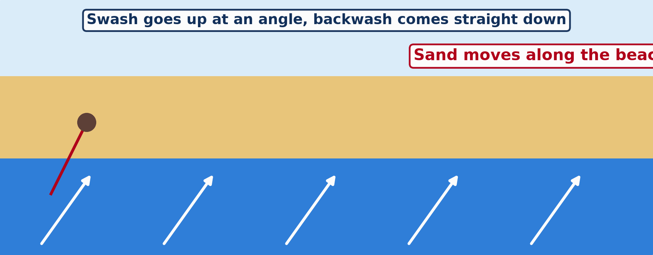
GEOGRAPHY — FORM 4
I. LONGSHORE DRIFT
Activity 1
Animation: sand moves along the beach.
2026 / 2027
DGCAST GAROUA — GEOGRAPHY DEPARTMENT
Mr KAMDEM E. | 14
Notes:
Without the projector: draw a zigzag line along a beach.

Slide 15
GEOGRAPHY — FORM 4
I. LONGSHORE DRIFT
Activity 1: Question
How does the sand move along the beach?
2026 / 2027
DGCAST GAROUA — GEOGRAPHY DEPARTMENT
Mr KAMDEM E. | 15

Slide 16
GEOGRAPHY — FORM 4
I. LONGSHORE DRIFT
Answer
The swash pushes it up at an angle; the backwash brings it straight down.
2026 / 2027
DGCAST GAROUA — GEOGRAPHY DEPARTMENT
Mr KAMDEM E. | 16

Slide 17

GEOGRAPHY — FORM 4
II. SPITS
Activity 2
A long, narrow strip of sand and land in the sea (England).
2026 / 2027
DGCAST GAROUA — GEOGRAPHY DEPARTMENT
Mr KAMDEM E. | 17
Notes:
Without the projector: draw a coast with a finger of sand.

Slide 18
GEOGRAPHY — FORM 4
II. SPITS
Activity 2: Question
This strip of sand is joined to the land at one end. What is it?
2026 / 2027
DGCAST GAROUA — GEOGRAPHY DEPARTMENT
Mr KAMDEM E. | 18

Slide 19
GEOGRAPHY — FORM 4
II. SPITS
Answer
A spit.
2026 / 2027
DGCAST GAROUA — GEOGRAPHY DEPARTMENT
Mr KAMDEM E. | 19

Slide 20
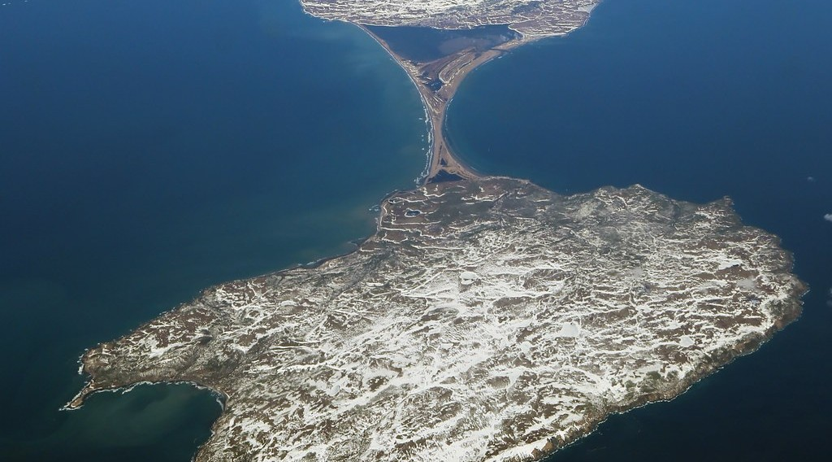
GEOGRAPHY — FORM 4
II. TOMBOLOS
Activity 3
Sand joins an island to the land.
2026 / 2027
DGCAST GAROUA — GEOGRAPHY DEPARTMENT
Mr KAMDEM E. | 20
Notes:
Without the projector: draw an island joined to the coast by sand.

Slide 21
GEOGRAPHY — FORM 4
II. TOMBOLOS
Activity 3: Question
What do we call sand that joins an island to the land?
2026 / 2027
DGCAST GAROUA — GEOGRAPHY DEPARTMENT
Mr KAMDEM E. | 21

Slide 22
GEOGRAPHY — FORM 4
II. TOMBOLOS
Answer
A tombolo.
2026 / 2027
DGCAST GAROUA — GEOGRAPHY DEPARTMENT
Mr KAMDEM E. | 22

Slide 23
GEOGRAPHY — FORM 4
BOARD SUMMARY
Main Depositional Features of Wave Action
Topic: Denudation Processes, Landforms and Impacts on Man
Sub-topic: Wave Action along the Coast and Impacts on Man
Lesson 25: Main Depositional Features of Wave Action
2026 / 2027
DGCAST GAROUA — GEOGRAPHY DEPARTMENT
Mr KAMDEM E. | 23
Notes:
Learners copy the board summary now. Give them enough time for each slide.

Slide 24
GEOGRAPHY — FORM 4
BOARD SUMMARY
I. Definitions (1/2)
Longshore drift: It is the movement of sand along the beach.
Beach: It is sand and pebbles between low and high tide.
Spit: It is a strip of sand joined to the land at one end.
2026 / 2027
DGCAST GAROUA — GEOGRAPHY DEPARTMENT
Mr KAMDEM E. | 24

Slide 25
GEOGRAPHY — FORM 4
BOARD SUMMARY
I. Definitions (2/2)
Tombolo: It is sand that joins an island to the land.
2026 / 2027
DGCAST GAROUA — GEOGRAPHY DEPARTMENT
Mr KAMDEM E. | 25

Slide 26
GEOGRAPHY — FORM 4
BOARD SUMMARY
II. Longshore Drift (1/2)
Step 1: Waves reach the beach at an angle.
Step 2: The swash pushes sand up at an angle.
Step 3: The backwash brings it straight down.
Step 4: The sand moves along in zigzags.
2026 / 2027
DGCAST GAROUA — GEOGRAPHY DEPARTMENT
Mr KAMDEM E. | 26

Slide 27
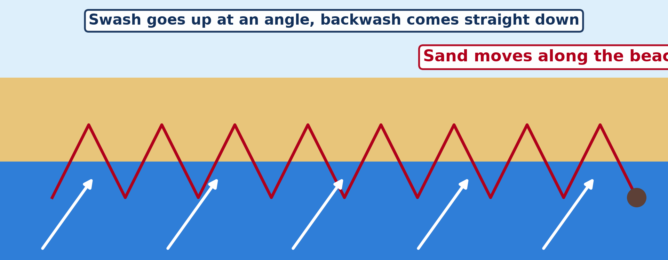
GEOGRAPHY — FORM 4
BOARD SUMMARY
II. Longshore Drift (2/2)
Copy the zigzag of longshore drift.
2026 / 2027
DGCAST GAROUA — GEOGRAPHY DEPARTMENT
Mr KAMDEM E. | 27

Slide 28
GEOGRAPHY — FORM 4
BOARD SUMMARY
III. Depositional Features
A. Beaches: Like Kribi and Limbe.
B. Spits: Fingers of sand in the sea.
C. Bars: Sand across a bay.
D. Tombolos: Sand to an island.
2026 / 2027
DGCAST GAROUA — GEOGRAPHY DEPARTMENT
Mr KAMDEM E. | 28

Slide 29
GEOGRAPHY — FORM 4
FORMATIVE EVALUATION
Formative Evaluation 1
What is longshore drift?
2026 / 2027
DGCAST GAROUA — GEOGRAPHY DEPARTMENT
Mr KAMDEM E. | 29

Slide 30
GEOGRAPHY — FORM 4
FORMATIVE EVALUATION
Expected Answer
The movement of sand along the beach by waves.
2026 / 2027
DGCAST GAROUA — GEOGRAPHY DEPARTMENT
Mr KAMDEM E. | 30

Slide 31
GEOGRAPHY — FORM 4
FORMATIVE EVALUATION
Formative Evaluation 2
What is the difference between a spit and a bar?
2026 / 2027
DGCAST GAROUA — GEOGRAPHY DEPARTMENT
Mr KAMDEM E. | 31

Slide 32
GEOGRAPHY — FORM 4
FORMATIVE EVALUATION
Expected Answer
A spit is joined at one end; a bar closes a bay.
2026 / 2027
DGCAST GAROUA — GEOGRAPHY DEPARTMENT
Mr KAMDEM E. | 32

Slide 33
GEOGRAPHY — FORM 4
REMEDIATION
Remediation
Fill in the blanks:
The movement of sand along the beach is ______ drift.
A strip of sand joined at one end is a ______.
Sand joining an island to the land is a ______.
2026 / 2027
DGCAST GAROUA — GEOGRAPHY DEPARTMENT
Mr KAMDEM E. | 33
Notes:
Answers: 1. longshore 2. spit 3. tombolo

Slide 34
GEOGRAPHY — FORM 4
HOMEWORK
Homework
List five goods sold in the market of Garoua that come from abroad. Ask a trader through which port they entered Cameroon.
This prepares Lesson 26: Impact of Wave Action on Human Development along Coastal Areas.
2026 / 2027
DGCAST GAROUA — GEOGRAPHY DEPARTMENT
Mr KAMDEM E. | 34
Notes:
This homework prepares the next lesson.

Slide 35
GEOGRAPHY — FORM 4
BILINGUAL GAME
Bilingual Game (Jeu Bilingue)
English | Français
Longshore drift | La dérive littorale
Beach | La plage
Spit | La flèche littorale
Bar | Le cordon littoral
Lagoon | La lagune
Tombolo | Le tombolo
Sand | Le sable
Pebble | Le galet
2026 / 2027
DGCAST GAROUA — GEOGRAPHY DEPARTMENT
Mr KAMDEM E. | 35
Notes:
Say the English word; learners give the French word, then the reverse.

Slide 36
GEOGRAPHY — FORM 4
LOGBOOK
Official Logbook (1/2)
Module / Topic | Denudation Processes, Landforms and Impacts on Man
Lesson Title | Lesson 25: Main Depositional Features of Wave Action
Expected Learning Outcomes | Explain longshore drift. Explain the formation of beaches, spits, bars and tombolos. Give examples of these features.
Competence | Learners are able to explain how beaches and spits are built, and why sand moves along a coast.
2026 / 2027
DGCAST GAROUA — GEOGRAPHY DEPARTMENT
Mr KAMDEM E. | 36

Slide 37
GEOGRAPHY — FORM 4
LOGBOOK
Official Logbook (2/2)
Matter Taught | I. Definitions: Longshore drift, Beach, Spit, Tombolo; II. Longshore Drift: Step 1, Step 2, Step 3, Step 4; III. Depositional Features: Beaches, Spits, Bars, Tombolos.
Evaluation | Formative evaluation (3 questions) and remediation exercise.
Homework | List five goods sold in the market of Garoua that come from abroad. Ask a trader through which port they entered Cameroon.
Enrolment / Present / Absent | ____ / ____ / ____
Achievement | To be completed by the teacher after the lesson.
2026 / 2027
DGCAST GAROUA — GEOGRAPHY DEPARTMENT
Mr KAMDEM E. | 37

Slide 38
GEOGRAPHY — FORM 4
TEACHER'S NOTE
Teacher's Note
Timing: Set-up, recall 5 min | Situation 5 min | 3 activities 12 min | Board summary (copying) 15 min | Evaluation, homework 5 min | Logbook 5 min | Spare 3 min
Activity 1 is an animation (GIF): it plays automatically in slide-show mode.
2026 / 2027
DGCAST GAROUA — GEOGRAPHY DEPARTMENT
Mr KAMDEM E. | 38

Slide 39
GEOGRAPHY — FORM 4
REFERENCES
References
National Geography Syllabus (MINESEC), Form 4 — Denudation Processes, Landforms and Impacts on Man.
Teacher's lesson notes (Form 4), checked and corrected where necessary.
Photo, Activity 2: “Coastal defences no longer being maintained - Why? Spurn Head, Yorkshi” by Richard Allaway, CC BY 2.0, via Flickr (https://www.flickr.com/photos/16287002@N00/6605676971)
Photo, Activity 3: “2017_04_10_lhr-ewr_083” by dsearls, CC BY 2.0, via Flickr (https://www.flickr.com/photos/52614599@N00/33953233846)
Diagrams and animations: drawn for this lesson (DGCAST Geography Department).
2026 / 2027
DGCAST GAROUA — GEOGRAPHY DEPARTMENT
Mr KAMDEM E. | 39

