Slide 1

DIVINE GRACE COLLEGE OF ARTS, SCIENCE AND TECHNOLOGY
(DGCAST) — GAROUA | GEOGRAPHY DEPARTMENT
FORM 4 GEOGRAPHY — LESSON 26
Impact of Wave Action on Human Development along Coastal Areas
Mr KAMDEM EMMANUEL
Geography Teacher — PLEG
Academic Year 2026 / 2027
Notes:
Good morning, class. Today we study Lesson 26: Impact of Wave Action on Human Development along Coastal Areas.

Slide 2
GEOGRAPHY — FORM 4
CLASS INFO
Class, Chapter & Duration
Class | Form 4
Chapter | Denudation Processes, Landforms and Impacts on Man — Wave Action along the Coast and Impacts on Man
Duration | 50 minutes
2026 / 2027
DGCAST GAROUA — GEOGRAPHY DEPARTMENT
Mr KAMDEM E. | 2

Slide 3
GEOGRAPHY — FORM 4
IDENTIFICATION
Lesson Identification
Topic | Denudation Processes, Landforms and Impacts on Man
Sub-topic | Wave Action along the Coast and Impacts on Man
Lesson | Lesson 26: Impact of Wave Action on Human Development along Coastal Areas
Notions / Concepts | Resource, hazard, coastal management.
Syllabus focus | Importance of coasts (resources); coastal hazards; coastal management strategies.
Competence | Learners are able to explain why coasts are important for Cameroon, and to suggest simple ways to protect them.
2026 / 2027
DGCAST GAROUA — GEOGRAPHY DEPARTMENT
Mr KAMDEM E. | 3

Slide 4
GEOGRAPHY — FORM 4
OBJECTIVES
Learning Objectives
By the end of the lesson, the learner should be able to:
Explain the importance of coasts.
Describe the main coastal hazards.
Explain coastal management strategies.
2026 / 2027
DGCAST GAROUA — GEOGRAPHY DEPARTMENT
Mr KAMDEM E. | 4

Slide 5
GEOGRAPHY — FORM 4
RECALL
Recall
Longshore drift moves sand along the coast.
Beaches, spits and bars are built by wave deposition.
Destructive waves erode the coast.
2026 / 2027
DGCAST GAROUA — GEOGRAPHY DEPARTMENT
Mr KAMDEM E. | 5
Notes:
Check the homework: imported goods and the ports through which they entered.

Slide 6
GEOGRAPHY — FORM 4
REAL-LIFE SITUATION
Real-Life Situation
In the market of Garoua, Idrissa sees phones, cloth and rice from abroad. Most of them came by ship to the ports of Douala or Kribi, then by road to Garoua.
2026 / 2027
DGCAST GAROUA — GEOGRAPHY DEPARTMENT
Mr KAMDEM E. | 6
Notes:
Read the situation slowly, twice.

Slide 7
GEOGRAPHY — FORM 4
REAL-LIFE SITUATION
Situation — Question 1
What is the problem in the situation?
2026 / 2027
DGCAST GAROUA — GEOGRAPHY DEPARTMENT
Mr KAMDEM E. | 7

Slide 8
GEOGRAPHY — FORM 4
REAL-LIFE SITUATION
Answer
Idrissa wants to know how goods from abroad reach Garoua.
2026 / 2027
DGCAST GAROUA — GEOGRAPHY DEPARTMENT
Mr KAMDEM E. | 8

Slide 9
GEOGRAPHY — FORM 4
REAL-LIFE SITUATION
Situation — Question 2
Where do the ships arrive?
2026 / 2027
DGCAST GAROUA — GEOGRAPHY DEPARTMENT
Mr KAMDEM E. | 9

Slide 10
GEOGRAPHY — FORM 4
REAL-LIFE SITUATION
Answer
At the ports of Douala and Kribi.
2026 / 2027
DGCAST GAROUA — GEOGRAPHY DEPARTMENT
Mr KAMDEM E. | 10

Slide 11
GEOGRAPHY — FORM 4
REAL-LIFE SITUATION
Situation — Question 3
Why is the coast important for Garoua?
2026 / 2027
DGCAST GAROUA — GEOGRAPHY DEPARTMENT
Mr KAMDEM E. | 11

Slide 12
GEOGRAPHY — FORM 4
REAL-LIFE SITUATION
Possible Answer
Goods arrive at the coast and then go north by road.
2026 / 2027
DGCAST GAROUA — GEOGRAPHY DEPARTMENT
Mr KAMDEM E. | 12

Slide 13
GEOGRAPHY — FORM 4
JUSTIFICATION
Justification of the Lesson
This lesson helps us to know the importance and the dangers of the coast.
2026 / 2027
DGCAST GAROUA — GEOGRAPHY DEPARTMENT
Mr KAMDEM E. | 13

Slide 14

GEOGRAPHY — FORM 4
I. IMPORTANCE
Activity 1
A port with a container ship.
2026 / 2027
DGCAST GAROUA — GEOGRAPHY DEPARTMENT
Mr KAMDEM E. | 14
Notes:
Without the projector: ask learners what products come from the port of Douala.

Slide 15
GEOGRAPHY — FORM 4
I. IMPORTANCE
Activity 1: Question
Why are ports important for Cameroon?
2026 / 2027
DGCAST GAROUA — GEOGRAPHY DEPARTMENT
Mr KAMDEM E. | 15

Slide 16
GEOGRAPHY — FORM 4
I. IMPORTANCE
Answer
Ships bring and take goods: trade.
2026 / 2027
DGCAST GAROUA — GEOGRAPHY DEPARTMENT
Mr KAMDEM E. | 16

Slide 17

GEOGRAPHY — FORM 4
II. HAZARDS
Activity 2
Old sea defences broken by the waves (England).
2026 / 2027
DGCAST GAROUA — GEOGRAPHY DEPARTMENT
Mr KAMDEM E. | 17
Notes:
Without the projector: describe houses near the sea that are damaged by waves.

Slide 18
GEOGRAPHY — FORM 4
II. HAZARDS
Activity 2: Question
What are the waves doing to this coast?
2026 / 2027
DGCAST GAROUA — GEOGRAPHY DEPARTMENT
Mr KAMDEM E. | 18

Slide 19
GEOGRAPHY — FORM 4
II. HAZARDS
Answer
Coastal erosion: waves wear away the beach and houses.
2026 / 2027
DGCAST GAROUA — GEOGRAPHY DEPARTMENT
Mr KAMDEM E. | 19

Slide 20
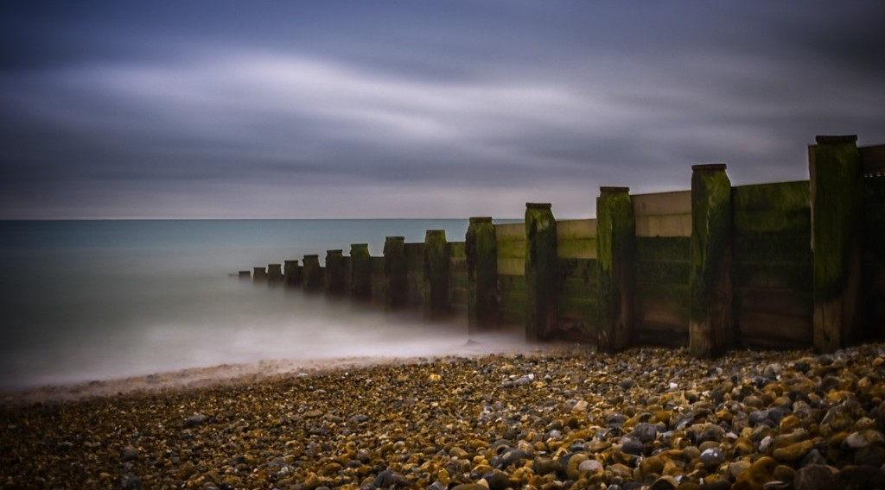
GEOGRAPHY — FORM 4
III. PROTECTION
Activity 3
Low walls built across a beach.
2026 / 2027
DGCAST GAROUA — GEOGRAPHY DEPARTMENT
Mr KAMDEM E. | 20
Notes:
Without the projector: draw a beach with walls across it.

Slide 21
GEOGRAPHY — FORM 4
III. PROTECTION
Activity 3: Question
How do these low walls protect the beach?
2026 / 2027
DGCAST GAROUA — GEOGRAPHY DEPARTMENT
Mr KAMDEM E. | 21

Slide 22
GEOGRAPHY — FORM 4
III. PROTECTION
Answer
They stop the sand from moving away.
2026 / 2027
DGCAST GAROUA — GEOGRAPHY DEPARTMENT
Mr KAMDEM E. | 22

Slide 23
GEOGRAPHY — FORM 4
BOARD SUMMARY
Impact of Wave Action on Human Development along Coastal Areas
Topic: Denudation Processes, Landforms and Impacts on Man
Sub-topic: Wave Action along the Coast and Impacts on Man
Lesson 26: Impact of Wave Action on Human Development along Coastal Areas
2026 / 2027
DGCAST GAROUA — GEOGRAPHY DEPARTMENT
Mr KAMDEM E. | 23
Notes:
Learners copy the board summary now. Give them enough time for each slide.

Slide 24
GEOGRAPHY — FORM 4
BOARD SUMMARY
I. Definitions
Port: It is a place where ships load and unload goods.
Coastal erosion: It is the wearing away of the coast by waves.
Groyne: It is a low wall built across a beach.
2026 / 2027
DGCAST GAROUA — GEOGRAPHY DEPARTMENT
Mr KAMDEM E. | 24

Slide 25
GEOGRAPHY — FORM 4
BOARD SUMMARY
II. Importance of Coasts
A. Ports: Douala and Kribi.
B. Fishing: Fish and shrimps.
C. Tourism: Beaches of Kribi and Limbe.
D. Oil: Oil is found under the sea.
2026 / 2027
DGCAST GAROUA — GEOGRAPHY DEPARTMENT
Mr KAMDEM E. | 25

Slide 26
GEOGRAPHY — FORM 4
BOARD SUMMARY
III. Coastal Hazards
A. Erosion: Waves destroy beaches and houses.
B. Floods: The sea covers low land.
C. Sea-level rise: Douala is in danger.
2026 / 2027
DGCAST GAROUA — GEOGRAPHY DEPARTMENT
Mr KAMDEM E. | 26

Slide 27
GEOGRAPHY — FORM 4
BOARD SUMMARY
IV. Protection (1/2)
A. Sea walls: They stop the waves.
B. Groynes: They keep the sand.
C. Mangroves: These trees protect the coast.
2026 / 2027
DGCAST GAROUA — GEOGRAPHY DEPARTMENT
Mr KAMDEM E. | 27

Slide 28
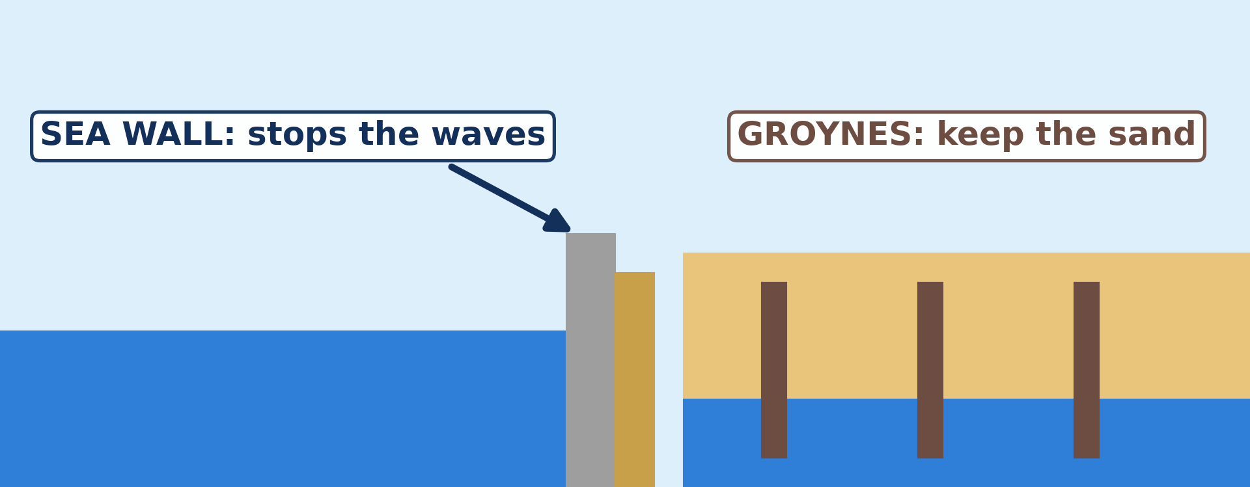
GEOGRAPHY — FORM 4
BOARD SUMMARY
IV. Protection (2/2)
Copy the sea wall and the groynes.
2026 / 2027
DGCAST GAROUA — GEOGRAPHY DEPARTMENT
Mr KAMDEM E. | 28

Slide 29
GEOGRAPHY — FORM 4
FORMATIVE EVALUATION
Formative Evaluation 1
Name two ports of Cameroon.
2026 / 2027
DGCAST GAROUA — GEOGRAPHY DEPARTMENT
Mr KAMDEM E. | 29

Slide 30
GEOGRAPHY — FORM 4
FORMATIVE EVALUATION
Expected Answer
Douala and Kribi.
2026 / 2027
DGCAST GAROUA — GEOGRAPHY DEPARTMENT
Mr KAMDEM E. | 30

Slide 31
GEOGRAPHY — FORM 4
FORMATIVE EVALUATION
Formative Evaluation 2
Give two ways to protect the coast.
2026 / 2027
DGCAST GAROUA — GEOGRAPHY DEPARTMENT
Mr KAMDEM E. | 31

Slide 32
GEOGRAPHY — FORM 4
FORMATIVE EVALUATION
Expected Answer
Sea walls and groynes (also mangroves).
2026 / 2027
DGCAST GAROUA — GEOGRAPHY DEPARTMENT
Mr KAMDEM E. | 32

Slide 33
GEOGRAPHY — FORM 4
REMEDIATION
Remediation
Fill in the blanks:
A place where ships load goods is a ______.
A low wall across a beach is a ______.
The wearing away of the coast is coastal ______.
2026 / 2027
DGCAST GAROUA — GEOGRAPHY DEPARTMENT
Mr KAMDEM E. | 33
Notes:
Answers: 1. port 2. groyne 3. erosion

Slide 34
GEOGRAPHY — FORM 4
HOMEWORK
Homework
On a map of Africa in your atlas, find the Sahara, the Sahel and the Kalahari. Write in which part of Africa each one is located.
This prepares Lesson 27: Semi-Arid and Desert Landscapes.
2026 / 2027
DGCAST GAROUA — GEOGRAPHY DEPARTMENT
Mr KAMDEM E. | 34
Notes:
This homework prepares the next lesson.

Slide 35
GEOGRAPHY — FORM 4
BILINGUAL GAME
Bilingual Game (Jeu Bilingue)
English | Français
Port | Le port
Coastal erosion | L'érosion côtière
Sea wall | La digue / le mur de protection
Groyne | L'épi
Mangrove | La mangrove
Sea-level rise | L'élévation du niveau de la mer
Estuary | L'estuaire
Pollution | La pollution
2026 / 2027
DGCAST GAROUA — GEOGRAPHY DEPARTMENT
Mr KAMDEM E. | 35
Notes:
Say the English word; learners give the French word, then the reverse.

Slide 36
GEOGRAPHY — FORM 4
LOGBOOK
Official Logbook (1/2)
Module / Topic | Denudation Processes, Landforms and Impacts on Man
Lesson Title | Lesson 26: Impact of Wave Action on Human Development along Coastal Areas
Expected Learning Outcomes | Explain the importance of coasts. Describe the main coastal hazards. Explain coastal management strategies.
Competence | Learners are able to explain why coasts are important for Cameroon, and to suggest simple ways to protect them.
2026 / 2027
DGCAST GAROUA — GEOGRAPHY DEPARTMENT
Mr KAMDEM E. | 36

Slide 37
GEOGRAPHY — FORM 4
LOGBOOK
Official Logbook (2/2)
Matter Taught | I. Definitions: Port, Coastal erosion, Groyne; II. Importance of Coasts: Ports, Fishing, Tourism, Oil; III. Coastal Hazards: Erosion, Floods, Sea-level rise; IV. Protection: Sea walls, Groynes, Mangroves.
Evaluation | Formative evaluation (3 questions) and remediation exercise.
Homework | On a map of Africa in your atlas, find the Sahara, the Sahel and the Kalahari. Write in which part of Africa each one is located.
Enrolment / Present / Absent | ____ / ____ / ____
Achievement | To be completed by the teacher after the lesson.
2026 / 2027
DGCAST GAROUA — GEOGRAPHY DEPARTMENT
Mr KAMDEM E. | 37

Slide 38
GEOGRAPHY — FORM 4
TEACHER'S NOTE
Teacher's Note
Timing: Set-up, recall 5 min | Situation 5 min | 3 activities 12 min | Board summary (copying) 15 min | Evaluation, homework 5 min | Logbook 5 min | Spare 3 min
2026 / 2027
DGCAST GAROUA — GEOGRAPHY DEPARTMENT
Mr KAMDEM E. | 38

Slide 39
GEOGRAPHY — FORM 4
REFERENCES
References
National Geography Syllabus (MINESEC), Form 4 — Denudation Processes, Landforms and Impacts on Man.
Teacher's lesson notes (Form 4), checked and corrected where necessary.
Photo, Activity 1: “JAXPORT Welcomes Largest Container Ship To Date” by JAXPORT, CC BY-NC 2.0, via Flickr (https://www.flickr.com/photos/24847875@N05/17069054628)
Photo, Activity 2: “Coastal defences no longer being maintained - Why? Spurn Head, Yorkshi” by Richard Allaway, CC BY 2.0, via Flickr (https://www.flickr.com/photos/16287002@N00/6605676971)
Photo, Activity 3: “Wooden groynes” by aevarg, CC BY 2.0, via Flickr (https://www.flickr.com/photos/25999920@N00/17139000460)
Diagrams and animations: drawn for this lesson (DGCAST Geography Department).
2026 / 2027
DGCAST GAROUA — GEOGRAPHY DEPARTMENT
Mr KAMDEM E. | 39

