Slide 1

DIVINE GRACE COLLEGE OF ARTS, SCIENCE AND TECHNOLOGY
(DGCAST) — GAROUA | GEOGRAPHY DEPARTMENT
FORM 4 GEOGRAPHY — LESSON 27
Semi-Arid and Desert Landscapes
Mr KAMDEM EMMANUEL
Geography Teacher — PLEG
Academic Year 2026 / 2027
Notes:
Good morning, class. Today we start a new sub-topic: hot desert landscapes. Lesson 27 is about semi-arid and desert landscapes.

Slide 2
GEOGRAPHY — FORM 4
CLASS INFO
Class, Chapter & Duration
Class | Form 4
Chapter | Denudation Processes, Landforms and Impacts on Man — Hot Desert Landscapes: Wind Action and Human Adaptation
Duration | 50 minutes
2026 / 2027
DGCAST GAROUA — GEOGRAPHY DEPARTMENT
Mr KAMDEM E. | 2

Slide 3
GEOGRAPHY — FORM 4
IDENTIFICATION
Lesson Identification
Topic | Denudation Processes, Landforms and Impacts on Man
Sub-topic | Hot Desert Landscapes: Wind Action and Human Adaptation
Lesson | Lesson 27: Semi-Arid and Desert Landscapes
Notions / Concepts | Rock pedestal, zeugen, yardangs, inselbergs.
Syllabus focus | Location of semi-arid areas and hot deserts in Africa; main erosional processes of wind; erosional features.
Competence | Learners are able to locate the hot deserts of Africa on a map and recognise rocks and walls worn by the wind.
2026 / 2027
DGCAST GAROUA — GEOGRAPHY DEPARTMENT
Mr KAMDEM E. | 3

Slide 4
GEOGRAPHY — FORM 4
OBJECTIVES
Learning Objectives
By the end of the lesson, the learner should be able to:
Locate the main hot deserts and the semi-arid Sahel on a map of Africa.
Describe the three processes of wind erosion: deflation, abrasion and attrition.
Explain the formation of rock pedestals, zeugen, yardangs and inselbergs.
2026 / 2027
DGCAST GAROUA — GEOGRAPHY DEPARTMENT
Mr KAMDEM E. | 4

Slide 5
GEOGRAPHY — FORM 4
RECALL
Recall
Rivers and waves are agents of erosion: they wear away, transport and deposit material.
Waves erode the coast and form cliffs, caves, arches and stacks.
Today, we study another agent of erosion: the wind, in dry areas.
2026 / 2027
DGCAST GAROUA — GEOGRAPHY DEPARTMENT
Mr KAMDEM E. | 5

Slide 6
GEOGRAPHY — FORM 4
REAL-LIFE SITUATION
Real-Life Situation
During the Harmattan, Moussa sees that the old wall of his compound is worn near the ground, but the top is still smooth. The worn side faces the north-east, where the Harmattan comes from.
2026 / 2027
DGCAST GAROUA — GEOGRAPHY DEPARTMENT
Mr KAMDEM E. | 6
Notes:
Read the situation slowly, twice.

Slide 7
GEOGRAPHY — FORM 4
REAL-LIFE SITUATION
Situation — Question 1
What is the problem in the situation?
2026 / 2027
DGCAST GAROUA — GEOGRAPHY DEPARTMENT
Mr KAMDEM E. | 7

Slide 8
GEOGRAPHY — FORM 4
REAL-LIFE SITUATION
Answer
Moussa does not know how the wind wore away the wall.
2026 / 2027
DGCAST GAROUA — GEOGRAPHY DEPARTMENT
Mr KAMDEM E. | 8

Slide 9
GEOGRAPHY — FORM 4
REAL-LIFE SITUATION
Situation — Question 2
Which part of the wall is worn?
2026 / 2027
DGCAST GAROUA — GEOGRAPHY DEPARTMENT
Mr KAMDEM E. | 9

Slide 10
GEOGRAPHY — FORM 4
REAL-LIFE SITUATION
Answer
The bottom, facing the north-east.
2026 / 2027
DGCAST GAROUA — GEOGRAPHY DEPARTMENT
Mr KAMDEM E. | 10

Slide 11
GEOGRAPHY — FORM 4
REAL-LIFE SITUATION
Situation — Question 3
What can protect the wall?
2026 / 2027
DGCAST GAROUA — GEOGRAPHY DEPARTMENT
Mr KAMDEM E. | 11

Slide 12
GEOGRAPHY — FORM 4
REAL-LIFE SITUATION
Possible Answer
A hedge or trees that stop the wind.
2026 / 2027
DGCAST GAROUA — GEOGRAPHY DEPARTMENT
Mr KAMDEM E. | 12

Slide 13
GEOGRAPHY — FORM 4
JUSTIFICATION
Justification of the Lesson
This lesson helps us to understand how wind shapes rocks in dry areas.
2026 / 2027
DGCAST GAROUA — GEOGRAPHY DEPARTMENT
Mr KAMDEM E. | 13

Slide 14

GEOGRAPHY — FORM 4
I. LOCATION
Activity 1
The hot deserts of the world.
2026 / 2027
DGCAST GAROUA — GEOGRAPHY DEPARTMENT
Mr KAMDEM E. | 14
Notes:
Without the projector: draw Africa with the Sahara and the Sahel.

Slide 15
GEOGRAPHY — FORM 4
I. LOCATION
Activity 1: Question
Name the largest hot desert. Which dry belt lies south of it?
2026 / 2027
DGCAST GAROUA — GEOGRAPHY DEPARTMENT
Mr KAMDEM E. | 15

Slide 16
GEOGRAPHY — FORM 4
I. LOCATION
Answer
The Sahara. The Sahel lies south of it.
2026 / 2027
DGCAST GAROUA — GEOGRAPHY DEPARTMENT
Mr KAMDEM E. | 16

Slide 17
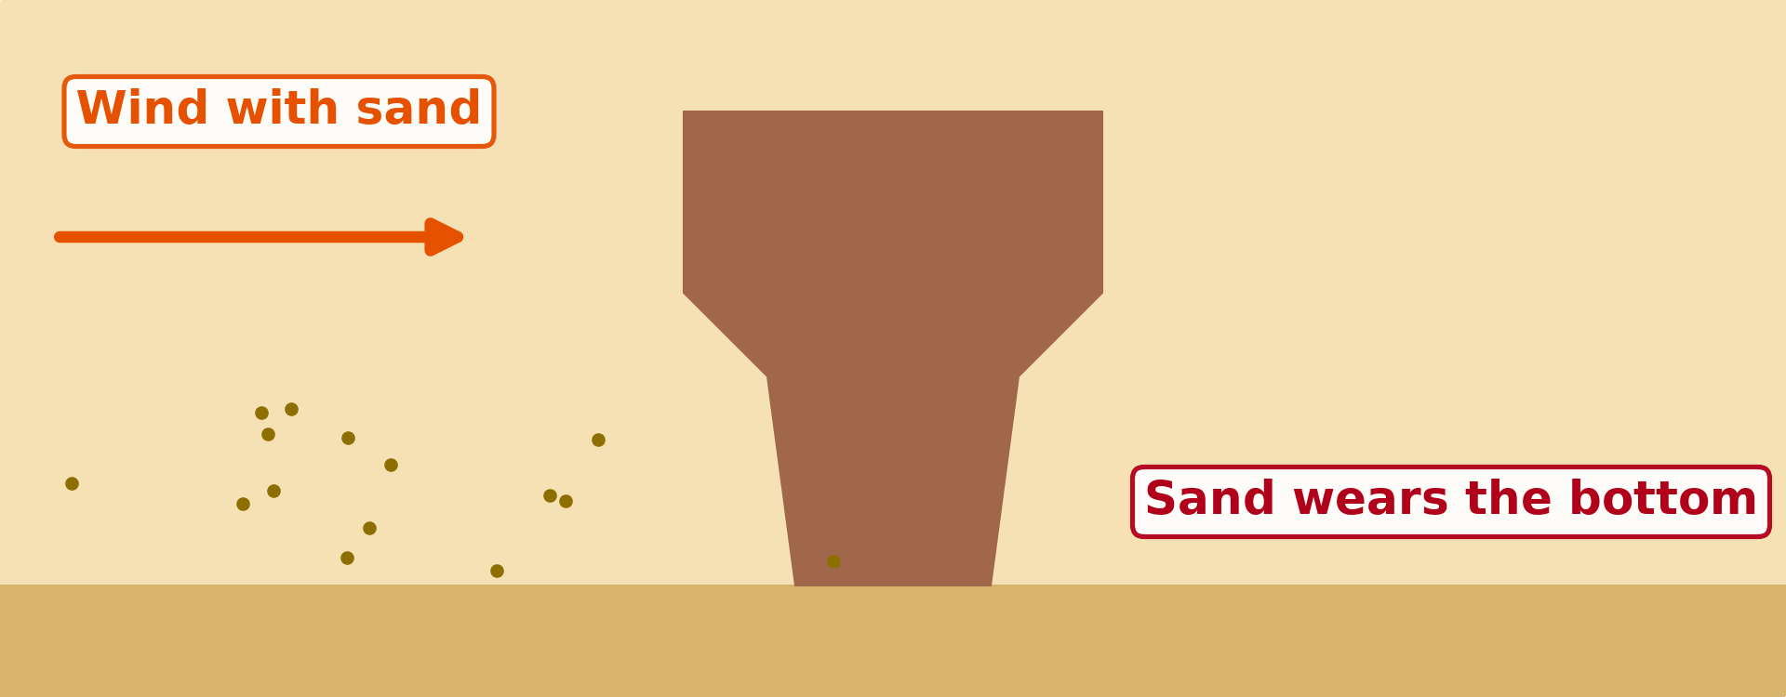
GEOGRAPHY — FORM 4
II. WIND EROSION
Activity 2
Animation: the wind throws sand against a rock.
2026 / 2027
DGCAST GAROUA — GEOGRAPHY DEPARTMENT
Mr KAMDEM E. | 17
Notes:
Without the projector: use the example of Moussa's wall.

Slide 18
GEOGRAPHY — FORM 4
II. WIND EROSION
Activity 2: Question
Why is the rock worn more at the bottom?
2026 / 2027
DGCAST GAROUA — GEOGRAPHY DEPARTMENT
Mr KAMDEM E. | 18

Slide 19
GEOGRAPHY — FORM 4
II. WIND EROSION
Answer
The wind carries most sand near the ground.
2026 / 2027
DGCAST GAROUA — GEOGRAPHY DEPARTMENT
Mr KAMDEM E. | 19

Slide 20
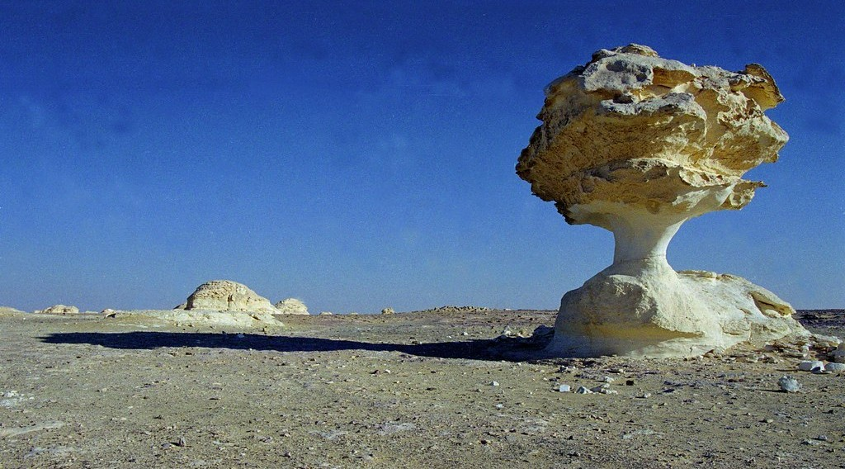
GEOGRAPHY — FORM 4
III. FEATURES
Activity 3
A rock worn by the wind.
2026 / 2027
DGCAST GAROUA — GEOGRAPHY DEPARTMENT
Mr KAMDEM E. | 20
Notes:
Without the projector: draw a mushroom-shaped rock.

Slide 21
GEOGRAPHY — FORM 4
III. FEATURES
Activity 3: Question
This rock is narrow at the bottom and wide at the top. What is it called?
2026 / 2027
DGCAST GAROUA — GEOGRAPHY DEPARTMENT
Mr KAMDEM E. | 21

Slide 22
GEOGRAPHY — FORM 4
III. FEATURES
Answer
A rock pedestal (mushroom rock).
2026 / 2027
DGCAST GAROUA — GEOGRAPHY DEPARTMENT
Mr KAMDEM E. | 22

Slide 23
GEOGRAPHY — FORM 4
BOARD SUMMARY
Semi-Arid and Desert Landscapes
Topic: Denudation Processes, Landforms and Impacts on Man
Sub-topic: Hot Desert Landscapes: Wind Action and Human Adaptation
Lesson 27: Semi-Arid and Desert Landscapes
2026 / 2027
DGCAST GAROUA — GEOGRAPHY DEPARTMENT
Mr KAMDEM E. | 23
Notes:
Learners copy the board summary now. Give them enough time for each slide.

Slide 24
GEOGRAPHY — FORM 4
BOARD SUMMARY
I. Definitions
Semi-arid region: It is a region with 250 to 500 mm of rain per year.
Deflation: It is the removal of sand by the wind.
Abrasion: It is the wearing of rocks by sand thrown by the wind.
2026 / 2027
DGCAST GAROUA — GEOGRAPHY DEPARTMENT
Mr KAMDEM E. | 24

Slide 25
GEOGRAPHY — FORM 4
BOARD SUMMARY
II. Location
A. The Sahara: The largest hot desert.
B. The Kalahari and the Namib: In Southern Africa.
C. The Sahel: A dry belt with the Far North of Cameroon.
2026 / 2027
DGCAST GAROUA — GEOGRAPHY DEPARTMENT
Mr KAMDEM E. | 25

Slide 26
GEOGRAPHY — FORM 4
BOARD SUMMARY
III. Wind Erosion
A. Deflation: The wind removes sand.
B. Abrasion: Sand wears rocks near the ground.
C. Attrition: Grains hit each other and get smaller.
2026 / 2027
DGCAST GAROUA — GEOGRAPHY DEPARTMENT
Mr KAMDEM E. | 26

Slide 27
GEOGRAPHY — FORM 4
BOARD SUMMARY
IV. Features (1/2)
A. Rock pedestal: A mushroom-shaped rock.
B. Zeugen: Hard rock on soft rock.
C. Yardangs: Long ridges in the direction of the wind.
D. Inselberg: A lonely hill on a plain.
2026 / 2027
DGCAST GAROUA — GEOGRAPHY DEPARTMENT
Mr KAMDEM E. | 27

Slide 28
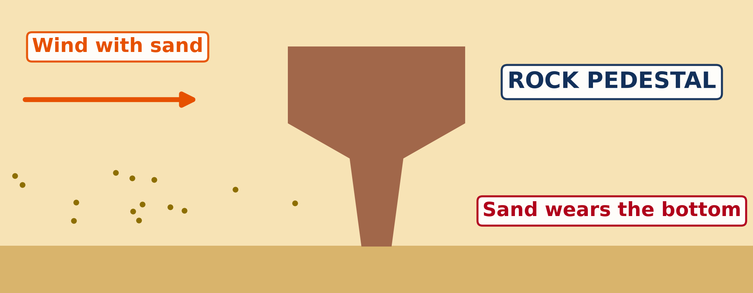
GEOGRAPHY — FORM 4
BOARD SUMMARY
IV. Features (2/2)
Copy the rock pedestal.
2026 / 2027
DGCAST GAROUA — GEOGRAPHY DEPARTMENT
Mr KAMDEM E. | 28

Slide 29
GEOGRAPHY — FORM 4
FORMATIVE EVALUATION
Formative Evaluation 1
What is abrasion?
2026 / 2027
DGCAST GAROUA — GEOGRAPHY DEPARTMENT
Mr KAMDEM E. | 29

Slide 30
GEOGRAPHY — FORM 4
FORMATIVE EVALUATION
Expected Answer
The wearing of rocks by sand thrown by the wind.
2026 / 2027
DGCAST GAROUA — GEOGRAPHY DEPARTMENT
Mr KAMDEM E. | 30

Slide 31
GEOGRAPHY — FORM 4
FORMATIVE EVALUATION
Formative Evaluation 2
Why is a rock pedestal narrow at the bottom?
2026 / 2027
DGCAST GAROUA — GEOGRAPHY DEPARTMENT
Mr KAMDEM E. | 31

Slide 32
GEOGRAPHY — FORM 4
FORMATIVE EVALUATION
Expected Answer
The wind throws most sand near the ground.
2026 / 2027
DGCAST GAROUA — GEOGRAPHY DEPARTMENT
Mr KAMDEM E. | 32

Slide 33
GEOGRAPHY — FORM 4
REMEDIATION
Remediation
Fill in the blanks:
The removal of loose sand by wind is ______.
A mushroom-shaped rock is a rock ______.
A lonely hill on a flat plain is an ______.
2026 / 2027
DGCAST GAROUA — GEOGRAPHY DEPARTMENT
Mr KAMDEM E. | 33
Notes:
Answers: 1. deflation 2. pedestal 3. inselberg

Slide 34
GEOGRAPHY — FORM 4
HOMEWORK
Homework
After the next windy day, look around your compound. Find a place where sand or dust has piled up, for example behind a wall, a stone or a bush, and write down why you think it collected there.
This prepares Lesson 28: Depositional Features of Wind Action.
2026 / 2027
DGCAST GAROUA — GEOGRAPHY DEPARTMENT
Mr KAMDEM E. | 34
Notes:
This homework prepares the next lesson.

Slide 35
GEOGRAPHY — FORM 4
BILINGUAL GAME
Bilingual Game (Jeu Bilingue)
English | Français
Desert | Le désert
Semi-arid | Semi-aride
Wind erosion | L'érosion éolienne
Deflation | La déflation
Abrasion | La corrasion
Rock pedestal | Le rocher-champignon
Inselberg | L'inselberg
Ridge | La crête
2026 / 2027
DGCAST GAROUA — GEOGRAPHY DEPARTMENT
Mr KAMDEM E. | 35
Notes:
Say the English word; learners give the French word, then the reverse.

Slide 36
GEOGRAPHY — FORM 4
LOGBOOK
Official Logbook (1/2)
Module / Topic | Denudation Processes, Landforms and Impacts on Man
Lesson Title | Lesson 27: Semi-Arid and Desert Landscapes
Expected Learning Outcomes | Locate the main hot deserts and the semi-arid Sahel on a map of Africa. Describe the three processes of wind erosion: deflation, abrasion and attrition. Explain the formation of rock pedestals, zeugen, yardangs and inselbergs.
Competence | Learners are able to locate the hot deserts of Africa on a map and recognise rocks and walls worn by the wind.
2026 / 2027
DGCAST GAROUA — GEOGRAPHY DEPARTMENT
Mr KAMDEM E. | 36

Slide 37
GEOGRAPHY — FORM 4
LOGBOOK
Official Logbook (2/2)
Matter Taught | I. Definitions: Semi-arid region, Deflation, Abrasion; II. Location: The Sahara, The Kalahari and the Namib, The Sahel; III. Wind Erosion: Deflation, Abrasion, Attrition; IV. Features: Rock pedestal, Zeugen, Yardangs, Inselberg.
Evaluation | Formative evaluation (3 questions) and remediation exercise.
Homework | After the next windy day, look around your compound. Find a place where sand or dust has piled up, for example behind a wall, a stone or a bush, and write down why you think it collected there.
Enrolment / Present / Absent | ____ / ____ / ____
Achievement | To be completed by the teacher after the lesson.
2026 / 2027
DGCAST GAROUA — GEOGRAPHY DEPARTMENT
Mr KAMDEM E. | 37

Slide 38
GEOGRAPHY — FORM 4
TEACHER'S NOTE
Teacher's Note
Timing: Set-up, recall 5 min | Situation 5 min | 3 activities 12 min | Board summary (copying) 15 min | Evaluation, homework 5 min | Logbook 5 min | Spare 3 min
Activity 2 is an animation (GIF): it plays automatically in slide-show mode.
2026 / 2027
DGCAST GAROUA — GEOGRAPHY DEPARTMENT
Mr KAMDEM E. | 38

Slide 39
GEOGRAPHY — FORM 4
REFERENCES
References
National Geography Syllabus (MINESEC), Form 4 — Denudation processes, landforms and impacts on man — Lesson 27.
Teacher's lesson notes, Lesson 27 (f4.docx).
Climate data for Garoua: Weather Spark; Mont Tinguelin: Wikipédia (fr).
Photo, Activity 3: “Stone Mushroom in White Desert. Qasr. Al-Farafra. Egypt. Free Stock Ph” by SkilledAdventurer, CC BY 2.0, via Flickr (https://www.flickr.com/photos/140589650@N06/26810236588)
Diagrams and animations: drawn for this lesson (DGCAST Geography Department).
2026 / 2027
DGCAST GAROUA — GEOGRAPHY DEPARTMENT
Mr KAMDEM E. | 39

