Slide 1

DIVINE GRACE COLLEGE OF ARTS, SCIENCE AND TECHNOLOGY
(DGCAST) — GAROUA | GEOGRAPHY DEPARTMENT
FORM 4 GEOGRAPHY — LESSON 28
Depositional Features of Wind Action
Mr KAMDEM EMMANUEL
Geography Teacher — PLEG
Academic Year 2026 / 2027
Notes:
Good morning, class. In Lesson 27 we saw how the wind erodes. Today, in Lesson 28, we see what the wind builds when it drops its sand.

Slide 2
GEOGRAPHY — FORM 4
CLASS INFO
Class, Chapter & Duration
Class | Form 4
Chapter | Denudation Processes, Landforms and Impacts on Man — Hot Desert Landscapes: Wind Action and Human Adaptation
Duration | 50 minutes
2026 / 2027
DGCAST GAROUA — GEOGRAPHY DEPARTMENT
Mr KAMDEM E. | 2

Slide 3
GEOGRAPHY — FORM 4
IDENTIFICATION
Lesson Identification
Topic | Denudation Processes, Landforms and Impacts on Man
Sub-topic | Hot Desert Landscapes: Wind Action and Human Adaptation
Lesson | Lesson 28: Depositional Features of Wind Action
Notions / Concepts | Barchans and seif dunes.
Syllabus focus | Depositional features of wind action; sand dunes (barchans and seif dunes).
Competence | Learners are able to explain why sand and dust pile up behind walls, stones and bushes, and to recognise barchan and seif dunes.
2026 / 2027
DGCAST GAROUA — GEOGRAPHY DEPARTMENT
Mr KAMDEM E. | 3

Slide 4
GEOGRAPHY — FORM 4
OBJECTIVES
Learning Objectives
By the end of the lesson, the learner should be able to:
Explain why the wind deposits the sand and dust it carries.
Describe the structure and movement of a sand dune.
Distinguish between barchan and seif dunes, and define loess.
2026 / 2027
DGCAST GAROUA — GEOGRAPHY DEPARTMENT
Mr KAMDEM E. | 4

Slide 5
GEOGRAPHY — FORM 4
RECALL
Recall
Wind erodes the land by deflation, abrasion and attrition.
Wind erosion forms rock pedestals, zeugen, yardangs and inselbergs.
The sand and dust removed by the wind must be dropped somewhere.
2026 / 2027
DGCAST GAROUA — GEOGRAPHY DEPARTMENT
Mr KAMDEM E. | 5
Notes:
Check the homework: where did learners find piles of sand in their compound?

Slide 6
GEOGRAPHY — FORM 4
REAL-LIFE SITUATION
Real-Life Situation
After a windy Harmattan day, Aminatou sweeps her compound. The sand has piled up only in some places: at the foot of a wall, behind a stone and around a bush.
2026 / 2027
DGCAST GAROUA — GEOGRAPHY DEPARTMENT
Mr KAMDEM E. | 6
Notes:
Read the situation slowly, twice.

Slide 7
GEOGRAPHY — FORM 4
REAL-LIFE SITUATION
Situation — Question 1
What is the problem in the situation?
2026 / 2027
DGCAST GAROUA — GEOGRAPHY DEPARTMENT
Mr KAMDEM E. | 7

Slide 8
GEOGRAPHY — FORM 4
REAL-LIFE SITUATION
Answer
Aminatou does not know why the sand piled up in some places.
2026 / 2027
DGCAST GAROUA — GEOGRAPHY DEPARTMENT
Mr KAMDEM E. | 8

Slide 9
GEOGRAPHY — FORM 4
REAL-LIFE SITUATION
Situation — Question 2
Where did the sand pile up?
2026 / 2027
DGCAST GAROUA — GEOGRAPHY DEPARTMENT
Mr KAMDEM E. | 9

Slide 10
GEOGRAPHY — FORM 4
REAL-LIFE SITUATION
Answer
Near the wall, the stone and the bush.
2026 / 2027
DGCAST GAROUA — GEOGRAPHY DEPARTMENT
Mr KAMDEM E. | 10

Slide 11
GEOGRAPHY — FORM 4
REAL-LIFE SITUATION
Situation — Question 3
Why there?
2026 / 2027
DGCAST GAROUA — GEOGRAPHY DEPARTMENT
Mr KAMDEM E. | 11

Slide 12
GEOGRAPHY — FORM 4
REAL-LIFE SITUATION
Possible Answer
These obstacles slow the wind, so it drops the sand.
2026 / 2027
DGCAST GAROUA — GEOGRAPHY DEPARTMENT
Mr KAMDEM E. | 12

Slide 13
GEOGRAPHY — FORM 4
JUSTIFICATION
Justification of the Lesson
This lesson helps us to know the landforms made when the wind drops sand.
2026 / 2027
DGCAST GAROUA — GEOGRAPHY DEPARTMENT
Mr KAMDEM E. | 13

Slide 14
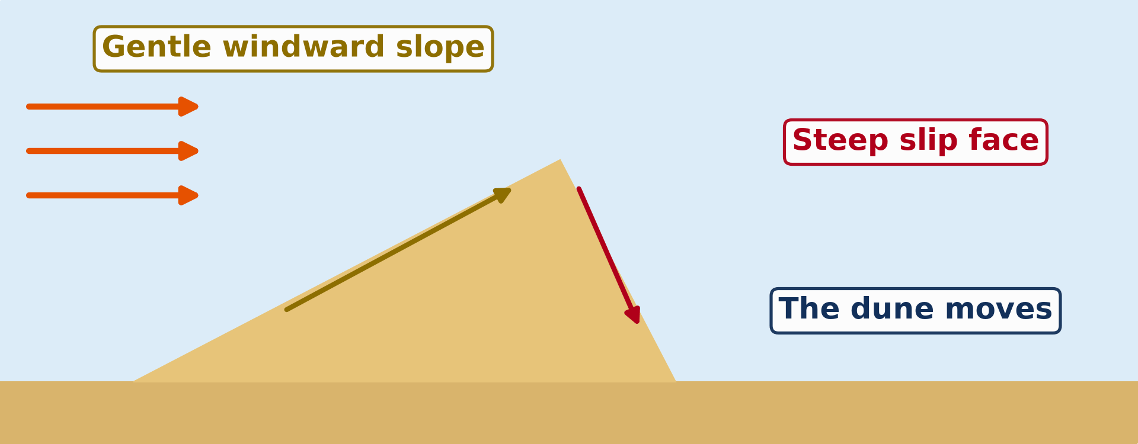
GEOGRAPHY — FORM 4
I. DUNES
Activity 1
Animation: a sand dune moves.
2026 / 2027
DGCAST GAROUA — GEOGRAPHY DEPARTMENT
Mr KAMDEM E. | 14
Notes:
Without the projector: draw a dune: a gentle slope and a steep slope.

Slide 15
GEOGRAPHY — FORM 4
I. DUNES
Activity 1: Question
Which slope faces the wind? Is it gentle or steep?
2026 / 2027
DGCAST GAROUA — GEOGRAPHY DEPARTMENT
Mr KAMDEM E. | 15

Slide 16
GEOGRAPHY — FORM 4
I. DUNES
Answer
The windward slope. It is gentle.
2026 / 2027
DGCAST GAROUA — GEOGRAPHY DEPARTMENT
Mr KAMDEM E. | 16

Slide 17
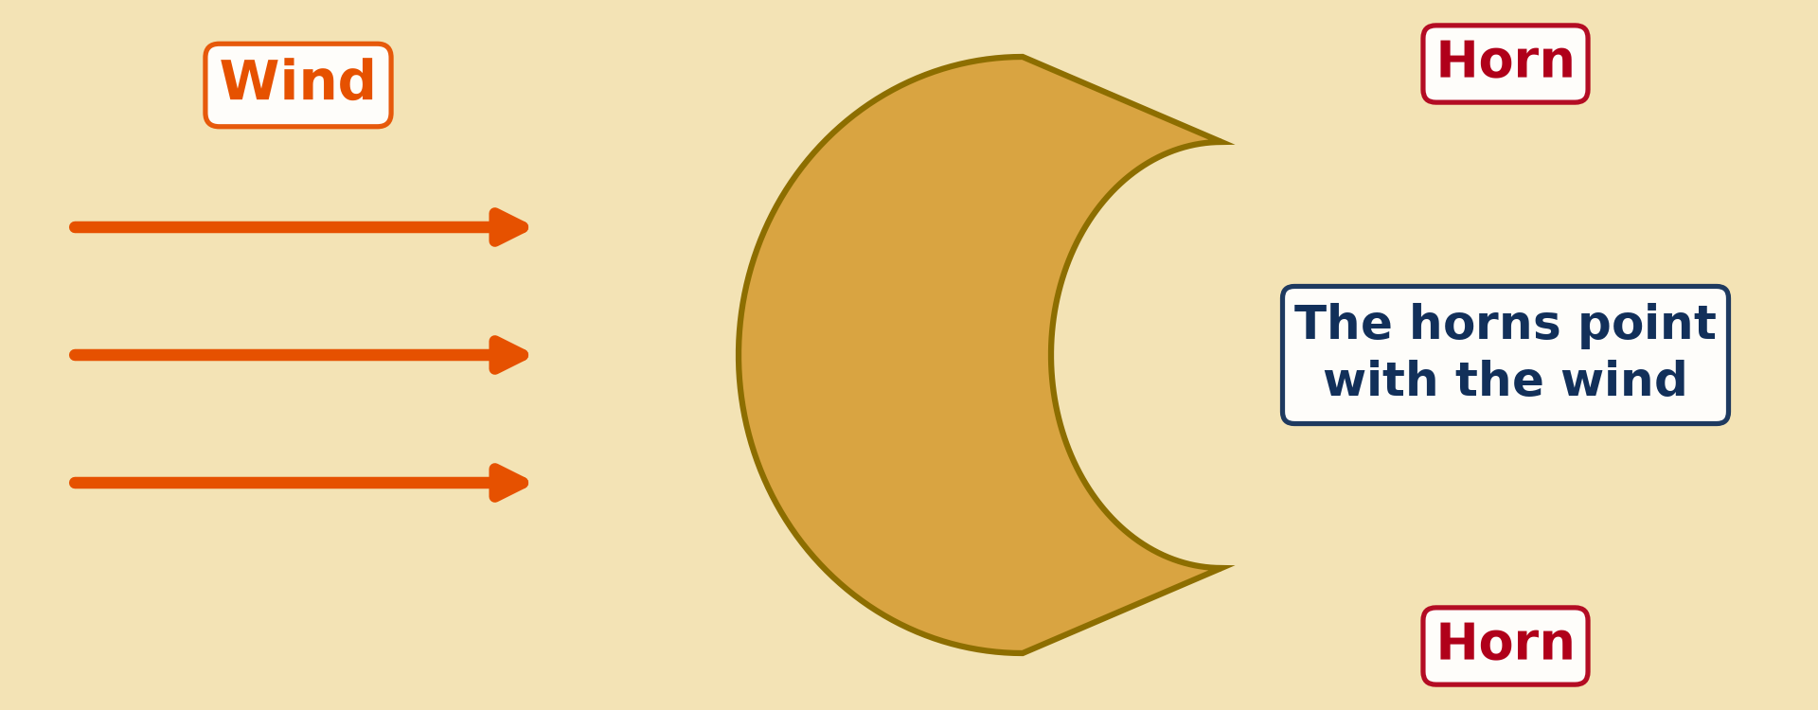
GEOGRAPHY — FORM 4
II. BARCHANS
Activity 2
A dune seen from above, shaped like a crescent (a new moon).
2026 / 2027
DGCAST GAROUA — GEOGRAPHY DEPARTMENT
Mr KAMDEM E. | 17
Notes:
Without the projector: draw a crescent with two horns.

Slide 18
GEOGRAPHY — FORM 4
II. BARCHANS
Activity 2: Question
What is this dune called?
2026 / 2027
DGCAST GAROUA — GEOGRAPHY DEPARTMENT
Mr KAMDEM E. | 18

Slide 19
GEOGRAPHY — FORM 4
II. BARCHANS
Answer
A barchan.
2026 / 2027
DGCAST GAROUA — GEOGRAPHY DEPARTMENT
Mr KAMDEM E. | 19

Slide 20
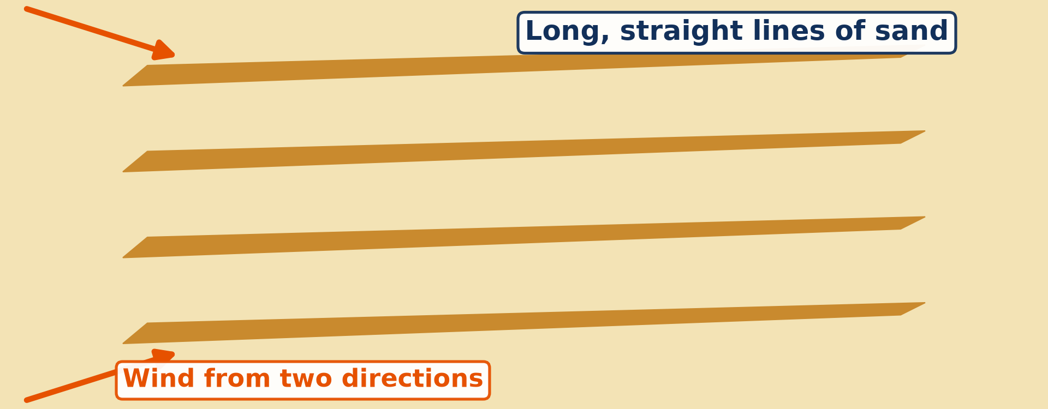
GEOGRAPHY — FORM 4
III. SEIF DUNES
Activity 3
Long, straight lines of dunes seen from above.
2026 / 2027
DGCAST GAROUA — GEOGRAPHY DEPARTMENT
Mr KAMDEM E. | 20
Notes:
Without the projector: draw long parallel lines of sand.

Slide 21
GEOGRAPHY — FORM 4
III. SEIF DUNES
Activity 3: Question
What do we call these long, narrow dunes?
2026 / 2027
DGCAST GAROUA — GEOGRAPHY DEPARTMENT
Mr KAMDEM E. | 21

Slide 22
GEOGRAPHY — FORM 4
III. SEIF DUNES
Answer
Seif dunes.
2026 / 2027
DGCAST GAROUA — GEOGRAPHY DEPARTMENT
Mr KAMDEM E. | 22

Slide 23
GEOGRAPHY — FORM 4
BOARD SUMMARY
Depositional Features of Wind Action
Topic: Denudation Processes, Landforms and Impacts on Man
Sub-topic: Hot Desert Landscapes: Wind Action and Human Adaptation
Lesson 28: Depositional Features of Wind Action
2026 / 2027
DGCAST GAROUA — GEOGRAPHY DEPARTMENT
Mr KAMDEM E. | 23
Notes:
Learners copy the board summary now. Give them enough time for each slide.

Slide 24
GEOGRAPHY — FORM 4
BOARD SUMMARY
I. Definitions
Wind deposition: It is the dropping of sand by the wind.
Sand dune: It is a hill of sand made by the wind.
Loess: It is a thick layer of fine dust.
2026 / 2027
DGCAST GAROUA — GEOGRAPHY DEPARTMENT
Mr KAMDEM E. | 24

Slide 25
GEOGRAPHY — FORM 4
BOARD SUMMARY
II. Why the Wind Drops Sand
A. Slower wind: The wind loses its force.
B. Obstacles: Walls, stones and bushes.
C. Rain: Wet sand is heavy.
2026 / 2027
DGCAST GAROUA — GEOGRAPHY DEPARTMENT
Mr KAMDEM E. | 25

Slide 26
GEOGRAPHY — FORM 4
BOARD SUMMARY
III. Features (1/2)
A. Sand dunes: Gentle windward slope, steep slip face.
B. Barchans: Crescent-shaped dunes.
C. Seif dunes: Long, straight dunes.
D. Loess: Fine dust far from the desert.
2026 / 2027
DGCAST GAROUA — GEOGRAPHY DEPARTMENT
Mr KAMDEM E. | 26

Slide 27
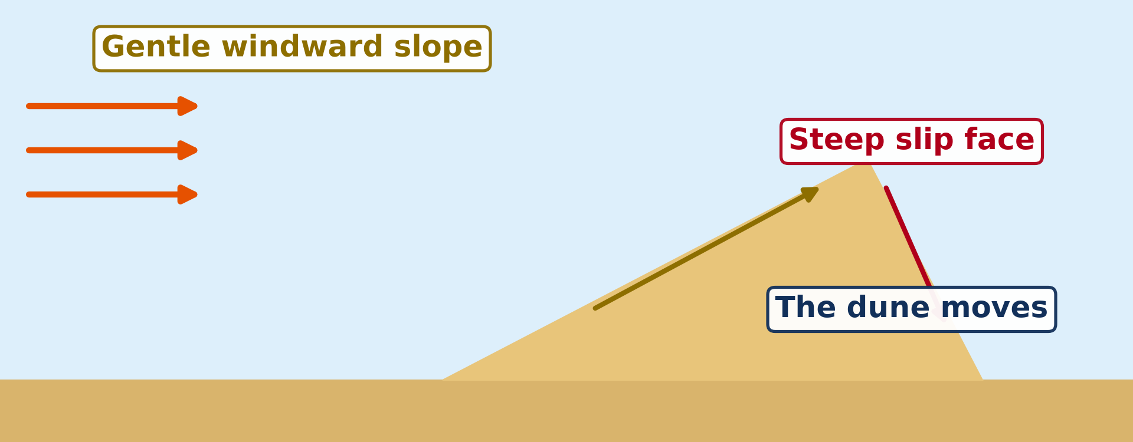
GEOGRAPHY — FORM 4
BOARD SUMMARY
III. Features (2/2)
Copy the dune and its two slopes.
2026 / 2027
DGCAST GAROUA — GEOGRAPHY DEPARTMENT
Mr KAMDEM E. | 27

Slide 28
GEOGRAPHY — FORM 4
FORMATIVE EVALUATION
Formative Evaluation 1
Why does the wind drop its sand behind a wall?
2026 / 2027
DGCAST GAROUA — GEOGRAPHY DEPARTMENT
Mr KAMDEM E. | 28

Slide 29
GEOGRAPHY — FORM 4
FORMATIVE EVALUATION
Expected Answer
The wall slows the wind.
2026 / 2027
DGCAST GAROUA — GEOGRAPHY DEPARTMENT
Mr KAMDEM E. | 29

Slide 30
GEOGRAPHY — FORM 4
FORMATIVE EVALUATION
Formative Evaluation 2
What is a barchan?
2026 / 2027
DGCAST GAROUA — GEOGRAPHY DEPARTMENT
Mr KAMDEM E. | 30

Slide 31
GEOGRAPHY — FORM 4
FORMATIVE EVALUATION
Expected Answer
A dune shaped like a crescent.
2026 / 2027
DGCAST GAROUA — GEOGRAPHY DEPARTMENT
Mr KAMDEM E. | 31

Slide 32
GEOGRAPHY — FORM 4
REMEDIATION
Remediation
Fill in the blanks:
A hill of sand made by the wind is a sand ______.
A crescent-shaped dune is a ______.
Long, straight dunes are ______ dunes.
2026 / 2027
DGCAST GAROUA — GEOGRAPHY DEPARTMENT
Mr KAMDEM E. | 32
Notes:
Answers: 1. dune 2. barchan 3. seif

Slide 33
GEOGRAPHY — FORM 4
HOMEWORK
Homework
Ask an elder in your family how people in your area cope with the heat, the dust and the shortage of water during the dry season. Write down two ways.
This prepares Lesson 29: Man in the Hot Desert Environments.
2026 / 2027
DGCAST GAROUA — GEOGRAPHY DEPARTMENT
Mr KAMDEM E. | 33
Notes:
This homework prepares the next lesson.

Slide 34
GEOGRAPHY — FORM 4
BILINGUAL GAME
Bilingual Game (Jeu Bilingue)
English | Français
Deposition | Le dépôt (l'accumulation)
Sand dune | La dune de sable
Barchan | La barkhane
Seif dune | Le sif (dune longitudinale)
Windward | Au vent
Leeward | Sous le vent
Slip face | La face d'avalanche
Loess | Le lœss
2026 / 2027
DGCAST GAROUA — GEOGRAPHY DEPARTMENT
Mr KAMDEM E. | 34
Notes:
Say the English word; learners give the French word, then the reverse.

Slide 35
GEOGRAPHY — FORM 4
LOGBOOK
Official Logbook (1/2)
Module / Topic | Denudation Processes, Landforms and Impacts on Man
Lesson Title | Lesson 28: Depositional Features of Wind Action
Expected Learning Outcomes | Explain why the wind deposits the sand and dust it carries. Describe the structure and movement of a sand dune. Distinguish between barchan and seif dunes, and define loess.
Competence | Learners are able to explain why sand and dust pile up behind walls, stones and bushes, and to recognise barchan and seif dunes.
2026 / 2027
DGCAST GAROUA — GEOGRAPHY DEPARTMENT
Mr KAMDEM E. | 35

Slide 36
GEOGRAPHY — FORM 4
LOGBOOK
Official Logbook (2/2)
Matter Taught | I. Definitions: Wind deposition, Sand dune, Loess; II. Why the Wind Drops Sand: Slower wind, Obstacles, Rain; III. Features: Sand dunes, Barchans, Seif dunes, Loess.
Evaluation | Formative evaluation (3 questions) and remediation exercise.
Homework | Ask an elder in your family how people in your area cope with the heat, the dust and the shortage of water during the dry season. Write down two ways.
Enrolment / Present / Absent | ____ / ____ / ____
Achievement | To be completed by the teacher after the lesson.
2026 / 2027
DGCAST GAROUA — GEOGRAPHY DEPARTMENT
Mr KAMDEM E. | 36

Slide 37
GEOGRAPHY — FORM 4
TEACHER'S NOTE
Teacher's Note
Timing: Set-up, recall 5 min | Situation 5 min | 3 activities 12 min | Board summary (copying) 15 min | Evaluation, homework 5 min | Logbook 5 min | Spare 3 min
Activity 1 is an animation (GIF): it plays automatically in slide-show mode.
2026 / 2027
DGCAST GAROUA — GEOGRAPHY DEPARTMENT
Mr KAMDEM E. | 37

Slide 38
GEOGRAPHY — FORM 4
REFERENCES
References
National Geography Syllabus (MINESEC), Form 4 — Denudation processes, landforms and impacts on man — Lesson 28.
Teacher's lesson notes, Lesson 28 (f4.docx).
Dune diagrams: teacher's images (dune profile, seif) and a barchan diagram redrawn with the horns pointing downwind.
Diagrams and animations: drawn for this lesson (DGCAST Geography Department).
2026 / 2027
DGCAST GAROUA — GEOGRAPHY DEPARTMENT
Mr KAMDEM E. | 38

