Slide 1

DIVINE GRACE COLLEGE OF ARTS, SCIENCE AND TECHNOLOGY
(DGCAST) — GAROUA | GEOGRAPHY DEPARTMENT
FORM 4 GEOGRAPHY — LESSON 37
Local Winds
Mr KAMDEM EMMANUEL
Geography Teacher — PLEG
Academic Year 2026 / 2027
Notes:
Good morning, class. Today we study Lesson 37: Local Winds.

Slide 2
GEOGRAPHY — FORM 4
CLASS INFO
Class, Chapter & Duration
Class | Form 4
Chapter | Module 3: Weather and Climate — Adaptation to Climatic Excesses
Duration | 50 minutes
2026 / 2027
DGCAST GAROUA — GEOGRAPHY DEPARTMENT
Mr KAMDEM E. | 2

Slide 3
GEOGRAPHY — FORM 4
IDENTIFICATION
Lesson Identification
Topic | The Earth-Atmosphere System
Sub-topic | Pressure and Winds
Lesson | Lesson 37: Local Winds
Notions / Concepts | Land and sea breezes, monsoon, mountain and valley winds.
Syllabus focus | Definition of local winds; types of local winds.
Competence | Learners are able to explain the daily change of winds at the coast and in the mountains, and to use this knowledge for fishing, farming or building.
2026 / 2027
DGCAST GAROUA — GEOGRAPHY DEPARTMENT
Mr KAMDEM E. | 3

Slide 4
GEOGRAPHY — FORM 4
OBJECTIVES
Learning Objectives
By the end of the lesson, the learner should be able to:
Define a local wind.
Explain land and sea breezes.
Explain mountain and valley breezes.
Explain the monsoon.
2026 / 2027
DGCAST GAROUA — GEOGRAPHY DEPARTMENT
Mr KAMDEM E. | 4

Slide 5
GEOGRAPHY — FORM 4
RECALL
Recall
Pressure belts are zones of high or low pressure around the Earth.
Planetary winds blow from high to low pressure, like the Trade Winds.
The rotation of the Earth deflects winds (Ferrel's law).
2026 / 2027
DGCAST GAROUA — GEOGRAPHY DEPARTMENT
Mr KAMDEM E. | 5
Notes:
Check the homework: day and night winds at the coast or in the mountains.

Slide 6
GEOGRAPHY — FORM 4
REAL-LIFE SITUATION
Real-Life Situation
In Kribi, fishermen leave the beach very early, before sunrise, and come back in the afternoon. They say the wind pushes their canoes to the sea in the morning and back to land later.
2026 / 2027
DGCAST GAROUA — GEOGRAPHY DEPARTMENT
Mr KAMDEM E. | 6
Notes:
Read the situation slowly, twice.

Slide 7
GEOGRAPHY — FORM 4
REAL-LIFE SITUATION
Situation — Question 1
What is the problem in the situation?
2026 / 2027
DGCAST GAROUA — GEOGRAPHY DEPARTMENT
Mr KAMDEM E. | 7

Slide 8
GEOGRAPHY — FORM 4
REAL-LIFE SITUATION
Answer
We want to know why the wind changes direction during the day.
2026 / 2027
DGCAST GAROUA — GEOGRAPHY DEPARTMENT
Mr KAMDEM E. | 8

Slide 9
GEOGRAPHY — FORM 4
REAL-LIFE SITUATION
Situation — Question 2
When do the fishermen leave?
2026 / 2027
DGCAST GAROUA — GEOGRAPHY DEPARTMENT
Mr KAMDEM E. | 9

Slide 10
GEOGRAPHY — FORM 4
REAL-LIFE SITUATION
Answer
Early in the morning.
2026 / 2027
DGCAST GAROUA — GEOGRAPHY DEPARTMENT
Mr KAMDEM E. | 10

Slide 11
GEOGRAPHY — FORM 4
REAL-LIFE SITUATION
Situation — Question 3
Which wind brings them back?
2026 / 2027
DGCAST GAROUA — GEOGRAPHY DEPARTMENT
Mr KAMDEM E. | 11

Slide 12
GEOGRAPHY — FORM 4
REAL-LIFE SITUATION
Possible Answer
The sea breeze in the afternoon.
2026 / 2027
DGCAST GAROUA — GEOGRAPHY DEPARTMENT
Mr KAMDEM E. | 12

Slide 13
GEOGRAPHY — FORM 4
JUSTIFICATION
Justification of the Lesson
This lesson helps us to know winds that blow over small areas.
2026 / 2027
DGCAST GAROUA — GEOGRAPHY DEPARTMENT
Mr KAMDEM E. | 13

Slide 14

GEOGRAPHY — FORM 4
I. LAND AND SEA BREEZES
Activity 1
Animation: the wind by day and by night.
2026 / 2027
DGCAST GAROUA — GEOGRAPHY DEPARTMENT
Mr KAMDEM E. | 14
Notes:
Without the projector: draw the sea and the land with arrows.

Slide 15
GEOGRAPHY — FORM 4
I. LAND AND SEA BREEZES
Activity 1: Question
By day, does the wind blow from the sea or from the land? And at night?
2026 / 2027
DGCAST GAROUA — GEOGRAPHY DEPARTMENT
Mr KAMDEM E. | 15

Slide 16
GEOGRAPHY — FORM 4
I. LAND AND SEA BREEZES
Answer
Day: from the sea (sea breeze). Night: from the land (land breeze).
2026 / 2027
DGCAST GAROUA — GEOGRAPHY DEPARTMENT
Mr KAMDEM E. | 16

Slide 17

GEOGRAPHY — FORM 4
I. LAND AND SEA BREEZES
Activity 2
Fishermen in canoes.
2026 / 2027
DGCAST GAROUA — GEOGRAPHY DEPARTMENT
Mr KAMDEM E. | 17
Notes:
Without the projector: use the situation of Kribi.

Slide 18
GEOGRAPHY — FORM 4
I. LAND AND SEA BREEZES
Activity 2: Question
Why do fishermen leave early in the morning?
2026 / 2027
DGCAST GAROUA — GEOGRAPHY DEPARTMENT
Mr KAMDEM E. | 18

Slide 19
GEOGRAPHY — FORM 4
I. LAND AND SEA BREEZES
Answer
The land breeze pushes the canoes to the sea.
2026 / 2027
DGCAST GAROUA — GEOGRAPHY DEPARTMENT
Mr KAMDEM E. | 19

Slide 20
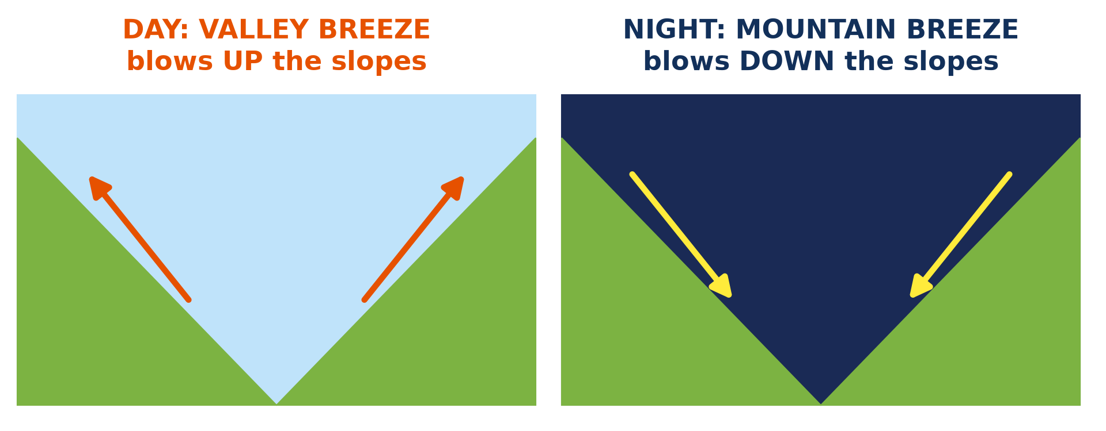
GEOGRAPHY — FORM 4
II. MOUNTAIN AND VALLEY BREEZES
Activity 3
Winds in a valley by day and by night.
2026 / 2027
DGCAST GAROUA — GEOGRAPHY DEPARTMENT
Mr KAMDEM E. | 20
Notes:
Without the projector: mention the Mandara Mountains near Mokolo.

Slide 21
GEOGRAPHY — FORM 4
II. MOUNTAIN AND VALLEY BREEZES
Activity 3: Question
Which wind blows up the slopes by day?
2026 / 2027
DGCAST GAROUA — GEOGRAPHY DEPARTMENT
Mr KAMDEM E. | 21

Slide 22
GEOGRAPHY — FORM 4
II. MOUNTAIN AND VALLEY BREEZES
Answer
The valley breeze.
2026 / 2027
DGCAST GAROUA — GEOGRAPHY DEPARTMENT
Mr KAMDEM E. | 22

Slide 23
GEOGRAPHY — FORM 4
BOARD SUMMARY
Local Winds
Topic: The Earth-Atmosphere System
Sub-topic: Pressure and Winds
Lesson 37: Local Winds
2026 / 2027
DGCAST GAROUA — GEOGRAPHY DEPARTMENT
Mr KAMDEM E. | 23
Notes:
Learners copy the board summary now. Give them enough time for each slide.

Slide 24
GEOGRAPHY — FORM 4
BOARD SUMMARY
I. Definitions
Local wind: It is a wind that blows over a small area.
Sea breeze: It is a wind from the sea by day.
Land breeze: It is a wind from the land at night.
2026 / 2027
DGCAST GAROUA — GEOGRAPHY DEPARTMENT
Mr KAMDEM E. | 24

Slide 25
GEOGRAPHY — FORM 4
BOARD SUMMARY
II. Types of Local Winds (1/2)
A. Sea breeze: By day, the land is hotter.
B. Land breeze: At night, the sea is warmer.
C. Valley breeze: Up the slopes by day.
D. Mountain breeze: Down the slopes at night.
2026 / 2027
DGCAST GAROUA — GEOGRAPHY DEPARTMENT
Mr KAMDEM E. | 25

Slide 26
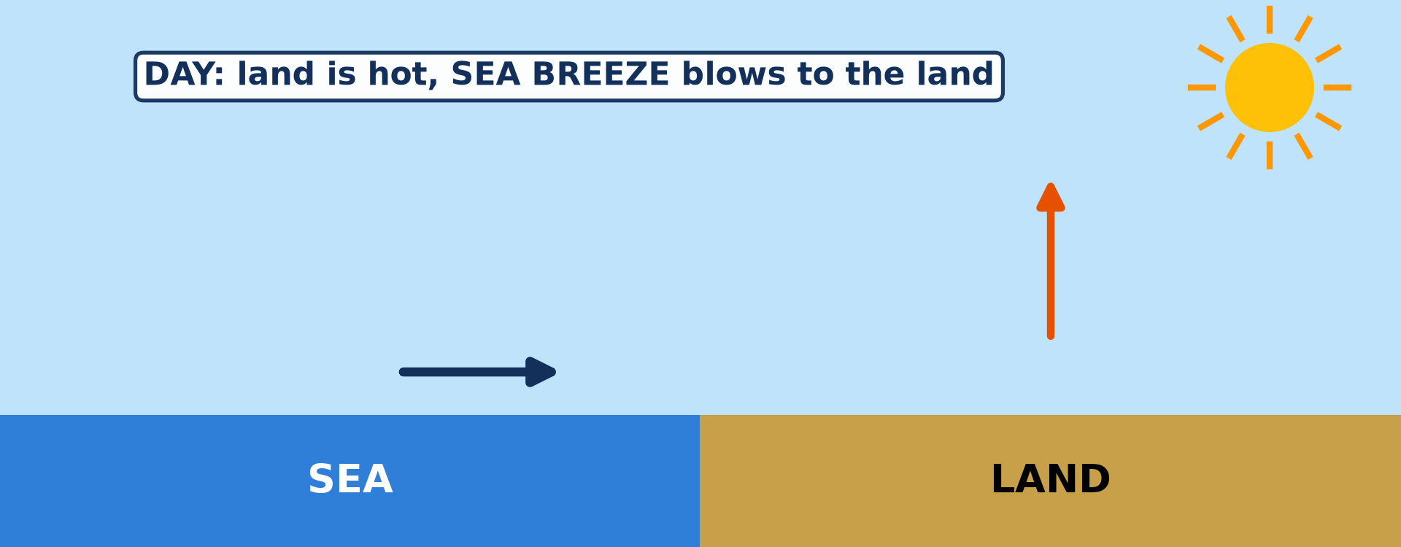
GEOGRAPHY — FORM 4
BOARD SUMMARY
II. Types of Local Winds (2/2)
Copy the sea breeze.
2026 / 2027
DGCAST GAROUA — GEOGRAPHY DEPARTMENT
Mr KAMDEM E. | 26

Slide 27
GEOGRAPHY — FORM 4
FORMATIVE EVALUATION
Formative Evaluation 1
Why does the sea breeze blow by day?
2026 / 2027
DGCAST GAROUA — GEOGRAPHY DEPARTMENT
Mr KAMDEM E. | 27

Slide 28
GEOGRAPHY — FORM 4
FORMATIVE EVALUATION
Expected Answer
The land heats faster than the sea.
2026 / 2027
DGCAST GAROUA — GEOGRAPHY DEPARTMENT
Mr KAMDEM E. | 28

Slide 29
GEOGRAPHY — FORM 4
FORMATIVE EVALUATION
Formative Evaluation 2
Which wind blows down the slopes at night?
2026 / 2027
DGCAST GAROUA — GEOGRAPHY DEPARTMENT
Mr KAMDEM E. | 29

Slide 30
GEOGRAPHY — FORM 4
FORMATIVE EVALUATION
Expected Answer
The mountain breeze.
2026 / 2027
DGCAST GAROUA — GEOGRAPHY DEPARTMENT
Mr KAMDEM E. | 30

Slide 31
GEOGRAPHY — FORM 4
REMEDIATION
Remediation
Fill in the blanks:
By day, the ______ breeze blows from the sea.
At night, the ______ breeze blows from the land.
The wind that blows up the slopes by day is the ______ breeze.
2026 / 2027
DGCAST GAROUA — GEOGRAPHY DEPARTMENT
Mr KAMDEM E. | 31
Notes:
Answers: 1. sea 2. land 3. valley

Slide 32
GEOGRAPHY — FORM 4
HOMEWORK
Homework
Compare the temperature of Garoua with that of Ngaoundéré (ask an adult who has travelled there). Write one sentence to say which town is cooler and one possible reason.
This prepares Lesson 38: Factors of Temperature.
2026 / 2027
DGCAST GAROUA — GEOGRAPHY DEPARTMENT
Mr KAMDEM E. | 32
Notes:
This homework prepares the next lesson.

Slide 33
GEOGRAPHY — FORM 4
BILINGUAL GAME
Bilingual Game (Jeu Bilingue)
English | Français
Local wind | Le vent local
Sea breeze | La brise de mer
Land breeze | La brise de terre
Valley breeze | La brise de vallée
Mountain breeze | La brise de montagne
Monsoon | La mousson
Slope | La pente
Coast | La côte
2026 / 2027
DGCAST GAROUA — GEOGRAPHY DEPARTMENT
Mr KAMDEM E. | 33
Notes:
Say the English word; learners give the French word, then the reverse.

Slide 34
GEOGRAPHY — FORM 4
LOGBOOK
Official Logbook (1/2)
Module / Topic | The Earth-Atmosphere System
Lesson Title | Lesson 37: Local Winds
Expected Learning Outcomes | Define a local wind. Explain land and sea breezes. Explain mountain and valley breezes. Explain the monsoon.
Competence | Learners are able to explain the daily change of winds at the coast and in the mountains, and to use this knowledge for fishing, farming or building.
2026 / 2027
DGCAST GAROUA — GEOGRAPHY DEPARTMENT
Mr KAMDEM E. | 34

Slide 35
GEOGRAPHY — FORM 4
LOGBOOK
Official Logbook (2/2)
Matter Taught | I. Definitions: Local wind, Sea breeze, Land breeze; II. Types of Local Winds: Sea breeze, Land breeze, Valley breeze, Mountain breeze.
Evaluation | Formative evaluation (3 questions) and remediation exercise.
Homework | Compare the temperature of Garoua with that of Ngaoundéré (ask an adult who has travelled there). Write one sentence to say which town is cooler and one possible reason.
Enrolment / Present / Absent | ____ / ____ / ____
Achievement | To be completed by the teacher after the lesson.
2026 / 2027
DGCAST GAROUA — GEOGRAPHY DEPARTMENT
Mr KAMDEM E. | 35

Slide 36
GEOGRAPHY — FORM 4
TEACHER'S NOTE
Teacher's Note
Timing: Set-up, recall 5 min | Situation 5 min | 3 activities 12 min | Board summary (copying) 15 min | Evaluation, homework 5 min | Logbook 5 min | Spare 3 min
Activity 1 is an animation (GIF): it plays automatically in slide-show mode.
2026 / 2027
DGCAST GAROUA — GEOGRAPHY DEPARTMENT
Mr KAMDEM E. | 36

Slide 37
GEOGRAPHY — FORM 4
REFERENCES
References
National Geography Syllabus (MINESEC), Form 4 — Module 3: Weather and Climate.
Teacher's lesson notes (f4.docx), checked and corrected where necessary.
Photo, Activity 2: “Fishermen, Lake Tana” by A.Davey, CC BY 2.0, via Flickr (https://www.flickr.com/photos/40595948@N00/2260748777)
Diagrams and animations: drawn for this lesson (DGCAST Geography Department).
2026 / 2027
DGCAST GAROUA — GEOGRAPHY DEPARTMENT
Mr KAMDEM E. | 37

