Slide 1

DIVINE GRACE COLLEGE OF ARTS, SCIENCE AND TECHNOLOGY
(DGCAST) — GAROUA | GEOGRAPHY DEPARTMENT
FORM 4 GEOGRAPHY — LESSON 42
Water Scarcity
Mr KAMDEM EMMANUEL
Geography Teacher — PLEG
Academic Year 2026 / 2027
Notes:
Good morning, class. Today we study Lesson 42: Water Scarcity.

Slide 2
GEOGRAPHY — FORM 4
CLASS INFO
Class, Chapter & Duration
Class | Form 4
Chapter | Module 3: Weather and Climate — Adaptation to Climatic Excesses
Duration | 50 minutes
2026 / 2027
DGCAST GAROUA — GEOGRAPHY DEPARTMENT
Mr KAMDEM E. | 2

Slide 3
GEOGRAPHY — FORM 4
IDENTIFICATION
Lesson Identification
Topic | Management of Climate and Hydrological Related Hazards
Sub-topic | Hydro-climatic Hazards
Lesson | Lesson 42: Water Scarcity
Notions / Concepts | Water stress, storage tanks, boreholes, dams, reservoirs.
Syllabus focus | Meaning; causes; effects; water conservation methods.
Competence | Learners are able to save water at home and at school, and to collect and store rainwater for the dry season.
2026 / 2027
DGCAST GAROUA — GEOGRAPHY DEPARTMENT
Mr KAMDEM E. | 3

Slide 4
GEOGRAPHY — FORM 4
OBJECTIVES
Learning Objectives
By the end of the lesson, the learner should be able to:
Define water scarcity and water stress.
Explain the causes of water scarcity.
Describe its effects.
Describe methods of water conservation.
2026 / 2027
DGCAST GAROUA — GEOGRAPHY DEPARTMENT
Mr KAMDEM E. | 4

Slide 5
GEOGRAPHY — FORM 4
RECALL
Recall
Floods cover dry land; droughts are long periods of low rainfall.
Desertification turns dry land into desert.
Storing water helps people to face droughts.
2026 / 2027
DGCAST GAROUA — GEOGRAPHY DEPARTMENT
Mr KAMDEM E. | 5
Notes:
Check the homework: water used by the family in one day.

Slide 6
GEOGRAPHY — FORM 4
REAL-LIFE SITUATION
Real-Life Situation
Every year in March, the taps in Aminatou's neighbourhood run dry for several days. Women and children queue for hours at the borehole, and water sellers raise their prices.
2026 / 2027
DGCAST GAROUA — GEOGRAPHY DEPARTMENT
Mr KAMDEM E. | 6
Notes:
Read the situation slowly, twice.

Slide 7
GEOGRAPHY — FORM 4
REAL-LIFE SITUATION
Situation — Question 1
What is the problem in the situation?
2026 / 2027
DGCAST GAROUA — GEOGRAPHY DEPARTMENT
Mr KAMDEM E. | 7

Slide 8
GEOGRAPHY — FORM 4
REAL-LIFE SITUATION
Answer
There is not enough water in March.
2026 / 2027
DGCAST GAROUA — GEOGRAPHY DEPARTMENT
Mr KAMDEM E. | 8

Slide 9
GEOGRAPHY — FORM 4
REAL-LIFE SITUATION
Situation — Question 2
What do the people do?
2026 / 2027
DGCAST GAROUA — GEOGRAPHY DEPARTMENT
Mr KAMDEM E. | 9

Slide 10
GEOGRAPHY — FORM 4
REAL-LIFE SITUATION
Answer
They queue at the borehole or buy water.
2026 / 2027
DGCAST GAROUA — GEOGRAPHY DEPARTMENT
Mr KAMDEM E. | 10

Slide 11
GEOGRAPHY — FORM 4
REAL-LIFE SITUATION
Situation — Question 3
What can families do?
2026 / 2027
DGCAST GAROUA — GEOGRAPHY DEPARTMENT
Mr KAMDEM E. | 11

Slide 12
GEOGRAPHY — FORM 4
REAL-LIFE SITUATION
Possible Answer
Store rain water and save water.
2026 / 2027
DGCAST GAROUA — GEOGRAPHY DEPARTMENT
Mr KAMDEM E. | 12

Slide 13
GEOGRAPHY — FORM 4
JUSTIFICATION
Justification of the Lesson
This lesson helps us to understand water scarcity and how to save water.
2026 / 2027
DGCAST GAROUA — GEOGRAPHY DEPARTMENT
Mr KAMDEM E. | 13

Slide 14

GEOGRAPHY — FORM 4
I. MEANING
Activity 1
Children fetch water at a hand pump.
2026 / 2027
DGCAST GAROUA — GEOGRAPHY DEPARTMENT
Mr KAMDEM E. | 14
Notes:
Without the projector: use the situation of Aminatou.

Slide 15
GEOGRAPHY — FORM 4
I. MEANING
Activity 1: Question
There is not enough clean water for everyone. What is this situation called?
2026 / 2027
DGCAST GAROUA — GEOGRAPHY DEPARTMENT
Mr KAMDEM E. | 15

Slide 16
GEOGRAPHY — FORM 4
I. MEANING
Answer
Water scarcity.
2026 / 2027
DGCAST GAROUA — GEOGRAPHY DEPARTMENT
Mr KAMDEM E. | 16

Slide 17
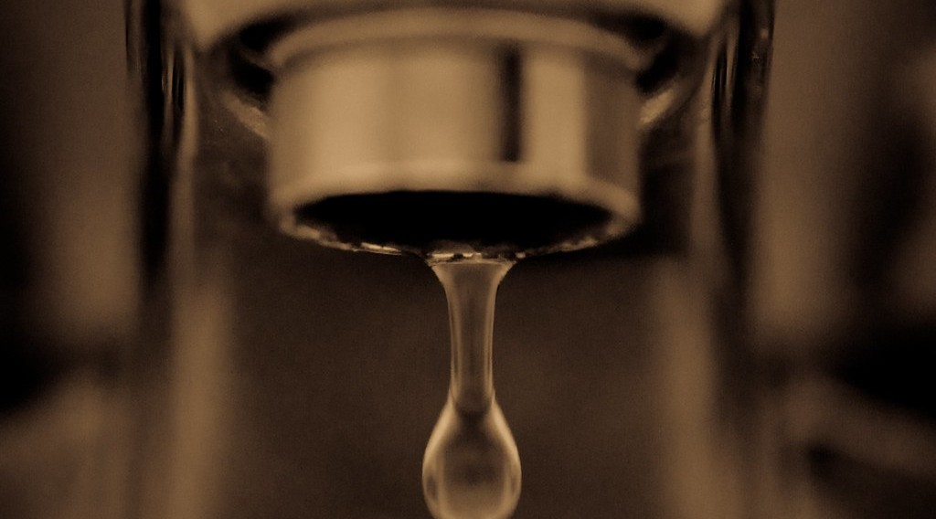
GEOGRAPHY — FORM 4
II. CAUSES
Activity 2
A tap that leaks.
2026 / 2027
DGCAST GAROUA — GEOGRAPHY DEPARTMENT
Mr KAMDEM E. | 17
Notes:
Without the projector: ask learners where water is wasted at school.

Slide 18
GEOGRAPHY — FORM 4
II. CAUSES
Activity 2: Question
Give one human cause of water scarcity.
2026 / 2027
DGCAST GAROUA — GEOGRAPHY DEPARTMENT
Mr KAMDEM E. | 18

Slide 19
GEOGRAPHY — FORM 4
II. CAUSES
Answer
Wasting water (leaks) or too many people.
2026 / 2027
DGCAST GAROUA — GEOGRAPHY DEPARTMENT
Mr KAMDEM E. | 19

Slide 20
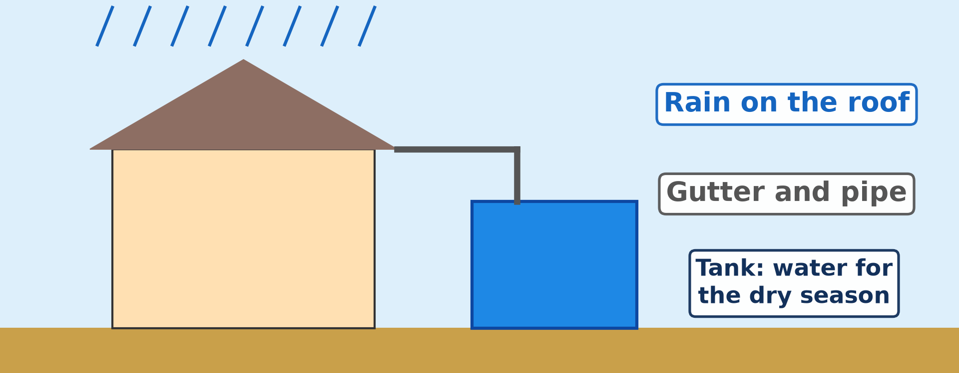
GEOGRAPHY — FORM 4
III. CONSERVATION
Activity 3
Collecting rain water.
2026 / 2027
DGCAST GAROUA — GEOGRAPHY DEPARTMENT
Mr KAMDEM E. | 20
Notes:
Without the projector: draw a house, a pipe and a tank.

Slide 21
GEOGRAPHY — FORM 4
III. CONSERVATION
Activity 3: Question
How can a family keep water for the dry season?
2026 / 2027
DGCAST GAROUA — GEOGRAPHY DEPARTMENT
Mr KAMDEM E. | 21

Slide 22
GEOGRAPHY — FORM 4
III. CONSERVATION
Answer
Collect rain water from the roof in a tank.
2026 / 2027
DGCAST GAROUA — GEOGRAPHY DEPARTMENT
Mr KAMDEM E. | 22

Slide 23
GEOGRAPHY — FORM 4
BOARD SUMMARY
Water Scarcity
Topic: Management of Climate and Hydrological Related Hazards
Sub-topic: Hydro-climatic Hazards
Lesson 42: Water Scarcity
2026 / 2027
DGCAST GAROUA — GEOGRAPHY DEPARTMENT
Mr KAMDEM E. | 23
Notes:
Learners copy the board summary now. Give them enough time for each slide.

Slide 24
GEOGRAPHY — FORM 4
BOARD SUMMARY
I. Definitions
Water scarcity: It is when there is not enough clean water.
Water conservation: It is using water carefully.
2026 / 2027
DGCAST GAROUA — GEOGRAPHY DEPARTMENT
Mr KAMDEM E. | 24

Slide 25
GEOGRAPHY — FORM 4
BOARD SUMMARY
II. Causes
A. Nature: Long dry season and droughts.
B. People: More people, waste and pollution.
C. Poor networks: Old pipes and few boreholes.
2026 / 2027
DGCAST GAROUA — GEOGRAPHY DEPARTMENT
Mr KAMDEM E. | 25

Slide 26
GEOGRAPHY — FORM 4
BOARD SUMMARY
III. Effects
A. Time: Long walks and queues.
B. Health: Cholera and diarrhoea.
C. Money: Water is expensive.
D. School: Children miss classes.
2026 / 2027
DGCAST GAROUA — GEOGRAPHY DEPARTMENT
Mr KAMDEM E. | 26

Slide 27
GEOGRAPHY — FORM 4
BOARD SUMMARY
IV. Water Conservation (1/2)
A. At home: Repair leaks and close taps.
B. Rain water: Store it in tanks.
C. Farming: Drip irrigation.
D. Big works: Dams and boreholes.
2026 / 2027
DGCAST GAROUA — GEOGRAPHY DEPARTMENT
Mr KAMDEM E. | 27

Slide 28
GEOGRAPHY — FORM 4
BOARD SUMMARY
IV. Water Conservation (2/2)
Copy rain water harvesting.
2026 / 2027
DGCAST GAROUA — GEOGRAPHY DEPARTMENT
Mr KAMDEM E. | 28

Slide 29
GEOGRAPHY — FORM 4
FORMATIVE EVALUATION
Formative Evaluation 1
Give two effects of water scarcity.
2026 / 2027
DGCAST GAROUA — GEOGRAPHY DEPARTMENT
Mr KAMDEM E. | 29

Slide 30
GEOGRAPHY — FORM 4
FORMATIVE EVALUATION
Expected Answer
Long queues and diseases like cholera.
2026 / 2027
DGCAST GAROUA — GEOGRAPHY DEPARTMENT
Mr KAMDEM E. | 30

Slide 31
GEOGRAPHY — FORM 4
FORMATIVE EVALUATION
Formative Evaluation 2
Give two ways of saving water at home.
2026 / 2027
DGCAST GAROUA — GEOGRAPHY DEPARTMENT
Mr KAMDEM E. | 31

Slide 32
GEOGRAPHY — FORM 4
FORMATIVE EVALUATION
Expected Answer
Repair leaks and close taps.
2026 / 2027
DGCAST GAROUA — GEOGRAPHY DEPARTMENT
Mr KAMDEM E. | 32

Slide 33
GEOGRAPHY — FORM 4
REMEDIATION
Remediation
Fill in the blanks:
Not enough clean water is water ______.
Using water carefully is water ______.
Rain water can be stored in a ______.
2026 / 2027
DGCAST GAROUA — GEOGRAPHY DEPARTMENT
Mr KAMDEM E. | 33
Notes:
Answers: 1. scarcity 2. conservation 3. tank

Slide 34
GEOGRAPHY — FORM 4
HOMEWORK
Homework
Revise Lessons 30 to 42. Draw one diagram of your choice (layers of the atmosphere, Stevenson screen, types of rainfall, pressure belts or water cycle) and label it.
This closes Module 3: Weather and Climate.
2026 / 2027
DGCAST GAROUA — GEOGRAPHY DEPARTMENT
Mr KAMDEM E. | 34
Notes:
This homework prepares the next lesson.

Slide 35
GEOGRAPHY — FORM 4
BILINGUAL GAME
Bilingual Game (Jeu Bilingue)
English | Français
Water scarcity | La pénurie d'eau
Water stress | Le stress hydrique
Storage tank | La citerne
Borehole | Le forage
Dam | Le barrage
Reservoir | Le réservoir
Leak | La fuite
To save water | Économiser l'eau
2026 / 2027
DGCAST GAROUA — GEOGRAPHY DEPARTMENT
Mr KAMDEM E. | 35
Notes:
Say the English word; learners give the French word, then the reverse.

Slide 36
GEOGRAPHY — FORM 4
LOGBOOK
Official Logbook (1/2)
Module / Topic | Management of Climate and Hydrological Related Hazards
Lesson Title | Lesson 42: Water Scarcity
Expected Learning Outcomes | Define water scarcity and water stress. Explain the causes of water scarcity. Describe its effects. Describe methods of water conservation.
Competence | Learners are able to save water at home and at school, and to collect and store rainwater for the dry season.
2026 / 2027
DGCAST GAROUA — GEOGRAPHY DEPARTMENT
Mr KAMDEM E. | 36

Slide 37
GEOGRAPHY — FORM 4
LOGBOOK
Official Logbook (2/2)
Matter Taught | I. Definitions: Water scarcity, Water conservation; II. Causes: Nature, People, Poor networks; III. Effects: Time, Health, Money, School; IV. Water Conservation: At home, Rain water, Farming, Big works.
Evaluation | Formative evaluation (3 questions) and remediation exercise.
Homework | Revise Lessons 30 to 42. Draw one diagram of your choice (layers of the atmosphere, Stevenson screen, types of rainfall, pressure belts or water cycle) and label it.
Enrolment / Present / Absent | ____ / ____ / ____
Achievement | To be completed by the teacher after the lesson.
2026 / 2027
DGCAST GAROUA — GEOGRAPHY DEPARTMENT
Mr KAMDEM E. | 37

Slide 38
GEOGRAPHY — FORM 4
TEACHER'S NOTE
Teacher's Note
Timing: Set-up, recall 5 min | Situation 5 min | 3 activities 12 min | Board summary (copying) 15 min | Evaluation, homework 5 min | Logbook 5 min | Spare 3 min
2026 / 2027
DGCAST GAROUA — GEOGRAPHY DEPARTMENT
Mr KAMDEM E. | 38

Slide 39
GEOGRAPHY — FORM 4
REFERENCES
References
National Geography Syllabus (MINESEC), Form 4 — Module 3: Weather and Climate.
Teacher's lesson notes (f4.docx), checked and corrected where necessary.
UN-Water: Water scarcity (Falkenmark indicator).
Photo, Activity 1: “i'll fight you for it...” by the apostrophe, CC BY-NC-SA 2.0, via Flickr (https://www.flickr.com/photos/66441426@N00/4019192363)
Photo, Activity 2: “Drip” by jronaldlee, CC BY 2.0, via Flickr (https://www.flickr.com/photos/37176760@N06/5996590138)
Diagrams and animations: drawn for this lesson (DGCAST Geography Department).
2026 / 2027
DGCAST GAROUA — GEOGRAPHY DEPARTMENT
Mr KAMDEM E. | 39

