Slide 1

DIVINE GRACE COLLEGE OF ARTS, SCIENCE AND TECHNOLOGY
(DGCAST) — GAROUA | GEOGRAPHY DEPARTMENT
FORM 4 GEOGRAPHY — PRACTICAL WORK 1
Locate a Place on a Map
Mr KAMDEM EMMANUEL
Geography Teacher — PLEG
Academic Year 2026 / 2027
Notes:
Good morning, class. Today we do Practical Work 1: we locate places on a map with their latitude and longitude. Take out your atlases, rulers and pencils.

Slide 2
GEOGRAPHY — FORM 4
CLASS INFO
Class, Chapter & Duration
Class | Form 4
Chapter | The Earth as a Planet in the Solar System — Location and Time
Duration | 50 minutes
2026 / 2027
DGCAST GAROUA — GEOGRAPHY DEPARTMENT
Mr KAMDEM E. | 2

Slide 3
GEOGRAPHY — FORM 4
IDENTIFICATION
Lesson Identification
Topic | The Earth as a Planet in the Solar System
Sub-topic | Location and Time
Lesson | Practical Work 1: Locate a Place on a Map
Notions / Concepts | Grid, coordinates, latitude, longitude.
Syllabus focus | Locating a place on a map using latitudes and longitudes; reading and writing geographical coordinates.
Competence | Learners are able to find a place on a map from its coordinates, and to give the coordinates of towns such as Garoua, Maroua and Ngaoundéré.
2026 / 2027
DGCAST GAROUA — GEOGRAPHY DEPARTMENT
Mr KAMDEM E. | 3

Slide 4
GEOGRAPHY — FORM 4
OBJECTIVES
Learning Objectives
By the end of the lesson, the learner should be able to:
Revise the meaning of latitude and longitude on a map.
Follow the steps to read the coordinates of a place.
Find a place on a map from its coordinates.
Give the coordinates of Cameroon and of some of its towns.
2026 / 2027
DGCAST GAROUA — GEOGRAPHY DEPARTMENT
Mr KAMDEM E. | 4

Slide 5
GEOGRAPHY — FORM 4
RECALL
Recall
A latitude measures the distance north or south of the Equator.
A longitude measures the distance east or west of the Prime Meridian.
We write the latitude first and the longitude second.
2026 / 2027
DGCAST GAROUA — GEOGRAPHY DEPARTMENT
Mr KAMDEM E. | 5
Notes:
Check that every pair of learners has an atlas and a ruler.

Slide 6
GEOGRAPHY — FORM 4
REAL-LIFE SITUATION
Real-Life Situation
A Red Cross team in Garoua must bring medicines to a small village. The office sends only two numbers: "10° N, 14° E". The team must find the village on their paper map.
2026 / 2027
DGCAST GAROUA — GEOGRAPHY DEPARTMENT
Mr KAMDEM E. | 6
Notes:
Read the situation slowly, twice.

Slide 7
GEOGRAPHY — FORM 4
REAL-LIFE SITUATION
Situation — Question 1
What is the problem in the situation?
2026 / 2027
DGCAST GAROUA — GEOGRAPHY DEPARTMENT
Mr KAMDEM E. | 7

Slide 8
GEOGRAPHY — FORM 4
REAL-LIFE SITUATION
Answer
The team must find a village with only two numbers.
2026 / 2027
DGCAST GAROUA — GEOGRAPHY DEPARTMENT
Mr KAMDEM E. | 8

Slide 9
GEOGRAPHY — FORM 4
REAL-LIFE SITUATION
Situation — Question 2
What do the two numbers show?
2026 / 2027
DGCAST GAROUA — GEOGRAPHY DEPARTMENT
Mr KAMDEM E. | 9

Slide 10
GEOGRAPHY — FORM 4
REAL-LIFE SITUATION
Answer
The latitude (10° N) and the longitude (14° E).
2026 / 2027
DGCAST GAROUA — GEOGRAPHY DEPARTMENT
Mr KAMDEM E. | 10

Slide 11
GEOGRAPHY — FORM 4
REAL-LIFE SITUATION
Situation — Question 3
Where are these numbers written on a map?
2026 / 2027
DGCAST GAROUA — GEOGRAPHY DEPARTMENT
Mr KAMDEM E. | 11

Slide 12
GEOGRAPHY — FORM 4
REAL-LIFE SITUATION
Possible Answer
On the sides (latitude) and the top (longitude) of the map.
2026 / 2027
DGCAST GAROUA — GEOGRAPHY DEPARTMENT
Mr KAMDEM E. | 12

Slide 13
GEOGRAPHY — FORM 4
JUSTIFICATION
Justification of the Lesson
This practical work helps us to find a place on a map with its coordinates.
2026 / 2027
DGCAST GAROUA — GEOGRAPHY DEPARTMENT
Mr KAMDEM E. | 13

Slide 14

GEOGRAPHY — FORM 4
I. REVISION
Activity 1
A map of Cameroon with a grid.
2026 / 2027
DGCAST GAROUA — GEOGRAPHY DEPARTMENT
Mr KAMDEM E. | 14
Notes:
Without the projector: draw a grid on the board and number its sides.

Slide 15
GEOGRAPHY — FORM 4
I. REVISION
Activity 1: Question
Where is the latitude written on this map? And the longitude?
2026 / 2027
DGCAST GAROUA — GEOGRAPHY DEPARTMENT
Mr KAMDEM E. | 15

Slide 16
GEOGRAPHY — FORM 4
I. REVISION
Answer
Latitude on the left side. Longitude at the top.
2026 / 2027
DGCAST GAROUA — GEOGRAPHY DEPARTMENT
Mr KAMDEM E. | 16

Slide 17
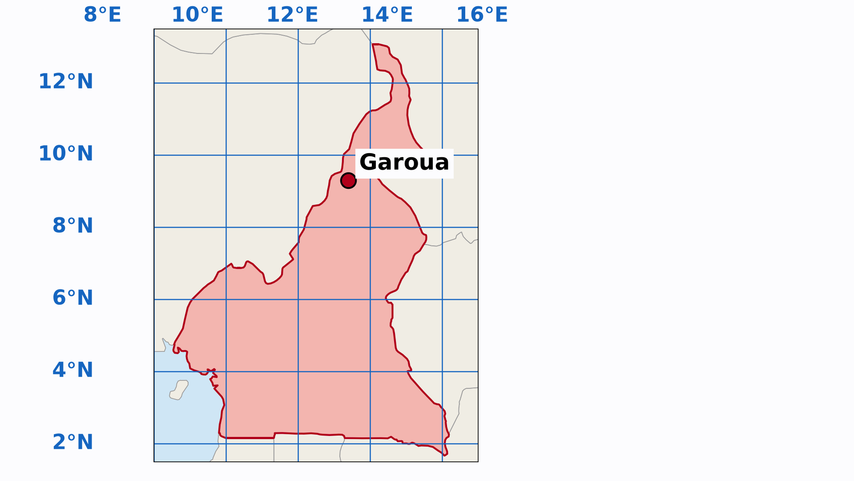
GEOGRAPHY — FORM 4
II. STEPS
Activity 2
Animation: reading the coordinates of Garoua.
2026 / 2027
DGCAST GAROUA — GEOGRAPHY DEPARTMENT
Mr KAMDEM E. | 17
Notes:
Without the projector: show the steps with a ruler on the map of the atlas.

Slide 18
GEOGRAPHY — FORM 4
II. STEPS
Activity 2: Question
What are the two steps to read the coordinates of Garoua?
2026 / 2027
DGCAST GAROUA — GEOGRAPHY DEPARTMENT
Mr KAMDEM E. | 18

Slide 19
GEOGRAPHY — FORM 4
II. STEPS
Answer
1. Go left to read the latitude: 9° N. 2. Go up to read the longitude: 13° E.
2026 / 2027
DGCAST GAROUA — GEOGRAPHY DEPARTMENT
Mr KAMDEM E. | 19

Slide 20
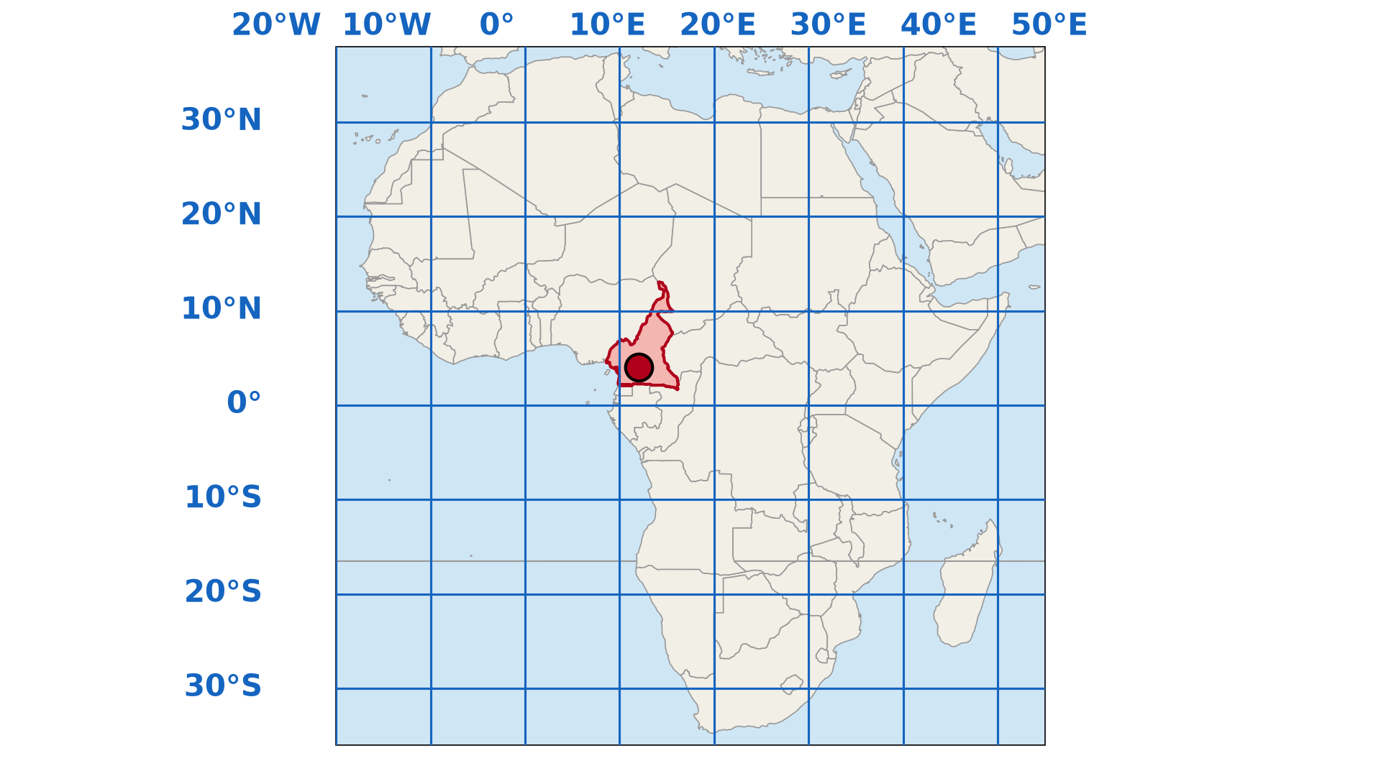
GEOGRAPHY — FORM 4
III. EXERCISE
Activity 3
Africa with a grid of 10°. Find the red dot.
2026 / 2027
DGCAST GAROUA — GEOGRAPHY DEPARTMENT
Mr KAMDEM E. | 20
Notes:
Without the projector: give learners the atlas map of Africa.

Slide 21
GEOGRAPHY — FORM 4
III. EXERCISE
Activity 3: Question
Give the coordinates of the red dot in Cameroon.
2026 / 2027
DGCAST GAROUA — GEOGRAPHY DEPARTMENT
Mr KAMDEM E. | 21

Slide 22
GEOGRAPHY — FORM 4
III. EXERCISE
Answer
About 4° N and 12° E.
2026 / 2027
DGCAST GAROUA — GEOGRAPHY DEPARTMENT
Mr KAMDEM E. | 22

Slide 23
GEOGRAPHY — FORM 4
BOARD SUMMARY
Locate a Place on a Map
Topic: The Earth as a Planet in the Solar System
Sub-topic: Location and Time
Practical Work 1: Locate a Place on a Map
2026 / 2027
DGCAST GAROUA — GEOGRAPHY DEPARTMENT
Mr KAMDEM E. | 23
Notes:
Learners copy the board summary now. Give them enough time for each slide.

Slide 24
GEOGRAPHY — FORM 4
BOARD SUMMARY
I. Definitions
Coordinates: They are the latitude and the longitude of a place.
Grid: It is the set of lines of latitude and longitude on a map.
2026 / 2027
DGCAST GAROUA — GEOGRAPHY DEPARTMENT
Mr KAMDEM E. | 24

Slide 25
GEOGRAPHY — FORM 4
BOARD SUMMARY
II. Steps to Read Coordinates (1/2)
Step 1: Find the place on the map.
Step 2: Go left and read the latitude.
Step 3: Go up and read the longitude.
Step 4: Write the latitude first: 9° N, 13° E.
2026 / 2027
DGCAST GAROUA — GEOGRAPHY DEPARTMENT
Mr KAMDEM E. | 25

Slide 26
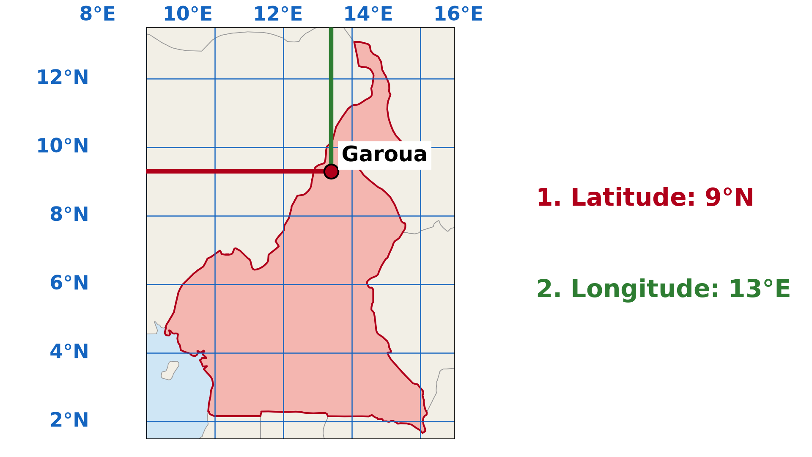
GEOGRAPHY — FORM 4
BOARD SUMMARY
II. Steps to Read Coordinates (2/2)
Copy the example of Garoua.
2026 / 2027
DGCAST GAROUA — GEOGRAPHY DEPARTMENT
Mr KAMDEM E. | 26

Slide 27
GEOGRAPHY — FORM 4
BOARD SUMMARY
III. Exercise
A. Garoua: about 9° N, 13° E.
B. Maroua: about 11° N, 14° E.
C. Yaoundé: about 4° N, 12° E.
2026 / 2027
DGCAST GAROUA — GEOGRAPHY DEPARTMENT
Mr KAMDEM E. | 27

Slide 28
GEOGRAPHY — FORM 4
FORMATIVE EVALUATION
Formative Evaluation 1
What do we read first: the latitude or the longitude?
2026 / 2027
DGCAST GAROUA — GEOGRAPHY DEPARTMENT
Mr KAMDEM E. | 28

Slide 29
GEOGRAPHY — FORM 4
FORMATIVE EVALUATION
Expected Answer
The latitude.
2026 / 2027
DGCAST GAROUA — GEOGRAPHY DEPARTMENT
Mr KAMDEM E. | 29

Slide 30
GEOGRAPHY — FORM 4
FORMATIVE EVALUATION
Formative Evaluation 2
Which town is at about 4° N, 12° E?
2026 / 2027
DGCAST GAROUA — GEOGRAPHY DEPARTMENT
Mr KAMDEM E. | 30

Slide 31
GEOGRAPHY — FORM 4
FORMATIVE EVALUATION
Expected Answer
Yaoundé.
2026 / 2027
DGCAST GAROUA — GEOGRAPHY DEPARTMENT
Mr KAMDEM E. | 31

Slide 32
GEOGRAPHY — FORM 4
REMEDIATION
Remediation
Fill in the blanks:
On a map, the latitude is read on the ______ side.
The longitude is read at the ______.
Garoua is at about 9° N and ______ ° E.
2026 / 2027
DGCAST GAROUA — GEOGRAPHY DEPARTMENT
Mr KAMDEM E. | 32
Notes:
Answers: 1. left (or right) 2. top (or bottom) 3. 13

Slide 33
GEOGRAPHY — FORM 4
HOMEWORK
Homework
Look at the time on a phone set to Cameroon time and on a phone or television showing the time in another country (for example Dubai or Brazil). Write both times and the difference.
This prepares Lesson 4: Local Time, Standard Time and Time Zones.
2026 / 2027
DGCAST GAROUA — GEOGRAPHY DEPARTMENT
Mr KAMDEM E. | 33
Notes:
This homework prepares the next lesson.

Slide 34
GEOGRAPHY — FORM 4
BILINGUAL GAME
Bilingual Game (Jeu Bilingue)
English | Français
Map | La carte
Atlas | L'atlas
Grid | La grille / le quadrillage
Edge | Le bord
Degree | Le degré
Minute (of arc) | La minute (d'angle)
Town | La ville
To locate | Localiser
2026 / 2027
DGCAST GAROUA — GEOGRAPHY DEPARTMENT
Mr KAMDEM E. | 34
Notes:
Say the English word; learners give the French word, then the reverse.

Slide 35
GEOGRAPHY — FORM 4
LOGBOOK
Official Logbook (1/2)
Module / Topic | The Earth as a Planet in the Solar System
Lesson Title | Practical Work 1: Locate a Place on a Map
Expected Learning Outcomes | Revise the meaning of latitude and longitude on a map. Follow the steps to read the coordinates of a place. Find a place on a map from its coordinates. Give the coordinates of Cameroon and of some of its towns.
Competence | Learners are able to find a place on a map from its coordinates, and to give the coordinates of towns such as Garoua, Maroua and Ngaoundéré.
2026 / 2027
DGCAST GAROUA — GEOGRAPHY DEPARTMENT
Mr KAMDEM E. | 35

Slide 36
GEOGRAPHY — FORM 4
LOGBOOK
Official Logbook (2/2)
Matter Taught | I. Definitions: Coordinates, Grid; II. Steps to Read Coordinates: Step 1, Step 2, Step 3, Step 4; III. Exercise: Garoua, Maroua, Yaoundé.
Evaluation | Formative evaluation (3 questions) and remediation exercise.
Homework | Look at the time on a phone set to Cameroon time and on a phone or television showing the time in another country (for example Dubai or Brazil). Write both times and the difference.
Enrolment / Present / Absent | ____ / ____ / ____
Achievement | To be completed by the teacher after the lesson.
2026 / 2027
DGCAST GAROUA — GEOGRAPHY DEPARTMENT
Mr KAMDEM E. | 36

Slide 37
GEOGRAPHY — FORM 4
TEACHER'S NOTE
Teacher's Note
Timing: Set-up, recall 5 min | Situation 5 min | 3 activities 12 min | Board summary (copying) 15 min | Evaluation, homework 5 min | Logbook 5 min | Spare 3 min
Activity 2 is an animation (GIF): it plays automatically in slide-show mode.
2026 / 2027
DGCAST GAROUA — GEOGRAPHY DEPARTMENT
Mr KAMDEM E. | 37

Slide 38
GEOGRAPHY — FORM 4
REFERENCES
References
National Geography Syllabus (MINESEC), Form 4 — The Earth as a Planet in the Solar System.
Teacher's lesson notes (Form 4), checked and corrected where necessary.
Diagrams and animations: drawn for this lesson (DGCAST Geography Department).
2026 / 2027
DGCAST GAROUA — GEOGRAPHY DEPARTMENT
Mr KAMDEM E. | 38

