Slide 1

DIVINE GRACE COLLEGE OF ARTS, SCIENCE AND TECHNOLOGY
(DGCAST) — GAROUA | GEOGRAPHY DEPARTMENT
LOWER SIXTH ARTS — BIOGEOGRAPHY — FURTHER STUDY 3
Ecosystem Services
Mr KAMDEM EMMANUEL
Geography Teacher — PLEG
Academic Year 2026 / 2027
Notes:
Good morning, class. Today we study Further Study 3: Ecosystem Services.

Slide 2
GEOGRAPHY — LOWER SIXTH ARTS
CLASS INFO
Class, Chapter & Duration
Class | Lower Sixth Arts
Chapter | Module 3: Understanding and managing biogeographic zones across the world in general and Cameroon in particular
Duration | 2 periods (2 × 50 minutes)
2026 / 2027
DGCAST GAROUA — GEOGRAPHY DEPARTMENT
Mr KAMDEM E. | 2

Slide 3
GEOGRAPHY — LOWER SIXTH ARTS
IDENTIFICATION
Lesson Identification
Topic | Ecological Systems (Ecosystems)
Sub-topic | Global Terrestrial Ecosystems (Biomes)
Lesson | Further Study 3: Ecosystem Services
Notions / Concepts | Ecosystem services, provisioning, regulating, cultural, supporting services.
Syllabus focus | Resources of ecosystems to man: provisioning, regulating, cultural and supporting services, with examples.
Competence | Learners are able to explain the benefits of ecosystems and why they must be protected.
2026 / 2027
DGCAST GAROUA — GEOGRAPHY DEPARTMENT
Mr KAMDEM E. | 3

Slide 4
GEOGRAPHY — LOWER SIXTH ARTS
OBJECTIVES
Learning Objectives
By the end of the lesson, the learner should be able to:
Define ecosystem services.
Explain the four types of services with examples.
Explain why ecosystem services must be protected.
2026 / 2027
DGCAST GAROUA — GEOGRAPHY DEPARTMENT
Mr KAMDEM E. | 4

Slide 5
GEOGRAPHY — LOWER SIXTH ARTS
RECALL
Recall
Ecosystems produce food and wood.
Vegetation protects soils and water.
2026 / 2027
DGCAST GAROUA — GEOGRAPHY DEPARTMENT
Mr KAMDEM E. | 5

Slide 6
GEOGRAPHY — LOWER SIXTH ARTS
REAL-LIFE SITUATION
Real-Life Situation
Villagers near Korup National Park say that the forest gives them bush mango, medicines and clean water. Tourists also pay to visit it. A logger says the forest is only useful for timber.
2026 / 2027
DGCAST GAROUA — GEOGRAPHY DEPARTMENT
Mr KAMDEM E. | 6
Notes:
Read the situation slowly, twice.

Slide 7
GEOGRAPHY — LOWER SIXTH ARTS
REAL-LIFE SITUATION
Situation — Question 1
What is the problem in the situation?
2026 / 2027
DGCAST GAROUA — GEOGRAPHY DEPARTMENT
Mr KAMDEM E. | 7

Slide 8
GEOGRAPHY — LOWER SIXTH ARTS
REAL-LIFE SITUATION
Answer
People see different benefits in the forest.
2026 / 2027
DGCAST GAROUA — GEOGRAPHY DEPARTMENT
Mr KAMDEM E. | 8

Slide 9
GEOGRAPHY — LOWER SIXTH ARTS
REAL-LIFE SITUATION
Situation — Question 2
Name three benefits the forest gives the villagers.
2026 / 2027
DGCAST GAROUA — GEOGRAPHY DEPARTMENT
Mr KAMDEM E. | 9

Slide 10
GEOGRAPHY — LOWER SIXTH ARTS
REAL-LIFE SITUATION
Answer
Food, medicines and clean water.
2026 / 2027
DGCAST GAROUA — GEOGRAPHY DEPARTMENT
Mr KAMDEM E. | 10

Slide 11
GEOGRAPHY — LOWER SIXTH ARTS
REAL-LIFE SITUATION
Situation — Question 3
What do we call these benefits?
2026 / 2027
DGCAST GAROUA — GEOGRAPHY DEPARTMENT
Mr KAMDEM E. | 11

Slide 12
GEOGRAPHY — LOWER SIXTH ARTS
REAL-LIFE SITUATION
Possible Answer
Ecosystem services.
2026 / 2027
DGCAST GAROUA — GEOGRAPHY DEPARTMENT
Mr KAMDEM E. | 12

Slide 13
GEOGRAPHY — LOWER SIXTH ARTS
JUSTIFICATION
Justification of the Lesson
This further study helps us to value all the benefits that ecosystems give us.
2026 / 2027
DGCAST GAROUA — GEOGRAPHY DEPARTMENT
Mr KAMDEM E. | 13

Slide 14
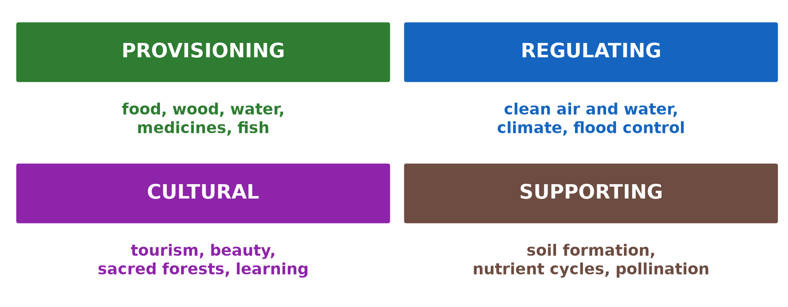
GEOGRAPHY — LOWER SIXTH ARTS
I. TYPES OF SERVICES
Activity 1
The four types of ecosystem services.
2026 / 2027
DGCAST GAROUA — GEOGRAPHY DEPARTMENT
Mr KAMDEM E. | 14
Notes:
Without the projector: draw four boxes.

Slide 15
GEOGRAPHY — LOWER SIXTH ARTS
I. TYPES OF SERVICES
Activity 1: Question
Name the four types of ecosystem services.
2026 / 2027
DGCAST GAROUA — GEOGRAPHY DEPARTMENT
Mr KAMDEM E. | 15

Slide 16
GEOGRAPHY — LOWER SIXTH ARTS
I. TYPES OF SERVICES
Answer
Provisioning, regulating, cultural and supporting.
2026 / 2027
DGCAST GAROUA — GEOGRAPHY DEPARTMENT
Mr KAMDEM E. | 16

Slide 17

GEOGRAPHY — LOWER SIXTH ARTS
II. PROVISIONING
Activity 2
A fish market.
2026 / 2027
DGCAST GAROUA — GEOGRAPHY DEPARTMENT
Mr KAMDEM E. | 17
Notes:
Without the projector: list products from forests and rivers.

Slide 18
GEOGRAPHY — LOWER SIXTH ARTS
II. PROVISIONING
Activity 2: Question
Give three provisioning services.
2026 / 2027
DGCAST GAROUA — GEOGRAPHY DEPARTMENT
Mr KAMDEM E. | 18

Slide 19
GEOGRAPHY — LOWER SIXTH ARTS
II. PROVISIONING
Answer
Food (fish, fruit), wood and water (also medicines).
2026 / 2027
DGCAST GAROUA — GEOGRAPHY DEPARTMENT
Mr KAMDEM E. | 19

Slide 20
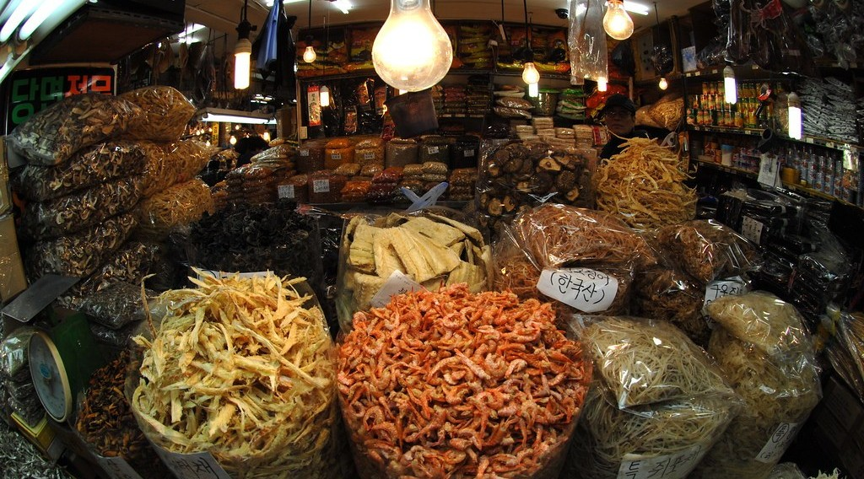
GEOGRAPHY — LOWER SIXTH ARTS
II. PROVISIONING
Activity 3
Dried medicinal plants for sale in a market (Seoul).
2026 / 2027
DGCAST GAROUA — GEOGRAPHY DEPARTMENT
Mr KAMDEM E. | 20
Notes:
Without the projector: name local medicinal plants.

Slide 21
GEOGRAPHY — LOWER SIXTH ARTS
II. PROVISIONING
Activity 3: Question
Why are ecosystems important for medicines?
2026 / 2027
DGCAST GAROUA — GEOGRAPHY DEPARTMENT
Mr KAMDEM E. | 21

Slide 22
GEOGRAPHY — LOWER SIXTH ARTS
II. PROVISIONING
Answer
Many medicines come from plants and animals.
2026 / 2027
DGCAST GAROUA — GEOGRAPHY DEPARTMENT
Mr KAMDEM E. | 22

Slide 23
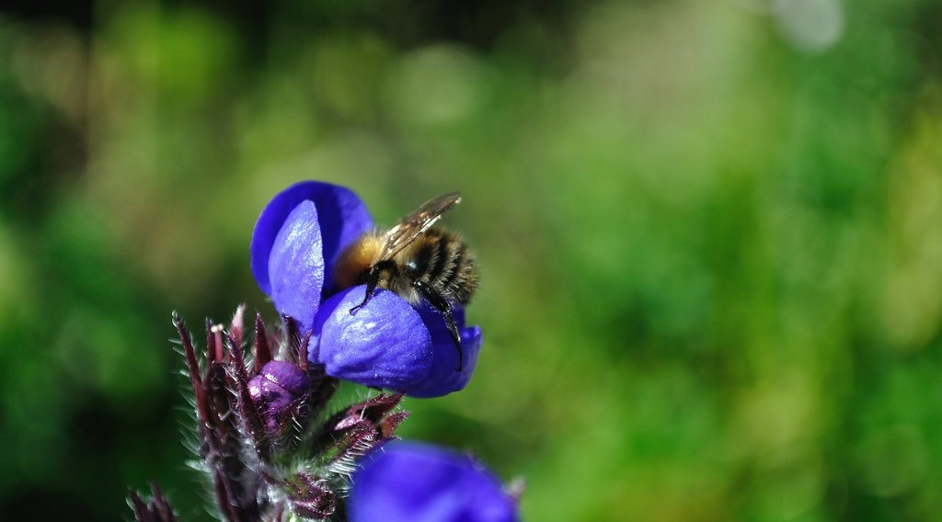
GEOGRAPHY — LOWER SIXTH ARTS
III. SUPPORTING
Activity 4
A bee pollinating a flower.
2026 / 2027
DGCAST GAROUA — GEOGRAPHY DEPARTMENT
Mr KAMDEM E. | 23
Notes:
Without the projector: explain pollination.

Slide 24
GEOGRAPHY — LOWER SIXTH ARTS
III. SUPPORTING
Activity 4: Question
Which service does the bee give to farmers?
2026 / 2027
DGCAST GAROUA — GEOGRAPHY DEPARTMENT
Mr KAMDEM E. | 24

Slide 25
GEOGRAPHY — LOWER SIXTH ARTS
III. SUPPORTING
Answer
Pollination (a supporting service).
2026 / 2027
DGCAST GAROUA — GEOGRAPHY DEPARTMENT
Mr KAMDEM E. | 25

Slide 26

GEOGRAPHY — LOWER SIXTH ARTS
IV. CULTURAL
Activity 5
A leopard seen on a safari drive.
2026 / 2027
DGCAST GAROUA — GEOGRAPHY DEPARTMENT
Mr KAMDEM E. | 26
Notes:
Without the projector: mention Waza and Limbe.

Slide 27
GEOGRAPHY — LOWER SIXTH ARTS
IV. CULTURAL
Activity 5: Question
Give two cultural services of ecosystems.
2026 / 2027
DGCAST GAROUA — GEOGRAPHY DEPARTMENT
Mr KAMDEM E. | 27

Slide 28
GEOGRAPHY — LOWER SIXTH ARTS
IV. CULTURAL
Answer
Tourism and recreation (also sacred forests, education).
2026 / 2027
DGCAST GAROUA — GEOGRAPHY DEPARTMENT
Mr KAMDEM E. | 28

Slide 29
GEOGRAPHY — LOWER SIXTH ARTS
BOARD SUMMARY
Ecosystem Services
Topic: Ecological Systems (Ecosystems)
Sub-topic: Global Terrestrial Ecosystems (Biomes)
Further Study 3: Ecosystem Services
2026 / 2027
DGCAST GAROUA — GEOGRAPHY DEPARTMENT
Mr KAMDEM E. | 29
Notes:
Learners copy the board summary now. Give them enough time for each slide.

Slide 30
GEOGRAPHY — LOWER SIXTH ARTS
BOARD SUMMARY
I. Definitions
Ecosystem services: They are the benefits that people get from ecosystems.
Pollination: It is the transfer of pollen that allows plants to make fruit and seeds.
Sacred forest: It is a forest protected for religious or traditional reasons.
2026 / 2027
DGCAST GAROUA — GEOGRAPHY DEPARTMENT
Mr KAMDEM E. | 30

Slide 31
GEOGRAPHY — LOWER SIXTH ARTS
BOARD SUMMARY
II. The Four Services (1/2)
A. Provisioning services: Ecosystems give food, wood, fibre, water and medicines. Forests, rivers and the sea feed millions of people.
B. Regulating services: Forests clean the air, store carbon and regulate climate. Wetlands and mangroves control floods and clean water.
2026 / 2027
DGCAST GAROUA — GEOGRAPHY DEPARTMENT
Mr KAMDEM E. | 31

Slide 32
GEOGRAPHY — LOWER SIXTH ARTS
BOARD SUMMARY
II. The Four Services (2/2)
C. Cultural services: Ecosystems give beauty, tourism, recreation and education. Sacred forests keep cultural traditions alive.
D. Supporting services: Soil formation, nutrient cycling and pollination support all other services. Without them there would be no food.
2026 / 2027
DGCAST GAROUA — GEOGRAPHY DEPARTMENT
Mr KAMDEM E. | 32

Slide 33
GEOGRAPHY — LOWER SIXTH ARTS
BOARD SUMMARY
III. Protecting Services (1/2)
A. Threats: Deforestation, pollution and overexploitation reduce services. The loss is often seen only when it is too late.
B. Measures: Parks, reserves and sustainable use protect ecosystems. Local people should share the benefits.
2026 / 2027
DGCAST GAROUA — GEOGRAPHY DEPARTMENT
Mr KAMDEM E. | 33

Slide 34
GEOGRAPHY — LOWER SIXTH ARTS
BOARD SUMMARY
III. Protecting Services (2/2)
Copy the four services.
2026 / 2027
DGCAST GAROUA — GEOGRAPHY DEPARTMENT
Mr KAMDEM E. | 34

Slide 35
GEOGRAPHY — LOWER SIXTH ARTS
FORMATIVE EVALUATION
Formative Evaluation 1
Define ecosystem services.
2026 / 2027
DGCAST GAROUA — GEOGRAPHY DEPARTMENT
Mr KAMDEM E. | 35

Slide 36
GEOGRAPHY — LOWER SIXTH ARTS
FORMATIVE EVALUATION
Expected Answer
The benefits that people get from ecosystems.
2026 / 2027
DGCAST GAROUA — GEOGRAPHY DEPARTMENT
Mr KAMDEM E. | 36

Slide 37
GEOGRAPHY — LOWER SIXTH ARTS
FORMATIVE EVALUATION
Formative Evaluation 2
Give one example of each type of service.
2026 / 2027
DGCAST GAROUA — GEOGRAPHY DEPARTMENT
Mr KAMDEM E. | 37

Slide 38
GEOGRAPHY — LOWER SIXTH ARTS
FORMATIVE EVALUATION
Expected Answer
Provisioning: food; regulating: flood control; cultural: tourism; supporting: pollination.
2026 / 2027
DGCAST GAROUA — GEOGRAPHY DEPARTMENT
Mr KAMDEM E. | 38

Slide 39
GEOGRAPHY — LOWER SIXTH ARTS
REMEDIATION
Remediation
Fill in the blanks:
Food and wood are ______ services.
Flood control is a ______ service.
Pollination is a ______ service.
2026 / 2027
DGCAST GAROUA — GEOGRAPHY DEPARTMENT
Mr KAMDEM E. | 39
Notes:
Answers: 1. provisioning 2. regulating 3. supporting

Slide 40
GEOGRAPHY — LOWER SIXTH ARTS
HOMEWORK
Homework
List the services given by an ecosystem near your home and classify them.
This ends the Biogeography branch of Lower Sixth.
2026 / 2027
DGCAST GAROUA — GEOGRAPHY DEPARTMENT
Mr KAMDEM E. | 40
Notes:
This homework prepares the next lesson.

Slide 41
GEOGRAPHY — LOWER SIXTH ARTS
BILINGUAL GAME
Bilingual Game (Jeu Bilingue)
English | Français
Service | Le service
Benefit | Le bénéfice
Pollination | La pollinisation
Tourism | Le tourisme
Medicine | Le médicament
Wetland | La zone humide
2026 / 2027
DGCAST GAROUA — GEOGRAPHY DEPARTMENT
Mr KAMDEM E. | 41
Notes:
Say the English word; learners give the French word, then the reverse.

Slide 42
GEOGRAPHY — LOWER SIXTH ARTS
LOGBOOK
Official Logbook (1/2)
Module / Topic | Ecological Systems (Ecosystems)
Lesson Title | Further Study 3: Ecosystem Services
Expected Learning Outcomes | Define ecosystem services. Explain the four types of services with examples. Explain why ecosystem services must be protected.
Competence | Learners are able to explain the benefits of ecosystems and why they must be protected.
2026 / 2027
DGCAST GAROUA — GEOGRAPHY DEPARTMENT
Mr KAMDEM E. | 42

Slide 43
GEOGRAPHY — LOWER SIXTH ARTS
LOGBOOK
Official Logbook (2/2)
Matter Taught | I. Definitions: Ecosystem services, Pollination, Sacred forest; II. The Four Services: Provisioning services, Regulating services, Cultural services, Supporting services; III. Protecting Services: Threats, Measures.
Evaluation | Formative evaluation (3 questions) and remediation exercise.
Homework | List the services given by an ecosystem near your home and classify them.
Enrolment / Present / Absent | ____ / ____ / ____
Achievement | To be completed by the teacher after the lesson.
2026 / 2027
DGCAST GAROUA — GEOGRAPHY DEPARTMENT
Mr KAMDEM E. | 43

Slide 44
GEOGRAPHY — LOWER SIXTH ARTS
TEACHER'S NOTE
Teacher's Note
Timing: Set-up, recall 8 min | Situation 8 min | 5 activities 30 min | Board summary (copying) 30 min | Evaluation, remediation 10 min | Homework, logbook 9 min | Spare 5 min
2026 / 2027
DGCAST GAROUA — GEOGRAPHY DEPARTMENT
Mr KAMDEM E. | 44

Slide 45
GEOGRAPHY — LOWER SIXTH ARTS
REFERENCES
References
National Geography Syllabus, Sixth Forms (Lower & Upper Sixth), MINESEC/IGE/IP-SS, August 2019 — Module 3 (Biogeography).
Photo, Activity 2: “Kenyan food, farming and landscapes” by CGIAR Climate, CC BY-NC-SA 2.0, via Flickr (https://www.flickr.com/photos/55227776@N04/14310899853)
Photo, Activity 3: “MEDICINE MARKET - SEOUL” by U.S. Army Korea (Historical Image Archive), CC BY-NC-ND 2.0, via Flickr (https://www.flickr.com/photos/28486074@N08/2920744660)
Photo, Activity 4: “Bee pollinating flower” by tombayly13, CC BY-SA 2.0, via Flickr (https://www.flickr.com/photos/60174932@N05/5797724005)
Photo, Activity 5: “Sri Lankan Leopard” by Shanaka Kalubowila, CC BY-NC-ND 2.0, via Flickr (https://www.flickr.com/photos/50057113@N06/43689916724)
Diagrams and animations: drawn for this lesson (DGCAST Geography Department).
2026 / 2027
DGCAST GAROUA — GEOGRAPHY DEPARTMENT
Mr KAMDEM E. | 45

