Slide 1

DIVINE GRACE COLLEGE OF ARTS, SCIENCE AND TECHNOLOGY
(DGCAST) — GAROUA | GEOGRAPHY DEPARTMENT
LOWER SIXTH ARTS — BIOGEOGRAPHY — LESSON 1
The Soil
Mr KAMDEM EMMANUEL
Geography Teacher — PLEG
Academic Year 2026 / 2027
Notes:
Good morning, class. Today we study Lesson 1: The Soil.

Slide 2
GEOGRAPHY — LOWER SIXTH ARTS
CLASS INFO
Class, Chapter & Duration
Class | Lower Sixth Arts
Chapter | Module 3: Understanding and managing biogeographic zones across the world in general and Cameroon in particular
Duration | 2 periods (2 × 50 minutes)
2026 / 2027
DGCAST GAROUA — GEOGRAPHY DEPARTMENT
Mr KAMDEM E. | 2

Slide 3
GEOGRAPHY — LOWER SIXTH ARTS
IDENTIFICATION
Lesson Identification
Topic | Soil and its Properties
Sub-topic | The Soil System
Lesson | Lesson 1: The Soil
Notions / Concepts | Soil, pedology, mineral matter, organic matter, soil air, soil water, soil system.
Syllabus focus | Meaning of soil; components and their variation with depth; importance of soil; the soil system.
Competence | Learners are able to describe what soil is made of and explain why it is important to man and to living things.
2026 / 2027
DGCAST GAROUA — GEOGRAPHY DEPARTMENT
Mr KAMDEM E. | 3

Slide 4
GEOGRAPHY — LOWER SIXTH ARTS
OBJECTIVES
Learning Objectives
By the end of the lesson, the learner should be able to:
Define soil and pedology.
Describe the four components of soil and how they change with depth.
Explain the importance of soil and the soil as a system.
2026 / 2027
DGCAST GAROUA — GEOGRAPHY DEPARTMENT
Mr KAMDEM E. | 4

Slide 5
GEOGRAPHY — LOWER SIXTH ARTS
RECALL
Recall
Weathering breaks rocks into small pieces.
Plants need water and nutrients.
2026 / 2027
DGCAST GAROUA — GEOGRAPHY DEPARTMENT
Mr KAMDEM E. | 5

Slide 6
GEOGRAPHY — LOWER SIXTH ARTS
REAL-LIFE SITUATION
Real-Life Situation
A farmer in Foumbot says that his dark soil feeds his family, while a builder says that soil is only "dirt" to be removed. The class wants to know what soil really is.
2026 / 2027
DGCAST GAROUA — GEOGRAPHY DEPARTMENT
Mr KAMDEM E. | 6
Notes:
Read the situation slowly, twice.

Slide 7
GEOGRAPHY — LOWER SIXTH ARTS
REAL-LIFE SITUATION
Situation — Question 1
What is the problem in the situation?
2026 / 2027
DGCAST GAROUA — GEOGRAPHY DEPARTMENT
Mr KAMDEM E. | 7

Slide 8
GEOGRAPHY — LOWER SIXTH ARTS
REAL-LIFE SITUATION
Answer
People do not agree on what soil is and why it matters.
2026 / 2027
DGCAST GAROUA — GEOGRAPHY DEPARTMENT
Mr KAMDEM E. | 8

Slide 9
GEOGRAPHY — LOWER SIXTH ARTS
REAL-LIFE SITUATION
Situation — Question 2
Is soil only broken rock?
2026 / 2027
DGCAST GAROUA — GEOGRAPHY DEPARTMENT
Mr KAMDEM E. | 9

Slide 10
GEOGRAPHY — LOWER SIXTH ARTS
REAL-LIFE SITUATION
Answer
No. It also contains humus, water, air and living things.
2026 / 2027
DGCAST GAROUA — GEOGRAPHY DEPARTMENT
Mr KAMDEM E. | 10

Slide 11
GEOGRAPHY — LOWER SIXTH ARTS
REAL-LIFE SITUATION
Situation — Question 3
Why is soil important?
2026 / 2027
DGCAST GAROUA — GEOGRAPHY DEPARTMENT
Mr KAMDEM E. | 11

Slide 12
GEOGRAPHY — LOWER SIXTH ARTS
REAL-LIFE SITUATION
Possible Answer
It grows our food and supports all land life.
2026 / 2027
DGCAST GAROUA — GEOGRAPHY DEPARTMENT
Mr KAMDEM E. | 12

Slide 13
GEOGRAPHY — LOWER SIXTH ARTS
JUSTIFICATION
Justification of the Lesson
This lesson helps us to understand the soil, the base of farming and of land ecosystems.
2026 / 2027
DGCAST GAROUA — GEOGRAPHY DEPARTMENT
Mr KAMDEM E. | 13

Slide 14

GEOGRAPHY — LOWER SIXTH ARTS
I. MEANING
Activity 1
A soil pit showing layers of soil.
2026 / 2027
DGCAST GAROUA — GEOGRAPHY DEPARTMENT
Mr KAMDEM E. | 14
Notes:
Without the projector: dig a small hole near the school.

Slide 15
GEOGRAPHY — LOWER SIXTH ARTS
I. MEANING
Activity 1: Question
What does the pit show about soil?
2026 / 2027
DGCAST GAROUA — GEOGRAPHY DEPARTMENT
Mr KAMDEM E. | 15

Slide 16
GEOGRAPHY — LOWER SIXTH ARTS
I. MEANING
Answer
Soil is a thin layer over rock, with different layers from the top down.
2026 / 2027
DGCAST GAROUA — GEOGRAPHY DEPARTMENT
Mr KAMDEM E. | 16

Slide 17
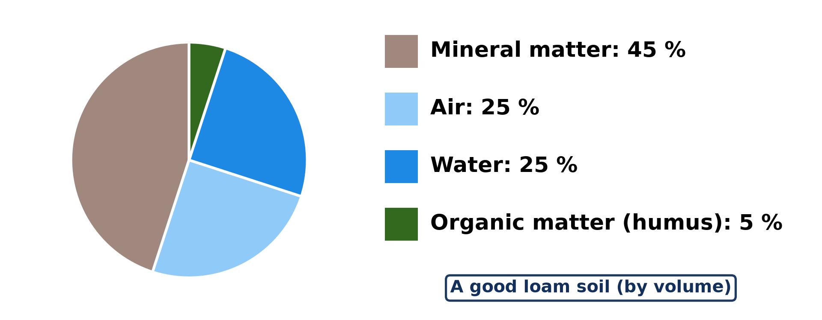
GEOGRAPHY — LOWER SIXTH ARTS
II. COMPONENTS
Activity 2
The four components of a good soil.
2026 / 2027
DGCAST GAROUA — GEOGRAPHY DEPARTMENT
Mr KAMDEM E. | 17
Notes:
Without the projector: draw the pie chart.

Slide 18
GEOGRAPHY — LOWER SIXTH ARTS
II. COMPONENTS
Activity 2: Question
Name the four components of soil. Which is the largest?
2026 / 2027
DGCAST GAROUA — GEOGRAPHY DEPARTMENT
Mr KAMDEM E. | 18

Slide 19
GEOGRAPHY — LOWER SIXTH ARTS
II. COMPONENTS
Answer
Mineral matter, water, air and organic matter; mineral matter is the largest (45 %).
2026 / 2027
DGCAST GAROUA — GEOGRAPHY DEPARTMENT
Mr KAMDEM E. | 19

Slide 20
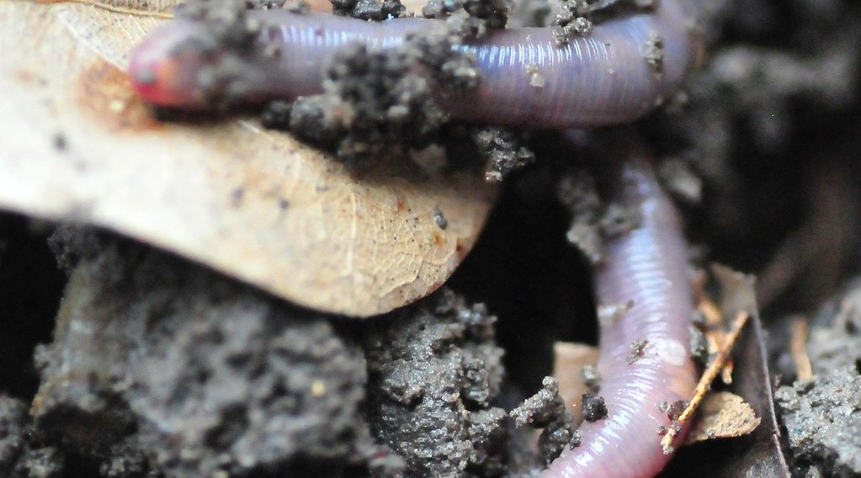
GEOGRAPHY — LOWER SIXTH ARTS
II. COMPONENTS
Activity 3
An earthworm in the soil.
2026 / 2027
DGCAST GAROUA — GEOGRAPHY DEPARTMENT
Mr KAMDEM E. | 20
Notes:
Without the projector: look for worms after rain.

Slide 21
GEOGRAPHY — LOWER SIXTH ARTS
II. COMPONENTS
Activity 3: Question
Why is the earthworm part of the soil?
2026 / 2027
DGCAST GAROUA — GEOGRAPHY DEPARTMENT
Mr KAMDEM E. | 21

Slide 22
GEOGRAPHY — LOWER SIXTH ARTS
II. COMPONENTS
Answer
Soil contains living organisms that mix it and make humus.
2026 / 2027
DGCAST GAROUA — GEOGRAPHY DEPARTMENT
Mr KAMDEM E. | 22

Slide 23

GEOGRAPHY — LOWER SIXTH ARTS
III. IMPORTANCE
Activity 4
A woman farmer in her farm in Cameroon.
2026 / 2027
DGCAST GAROUA — GEOGRAPHY DEPARTMENT
Mr KAMDEM E. | 23
Notes:
Without the projector: list crops grown in your area.

Slide 24
GEOGRAPHY — LOWER SIXTH ARTS
III. IMPORTANCE
Activity 4: Question
Give two uses of soil for man.
2026 / 2027
DGCAST GAROUA — GEOGRAPHY DEPARTMENT
Mr KAMDEM E. | 24

Slide 25
GEOGRAPHY — LOWER SIXTH ARTS
III. IMPORTANCE
Answer
It grows food and cash crops and gives building materials (clay, sand).
2026 / 2027
DGCAST GAROUA — GEOGRAPHY DEPARTMENT
Mr KAMDEM E. | 25

Slide 26
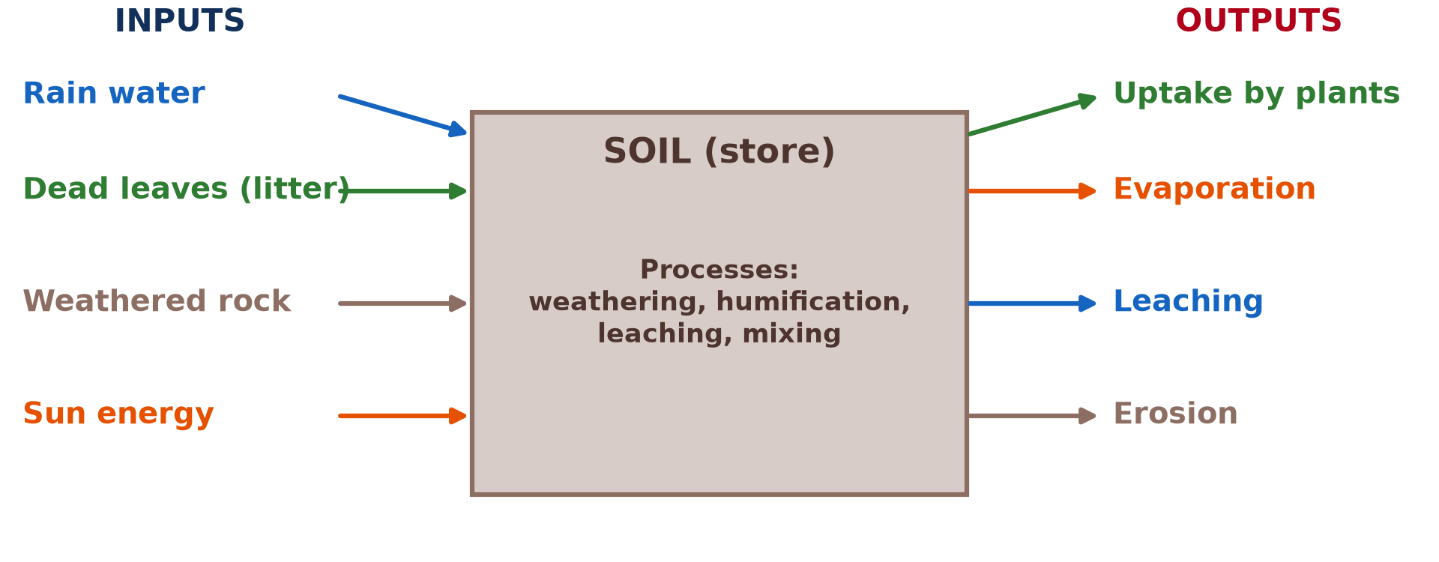
GEOGRAPHY — LOWER SIXTH ARTS
IV. THE SOIL SYSTEM
Activity 5
The soil as an open system.
2026 / 2027
DGCAST GAROUA — GEOGRAPHY DEPARTMENT
Mr KAMDEM E. | 26
Notes:
Without the projector: draw the three boxes.

Slide 27
GEOGRAPHY — LOWER SIXTH ARTS
IV. THE SOIL SYSTEM
Activity 5: Question
Name two inputs and two outputs of the soil system.
2026 / 2027
DGCAST GAROUA — GEOGRAPHY DEPARTMENT
Mr KAMDEM E. | 27

Slide 28
GEOGRAPHY — LOWER SIXTH ARTS
IV. THE SOIL SYSTEM
Answer
Inputs: rain, dead leaves (also weathered rock, sun). Outputs: leaching, erosion (also uptake, evaporation).
2026 / 2027
DGCAST GAROUA — GEOGRAPHY DEPARTMENT
Mr KAMDEM E. | 28

Slide 29
GEOGRAPHY — LOWER SIXTH ARTS
BOARD SUMMARY
The Soil
Topic: Soil and its Properties
Sub-topic: The Soil System
Lesson 1: The Soil
2026 / 2027
DGCAST GAROUA — GEOGRAPHY DEPARTMENT
Mr KAMDEM E. | 29
Notes:
Learners copy the board summary now. Give them enough time for each slide.

Slide 30
GEOGRAPHY — LOWER SIXTH ARTS
BOARD SUMMARY
I. Definitions
Soil: It is the thin, loose top layer of the Earth where plants grow.
Pedology: It is the scientific study of soils.
Humus: It is dark, decayed organic matter in the soil.
2026 / 2027
DGCAST GAROUA — GEOGRAPHY DEPARTMENT
Mr KAMDEM E. | 30

Slide 31
GEOGRAPHY — LOWER SIXTH ARTS
BOARD SUMMARY
II. Components of Soil (1/2)
A. Mineral matter (45 %): It comes from weathered rock as sand, silt and clay. It gives the soil its body.
B. Water and air (25 % each): They fill the pores between particles. Plants and soil animals need both.
2026 / 2027
DGCAST GAROUA — GEOGRAPHY DEPARTMENT
Mr KAMDEM E. | 31

Slide 32
GEOGRAPHY — LOWER SIXTH ARTS
BOARD SUMMARY
II. Components of Soil (2/2)
C. Organic matter (5 %): It comes from dead plants and animals and becomes humus. It holds water and nutrients.
D. Variation with depth: Humus and life are highest near the surface. Deeper down there is more rock and less air.
2026 / 2027
DGCAST GAROUA — GEOGRAPHY DEPARTMENT
Mr KAMDEM E. | 32

Slide 33
GEOGRAPHY — LOWER SIXTH ARTS
BOARD SUMMARY
III. Importance and the Soil System (1/3)
A. Importance to man: Soil grows food, cash crops and forests. It also gives clay, sand and laterite for building.
B. Importance to the biosphere: Soil stores water and nutrients for plants. It is home to many living things.
2026 / 2027
DGCAST GAROUA — GEOGRAPHY DEPARTMENT
Mr KAMDEM E. | 33

Slide 34
GEOGRAPHY — LOWER SIXTH ARTS
BOARD SUMMARY
III. Importance and the Soil System (2/3)
C. The soil system: Inputs are rain, weathered rock, litter and energy. Outputs are uptake, leaching, evaporation and erosion.
2026 / 2027
DGCAST GAROUA — GEOGRAPHY DEPARTMENT
Mr KAMDEM E. | 34

Slide 35
GEOGRAPHY — LOWER SIXTH ARTS
BOARD SUMMARY
III. Importance and the Soil System (3/3)
Copy the soil system.
2026 / 2027
DGCAST GAROUA — GEOGRAPHY DEPARTMENT
Mr KAMDEM E. | 35

Slide 36
GEOGRAPHY — LOWER SIXTH ARTS
FORMATIVE EVALUATION
Formative Evaluation 1
Name the four components of soil with their proportions.
2026 / 2027
DGCAST GAROUA — GEOGRAPHY DEPARTMENT
Mr KAMDEM E. | 36

Slide 37
GEOGRAPHY — LOWER SIXTH ARTS
FORMATIVE EVALUATION
Expected Answer
Mineral matter 45 %, water 25 %, air 25 %, organic matter 5 %.
2026 / 2027
DGCAST GAROUA — GEOGRAPHY DEPARTMENT
Mr KAMDEM E. | 37

Slide 38
GEOGRAPHY — LOWER SIXTH ARTS
FORMATIVE EVALUATION
Formative Evaluation 2
Give two outputs of the soil system.
2026 / 2027
DGCAST GAROUA — GEOGRAPHY DEPARTMENT
Mr KAMDEM E. | 38

Slide 39
GEOGRAPHY — LOWER SIXTH ARTS
FORMATIVE EVALUATION
Expected Answer
Leaching and erosion (also uptake, evaporation).
2026 / 2027
DGCAST GAROUA — GEOGRAPHY DEPARTMENT
Mr KAMDEM E. | 39

Slide 40
GEOGRAPHY — LOWER SIXTH ARTS
REMEDIATION
Remediation
Fill in the blanks:
The study of soils is ______.
Decayed organic matter is ______.
The largest component of soil is ______ matter.
2026 / 2027
DGCAST GAROUA — GEOGRAPHY DEPARTMENT
Mr KAMDEM E. | 40
Notes:
Answers: 1. pedology 2. humus 3. mineral

Slide 41
GEOGRAPHY — LOWER SIXTH ARTS
HOMEWORK
Homework
Collect a handful of soil and list what you can see in it.
This prepares Lesson 2: Physical Properties of the Soil.
2026 / 2027
DGCAST GAROUA — GEOGRAPHY DEPARTMENT
Mr KAMDEM E. | 41
Notes:
This homework prepares the next lesson.

Slide 42
GEOGRAPHY — LOWER SIXTH ARTS
BILINGUAL GAME
Bilingual Game (Jeu Bilingue)
English | Français
Soil | Le sol
Humus | L'humus
Pore | Le pore
Earthworm | Le ver de terre
Leaching | Le lessivage
Pedology | La pédologie
2026 / 2027
DGCAST GAROUA — GEOGRAPHY DEPARTMENT
Mr KAMDEM E. | 42
Notes:
Say the English word; learners give the French word, then the reverse.

Slide 43
GEOGRAPHY — LOWER SIXTH ARTS
LOGBOOK
Official Logbook (1/2)
Module / Topic | Soil and its Properties
Lesson Title | Lesson 1: The Soil
Expected Learning Outcomes | Define soil and pedology. Describe the four components of soil and how they change with depth. Explain the importance of soil and the soil as a system.
Competence | Learners are able to describe what soil is made of and explain why it is important to man and to living things.
2026 / 2027
DGCAST GAROUA — GEOGRAPHY DEPARTMENT
Mr KAMDEM E. | 43

Slide 44
GEOGRAPHY — LOWER SIXTH ARTS
LOGBOOK
Official Logbook (2/2)
Matter Taught | I. Definitions: Soil, Pedology, Humus; II. Components of Soil: Mineral matter (45 %), Water and air (25 % each), Organic matter (5 %), Variation with depth; III. Importance and the Soil System: Importance to man, Importance to the biosphere, The soil system.
Evaluation | Formative evaluation (3 questions) and remediation exercise.
Homework | Collect a handful of soil and list what you can see in it.
Enrolment / Present / Absent | ____ / ____ / ____
Achievement | To be completed by the teacher after the lesson.
2026 / 2027
DGCAST GAROUA — GEOGRAPHY DEPARTMENT
Mr KAMDEM E. | 44

Slide 45
GEOGRAPHY — LOWER SIXTH ARTS
TEACHER'S NOTE
Teacher's Note
Timing: Set-up, recall 8 min | Situation 8 min | 5 activities 30 min | Board summary (copying) 30 min | Evaluation, remediation 10 min | Homework, logbook 9 min | Spare 5 min
2026 / 2027
DGCAST GAROUA — GEOGRAPHY DEPARTMENT
Mr KAMDEM E. | 45

Slide 46
GEOGRAPHY — LOWER SIXTH ARTS
REFERENCES
References
National Geography Syllabus, Sixth Forms (Lower & Upper Sixth), MINESEC/IGE/IP-SS, August 2019 — Module 3 (Biogeography).
Photo, Activity 1: “Humic Dystrudept (fine-loamy, isotic, frigid)” by SoilScience.info, CC BY 2.0, via Flickr (https://www.flickr.com/photos/22503286@N06/5140645742)
Photo, Activity 3: “Earthworm In Soil” by jwinfred, CC BY-NC-ND 2.0, via Flickr (https://www.flickr.com/photos/98937825@N00/3532746937)
Photo, Activity 4: “Cameroon - UN Women's Gender Road Project” by UN Women Gallery, CC BY-NC-ND 2.0, via Flickr (https://www.flickr.com/photos/51431730@N04/46914753474)
Diagrams and animations: drawn for this lesson (DGCAST Geography Department).
2026 / 2027
DGCAST GAROUA — GEOGRAPHY DEPARTMENT
Mr KAMDEM E. | 46

