Slide 1

DIVINE GRACE COLLEGE OF ARTS, SCIENCE AND TECHNOLOGY
(DGCAST) — GAROUA | GEOGRAPHY DEPARTMENT
LOWER SIXTH ARTS — BIOGEOGRAPHY — LESSON 21
Energy Flows in Ecosystems
Mr KAMDEM EMMANUEL
Geography Teacher — PLEG
Academic Year 2026 / 2027
Notes:
Good morning, class. Today we study Lesson 21: Energy Flows in Ecosystems.

Slide 2
GEOGRAPHY — LOWER SIXTH ARTS
CLASS INFO
Class, Chapter & Duration
Class | Lower Sixth Arts
Chapter | Module 3: Understanding and managing biogeographic zones across the world in general and Cameroon in particular
Duration | 2 periods (2 × 50 minutes)
2026 / 2027
DGCAST GAROUA — GEOGRAPHY DEPARTMENT
Mr KAMDEM E. | 2

Slide 3
GEOGRAPHY — LOWER SIXTH ARTS
IDENTIFICATION
Lesson Identification
Topic | Ecological Systems (Ecosystems)
Sub-topic | The Functioning of Ecosystems
Lesson | Lesson 21: Energy Flows in Ecosystems
Notions / Concepts | Energy flow, photosynthesis, respiration, first law of thermodynamics, second law of thermodynamics, 10 % rule.
Syllabus focus | Sources of energy in the ecosystem; the two energy laws analysed.
Competence | Learners are able to explain how energy enters and flows through ecosystems using the two energy laws.
2026 / 2027
DGCAST GAROUA — GEOGRAPHY DEPARTMENT
Mr KAMDEM E. | 3

Slide 4
GEOGRAPHY — LOWER SIXTH ARTS
OBJECTIVES
Learning Objectives
By the end of the lesson, the learner should be able to:
Identify the source of energy in ecosystems.
Explain the first and second laws of energy.
Explain why energy decreases along a food chain.
2026 / 2027
DGCAST GAROUA — GEOGRAPHY DEPARTMENT
Mr KAMDEM E. | 4

Slide 5
GEOGRAPHY — LOWER SIXTH ARTS
RECALL
Recall
Plants make food by photosynthesis.
Animals eat plants or other animals.
2026 / 2027
DGCAST GAROUA — GEOGRAPHY DEPARTMENT
Mr KAMDEM E. | 5

Slide 6
GEOGRAPHY — LOWER SIXTH ARTS
REAL-LIFE SITUATION
Real-Life Situation
A herder feeds his cattle on grass. A learner calculates that the cattle use most of the energy in the grass to walk and keep warm, and very little becomes meat.
2026 / 2027
DGCAST GAROUA — GEOGRAPHY DEPARTMENT
Mr KAMDEM E. | 6
Notes:
Read the situation slowly, twice.

Slide 7
GEOGRAPHY — LOWER SIXTH ARTS
REAL-LIFE SITUATION
Situation — Question 1
What is the problem in the situation?
2026 / 2027
DGCAST GAROUA — GEOGRAPHY DEPARTMENT
Mr KAMDEM E. | 7

Slide 8
GEOGRAPHY — LOWER SIXTH ARTS
REAL-LIFE SITUATION
Answer
Much energy is lost between grass and meat.
2026 / 2027
DGCAST GAROUA — GEOGRAPHY DEPARTMENT
Mr KAMDEM E. | 8

Slide 9
GEOGRAPHY — LOWER SIXTH ARTS
REAL-LIFE SITUATION
Situation — Question 2
Where does the energy go?
2026 / 2027
DGCAST GAROUA — GEOGRAPHY DEPARTMENT
Mr KAMDEM E. | 9

Slide 10
GEOGRAPHY — LOWER SIXTH ARTS
REAL-LIFE SITUATION
Answer
It is lost as heat through respiration and movement.
2026 / 2027
DGCAST GAROUA — GEOGRAPHY DEPARTMENT
Mr KAMDEM E. | 10

Slide 11
GEOGRAPHY — LOWER SIXTH ARTS
REAL-LIFE SITUATION
Situation — Question 3
Where does the energy of grass come from?
2026 / 2027
DGCAST GAROUA — GEOGRAPHY DEPARTMENT
Mr KAMDEM E. | 11

Slide 12
GEOGRAPHY — LOWER SIXTH ARTS
REAL-LIFE SITUATION
Possible Answer
From the Sun.
2026 / 2027
DGCAST GAROUA — GEOGRAPHY DEPARTMENT
Mr KAMDEM E. | 12

Slide 13
GEOGRAPHY — LOWER SIXTH ARTS
JUSTIFICATION
Justification of the Lesson
This lesson helps us to understand why energy flows in one direction and why food chains are short.
2026 / 2027
DGCAST GAROUA — GEOGRAPHY DEPARTMENT
Mr KAMDEM E. | 13

Slide 14
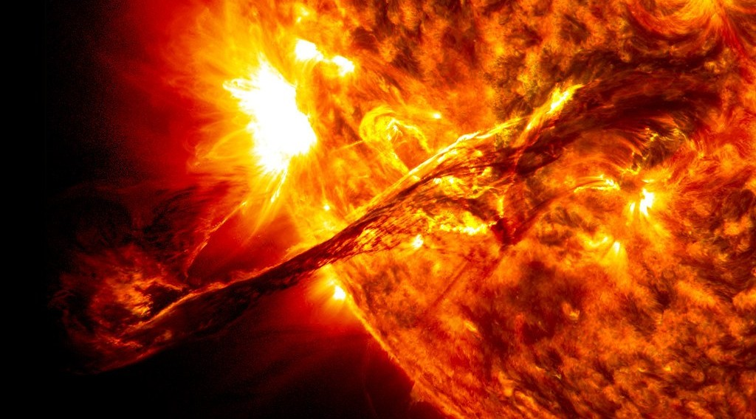
GEOGRAPHY — LOWER SIXTH ARTS
I. SOURCE OF ENERGY
Activity 1
The Sun, source of all energy in ecosystems.
2026 / 2027
DGCAST GAROUA — GEOGRAPHY DEPARTMENT
Mr KAMDEM E. | 14
Notes:
Without the projector: explain why plants need light.

Slide 15
GEOGRAPHY — LOWER SIXTH ARTS
I. SOURCE OF ENERGY
Activity 1: Question
How does solar energy enter the ecosystem?
2026 / 2027
DGCAST GAROUA — GEOGRAPHY DEPARTMENT
Mr KAMDEM E. | 15

Slide 16
GEOGRAPHY — LOWER SIXTH ARTS
I. SOURCE OF ENERGY
Answer
Through photosynthesis by green plants.
2026 / 2027
DGCAST GAROUA — GEOGRAPHY DEPARTMENT
Mr KAMDEM E. | 16

Slide 17

GEOGRAPHY — LOWER SIXTH ARTS
I. SOURCE OF ENERGY
Activity 2
Photosynthesis.
2026 / 2027
DGCAST GAROUA — GEOGRAPHY DEPARTMENT
Mr KAMDEM E. | 17
Notes:
Without the projector: write the equation in words.

Slide 18
GEOGRAPHY — LOWER SIXTH ARTS
I. SOURCE OF ENERGY
Activity 2: Question
Into what form is solar energy changed by plants?
2026 / 2027
DGCAST GAROUA — GEOGRAPHY DEPARTMENT
Mr KAMDEM E. | 18

Slide 19
GEOGRAPHY — LOWER SIXTH ARTS
I. SOURCE OF ENERGY
Answer
Chemical energy stored in food (sugars).
2026 / 2027
DGCAST GAROUA — GEOGRAPHY DEPARTMENT
Mr KAMDEM E. | 19

Slide 20
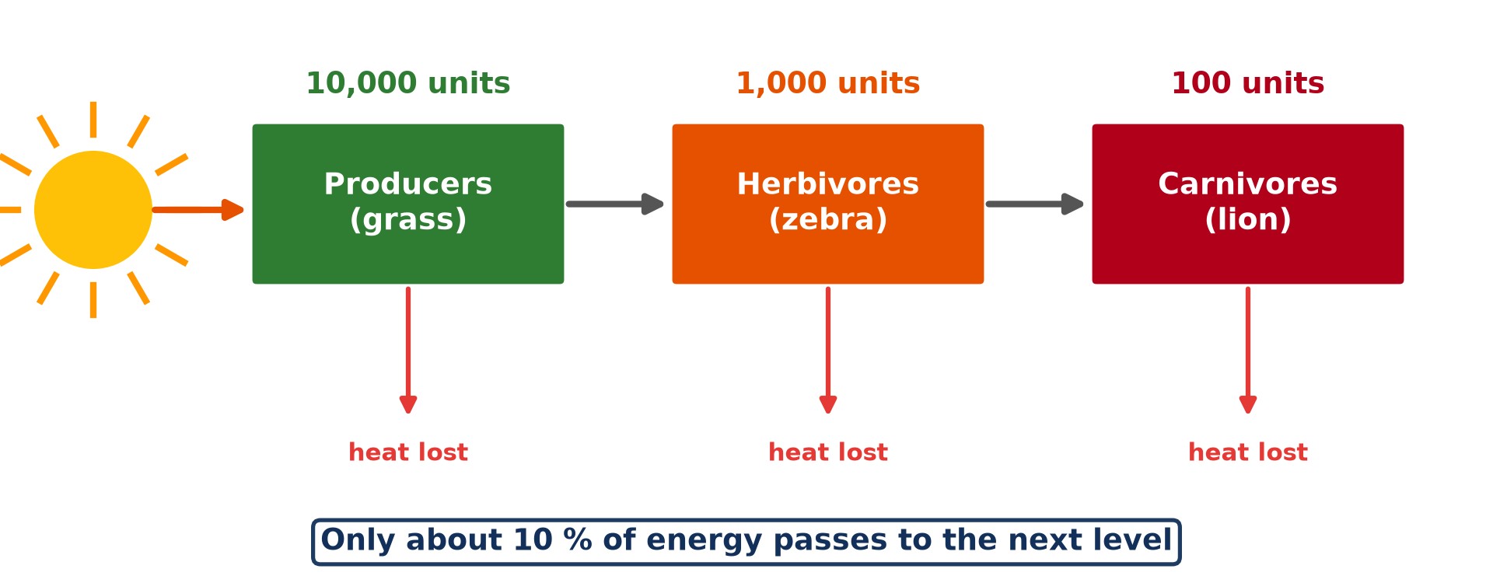
GEOGRAPHY — LOWER SIXTH ARTS
II. ENERGY FLOW
Activity 3
Energy flow along a food chain.
2026 / 2027
DGCAST GAROUA — GEOGRAPHY DEPARTMENT
Mr KAMDEM E. | 20
Notes:
Without the projector: do the calculation.

Slide 21
GEOGRAPHY — LOWER SIXTH ARTS
II. ENERGY FLOW
Activity 3: Question
If grass has 10,000 units, how much reaches the lion?
2026 / 2027
DGCAST GAROUA — GEOGRAPHY DEPARTMENT
Mr KAMDEM E. | 21

Slide 22
GEOGRAPHY — LOWER SIXTH ARTS
II. ENERGY FLOW
Answer
About 100 units (10 % at each step).
2026 / 2027
DGCAST GAROUA — GEOGRAPHY DEPARTMENT
Mr KAMDEM E. | 22

Slide 23

GEOGRAPHY — LOWER SIXTH ARTS
III. THE ENERGY LAWS
Activity 4
Zebras grazing.
2026 / 2027
DGCAST GAROUA — GEOGRAPHY DEPARTMENT
Mr KAMDEM E. | 23
Notes:
Without the projector: feel body heat after running.

Slide 24
GEOGRAPHY — LOWER SIXTH ARTS
III. THE ENERGY LAWS
Activity 4: Question
Why does the zebra keep only a small part of the grass energy?
2026 / 2027
DGCAST GAROUA — GEOGRAPHY DEPARTMENT
Mr KAMDEM E. | 24

Slide 25
GEOGRAPHY — LOWER SIXTH ARTS
III. THE ENERGY LAWS
Answer
It loses most as heat when it moves and breathes (second law).
2026 / 2027
DGCAST GAROUA — GEOGRAPHY DEPARTMENT
Mr KAMDEM E. | 25

Slide 26

GEOGRAPHY — LOWER SIXTH ARTS
III. THE ENERGY LAWS
Activity 5
A lioness stalking zebras.
2026 / 2027
DGCAST GAROUA — GEOGRAPHY DEPARTMENT
Mr KAMDEM E. | 26
Notes:
Without the projector: compare numbers in a park.

Slide 27
GEOGRAPHY — LOWER SIXTH ARTS
III. THE ENERGY LAWS
Activity 5: Question
Why are there few lions and many zebras?
2026 / 2027
DGCAST GAROUA — GEOGRAPHY DEPARTMENT
Mr KAMDEM E. | 27

Slide 28
GEOGRAPHY — LOWER SIXTH ARTS
III. THE ENERGY LAWS
Answer
Little energy is left at the top of the chain.
2026 / 2027
DGCAST GAROUA — GEOGRAPHY DEPARTMENT
Mr KAMDEM E. | 28

Slide 29
GEOGRAPHY — LOWER SIXTH ARTS
BOARD SUMMARY
Energy Flows in Ecosystems
Topic: Ecological Systems (Ecosystems)
Sub-topic: The Functioning of Ecosystems
Lesson 21: Energy Flows in Ecosystems
2026 / 2027
DGCAST GAROUA — GEOGRAPHY DEPARTMENT
Mr KAMDEM E. | 29
Notes:
Learners copy the board summary now. Give them enough time for each slide.

Slide 30
GEOGRAPHY — LOWER SIXTH ARTS
BOARD SUMMARY
I. Definitions
Energy flow: It is the movement of energy through an ecosystem.
First law of thermodynamics: It says that energy cannot be created or destroyed, only changed.
Second law of thermodynamics: It says that each change of energy loses some as heat.
2026 / 2027
DGCAST GAROUA — GEOGRAPHY DEPARTMENT
Mr KAMDEM E. | 30

Slide 31
GEOGRAPHY — LOWER SIXTH ARTS
BOARD SUMMARY
II. Sources of Energy (1/2)
A. The Sun: Nearly all energy in ecosystems comes from sunlight. Plants use only about 1 % of it.
B. Photosynthesis: Plants change light energy into chemical energy in food. This is the entry point of energy.
2026 / 2027
DGCAST GAROUA — GEOGRAPHY DEPARTMENT
Mr KAMDEM E. | 31

Slide 32
GEOGRAPHY — LOWER SIXTH ARTS
BOARD SUMMARY
II. Sources of Energy (2/2)
C. Other sources: Some bacteria use chemical energy from rocks or hot springs. This is rare.
2026 / 2027
DGCAST GAROUA — GEOGRAPHY DEPARTMENT
Mr KAMDEM E. | 32

Slide 33
GEOGRAPHY — LOWER SIXTH ARTS
BOARD SUMMARY
III. The Two Energy Laws (1/3)
A. First law: Energy is changed from light to chemical energy and then to heat. The total amount stays the same.
B. Second law: At each step energy is lost as heat by respiration and movement. Only about 10 % passes to the next level.
2026 / 2027
DGCAST GAROUA — GEOGRAPHY DEPARTMENT
Mr KAMDEM E. | 33

Slide 34
GEOGRAPHY — LOWER SIXTH ARTS
BOARD SUMMARY
III. The Two Energy Laws (2/3)
C. Consequences: Energy flows in one direction and is not recycled. Food chains are short, and top carnivores are few.
2026 / 2027
DGCAST GAROUA — GEOGRAPHY DEPARTMENT
Mr KAMDEM E. | 34

Slide 35
GEOGRAPHY — LOWER SIXTH ARTS
BOARD SUMMARY
III. The Two Energy Laws (3/3)
Copy the energy flow.
2026 / 2027
DGCAST GAROUA — GEOGRAPHY DEPARTMENT
Mr KAMDEM E. | 35

Slide 36
GEOGRAPHY — LOWER SIXTH ARTS
FORMATIVE EVALUATION
Formative Evaluation 1
State the two energy laws.
2026 / 2027
DGCAST GAROUA — GEOGRAPHY DEPARTMENT
Mr KAMDEM E. | 36

Slide 37
GEOGRAPHY — LOWER SIXTH ARTS
FORMATIVE EVALUATION
Expected Answer
First: energy is not created or destroyed, only changed. Second: each change loses some energy as heat.
2026 / 2027
DGCAST GAROUA — GEOGRAPHY DEPARTMENT
Mr KAMDEM E. | 37

Slide 38
GEOGRAPHY — LOWER SIXTH ARTS
FORMATIVE EVALUATION
Formative Evaluation 2
Why are food chains short?
2026 / 2027
DGCAST GAROUA — GEOGRAPHY DEPARTMENT
Mr KAMDEM E. | 38

Slide 39
GEOGRAPHY — LOWER SIXTH ARTS
FORMATIVE EVALUATION
Expected Answer
About 90 % of energy is lost at each level.
2026 / 2027
DGCAST GAROUA — GEOGRAPHY DEPARTMENT
Mr KAMDEM E. | 39

Slide 40
GEOGRAPHY — LOWER SIXTH ARTS
REMEDIATION
Remediation
Fill in the blanks:
All energy in ecosystems comes from the ______.
Plants take in energy by ______.
At each level about ______ % of energy passes on.
2026 / 2027
DGCAST GAROUA — GEOGRAPHY DEPARTMENT
Mr KAMDEM E. | 40
Notes:
Answers: 1. Sun 2. photosynthesis 3. 10

Slide 41
GEOGRAPHY — LOWER SIXTH ARTS
HOMEWORK
Homework
Calculate how much energy reaches a hawk if grass has 50,000 units in the chain grass → grasshopper → bird → hawk.
This prepares Lesson 22: Trophic Levels.
2026 / 2027
DGCAST GAROUA — GEOGRAPHY DEPARTMENT
Mr KAMDEM E. | 41
Notes:
This homework prepares the next lesson.

Slide 42
GEOGRAPHY — LOWER SIXTH ARTS
BILINGUAL GAME
Bilingual Game (Jeu Bilingue)
English | Français
Energy | L'énergie
Heat | La chaleur
Law | La loi
Flow | Le flux
Sunlight | La lumière solaire
Respiration | La respiration
2026 / 2027
DGCAST GAROUA — GEOGRAPHY DEPARTMENT
Mr KAMDEM E. | 42
Notes:
Say the English word; learners give the French word, then the reverse.

Slide 43
GEOGRAPHY — LOWER SIXTH ARTS
LOGBOOK
Official Logbook (1/2)
Module / Topic | Ecological Systems (Ecosystems)
Lesson Title | Lesson 21: Energy Flows in Ecosystems
Expected Learning Outcomes | Identify the source of energy in ecosystems. Explain the first and second laws of energy. Explain why energy decreases along a food chain.
Competence | Learners are able to explain how energy enters and flows through ecosystems using the two energy laws.
2026 / 2027
DGCAST GAROUA — GEOGRAPHY DEPARTMENT
Mr KAMDEM E. | 43

Slide 44
GEOGRAPHY — LOWER SIXTH ARTS
LOGBOOK
Official Logbook (2/2)
Matter Taught | I. Definitions: Energy flow, First law of thermodynamics, Second law of thermodynamics; II. Sources of Energy: The Sun, Photosynthesis, Other sources; III. The Two Energy Laws: First law, Second law, Consequences.
Evaluation | Formative evaluation (3 questions) and remediation exercise.
Homework | Calculate how much energy reaches a hawk if grass has 50,000 units in the chain grass → grasshopper → bird → hawk.
Enrolment / Present / Absent | ____ / ____ / ____
Achievement | To be completed by the teacher after the lesson.
2026 / 2027
DGCAST GAROUA — GEOGRAPHY DEPARTMENT
Mr KAMDEM E. | 44

Slide 45
GEOGRAPHY — LOWER SIXTH ARTS
TEACHER'S NOTE
Teacher's Note
Timing: Set-up, recall 8 min | Situation 8 min | 5 activities 30 min | Board summary (copying) 30 min | Evaluation, remediation 10 min | Homework, logbook 9 min | Spare 5 min
2026 / 2027
DGCAST GAROUA — GEOGRAPHY DEPARTMENT
Mr KAMDEM E. | 45

Slide 46
GEOGRAPHY — LOWER SIXTH ARTS
REFERENCES
References
National Geography Syllabus, Sixth Forms (Lower & Upper Sixth), MINESEC/IGE/IP-SS, August 2019 — Module 3 (Biogeography).
Photo, Activity 1: “Scientists Propose Mechanism to Describe Solar Eruptions of All Sizes” by NASA's Marshall Space Flight Center, CC BY-NC 2.0, via nasa (https://www.flickr.com/photos/28634332@N05/36084784530)
Photo, Activity 4: “Zebra” by mape_s, CC BY 2.0, via Flickr (https://www.flickr.com/photos/50931380@N00/333863114)
Photo, Activity 5: “hunt is on” by @Doug88888, CC BY-NC-SA 2.0, via Flickr (https://www.flickr.com/photos/29468339@N02/2930690305)
Diagrams and animations: drawn for this lesson (DGCAST Geography Department).
2026 / 2027
DGCAST GAROUA — GEOGRAPHY DEPARTMENT
Mr KAMDEM E. | 46

