Slide 1

DIVINE GRACE COLLEGE OF ARTS, SCIENCE AND TECHNOLOGY
(DGCAST) — GAROUA | GEOGRAPHY DEPARTMENT
LOWER SIXTH ARTS — BIOGEOGRAPHY — LESSON 22
Trophic Levels, Food Chains and Food Webs
Mr KAMDEM EMMANUEL
Geography Teacher — PLEG
Academic Year 2026 / 2027
Notes:
Good morning, class. Today we study Lesson 22: Trophic Levels, Food Chains and Food Webs.

Slide 2
GEOGRAPHY — LOWER SIXTH ARTS
CLASS INFO
Class, Chapter & Duration
Class | Lower Sixth Arts
Chapter | Module 3: Understanding and managing biogeographic zones across the world in general and Cameroon in particular
Duration | 2 periods (2 × 50 minutes)
2026 / 2027
DGCAST GAROUA — GEOGRAPHY DEPARTMENT
Mr KAMDEM E. | 2

Slide 3
GEOGRAPHY — LOWER SIXTH ARTS
IDENTIFICATION
Lesson Identification
Topic | Ecological Systems (Ecosystems)
Sub-topic | The Functioning of Ecosystems
Lesson | Lesson 22: Trophic Levels, Food Chains and Food Webs
Notions / Concepts | Trophic level, herbivore, carnivore, omnivore, food chain, food web, ecological pyramid.
Syllabus focus | Meaning and illustration of trophic levels; stepwise nature and limits; food chains and food webs.
Competence | Learners are able to build food chains and food webs and explain trophic levels.
2026 / 2027
DGCAST GAROUA — GEOGRAPHY DEPARTMENT
Mr KAMDEM E. | 3

Slide 4
GEOGRAPHY — LOWER SIXTH ARTS
OBJECTIVES
Learning Objectives
By the end of the lesson, the learner should be able to:
Define trophic level and name the levels.
Build a food chain and a food web.
Explain why the number of trophic levels is limited.
2026 / 2027
DGCAST GAROUA — GEOGRAPHY DEPARTMENT
Mr KAMDEM E. | 4

Slide 5
GEOGRAPHY — LOWER SIXTH ARTS
RECALL
Recall
Energy decreases by about 90 % at each level.
Producers, consumers and decomposers make an ecosystem.
2026 / 2027
DGCAST GAROUA — GEOGRAPHY DEPARTMENT
Mr KAMDEM E. | 5

Slide 6
GEOGRAPHY — LOWER SIXTH ARTS
REAL-LIFE SITUATION
Real-Life Situation
In the Bénoué National Park, poachers killed many lions. Rangers then saw antelopes and warthogs increase and the grass disappear in some places.
2026 / 2027
DGCAST GAROUA — GEOGRAPHY DEPARTMENT
Mr KAMDEM E. | 6
Notes:
Read the situation slowly, twice.

Slide 7
GEOGRAPHY — LOWER SIXTH ARTS
REAL-LIFE SITUATION
Situation — Question 1
What is the problem in the situation?
2026 / 2027
DGCAST GAROUA — GEOGRAPHY DEPARTMENT
Mr KAMDEM E. | 7

Slide 8
GEOGRAPHY — LOWER SIXTH ARTS
REAL-LIFE SITUATION
Answer
Removing one animal changed the whole food web.
2026 / 2027
DGCAST GAROUA — GEOGRAPHY DEPARTMENT
Mr KAMDEM E. | 8

Slide 9
GEOGRAPHY — LOWER SIXTH ARTS
REAL-LIFE SITUATION
Situation — Question 2
Which level did the lions occupy?
2026 / 2027
DGCAST GAROUA — GEOGRAPHY DEPARTMENT
Mr KAMDEM E. | 9

Slide 10
GEOGRAPHY — LOWER SIXTH ARTS
REAL-LIFE SITUATION
Answer
The top carnivore level.
2026 / 2027
DGCAST GAROUA — GEOGRAPHY DEPARTMENT
Mr KAMDEM E. | 10

Slide 11
GEOGRAPHY — LOWER SIXTH ARTS
REAL-LIFE SITUATION
Situation — Question 3
Why did the grass disappear?
2026 / 2027
DGCAST GAROUA — GEOGRAPHY DEPARTMENT
Mr KAMDEM E. | 11

Slide 12
GEOGRAPHY — LOWER SIXTH ARTS
REAL-LIFE SITUATION
Possible Answer
More herbivores ate more grass.
2026 / 2027
DGCAST GAROUA — GEOGRAPHY DEPARTMENT
Mr KAMDEM E. | 12

Slide 13
GEOGRAPHY — LOWER SIXTH ARTS
JUSTIFICATION
Justification of the Lesson
This lesson helps us to understand feeding links and why protecting all species keeps ecosystems stable.
2026 / 2027
DGCAST GAROUA — GEOGRAPHY DEPARTMENT
Mr KAMDEM E. | 13

Slide 14
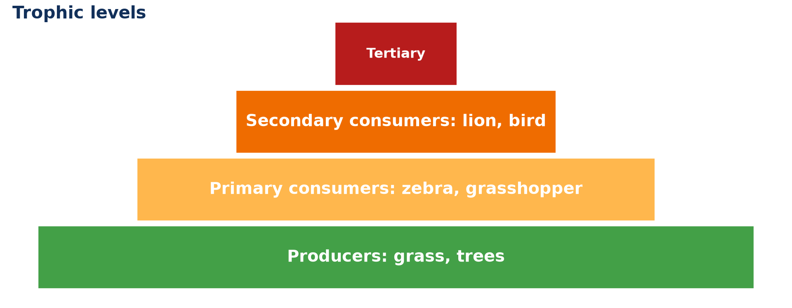
GEOGRAPHY — LOWER SIXTH ARTS
I. TROPHIC LEVELS
Activity 1
Trophic levels as a pyramid.
2026 / 2027
DGCAST GAROUA — GEOGRAPHY DEPARTMENT
Mr KAMDEM E. | 14
Notes:
Without the projector: draw the pyramid.

Slide 15
GEOGRAPHY — LOWER SIXTH ARTS
I. TROPHIC LEVELS
Activity 1: Question
Name the trophic levels from the bottom to the top.
2026 / 2027
DGCAST GAROUA — GEOGRAPHY DEPARTMENT
Mr KAMDEM E. | 15

Slide 16
GEOGRAPHY — LOWER SIXTH ARTS
I. TROPHIC LEVELS
Answer
Producers, primary consumers, secondary consumers, tertiary consumers.
2026 / 2027
DGCAST GAROUA — GEOGRAPHY DEPARTMENT
Mr KAMDEM E. | 16

Slide 17

GEOGRAPHY — LOWER SIXTH ARTS
II. FOOD CHAIN
Activity 2
A lioness stalking zebras.
2026 / 2027
DGCAST GAROUA — GEOGRAPHY DEPARTMENT
Mr KAMDEM E. | 17
Notes:
Without the projector: write chains from the savanna.

Slide 18
GEOGRAPHY — LOWER SIXTH ARTS
II. FOOD CHAIN
Activity 2: Question
Write a food chain with the lion.
2026 / 2027
DGCAST GAROUA — GEOGRAPHY DEPARTMENT
Mr KAMDEM E. | 18

Slide 19
GEOGRAPHY — LOWER SIXTH ARTS
II. FOOD CHAIN
Answer
Grass → zebra → lion.
2026 / 2027
DGCAST GAROUA — GEOGRAPHY DEPARTMENT
Mr KAMDEM E. | 19

Slide 20
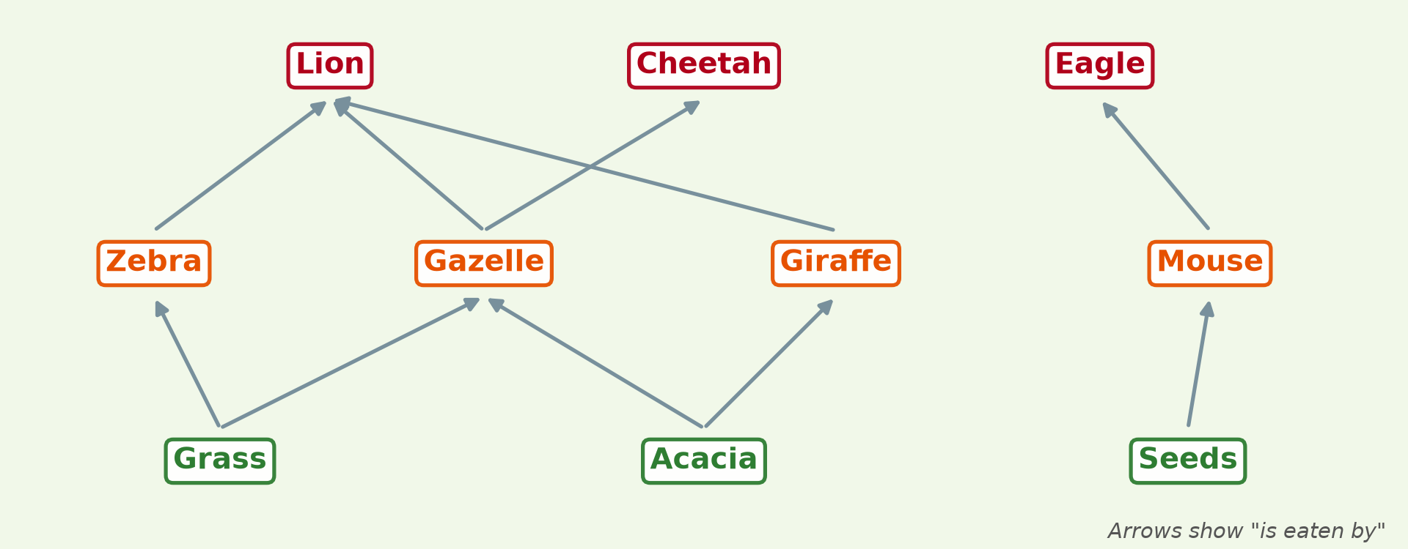
GEOGRAPHY — LOWER SIXTH ARTS
II. FOOD WEB
Activity 3
A savanna food web.
2026 / 2027
DGCAST GAROUA — GEOGRAPHY DEPARTMENT
Mr KAMDEM E. | 20
Notes:
Without the projector: draw arrows between animals.

Slide 21
GEOGRAPHY — LOWER SIXTH ARTS
II. FOOD WEB
Activity 3: Question
Why is a food web more stable than a single chain?
2026 / 2027
DGCAST GAROUA — GEOGRAPHY DEPARTMENT
Mr KAMDEM E. | 21

Slide 22
GEOGRAPHY — LOWER SIXTH ARTS
II. FOOD WEB
Answer
Animals have several food sources, so losing one is less serious.
2026 / 2027
DGCAST GAROUA — GEOGRAPHY DEPARTMENT
Mr KAMDEM E. | 22

Slide 23

GEOGRAPHY — LOWER SIXTH ARTS
III. DECOMPOSERS
Activity 4
A fungus feeding on dead wood.
2026 / 2027
DGCAST GAROUA — GEOGRAPHY DEPARTMENT
Mr KAMDEM E. | 23
Notes:
Without the projector: add decomposers to the web.

Slide 24
GEOGRAPHY — LOWER SIXTH ARTS
III. DECOMPOSERS
Activity 4: Question
Where do decomposers fit in a food web?
2026 / 2027
DGCAST GAROUA — GEOGRAPHY DEPARTMENT
Mr KAMDEM E. | 24

Slide 25
GEOGRAPHY — LOWER SIXTH ARTS
III. DECOMPOSERS
Answer
They feed on dead matter from all levels.
2026 / 2027
DGCAST GAROUA — GEOGRAPHY DEPARTMENT
Mr KAMDEM E. | 25

Slide 26

GEOGRAPHY — LOWER SIXTH ARTS
III. LIMITS
Activity 5
Elephants, large herbivores.
2026 / 2027
DGCAST GAROUA — GEOGRAPHY DEPARTMENT
Mr KAMDEM E. | 26
Notes:
Without the projector: recall the 10 % rule.

Slide 27
GEOGRAPHY — LOWER SIXTH ARTS
III. LIMITS
Activity 5: Question
Why are there rarely more than four or five trophic levels?
2026 / 2027
DGCAST GAROUA — GEOGRAPHY DEPARTMENT
Mr KAMDEM E. | 27

Slide 28
GEOGRAPHY — LOWER SIXTH ARTS
III. LIMITS
Answer
Too little energy is left for another level.
2026 / 2027
DGCAST GAROUA — GEOGRAPHY DEPARTMENT
Mr KAMDEM E. | 28

Slide 29
GEOGRAPHY — LOWER SIXTH ARTS
BOARD SUMMARY
Trophic Levels, Food Chains and Food Webs
Topic: Ecological Systems (Ecosystems)
Sub-topic: The Functioning of Ecosystems
Lesson 22: Trophic Levels, Food Chains and Food Webs
2026 / 2027
DGCAST GAROUA — GEOGRAPHY DEPARTMENT
Mr KAMDEM E. | 29
Notes:
Learners copy the board summary now. Give them enough time for each slide.

Slide 30
GEOGRAPHY — LOWER SIXTH ARTS
BOARD SUMMARY
I. Definitions
Trophic level: It is a feeding level in an ecosystem.
Food chain: It is a single line showing who eats whom.
Food web: It is a network of linked food chains.
2026 / 2027
DGCAST GAROUA — GEOGRAPHY DEPARTMENT
Mr KAMDEM E. | 30

Slide 31
GEOGRAPHY — LOWER SIXTH ARTS
BOARD SUMMARY
II. Trophic Levels (1/2)
A. Producers: Green plants form the first level. They make food from sunlight.
B. Consumers: Herbivores are primary consumers, and carnivores are secondary or tertiary consumers. Omnivores eat at several levels.
2026 / 2027
DGCAST GAROUA — GEOGRAPHY DEPARTMENT
Mr KAMDEM E. | 31

Slide 32
GEOGRAPHY — LOWER SIXTH ARTS
BOARD SUMMARY
II. Trophic Levels (2/2)
C. Stepwise nature: Energy passes up one level at a time. Numbers and biomass usually decrease upwards, forming a pyramid.
2026 / 2027
DGCAST GAROUA — GEOGRAPHY DEPARTMENT
Mr KAMDEM E. | 32

Slide 33
GEOGRAPHY — LOWER SIXTH ARTS
BOARD SUMMARY
III. Food Chains and Food Webs (1/3)
A. Food chains: They show one path of energy, like grass → zebra → lion. They are simple but rare in nature.
B. Food webs: Most animals eat several foods, so chains link into webs. Webs make ecosystems more stable.
2026 / 2027
DGCAST GAROUA — GEOGRAPHY DEPARTMENT
Mr KAMDEM E. | 33

Slide 34
GEOGRAPHY — LOWER SIXTH ARTS
BOARD SUMMARY
III. Food Chains and Food Webs (2/3)
C. Limits: Energy loss limits chains to four or five levels. Removing a species can upset the whole web.
2026 / 2027
DGCAST GAROUA — GEOGRAPHY DEPARTMENT
Mr KAMDEM E. | 34

Slide 35
GEOGRAPHY — LOWER SIXTH ARTS
BOARD SUMMARY
III. Food Chains and Food Webs (3/3)
Copy the food web.
2026 / 2027
DGCAST GAROUA — GEOGRAPHY DEPARTMENT
Mr KAMDEM E. | 35

Slide 36
GEOGRAPHY — LOWER SIXTH ARTS
FORMATIVE EVALUATION
Formative Evaluation 1
Distinguish a food chain and a food web.
2026 / 2027
DGCAST GAROUA — GEOGRAPHY DEPARTMENT
Mr KAMDEM E. | 36

Slide 37
GEOGRAPHY — LOWER SIXTH ARTS
FORMATIVE EVALUATION
Expected Answer
A food chain is one line of feeding; a food web is a network of linked chains.
2026 / 2027
DGCAST GAROUA — GEOGRAPHY DEPARTMENT
Mr KAMDEM E. | 37

Slide 38
GEOGRAPHY — LOWER SIXTH ARTS
FORMATIVE EVALUATION
Formative Evaluation 2
Why are trophic levels limited?
2026 / 2027
DGCAST GAROUA — GEOGRAPHY DEPARTMENT
Mr KAMDEM E. | 38

Slide 39
GEOGRAPHY — LOWER SIXTH ARTS
FORMATIVE EVALUATION
Expected Answer
Energy is lost at each level, so little is left for higher levels.
2026 / 2027
DGCAST GAROUA — GEOGRAPHY DEPARTMENT
Mr KAMDEM E. | 39

Slide 40
GEOGRAPHY — LOWER SIXTH ARTS
REMEDIATION
Remediation
Fill in the blanks:
Plants are on the first ______ level.
Herbivores are ______ consumers.
A network of food chains is a food ______.
2026 / 2027
DGCAST GAROUA — GEOGRAPHY DEPARTMENT
Mr KAMDEM E. | 40
Notes:
Answers: 1. trophic 2. primary 3. web

Slide 41
GEOGRAPHY — LOWER SIXTH ARTS
HOMEWORK
Homework
Build a food web of five animals and three plants from your area.
This prepares Lesson 23: Nutrient Cycling.
2026 / 2027
DGCAST GAROUA — GEOGRAPHY DEPARTMENT
Mr KAMDEM E. | 41
Notes:
This homework prepares the next lesson.

Slide 42
GEOGRAPHY — LOWER SIXTH ARTS
BILINGUAL GAME
Bilingual Game (Jeu Bilingue)
English | Français
Trophic level | Le niveau trophique
Herbivore | L'herbivore
Carnivore | Le carnivore
Food web | Le réseau alimentaire
Pyramid | La pyramide
Prey | La proie
2026 / 2027
DGCAST GAROUA — GEOGRAPHY DEPARTMENT
Mr KAMDEM E. | 42
Notes:
Say the English word; learners give the French word, then the reverse.

Slide 43
GEOGRAPHY — LOWER SIXTH ARTS
LOGBOOK
Official Logbook (1/2)
Module / Topic | Ecological Systems (Ecosystems)
Lesson Title | Lesson 22: Trophic Levels, Food Chains and Food Webs
Expected Learning Outcomes | Define trophic level and name the levels. Build a food chain and a food web. Explain why the number of trophic levels is limited.
Competence | Learners are able to build food chains and food webs and explain trophic levels.
2026 / 2027
DGCAST GAROUA — GEOGRAPHY DEPARTMENT
Mr KAMDEM E. | 43

Slide 44
GEOGRAPHY — LOWER SIXTH ARTS
LOGBOOK
Official Logbook (2/2)
Matter Taught | I. Definitions: Trophic level, Food chain, Food web; II. Trophic Levels: Producers, Consumers, Stepwise nature; III. Food Chains and Food Webs: Food chains, Food webs, Limits.
Evaluation | Formative evaluation (3 questions) and remediation exercise.
Homework | Build a food web of five animals and three plants from your area.
Enrolment / Present / Absent | ____ / ____ / ____
Achievement | To be completed by the teacher after the lesson.
2026 / 2027
DGCAST GAROUA — GEOGRAPHY DEPARTMENT
Mr KAMDEM E. | 44

Slide 45
GEOGRAPHY — LOWER SIXTH ARTS
TEACHER'S NOTE
Teacher's Note
Timing: Set-up, recall 8 min | Situation 8 min | 5 activities 30 min | Board summary (copying) 30 min | Evaluation, remediation 10 min | Homework, logbook 9 min | Spare 5 min
2026 / 2027
DGCAST GAROUA — GEOGRAPHY DEPARTMENT
Mr KAMDEM E. | 45

Slide 46
GEOGRAPHY — LOWER SIXTH ARTS
REFERENCES
References
National Geography Syllabus, Sixth Forms (Lower & Upper Sixth), MINESEC/IGE/IP-SS, August 2019 — Module 3 (Biogeography).
Photo, Activity 2: “hunt is on” by @Doug88888, CC BY-NC-SA 2.0, via Flickr (https://www.flickr.com/photos/29468339@N02/2930690305)
Photo, Activity 4: “Mushroom, underneath_2012-09-21-14.51.00 ZS PMax” by Sam Droege, Public domain 1.0, via Flickr (https://www.flickr.com/photos/54563451@N08/8016189217)
Photo, Activity 5: “African Bush Elephants, Maasai Mara” by Ray in Manila, CC BY 2.0, via Flickr (https://www.flickr.com/photos/21186555@N07/50627864261)
Diagrams and animations: drawn for this lesson (DGCAST Geography Department).
2026 / 2027
DGCAST GAROUA — GEOGRAPHY DEPARTMENT
Mr KAMDEM E. | 46

