Slide 1

DIVINE GRACE COLLEGE OF ARTS, SCIENCE AND TECHNOLOGY
(DGCAST) — GAROUA | GEOGRAPHY DEPARTMENT
LOWER SIXTH ARTS — CLIMATOLOGY — LESSON 4
The Earth's Radiation Balance
Mr KAMDEM EMMANUEL
Geography Teacher — PLEG
Academic Year 2026 / 2027
Notes:
Good morning, class. Today we study Lesson 4: The Earth's Radiation Balance.

Slide 2
GEOGRAPHY — LOWER SIXTH ARTS
CLASS INFO
Class, Chapter & Duration
Class | Lower Sixth Arts
Chapter | Module 1: Understanding and managing atmospheric and hydrological phenomena and hazards across the world in general and Cameroon in particular
Duration | 2 periods (2 × 50 minutes)
2026 / 2027
DGCAST GAROUA — GEOGRAPHY DEPARTMENT
Mr KAMDEM E. | 2

Slide 3
GEOGRAPHY — LOWER SIXTH ARTS
IDENTIFICATION
Lesson Identification
Topic | Energy in the Atmosphere
Sub-topic | The Earth's Heat Budget on a Global Scale
Lesson | Lesson 4: The Earth's Radiation Balance
Notions / Concepts | Heat budget, terrestrial radiation, long-wave radiation, surplus, deficit, balancing mechanisms.
Syllabus focus | Incoming solar radiation equals outgoing terrestrial radiation; zones of surplus and deficit; reasons and balancing mechanisms.
Competence | Learners are able to explain why the tropics gain energy and the poles lose energy, and how heat is shared.
2026 / 2027
DGCAST GAROUA — GEOGRAPHY DEPARTMENT
Mr KAMDEM E. | 3

Slide 4
GEOGRAPHY — LOWER SIXTH ARTS
OBJECTIVES
Learning Objectives
By the end of the lesson, the learner should be able to:
Define the heat budget.
Identify zones of positive and negative balance.
Explain the balancing mechanisms.
2026 / 2027
DGCAST GAROUA — GEOGRAPHY DEPARTMENT
Mr KAMDEM E. | 4

Slide 5
GEOGRAPHY — LOWER SIXTH ARTS
RECALL
Recall
About half of the sunlight reaches the ground.
The Sun is overhead between the tropics.
2026 / 2027
DGCAST GAROUA — GEOGRAPHY DEPARTMENT
Mr KAMDEM E. | 5

Slide 6
GEOGRAPHY — LOWER SIXTH ARTS
REAL-LIFE SITUATION
Real-Life Situation
A learner reads that the tropics receive more energy than they lose every year. He asks why the tropics do not become hotter and hotter, and why the poles do not freeze more every year.
2026 / 2027
DGCAST GAROUA — GEOGRAPHY DEPARTMENT
Mr KAMDEM E. | 6
Notes:
Read the situation slowly, twice.

Slide 7
GEOGRAPHY — LOWER SIXTH ARTS
REAL-LIFE SITUATION
Situation — Question 1
What is the problem in the situation?
2026 / 2027
DGCAST GAROUA — GEOGRAPHY DEPARTMENT
Mr KAMDEM E. | 7

Slide 8
GEOGRAPHY — LOWER SIXTH ARTS
REAL-LIFE SITUATION
Answer
The learner does not understand how the Earth keeps its heat in balance.
2026 / 2027
DGCAST GAROUA — GEOGRAPHY DEPARTMENT
Mr KAMDEM E. | 8

Slide 9
GEOGRAPHY — LOWER SIXTH ARTS
REAL-LIFE SITUATION
Situation — Question 2
Which zone has a surplus of energy?
2026 / 2027
DGCAST GAROUA — GEOGRAPHY DEPARTMENT
Mr KAMDEM E. | 9

Slide 10
GEOGRAPHY — LOWER SIXTH ARTS
REAL-LIFE SITUATION
Answer
The inter-tropical zone.
2026 / 2027
DGCAST GAROUA — GEOGRAPHY DEPARTMENT
Mr KAMDEM E. | 10

Slide 11
GEOGRAPHY — LOWER SIXTH ARTS
REAL-LIFE SITUATION
Situation — Question 3
How is the extra heat removed?
2026 / 2027
DGCAST GAROUA — GEOGRAPHY DEPARTMENT
Mr KAMDEM E. | 11

Slide 12
GEOGRAPHY — LOWER SIXTH ARTS
REAL-LIFE SITUATION
Possible Answer
Winds and ocean currents carry it towards the poles.
2026 / 2027
DGCAST GAROUA — GEOGRAPHY DEPARTMENT
Mr KAMDEM E. | 12

Slide 13
GEOGRAPHY — LOWER SIXTH ARTS
JUSTIFICATION
Justification of the Lesson
This lesson helps us to understand why the Earth keeps an almost constant average temperature.
2026 / 2027
DGCAST GAROUA — GEOGRAPHY DEPARTMENT
Mr KAMDEM E. | 13

Slide 14

GEOGRAPHY — LOWER SIXTH ARTS
I. THE HEAT BUDGET
Activity 1
The Earth receives sunlight and gives out heat.
2026 / 2027
DGCAST GAROUA — GEOGRAPHY DEPARTMENT
Mr KAMDEM E. | 14
Notes:
Without the projector: feel the heat of a wall after sunset.

Slide 15
GEOGRAPHY — LOWER SIXTH ARTS
I. THE HEAT BUDGET
Activity 1: Question
The ground gives heat back to the sky as long waves. What is this radiation called?
2026 / 2027
DGCAST GAROUA — GEOGRAPHY DEPARTMENT
Mr KAMDEM E. | 15

Slide 16
GEOGRAPHY — LOWER SIXTH ARTS
I. THE HEAT BUDGET
Answer
Terrestrial (long-wave) radiation.
2026 / 2027
DGCAST GAROUA — GEOGRAPHY DEPARTMENT
Mr KAMDEM E. | 16

Slide 17
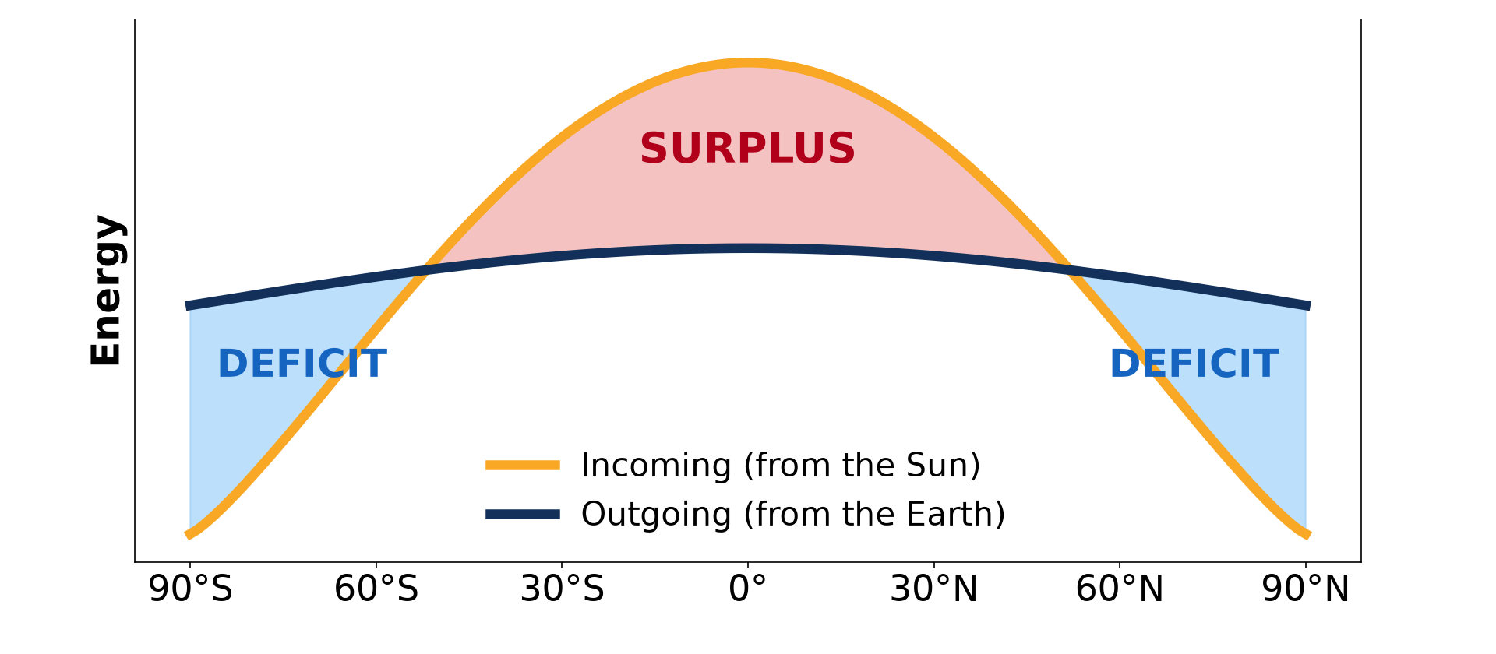
GEOGRAPHY — LOWER SIXTH ARTS
II. SURPLUS AND DEFICIT
Activity 2
Incoming and outgoing energy by latitude.
2026 / 2027
DGCAST GAROUA — GEOGRAPHY DEPARTMENT
Mr KAMDEM E. | 17
Notes:
Without the projector: draw the two curves.

Slide 18
GEOGRAPHY — LOWER SIXTH ARTS
II. SURPLUS AND DEFICIT
Activity 2: Question
Between which latitudes is there a surplus? Where is there a deficit?
2026 / 2027
DGCAST GAROUA — GEOGRAPHY DEPARTMENT
Mr KAMDEM E. | 18

Slide 19
GEOGRAPHY — LOWER SIXTH ARTS
II. SURPLUS AND DEFICIT
Answer
Surplus between about 38°N and 38°S; deficit towards the poles.
2026 / 2027
DGCAST GAROUA — GEOGRAPHY DEPARTMENT
Mr KAMDEM E. | 19

Slide 20

GEOGRAPHY — LOWER SIXTH ARTS
III. REASONS
Activity 3
Rays are direct at the Equator and spread at the poles.
2026 / 2027
DGCAST GAROUA — GEOGRAPHY DEPARTMENT
Mr KAMDEM E. | 20
Notes:
Without the projector: shine a torch straight and slanted on a table.

Slide 21
GEOGRAPHY — LOWER SIXTH ARTS
III. REASONS
Activity 3: Question
Why do the poles receive less energy?
2026 / 2027
DGCAST GAROUA — GEOGRAPHY DEPARTMENT
Mr KAMDEM E. | 21

Slide 22
GEOGRAPHY — LOWER SIXTH ARTS
III. REASONS
Answer
The rays are slanting, so the energy is spread over a large area and crosses more air.
2026 / 2027
DGCAST GAROUA — GEOGRAPHY DEPARTMENT
Mr KAMDEM E. | 22

Slide 23
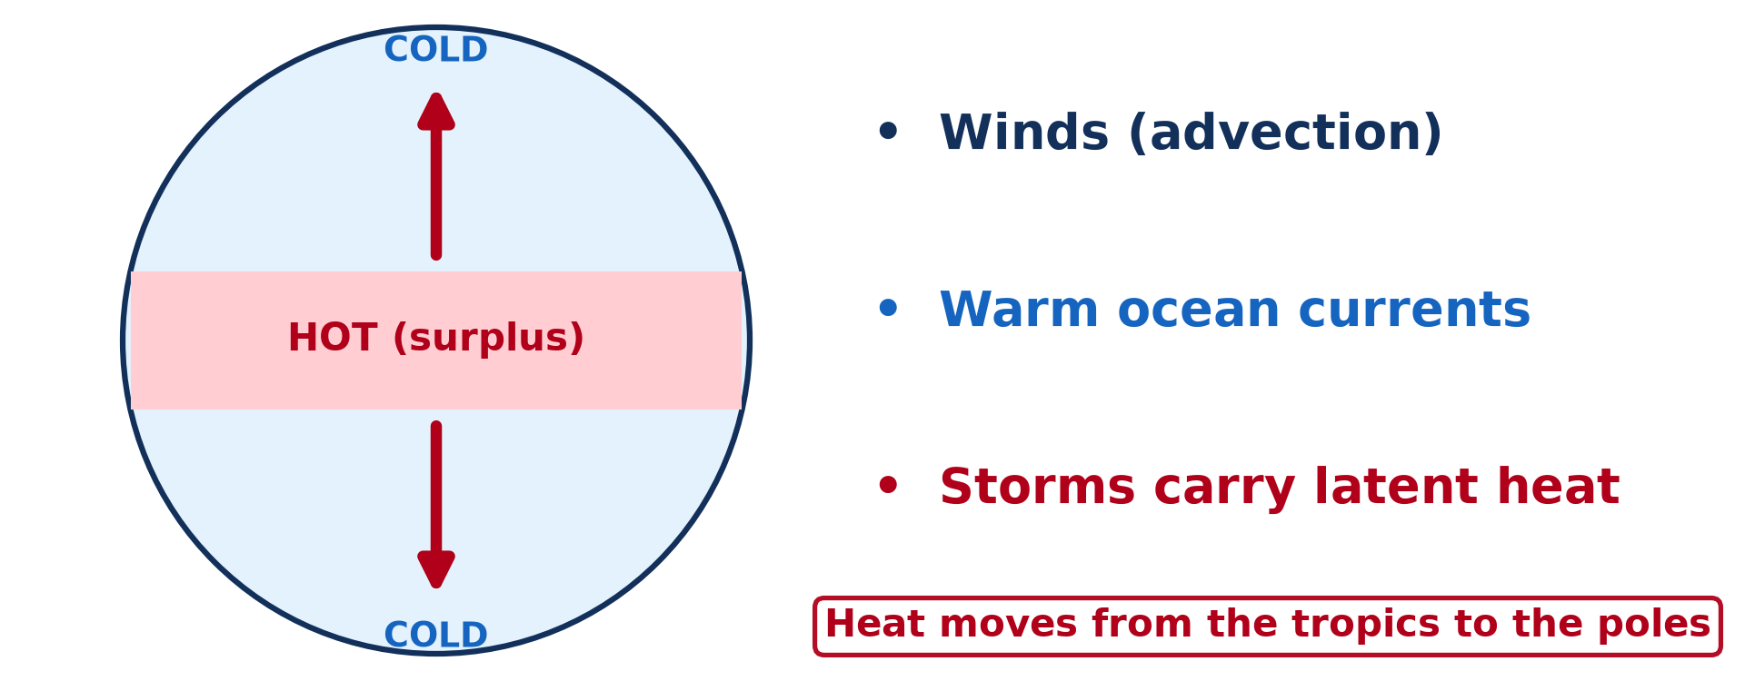
GEOGRAPHY — LOWER SIXTH ARTS
IV. BALANCING
Activity 4
Heat moves from the tropics to the poles.
2026 / 2027
DGCAST GAROUA — GEOGRAPHY DEPARTMENT
Mr KAMDEM E. | 23
Notes:
Without the projector: draw arrows from the Equator to the poles.

Slide 24
GEOGRAPHY — LOWER SIXTH ARTS
IV. BALANCING
Activity 4: Question
Name two ways heat is carried to the poles.
2026 / 2027
DGCAST GAROUA — GEOGRAPHY DEPARTMENT
Mr KAMDEM E. | 24

Slide 25
GEOGRAPHY — LOWER SIXTH ARTS
IV. BALANCING
Answer
Winds (air masses) and warm ocean currents.
2026 / 2027
DGCAST GAROUA — GEOGRAPHY DEPARTMENT
Mr KAMDEM E. | 25

Slide 26

GEOGRAPHY — LOWER SIXTH ARTS
IV. BALANCING
Activity 5
A tropical cyclone seen from space.
2026 / 2027
DGCAST GAROUA — GEOGRAPHY DEPARTMENT
Mr KAMDEM E. | 26
Notes:
Without the projector: mention the hurricanes of the Caribbean.

Slide 27
GEOGRAPHY — LOWER SIXTH ARTS
IV. BALANCING
Activity 5: Question
How do storms help to share heat?
2026 / 2027
DGCAST GAROUA — GEOGRAPHY DEPARTMENT
Mr KAMDEM E. | 27

Slide 28
GEOGRAPHY — LOWER SIXTH ARTS
IV. BALANCING
Answer
They carry latent heat from warm tropical seas towards higher latitudes.
2026 / 2027
DGCAST GAROUA — GEOGRAPHY DEPARTMENT
Mr KAMDEM E. | 28

Slide 29
GEOGRAPHY — LOWER SIXTH ARTS
BOARD SUMMARY
The Earth's Radiation Balance
Topic: Energy in the Atmosphere
Sub-topic: The Earth's Heat Budget on a Global Scale
Lesson 4: The Earth's Radiation Balance
2026 / 2027
DGCAST GAROUA — GEOGRAPHY DEPARTMENT
Mr KAMDEM E. | 29
Notes:
Learners copy the board summary now. Give them enough time for each slide.

Slide 30
GEOGRAPHY — LOWER SIXTH ARTS
BOARD SUMMARY
I. Definitions (1/2)
Heat budget: It is the balance between the energy the Earth receives and the energy it loses.
Terrestrial radiation: It is the long-wave heat given out by the Earth.
Surplus: It is a zone that receives more energy than it loses.
2026 / 2027
DGCAST GAROUA — GEOGRAPHY DEPARTMENT
Mr KAMDEM E. | 30

Slide 31
GEOGRAPHY — LOWER SIXTH ARTS
BOARD SUMMARY
I. Definitions (2/2)
Deficit: It is a zone that loses more energy than it receives.
2026 / 2027
DGCAST GAROUA — GEOGRAPHY DEPARTMENT
Mr KAMDEM E. | 31

Slide 32
GEOGRAPHY — LOWER SIXTH ARTS
BOARD SUMMARY
II. The Global Balance (1/2)
A. Balance: For the whole Earth, incoming solar radiation equals outgoing terrestrial radiation. That is why the average temperature stays about 15 °C.
B. Surplus zone: The inter-tropical zone gains more energy than it loses. It lies roughly between 38°N and 38°S.
2026 / 2027
DGCAST GAROUA — GEOGRAPHY DEPARTMENT
Mr KAMDEM E. | 32

Slide 33
GEOGRAPHY — LOWER SIXTH ARTS
BOARD SUMMARY
II. The Global Balance (2/2)
C. Deficit zones: The mid-latitudes and polar zones lose more energy than they gain. They would get colder every year without heat transfer.
2026 / 2027
DGCAST GAROUA — GEOGRAPHY DEPARTMENT
Mr KAMDEM E. | 33

Slide 34
GEOGRAPHY — LOWER SIXTH ARTS
BOARD SUMMARY
III. Reasons and Balancing (1/3)
A. Reasons: At the poles the rays are slanting and cross more air. Snow and ice also reflect much sunlight.
B. Winds: Winds and air masses carry warm air towards the poles. Cold air moves back towards the Equator.
2026 / 2027
DGCAST GAROUA — GEOGRAPHY DEPARTMENT
Mr KAMDEM E. | 34

Slide 35
GEOGRAPHY — LOWER SIXTH ARTS
BOARD SUMMARY
III. Reasons and Balancing (2/3)
C. Ocean currents and storms: Warm currents like the Gulf Stream carry heat north. Tropical storms also carry latent heat.
2026 / 2027
DGCAST GAROUA — GEOGRAPHY DEPARTMENT
Mr KAMDEM E. | 35

Slide 36
GEOGRAPHY — LOWER SIXTH ARTS
BOARD SUMMARY
III. Reasons and Balancing (3/3)
Copy the graph.
2026 / 2027
DGCAST GAROUA — GEOGRAPHY DEPARTMENT
Mr KAMDEM E. | 36

Slide 37
GEOGRAPHY — LOWER SIXTH ARTS
FORMATIVE EVALUATION
Formative Evaluation 1
What is the heat budget?
2026 / 2027
DGCAST GAROUA — GEOGRAPHY DEPARTMENT
Mr KAMDEM E. | 37

Slide 38
GEOGRAPHY — LOWER SIXTH ARTS
FORMATIVE EVALUATION
Expected Answer
The balance between the energy received and the energy lost by the Earth.
2026 / 2027
DGCAST GAROUA — GEOGRAPHY DEPARTMENT
Mr KAMDEM E. | 38

Slide 39
GEOGRAPHY — LOWER SIXTH ARTS
FORMATIVE EVALUATION
Formative Evaluation 2
Explain why the tropics do not get hotter every year.
2026 / 2027
DGCAST GAROUA — GEOGRAPHY DEPARTMENT
Mr KAMDEM E. | 39

Slide 40
GEOGRAPHY — LOWER SIXTH ARTS
FORMATIVE EVALUATION
Expected Answer
Winds and ocean currents carry their extra heat towards the poles.
2026 / 2027
DGCAST GAROUA — GEOGRAPHY DEPARTMENT
Mr KAMDEM E. | 40

Slide 41
GEOGRAPHY — LOWER SIXTH ARTS
REMEDIATION
Remediation
Fill in the blanks:
The inter-tropical zone has an energy ______.
The Earth gives out ______-wave radiation.
The Gulf Stream is a warm ocean ______.
2026 / 2027
DGCAST GAROUA — GEOGRAPHY DEPARTMENT
Mr KAMDEM E. | 41
Notes:
Answers: 1. surplus 2. long 3. current

Slide 42
GEOGRAPHY — LOWER SIXTH ARTS
HOMEWORK
Homework
Draw the radiation balance graph and colour the surplus and deficit zones.
This prepares Lesson 5: Heat Transport.
2026 / 2027
DGCAST GAROUA — GEOGRAPHY DEPARTMENT
Mr KAMDEM E. | 42
Notes:
This homework prepares the next lesson.

Slide 43
GEOGRAPHY — LOWER SIXTH ARTS
BILINGUAL GAME
Bilingual Game (Jeu Bilingue)
English | Français
Heat budget | Le bilan thermique
Surplus | L'excédent
Deficit | Le déficit
Ocean current | Le courant marin
Balance | L'équilibre
Long-wave | Grande longueur d'onde
2026 / 2027
DGCAST GAROUA — GEOGRAPHY DEPARTMENT
Mr KAMDEM E. | 43
Notes:
Say the English word; learners give the French word, then the reverse.

Slide 44
GEOGRAPHY — LOWER SIXTH ARTS
LOGBOOK
Official Logbook (1/2)
Module / Topic | Energy in the Atmosphere
Lesson Title | Lesson 4: The Earth's Radiation Balance
Expected Learning Outcomes | Define the heat budget. Identify zones of positive and negative balance. Explain the balancing mechanisms.
Competence | Learners are able to explain why the tropics gain energy and the poles lose energy, and how heat is shared.
2026 / 2027
DGCAST GAROUA — GEOGRAPHY DEPARTMENT
Mr KAMDEM E. | 44

Slide 45
GEOGRAPHY — LOWER SIXTH ARTS
LOGBOOK
Official Logbook (2/2)
Matter Taught | I. Definitions: Heat budget, Terrestrial radiation, Surplus, Deficit; II. The Global Balance: Balance, Surplus zone, Deficit zones; III. Reasons and Balancing: Reasons, Winds, Ocean currents and storms.
Evaluation | Formative evaluation (3 questions) and remediation exercise.
Homework | Draw the radiation balance graph and colour the surplus and deficit zones.
Enrolment / Present / Absent | ____ / ____ / ____
Achievement | To be completed by the teacher after the lesson.
2026 / 2027
DGCAST GAROUA — GEOGRAPHY DEPARTMENT
Mr KAMDEM E. | 45

Slide 46
GEOGRAPHY — LOWER SIXTH ARTS
TEACHER'S NOTE
Teacher's Note
Timing: Set-up, recall 8 min | Situation 8 min | 5 activities 30 min | Board summary (copying) 30 min | Evaluation, remediation 10 min | Homework, logbook 9 min | Spare 5 min
2026 / 2027
DGCAST GAROUA — GEOGRAPHY DEPARTMENT
Mr KAMDEM E. | 46

Slide 47
GEOGRAPHY — LOWER SIXTH ARTS
REFERENCES
References
National Geography Syllabus, Sixth Forms (Lower & Upper Sixth), MINESEC/IGE/IP-SS, August 2019 — Module 1 (Meteorology, Climatology & Hydrology).
Photo, Activity 5: “NASA's Aqua Satellite Captures Hurricane Danielle” by NASA Goddard Photo and Video, CC BY 2.0, via nasa (https://www.flickr.com/photos/24662369@N07/4931591817)
Diagrams and animations: drawn for this lesson (DGCAST Geography Department).
2026 / 2027
DGCAST GAROUA — GEOGRAPHY DEPARTMENT
Mr KAMDEM E. | 47

