Slide 1

DIVINE GRACE COLLEGE OF ARTS, SCIENCE AND TECHNOLOGY
(DGCAST) — GAROUA | GEOGRAPHY DEPARTMENT
LOWER SIXTH ARTS — CLIMATOLOGY — LESSON 11
Forms of Condensation and Precipitation
Mr KAMDEM EMMANUEL
Geography Teacher — PLEG
Academic Year 2026 / 2027
Notes:
Good morning, class. Today we study Lesson 11: Forms of Condensation and Precipitation.

Slide 2
GEOGRAPHY — LOWER SIXTH ARTS
CLASS INFO
Class, Chapter & Duration
Class | Lower Sixth Arts
Chapter | Module 1: Understanding and managing atmospheric and hydrological phenomena and hazards across the world in general and Cameroon in particular
Duration | 2 periods (2 × 50 minutes)
2026 / 2027
DGCAST GAROUA — GEOGRAPHY DEPARTMENT
Mr KAMDEM E. | 2

Slide 3
GEOGRAPHY — LOWER SIXTH ARTS
IDENTIFICATION
Lesson Identification
Topic | Moisture in the Atmosphere
Sub-topic | Precipitation
Lesson | Lesson 11: Forms of Condensation and Precipitation
Notions / Concepts | Condensation, cloud, fog, mist, dew, precipitation, hail, convectional, orographic and frontal rain.
Syllabus focus | Cloud formation and types; fog and mist; forms of precipitation; types of rainfall.
Competence | Learners are able to identify clouds, forms of precipitation and types of rainfall and predict the weather.
2026 / 2027
DGCAST GAROUA — GEOGRAPHY DEPARTMENT
Mr KAMDEM E. | 3

Slide 4
GEOGRAPHY — LOWER SIXTH ARTS
OBJECTIVES
Learning Objectives
By the end of the lesson, the learner should be able to:
Explain condensation and classify clouds.
Describe solid and liquid forms of precipitation.
Explain convectional, relief and frontal rain.
2026 / 2027
DGCAST GAROUA — GEOGRAPHY DEPARTMENT
Mr KAMDEM E. | 4

Slide 5
GEOGRAPHY — LOWER SIXTH ARTS
RECALL
Recall
Air becomes saturated at the dew point.
Rising air cools.
2026 / 2027
DGCAST GAROUA — GEOGRAPHY DEPARTMENT
Mr KAMDEM E. | 5

Slide 6
GEOGRAPHY — LOWER SIXTH ARTS
REAL-LIFE SITUATION
Real-Life Situation
Farmers in the West Region look at the sky each morning. When they see tall, dark clouds building up in the afternoon, they hurry home because a storm will come.
2026 / 2027
DGCAST GAROUA — GEOGRAPHY DEPARTMENT
Mr KAMDEM E. | 6
Notes:
Read the situation slowly, twice.

Slide 7
GEOGRAPHY — LOWER SIXTH ARTS
REAL-LIFE SITUATION
Situation — Question 1
What is the problem in the situation?
2026 / 2027
DGCAST GAROUA — GEOGRAPHY DEPARTMENT
Mr KAMDEM E. | 7

Slide 8
GEOGRAPHY — LOWER SIXTH ARTS
REAL-LIFE SITUATION
Answer
Farmers need to predict rain from clouds.
2026 / 2027
DGCAST GAROUA — GEOGRAPHY DEPARTMENT
Mr KAMDEM E. | 8

Slide 9
GEOGRAPHY — LOWER SIXTH ARTS
REAL-LIFE SITUATION
Situation — Question 2
What type of cloud gives storms?
2026 / 2027
DGCAST GAROUA — GEOGRAPHY DEPARTMENT
Mr KAMDEM E. | 9

Slide 10
GEOGRAPHY — LOWER SIXTH ARTS
REAL-LIFE SITUATION
Answer
Cumulonimbus.
2026 / 2027
DGCAST GAROUA — GEOGRAPHY DEPARTMENT
Mr KAMDEM E. | 10

Slide 11
GEOGRAPHY — LOWER SIXTH ARTS
REAL-LIFE SITUATION
Situation — Question 3
How do clouds form?
2026 / 2027
DGCAST GAROUA — GEOGRAPHY DEPARTMENT
Mr KAMDEM E. | 11

Slide 12
GEOGRAPHY — LOWER SIXTH ARTS
REAL-LIFE SITUATION
Possible Answer
Rising air cools to dew point and vapour condenses.
2026 / 2027
DGCAST GAROUA — GEOGRAPHY DEPARTMENT
Mr KAMDEM E. | 12

Slide 13
GEOGRAPHY — LOWER SIXTH ARTS
JUSTIFICATION
Justification of the Lesson
This lesson helps us to read the sky and understand how rain forms.
2026 / 2027
DGCAST GAROUA — GEOGRAPHY DEPARTMENT
Mr KAMDEM E. | 13

Slide 14
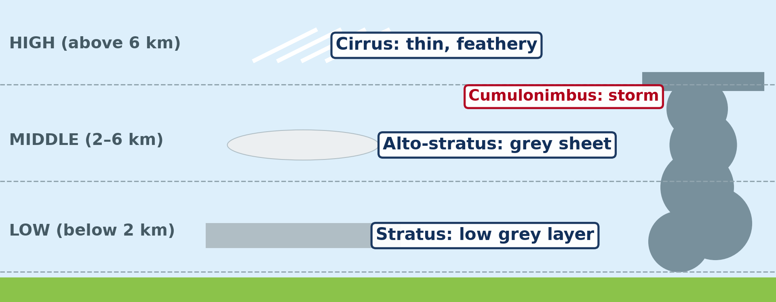
GEOGRAPHY — LOWER SIXTH ARTS
I. CLOUDS
Activity 1
Clouds classified by height and shape.
2026 / 2027
DGCAST GAROUA — GEOGRAPHY DEPARTMENT
Mr KAMDEM E. | 14
Notes:
Without the projector: draw the three levels.

Slide 15
GEOGRAPHY — LOWER SIXTH ARTS
I. CLOUDS
Activity 1: Question
Name a high cloud and a low cloud.
2026 / 2027
DGCAST GAROUA — GEOGRAPHY DEPARTMENT
Mr KAMDEM E. | 15

Slide 16
GEOGRAPHY — LOWER SIXTH ARTS
I. CLOUDS
Answer
Cirrus is high; stratus is low.
2026 / 2027
DGCAST GAROUA — GEOGRAPHY DEPARTMENT
Mr KAMDEM E. | 16

Slide 17
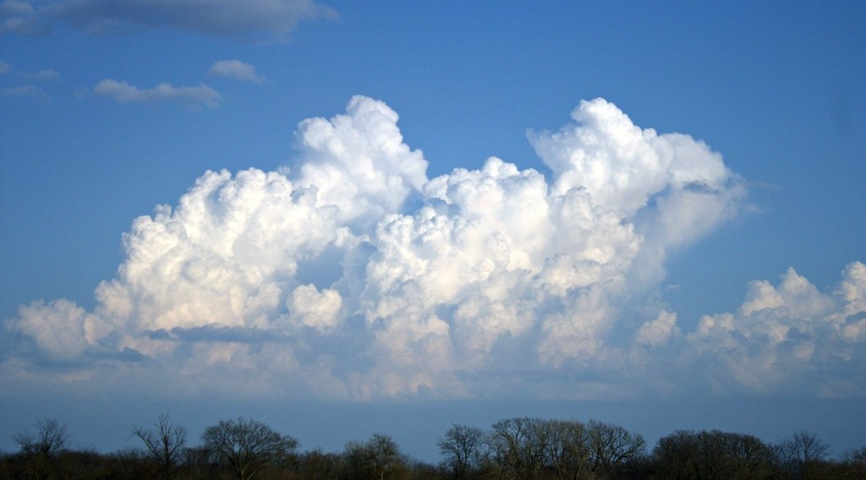
GEOGRAPHY — LOWER SIXTH ARTS
I. CLOUDS
Activity 2
Cumulus clouds on a sunny day.
2026 / 2027
DGCAST GAROUA — GEOGRAPHY DEPARTMENT
Mr KAMDEM E. | 17
Notes:
Without the projector: look at the clouds outside.

Slide 18
GEOGRAPHY — LOWER SIXTH ARTS
I. CLOUDS
Activity 2: Question
What weather do small white cumulus clouds show? What if they grow tall and dark?
2026 / 2027
DGCAST GAROUA — GEOGRAPHY DEPARTMENT
Mr KAMDEM E. | 18

Slide 19
GEOGRAPHY — LOWER SIXTH ARTS
I. CLOUDS
Answer
Fair weather; if they grow into cumulonimbus, storms and heavy rain.
2026 / 2027
DGCAST GAROUA — GEOGRAPHY DEPARTMENT
Mr KAMDEM E. | 19

Slide 20
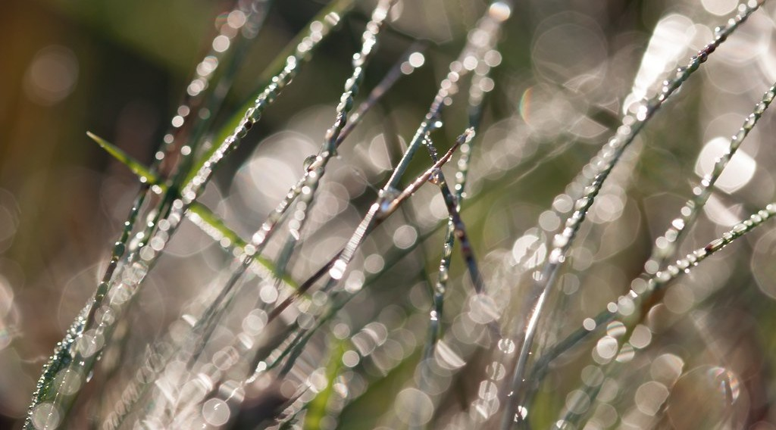
GEOGRAPHY — LOWER SIXTH ARTS
II. SURFACE CONDENSATION
Activity 3
Dew drops on grass in the morning.
2026 / 2027
DGCAST GAROUA — GEOGRAPHY DEPARTMENT
Mr KAMDEM E. | 20
Notes:
Without the projector: take a cold bottle from the fridge: drops form on it.

Slide 21
GEOGRAPHY — LOWER SIXTH ARTS
II. SURFACE CONDENSATION
Activity 3: Question
How does dew form?
2026 / 2027
DGCAST GAROUA — GEOGRAPHY DEPARTMENT
Mr KAMDEM E. | 21

Slide 22
GEOGRAPHY — LOWER SIXTH ARTS
II. SURFACE CONDENSATION
Answer
At night the grass cools below the dew point and vapour condenses on it.
2026 / 2027
DGCAST GAROUA — GEOGRAPHY DEPARTMENT
Mr KAMDEM E. | 22

Slide 23
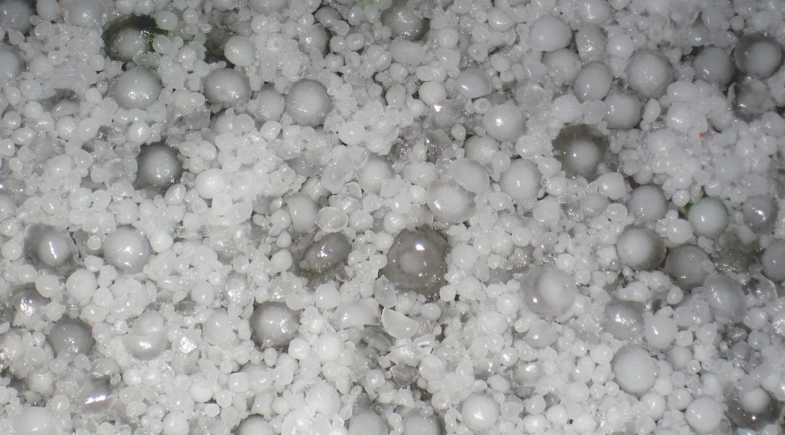
GEOGRAPHY — LOWER SIXTH ARTS
III. PRECIPITATION
Activity 4
Hailstones after a storm.
2026 / 2027
DGCAST GAROUA — GEOGRAPHY DEPARTMENT
Mr KAMDEM E. | 23
Notes:
Without the projector: ask if learners have seen hail.

Slide 24
GEOGRAPHY — LOWER SIXTH ARTS
III. PRECIPITATION
Activity 4: Question
In which cloud does hail form?
2026 / 2027
DGCAST GAROUA — GEOGRAPHY DEPARTMENT
Mr KAMDEM E. | 24

Slide 25
GEOGRAPHY — LOWER SIXTH ARTS
III. PRECIPITATION
Answer
In a cumulonimbus with strong rising air that lifts drops high to freeze.
2026 / 2027
DGCAST GAROUA — GEOGRAPHY DEPARTMENT
Mr KAMDEM E. | 25

Slide 26

GEOGRAPHY — LOWER SIXTH ARTS
IV. TYPES OF RAIN
Activity 5
Convectional, relief and frontal rain.
2026 / 2027
DGCAST GAROUA — GEOGRAPHY DEPARTMENT
Mr KAMDEM E. | 26
Notes:
Without the projector: draw the three types.

Slide 27
GEOGRAPHY — LOWER SIXTH ARTS
IV. TYPES OF RAIN
Activity 5: Question
Which type of rain falls on the windward side of Mount Cameroon?
2026 / 2027
DGCAST GAROUA — GEOGRAPHY DEPARTMENT
Mr KAMDEM E. | 27

Slide 28
GEOGRAPHY — LOWER SIXTH ARTS
IV. TYPES OF RAIN
Answer
Relief (orographic) rain.
2026 / 2027
DGCAST GAROUA — GEOGRAPHY DEPARTMENT
Mr KAMDEM E. | 28

Slide 29
GEOGRAPHY — LOWER SIXTH ARTS
BOARD SUMMARY
Forms of Condensation and Precipitation
Topic: Moisture in the Atmosphere
Sub-topic: Precipitation
Lesson 11: Forms of Condensation and Precipitation
2026 / 2027
DGCAST GAROUA — GEOGRAPHY DEPARTMENT
Mr KAMDEM E. | 29
Notes:
Learners copy the board summary now. Give them enough time for each slide.

Slide 30
GEOGRAPHY — LOWER SIXTH ARTS
BOARD SUMMARY
I. Definitions (1/2)
Condensation: It is the change of water vapour into liquid water.
Cloud: It is a mass of tiny water drops or ice crystals in the air.
Precipitation: It is water falling from clouds as rain, snow or hail.
2026 / 2027
DGCAST GAROUA — GEOGRAPHY DEPARTMENT
Mr KAMDEM E. | 30

Slide 31
GEOGRAPHY — LOWER SIXTH ARTS
BOARD SUMMARY
I. Definitions (2/2)
Dew: It is water drops formed on cold surfaces at night.
2026 / 2027
DGCAST GAROUA — GEOGRAPHY DEPARTMENT
Mr KAMDEM E. | 31

Slide 32
GEOGRAPHY — LOWER SIXTH ARTS
BOARD SUMMARY
II. Clouds, Fog and Mist (1/2)
A. Formation: Rising air cools to its dew point, and vapour condenses on dust. Cloud drops form.
B. Types: High clouds are cirrus, middle clouds are alto, and low clouds are stratus. Cumulus and cumulonimbus grow upwards and give showers and storms.
2026 / 2027
DGCAST GAROUA — GEOGRAPHY DEPARTMENT
Mr KAMDEM E. | 32

Slide 33
GEOGRAPHY — LOWER SIXTH ARTS
BOARD SUMMARY
II. Clouds, Fog and Mist (2/2)
C. Fog and mist: Fog is a cloud at ground level, with visibility under 1 km. Mist is thinner, with visibility over 1 km.
2026 / 2027
DGCAST GAROUA — GEOGRAPHY DEPARTMENT
Mr KAMDEM E. | 33

Slide 34
GEOGRAPHY — LOWER SIXTH ARTS
BOARD SUMMARY
III. Precipitation and Rain Types (1/3)
A. Forms: Liquid forms are rain, drizzle and dew. Solid forms are snow, sleet, hail and frost.
B. Convectional rain: Hot ground heats the air, which rises and forms cumulonimbus. It gives afternoon storms in the tropics.
2026 / 2027
DGCAST GAROUA — GEOGRAPHY DEPARTMENT
Mr KAMDEM E. | 34

Slide 35
GEOGRAPHY — LOWER SIXTH ARTS
BOARD SUMMARY
III. Precipitation and Rain Types (2/3)
C. Relief and frontal rain: Relief rain falls when mountains force wet air to rise. Frontal rain falls when warm air rises over cold air.
2026 / 2027
DGCAST GAROUA — GEOGRAPHY DEPARTMENT
Mr KAMDEM E. | 35

Slide 36
GEOGRAPHY — LOWER SIXTH ARTS
BOARD SUMMARY
III. Precipitation and Rain Types (3/3)
Copy the three types of rain.
2026 / 2027
DGCAST GAROUA — GEOGRAPHY DEPARTMENT
Mr KAMDEM E. | 36

Slide 37
GEOGRAPHY — LOWER SIXTH ARTS
FORMATIVE EVALUATION
Formative Evaluation 1
How does a cloud form?
2026 / 2027
DGCAST GAROUA — GEOGRAPHY DEPARTMENT
Mr KAMDEM E. | 37

Slide 38
GEOGRAPHY — LOWER SIXTH ARTS
FORMATIVE EVALUATION
Expected Answer
Rising air cools to dew point and vapour condenses on dust particles.
2026 / 2027
DGCAST GAROUA — GEOGRAPHY DEPARTMENT
Mr KAMDEM E. | 38

Slide 39
GEOGRAPHY — LOWER SIXTH ARTS
FORMATIVE EVALUATION
Formative Evaluation 2
Name the three types of rainfall.
2026 / 2027
DGCAST GAROUA — GEOGRAPHY DEPARTMENT
Mr KAMDEM E. | 39

Slide 40
GEOGRAPHY — LOWER SIXTH ARTS
FORMATIVE EVALUATION
Expected Answer
Convectional, relief (orographic) and frontal (cyclonic).
2026 / 2027
DGCAST GAROUA — GEOGRAPHY DEPARTMENT
Mr KAMDEM E. | 40

Slide 41
GEOGRAPHY — LOWER SIXTH ARTS
REMEDIATION
Remediation
Fill in the blanks:
The change from vapour to water is ______.
Storm clouds are called ______.
Rain on the windward side of a mountain is ______ rain.
2026 / 2027
DGCAST GAROUA — GEOGRAPHY DEPARTMENT
Mr KAMDEM E. | 41
Notes:
Answers: 1. condensation 2. cumulonimbus 3. relief

Slide 42
GEOGRAPHY — LOWER SIXTH ARTS
HOMEWORK
Homework
Observe the clouds at 7 a.m. and 3 p.m. for a week and record their types.
This prepares Lesson 12: Global Distribution of Precipitation.
2026 / 2027
DGCAST GAROUA — GEOGRAPHY DEPARTMENT
Mr KAMDEM E. | 42
Notes:
This homework prepares the next lesson.

Slide 43
GEOGRAPHY — LOWER SIXTH ARTS
BILINGUAL GAME
Bilingual Game (Jeu Bilingue)
English | Français
Cloud | Le nuage
Hail | La grêle
Dew | La rosée
Condensation | La condensation
Relief rain | Pluie orographique
Storm | L'orage
2026 / 2027
DGCAST GAROUA — GEOGRAPHY DEPARTMENT
Mr KAMDEM E. | 43
Notes:
Say the English word; learners give the French word, then the reverse.

Slide 44
GEOGRAPHY — LOWER SIXTH ARTS
LOGBOOK
Official Logbook (1/2)
Module / Topic | Moisture in the Atmosphere
Lesson Title | Lesson 11: Forms of Condensation and Precipitation
Expected Learning Outcomes | Explain condensation and classify clouds. Describe solid and liquid forms of precipitation. Explain convectional, relief and frontal rain.
Competence | Learners are able to identify clouds, forms of precipitation and types of rainfall and predict the weather.
2026 / 2027
DGCAST GAROUA — GEOGRAPHY DEPARTMENT
Mr KAMDEM E. | 44

Slide 45
GEOGRAPHY — LOWER SIXTH ARTS
LOGBOOK
Official Logbook (2/2)
Matter Taught | I. Definitions: Condensation, Cloud, Precipitation, Dew; II. Clouds, Fog and Mist: Formation, Types, Fog and mist; III. Precipitation and Rain Types: Forms, Convectional rain, Relief and frontal rain.
Evaluation | Formative evaluation (3 questions) and remediation exercise.
Homework | Observe the clouds at 7 a.m. and 3 p.m. for a week and record their types.
Enrolment / Present / Absent | ____ / ____ / ____
Achievement | To be completed by the teacher after the lesson.
2026 / 2027
DGCAST GAROUA — GEOGRAPHY DEPARTMENT
Mr KAMDEM E. | 45

Slide 46
GEOGRAPHY — LOWER SIXTH ARTS
TEACHER'S NOTE
Teacher's Note
Timing: Set-up, recall 8 min | Situation 8 min | 5 activities 30 min | Board summary (copying) 30 min | Evaluation, remediation 10 min | Homework, logbook 9 min | Spare 5 min
2026 / 2027
DGCAST GAROUA — GEOGRAPHY DEPARTMENT
Mr KAMDEM E. | 46

Slide 47
GEOGRAPHY — LOWER SIXTH ARTS
REFERENCES
References
National Geography Syllabus, Sixth Forms (Lower & Upper Sixth), MINESEC/IGE/IP-SS, August 2019 — Module 1 (Meteorology, Climatology & Hydrology).
Photo, Activity 2: “Epic Cloud (Explored)” by Christina Ann VanMeter, CC BY-NC 2.0, via Flickr (https://www.flickr.com/photos/54129831@N02/6984912657)
Photo, Activity 3: “Dew drops on grass” by Ervins Strauhmanis, CC BY 2.0, via Flickr (https://www.flickr.com/photos/76523360@N03/9537409567)
Photo, Activity 4: “Hailstones (4 July 2010) (Limon, eastern Colorado, USA) 3” by James St. John, CC BY 2.0, via Flickr (https://www.flickr.com/photos/47445767@N05/15148092311)
Diagrams and animations: drawn for this lesson (DGCAST Geography Department).
2026 / 2027
DGCAST GAROUA — GEOGRAPHY DEPARTMENT
Mr KAMDEM E. | 47

