Slide 1

DIVINE GRACE COLLEGE OF ARTS, SCIENCE AND TECHNOLOGY
(DGCAST) — GAROUA | GEOGRAPHY DEPARTMENT
LOWER SIXTH ARTS — CLIMATOLOGY — LESSON 13
Pressure Systems
Mr KAMDEM EMMANUEL
Geography Teacher — PLEG
Academic Year 2026 / 2027
Notes:
Good morning, class. Today we study Lesson 13: Pressure Systems.

Slide 2
GEOGRAPHY — LOWER SIXTH ARTS
CLASS INFO
Class, Chapter & Duration
Class | Lower Sixth Arts
Chapter | Module 1: Understanding and managing atmospheric and hydrological phenomena and hazards across the world in general and Cameroon in particular
Duration | 2 periods (2 × 50 minutes)
2026 / 2027
DGCAST GAROUA — GEOGRAPHY DEPARTMENT
Mr KAMDEM E. | 2

Slide 3
GEOGRAPHY — LOWER SIXTH ARTS
IDENTIFICATION
Lesson Identification
Topic | Global and Local Atmospheric Circulation
Sub-topic | Pressure Belts
Lesson | Lesson 13: Pressure Systems
Notions / Concepts | Atmospheric pressure, isobar, barometer, high pressure, low pressure, Hadley cell, tricellular model.
Syllabus focus | Meaning of pressure; pressure belts; the tricellular model with emphasis on the Hadley cell.
Competence | Learners are able to explain pressure belts and the general circulation of the atmosphere.
2026 / 2027
DGCAST GAROUA — GEOGRAPHY DEPARTMENT
Mr KAMDEM E. | 3

Slide 4
GEOGRAPHY — LOWER SIXTH ARTS
OBJECTIVES
Learning Objectives
By the end of the lesson, the learner should be able to:
Define atmospheric pressure and name its units.
Describe the pressure belts.
Explain the tricellular model and the Hadley cell.
2026 / 2027
DGCAST GAROUA — GEOGRAPHY DEPARTMENT
Mr KAMDEM E. | 4

Slide 5
GEOGRAPHY — LOWER SIXTH ARTS
RECALL
Recall
Hot air rises and cold air sinks.
Deserts lie under high pressure.
2026 / 2027
DGCAST GAROUA — GEOGRAPHY DEPARTMENT
Mr KAMDEM E. | 5

Slide 6
GEOGRAPHY — LOWER SIXTH ARTS
REAL-LIFE SITUATION
Real-Life Situation
A weather report on the radio says that low pressure is bringing storms to Douala while high pressure keeps the Sahara dry. Learners wonder what pressure is and why it changes.
2026 / 2027
DGCAST GAROUA — GEOGRAPHY DEPARTMENT
Mr KAMDEM E. | 6
Notes:
Read the situation slowly, twice.

Slide 7
GEOGRAPHY — LOWER SIXTH ARTS
REAL-LIFE SITUATION
Situation — Question 1
What is the problem in the situation?
2026 / 2027
DGCAST GAROUA — GEOGRAPHY DEPARTMENT
Mr KAMDEM E. | 7

Slide 8
GEOGRAPHY — LOWER SIXTH ARTS
REAL-LIFE SITUATION
Answer
Learners do not understand pressure systems.
2026 / 2027
DGCAST GAROUA — GEOGRAPHY DEPARTMENT
Mr KAMDEM E. | 8

Slide 9
GEOGRAPHY — LOWER SIXTH ARTS
REAL-LIFE SITUATION
Situation — Question 2
What weather comes with low pressure?
2026 / 2027
DGCAST GAROUA — GEOGRAPHY DEPARTMENT
Mr KAMDEM E. | 9

Slide 10
GEOGRAPHY — LOWER SIXTH ARTS
REAL-LIFE SITUATION
Answer
Clouds and rain.
2026 / 2027
DGCAST GAROUA — GEOGRAPHY DEPARTMENT
Mr KAMDEM E. | 10

Slide 11
GEOGRAPHY — LOWER SIXTH ARTS
REAL-LIFE SITUATION
Situation — Question 3
What weather comes with high pressure?
2026 / 2027
DGCAST GAROUA — GEOGRAPHY DEPARTMENT
Mr KAMDEM E. | 11

Slide 12
GEOGRAPHY — LOWER SIXTH ARTS
REAL-LIFE SITUATION
Possible Answer
Dry, clear weather.
2026 / 2027
DGCAST GAROUA — GEOGRAPHY DEPARTMENT
Mr KAMDEM E. | 12

Slide 13
GEOGRAPHY — LOWER SIXTH ARTS
JUSTIFICATION
Justification of the Lesson
This lesson helps us to understand the great movements of air that control world climates.
2026 / 2027
DGCAST GAROUA — GEOGRAPHY DEPARTMENT
Mr KAMDEM E. | 13

Slide 14

GEOGRAPHY — LOWER SIXTH ARTS
I. PRESSURE
Activity 1
A barometer measures air pressure.
2026 / 2027
DGCAST GAROUA — GEOGRAPHY DEPARTMENT
Mr KAMDEM E. | 14
Notes:
Without the projector: press on a table to show weight.

Slide 15
GEOGRAPHY — LOWER SIXTH ARTS
I. PRESSURE
Activity 1: Question
What is the average pressure at sea level? In what unit?
2026 / 2027
DGCAST GAROUA — GEOGRAPHY DEPARTMENT
Mr KAMDEM E. | 15

Slide 16
GEOGRAPHY — LOWER SIXTH ARTS
I. PRESSURE
Answer
About 1013 hectopascals (hPa or millibars).
2026 / 2027
DGCAST GAROUA — GEOGRAPHY DEPARTMENT
Mr KAMDEM E. | 16

Slide 17

GEOGRAPHY — LOWER SIXTH ARTS
II. PRESSURE BELTS
Activity 2
The pressure belts of the northern hemisphere.
2026 / 2027
DGCAST GAROUA — GEOGRAPHY DEPARTMENT
Mr KAMDEM E. | 17
Notes:
Without the projector: draw the belts on a circle.

Slide 18
GEOGRAPHY — LOWER SIXTH ARTS
II. PRESSURE BELTS
Activity 2: Question
Name the four pressure belts from the Equator to the pole.
2026 / 2027
DGCAST GAROUA — GEOGRAPHY DEPARTMENT
Mr KAMDEM E. | 18

Slide 19
GEOGRAPHY — LOWER SIXTH ARTS
II. PRESSURE BELTS
Answer
Equatorial low, subtropical high, temperate low, polar high.
2026 / 2027
DGCAST GAROUA — GEOGRAPHY DEPARTMENT
Mr KAMDEM E. | 19

Slide 20
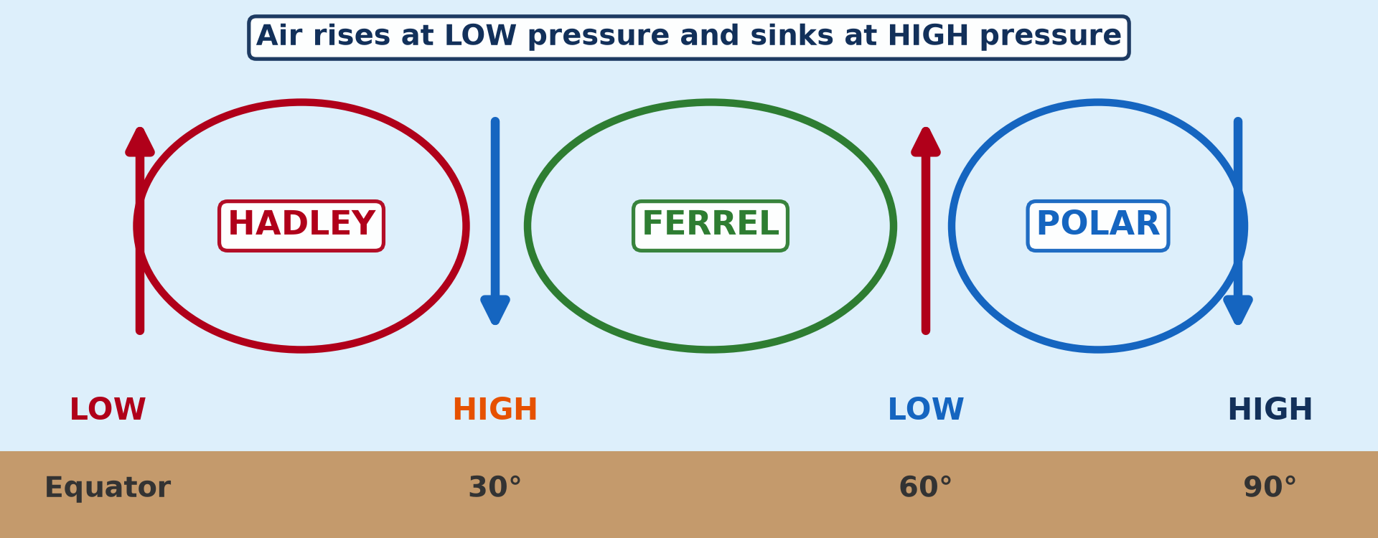
GEOGRAPHY — LOWER SIXTH ARTS
III. THE TRICELLULAR MODEL
Activity 3
The three cells of the general circulation.
2026 / 2027
DGCAST GAROUA — GEOGRAPHY DEPARTMENT
Mr KAMDEM E. | 20
Notes:
Without the projector: draw three loops.

Slide 21
GEOGRAPHY — LOWER SIXTH ARTS
III. THE TRICELLULAR MODEL
Activity 3: Question
Name the three cells from the Equator to the pole.
2026 / 2027
DGCAST GAROUA — GEOGRAPHY DEPARTMENT
Mr KAMDEM E. | 21

Slide 22
GEOGRAPHY — LOWER SIXTH ARTS
III. THE TRICELLULAR MODEL
Answer
Hadley cell, Ferrel cell and Polar cell.
2026 / 2027
DGCAST GAROUA — GEOGRAPHY DEPARTMENT
Mr KAMDEM E. | 22

Slide 23
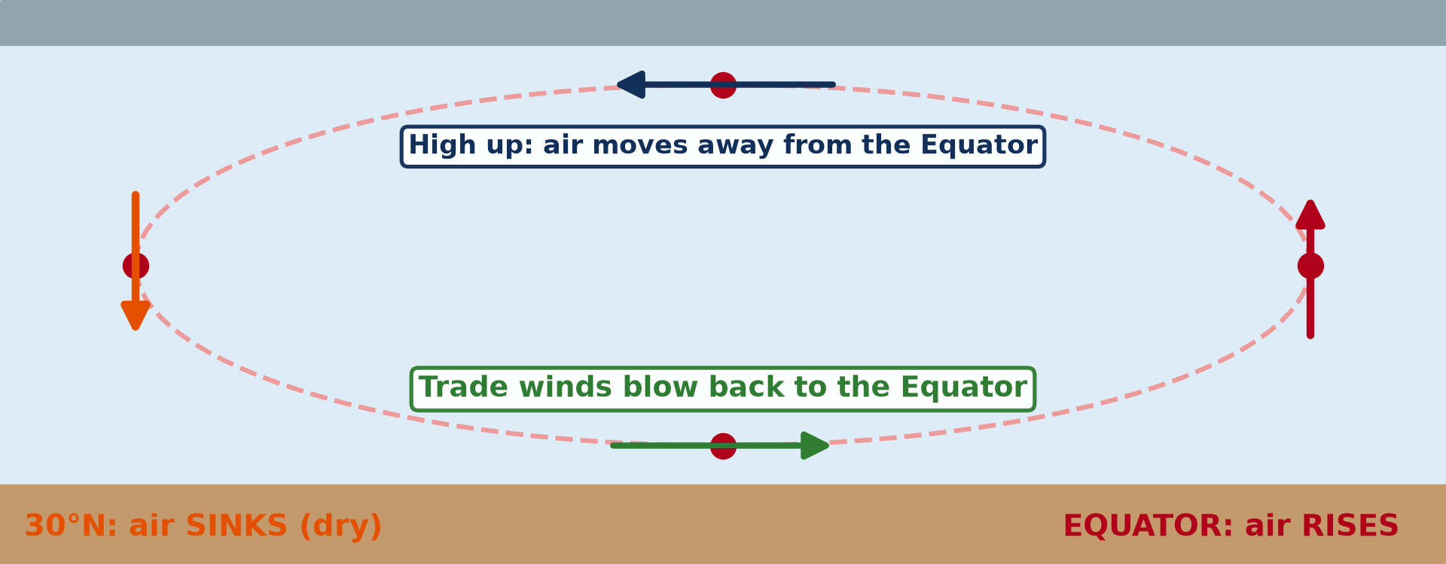
GEOGRAPHY — LOWER SIXTH ARTS
III. THE HADLEY CELL
Activity 4
Animation: the Hadley cell.
2026 / 2027
DGCAST GAROUA — GEOGRAPHY DEPARTMENT
Mr KAMDEM E. | 23
Notes:
Without the projector: describe the circulation with the hands.

Slide 24
GEOGRAPHY — LOWER SIXTH ARTS
III. THE HADLEY CELL
Activity 4: Question
Where does air rise and where does it sink in the Hadley cell?
2026 / 2027
DGCAST GAROUA — GEOGRAPHY DEPARTMENT
Mr KAMDEM E. | 24

Slide 25
GEOGRAPHY — LOWER SIXTH ARTS
III. THE HADLEY CELL
Answer
It rises at the Equator and sinks near 30°.
2026 / 2027
DGCAST GAROUA — GEOGRAPHY DEPARTMENT
Mr KAMDEM E. | 25

Slide 26

GEOGRAPHY — LOWER SIXTH ARTS
III. THE HADLEY CELL
Activity 5
The Sahara under the subtropical high.
2026 / 2027
DGCAST GAROUA — GEOGRAPHY DEPARTMENT
Mr KAMDEM E. | 26
Notes:
Without the projector: show the Sahara on the map.

Slide 27
GEOGRAPHY — LOWER SIXTH ARTS
III. THE HADLEY CELL
Activity 5: Question
What is the effect of sinking air near 30°?
2026 / 2027
DGCAST GAROUA — GEOGRAPHY DEPARTMENT
Mr KAMDEM E. | 27

Slide 28
GEOGRAPHY — LOWER SIXTH ARTS
III. THE HADLEY CELL
Answer
It warms and dries, giving deserts like the Sahara.
2026 / 2027
DGCAST GAROUA — GEOGRAPHY DEPARTMENT
Mr KAMDEM E. | 28

Slide 29
GEOGRAPHY — LOWER SIXTH ARTS
BOARD SUMMARY
Pressure Systems
Topic: Global and Local Atmospheric Circulation
Sub-topic: Pressure Belts
Lesson 13: Pressure Systems
2026 / 2027
DGCAST GAROUA — GEOGRAPHY DEPARTMENT
Mr KAMDEM E. | 29
Notes:
Learners copy the board summary now. Give them enough time for each slide.

Slide 30
GEOGRAPHY — LOWER SIXTH ARTS
BOARD SUMMARY
I. Definitions
Atmospheric pressure: It is the weight of the air on the Earth's surface.
Isobar: It is a line joining places with the same pressure.
Tricellular model: It is a model of the atmosphere with three cells of air in each hemisphere.
2026 / 2027
DGCAST GAROUA — GEOGRAPHY DEPARTMENT
Mr KAMDEM E. | 30

Slide 31
GEOGRAPHY — LOWER SIXTH ARTS
BOARD SUMMARY
II. Pressure Belts (1/2)
A. Equatorial low (0°): Hot air rises and gives clouds and rain. It is also called the ITCZ or doldrums.
B. Subtropical high (30°): Air sinks and warms, so the weather is dry. The great deserts are here.
2026 / 2027
DGCAST GAROUA — GEOGRAPHY DEPARTMENT
Mr KAMDEM E. | 31

Slide 32
GEOGRAPHY — LOWER SIXTH ARTS
BOARD SUMMARY
II. Pressure Belts (2/2)
C. Temperate low (60°) and polar high (90°): At 60° warm and cold air meet and rise. At the poles cold, heavy air sinks.
2026 / 2027
DGCAST GAROUA — GEOGRAPHY DEPARTMENT
Mr KAMDEM E. | 32

Slide 33
GEOGRAPHY — LOWER SIXTH ARTS
BOARD SUMMARY
III. The Tricellular Model (1/3)
A. Hadley cell: Air rises at the Equator, moves towards the poles high up and sinks at 30°. It returns to the Equator as the trade winds.
B. Ferrel cell: It lies between 30° and 60°. Air near the ground moves towards the poles as the westerlies.
2026 / 2027
DGCAST GAROUA — GEOGRAPHY DEPARTMENT
Mr KAMDEM E. | 33

Slide 34
GEOGRAPHY — LOWER SIXTH ARTS
BOARD SUMMARY
III. The Tricellular Model (2/3)
C. Polar cell: Cold air sinks at the poles and moves towards 60°. It rises there at the polar front.
2026 / 2027
DGCAST GAROUA — GEOGRAPHY DEPARTMENT
Mr KAMDEM E. | 34

Slide 35
GEOGRAPHY — LOWER SIXTH ARTS
BOARD SUMMARY
III. The Tricellular Model (3/3)
Copy the three cells.
2026 / 2027
DGCAST GAROUA — GEOGRAPHY DEPARTMENT
Mr KAMDEM E. | 35

Slide 36
GEOGRAPHY — LOWER SIXTH ARTS
FORMATIVE EVALUATION
Formative Evaluation 1
What weather is found under high pressure? Why?
2026 / 2027
DGCAST GAROUA — GEOGRAPHY DEPARTMENT
Mr KAMDEM E. | 36

Slide 37
GEOGRAPHY — LOWER SIXTH ARTS
FORMATIVE EVALUATION
Expected Answer
Dry, clear weather, because air sinks and warms.
2026 / 2027
DGCAST GAROUA — GEOGRAPHY DEPARTMENT
Mr KAMDEM E. | 37

Slide 38
GEOGRAPHY — LOWER SIXTH ARTS
FORMATIVE EVALUATION
Formative Evaluation 2
Describe the Hadley cell.
2026 / 2027
DGCAST GAROUA — GEOGRAPHY DEPARTMENT
Mr KAMDEM E. | 38

Slide 39
GEOGRAPHY — LOWER SIXTH ARTS
FORMATIVE EVALUATION
Expected Answer
Air rises at the Equator, moves poleward high up, sinks at 30° and returns as trade winds.
2026 / 2027
DGCAST GAROUA — GEOGRAPHY DEPARTMENT
Mr KAMDEM E. | 39

Slide 40
GEOGRAPHY — LOWER SIXTH ARTS
REMEDIATION
Remediation
Fill in the blanks:
Pressure is measured with a ______.
The deserts lie under the subtropical ______.
The cell between 0° and 30° is the ______ cell.
2026 / 2027
DGCAST GAROUA — GEOGRAPHY DEPARTMENT
Mr KAMDEM E. | 40
Notes:
Answers: 1. barometer 2. high 3. Hadley

Slide 41
GEOGRAPHY — LOWER SIXTH ARTS
HOMEWORK
Homework
Draw the tricellular model and label the pressure belts.
This prepares Lesson 14: Vertical Motions.
2026 / 2027
DGCAST GAROUA — GEOGRAPHY DEPARTMENT
Mr KAMDEM E. | 41
Notes:
This homework prepares the next lesson.

Slide 42
GEOGRAPHY — LOWER SIXTH ARTS
BILINGUAL GAME
Bilingual Game (Jeu Bilingue)
English | Français
Pressure | La pression
Barometer | Le baromètre
Isobar | L'isobare
High pressure | Anticyclone
Low pressure | Dépression
Cell | La cellule
2026 / 2027
DGCAST GAROUA — GEOGRAPHY DEPARTMENT
Mr KAMDEM E. | 42
Notes:
Say the English word; learners give the French word, then the reverse.

Slide 43
GEOGRAPHY — LOWER SIXTH ARTS
LOGBOOK
Official Logbook (1/2)
Module / Topic | Global and Local Atmospheric Circulation
Lesson Title | Lesson 13: Pressure Systems
Expected Learning Outcomes | Define atmospheric pressure and name its units. Describe the pressure belts. Explain the tricellular model and the Hadley cell.
Competence | Learners are able to explain pressure belts and the general circulation of the atmosphere.
2026 / 2027
DGCAST GAROUA — GEOGRAPHY DEPARTMENT
Mr KAMDEM E. | 43

Slide 44
GEOGRAPHY — LOWER SIXTH ARTS
LOGBOOK
Official Logbook (2/2)
Matter Taught | I. Definitions: Atmospheric pressure, Isobar, Tricellular model; II. Pressure Belts: Equatorial low (0°), Subtropical high (30°), Temperate low (60°) and polar high (90°); III. The Tricellular Model: Hadley cell, Ferrel cell, Polar cell.
Evaluation | Formative evaluation (3 questions) and remediation exercise.
Homework | Draw the tricellular model and label the pressure belts.
Enrolment / Present / Absent | ____ / ____ / ____
Achievement | To be completed by the teacher after the lesson.
2026 / 2027
DGCAST GAROUA — GEOGRAPHY DEPARTMENT
Mr KAMDEM E. | 44

Slide 45
GEOGRAPHY — LOWER SIXTH ARTS
TEACHER'S NOTE
Teacher's Note
Timing: Set-up, recall 8 min | Situation 8 min | 5 activities 30 min | Board summary (copying) 30 min | Evaluation, remediation 10 min | Homework, logbook 9 min | Spare 5 min
Activity 4 is an animation (GIF): it plays automatically in slide-show mode.
2026 / 2027
DGCAST GAROUA — GEOGRAPHY DEPARTMENT
Mr KAMDEM E. | 45

Slide 46
GEOGRAPHY — LOWER SIXTH ARTS
REFERENCES
References
National Geography Syllabus, Sixth Forms (Lower & Upper Sixth), MINESEC/IGE/IP-SS, August 2019 — Module 1 (Meteorology, Climatology & Hydrology).
Photo, Activity 1: “Aneroid Barometer, with dial designed by Sir Napier Shaw, 1914” by Negretti & Zambra; Shaw, Sir Napier, CC BY-NC-SA 4.0, via sciencemuseum (https://collection.sciencemuseumgroup.org.uk/objects/co54459/aneroid-barometer-with-dial-designed-by-sir-napier-shaw-1914)
Photo, Activity 5: “Desert trekking in Merzouga” by Antonio Cinotti , CC BY-NC-ND 2.0, via Flickr (https://www.flickr.com/photos/46378751@N02/15331399979)
Diagrams and animations: drawn for this lesson (DGCAST Geography Department).
2026 / 2027
DGCAST GAROUA — GEOGRAPHY DEPARTMENT
Mr KAMDEM E. | 46

