Slide 1

DIVINE GRACE COLLEGE OF ARTS, SCIENCE AND TECHNOLOGY
(DGCAST) — GAROUA | GEOGRAPHY DEPARTMENT
LOWER SIXTH ARTS — CLIMATOLOGY — LESSON 14
Vertical Motions: Stability and Instability
Mr KAMDEM EMMANUEL
Geography Teacher — PLEG
Academic Year 2026 / 2027
Notes:
Good morning, class. Today we study Lesson 14: Vertical Motions: Stability and Instability.

Slide 2
GEOGRAPHY — LOWER SIXTH ARTS
CLASS INFO
Class, Chapter & Duration
Class | Lower Sixth Arts
Chapter | Module 1: Understanding and managing atmospheric and hydrological phenomena and hazards across the world in general and Cameroon in particular
Duration | 2 periods (2 × 50 minutes)
2026 / 2027
DGCAST GAROUA — GEOGRAPHY DEPARTMENT
Mr KAMDEM E. | 2

Slide 3
GEOGRAPHY — LOWER SIXTH ARTS
IDENTIFICATION
Lesson Identification
Topic | Global and Local Atmospheric Circulation
Sub-topic | Atmospheric Motions
Lesson | Lesson 14: Vertical Motions: Stability and Instability
Notions / Concepts | Air parcel, stability, instability, conditional instability, dry and saturated adiabatic lapse rates.
Syllabus focus | Meaning, types and weather of instability and stability.
Competence | Learners are able to explain why air rises or sinks and predict the weather that follows.
2026 / 2027
DGCAST GAROUA — GEOGRAPHY DEPARTMENT
Mr KAMDEM E. | 3

Slide 4
GEOGRAPHY — LOWER SIXTH ARTS
OBJECTIVES
Learning Objectives
By the end of the lesson, the learner should be able to:
Define stability and instability.
Compare the lapse rates of a rising parcel and the surrounding air.
Describe the weather of stable and unstable air.
2026 / 2027
DGCAST GAROUA — GEOGRAPHY DEPARTMENT
Mr KAMDEM E. | 4

Slide 5
GEOGRAPHY — LOWER SIXTH ARTS
RECALL
Recall
Rising air cools by expansion.
The environmental lapse rate is about 6.5 °C per 1,000 m.
2026 / 2027
DGCAST GAROUA — GEOGRAPHY DEPARTMENT
Mr KAMDEM E. | 5

Slide 6
GEOGRAPHY — LOWER SIXTH ARTS
REAL-LIFE SITUATION
Real-Life Situation
On some afternoons in Yaoundé, huge clouds grow very fast and storms break out. On other days the sky stays grey and flat, and smoke hangs low over the town.
2026 / 2027
DGCAST GAROUA — GEOGRAPHY DEPARTMENT
Mr KAMDEM E. | 6
Notes:
Read the situation slowly, twice.

Slide 7
GEOGRAPHY — LOWER SIXTH ARTS
REAL-LIFE SITUATION
Situation — Question 1
What is the problem in the situation?
2026 / 2027
DGCAST GAROUA — GEOGRAPHY DEPARTMENT
Mr KAMDEM E. | 7

Slide 8
GEOGRAPHY — LOWER SIXTH ARTS
REAL-LIFE SITUATION
Answer
Learners do not know why some days are stormy and others calm.
2026 / 2027
DGCAST GAROUA — GEOGRAPHY DEPARTMENT
Mr KAMDEM E. | 8

Slide 9
GEOGRAPHY — LOWER SIXTH ARTS
REAL-LIFE SITUATION
Situation — Question 2
What happens on stormy days?
2026 / 2027
DGCAST GAROUA — GEOGRAPHY DEPARTMENT
Mr KAMDEM E. | 9

Slide 10
GEOGRAPHY — LOWER SIXTH ARTS
REAL-LIFE SITUATION
Answer
Air rises quickly: it is unstable.
2026 / 2027
DGCAST GAROUA — GEOGRAPHY DEPARTMENT
Mr KAMDEM E. | 10

Slide 11
GEOGRAPHY — LOWER SIXTH ARTS
REAL-LIFE SITUATION
Situation — Question 3
What happens on calm grey days?
2026 / 2027
DGCAST GAROUA — GEOGRAPHY DEPARTMENT
Mr KAMDEM E. | 11

Slide 12
GEOGRAPHY — LOWER SIXTH ARTS
REAL-LIFE SITUATION
Possible Answer
Air does not rise: it is stable.
2026 / 2027
DGCAST GAROUA — GEOGRAPHY DEPARTMENT
Mr KAMDEM E. | 12

Slide 13
GEOGRAPHY — LOWER SIXTH ARTS
JUSTIFICATION
Justification of the Lesson
This lesson helps us to understand why storms form and why some days stay calm.
2026 / 2027
DGCAST GAROUA — GEOGRAPHY DEPARTMENT
Mr KAMDEM E. | 13

Slide 14
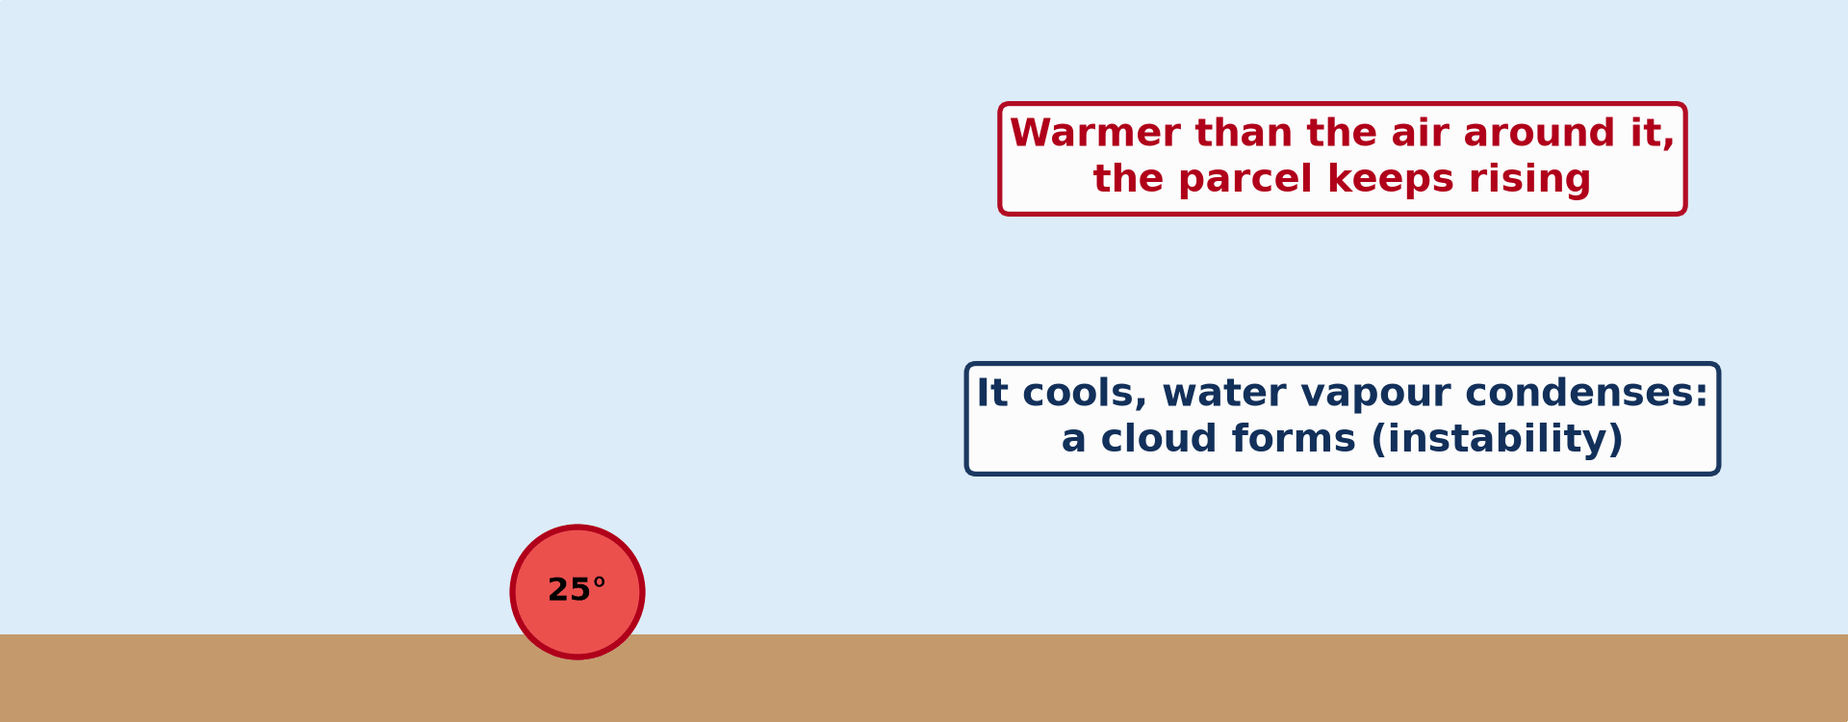
GEOGRAPHY — LOWER SIXTH ARTS
I. AIR PARCELS
Activity 1
Animation: a warm bubble of air rises and forms a cloud.
2026 / 2027
DGCAST GAROUA — GEOGRAPHY DEPARTMENT
Mr KAMDEM E. | 14
Notes:
Without the projector: describe a hot-air balloon.

Slide 15
GEOGRAPHY — LOWER SIXTH ARTS
I. AIR PARCELS
Activity 1: Question
Why does the parcel keep rising?
2026 / 2027
DGCAST GAROUA — GEOGRAPHY DEPARTMENT
Mr KAMDEM E. | 15

Slide 16
GEOGRAPHY — LOWER SIXTH ARTS
I. AIR PARCELS
Answer
It stays warmer and lighter than the air around it.
2026 / 2027
DGCAST GAROUA — GEOGRAPHY DEPARTMENT
Mr KAMDEM E. | 16

Slide 17
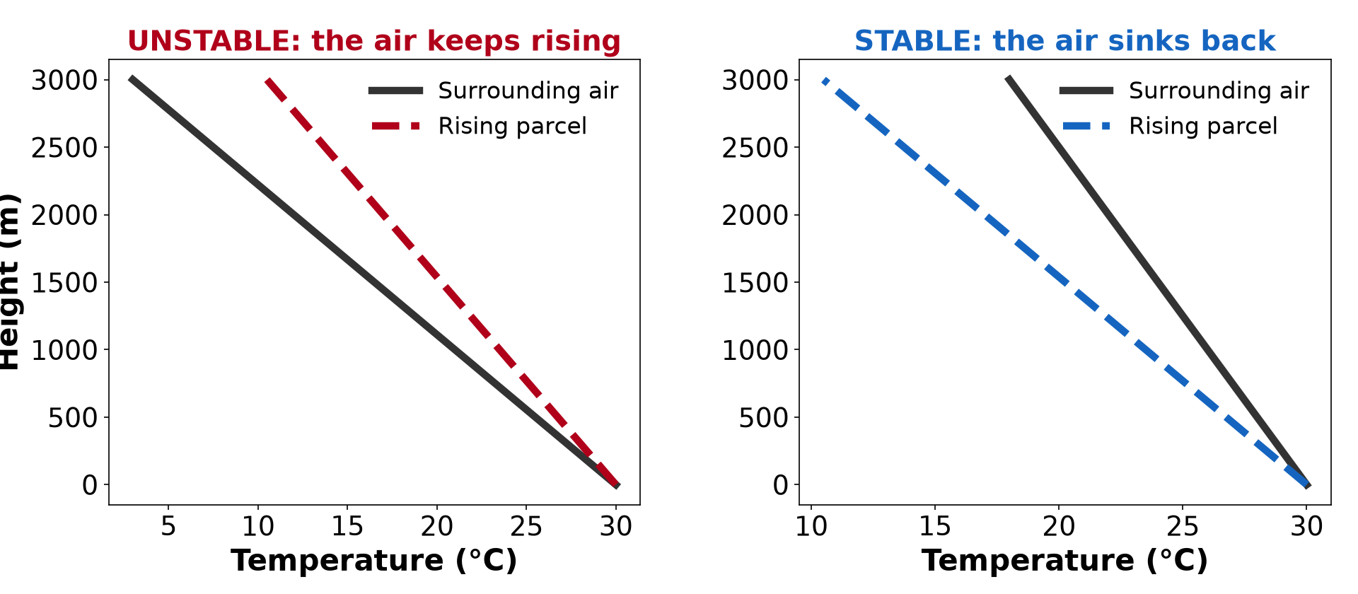
GEOGRAPHY — LOWER SIXTH ARTS
II. STABILITY AND INSTABILITY
Activity 2
An unstable and a stable atmosphere.
2026 / 2027
DGCAST GAROUA — GEOGRAPHY DEPARTMENT
Mr KAMDEM E. | 17
Notes:
Without the projector: draw the two graphs.

Slide 18
GEOGRAPHY — LOWER SIXTH ARTS
II. STABILITY AND INSTABILITY
Activity 2: Question
In the unstable case, is the rising air warmer or colder than the air around it?
2026 / 2027
DGCAST GAROUA — GEOGRAPHY DEPARTMENT
Mr KAMDEM E. | 18

Slide 19
GEOGRAPHY — LOWER SIXTH ARTS
II. STABILITY AND INSTABILITY
Answer
Warmer, so it keeps rising.
2026 / 2027
DGCAST GAROUA — GEOGRAPHY DEPARTMENT
Mr KAMDEM E. | 19

Slide 20

GEOGRAPHY — LOWER SIXTH ARTS
III. WEATHER OF INSTABILITY
Activity 3
A cumulonimbus cloud.
2026 / 2027
DGCAST GAROUA — GEOGRAPHY DEPARTMENT
Mr KAMDEM E. | 20
Notes:
Without the projector: describe an afternoon storm.

Slide 21
GEOGRAPHY — LOWER SIXTH ARTS
III. WEATHER OF INSTABILITY
Activity 3: Question
What weather comes with unstable air?
2026 / 2027
DGCAST GAROUA — GEOGRAPHY DEPARTMENT
Mr KAMDEM E. | 21

Slide 22
GEOGRAPHY — LOWER SIXTH ARTS
III. WEATHER OF INSTABILITY
Answer
Tall clouds, heavy showers, thunder and sometimes hail.
2026 / 2027
DGCAST GAROUA — GEOGRAPHY DEPARTMENT
Mr KAMDEM E. | 22

Slide 23
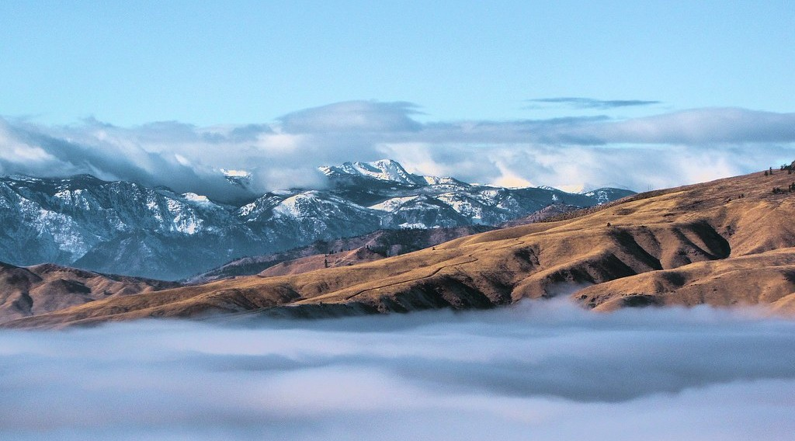
GEOGRAPHY — LOWER SIXTH ARTS
IV. WEATHER OF STABILITY
Activity 4
Flat layers of cloud below a stable layer.
2026 / 2027
DGCAST GAROUA — GEOGRAPHY DEPARTMENT
Mr KAMDEM E. | 23
Notes:
Without the projector: describe a grey, calm morning.

Slide 24
GEOGRAPHY — LOWER SIXTH ARTS
IV. WEATHER OF STABILITY
Activity 4: Question
What weather comes with stable air?
2026 / 2027
DGCAST GAROUA — GEOGRAPHY DEPARTMENT
Mr KAMDEM E. | 24

Slide 25
GEOGRAPHY — LOWER SIXTH ARTS
IV. WEATHER OF STABILITY
Answer
Flat layer clouds, fog or clear skies, and no storms.
2026 / 2027
DGCAST GAROUA — GEOGRAPHY DEPARTMENT
Mr KAMDEM E. | 25

Slide 26

GEOGRAPHY — LOWER SIXTH ARTS
IV. WEATHER OF STABILITY
Activity 5
Smoke and haze trapped over a city.
2026 / 2027
DGCAST GAROUA — GEOGRAPHY DEPARTMENT
Mr KAMDEM E. | 26
Notes:
Without the projector: watch smoke from a kitchen fire.

Slide 27
GEOGRAPHY — LOWER SIXTH ARTS
IV. WEATHER OF STABILITY
Activity 5: Question
Why does smoke stay near the ground in stable air?
2026 / 2027
DGCAST GAROUA — GEOGRAPHY DEPARTMENT
Mr KAMDEM E. | 27

Slide 28
GEOGRAPHY — LOWER SIXTH ARTS
IV. WEATHER OF STABILITY
Answer
The air cannot rise, so smoke and dust are trapped.
2026 / 2027
DGCAST GAROUA — GEOGRAPHY DEPARTMENT
Mr KAMDEM E. | 28

Slide 29
GEOGRAPHY — LOWER SIXTH ARTS
BOARD SUMMARY
Vertical Motions: Stability and Instability
Topic: Global and Local Atmospheric Circulation
Sub-topic: Atmospheric Motions
Lesson 14: Vertical Motions: Stability and Instability
2026 / 2027
DGCAST GAROUA — GEOGRAPHY DEPARTMENT
Mr KAMDEM E. | 29
Notes:
Learners copy the board summary now. Give them enough time for each slide.

Slide 30
GEOGRAPHY — LOWER SIXTH ARTS
BOARD SUMMARY
I. Definitions
Air parcel: It is a small bubble of air that moves as one unit.
Instability: It is when a rising parcel stays warmer than the air around it and keeps rising.
Stability: It is when a rising parcel becomes colder than the air around it and sinks back.
2026 / 2027
DGCAST GAROUA — GEOGRAPHY DEPARTMENT
Mr KAMDEM E. | 30

Slide 31
GEOGRAPHY — LOWER SIXTH ARTS
BOARD SUMMARY
II. Lapse Rates (1/2)
A. Dry adiabatic lapse rate: Unsaturated rising air cools by about 10 °C per 1,000 m. This is the DALR.
B. Saturated adiabatic lapse rate: Saturated air cools more slowly, about 5 °C per 1,000 m. Condensation releases latent heat.
2026 / 2027
DGCAST GAROUA — GEOGRAPHY DEPARTMENT
Mr KAMDEM E. | 31

Slide 32
GEOGRAPHY — LOWER SIXTH ARTS
BOARD SUMMARY
II. Lapse Rates (2/2)
C. Comparison: We compare the parcel with the environmental lapse rate. This tells us if the air is stable or unstable.
2026 / 2027
DGCAST GAROUA — GEOGRAPHY DEPARTMENT
Mr KAMDEM E. | 32

Slide 33
GEOGRAPHY — LOWER SIXTH ARTS
BOARD SUMMARY
III. Types and Weather (1/3)
A. Absolute instability: The environmental lapse rate is greater than the DALR. Air rises strongly and gives cumulonimbus and storms.
B. Absolute stability: The environmental lapse rate is less than the SALR. Air sinks back, and the weather is calm, with fog or layer clouds.
2026 / 2027
DGCAST GAROUA — GEOGRAPHY DEPARTMENT
Mr KAMDEM E. | 33

Slide 34
GEOGRAPHY — LOWER SIXTH ARTS
BOARD SUMMARY
III. Types and Weather (2/3)
C. Conditional instability: The air is stable when dry but unstable once saturated. It is common in the humid tropics.
2026 / 2027
DGCAST GAROUA — GEOGRAPHY DEPARTMENT
Mr KAMDEM E. | 34

Slide 35
GEOGRAPHY — LOWER SIXTH ARTS
BOARD SUMMARY
III. Types and Weather (3/3)
Copy the two graphs.
2026 / 2027
DGCAST GAROUA — GEOGRAPHY DEPARTMENT
Mr KAMDEM E. | 35

Slide 36
GEOGRAPHY — LOWER SIXTH ARTS
FORMATIVE EVALUATION
Formative Evaluation 1
Distinguish stability and instability.
2026 / 2027
DGCAST GAROUA — GEOGRAPHY DEPARTMENT
Mr KAMDEM E. | 36

Slide 37
GEOGRAPHY — LOWER SIXTH ARTS
FORMATIVE EVALUATION
Expected Answer
Unstable air keeps rising because it stays warmer; stable air sinks back because it becomes colder.
2026 / 2027
DGCAST GAROUA — GEOGRAPHY DEPARTMENT
Mr KAMDEM E. | 37

Slide 38
GEOGRAPHY — LOWER SIXTH ARTS
FORMATIVE EVALUATION
Formative Evaluation 2
Give the weather of unstable air.
2026 / 2027
DGCAST GAROUA — GEOGRAPHY DEPARTMENT
Mr KAMDEM E. | 38

Slide 39
GEOGRAPHY — LOWER SIXTH ARTS
FORMATIVE EVALUATION
Expected Answer
Tall cumulonimbus clouds, heavy showers, thunderstorms.
2026 / 2027
DGCAST GAROUA — GEOGRAPHY DEPARTMENT
Mr KAMDEM E. | 39

Slide 40
GEOGRAPHY — LOWER SIXTH ARTS
REMEDIATION
Remediation
Fill in the blanks:
Unsaturated air cools at about ______ °C per 1,000 m.
Storms come with ______ air.
Fog and smog come with ______ air.
2026 / 2027
DGCAST GAROUA — GEOGRAPHY DEPARTMENT
Mr KAMDEM E. | 40
Notes:
Answers: 1. 10 2. unstable 3. stable

Slide 41
GEOGRAPHY — LOWER SIXTH ARTS
HOMEWORK
Homework
For one week, note whether the afternoon is stormy or calm and link it to stability.
This prepares Lesson 15: Planetary Winds.
2026 / 2027
DGCAST GAROUA — GEOGRAPHY DEPARTMENT
Mr KAMDEM E. | 41
Notes:
This homework prepares the next lesson.

Slide 42
GEOGRAPHY — LOWER SIXTH ARTS
BILINGUAL GAME
Bilingual Game (Jeu Bilingue)
English | Français
Stability | La stabilité
Instability | L'instabilité
Air parcel | La particule d'air
Thunderstorm | L'orage
Saturated | Saturé
Lapse rate | Le gradient
2026 / 2027
DGCAST GAROUA — GEOGRAPHY DEPARTMENT
Mr KAMDEM E. | 42
Notes:
Say the English word; learners give the French word, then the reverse.

Slide 43
GEOGRAPHY — LOWER SIXTH ARTS
LOGBOOK
Official Logbook (1/2)
Module / Topic | Global and Local Atmospheric Circulation
Lesson Title | Lesson 14: Vertical Motions: Stability and Instability
Expected Learning Outcomes | Define stability and instability. Compare the lapse rates of a rising parcel and the surrounding air. Describe the weather of stable and unstable air.
Competence | Learners are able to explain why air rises or sinks and predict the weather that follows.
2026 / 2027
DGCAST GAROUA — GEOGRAPHY DEPARTMENT
Mr KAMDEM E. | 43

Slide 44
GEOGRAPHY — LOWER SIXTH ARTS
LOGBOOK
Official Logbook (2/2)
Matter Taught | I. Definitions: Air parcel, Instability, Stability; II. Lapse Rates: Dry adiabatic lapse rate, Saturated adiabatic lapse rate, Comparison; III. Types and Weather: Absolute instability, Absolute stability, Conditional instability.
Evaluation | Formative evaluation (3 questions) and remediation exercise.
Homework | For one week, note whether the afternoon is stormy or calm and link it to stability.
Enrolment / Present / Absent | ____ / ____ / ____
Achievement | To be completed by the teacher after the lesson.
2026 / 2027
DGCAST GAROUA — GEOGRAPHY DEPARTMENT
Mr KAMDEM E. | 44

Slide 45
GEOGRAPHY — LOWER SIXTH ARTS
TEACHER'S NOTE
Teacher's Note
Timing: Set-up, recall 8 min | Situation 8 min | 5 activities 30 min | Board summary (copying) 30 min | Evaluation, remediation 10 min | Homework, logbook 9 min | Spare 5 min
Activity 1 is an animation (GIF): it plays automatically in slide-show mode.
2026 / 2027
DGCAST GAROUA — GEOGRAPHY DEPARTMENT
Mr KAMDEM E. | 45

Slide 46
GEOGRAPHY — LOWER SIXTH ARTS
REFERENCES
References
National Geography Syllabus, Sixth Forms (Lower & Upper Sixth), MINESEC/IGE/IP-SS, August 2019 — Module 1 (Meteorology, Climatology & Hydrology).
Photo, Activity 3: “06172012 Sunday evening pulse storms/cumulonimbi” by StormRider93 | Into the Storm, CC BY-NC-ND 2.0, via Flickr (https://www.flickr.com/photos/65232104@N04/7395715628)
Photo, Activity 4: “Rising above the Inversion” by Pictoscribe -, CC BY-NC-ND 2.0, via Flickr (https://www.flickr.com/photos/70414856@N00/6535713585)
Photo, Activity 5: “Beijing smog” by kevin dooley, CC BY 2.0, via Flickr (https://www.flickr.com/photos/12836528@N00/386198516)
Diagrams and animations: drawn for this lesson (DGCAST Geography Department).
2026 / 2027
DGCAST GAROUA — GEOGRAPHY DEPARTMENT
Mr KAMDEM E. | 46

