Slide 1

DIVINE GRACE COLLEGE OF ARTS, SCIENCE AND TECHNOLOGY
(DGCAST) — GAROUA | GEOGRAPHY DEPARTMENT
LOWER SIXTH ARTS — GEOMORPHOLOGY — FURTHER STUDY 2
Theory of Sea-Floor Spreading
Mr KAMDEM EMMANUEL
Geography Teacher — PLEG
Academic Year 2026 / 2027
Notes:
Good morning, class. Today we study Further Study 2: Theory of Sea-Floor Spreading.

Slide 2
GEOGRAPHY — LOWER SIXTH ARTS
CLASS INFO
Class, Chapter & Duration
Class | Lower Sixth Arts
Chapter | Module 2: Understanding and managing physical landscapes, geomorphological processes and hazards across the world in general and Cameroon in particular
Duration | 2 periods (2 × 50 minutes)
2026 / 2027
DGCAST GAROUA — GEOGRAPHY DEPARTMENT
Mr KAMDEM E. | 2

Slide 3
GEOGRAPHY — LOWER SIXTH ARTS
IDENTIFICATION
Lesson Identification
Topic | The Development of the Earth's Structure
Sub-topic | Theories of Earth Structure and Resultant Landforms
Lesson | Further Study 2: Theory of Sea-Floor Spreading
Notions / Concepts | Sea-floor spreading, mid-ocean ridge, magnetic striping, pillow lava.
Syllabus focus | What the theory says; mid-oceanic eruptions as a cause; evidence and effects on ocean relief.
Competence | Learners are able to explain how new ocean floor is created and give evidence for it.
2026 / 2027
DGCAST GAROUA — GEOGRAPHY DEPARTMENT
Mr KAMDEM E. | 3

Slide 4
GEOGRAPHY — LOWER SIXTH ARTS
OBJECTIVES
Learning Objectives
By the end of the lesson, the learner should be able to:
State the theory of sea-floor spreading.
Explain the role of mid-ocean ridges.
Give evidence of sea-floor spreading.
2026 / 2027
DGCAST GAROUA — GEOGRAPHY DEPARTMENT
Mr KAMDEM E. | 4

Slide 5
GEOGRAPHY — LOWER SIXTH ARTS
RECALL
Recall
Wegener said that continents drift.
He could not explain what moves them.
2026 / 2027
DGCAST GAROUA — GEOGRAPHY DEPARTMENT
Mr KAMDEM E. | 5

Slide 6
GEOGRAPHY — LOWER SIXTH ARTS
REAL-LIFE SITUATION
Real-Life Situation
In the 1960s, ships studying the Atlantic Ocean found a long chain of underwater mountains. The rocks there were very young, while rocks far from the ridge were older.
2026 / 2027
DGCAST GAROUA — GEOGRAPHY DEPARTMENT
Mr KAMDEM E. | 6
Notes:
Read the situation slowly, twice.

Slide 7
GEOGRAPHY — LOWER SIXTH ARTS
REAL-LIFE SITUATION
Situation — Question 1
What is the problem in the situation?
2026 / 2027
DGCAST GAROUA — GEOGRAPHY DEPARTMENT
Mr KAMDEM E. | 7

Slide 8
GEOGRAPHY — LOWER SIXTH ARTS
REAL-LIFE SITUATION
Answer
Scientists wanted to explain why the rocks near the ridge are young.
2026 / 2027
DGCAST GAROUA — GEOGRAPHY DEPARTMENT
Mr KAMDEM E. | 8

Slide 9
GEOGRAPHY — LOWER SIXTH ARTS
REAL-LIFE SITUATION
Situation — Question 2
Where are the youngest rocks?
2026 / 2027
DGCAST GAROUA — GEOGRAPHY DEPARTMENT
Mr KAMDEM E. | 9

Slide 10
GEOGRAPHY — LOWER SIXTH ARTS
REAL-LIFE SITUATION
Answer
At the mid-ocean ridge.
2026 / 2027
DGCAST GAROUA — GEOGRAPHY DEPARTMENT
Mr KAMDEM E. | 10

Slide 11
GEOGRAPHY — LOWER SIXTH ARTS
REAL-LIFE SITUATION
Situation — Question 3
What does this suggest?
2026 / 2027
DGCAST GAROUA — GEOGRAPHY DEPARTMENT
Mr KAMDEM E. | 11

Slide 12
GEOGRAPHY — LOWER SIXTH ARTS
REAL-LIFE SITUATION
Possible Answer
New ocean floor is made at the ridge and moves away.
2026 / 2027
DGCAST GAROUA — GEOGRAPHY DEPARTMENT
Mr KAMDEM E. | 12

Slide 13
GEOGRAPHY — LOWER SIXTH ARTS
JUSTIFICATION
Justification of the Lesson
This lesson helps us to understand how oceans grow and why continents move apart.
2026 / 2027
DGCAST GAROUA — GEOGRAPHY DEPARTMENT
Mr KAMDEM E. | 13

Slide 14
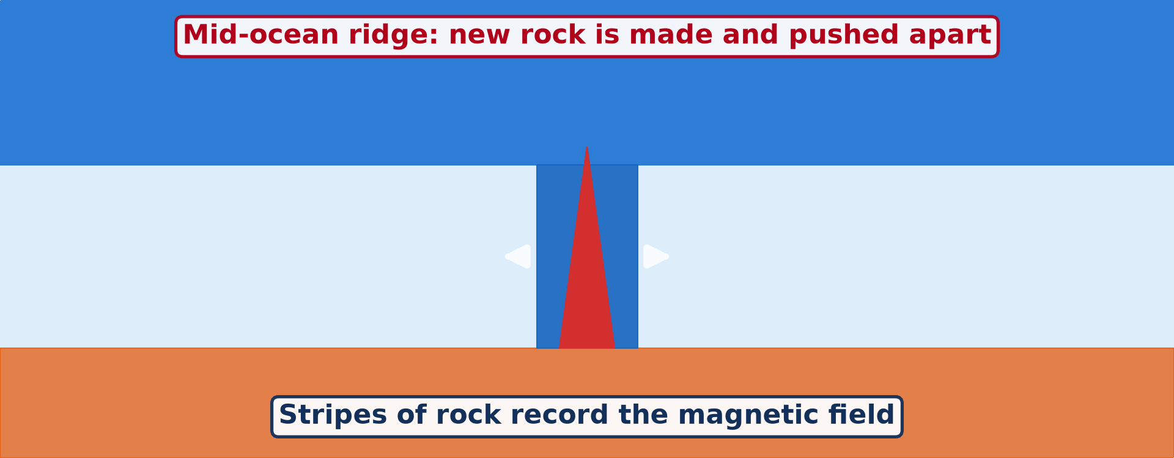
GEOGRAPHY — LOWER SIXTH ARTS
I. THE THEORY
Activity 1
Animation: new rock forms at the ridge and moves away.
2026 / 2027
DGCAST GAROUA — GEOGRAPHY DEPARTMENT
Mr KAMDEM E. | 14
Notes:
Without the projector: draw a ridge with arrows going left and right.

Slide 15
GEOGRAPHY — LOWER SIXTH ARTS
I. THE THEORY
Activity 1: Question
Where is new ocean floor made?
2026 / 2027
DGCAST GAROUA — GEOGRAPHY DEPARTMENT
Mr KAMDEM E. | 15

Slide 16
GEOGRAPHY — LOWER SIXTH ARTS
I. THE THEORY
Answer
At the mid-ocean ridge, where magma rises and cools.
2026 / 2027
DGCAST GAROUA — GEOGRAPHY DEPARTMENT
Mr KAMDEM E. | 16

Slide 17
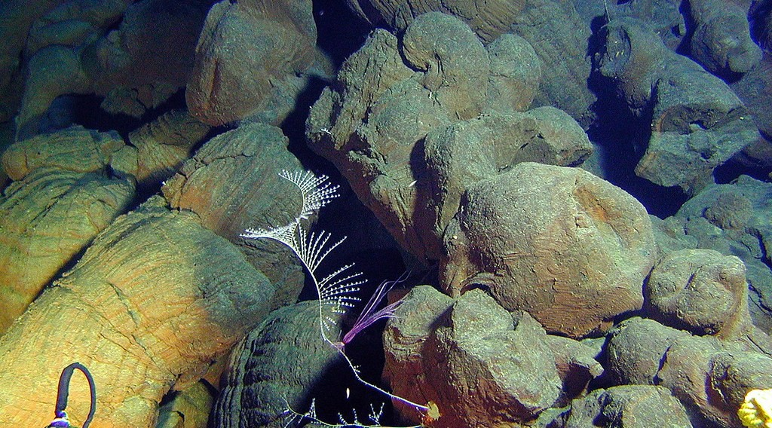
GEOGRAPHY — LOWER SIXTH ARTS
II. MID-OCEAN ERUPTIONS
Activity 2
Pillow lava: lava that cooled under water.
2026 / 2027
DGCAST GAROUA — GEOGRAPHY DEPARTMENT
Mr KAMDEM E. | 17
Notes:
Without the projector: describe hot wax dropped into cold water.

Slide 18
GEOGRAPHY — LOWER SIXTH ARTS
II. MID-OCEAN ERUPTIONS
Activity 2: Question
How does pillow lava form?
2026 / 2027
DGCAST GAROUA — GEOGRAPHY DEPARTMENT
Mr KAMDEM E. | 18

Slide 19
GEOGRAPHY — LOWER SIXTH ARTS
II. MID-OCEAN ERUPTIONS
Answer
Lava erupts under the sea and cools very quickly into round shapes.
2026 / 2027
DGCAST GAROUA — GEOGRAPHY DEPARTMENT
Mr KAMDEM E. | 19

Slide 20
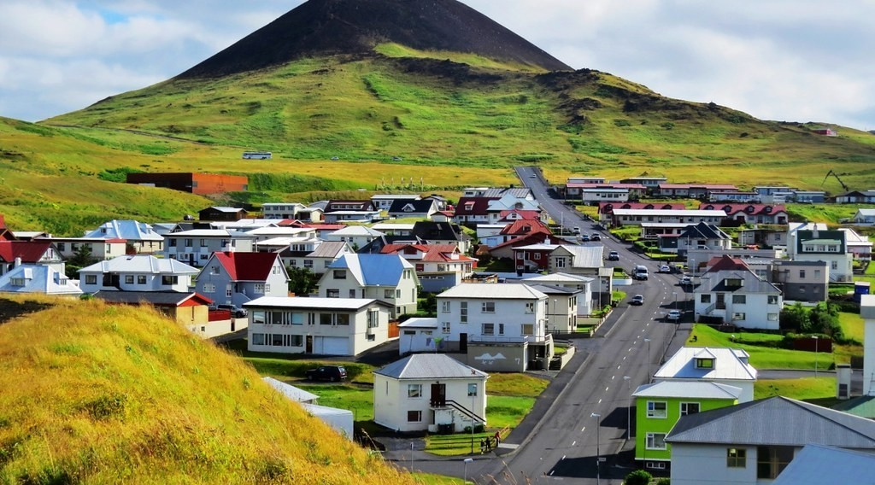
GEOGRAPHY — LOWER SIXTH ARTS
II. MID-OCEAN ERUPTIONS
Activity 3
Heimaey, Iceland: the young volcano Eldfell (1973) beside the town.
2026 / 2027
DGCAST GAROUA — GEOGRAPHY DEPARTMENT
Mr KAMDEM E. | 20
Notes:
Without the projector: find Iceland on the atlas.

Slide 21
GEOGRAPHY — LOWER SIXTH ARTS
II. MID-OCEAN ERUPTIONS
Activity 3: Question
Iceland lies on the Mid-Atlantic Ridge. Why are there so many volcanoes there?
2026 / 2027
DGCAST GAROUA — GEOGRAPHY DEPARTMENT
Mr KAMDEM E. | 21

Slide 22
GEOGRAPHY — LOWER SIXTH ARTS
II. MID-OCEAN ERUPTIONS
Answer
Magma rises where the plates move apart.
2026 / 2027
DGCAST GAROUA — GEOGRAPHY DEPARTMENT
Mr KAMDEM E. | 22

Slide 23
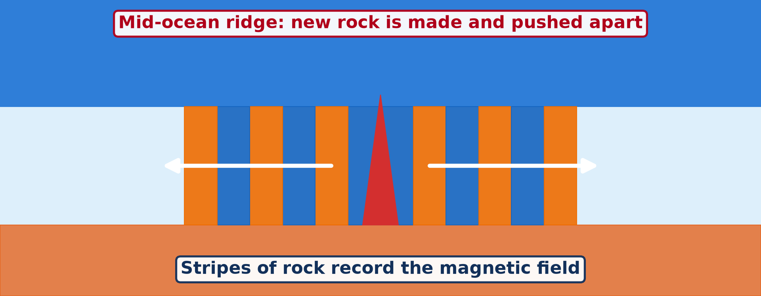
GEOGRAPHY — LOWER SIXTH ARTS
III. EVIDENCE
Activity 4
Magnetic stripes on each side of the ridge.
2026 / 2027
DGCAST GAROUA — GEOGRAPHY DEPARTMENT
Mr KAMDEM E. | 23
Notes:
Without the projector: draw matching stripes on both sides of a line.

Slide 24
GEOGRAPHY — LOWER SIXTH ARTS
III. EVIDENCE
Activity 4: Question
The stripes are the same on both sides of the ridge. What does this prove?
2026 / 2027
DGCAST GAROUA — GEOGRAPHY DEPARTMENT
Mr KAMDEM E. | 24

Slide 25
GEOGRAPHY — LOWER SIXTH ARTS
III. EVIDENCE
Answer
The floor was formed at the ridge and spread out equally on both sides.
2026 / 2027
DGCAST GAROUA — GEOGRAPHY DEPARTMENT
Mr KAMDEM E. | 25

Slide 26

GEOGRAPHY — LOWER SIXTH ARTS
IV. EFFECTS ON RELIEF
Activity 5
A crack in the ground in Iceland.
2026 / 2027
DGCAST GAROUA — GEOGRAPHY DEPARTMENT
Mr KAMDEM E. | 26
Notes:
Without the projector: list the features on the board.

Slide 27
GEOGRAPHY — LOWER SIXTH ARTS
IV. EFFECTS ON RELIEF
Activity 5: Question
What features does spreading create on the ocean floor?
2026 / 2027
DGCAST GAROUA — GEOGRAPHY DEPARTMENT
Mr KAMDEM E. | 27

Slide 28
GEOGRAPHY — LOWER SIXTH ARTS
IV. EFFECTS ON RELIEF
Answer
Ridges, rift valleys, volcanic islands and wide ocean basins.
2026 / 2027
DGCAST GAROUA — GEOGRAPHY DEPARTMENT
Mr KAMDEM E. | 28

Slide 29
GEOGRAPHY — LOWER SIXTH ARTS
BOARD SUMMARY
Theory of Sea-Floor Spreading
Topic: The Development of the Earth's Structure
Sub-topic: Theories of Earth Structure and Resultant Landforms
Further Study 2: Theory of Sea-Floor Spreading
2026 / 2027
DGCAST GAROUA — GEOGRAPHY DEPARTMENT
Mr KAMDEM E. | 29
Notes:
Learners copy the board summary now. Give them enough time for each slide.

Slide 30
GEOGRAPHY — LOWER SIXTH ARTS
BOARD SUMMARY
I. Definitions
Sea-floor spreading: It is the creation of new ocean floor at mid-ocean ridges and its movement away from them.
Mid-ocean ridge: It is a long underwater mountain chain where plates move apart.
2026 / 2027
DGCAST GAROUA — GEOGRAPHY DEPARTMENT
Mr KAMDEM E. | 30

Slide 31
GEOGRAPHY — LOWER SIXTH ARTS
BOARD SUMMARY
II. The Theory (Hess, 1962)
A. What it says: Magma rises at mid-ocean ridges and forms new crust. The new crust moves away on both sides, so the ocean becomes wider.
B. Cause: Mid-ocean volcanic eruptions push out new rock. Convection currents in the mantle carry the floor away.
2026 / 2027
DGCAST GAROUA — GEOGRAPHY DEPARTMENT
Mr KAMDEM E. | 31

Slide 32
GEOGRAPHY — LOWER SIXTH ARTS
BOARD SUMMARY
III. Evidence and Effects (1/3)
A. Age of rocks: Rocks are youngest at the ridge and older towards the continents. Ocean sediments are thin near the ridge.
B. Magnetic stripes: Rocks record the magnetic field when they cool. The pattern of stripes is the same on both sides of the ridge.
2026 / 2027
DGCAST GAROUA — GEOGRAPHY DEPARTMENT
Mr KAMDEM E. | 32

Slide 33
GEOGRAPHY — LOWER SIXTH ARTS
BOARD SUMMARY
III. Evidence and Effects (2/3)
C. Effects on relief: Spreading forms ridges, rift valleys and volcanic islands such as Iceland. It widens oceans like the Atlantic.
2026 / 2027
DGCAST GAROUA — GEOGRAPHY DEPARTMENT
Mr KAMDEM E. | 33

Slide 34
GEOGRAPHY — LOWER SIXTH ARTS
BOARD SUMMARY
III. Evidence and Effects (3/3)
Copy the ridge and the stripes.
2026 / 2027
DGCAST GAROUA — GEOGRAPHY DEPARTMENT
Mr KAMDEM E. | 34

Slide 35
GEOGRAPHY — LOWER SIXTH ARTS
FORMATIVE EVALUATION
Formative Evaluation 1
Where is new ocean floor made?
2026 / 2027
DGCAST GAROUA — GEOGRAPHY DEPARTMENT
Mr KAMDEM E. | 35

Slide 36
GEOGRAPHY — LOWER SIXTH ARTS
FORMATIVE EVALUATION
Expected Answer
At mid-ocean ridges.
2026 / 2027
DGCAST GAROUA — GEOGRAPHY DEPARTMENT
Mr KAMDEM E. | 36

Slide 37
GEOGRAPHY — LOWER SIXTH ARTS
FORMATIVE EVALUATION
Formative Evaluation 2
Give two pieces of evidence for sea-floor spreading.
2026 / 2027
DGCAST GAROUA — GEOGRAPHY DEPARTMENT
Mr KAMDEM E. | 37

Slide 38
GEOGRAPHY — LOWER SIXTH ARTS
FORMATIVE EVALUATION
Expected Answer
Rocks are youngest at the ridge; magnetic stripes are symmetrical.
2026 / 2027
DGCAST GAROUA — GEOGRAPHY DEPARTMENT
Mr KAMDEM E. | 38

Slide 39
GEOGRAPHY — LOWER SIXTH ARTS
REMEDIATION
Remediation
Fill in the blanks:
New ocean floor forms at ______.
Lava cooled under water forms ______ lava.
Iceland lies on the Mid-______ Ridge.
2026 / 2027
DGCAST GAROUA — GEOGRAPHY DEPARTMENT
Mr KAMDEM E. | 39
Notes:
Answers: 1. mid-ocean ridges 2. pillow 3. Atlantic

Slide 40
GEOGRAPHY — LOWER SIXTH ARTS
HOMEWORK
Homework
Name three countries that often have earthquakes or volcanoes. Find them on a map.
This prepares Lesson 3: The Theory of Plate Tectonics.
2026 / 2027
DGCAST GAROUA — GEOGRAPHY DEPARTMENT
Mr KAMDEM E. | 40
Notes:
This homework prepares the next lesson.

Slide 41
GEOGRAPHY — LOWER SIXTH ARTS
BILINGUAL GAME
Bilingual Game (Jeu Bilingue)
English | Français
Sea-floor spreading | L'expansion des fonds océaniques
Ridge | La dorsale
Magnetic stripe | La bande magnétique
Pillow lava | La lave en coussin
Island | L'île
Ocean floor | Le plancher océanique
2026 / 2027
DGCAST GAROUA — GEOGRAPHY DEPARTMENT
Mr KAMDEM E. | 41
Notes:
Say the English word; learners give the French word, then the reverse.

Slide 42
GEOGRAPHY — LOWER SIXTH ARTS
LOGBOOK
Official Logbook (1/2)
Module / Topic | The Development of the Earth's Structure
Lesson Title | Further Study 2: Theory of Sea-Floor Spreading
Expected Learning Outcomes | State the theory of sea-floor spreading. Explain the role of mid-ocean ridges. Give evidence of sea-floor spreading.
Competence | Learners are able to explain how new ocean floor is created and give evidence for it.
2026 / 2027
DGCAST GAROUA — GEOGRAPHY DEPARTMENT
Mr KAMDEM E. | 42

Slide 43
GEOGRAPHY — LOWER SIXTH ARTS
LOGBOOK
Official Logbook (2/2)
Matter Taught | I. Definitions: Sea-floor spreading, Mid-ocean ridge; II. The Theory (Hess, 1962): What it says, Cause; III. Evidence and Effects: Age of rocks, Magnetic stripes, Effects on relief.
Evaluation | Formative evaluation (3 questions) and remediation exercise.
Homework | Name three countries that often have earthquakes or volcanoes. Find them on a map.
Enrolment / Present / Absent | ____ / ____ / ____
Achievement | To be completed by the teacher after the lesson.
2026 / 2027
DGCAST GAROUA — GEOGRAPHY DEPARTMENT
Mr KAMDEM E. | 43

Slide 44
GEOGRAPHY — LOWER SIXTH ARTS
TEACHER'S NOTE
Teacher's Note
Timing: Set-up, recall 8 min | Situation 8 min | 5 activities 30 min | Board summary (copying) 30 min | Evaluation, remediation 10 min | Homework, logbook 9 min | Spare 5 min
Activity 1 is an animation (GIF): it plays automatically in slide-show mode.
2026 / 2027
DGCAST GAROUA — GEOGRAPHY DEPARTMENT
Mr KAMDEM E. | 44

Slide 45
GEOGRAPHY — LOWER SIXTH ARTS
REFERENCES
References
National Geography Syllabus, Sixth Forms (Lower & Upper Sixth), MINESEC/IGE/IP-SS, August 2019 — Module 2 (Geomorphology).
Photo, Activity 2: “expl1536” by NOAA Photo Library, CC BY 2.0, via Flickr (https://www.flickr.com/photos/51647007@N08/9664185645)
Photo, Activity 3: “Iceland's Vestmannaeyjar the town that held back an erupting lava flow” by moonjazz, CC BY-SA 2.0, via Flickr (https://www.flickr.com/photos/8398907@N02/21228033348)
Photo, Activity 5: “Silfra Fissure” by Daveography.ca, CC BY-NC-SA 2.0, via Flickr (https://www.flickr.com/photos/71482738@N00/32857247053)
Diagrams and animations: drawn for this lesson (DGCAST Geography Department).
2026 / 2027
DGCAST GAROUA — GEOGRAPHY DEPARTMENT
Mr KAMDEM E. | 45

