Slide 1

DIVINE GRACE COLLEGE OF ARTS, SCIENCE AND TECHNOLOGY
(DGCAST) — GAROUA | GEOGRAPHY DEPARTMENT
LOWER SIXTH ARTS — GEOMORPHOLOGY — LESSON 1
Origin of the Earth
Mr KAMDEM EMMANUEL
Geography Teacher — PLEG
Academic Year 2026 / 2027
Notes:
Good morning, class. Today we study Lesson 1: Origin of the Earth.

Slide 2
GEOGRAPHY — LOWER SIXTH ARTS
CLASS INFO
Class, Chapter & Duration
Class | Lower Sixth Arts
Chapter | Module 2: Understanding and managing physical landscapes, geomorphological processes and hazards across the world in general and Cameroon in particular
Duration | 2 periods (2 × 50 minutes)
2026 / 2027
DGCAST GAROUA — GEOGRAPHY DEPARTMENT
Mr KAMDEM E. | 2

Slide 3
GEOGRAPHY — LOWER SIXTH ARTS
IDENTIFICATION
Lesson Identification
Topic | The Development of the Earth's Structure
Sub-topic | The Origin and Earth's Structure
Lesson | Lesson 1: Origin of the Earth
Notions / Concepts | Geomorphology, Big Bang, geologic time scale, era.
Syllabus focus | The Big Bang theory; the geologic time scale and the four eras.
Competence | Learners are able to explain how the Earth was formed and to place the main events of its history on a time scale.
2026 / 2027
DGCAST GAROUA — GEOGRAPHY DEPARTMENT
Mr KAMDEM E. | 3

Slide 4
GEOGRAPHY — LOWER SIXTH ARTS
OBJECTIVES
Learning Objectives
By the end of the lesson, the learner should be able to:
Define geomorphology.
Explain the Big Bang theory.
Describe the four eras of the geologic time scale.
2026 / 2027
DGCAST GAROUA — GEOGRAPHY DEPARTMENT
Mr KAMDEM E. | 4

Slide 5
GEOGRAPHY — LOWER SIXTH ARTS
RECALL
Recall
The Earth is one of the eight planets of the solar system.
Rocks and fossils tell us about the past of the Earth.
2026 / 2027
DGCAST GAROUA — GEOGRAPHY DEPARTMENT
Mr KAMDEM E. | 5

Slide 6
GEOGRAPHY — LOWER SIXTH ARTS
REAL-LIFE SITUATION
Real-Life Situation
In a museum in Yaoundé, Ibrahim sees a fossil shell found in rocks of the North Region. The guide says that the shell is millions of years old and that the sea once covered that area.
2026 / 2027
DGCAST GAROUA — GEOGRAPHY DEPARTMENT
Mr KAMDEM E. | 6
Notes:
Read the situation slowly, twice.

Slide 7
GEOGRAPHY — LOWER SIXTH ARTS
REAL-LIFE SITUATION
Situation — Question 1
What is the problem in the situation?
2026 / 2027
DGCAST GAROUA — GEOGRAPHY DEPARTMENT
Mr KAMDEM E. | 7

Slide 8
GEOGRAPHY — LOWER SIXTH ARTS
REAL-LIFE SITUATION
Answer
Ibrahim does not understand how the Earth and its rocks have changed over time.
2026 / 2027
DGCAST GAROUA — GEOGRAPHY DEPARTMENT
Mr KAMDEM E. | 8

Slide 9
GEOGRAPHY — LOWER SIXTH ARTS
REAL-LIFE SITUATION
Situation — Question 2
What does the fossil show?
2026 / 2027
DGCAST GAROUA — GEOGRAPHY DEPARTMENT
Mr KAMDEM E. | 9

Slide 10
GEOGRAPHY — LOWER SIXTH ARTS
REAL-LIFE SITUATION
Answer
That the sea once covered that area.
2026 / 2027
DGCAST GAROUA — GEOGRAPHY DEPARTMENT
Mr KAMDEM E. | 10

Slide 11
GEOGRAPHY — LOWER SIXTH ARTS
REAL-LIFE SITUATION
Situation — Question 3
How do geographers study the history of the Earth?
2026 / 2027
DGCAST GAROUA — GEOGRAPHY DEPARTMENT
Mr KAMDEM E. | 11

Slide 12
GEOGRAPHY — LOWER SIXTH ARTS
REAL-LIFE SITUATION
Possible Answer
They study rocks and fossils and use the geologic time scale.
2026 / 2027
DGCAST GAROUA — GEOGRAPHY DEPARTMENT
Mr KAMDEM E. | 12

Slide 13
GEOGRAPHY — LOWER SIXTH ARTS
JUSTIFICATION
Justification of the Lesson
This lesson helps us to understand how the Earth was formed and how its surface has changed over millions of years.
2026 / 2027
DGCAST GAROUA — GEOGRAPHY DEPARTMENT
Mr KAMDEM E. | 13

Slide 14
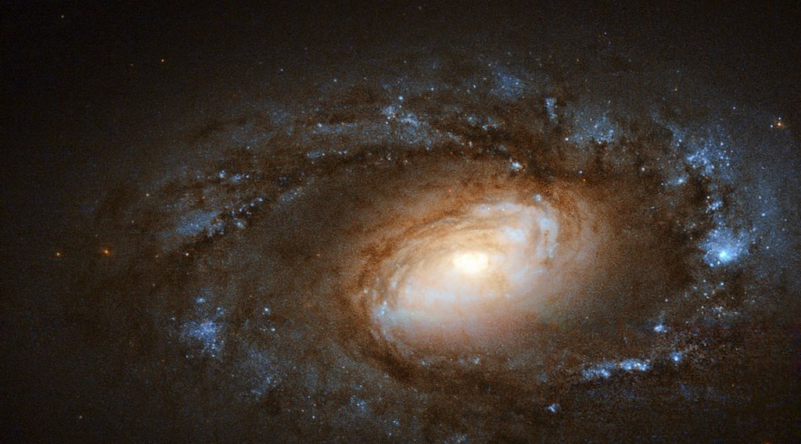
GEOGRAPHY — LOWER SIXTH ARTS
I. ORIGIN OF THE EARTH
Activity 1
Thousands of galaxies seen by a space telescope.
2026 / 2027
DGCAST GAROUA — GEOGRAPHY DEPARTMENT
Mr KAMDEM E. | 14
Notes:
Without the projector: blow up a balloon with dots on it: the dots move apart.

Slide 15
GEOGRAPHY — LOWER SIXTH ARTS
I. ORIGIN OF THE EARTH
Activity 1: Question
Scientists say that the universe began with a great expansion about 13.8 billion years ago. What is this theory called?
2026 / 2027
DGCAST GAROUA — GEOGRAPHY DEPARTMENT
Mr KAMDEM E. | 15

Slide 16
GEOGRAPHY — LOWER SIXTH ARTS
I. ORIGIN OF THE EARTH
Answer
The Big Bang theory. The Sun and the Earth formed much later, about 4.6 billion years ago.
2026 / 2027
DGCAST GAROUA — GEOGRAPHY DEPARTMENT
Mr KAMDEM E. | 16

Slide 17
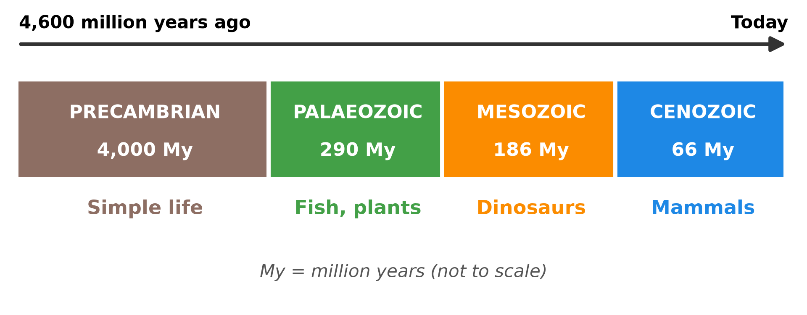
GEOGRAPHY — LOWER SIXTH ARTS
II. THE GEOLOGIC TIME SCALE
Activity 2
The four eras of the history of the Earth.
2026 / 2027
DGCAST GAROUA — GEOGRAPHY DEPARTMENT
Mr KAMDEM E. | 17
Notes:
Without the projector: draw a long bar on the board and divide it into four parts.

Slide 18
GEOGRAPHY — LOWER SIXTH ARTS
II. THE GEOLOGIC TIME SCALE
Activity 2: Question
Name the four eras from the oldest to the youngest. Which one is the longest?
2026 / 2027
DGCAST GAROUA — GEOGRAPHY DEPARTMENT
Mr KAMDEM E. | 18

Slide 19
GEOGRAPHY — LOWER SIXTH ARTS
II. THE GEOLOGIC TIME SCALE
Answer
Precambrian, Palaeozoic, Mesozoic, Cenozoic. The Precambrian is by far the longest.
2026 / 2027
DGCAST GAROUA — GEOGRAPHY DEPARTMENT
Mr KAMDEM E. | 19

Slide 20
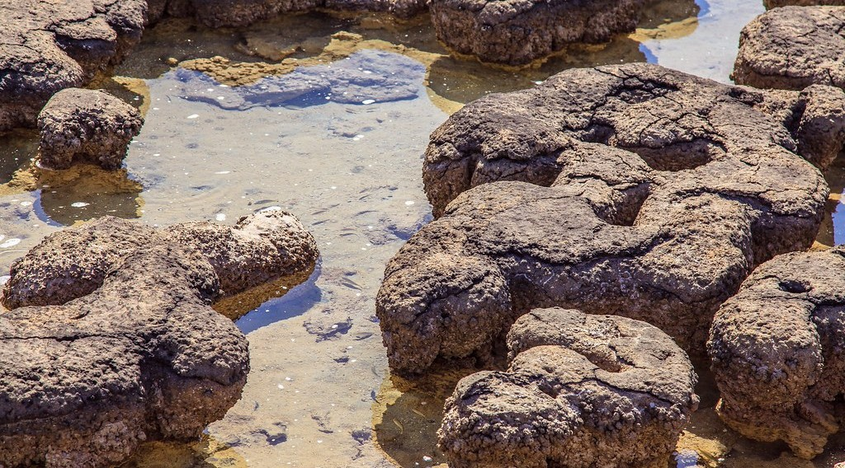
GEOGRAPHY — LOWER SIXTH ARTS
II. THE GEOLOGIC TIME SCALE
Activity 3
Stromatolites: rocks built by very simple living things.
2026 / 2027
DGCAST GAROUA — GEOGRAPHY DEPARTMENT
Mr KAMDEM E. | 20
Notes:
Without the projector: explain that the first life was very small and simple.

Slide 21
GEOGRAPHY — LOWER SIXTH ARTS
II. THE GEOLOGIC TIME SCALE
Activity 3: Question
These rocks were built by bacteria. In which era did such simple life appear?
2026 / 2027
DGCAST GAROUA — GEOGRAPHY DEPARTMENT
Mr KAMDEM E. | 21

Slide 22
GEOGRAPHY — LOWER SIXTH ARTS
II. THE GEOLOGIC TIME SCALE
Answer
In the Precambrian era.
2026 / 2027
DGCAST GAROUA — GEOGRAPHY DEPARTMENT
Mr KAMDEM E. | 22

Slide 23
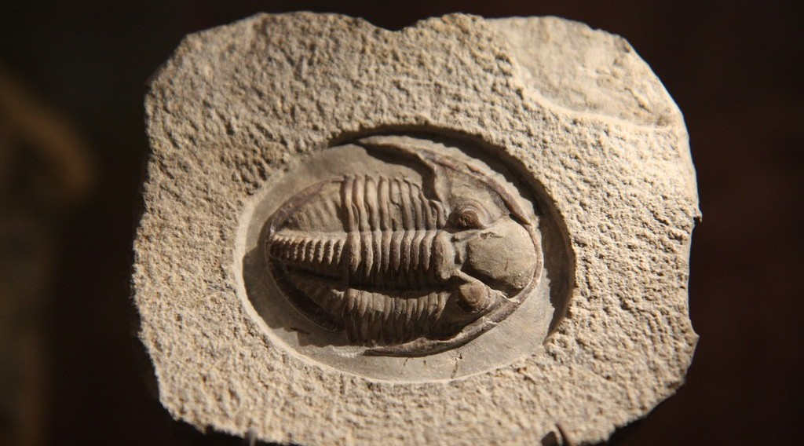
GEOGRAPHY — LOWER SIXTH ARTS
II. THE GEOLOGIC TIME SCALE
Activity 4
A trilobite fossil (a sea animal).
2026 / 2027
DGCAST GAROUA — GEOGRAPHY DEPARTMENT
Mr KAMDEM E. | 23
Notes:
Without the projector: show a fossil shell or a picture of one.

Slide 24
GEOGRAPHY — LOWER SIXTH ARTS
II. THE GEOLOGIC TIME SCALE
Activity 4: Question
Trilobites lived in the Palaeozoic seas. What does their fossil tell us about the rock?
2026 / 2027
DGCAST GAROUA — GEOGRAPHY DEPARTMENT
Mr KAMDEM E. | 24

Slide 25
GEOGRAPHY — LOWER SIXTH ARTS
II. THE GEOLOGIC TIME SCALE
Answer
The rock was formed under the sea.
2026 / 2027
DGCAST GAROUA — GEOGRAPHY DEPARTMENT
Mr KAMDEM E. | 25

Slide 26
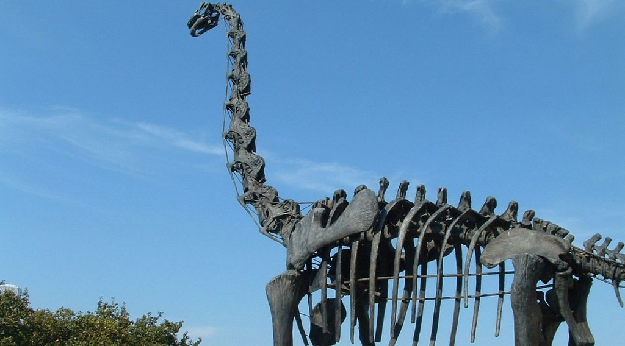
GEOGRAPHY — LOWER SIXTH ARTS
II. THE GEOLOGIC TIME SCALE
Activity 5
The skeleton of a dinosaur.
2026 / 2027
DGCAST GAROUA — GEOGRAPHY DEPARTMENT
Mr KAMDEM E. | 26
Notes:
Without the projector: ask learners what they know about dinosaurs.

Slide 27
GEOGRAPHY — LOWER SIXTH ARTS
II. THE GEOLOGIC TIME SCALE
Activity 5: Question
In which era did dinosaurs live? Which era is the age of mammals?
2026 / 2027
DGCAST GAROUA — GEOGRAPHY DEPARTMENT
Mr KAMDEM E. | 27

Slide 28
GEOGRAPHY — LOWER SIXTH ARTS
II. THE GEOLOGIC TIME SCALE
Answer
Dinosaurs lived in the Mesozoic. The Cenozoic is the age of mammals.
2026 / 2027
DGCAST GAROUA — GEOGRAPHY DEPARTMENT
Mr KAMDEM E. | 28

Slide 29
GEOGRAPHY — LOWER SIXTH ARTS
BOARD SUMMARY
Origin of the Earth
Topic: The Development of the Earth's Structure
Sub-topic: The Origin and Earth's Structure
Lesson 1: Origin of the Earth
2026 / 2027
DGCAST GAROUA — GEOGRAPHY DEPARTMENT
Mr KAMDEM E. | 29
Notes:
Learners copy the board summary now. Give them enough time for each slide.

Slide 30
GEOGRAPHY — LOWER SIXTH ARTS
BOARD SUMMARY
I. Definitions
Geomorphology: It is the study of landforms and the processes that shape them.
Geologic time scale: It is the division of the history of the Earth into eras and periods.
Era: It is a very long division of geologic time.
2026 / 2027
DGCAST GAROUA — GEOGRAPHY DEPARTMENT
Mr KAMDEM E. | 30

Slide 31
GEOGRAPHY — LOWER SIXTH ARTS
BOARD SUMMARY
II. Origin of the Earth
A. The Big Bang: The universe began with a great expansion about 13.8 billion years ago. Galaxies, stars and planets formed from this matter.
B. Formation of the Earth: The Earth formed about 4.6 billion years ago from dust and gas around the Sun. It cooled slowly and formed a solid crust.
2026 / 2027
DGCAST GAROUA — GEOGRAPHY DEPARTMENT
Mr KAMDEM E. | 31

Slide 32
GEOGRAPHY — LOWER SIXTH ARTS
BOARD SUMMARY
III. The Four Eras (1/3)
A. Precambrian: It is the oldest and longest era, about 4,000 million years. The crust formed and simple life appeared in the seas.
B. Palaeozoic: It lasted about 290 million years. Fish, land plants and the first reptiles appeared.
2026 / 2027
DGCAST GAROUA — GEOGRAPHY DEPARTMENT
Mr KAMDEM E. | 32

Slide 33
GEOGRAPHY — LOWER SIXTH ARTS
BOARD SUMMARY
III. The Four Eras (2/3)
C. Mesozoic: It lasted about 186 million years. It was the age of the dinosaurs, and Pangaea broke up.
D. Cenozoic: It began 66 million years ago and continues today. Mammals and humans appeared, and the Alps and the Himalayas were formed.
2026 / 2027
DGCAST GAROUA — GEOGRAPHY DEPARTMENT
Mr KAMDEM E. | 33

Slide 34
GEOGRAPHY — LOWER SIXTH ARTS
BOARD SUMMARY
III. The Four Eras (3/3)
Copy the time scale.
2026 / 2027
DGCAST GAROUA — GEOGRAPHY DEPARTMENT
Mr KAMDEM E. | 34

Slide 35
GEOGRAPHY — LOWER SIXTH ARTS
FORMATIVE EVALUATION
Formative Evaluation 1
Define geomorphology.
2026 / 2027
DGCAST GAROUA — GEOGRAPHY DEPARTMENT
Mr KAMDEM E. | 35

Slide 36
GEOGRAPHY — LOWER SIXTH ARTS
FORMATIVE EVALUATION
Expected Answer
It is the study of landforms and the processes that shape them.
2026 / 2027
DGCAST GAROUA — GEOGRAPHY DEPARTMENT
Mr KAMDEM E. | 36

Slide 37
GEOGRAPHY — LOWER SIXTH ARTS
FORMATIVE EVALUATION
Formative Evaluation 2
Name the four eras and give one event of each.
2026 / 2027
DGCAST GAROUA — GEOGRAPHY DEPARTMENT
Mr KAMDEM E. | 37

Slide 38
GEOGRAPHY — LOWER SIXTH ARTS
FORMATIVE EVALUATION
Expected Answer
Precambrian (simple life), Palaeozoic (fish, land plants), Mesozoic (dinosaurs), Cenozoic (mammals, humans).
2026 / 2027
DGCAST GAROUA — GEOGRAPHY DEPARTMENT
Mr KAMDEM E. | 38

Slide 39
GEOGRAPHY — LOWER SIXTH ARTS
REMEDIATION
Remediation
Fill in the blanks:
The theory of the origin of the universe is the ______ theory.
The oldest and longest era is the ______.
The age of the dinosaurs is the ______ era.
2026 / 2027
DGCAST GAROUA — GEOGRAPHY DEPARTMENT
Mr KAMDEM E. | 39
Notes:
Answers: 1. Big Bang 2. Precambrian 3. Mesozoic

Slide 40
GEOGRAPHY — LOWER SIXTH ARTS
HOMEWORK
Homework
Draw the geologic time scale in your exercise book and write one event for each era.
This prepares Lesson 2: Internal Structure of the Earth.
2026 / 2027
DGCAST GAROUA — GEOGRAPHY DEPARTMENT
Mr KAMDEM E. | 40
Notes:
This homework prepares the next lesson.

Slide 41
GEOGRAPHY — LOWER SIXTH ARTS
BILINGUAL GAME
Bilingual Game (Jeu Bilingue)
English | Français
Geomorphology | La géomorphologie
Era | L'ère
Fossil | Le fossile
Time scale | L'échelle des temps
Galaxy | La galaxie
Expansion | L'expansion
2026 / 2027
DGCAST GAROUA — GEOGRAPHY DEPARTMENT
Mr KAMDEM E. | 41
Notes:
Say the English word; learners give the French word, then the reverse.

Slide 42
GEOGRAPHY — LOWER SIXTH ARTS
LOGBOOK
Official Logbook (1/2)
Module / Topic | The Development of the Earth's Structure
Lesson Title | Lesson 1: Origin of the Earth
Expected Learning Outcomes | Define geomorphology. Explain the Big Bang theory. Describe the four eras of the geologic time scale.
Competence | Learners are able to explain how the Earth was formed and to place the main events of its history on a time scale.
2026 / 2027
DGCAST GAROUA — GEOGRAPHY DEPARTMENT
Mr KAMDEM E. | 42

Slide 43
GEOGRAPHY — LOWER SIXTH ARTS
LOGBOOK
Official Logbook (2/2)
Matter Taught | I. Definitions: Geomorphology, Geologic time scale, Era; II. Origin of the Earth: The Big Bang, Formation of the Earth; III. The Four Eras: Precambrian, Palaeozoic, Mesozoic, Cenozoic.
Evaluation | Formative evaluation (3 questions) and remediation exercise.
Homework | Draw the geologic time scale in your exercise book and write one event for each era.
Enrolment / Present / Absent | ____ / ____ / ____
Achievement | To be completed by the teacher after the lesson.
2026 / 2027
DGCAST GAROUA — GEOGRAPHY DEPARTMENT
Mr KAMDEM E. | 43

Slide 44
GEOGRAPHY — LOWER SIXTH ARTS
TEACHER'S NOTE
Teacher's Note
Timing: Set-up, recall 8 min | Situation 8 min | 5 activities 30 min | Board summary (copying) 30 min | Evaluation, remediation 10 min | Homework, logbook 9 min | Spare 5 min
2026 / 2027
DGCAST GAROUA — GEOGRAPHY DEPARTMENT
Mr KAMDEM E. | 44

Slide 45
GEOGRAPHY — LOWER SIXTH ARTS
REFERENCES
References
National Geography Syllabus, Sixth Forms (Lower & Upper Sixth), MINESEC/IGE/IP-SS, August 2019 — Module 2 (Geomorphology).
Photo, Activity 1: “Hubble Spies Charming Spiral Galaxy Bursting with Stars” by NASA Goddard Photo and Video, CC BY 2.0, via nasa (https://www.flickr.com/photos/24662369@N07/15766783527)
Photo, Activity 3: “Western Australia, Stromatolites Sharks Bay” by VladPix, CC BY-NC-ND 2.0, via Flickr (https://www.flickr.com/photos/62825712@N07/8766549873)
Photo, Activity 4: “Trilobite Fossil at NMNH” by Mr.TinDC, CC BY-ND 2.0, via Flickr (https://www.flickr.com/photos/7471115@N08/2948579998)
Photo, Activity 5: “dinosaur” by ianturton, CC BY-NC-SA 2.0, via Flickr (https://www.flickr.com/photos/16041363@N00/9555513)
Diagrams and animations: drawn for this lesson (DGCAST Geography Department).
2026 / 2027
DGCAST GAROUA — GEOGRAPHY DEPARTMENT
Mr KAMDEM E. | 45

