Slide 1

DIVINE GRACE COLLEGE OF ARTS, SCIENCE AND TECHNOLOGY
(DGCAST) — GAROUA | GEOGRAPHY DEPARTMENT
LOWER SIXTH ARTS — GEOMORPHOLOGY — LESSON 6
Volcanism
Mr KAMDEM EMMANUEL
Geography Teacher — PLEG
Academic Year 2026 / 2027
Notes:
Good morning, class. Today we study Lesson 6: Volcanism.

Slide 2
GEOGRAPHY — LOWER SIXTH ARTS
CLASS INFO
Class, Chapter & Duration
Class | Lower Sixth Arts
Chapter | Module 2: Understanding and managing physical landscapes, geomorphological processes and hazards across the world in general and Cameroon in particular
Duration | 2 periods (2 × 50 minutes)
2026 / 2027
DGCAST GAROUA — GEOGRAPHY DEPARTMENT
Mr KAMDEM E. | 2

Slide 3
GEOGRAPHY — LOWER SIXTH ARTS
IDENTIFICATION
Lesson Identification
Topic | Crustal Processes and their Effect on the Land Surface and Man
Sub-topic | Volcanicity
Lesson | Lesson 6: Volcanism
Notions / Concepts | Volcanicity, lava, magma, cones, crater, caldera.
Syllabus focus | Meaning and process; products; types of cones and why they differ; the life cycle of a volcano.
Competence | Learners are able to identify volcanic landforms and explain why they differ.
2026 / 2027
DGCAST GAROUA — GEOGRAPHY DEPARTMENT
Mr KAMDEM E. | 3

Slide 4
GEOGRAPHY — LOWER SIXTH ARTS
OBJECTIVES
Learning Objectives
By the end of the lesson, the learner should be able to:
Explain the process of volcanism.
Describe the products of volcanoes.
Explain the different types of volcanic cones and depressions.
2026 / 2027
DGCAST GAROUA — GEOGRAPHY DEPARTMENT
Mr KAMDEM E. | 4

Slide 5
GEOGRAPHY — LOWER SIXTH ARTS
RECALL
Recall
Magma rises at plate margins and hot spots.
Mount Cameroon is an active volcano.
2026 / 2027
DGCAST GAROUA — GEOGRAPHY DEPARTMENT
Mr KAMDEM E. | 5

Slide 6
GEOGRAPHY — LOWER SIXTH ARTS
REAL-LIFE SITUATION
Real-Life Situation
In 2000, lava from Mount Cameroon flowed towards the road near Bakingili. Some visitors are surprised that the mountain has gentle slopes, while pictures of Mount Fuji show a steep cone.
2026 / 2027
DGCAST GAROUA — GEOGRAPHY DEPARTMENT
Mr KAMDEM E. | 6
Notes:
Read the situation slowly, twice.

Slide 7
GEOGRAPHY — LOWER SIXTH ARTS
REAL-LIFE SITUATION
Situation — Question 1
What is the problem in the situation?
2026 / 2027
DGCAST GAROUA — GEOGRAPHY DEPARTMENT
Mr KAMDEM E. | 7

Slide 8
GEOGRAPHY — LOWER SIXTH ARTS
REAL-LIFE SITUATION
Answer
The visitors do not know why volcanoes have different shapes.
2026 / 2027
DGCAST GAROUA — GEOGRAPHY DEPARTMENT
Mr KAMDEM E. | 8

Slide 9
GEOGRAPHY — LOWER SIXTH ARTS
REAL-LIFE SITUATION
Situation — Question 2
What came out of Mount Cameroon in 2000?
2026 / 2027
DGCAST GAROUA — GEOGRAPHY DEPARTMENT
Mr KAMDEM E. | 9

Slide 10
GEOGRAPHY — LOWER SIXTH ARTS
REAL-LIFE SITUATION
Answer
Lava.
2026 / 2027
DGCAST GAROUA — GEOGRAPHY DEPARTMENT
Mr KAMDEM E. | 10

Slide 11
GEOGRAPHY — LOWER SIXTH ARTS
REAL-LIFE SITUATION
Situation — Question 3
What decides the shape of a volcano?
2026 / 2027
DGCAST GAROUA — GEOGRAPHY DEPARTMENT
Mr KAMDEM E. | 11

Slide 12
GEOGRAPHY — LOWER SIXTH ARTS
REAL-LIFE SITUATION
Possible Answer
The type of lava and the type of eruption.
2026 / 2027
DGCAST GAROUA — GEOGRAPHY DEPARTMENT
Mr KAMDEM E. | 12

Slide 13
GEOGRAPHY — LOWER SIXTH ARTS
JUSTIFICATION
Justification of the Lesson
This lesson helps us to understand how volcanoes form and why their landforms differ.
2026 / 2027
DGCAST GAROUA — GEOGRAPHY DEPARTMENT
Mr KAMDEM E. | 13

Slide 14
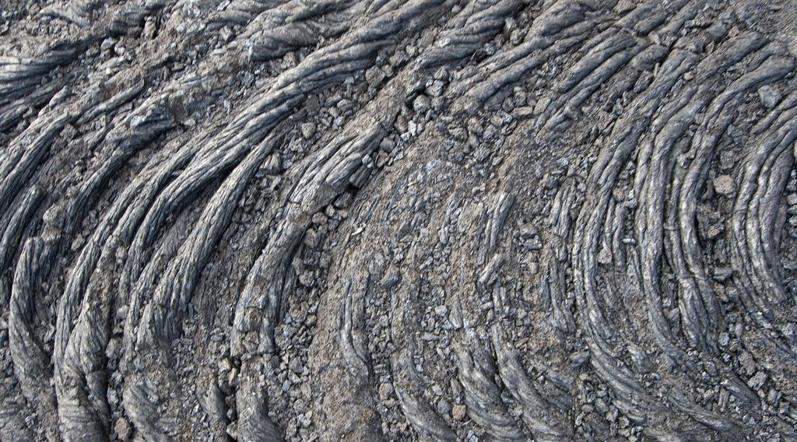
GEOGRAPHY — LOWER SIXTH ARTS
I. MEANING AND PROCESS
Activity 1
A flow of hot lava.
2026 / 2027
DGCAST GAROUA — GEOGRAPHY DEPARTMENT
Mr KAMDEM E. | 14
Notes:
Without the projector: draw a volcano and mark magma and lava.

Slide 15
GEOGRAPHY — LOWER SIXTH ARTS
I. MEANING AND PROCESS
Activity 1: Question
What is the difference between magma and lava?
2026 / 2027
DGCAST GAROUA — GEOGRAPHY DEPARTMENT
Mr KAMDEM E. | 15

Slide 16
GEOGRAPHY — LOWER SIXTH ARTS
I. MEANING AND PROCESS
Answer
Magma is melted rock underground; lava is magma that reaches the surface.
2026 / 2027
DGCAST GAROUA — GEOGRAPHY DEPARTMENT
Mr KAMDEM E. | 16

Slide 17

GEOGRAPHY — LOWER SIXTH ARTS
II. STRUCTURE AND PRODUCTS
Activity 2
The parts of a volcano.
2026 / 2027
DGCAST GAROUA — GEOGRAPHY DEPARTMENT
Mr KAMDEM E. | 17
Notes:
Without the projector: list solid, liquid and gas products.

Slide 18
GEOGRAPHY — LOWER SIXTH ARTS
II. STRUCTURE AND PRODUCTS
Activity 2: Question
Name three products of a volcano.
2026 / 2027
DGCAST GAROUA — GEOGRAPHY DEPARTMENT
Mr KAMDEM E. | 18

Slide 19
GEOGRAPHY — LOWER SIXTH ARTS
II. STRUCTURE AND PRODUCTS
Answer
Lava, ash (pyroclasts) and gases.
2026 / 2027
DGCAST GAROUA — GEOGRAPHY DEPARTMENT
Mr KAMDEM E. | 19

Slide 20
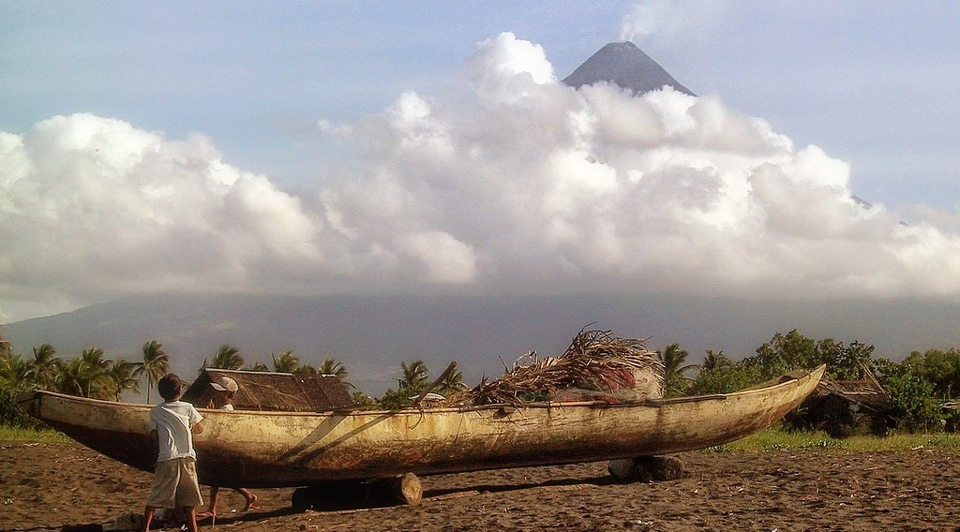
GEOGRAPHY — LOWER SIXTH ARTS
III. CONES
Activity 3
Mayon Volcano, Philippines: a steep cone of ash and lava.
2026 / 2027
DGCAST GAROUA — GEOGRAPHY DEPARTMENT
Mr KAMDEM E. | 20
Notes:
Without the projector: draw alternating layers of ash and lava.

Slide 21
GEOGRAPHY — LOWER SIXTH ARTS
III. CONES
Activity 3: Question
This cone has layers of ash and lava. What type of cone is it?
2026 / 2027
DGCAST GAROUA — GEOGRAPHY DEPARTMENT
Mr KAMDEM E. | 21

Slide 22
GEOGRAPHY — LOWER SIXTH ARTS
III. CONES
Answer
A strato-volcano (composite cone).
2026 / 2027
DGCAST GAROUA — GEOGRAPHY DEPARTMENT
Mr KAMDEM E. | 22

Slide 23

GEOGRAPHY — LOWER SIXTH ARTS
IV. DEPRESSIONS
Activity 4
A large lake inside an old volcano.
2026 / 2027
DGCAST GAROUA — GEOGRAPHY DEPARTMENT
Mr KAMDEM E. | 23
Notes:
Without the projector: mention crater lakes of Cameroon (Barombi Mbo, Nyos).

Slide 24
GEOGRAPHY — LOWER SIXTH ARTS
IV. DEPRESSIONS
Activity 4: Question
What is the difference between a crater and a caldera?
2026 / 2027
DGCAST GAROUA — GEOGRAPHY DEPARTMENT
Mr KAMDEM E. | 24

Slide 25
GEOGRAPHY — LOWER SIXTH ARTS
IV. DEPRESSIONS
Answer
A crater is a small hollow at the top; a caldera is a huge hollow after a collapse.
2026 / 2027
DGCAST GAROUA — GEOGRAPHY DEPARTMENT
Mr KAMDEM E. | 25

Slide 26
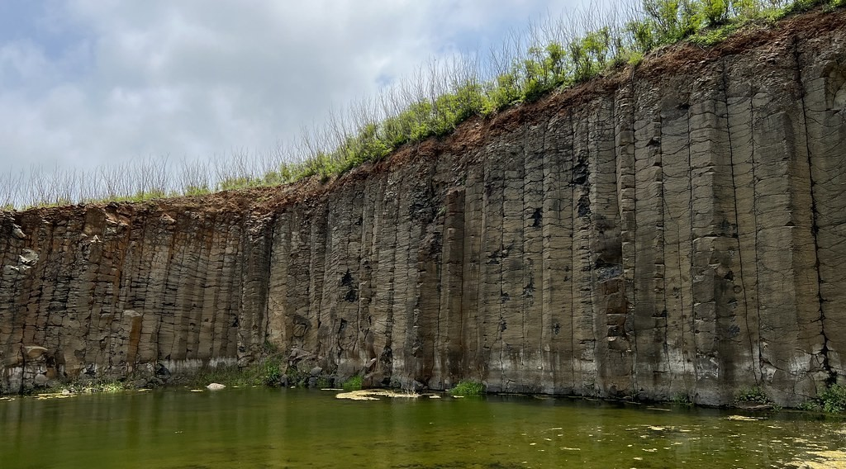
GEOGRAPHY — LOWER SIXTH ARTS
V. LAVA PLATEAUX
Activity 5
Columns of basalt from old lava.
2026 / 2027
DGCAST GAROUA — GEOGRAPHY DEPARTMENT
Mr KAMDEM E. | 26
Notes:
Without the projector: mention the basalt plateaux of the Western Highlands.

Slide 27
GEOGRAPHY — LOWER SIXTH ARTS
V. LAVA PLATEAUX
Activity 5: Question
Many flows of runny lava can cover a large area. What landform do they form?
2026 / 2027
DGCAST GAROUA — GEOGRAPHY DEPARTMENT
Mr KAMDEM E. | 27

Slide 28
GEOGRAPHY — LOWER SIXTH ARTS
V. LAVA PLATEAUX
Answer
A lava plateau.
2026 / 2027
DGCAST GAROUA — GEOGRAPHY DEPARTMENT
Mr KAMDEM E. | 28

Slide 29
GEOGRAPHY — LOWER SIXTH ARTS
BOARD SUMMARY
Volcanism
Topic: Crustal Processes and their Effect on the Land Surface and Man
Sub-topic: Volcanicity
Lesson 6: Volcanism
2026 / 2027
DGCAST GAROUA — GEOGRAPHY DEPARTMENT
Mr KAMDEM E. | 29
Notes:
Learners copy the board summary now. Give them enough time for each slide.

Slide 30
GEOGRAPHY — LOWER SIXTH ARTS
BOARD SUMMARY
I. Definitions
Volcanism: It is the movement of magma from inside the Earth to the surface.
Lava: It is magma that reaches the surface.
Caldera: It is a very large depression formed when a volcano collapses.
2026 / 2027
DGCAST GAROUA — GEOGRAPHY DEPARTMENT
Mr KAMDEM E. | 30

Slide 31
GEOGRAPHY — LOWER SIXTH ARTS
BOARD SUMMARY
II. Process and Products (1/2)
A. Process: Magma rises through the crust and erupts through a vent. It can erupt gently or explode.
B. Products: Volcanoes give lava, ash, bombs and gases. The type of magma (basic or acid) controls the eruption.
2026 / 2027
DGCAST GAROUA — GEOGRAPHY DEPARTMENT
Mr KAMDEM E. | 31

Slide 32
GEOGRAPHY — LOWER SIXTH ARTS
BOARD SUMMARY
II. Process and Products (2/2)
C. Life cycle: A volcano can be active, dormant or extinct. Mount Cameroon is active.
2026 / 2027
DGCAST GAROUA — GEOGRAPHY DEPARTMENT
Mr KAMDEM E. | 32

Slide 33
GEOGRAPHY — LOWER SIXTH ARTS
BOARD SUMMARY
III. Volcanic Landforms (1/3)
A. Basic lava cones: Runny lava forms wide cones with gentle slopes. Example: Mauna Loa.
B. Acid lava cones: Thick lava forms steep domes (cumulo-domes). They are small and steep.
2026 / 2027
DGCAST GAROUA — GEOGRAPHY DEPARTMENT
Mr KAMDEM E. | 33

Slide 34
GEOGRAPHY — LOWER SIXTH ARTS
BOARD SUMMARY
III. Volcanic Landforms (2/3)
C. Ash cones and composite cones: Ash forms steep cinder cones. Layers of ash and lava form strato-volcanoes like Fuji and Mount Cameroon.
D. Depressions and plateaux: Craters and calderas are hollows at the top. Many lava flows form lava plateaux.
2026 / 2027
DGCAST GAROUA — GEOGRAPHY DEPARTMENT
Mr KAMDEM E. | 34

Slide 35
GEOGRAPHY — LOWER SIXTH ARTS
BOARD SUMMARY
III. Volcanic Landforms (3/3)
Copy the volcano and its parts.
2026 / 2027
DGCAST GAROUA — GEOGRAPHY DEPARTMENT
Mr KAMDEM E. | 35

Slide 36
GEOGRAPHY — LOWER SIXTH ARTS
FORMATIVE EVALUATION
Formative Evaluation 1
What is the difference between magma and lava?
2026 / 2027
DGCAST GAROUA — GEOGRAPHY DEPARTMENT
Mr KAMDEM E. | 36

Slide 37
GEOGRAPHY — LOWER SIXTH ARTS
FORMATIVE EVALUATION
Expected Answer
Magma is underground; lava is on the surface.
2026 / 2027
DGCAST GAROUA — GEOGRAPHY DEPARTMENT
Mr KAMDEM E. | 37

Slide 38
GEOGRAPHY — LOWER SIXTH ARTS
FORMATIVE EVALUATION
Formative Evaluation 2
Why is a composite cone steep and layered?
2026 / 2027
DGCAST GAROUA — GEOGRAPHY DEPARTMENT
Mr KAMDEM E. | 38

Slide 39
GEOGRAPHY — LOWER SIXTH ARTS
FORMATIVE EVALUATION
Expected Answer
It is built of alternating layers of ash and lava.
2026 / 2027
DGCAST GAROUA — GEOGRAPHY DEPARTMENT
Mr KAMDEM E. | 39

Slide 40
GEOGRAPHY — LOWER SIXTH ARTS
REMEDIATION
Remediation
Fill in the blanks:
Magma on the surface is ______.
A huge hollow after a collapse is a ______.
Runny lava forms ______ volcanoes with gentle slopes.
2026 / 2027
DGCAST GAROUA — GEOGRAPHY DEPARTMENT
Mr KAMDEM E. | 40
Notes:
Answers: 1. lava 2. caldera 3. shield (basic lava)

Slide 41
GEOGRAPHY — LOWER SIXTH ARTS
HOMEWORK
Homework
Ask an adult what people grow around Buea and Limbe, and why the soils are good.
This prepares Lesson 7: Volcanoes and Man.
2026 / 2027
DGCAST GAROUA — GEOGRAPHY DEPARTMENT
Mr KAMDEM E. | 41
Notes:
This homework prepares the next lesson.

Slide 42
GEOGRAPHY — LOWER SIXTH ARTS
BILINGUAL GAME
Bilingual Game (Jeu Bilingue)
English | Français
Volcano | Le volcan
Lava | La lave
Ash | La cendre
Crater | Le cratère
Caldera | La caldeira
Cone | Le cône
2026 / 2027
DGCAST GAROUA — GEOGRAPHY DEPARTMENT
Mr KAMDEM E. | 42
Notes:
Say the English word; learners give the French word, then the reverse.

Slide 43
GEOGRAPHY — LOWER SIXTH ARTS
LOGBOOK
Official Logbook (1/2)
Module / Topic | Crustal Processes and their Effect on the Land Surface and Man
Lesson Title | Lesson 6: Volcanism
Expected Learning Outcomes | Explain the process of volcanism. Describe the products of volcanoes. Explain the different types of volcanic cones and depressions.
Competence | Learners are able to identify volcanic landforms and explain why they differ.
2026 / 2027
DGCAST GAROUA — GEOGRAPHY DEPARTMENT
Mr KAMDEM E. | 43

Slide 44
GEOGRAPHY — LOWER SIXTH ARTS
LOGBOOK
Official Logbook (2/2)
Matter Taught | I. Definitions: Volcanism, Lava, Caldera; II. Process and Products: Process, Products, Life cycle; III. Volcanic Landforms: Basic lava cones, Acid lava cones, Ash cones and composite cones, Depressions and plateaux.
Evaluation | Formative evaluation (3 questions) and remediation exercise.
Homework | Ask an adult what people grow around Buea and Limbe, and why the soils are good.
Enrolment / Present / Absent | ____ / ____ / ____
Achievement | To be completed by the teacher after the lesson.
2026 / 2027
DGCAST GAROUA — GEOGRAPHY DEPARTMENT
Mr KAMDEM E. | 44

Slide 45
GEOGRAPHY — LOWER SIXTH ARTS
TEACHER'S NOTE
Teacher's Note
Timing: Set-up, recall 8 min | Situation 8 min | 5 activities 30 min | Board summary (copying) 30 min | Evaluation, remediation 10 min | Homework, logbook 9 min | Spare 5 min
2026 / 2027
DGCAST GAROUA — GEOGRAPHY DEPARTMENT
Mr KAMDEM E. | 45

Slide 46
GEOGRAPHY — LOWER SIXTH ARTS
REFERENCES
References
National Geography Syllabus, Sixth Forms (Lower & Upper Sixth), MINESEC/IGE/IP-SS, August 2019 — Module 2 (Geomorphology).
Photo, Activity 1: “Pahoehoe Lava Flow” by graysky., CC BY-NC-SA 2.0, via Flickr (https://www.flickr.com/photos/20021588@N00/540223861)
Photo, Activity 3: “Mayon Volcano, Albay, Luzon, Philippines” by Ray in Manila, CC BY 2.0, via Flickr (https://www.flickr.com/photos/21186555@N07/20591774278)
Photo, Activity 4: “Taal Lake and Volcano, Tagaytay, Philippines” by Ray in Manila, CC BY 2.0, via Flickr (https://www.flickr.com/photos/21186555@N07/28260012661)
Photo, Activity 5: “Snapshot, Daguoye Columnar Basalt, Penghu, Taiwan, 隨拍, 池東大菓葉玄武岩, 大菓葉柱狀” by bryan..., CC BY-SA 2.0, via Flickr (https://www.flickr.com/photos/91049143@N00/52316527525)
Diagrams and animations: drawn for this lesson (DGCAST Geography Department).
2026 / 2027
DGCAST GAROUA — GEOGRAPHY DEPARTMENT
Mr KAMDEM E. | 46

