Slide 1

DIVINE GRACE COLLEGE OF ARTS, SCIENCE AND TECHNOLOGY
(DGCAST) — GAROUA | GEOGRAPHY DEPARTMENT
LOWER SIXTH ARTS — GEOMORPHOLOGY — LESSON 10
Intensity and Factors of Weathering
Mr KAMDEM EMMANUEL
Geography Teacher — PLEG
Academic Year 2026 / 2027
Notes:
Good morning, class. Today we study Lesson 10: Intensity and Factors of Weathering.

Slide 2
GEOGRAPHY — LOWER SIXTH ARTS
CLASS INFO
Class, Chapter & Duration
Class | Lower Sixth Arts
Chapter | Module 2: Understanding and managing physical landscapes, geomorphological processes and hazards across the world in general and Cameroon in particular
Duration | 2 periods (2 × 50 minutes)
2026 / 2027
DGCAST GAROUA — GEOGRAPHY DEPARTMENT
Mr KAMDEM E. | 2

Slide 3
GEOGRAPHY — LOWER SIXTH ARTS
IDENTIFICATION
Lesson Identification
Topic | Denudational Processes on Slopes
Sub-topic | Weathering
Lesson | Lesson 10: Intensity and Factors of Weathering
Notions / Concepts | Peltier's graph, regolith, lithology, joints.
Syllabus focus | Factors of weathering: climate (Peltier), geology, relief, vegetation, human activities.
Competence | Learners are able to explain why weathering is stronger in some places than in others.
2026 / 2027
DGCAST GAROUA — GEOGRAPHY DEPARTMENT
Mr KAMDEM E. | 3

Slide 4
GEOGRAPHY — LOWER SIXTH ARTS
OBJECTIVES
Learning Objectives
By the end of the lesson, the learner should be able to:
Use Peltier's graph to explain the effect of climate.
Explain the influence of rock type and relief.
Explain the role of vegetation and people.
2026 / 2027
DGCAST GAROUA — GEOGRAPHY DEPARTMENT
Mr KAMDEM E. | 4

Slide 5
GEOGRAPHY — LOWER SIXTH ARTS
RECALL
Recall
There are physical, chemical and biological weathering.
Weathering breaks rocks in place.
2026 / 2027
DGCAST GAROUA — GEOGRAPHY DEPARTMENT
Mr KAMDEM E. | 5

Slide 6
GEOGRAPHY — LOWER SIXTH ARTS
REAL-LIFE SITUATION
Real-Life Situation
In Douala, road cuttings show red soil tens of metres deep. In the Far North, bare granite rocks stand on the surface with only a thin layer of soil.
2026 / 2027
DGCAST GAROUA — GEOGRAPHY DEPARTMENT
Mr KAMDEM E. | 6
Notes:
Read the situation slowly, twice.

Slide 7
GEOGRAPHY — LOWER SIXTH ARTS
REAL-LIFE SITUATION
Situation — Question 1
What is the problem in the situation?
2026 / 2027
DGCAST GAROUA — GEOGRAPHY DEPARTMENT
Mr KAMDEM E. | 7

Slide 8
GEOGRAPHY — LOWER SIXTH ARTS
REAL-LIFE SITUATION
Answer
We want to know why weathering is deeper in Douala.
2026 / 2027
DGCAST GAROUA — GEOGRAPHY DEPARTMENT
Mr KAMDEM E. | 8

Slide 9
GEOGRAPHY — LOWER SIXTH ARTS
REAL-LIFE SITUATION
Situation — Question 2
What is the difference between the two climates?
2026 / 2027
DGCAST GAROUA — GEOGRAPHY DEPARTMENT
Mr KAMDEM E. | 9

Slide 10
GEOGRAPHY — LOWER SIXTH ARTS
REAL-LIFE SITUATION
Answer
Douala is hot and very wet; the Far North is hot and dry.
2026 / 2027
DGCAST GAROUA — GEOGRAPHY DEPARTMENT
Mr KAMDEM E. | 10

Slide 11
GEOGRAPHY — LOWER SIXTH ARTS
REAL-LIFE SITUATION
Situation — Question 3
Which type of weathering is strong in Douala?
2026 / 2027
DGCAST GAROUA — GEOGRAPHY DEPARTMENT
Mr KAMDEM E. | 11

Slide 12
GEOGRAPHY — LOWER SIXTH ARTS
REAL-LIFE SITUATION
Possible Answer
Chemical weathering.
2026 / 2027
DGCAST GAROUA — GEOGRAPHY DEPARTMENT
Mr KAMDEM E. | 12

Slide 13
GEOGRAPHY — LOWER SIXTH ARTS
JUSTIFICATION
Justification of the Lesson
This lesson helps us to understand why soils and landscapes differ from place to place.
2026 / 2027
DGCAST GAROUA — GEOGRAPHY DEPARTMENT
Mr KAMDEM E. | 13

Slide 14
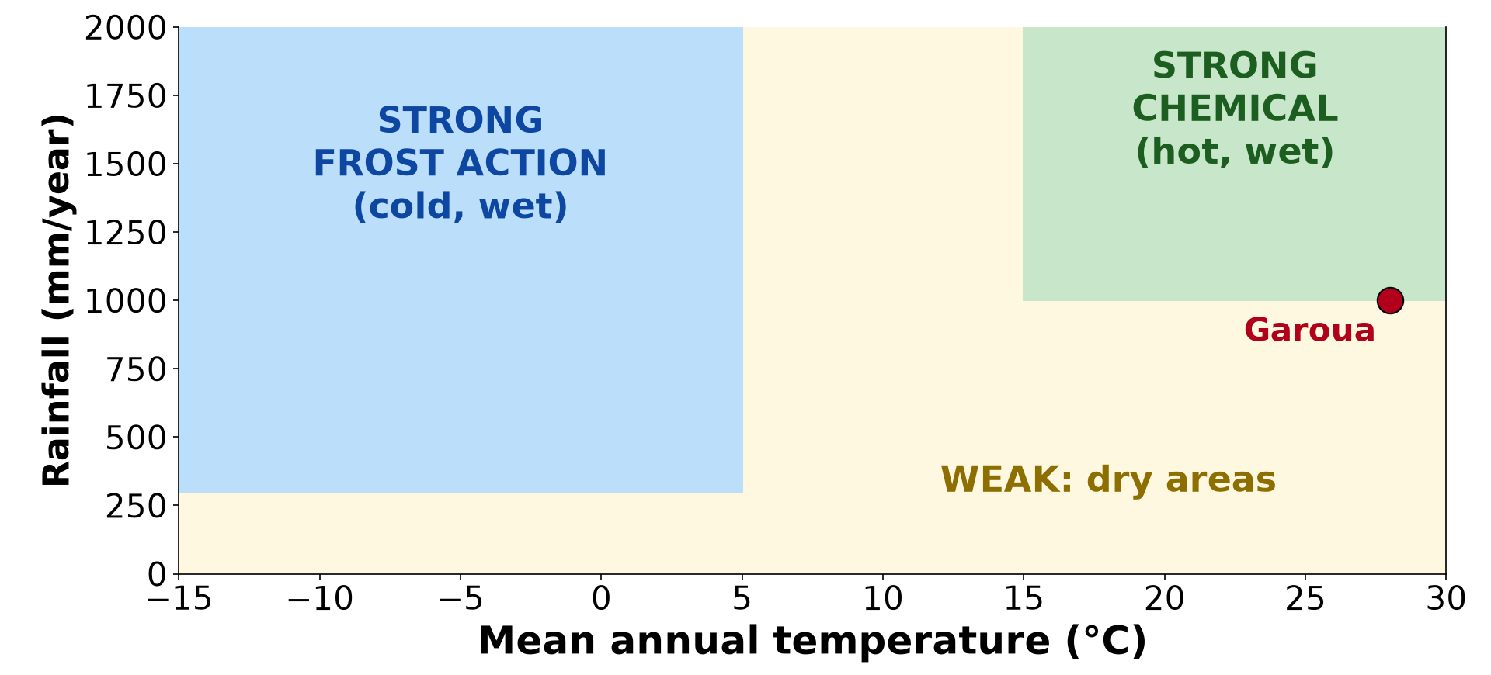
GEOGRAPHY — LOWER SIXTH ARTS
I. CLIMATE
Activity 1
Peltier's graph: climate and weathering.
2026 / 2027
DGCAST GAROUA — GEOGRAPHY DEPARTMENT
Mr KAMDEM E. | 14
Notes:
Without the projector: draw the graph with two axes: temperature and rainfall.

Slide 15
GEOGRAPHY — LOWER SIXTH ARTS
I. CLIMATE
Activity 1: Question
Where is chemical weathering strongest? Where is frost action strongest?
2026 / 2027
DGCAST GAROUA — GEOGRAPHY DEPARTMENT
Mr KAMDEM E. | 15

Slide 16
GEOGRAPHY — LOWER SIXTH ARTS
I. CLIMATE
Answer
Chemical: hot and wet climates. Frost action: cold and wet climates.
2026 / 2027
DGCAST GAROUA — GEOGRAPHY DEPARTMENT
Mr KAMDEM E. | 16

Slide 17

GEOGRAPHY — LOWER SIXTH ARTS
I. CLIMATE
Activity 2
A deep red weathered soil.
2026 / 2027
DGCAST GAROUA — GEOGRAPHY DEPARTMENT
Mr KAMDEM E. | 17
Notes:
Without the projector: describe road cuttings in the South.

Slide 18
GEOGRAPHY — LOWER SIXTH ARTS
I. CLIMATE
Activity 2: Question
Why is the weathered layer very deep in humid tropical areas?
2026 / 2027
DGCAST GAROUA — GEOGRAPHY DEPARTMENT
Mr KAMDEM E. | 18

Slide 19
GEOGRAPHY — LOWER SIXTH ARTS
I. CLIMATE
Answer
Heat and water speed up chemical reactions all year.
2026 / 2027
DGCAST GAROUA — GEOGRAPHY DEPARTMENT
Mr KAMDEM E. | 19

Slide 20
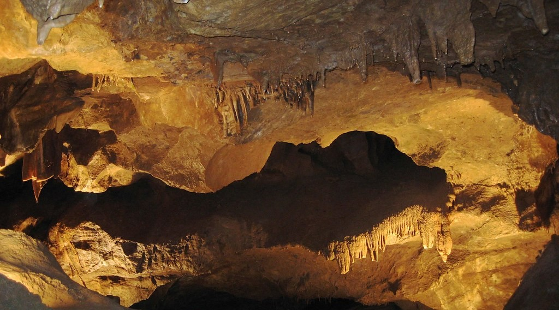
GEOGRAPHY — LOWER SIXTH ARTS
II. GEOLOGY
Activity 3
A cave in limestone.
2026 / 2027
DGCAST GAROUA — GEOGRAPHY DEPARTMENT
Mr KAMDEM E. | 20
Notes:
Without the projector: drop chalk in vinegar.

Slide 21
GEOGRAPHY — LOWER SIXTH ARTS
II. GEOLOGY
Activity 3: Question
Why is limestone quickly weathered by rain water?
2026 / 2027
DGCAST GAROUA — GEOGRAPHY DEPARTMENT
Mr KAMDEM E. | 21

Slide 22
GEOGRAPHY — LOWER SIXTH ARTS
II. GEOLOGY
Answer
It is dissolved by weak acid in rain (carbonation).
2026 / 2027
DGCAST GAROUA — GEOGRAPHY DEPARTMENT
Mr KAMDEM E. | 22

Slide 23

GEOGRAPHY — LOWER SIXTH ARTS
III. RELIEF AND VEGETATION
Activity 4
Broken rocks on a steep mountain slope.
2026 / 2027
DGCAST GAROUA — GEOGRAPHY DEPARTMENT
Mr KAMDEM E. | 23
Notes:
Without the projector: compare a steep slope and a flat plain.

Slide 24
GEOGRAPHY — LOWER SIXTH ARTS
III. RELIEF AND VEGETATION
Activity 4: Question
Why are there many broken rocks on steep mountain slopes?
2026 / 2027
DGCAST GAROUA — GEOGRAPHY DEPARTMENT
Mr KAMDEM E. | 24

Slide 25
GEOGRAPHY — LOWER SIXTH ARTS
III. RELIEF AND VEGETATION
Answer
Freezing and heating break the rocks, and the pieces fall down the steep slope.
2026 / 2027
DGCAST GAROUA — GEOGRAPHY DEPARTMENT
Mr KAMDEM E. | 25

Slide 26
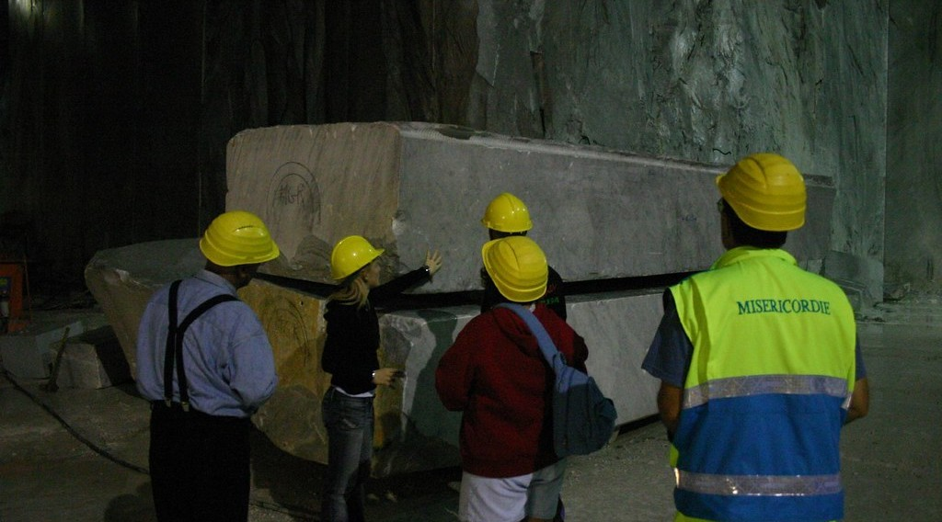
GEOGRAPHY — LOWER SIXTH ARTS
IV. HUMAN ACTIVITIES
Activity 5
A quarry.
2026 / 2027
DGCAST GAROUA — GEOGRAPHY DEPARTMENT
Mr KAMDEM E. | 26
Notes:
Without the projector: ask where stones are quarried near the school.

Slide 27
GEOGRAPHY — LOWER SIXTH ARTS
IV. HUMAN ACTIVITIES
Activity 5: Question
How do people speed up weathering?
2026 / 2027
DGCAST GAROUA — GEOGRAPHY DEPARTMENT
Mr KAMDEM E. | 27

Slide 28
GEOGRAPHY — LOWER SIXTH ARTS
IV. HUMAN ACTIVITIES
Answer
Quarries, roads and deforestation expose fresh rock; pollution makes acid rain.
2026 / 2027
DGCAST GAROUA — GEOGRAPHY DEPARTMENT
Mr KAMDEM E. | 28

Slide 29
GEOGRAPHY — LOWER SIXTH ARTS
BOARD SUMMARY
Intensity and Factors of Weathering
Topic: Denudational Processes on Slopes
Sub-topic: Weathering
Lesson 10: Intensity and Factors of Weathering
2026 / 2027
DGCAST GAROUA — GEOGRAPHY DEPARTMENT
Mr KAMDEM E. | 29
Notes:
Learners copy the board summary now. Give them enough time for each slide.

Slide 30
GEOGRAPHY — LOWER SIXTH ARTS
BOARD SUMMARY
I. Definitions
Regolith: It is the layer of loose weathered material above solid rock.
Lithology: It is the type and composition of a rock.
Joints: They are natural cracks in rocks.
2026 / 2027
DGCAST GAROUA — GEOGRAPHY DEPARTMENT
Mr KAMDEM E. | 30

Slide 31
GEOGRAPHY — LOWER SIXTH ARTS
BOARD SUMMARY
II. Climate (1/2)
A. Peltier's graph: It shows the type of weathering according to temperature and rainfall. Chemical weathering is strong in hot wet climates and frost action in cold wet climates.
B. Tropical areas: Heat and rain produce deep chemical weathering. The regolith can be more than 30 m deep.
2026 / 2027
DGCAST GAROUA — GEOGRAPHY DEPARTMENT
Mr KAMDEM E. | 31

Slide 32
GEOGRAPHY — LOWER SIXTH ARTS
BOARD SUMMARY
II. Climate (2/2)
Copy Peltier's graph.
2026 / 2027
DGCAST GAROUA — GEOGRAPHY DEPARTMENT
Mr KAMDEM E. | 32

Slide 33
GEOGRAPHY — LOWER SIXTH ARTS
BOARD SUMMARY
III. Other Factors (1/2)
A. Geology: Rock minerals, joints and hardness control weathering. Limestone dissolves quickly while quartz resists.
B. Relief: Steep slopes remove weathered material and expose fresh rock. Gentle slopes keep a thick regolith.
2026 / 2027
DGCAST GAROUA — GEOGRAPHY DEPARTMENT
Mr KAMDEM E. | 33

Slide 34
GEOGRAPHY — LOWER SIXTH ARTS
BOARD SUMMARY
III. Other Factors (2/2)
C. Vegetation: Roots break rocks and humus gives acids. Plants also protect the regolith from removal.
D. Human activities: Quarrying, road building and pollution speed up weathering. Acid rain attacks buildings and rocks.
2026 / 2027
DGCAST GAROUA — GEOGRAPHY DEPARTMENT
Mr KAMDEM E. | 34

Slide 35
GEOGRAPHY — LOWER SIXTH ARTS
FORMATIVE EVALUATION
Formative Evaluation 1
According to Peltier, where is chemical weathering strongest?
2026 / 2027
DGCAST GAROUA — GEOGRAPHY DEPARTMENT
Mr KAMDEM E. | 35

Slide 36
GEOGRAPHY — LOWER SIXTH ARTS
FORMATIVE EVALUATION
Expected Answer
In hot and wet climates.
2026 / 2027
DGCAST GAROUA — GEOGRAPHY DEPARTMENT
Mr KAMDEM E. | 36

Slide 37
GEOGRAPHY — LOWER SIXTH ARTS
FORMATIVE EVALUATION
Formative Evaluation 2
Give two factors of weathering other than climate.
2026 / 2027
DGCAST GAROUA — GEOGRAPHY DEPARTMENT
Mr KAMDEM E. | 37

Slide 38
GEOGRAPHY — LOWER SIXTH ARTS
FORMATIVE EVALUATION
Expected Answer
Rock type (geology) and vegetation.
2026 / 2027
DGCAST GAROUA — GEOGRAPHY DEPARTMENT
Mr KAMDEM E. | 38

Slide 39
GEOGRAPHY — LOWER SIXTH ARTS
REMEDIATION
Remediation
Fill in the blanks:
The layer of loose weathered material is the ______.
Natural cracks in rocks are ______.
Limestone is weathered by ______.
2026 / 2027
DGCAST GAROUA — GEOGRAPHY DEPARTMENT
Mr KAMDEM E. | 39
Notes:
Answers: 1. regolith 2. joints 3. carbonation (solution)

Slide 40
GEOGRAPHY — LOWER SIXTH ARTS
HOMEWORK
Homework
List three useful materials that come from weathered rock (for example sand, clay, laterite).
This prepares Lesson 11: The Impact of Weathering.
2026 / 2027
DGCAST GAROUA — GEOGRAPHY DEPARTMENT
Mr KAMDEM E. | 40
Notes:
This homework prepares the next lesson.

Slide 41
GEOGRAPHY — LOWER SIXTH ARTS
BILINGUAL GAME
Bilingual Game (Jeu Bilingue)
English | Français
Regolith | Le régolithe
Rock type | Le type de roche
Joint | La diaclase
Climate | Le climat
Quarry | La carrière
Acid rain | La pluie acide
2026 / 2027
DGCAST GAROUA — GEOGRAPHY DEPARTMENT
Mr KAMDEM E. | 41
Notes:
Say the English word; learners give the French word, then the reverse.

Slide 42
GEOGRAPHY — LOWER SIXTH ARTS
LOGBOOK
Official Logbook (1/2)
Module / Topic | Denudational Processes on Slopes
Lesson Title | Lesson 10: Intensity and Factors of Weathering
Expected Learning Outcomes | Use Peltier's graph to explain the effect of climate. Explain the influence of rock type and relief. Explain the role of vegetation and people.
Competence | Learners are able to explain why weathering is stronger in some places than in others.
2026 / 2027
DGCAST GAROUA — GEOGRAPHY DEPARTMENT
Mr KAMDEM E. | 42

Slide 43
GEOGRAPHY — LOWER SIXTH ARTS
LOGBOOK
Official Logbook (2/2)
Matter Taught | I. Definitions: Regolith, Lithology, Joints; II. Climate: Peltier's graph, Tropical areas; III. Other Factors: Geology, Relief, Vegetation, Human activities.
Evaluation | Formative evaluation (3 questions) and remediation exercise.
Homework | List three useful materials that come from weathered rock (for example sand, clay, laterite).
Enrolment / Present / Absent | ____ / ____ / ____
Achievement | To be completed by the teacher after the lesson.
2026 / 2027
DGCAST GAROUA — GEOGRAPHY DEPARTMENT
Mr KAMDEM E. | 43

Slide 44
GEOGRAPHY — LOWER SIXTH ARTS
TEACHER'S NOTE
Teacher's Note
Timing: Set-up, recall 8 min | Situation 8 min | 5 activities 30 min | Board summary (copying) 30 min | Evaluation, remediation 10 min | Homework, logbook 9 min | Spare 5 min
2026 / 2027
DGCAST GAROUA — GEOGRAPHY DEPARTMENT
Mr KAMDEM E. | 44

Slide 45
GEOGRAPHY — LOWER SIXTH ARTS
REFERENCES
References
National Geography Syllabus, Sixth Forms (Lower & Upper Sixth), MINESEC/IGE/IP-SS, August 2019 — Module 2 (Geomorphology).
Photo, Activity 2: “in the middle of nowhere, morocco” by mariusz kluzniak, CC BY-NC-ND 2.0, via Flickr (https://www.flickr.com/photos/39997856@N03/8398997251)
Photo, Activity 3: “Songam Cave” by D-Stanley, CC BY 2.0, via Flickr (https://www.flickr.com/photos/79721788@N00/5063216873)
Photo, Activity 4: “Full Screen Plate Tectonics” by subarcticmike, CC BY 2.0, via Flickr (https://www.flickr.com/photos/31856336@N03/3109980958)
Photo, Activity 5: “Marble quarry, Carrara” by Russell Carman, CC BY-NC-SA 2.0, via Flickr (https://www.flickr.com/photos/11328254@N02/2095886412)
Diagrams and animations: drawn for this lesson (DGCAST Geography Department).
2026 / 2027
DGCAST GAROUA — GEOGRAPHY DEPARTMENT
Mr KAMDEM E. | 45

