Slide 1

DIVINE GRACE COLLEGE OF ARTS, SCIENCE AND TECHNOLOGY
(DGCAST) — GAROUA | GEOGRAPHY DEPARTMENT
LOWER SIXTH ARTS — GEOMORPHOLOGY — LESSON 13
Processes and Features of Mass Wasting
Mr KAMDEM EMMANUEL
Geography Teacher — PLEG
Academic Year 2026 / 2027
Notes:
Good morning, class. Today we study Lesson 13: Processes and Features of Mass Wasting.

Slide 2
GEOGRAPHY — LOWER SIXTH ARTS
CLASS INFO
Class, Chapter & Duration
Class | Lower Sixth Arts
Chapter | Module 2: Understanding and managing physical landscapes, geomorphological processes and hazards across the world in general and Cameroon in particular
Duration | 2 periods (2 × 50 minutes)
2026 / 2027
DGCAST GAROUA — GEOGRAPHY DEPARTMENT
Mr KAMDEM E. | 2

Slide 3
GEOGRAPHY — LOWER SIXTH ARTS
IDENTIFICATION
Lesson Identification
Topic | Denudational Processes on Slopes
Sub-topic | Mass Movements
Lesson | Lesson 13: Processes and Features of Mass Wasting
Notions / Concepts | Solifluction, slumping, subsidence, mudflow, lahar.
Syllabus focus | Slow and fast mass movements; impacts on man and environment; solutions.
Competence | Learners are able to describe mass movements and propose measures to reduce their impacts.
2026 / 2027
DGCAST GAROUA — GEOGRAPHY DEPARTMENT
Mr KAMDEM E. | 3

Slide 4
GEOGRAPHY — LOWER SIXTH ARTS
OBJECTIVES
Learning Objectives
By the end of the lesson, the learner should be able to:
Describe slow mass movements.
Describe fast mass movements.
Explain their impacts and propose solutions.
2026 / 2027
DGCAST GAROUA — GEOGRAPHY DEPARTMENT
Mr KAMDEM E. | 4

Slide 5
GEOGRAPHY — LOWER SIXTH ARTS
RECALL
Recall
Mass wasting is caused by gravity.
Carson and Kirkby classify movements by speed and water.
2026 / 2027
DGCAST GAROUA — GEOGRAPHY DEPARTMENT
Mr KAMDEM E. | 5

Slide 6
GEOGRAPHY — LOWER SIXTH ARTS
REAL-LIFE SITUATION
Real-Life Situation
In October 2019, a landslide in Gouache, Bafoussam, killed more than 40 people. Houses had been built at the foot of a steep, deforested slope.
2026 / 2027
DGCAST GAROUA — GEOGRAPHY DEPARTMENT
Mr KAMDEM E. | 6
Notes:
Read the situation slowly, twice.

Slide 7
GEOGRAPHY — LOWER SIXTH ARTS
REAL-LIFE SITUATION
Situation — Question 1
What is the problem in the situation?
2026 / 2027
DGCAST GAROUA — GEOGRAPHY DEPARTMENT
Mr KAMDEM E. | 7

Slide 8
GEOGRAPHY — LOWER SIXTH ARTS
REAL-LIFE SITUATION
Answer
A landslide killed many people.
2026 / 2027
DGCAST GAROUA — GEOGRAPHY DEPARTMENT
Mr KAMDEM E. | 8

Slide 9
GEOGRAPHY — LOWER SIXTH ARTS
REAL-LIFE SITUATION
Situation — Question 2
What made the slope dangerous?
2026 / 2027
DGCAST GAROUA — GEOGRAPHY DEPARTMENT
Mr KAMDEM E. | 9

Slide 10
GEOGRAPHY — LOWER SIXTH ARTS
REAL-LIFE SITUATION
Answer
It was steep and deforested, with houses at its foot.
2026 / 2027
DGCAST GAROUA — GEOGRAPHY DEPARTMENT
Mr KAMDEM E. | 10

Slide 11
GEOGRAPHY — LOWER SIXTH ARTS
REAL-LIFE SITUATION
Situation — Question 3
What can be done?
2026 / 2027
DGCAST GAROUA — GEOGRAPHY DEPARTMENT
Mr KAMDEM E. | 11

Slide 12
GEOGRAPHY — LOWER SIXTH ARTS
REAL-LIFE SITUATION
Possible Answer
Avoid building on dangerous slopes, plant trees and drain water.
2026 / 2027
DGCAST GAROUA — GEOGRAPHY DEPARTMENT
Mr KAMDEM E. | 12

Slide 13
GEOGRAPHY — LOWER SIXTH ARTS
JUSTIFICATION
Justification of the Lesson
This lesson helps us to protect lives and property from mass movements.
2026 / 2027
DGCAST GAROUA — GEOGRAPHY DEPARTMENT
Mr KAMDEM E. | 13

Slide 14
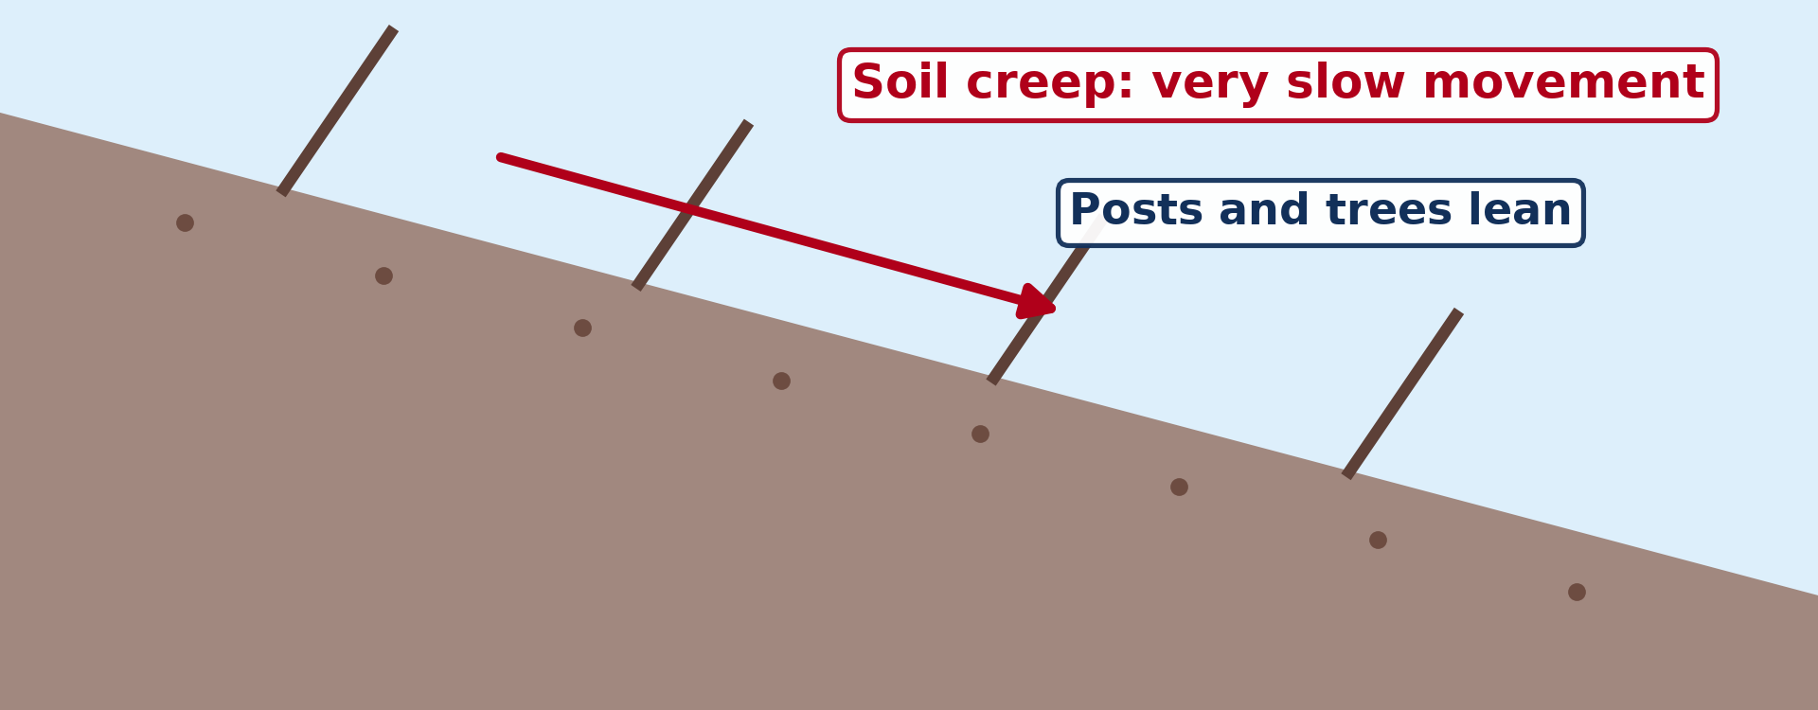
GEOGRAPHY — LOWER SIXTH ARTS
I. SLOW MOVEMENTS
Activity 1
Soil creep on a slope.
2026 / 2027
DGCAST GAROUA — GEOGRAPHY DEPARTMENT
Mr KAMDEM E. | 14
Notes:
Without the projector: use leaning fences as examples.

Slide 15
GEOGRAPHY — LOWER SIXTH ARTS
I. SLOW MOVEMENTS
Activity 1: Question
Describe soil creep.
2026 / 2027
DGCAST GAROUA — GEOGRAPHY DEPARTMENT
Mr KAMDEM E. | 15

Slide 16
GEOGRAPHY — LOWER SIXTH ARTS
I. SLOW MOVEMENTS
Answer
Very slow movement of soil, often only a few millimetres per year.
2026 / 2027
DGCAST GAROUA — GEOGRAPHY DEPARTMENT
Mr KAMDEM E. | 16

Slide 17
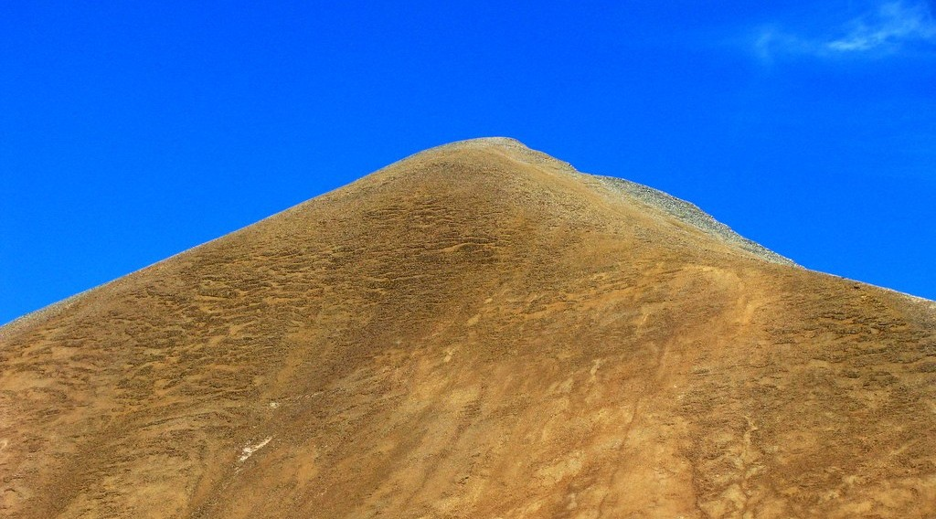
GEOGRAPHY — LOWER SIXTH ARTS
I. SLOW MOVEMENTS
Activity 2
Smooth, rounded slopes: the soil moves slowly down them.
2026 / 2027
DGCAST GAROUA — GEOGRAPHY DEPARTMENT
Mr KAMDEM E. | 17
Notes:
Without the projector: describe wet soil sliding over hard ground.

Slide 18
GEOGRAPHY — LOWER SIXTH ARTS
I. SLOW MOVEMENTS
Activity 2: Question
In cold areas, wet soil slowly flows over frozen ground. What is this called?
2026 / 2027
DGCAST GAROUA — GEOGRAPHY DEPARTMENT
Mr KAMDEM E. | 18

Slide 19
GEOGRAPHY — LOWER SIXTH ARTS
I. SLOW MOVEMENTS
Answer
Solifluction.
2026 / 2027
DGCAST GAROUA — GEOGRAPHY DEPARTMENT
Mr KAMDEM E. | 19

Slide 20
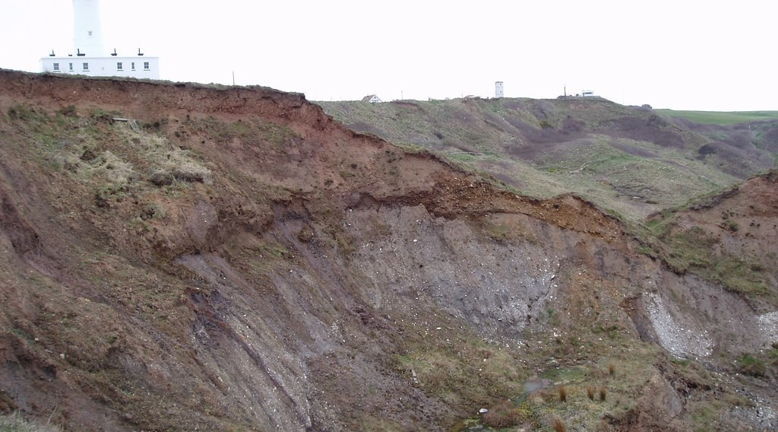
GEOGRAPHY — LOWER SIXTH ARTS
II. FAST MOVEMENTS
Activity 3
A slump.
2026 / 2027
DGCAST GAROUA — GEOGRAPHY DEPARTMENT
Mr KAMDEM E. | 20
Notes:
Without the projector: cut wet sand with a spoon and watch it slide.

Slide 21
GEOGRAPHY — LOWER SIXTH ARTS
II. FAST MOVEMENTS
Activity 3: Question
In a slump, how does the soil move?
2026 / 2027
DGCAST GAROUA — GEOGRAPHY DEPARTMENT
Mr KAMDEM E. | 21

Slide 22
GEOGRAPHY — LOWER SIXTH ARTS
II. FAST MOVEMENTS
Answer
A block slides down a curved surface and tilts backwards.
2026 / 2027
DGCAST GAROUA — GEOGRAPHY DEPARTMENT
Mr KAMDEM E. | 22

Slide 23
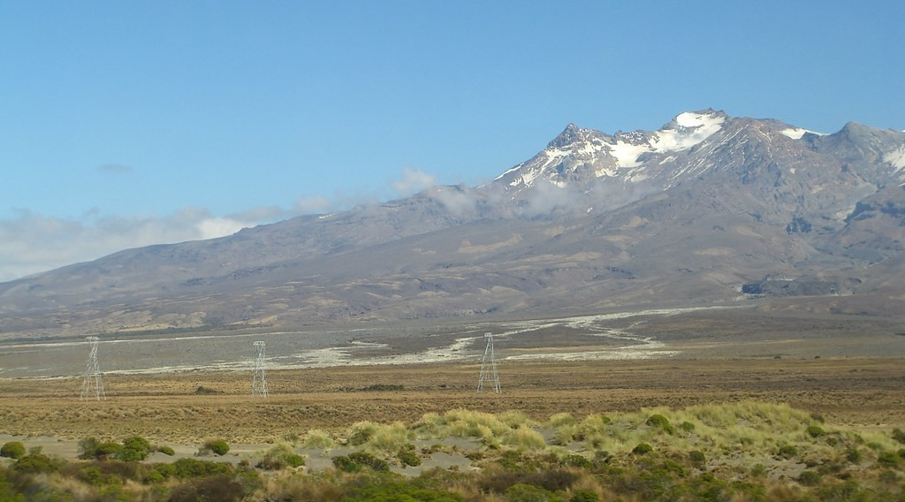
GEOGRAPHY — LOWER SIXTH ARTS
II. FAST MOVEMENTS
Activity 4
Remains of a lahar (volcanic mudflow) from Mount Ruapehu, New Zealand.
2026 / 2027
DGCAST GAROUA — GEOGRAPHY DEPARTMENT
Mr KAMDEM E. | 23
Notes:
Without the projector: mention lahars on volcanoes.

Slide 24
GEOGRAPHY — LOWER SIXTH ARTS
II. FAST MOVEMENTS
Activity 4: Question
What is a mudflow? Why is it very dangerous?
2026 / 2027
DGCAST GAROUA — GEOGRAPHY DEPARTMENT
Mr KAMDEM E. | 24

Slide 25
GEOGRAPHY — LOWER SIXTH ARTS
II. FAST MOVEMENTS
Answer
A fast flow of mud and water; it can bury villages quickly.
2026 / 2027
DGCAST GAROUA — GEOGRAPHY DEPARTMENT
Mr KAMDEM E. | 25

Slide 26

GEOGRAPHY — LOWER SIXTH ARTS
III. SOLUTIONS
Activity 5
Terraces on a hillside.
2026 / 2027
DGCAST GAROUA — GEOGRAPHY DEPARTMENT
Mr KAMDEM E. | 26
Notes:
Without the projector: list solutions on the board.

Slide 27
GEOGRAPHY — LOWER SIXTH ARTS
III. SOLUTIONS
Activity 5: Question
Give two ways to reduce mass wasting.
2026 / 2027
DGCAST GAROUA — GEOGRAPHY DEPARTMENT
Mr KAMDEM E. | 27

Slide 28
GEOGRAPHY — LOWER SIXTH ARTS
III. SOLUTIONS
Answer
Plant trees, build terraces and retaining walls, and drain water.
2026 / 2027
DGCAST GAROUA — GEOGRAPHY DEPARTMENT
Mr KAMDEM E. | 28

Slide 29
GEOGRAPHY — LOWER SIXTH ARTS
BOARD SUMMARY
Processes and Features of Mass Wasting
Topic: Denudational Processes on Slopes
Sub-topic: Mass Movements
Lesson 13: Processes and Features of Mass Wasting
2026 / 2027
DGCAST GAROUA — GEOGRAPHY DEPARTMENT
Mr KAMDEM E. | 29
Notes:
Learners copy the board summary now. Give them enough time for each slide.

Slide 30
GEOGRAPHY — LOWER SIXTH ARTS
BOARD SUMMARY
I. Definitions
Solifluction: It is the slow flow of wet soil over frozen ground.
Slumping: It is the rotational slide of a block of soil along a curved surface.
Subsidence: It is the sinking of the ground surface.
2026 / 2027
DGCAST GAROUA — GEOGRAPHY DEPARTMENT
Mr KAMDEM E. | 30

Slide 31
GEOGRAPHY — LOWER SIXTH ARTS
BOARD SUMMARY
II. Slow and Fast Movements (1/2)
A. Soil creep: Soil moves very slowly downslope. Wetting, drying and animals push particles down.
B. Solifluction: Wet soil flows over frozen subsoil in cold climates. It forms lobes and terraces.
2026 / 2027
DGCAST GAROUA — GEOGRAPHY DEPARTMENT
Mr KAMDEM E. | 31

Slide 32
GEOGRAPHY — LOWER SIXTH ARTS
BOARD SUMMARY
II. Slow and Fast Movements (2/2)
C. Falls and slides: Rocks fall from cliffs and landslides move along a plane. They are sudden and dangerous.
D. Slumps and flows: Slumps rotate along a curved surface. Mudflows and lahars are fast flows of water and mud.
2026 / 2027
DGCAST GAROUA — GEOGRAPHY DEPARTMENT
Mr KAMDEM E. | 32

Slide 33
GEOGRAPHY — LOWER SIXTH ARTS
BOARD SUMMARY
III. Impacts and Solutions (1/2)
A. Impacts: Mass movements kill people and destroy houses, roads and farms. Examples: Bafoussam (2019) and Dschang.
B. Environmental impacts: They remove soil and vegetation. They also block rivers and fill valleys with debris.
2026 / 2027
DGCAST GAROUA — GEOGRAPHY DEPARTMENT
Mr KAMDEM E. | 33

Slide 34
GEOGRAPHY — LOWER SIXTH ARTS
BOARD SUMMARY
III. Impacts and Solutions (2/2)
C. Solutions: Plant trees, build terraces, retaining walls and drains. Avoid building on steep, unstable slopes.
2026 / 2027
DGCAST GAROUA — GEOGRAPHY DEPARTMENT
Mr KAMDEM E. | 34

Slide 35
GEOGRAPHY — LOWER SIXTH ARTS
FORMATIVE EVALUATION
Formative Evaluation 1
What is the difference between a slump and a landslide?
2026 / 2027
DGCAST GAROUA — GEOGRAPHY DEPARTMENT
Mr KAMDEM E. | 35

Slide 36
GEOGRAPHY — LOWER SIXTH ARTS
FORMATIVE EVALUATION
Expected Answer
A slump rotates on a curved surface; a landslide moves on a flat plane.
2026 / 2027
DGCAST GAROUA — GEOGRAPHY DEPARTMENT
Mr KAMDEM E. | 36

Slide 37
GEOGRAPHY — LOWER SIXTH ARTS
FORMATIVE EVALUATION
Formative Evaluation 2
Give two measures against landslides.
2026 / 2027
DGCAST GAROUA — GEOGRAPHY DEPARTMENT
Mr KAMDEM E. | 37

Slide 38
GEOGRAPHY — LOWER SIXTH ARTS
FORMATIVE EVALUATION
Expected Answer
Plant trees; build retaining walls and drains.
2026 / 2027
DGCAST GAROUA — GEOGRAPHY DEPARTMENT
Mr KAMDEM E. | 38

Slide 39
GEOGRAPHY — LOWER SIXTH ARTS
REMEDIATION
Remediation
Fill in the blanks:
Wet soil flowing over frozen ground is ______.
A rotational slide is a ______.
The sinking of the ground is ______.
2026 / 2027
DGCAST GAROUA — GEOGRAPHY DEPARTMENT
Mr KAMDEM E. | 39
Notes:
Answers: 1. solifluction 2. slump 3. subsidence

Slide 40
GEOGRAPHY — LOWER SIXTH ARTS
HOMEWORK
Homework
Observe the Benue or a stream after rain. What does the water carry? Write three things.
This prepares Lesson 14: Erosional Processes.
2026 / 2027
DGCAST GAROUA — GEOGRAPHY DEPARTMENT
Mr KAMDEM E. | 40
Notes:
This homework prepares the next lesson.

Slide 41
GEOGRAPHY — LOWER SIXTH ARTS
BILINGUAL GAME
Bilingual Game (Jeu Bilingue)
English | Français
Solifluction | La solifluxion
Slump | Le glissement rotationnel
Mudflow | La coulée de boue
Subsidence | L'affaissement
Retaining wall | Le mur de soutènement
Terrace | La terrasse
2026 / 2027
DGCAST GAROUA — GEOGRAPHY DEPARTMENT
Mr KAMDEM E. | 41
Notes:
Say the English word; learners give the French word, then the reverse.

Slide 42
GEOGRAPHY — LOWER SIXTH ARTS
LOGBOOK
Official Logbook (1/2)
Module / Topic | Denudational Processes on Slopes
Lesson Title | Lesson 13: Processes and Features of Mass Wasting
Expected Learning Outcomes | Describe slow mass movements. Describe fast mass movements. Explain their impacts and propose solutions.
Competence | Learners are able to describe mass movements and propose measures to reduce their impacts.
2026 / 2027
DGCAST GAROUA — GEOGRAPHY DEPARTMENT
Mr KAMDEM E. | 42

Slide 43
GEOGRAPHY — LOWER SIXTH ARTS
LOGBOOK
Official Logbook (2/2)
Matter Taught | I. Definitions: Solifluction, Slumping, Subsidence; II. Slow and Fast Movements: Soil creep, Solifluction, Falls and slides, Slumps and flows; III. Impacts and Solutions: Impacts, Environmental impacts, Solutions.
Evaluation | Formative evaluation (3 questions) and remediation exercise.
Homework | Observe the Benue or a stream after rain. What does the water carry? Write three things.
Enrolment / Present / Absent | ____ / ____ / ____
Achievement | To be completed by the teacher after the lesson.
2026 / 2027
DGCAST GAROUA — GEOGRAPHY DEPARTMENT
Mr KAMDEM E. | 43

Slide 44
GEOGRAPHY — LOWER SIXTH ARTS
TEACHER'S NOTE
Teacher's Note
Timing: Set-up, recall 8 min | Situation 8 min | 5 activities 30 min | Board summary (copying) 30 min | Evaluation, remediation 10 min | Homework, logbook 9 min | Spare 5 min
2026 / 2027
DGCAST GAROUA — GEOGRAPHY DEPARTMENT
Mr KAMDEM E. | 44

Slide 45
GEOGRAPHY — LOWER SIXTH ARTS
REFERENCES
References
National Geography Syllabus, Sixth Forms (Lower & Upper Sixth), MINESEC/IGE/IP-SS, August 2019 — Module 2 (Geomorphology).
Photo, Activity 2: “Opal Hills” by Dru!, CC BY-NC 2.0, via Flickr (https://www.flickr.com/photos/36543076@N00/17159561341)
Photo, Activity 3: “Holderness landslides 026” by Madingley, CC BY-NC 2.0, via Flickr (https://www.flickr.com/photos/26004680@N00/256596582)
Photo, Activity 4: “Lahar (mudflow) remnants from Mount Ruapehu” by Wade Tregaskis, CC BY-NC 2.0, via Flickr (https://www.flickr.com/photos/7725552@N06/502073245)
Photo, Activity 5: “Terraced Hillside” by AdamCohn, CC BY-NC-ND 2.0, via Flickr (https://www.flickr.com/photos/96142515@N00/6311042523)
Diagrams and animations: drawn for this lesson (DGCAST Geography Department).
2026 / 2027
DGCAST GAROUA — GEOGRAPHY DEPARTMENT
Mr KAMDEM E. | 45

