Slide 1

DIVINE GRACE COLLEGE OF ARTS, SCIENCE AND TECHNOLOGY
(DGCAST) — GAROUA | GEOGRAPHY DEPARTMENT
LOWER SIXTH ARTS — HYDROLOGY — LESSON 22
Introduction to Hydrology
Mr KAMDEM EMMANUEL
Geography Teacher — PLEG
Academic Year 2026 / 2027
Notes:
Good morning, class. Today we study Lesson 22: Introduction to Hydrology.

Slide 2
GEOGRAPHY — LOWER SIXTH ARTS
CLASS INFO
Class, Chapter & Duration
Class | Lower Sixth Arts
Chapter | Module 1: Understanding and managing atmospheric and hydrological phenomena and hazards across the world in general and Cameroon in particular
Duration | 2 periods (2 × 50 minutes)
2026 / 2027
DGCAST GAROUA — GEOGRAPHY DEPARTMENT
Mr KAMDEM E. | 2

Slide 3
GEOGRAPHY — LOWER SIXTH ARTS
IDENTIFICATION
Lesson Identification
Topic | Global Water in Storage and Circulation
Sub-topic | Introduction and Scope of Hydrology
Lesson | Lesson 22: Introduction to Hydrology
Notions / Concepts | Hydrology, fresh water, salt water, ground water, ice cap, water demand.
Syllabus focus | Meaning and scope of hydrology; distribution of the world's water; main uses and increasing demand.
Competence | Learners are able to describe where the world's water is stored and explain why demand for water is increasing.
2026 / 2027
DGCAST GAROUA — GEOGRAPHY DEPARTMENT
Mr KAMDEM E. | 3

Slide 4
GEOGRAPHY — LOWER SIXTH ARTS
OBJECTIVES
Learning Objectives
By the end of the lesson, the learner should be able to:
Define hydrology and give its scope.
Describe the distribution of the world's water.
Explain the main uses of water and the rising demand.
2026 / 2027
DGCAST GAROUA — GEOGRAPHY DEPARTMENT
Mr KAMDEM E. | 4

Slide 5
GEOGRAPHY — LOWER SIXTH ARTS
RECALL
Recall
Water exists as ice, liquid water and vapour.
Rain comes from the evaporation of seas and lakes.
2026 / 2027
DGCAST GAROUA — GEOGRAPHY DEPARTMENT
Mr KAMDEM E. | 5

Slide 6
GEOGRAPHY — LOWER SIXTH ARTS
REAL-LIFE SITUATION
Real-Life Situation
In Maroua, women walk many kilometres to fetch water in the dry season, yet most of the Earth is covered by water. A learner asks why there is not enough water if the planet is "blue".
2026 / 2027
DGCAST GAROUA — GEOGRAPHY DEPARTMENT
Mr KAMDEM E. | 6
Notes:
Read the situation slowly, twice.

Slide 7
GEOGRAPHY — LOWER SIXTH ARTS
REAL-LIFE SITUATION
Situation — Question 1
What is the problem in the situation?
2026 / 2027
DGCAST GAROUA — GEOGRAPHY DEPARTMENT
Mr KAMDEM E. | 7

Slide 8
GEOGRAPHY — LOWER SIXTH ARTS
REAL-LIFE SITUATION
Answer
People lack fresh water although the Earth has much water.
2026 / 2027
DGCAST GAROUA — GEOGRAPHY DEPARTMENT
Mr KAMDEM E. | 8

Slide 9
GEOGRAPHY — LOWER SIXTH ARTS
REAL-LIFE SITUATION
Situation — Question 2
Why is most of the water not usable?
2026 / 2027
DGCAST GAROUA — GEOGRAPHY DEPARTMENT
Mr KAMDEM E. | 9

Slide 10
GEOGRAPHY — LOWER SIXTH ARTS
REAL-LIFE SITUATION
Answer
About 97.5 % is salt water in the oceans.
2026 / 2027
DGCAST GAROUA — GEOGRAPHY DEPARTMENT
Mr KAMDEM E. | 10

Slide 11
GEOGRAPHY — LOWER SIXTH ARTS
REAL-LIFE SITUATION
Situation — Question 3
Where is most fresh water?
2026 / 2027
DGCAST GAROUA — GEOGRAPHY DEPARTMENT
Mr KAMDEM E. | 11

Slide 12
GEOGRAPHY — LOWER SIXTH ARTS
REAL-LIFE SITUATION
Possible Answer
In ice caps and glaciers, then under the ground.
2026 / 2027
DGCAST GAROUA — GEOGRAPHY DEPARTMENT
Mr KAMDEM E. | 12

Slide 13
GEOGRAPHY — LOWER SIXTH ARTS
JUSTIFICATION
Justification of the Lesson
This lesson helps us to understand how little fresh water we have and why we must manage it well.
2026 / 2027
DGCAST GAROUA — GEOGRAPHY DEPARTMENT
Mr KAMDEM E. | 13

Slide 14

GEOGRAPHY — LOWER SIXTH ARTS
I. MEANING
Activity 1
The "blue planet" seen from space.
2026 / 2027
DGCAST GAROUA — GEOGRAPHY DEPARTMENT
Mr KAMDEM E. | 14
Notes:
Without the projector: show a globe.

Slide 15
GEOGRAPHY — LOWER SIXTH ARTS
I. MEANING
Activity 1: Question
Which part of the Earth's surface is covered by water?
2026 / 2027
DGCAST GAROUA — GEOGRAPHY DEPARTMENT
Mr KAMDEM E. | 15

Slide 16
GEOGRAPHY — LOWER SIXTH ARTS
I. MEANING
Answer
About 71 %.
2026 / 2027
DGCAST GAROUA — GEOGRAPHY DEPARTMENT
Mr KAMDEM E. | 16

Slide 17
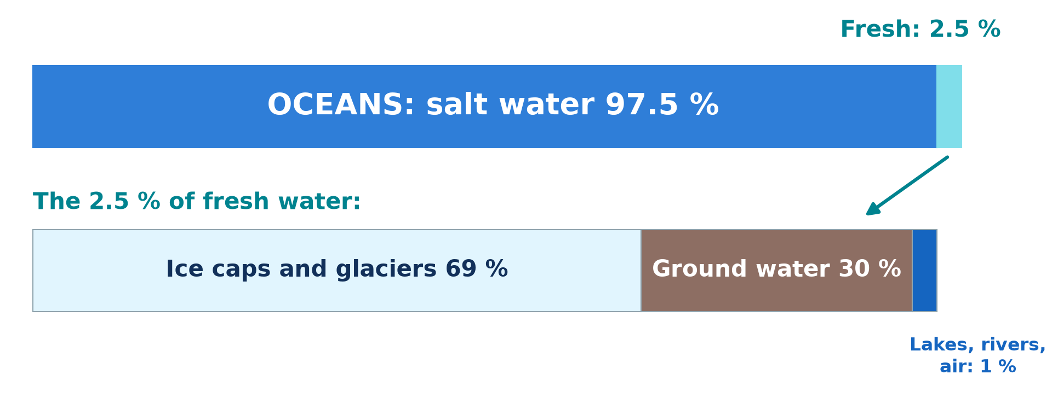
GEOGRAPHY — LOWER SIXTH ARTS
II. DISTRIBUTION
Activity 2
Where the world's water is.
2026 / 2027
DGCAST GAROUA — GEOGRAPHY DEPARTMENT
Mr KAMDEM E. | 17
Notes:
Without the projector: draw the two bars.

Slide 18
GEOGRAPHY — LOWER SIXTH ARTS
II. DISTRIBUTION
Activity 2: Question
What percentage of the world's water is fresh? Where is most of it?
2026 / 2027
DGCAST GAROUA — GEOGRAPHY DEPARTMENT
Mr KAMDEM E. | 18

Slide 19
GEOGRAPHY — LOWER SIXTH ARTS
II. DISTRIBUTION
Answer
About 2.5 %; most of it is in ice caps and glaciers.
2026 / 2027
DGCAST GAROUA — GEOGRAPHY DEPARTMENT
Mr KAMDEM E. | 19

Slide 20
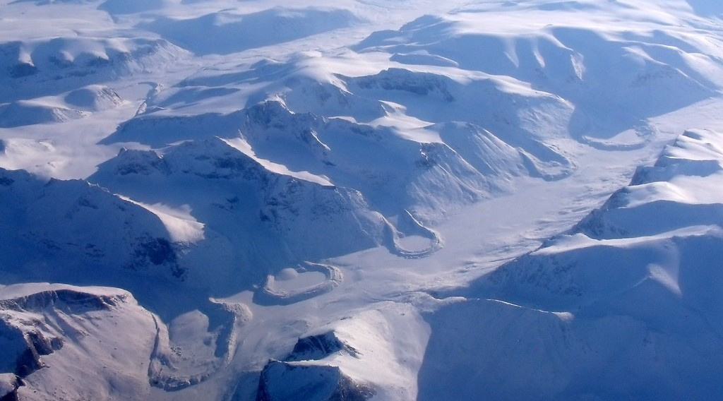
GEOGRAPHY — LOWER SIXTH ARTS
II. DISTRIBUTION
Activity 3
Ice caps and glaciers in the Arctic.
2026 / 2027
DGCAST GAROUA — GEOGRAPHY DEPARTMENT
Mr KAMDEM E. | 20
Notes:
Without the projector: find Greenland and Antarctica on the map.

Slide 21
GEOGRAPHY — LOWER SIXTH ARTS
II. DISTRIBUTION
Activity 3: Question
Why can people not easily use the water in ice caps?
2026 / 2027
DGCAST GAROUA — GEOGRAPHY DEPARTMENT
Mr KAMDEM E. | 21

Slide 22
GEOGRAPHY — LOWER SIXTH ARTS
II. DISTRIBUTION
Answer
It is frozen and far from where people live.
2026 / 2027
DGCAST GAROUA — GEOGRAPHY DEPARTMENT
Mr KAMDEM E. | 22

Slide 23

GEOGRAPHY — LOWER SIXTH ARTS
II. DISTRIBUTION
Activity 4
People collecting water at a borehole.
2026 / 2027
DGCAST GAROUA — GEOGRAPHY DEPARTMENT
Mr KAMDEM E. | 23
Notes:
Without the projector: ask where the village gets its water.

Slide 24
GEOGRAPHY — LOWER SIXTH ARTS
II. DISTRIBUTION
Activity 4: Question
Where does the water from a borehole come from?
2026 / 2027
DGCAST GAROUA — GEOGRAPHY DEPARTMENT
Mr KAMDEM E. | 24

Slide 25
GEOGRAPHY — LOWER SIXTH ARTS
II. DISTRIBUTION
Answer
From ground water stored in rocks under the surface.
2026 / 2027
DGCAST GAROUA — GEOGRAPHY DEPARTMENT
Mr KAMDEM E. | 25

Slide 26

GEOGRAPHY — LOWER SIXTH ARTS
III. USES AND DEMAND
Activity 5
Irrigation of a field.
2026 / 2027
DGCAST GAROUA — GEOGRAPHY DEPARTMENT
Mr KAMDEM E. | 26
Notes:
Without the projector: list uses of water at home and on farms.

Slide 27
GEOGRAPHY — LOWER SIXTH ARTS
III. USES AND DEMAND
Activity 5: Question
Which activity uses the most fresh water in the world? Why is demand rising?
2026 / 2027
DGCAST GAROUA — GEOGRAPHY DEPARTMENT
Mr KAMDEM E. | 27

Slide 28
GEOGRAPHY — LOWER SIXTH ARTS
III. USES AND DEMAND
Answer
Agriculture (about 70 %). Demand rises with population, towns and industry.
2026 / 2027
DGCAST GAROUA — GEOGRAPHY DEPARTMENT
Mr KAMDEM E. | 28

Slide 29
GEOGRAPHY — LOWER SIXTH ARTS
BOARD SUMMARY
Introduction to Hydrology
Topic: Global Water in Storage and Circulation
Sub-topic: Introduction and Scope of Hydrology
Lesson 22: Introduction to Hydrology
2026 / 2027
DGCAST GAROUA — GEOGRAPHY DEPARTMENT
Mr KAMDEM E. | 29
Notes:
Learners copy the board summary now. Give them enough time for each slide.

Slide 30
GEOGRAPHY — LOWER SIXTH ARTS
BOARD SUMMARY
I. Definitions
Hydrology: It is the study of water on and under the Earth and in the air.
Fresh water: It is water with little salt, found in rivers, lakes, ice and underground.
Ground water: It is water stored in the pores and cracks of rocks under the ground.
2026 / 2027
DGCAST GAROUA — GEOGRAPHY DEPARTMENT
Mr KAMDEM E. | 30

Slide 31
GEOGRAPHY — LOWER SIXTH ARTS
BOARD SUMMARY
II. Scope and Distribution (1/2)
A. Scope: Hydrology studies rain, rivers, lakes, soil water and ground water. It also studies floods, droughts and water use.
B. Salt water: Oceans hold about 97.5 % of the world's water. It cannot be drunk or used for farming without costly treatment.
2026 / 2027
DGCAST GAROUA — GEOGRAPHY DEPARTMENT
Mr KAMDEM E. | 31

Slide 32
GEOGRAPHY — LOWER SIXTH ARTS
BOARD SUMMARY
II. Scope and Distribution (2/2)
C. Fresh water: Only 2.5 % is fresh, and about 69 % of it is ice. About 30 % is ground water, and only 1 % is in lakes, rivers and the air.
2026 / 2027
DGCAST GAROUA — GEOGRAPHY DEPARTMENT
Mr KAMDEM E. | 32

Slide 33
GEOGRAPHY — LOWER SIXTH ARTS
BOARD SUMMARY
III. Uses and Demand (1/3)
A. Uses: Water is used for farming, homes, industry and hydro-electricity. It is also used for transport and fishing.
B. Rising demand: Population growth, towns and industry increase the demand for water. Irrigation uses the largest share.
2026 / 2027
DGCAST GAROUA — GEOGRAPHY DEPARTMENT
Mr KAMDEM E. | 33

Slide 34
GEOGRAPHY — LOWER SIXTH ARTS
BOARD SUMMARY
III. Uses and Demand (2/3)
C. Problems: Many regions face shortages and pollution. Water must be saved and shared fairly.
2026 / 2027
DGCAST GAROUA — GEOGRAPHY DEPARTMENT
Mr KAMDEM E. | 34

Slide 35
GEOGRAPHY — LOWER SIXTH ARTS
BOARD SUMMARY
III. Uses and Demand (3/3)
Copy the diagram.
2026 / 2027
DGCAST GAROUA — GEOGRAPHY DEPARTMENT
Mr KAMDEM E. | 35

Slide 36
GEOGRAPHY — LOWER SIXTH ARTS
FORMATIVE EVALUATION
Formative Evaluation 1
Define hydrology.
2026 / 2027
DGCAST GAROUA — GEOGRAPHY DEPARTMENT
Mr KAMDEM E. | 36

Slide 37
GEOGRAPHY — LOWER SIXTH ARTS
FORMATIVE EVALUATION
Expected Answer
The study of water on and under the Earth and in the air.
2026 / 2027
DGCAST GAROUA — GEOGRAPHY DEPARTMENT
Mr KAMDEM E. | 37

Slide 38
GEOGRAPHY — LOWER SIXTH ARTS
FORMATIVE EVALUATION
Formative Evaluation 2
Why is fresh water scarce although the Earth is covered by water?
2026 / 2027
DGCAST GAROUA — GEOGRAPHY DEPARTMENT
Mr KAMDEM E. | 38

Slide 39
GEOGRAPHY — LOWER SIXTH ARTS
FORMATIVE EVALUATION
Expected Answer
97.5 % is salt water and most fresh water is frozen in ice caps.
2026 / 2027
DGCAST GAROUA — GEOGRAPHY DEPARTMENT
Mr KAMDEM E. | 39

Slide 40
GEOGRAPHY — LOWER SIXTH ARTS
REMEDIATION
Remediation
Fill in the blanks:
About ______ % of the world's water is salt water.
Most fresh water is stored in ______.
The activity that uses most water is ______.
2026 / 2027
DGCAST GAROUA — GEOGRAPHY DEPARTMENT
Mr KAMDEM E. | 40
Notes:
Answers: 1. 97.5 2. ice caps and glaciers 3. agriculture

Slide 41
GEOGRAPHY — LOWER SIXTH ARTS
HOMEWORK
Homework
List the sources of water in your area and say which ones dry up in the dry season.
This prepares Lesson 23: The Hydrological Cycle.
2026 / 2027
DGCAST GAROUA — GEOGRAPHY DEPARTMENT
Mr KAMDEM E. | 41
Notes:
This homework prepares the next lesson.

Slide 42
GEOGRAPHY — LOWER SIXTH ARTS
BILINGUAL GAME
Bilingual Game (Jeu Bilingue)
English | Français
Hydrology | L'hydrologie
Fresh water | L'eau douce
Ground water | L'eau souterraine
Ice cap | La calotte glaciaire
Demand | La demande
Irrigation | L'irrigation
2026 / 2027
DGCAST GAROUA — GEOGRAPHY DEPARTMENT
Mr KAMDEM E. | 42
Notes:
Say the English word; learners give the French word, then the reverse.

Slide 43
GEOGRAPHY — LOWER SIXTH ARTS
LOGBOOK
Official Logbook (1/2)
Module / Topic | Global Water in Storage and Circulation
Lesson Title | Lesson 22: Introduction to Hydrology
Expected Learning Outcomes | Define hydrology and give its scope. Describe the distribution of the world's water. Explain the main uses of water and the rising demand.
Competence | Learners are able to describe where the world's water is stored and explain why demand for water is increasing.
2026 / 2027
DGCAST GAROUA — GEOGRAPHY DEPARTMENT
Mr KAMDEM E. | 43

Slide 44
GEOGRAPHY — LOWER SIXTH ARTS
LOGBOOK
Official Logbook (2/2)
Matter Taught | I. Definitions: Hydrology, Fresh water, Ground water; II. Scope and Distribution: Scope, Salt water, Fresh water; III. Uses and Demand: Uses, Rising demand, Problems.
Evaluation | Formative evaluation (3 questions) and remediation exercise.
Homework | List the sources of water in your area and say which ones dry up in the dry season.
Enrolment / Present / Absent | ____ / ____ / ____
Achievement | To be completed by the teacher after the lesson.
2026 / 2027
DGCAST GAROUA — GEOGRAPHY DEPARTMENT
Mr KAMDEM E. | 44

Slide 45
GEOGRAPHY — LOWER SIXTH ARTS
TEACHER'S NOTE
Teacher's Note
Timing: Set-up, recall 8 min | Situation 8 min | 5 activities 30 min | Board summary (copying) 30 min | Evaluation, remediation 10 min | Homework, logbook 9 min | Spare 5 min
2026 / 2027
DGCAST GAROUA — GEOGRAPHY DEPARTMENT
Mr KAMDEM E. | 45

Slide 46
GEOGRAPHY — LOWER SIXTH ARTS
REFERENCES
References
National Geography Syllabus, Sixth Forms (Lower & Upper Sixth), MINESEC/IGE/IP-SS, August 2019 — Module 1 (Meteorology, Climatology & Hydrology).
Photo, Activity 1: “Blue Marble, Eastern Hemisphere March 2014” by NASA Goddard Photo and Video, CC BY 2.0, via nasa (https://www.flickr.com/photos/24662369@N07/14990033062)
Photo, Activity 3: “The Art of Retreat” by subarcticmike, CC BY 2.0, via Flickr (https://www.flickr.com/photos/31856336@N03/7048837663)
Photo, Activity 4: “i'll fight you for it...” by the apostrophe, CC BY-NC-SA 2.0, via Flickr (https://www.flickr.com/photos/66441426@N00/4019192363)
Photo, Activity 5: “Mid-West Agriculture” by Djof, CC BY-NC-SA 2.0, via Flickr (https://www.flickr.com/photos/10787942@N00/147222315)
Diagrams and animations: drawn for this lesson (DGCAST Geography Department).
2026 / 2027
DGCAST GAROUA — GEOGRAPHY DEPARTMENT
Mr KAMDEM E. | 46

