Slide 1

DIVINE GRACE COLLEGE OF ARTS, SCIENCE AND TECHNOLOGY
(DGCAST) — GAROUA | GEOGRAPHY DEPARTMENT
LOWER SIXTH ARTS — HYDROLOGY — LESSON 23
The Hydrological Cycle
Mr KAMDEM EMMANUEL
Geography Teacher — PLEG
Academic Year 2026 / 2027
Notes:
Good morning, class. Today we study Lesson 23: The Hydrological Cycle.

Slide 2
GEOGRAPHY — LOWER SIXTH ARTS
CLASS INFO
Class, Chapter & Duration
Class | Lower Sixth Arts
Chapter | Module 1: Understanding and managing atmospheric and hydrological phenomena and hazards across the world in general and Cameroon in particular
Duration | 2 periods (2 × 50 minutes)
2026 / 2027
DGCAST GAROUA — GEOGRAPHY DEPARTMENT
Mr KAMDEM E. | 2

Slide 3
GEOGRAPHY — LOWER SIXTH ARTS
IDENTIFICATION
Lesson Identification
Topic | Global Water in Storage and Circulation
Sub-topic | The Hydrological Cycle
Lesson | Lesson 23: The Hydrological Cycle
Notions / Concepts | Hydrological cycle, system, store, flow, closed system, residence time.
Syllabus focus | Meaning; systems approach; the global hydrological cycle as a closed system with its stores, flows and quantities.
Competence | Learners are able to describe the global water cycle as a closed system with stores and flows.
2026 / 2027
DGCAST GAROUA — GEOGRAPHY DEPARTMENT
Mr KAMDEM E. | 3

Slide 4
GEOGRAPHY — LOWER SIXTH ARTS
OBJECTIVES
Learning Objectives
By the end of the lesson, the learner should be able to:
Define the hydrological cycle.
Explain the systems approach (stores and flows).
Describe the global cycle as a closed system with quantities.
2026 / 2027
DGCAST GAROUA — GEOGRAPHY DEPARTMENT
Mr KAMDEM E. | 4

Slide 5
GEOGRAPHY — LOWER SIXTH ARTS
RECALL
Recall
Water evaporates, condenses and falls as rain.
Most water is in the oceans.
2026 / 2027
DGCAST GAROUA — GEOGRAPHY DEPARTMENT
Mr KAMDEM E. | 5

Slide 6
GEOGRAPHY — LOWER SIXTH ARTS
REAL-LIFE SITUATION
Real-Life Situation
A teacher says that the water we drink today may once have been drunk by a dinosaur. Learners laugh, but the teacher insists that water is never lost; it only moves.
2026 / 2027
DGCAST GAROUA — GEOGRAPHY DEPARTMENT
Mr KAMDEM E. | 6
Notes:
Read the situation slowly, twice.

Slide 7
GEOGRAPHY — LOWER SIXTH ARTS
REAL-LIFE SITUATION
Situation — Question 1
What is the problem in the situation?
2026 / 2027
DGCAST GAROUA — GEOGRAPHY DEPARTMENT
Mr KAMDEM E. | 7

Slide 8
GEOGRAPHY — LOWER SIXTH ARTS
REAL-LIFE SITUATION
Answer
Learners do not see how water moves and is reused.
2026 / 2027
DGCAST GAROUA — GEOGRAPHY DEPARTMENT
Mr KAMDEM E. | 8

Slide 9
GEOGRAPHY — LOWER SIXTH ARTS
REAL-LIFE SITUATION
Situation — Question 2
Is water lost from the Earth?
2026 / 2027
DGCAST GAROUA — GEOGRAPHY DEPARTMENT
Mr KAMDEM E. | 9

Slide 10
GEOGRAPHY — LOWER SIXTH ARTS
REAL-LIFE SITUATION
Answer
No. The total amount stays the same.
2026 / 2027
DGCAST GAROUA — GEOGRAPHY DEPARTMENT
Mr KAMDEM E. | 10

Slide 11
GEOGRAPHY — LOWER SIXTH ARTS
REAL-LIFE SITUATION
Situation — Question 3
What is this movement called?
2026 / 2027
DGCAST GAROUA — GEOGRAPHY DEPARTMENT
Mr KAMDEM E. | 11

Slide 12
GEOGRAPHY — LOWER SIXTH ARTS
REAL-LIFE SITUATION
Possible Answer
The hydrological (water) cycle.
2026 / 2027
DGCAST GAROUA — GEOGRAPHY DEPARTMENT
Mr KAMDEM E. | 12

Slide 13
GEOGRAPHY — LOWER SIXTH ARTS
JUSTIFICATION
Justification of the Lesson
This lesson helps us to understand how water moves between the sea, the air and the land.
2026 / 2027
DGCAST GAROUA — GEOGRAPHY DEPARTMENT
Mr KAMDEM E. | 13

Slide 14

GEOGRAPHY — LOWER SIXTH ARTS
I. MEANING
Activity 1
Animation: the water cycle.
2026 / 2027
DGCAST GAROUA — GEOGRAPHY DEPARTMENT
Mr KAMDEM E. | 14
Notes:
Without the projector: draw the cycle on the board.

Slide 15
GEOGRAPHY — LOWER SIXTH ARTS
I. MEANING
Activity 1: Question
Name the main processes of the water cycle.
2026 / 2027
DGCAST GAROUA — GEOGRAPHY DEPARTMENT
Mr KAMDEM E. | 15

Slide 16
GEOGRAPHY — LOWER SIXTH ARTS
I. MEANING
Answer
Evaporation, condensation, precipitation and runoff.
2026 / 2027
DGCAST GAROUA — GEOGRAPHY DEPARTMENT
Mr KAMDEM E. | 16

Slide 17

GEOGRAPHY — LOWER SIXTH ARTS
II. A CLOSED SYSTEM
Activity 2
The Earth: its water never leaves the planet.
2026 / 2027
DGCAST GAROUA — GEOGRAPHY DEPARTMENT
Mr KAMDEM E. | 17
Notes:
Without the projector: compare with water boiling in a closed pot.

Slide 18
GEOGRAPHY — LOWER SIXTH ARTS
II. A CLOSED SYSTEM
Activity 2: Question
Why is the global water cycle called a closed system?
2026 / 2027
DGCAST GAROUA — GEOGRAPHY DEPARTMENT
Mr KAMDEM E. | 18

Slide 19
GEOGRAPHY — LOWER SIXTH ARTS
II. A CLOSED SYSTEM
Answer
No water enters or leaves the Earth; it only moves between stores.
2026 / 2027
DGCAST GAROUA — GEOGRAPHY DEPARTMENT
Mr KAMDEM E. | 19

Slide 20
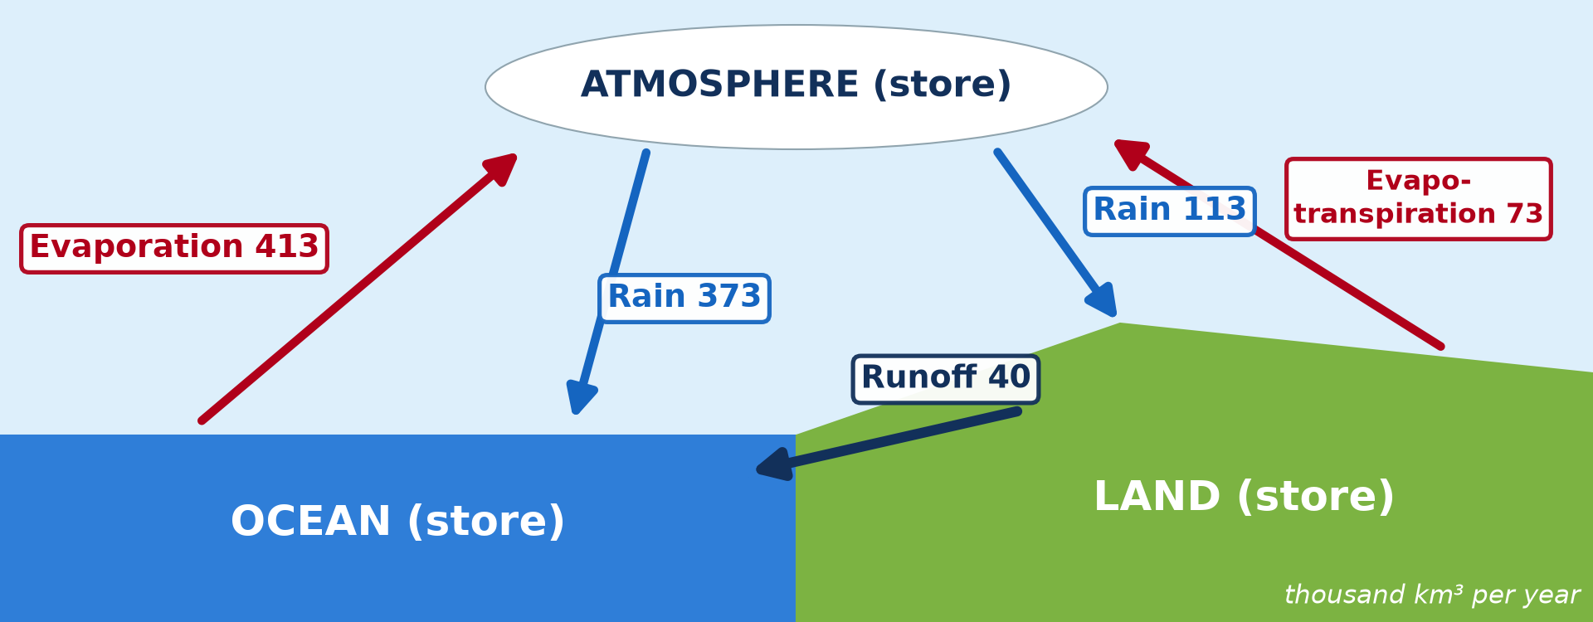
GEOGRAPHY — LOWER SIXTH ARTS
II. A CLOSED SYSTEM
Activity 3
Flows between the stores.
2026 / 2027
DGCAST GAROUA — GEOGRAPHY DEPARTMENT
Mr KAMDEM E. | 20
Notes:
Without the projector: do the calculation on the board.

Slide 21
GEOGRAPHY — LOWER SIXTH ARTS
II. A CLOSED SYSTEM
Activity 3: Question
Evaporation from the ocean is 413 and rain on the ocean is 373. Where do the other 40 go?
2026 / 2027
DGCAST GAROUA — GEOGRAPHY DEPARTMENT
Mr KAMDEM E. | 21

Slide 22
GEOGRAPHY — LOWER SIXTH ARTS
II. A CLOSED SYSTEM
Answer
They fall on land and return to the sea as runoff (40).
2026 / 2027
DGCAST GAROUA — GEOGRAPHY DEPARTMENT
Mr KAMDEM E. | 22

Slide 23

GEOGRAPHY — LOWER SIXTH ARTS
III. STORES
Activity 4
Clouds: water stored in the atmosphere.
2026 / 2027
DGCAST GAROUA — GEOGRAPHY DEPARTMENT
Mr KAMDEM E. | 23
Notes:
Without the projector: explain residence time with a bus stop.

Slide 24
GEOGRAPHY — LOWER SIXTH ARTS
III. STORES
Activity 4: Question
Is the atmosphere a big or a small store? Why is it important?
2026 / 2027
DGCAST GAROUA — GEOGRAPHY DEPARTMENT
Mr KAMDEM E. | 24

Slide 25
GEOGRAPHY — LOWER SIXTH ARTS
III. STORES
Answer
A small store, but water passes through it quickly and gives all the rain.
2026 / 2027
DGCAST GAROUA — GEOGRAPHY DEPARTMENT
Mr KAMDEM E. | 25

Slide 26
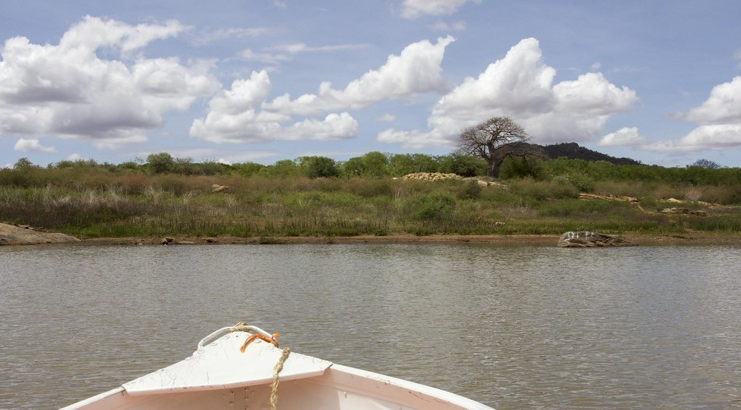
GEOGRAPHY — LOWER SIXTH ARTS
III. STORES
Activity 5
A lake: a surface store of water.
2026 / 2027
DGCAST GAROUA — GEOGRAPHY DEPARTMENT
Mr KAMDEM E. | 26
Notes:
Without the projector: list stores on the board.

Slide 27
GEOGRAPHY — LOWER SIXTH ARTS
III. STORES
Activity 5: Question
Name three stores of water on land.
2026 / 2027
DGCAST GAROUA — GEOGRAPHY DEPARTMENT
Mr KAMDEM E. | 27

Slide 28
GEOGRAPHY — LOWER SIXTH ARTS
III. STORES
Answer
Lakes and rivers, soil water, ground water (also ice and plants).
2026 / 2027
DGCAST GAROUA — GEOGRAPHY DEPARTMENT
Mr KAMDEM E. | 28

Slide 29
GEOGRAPHY — LOWER SIXTH ARTS
BOARD SUMMARY
The Hydrological Cycle
Topic: Global Water in Storage and Circulation
Sub-topic: The Hydrological Cycle
Lesson 23: The Hydrological Cycle
2026 / 2027
DGCAST GAROUA — GEOGRAPHY DEPARTMENT
Mr KAMDEM E. | 29
Notes:
Learners copy the board summary now. Give them enough time for each slide.

Slide 30
GEOGRAPHY — LOWER SIXTH ARTS
BOARD SUMMARY
I. Definitions (1/2)
Hydrological cycle: It is the continuous movement of water between the sea, the air and the land.
Store: It is a place where water is kept for some time.
Flow: It is the movement of water from one store to another.
2026 / 2027
DGCAST GAROUA — GEOGRAPHY DEPARTMENT
Mr KAMDEM E. | 30

Slide 31
GEOGRAPHY — LOWER SIXTH ARTS
BOARD SUMMARY
I. Definitions (2/2)
Closed system: It is a system where nothing enters or leaves, only energy.
2026 / 2027
DGCAST GAROUA — GEOGRAPHY DEPARTMENT
Mr KAMDEM E. | 31

Slide 32
GEOGRAPHY — LOWER SIXTH ARTS
BOARD SUMMARY
II. The Systems Approach (1/2)
A. Stores: The main stores are oceans, ice, ground water, lakes, soil, rivers, plants and the atmosphere. The ocean is by far the largest.
B. Flows: Water moves by evaporation, condensation, precipitation, infiltration and runoff. The Sun gives the energy for these flows.
2026 / 2027
DGCAST GAROUA — GEOGRAPHY DEPARTMENT
Mr KAMDEM E. | 32

Slide 33
GEOGRAPHY — LOWER SIXTH ARTS
BOARD SUMMARY
II. The Systems Approach (2/2)
C. Residence time: Water stays thousands of years in oceans and ice. It stays only about 9 days in the atmosphere.
2026 / 2027
DGCAST GAROUA — GEOGRAPHY DEPARTMENT
Mr KAMDEM E. | 33

Slide 34
GEOGRAPHY — LOWER SIXTH ARTS
BOARD SUMMARY
III. The Global Cycle (1/3)
A. Over the oceans: About 413 thousand km³ evaporate every year, and 373 fall back as rain. The rest is carried over the land.
B. Over the land: About 113 thousand km³ fall as rain, and 73 return to the air by evapotranspiration. About 40 flow back to the sea as runoff.
2026 / 2027
DGCAST GAROUA — GEOGRAPHY DEPARTMENT
Mr KAMDEM E. | 34

Slide 35
GEOGRAPHY — LOWER SIXTH ARTS
BOARD SUMMARY
III. The Global Cycle (2/3)
C. Balance: The total amount of water on Earth does not change. What leaves one store enters another.
2026 / 2027
DGCAST GAROUA — GEOGRAPHY DEPARTMENT
Mr KAMDEM E. | 35

Slide 36
GEOGRAPHY — LOWER SIXTH ARTS
BOARD SUMMARY
III. The Global Cycle (3/3)
Copy the diagram.
2026 / 2027
DGCAST GAROUA — GEOGRAPHY DEPARTMENT
Mr KAMDEM E. | 36

Slide 37
GEOGRAPHY — LOWER SIXTH ARTS
FORMATIVE EVALUATION
Formative Evaluation 1
Why is the global hydrological cycle a closed system?
2026 / 2027
DGCAST GAROUA — GEOGRAPHY DEPARTMENT
Mr KAMDEM E. | 37

Slide 38
GEOGRAPHY — LOWER SIXTH ARTS
FORMATIVE EVALUATION
Expected Answer
Water does not enter or leave the Earth; it only moves between stores.
2026 / 2027
DGCAST GAROUA — GEOGRAPHY DEPARTMENT
Mr KAMDEM E. | 38

Slide 39
GEOGRAPHY — LOWER SIXTH ARTS
FORMATIVE EVALUATION
Formative Evaluation 2
Name four flows of the water cycle.
2026 / 2027
DGCAST GAROUA — GEOGRAPHY DEPARTMENT
Mr KAMDEM E. | 39

Slide 40
GEOGRAPHY — LOWER SIXTH ARTS
FORMATIVE EVALUATION
Expected Answer
Evaporation, condensation, precipitation, runoff (also infiltration).
2026 / 2027
DGCAST GAROUA — GEOGRAPHY DEPARTMENT
Mr KAMDEM E. | 40

Slide 41
GEOGRAPHY — LOWER SIXTH ARTS
REMEDIATION
Remediation
Fill in the blanks:
The largest store of water is the ______.
Water returns from land to sea as ______.
The energy of the water cycle comes from the ______.
2026 / 2027
DGCAST GAROUA — GEOGRAPHY DEPARTMENT
Mr KAMDEM E. | 41
Notes:
Answers: 1. ocean 2. runoff 3. Sun

Slide 42
GEOGRAPHY — LOWER SIXTH ARTS
HOMEWORK
Homework
Draw the global water cycle and write the quantities on the arrows.
This prepares Lesson 24: The Drainage Basin as an Open System.
2026 / 2027
DGCAST GAROUA — GEOGRAPHY DEPARTMENT
Mr KAMDEM E. | 42
Notes:
This homework prepares the next lesson.

Slide 43
GEOGRAPHY — LOWER SIXTH ARTS
BILINGUAL GAME
Bilingual Game (Jeu Bilingue)
English | Français
Water cycle | Le cycle de l'eau
Store | Le stock
Flow | Le flux
Closed system | Le système fermé
Runoff | L'écoulement
Evaporation | L'évaporation
2026 / 2027
DGCAST GAROUA — GEOGRAPHY DEPARTMENT
Mr KAMDEM E. | 43
Notes:
Say the English word; learners give the French word, then the reverse.

Slide 44
GEOGRAPHY — LOWER SIXTH ARTS
LOGBOOK
Official Logbook (1/2)
Module / Topic | Global Water in Storage and Circulation
Lesson Title | Lesson 23: The Hydrological Cycle
Expected Learning Outcomes | Define the hydrological cycle. Explain the systems approach (stores and flows). Describe the global cycle as a closed system with quantities.
Competence | Learners are able to describe the global water cycle as a closed system with stores and flows.
2026 / 2027
DGCAST GAROUA — GEOGRAPHY DEPARTMENT
Mr KAMDEM E. | 44

Slide 45
GEOGRAPHY — LOWER SIXTH ARTS
LOGBOOK
Official Logbook (2/2)
Matter Taught | I. Definitions: Hydrological cycle, Store, Flow, Closed system; II. The Systems Approach: Stores, Flows, Residence time; III. The Global Cycle: Over the oceans, Over the land, Balance.
Evaluation | Formative evaluation (3 questions) and remediation exercise.
Homework | Draw the global water cycle and write the quantities on the arrows.
Enrolment / Present / Absent | ____ / ____ / ____
Achievement | To be completed by the teacher after the lesson.
2026 / 2027
DGCAST GAROUA — GEOGRAPHY DEPARTMENT
Mr KAMDEM E. | 45

Slide 46
GEOGRAPHY — LOWER SIXTH ARTS
TEACHER'S NOTE
Teacher's Note
Timing: Set-up, recall 8 min | Situation 8 min | 5 activities 30 min | Board summary (copying) 30 min | Evaluation, remediation 10 min | Homework, logbook 9 min | Spare 5 min
Activity 1 is an animation (GIF): it plays automatically in slide-show mode.
2026 / 2027
DGCAST GAROUA — GEOGRAPHY DEPARTMENT
Mr KAMDEM E. | 46

Slide 47
GEOGRAPHY — LOWER SIXTH ARTS
REFERENCES
References
National Geography Syllabus, Sixth Forms (Lower & Upper Sixth), MINESEC/IGE/IP-SS, August 2019 — Module 1 (Meteorology, Climatology & Hydrology).
Photo, Activity 2: “Blue Marble, Eastern Hemisphere March 2014” by NASA Goddard Photo and Video, CC BY 2.0, via nasa (https://www.flickr.com/photos/24662369@N07/14990033062)
Photo, Activity 4: “06172012 Sunday evening pulse storms/cumulonimbi” by StormRider93 | Into the Storm, CC BY-NC-ND 2.0, via Flickr (https://www.flickr.com/photos/65232104@N04/7395715628)
Photo, Activity 5: “Lake Kamburu” by World Bank Photo Collection, CC BY-NC-ND 2.0, via Flickr (https://www.flickr.com/photos/10816734@N03/25644146245)
Diagrams and animations: drawn for this lesson (DGCAST Geography Department).
2026 / 2027
DGCAST GAROUA — GEOGRAPHY DEPARTMENT
Mr KAMDEM E. | 47

