Slide 1

DIVINE GRACE COLLEGE OF ARTS, SCIENCE AND TECHNOLOGY
(DGCAST) — GAROUA | GEOGRAPHY DEPARTMENT
LOWER SIXTH ARTS — HYDROLOGY — LESSON 29
Infiltration and Overland Flow
Mr KAMDEM EMMANUEL
Geography Teacher — PLEG
Academic Year 2026 / 2027
Notes:
Good morning, class. Today we study Lesson 29: Infiltration and Overland Flow.

Slide 2
GEOGRAPHY — LOWER SIXTH ARTS
CLASS INFO
Class, Chapter & Duration
Class | Lower Sixth Arts
Chapter | Module 1: Understanding and managing atmospheric and hydrological phenomena and hazards across the world in general and Cameroon in particular
Duration | 2 periods (2 × 50 minutes)
2026 / 2027
DGCAST GAROUA — GEOGRAPHY DEPARTMENT
Mr KAMDEM E. | 2

Slide 3
GEOGRAPHY — LOWER SIXTH ARTS
IDENTIFICATION
Lesson Identification
Topic | The Drainage Basin Hydrological Cycle
Sub-topic | Components of the Drainage Basin Hydrological Cycle
Lesson | Lesson 29: Infiltration and Overland Flow
Notions / Concepts | Infiltration, infiltration capacity, infiltration rate, Hortonian overland flow, saturation overland flow, infiltrometer.
Syllabus focus | Meaning, types, process, measurement, variations, factors and significance of infiltration and overland flow.
Competence | Learners are able to explain why rain soaks in or runs off, and how to increase infiltration.
2026 / 2027
DGCAST GAROUA — GEOGRAPHY DEPARTMENT
Mr KAMDEM E. | 3

Slide 4
GEOGRAPHY — LOWER SIXTH ARTS
OBJECTIVES
Learning Objectives
By the end of the lesson, the learner should be able to:
Define infiltration and infiltration capacity.
Distinguish Hortonian and saturation overland flow.
Explain the factors and significance of infiltration.
2026 / 2027
DGCAST GAROUA — GEOGRAPHY DEPARTMENT
Mr KAMDEM E. | 4

Slide 5
GEOGRAPHY — LOWER SIXTH ARTS
RECALL
Recall
Intense rain gives more runoff.
Soil can store water.
2026 / 2027
DGCAST GAROUA — GEOGRAPHY DEPARTMENT
Mr KAMDEM E. | 5

Slide 6
GEOGRAPHY — LOWER SIXTH ARTS
REAL-LIFE SITUATION
Real-Life Situation
After a storm in Maroua, water runs over a hard, bare football field and cuts small channels, but in the nearby millet field with zai pits the water soaks into the soil.
2026 / 2027
DGCAST GAROUA — GEOGRAPHY DEPARTMENT
Mr KAMDEM E. | 6
Notes:
Read the situation slowly, twice.

Slide 7
GEOGRAPHY — LOWER SIXTH ARTS
REAL-LIFE SITUATION
Situation — Question 1
What is the problem in the situation?
2026 / 2027
DGCAST GAROUA — GEOGRAPHY DEPARTMENT
Mr KAMDEM E. | 7

Slide 8
GEOGRAPHY — LOWER SIXTH ARTS
REAL-LIFE SITUATION
Answer
On bare ground the water runs off instead of soaking in.
2026 / 2027
DGCAST GAROUA — GEOGRAPHY DEPARTMENT
Mr KAMDEM E. | 8

Slide 9
GEOGRAPHY — LOWER SIXTH ARTS
REAL-LIFE SITUATION
Situation — Question 2
What do we call water soaking into the soil?
2026 / 2027
DGCAST GAROUA — GEOGRAPHY DEPARTMENT
Mr KAMDEM E. | 9

Slide 10
GEOGRAPHY — LOWER SIXTH ARTS
REAL-LIFE SITUATION
Answer
Infiltration.
2026 / 2027
DGCAST GAROUA — GEOGRAPHY DEPARTMENT
Mr KAMDEM E. | 10

Slide 11
GEOGRAPHY — LOWER SIXTH ARTS
REAL-LIFE SITUATION
Situation — Question 3
How do zai pits help?
2026 / 2027
DGCAST GAROUA — GEOGRAPHY DEPARTMENT
Mr KAMDEM E. | 11

Slide 12
GEOGRAPHY — LOWER SIXTH ARTS
REAL-LIFE SITUATION
Possible Answer
They hold the water so it has time to infiltrate.
2026 / 2027
DGCAST GAROUA — GEOGRAPHY DEPARTMENT
Mr KAMDEM E. | 12

Slide 13
GEOGRAPHY — LOWER SIXTH ARTS
JUSTIFICATION
Justification of the Lesson
This lesson helps us to understand how to keep water in the soil and reduce erosion and floods.
2026 / 2027
DGCAST GAROUA — GEOGRAPHY DEPARTMENT
Mr KAMDEM E. | 13

Slide 14
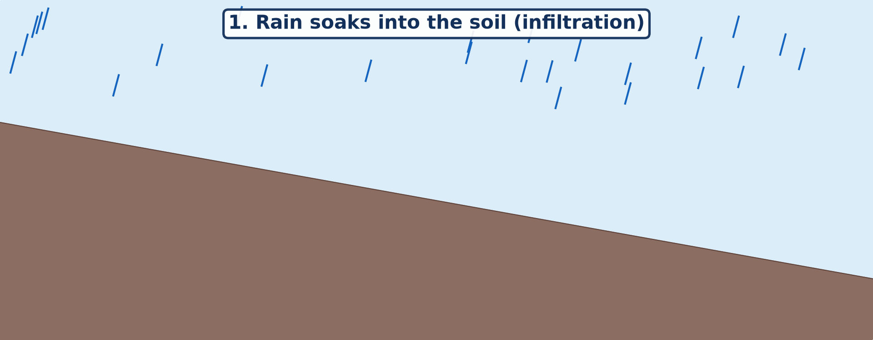
GEOGRAPHY — LOWER SIXTH ARTS
I. MEANING
Activity 1
Animation: rain soaks in, then flows over the surface.
2026 / 2027
DGCAST GAROUA — GEOGRAPHY DEPARTMENT
Mr KAMDEM E. | 14
Notes:
Without the projector: pour water slowly, then fast, on a pot of soil.

Slide 15
GEOGRAPHY — LOWER SIXTH ARTS
I. MEANING
Activity 1: Question
When does water start to flow over the surface?
2026 / 2027
DGCAST GAROUA — GEOGRAPHY DEPARTMENT
Mr KAMDEM E. | 15

Slide 16
GEOGRAPHY — LOWER SIXTH ARTS
I. MEANING
Answer
When the soil cannot take in more water.
2026 / 2027
DGCAST GAROUA — GEOGRAPHY DEPARTMENT
Mr KAMDEM E. | 16

Slide 17
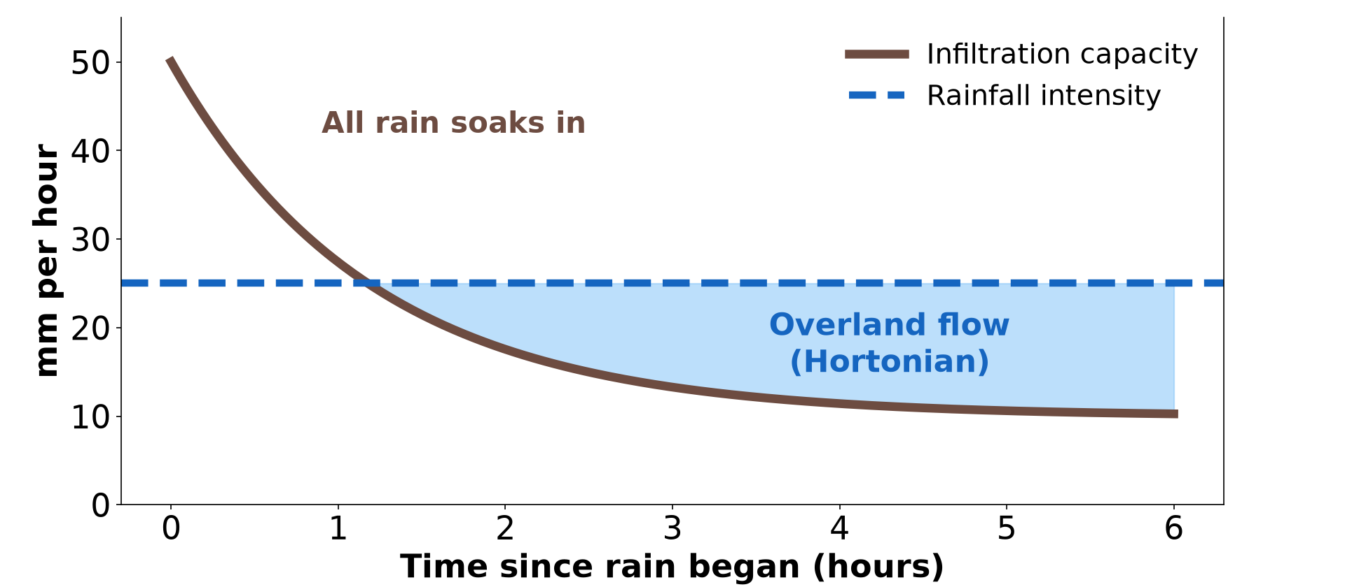
GEOGRAPHY — LOWER SIXTH ARTS
II. TYPES OF OVERLAND FLOW
Activity 2
Infiltration capacity falls during a storm.
2026 / 2027
DGCAST GAROUA — GEOGRAPHY DEPARTMENT
Mr KAMDEM E. | 17
Notes:
Without the projector: draw the two lines.

Slide 18
GEOGRAPHY — LOWER SIXTH ARTS
II. TYPES OF OVERLAND FLOW
Activity 2: Question
What is Hortonian overland flow?
2026 / 2027
DGCAST GAROUA — GEOGRAPHY DEPARTMENT
Mr KAMDEM E. | 18

Slide 19
GEOGRAPHY — LOWER SIXTH ARTS
II. TYPES OF OVERLAND FLOW
Answer
Flow that happens when rain falls faster than the soil can absorb it.
2026 / 2027
DGCAST GAROUA — GEOGRAPHY DEPARTMENT
Mr KAMDEM E. | 19

Slide 20
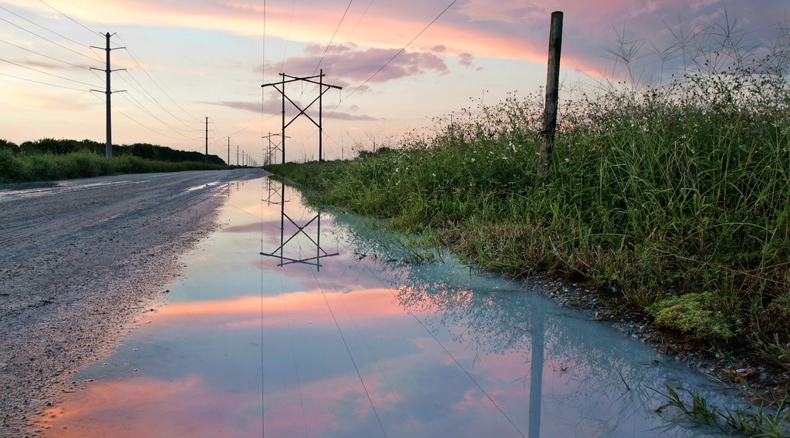
GEOGRAPHY — LOWER SIXTH ARTS
II. TYPES OF OVERLAND FLOW
Activity 3
Water lying on the surface after rain.
2026 / 2027
DGCAST GAROUA — GEOGRAPHY DEPARTMENT
Mr KAMDEM E. | 20
Notes:
Without the projector: describe waterlogged fields.

Slide 21
GEOGRAPHY — LOWER SIXTH ARTS
II. TYPES OF OVERLAND FLOW
Activity 3: Question
The soil is full of water. What type of overland flow follows?
2026 / 2027
DGCAST GAROUA — GEOGRAPHY DEPARTMENT
Mr KAMDEM E. | 21

Slide 22
GEOGRAPHY — LOWER SIXTH ARTS
II. TYPES OF OVERLAND FLOW
Answer
Saturation overland flow.
2026 / 2027
DGCAST GAROUA — GEOGRAPHY DEPARTMENT
Mr KAMDEM E. | 22

Slide 23

GEOGRAPHY — LOWER SIXTH ARTS
III. FACTORS
Activity 4
A gully on bare ground.
2026 / 2027
DGCAST GAROUA — GEOGRAPHY DEPARTMENT
Mr KAMDEM E. | 23
Notes:
Without the projector: compare sand and clay.

Slide 24
GEOGRAPHY — LOWER SIXTH ARTS
III. FACTORS
Activity 4: Question
Give three factors that reduce infiltration.
2026 / 2027
DGCAST GAROUA — GEOGRAPHY DEPARTMENT
Mr KAMDEM E. | 24

Slide 25
GEOGRAPHY — LOWER SIXTH ARTS
III. FACTORS
Answer
Bare, compacted or clay soil, steep slopes, and very intense rain.
2026 / 2027
DGCAST GAROUA — GEOGRAPHY DEPARTMENT
Mr KAMDEM E. | 25

Slide 26

GEOGRAPHY — LOWER SIXTH ARTS
III. SIGNIFICANCE
Activity 5
Zai pits in the Sahel.
2026 / 2027
DGCAST GAROUA — GEOGRAPHY DEPARTMENT
Mr KAMDEM E. | 26
Notes:
Without the projector: describe farming in the Far North.

Slide 27
GEOGRAPHY — LOWER SIXTH ARTS
III. SIGNIFICANCE
Activity 5: Question
Why do farmers dig zai pits?
2026 / 2027
DGCAST GAROUA — GEOGRAPHY DEPARTMENT
Mr KAMDEM E. | 27

Slide 28
GEOGRAPHY — LOWER SIXTH ARTS
III. SIGNIFICANCE
Answer
To hold rain so it infiltrates and waters the crops.
2026 / 2027
DGCAST GAROUA — GEOGRAPHY DEPARTMENT
Mr KAMDEM E. | 28

Slide 29
GEOGRAPHY — LOWER SIXTH ARTS
BOARD SUMMARY
Infiltration and Overland Flow
Topic: The Drainage Basin Hydrological Cycle
Sub-topic: Components of the Drainage Basin Hydrological Cycle
Lesson 29: Infiltration and Overland Flow
2026 / 2027
DGCAST GAROUA — GEOGRAPHY DEPARTMENT
Mr KAMDEM E. | 29
Notes:
Learners copy the board summary now. Give them enough time for each slide.

Slide 30
GEOGRAPHY — LOWER SIXTH ARTS
BOARD SUMMARY
I. Definitions
Infiltration: It is the movement of water from the surface into the soil.
Infiltration capacity: It is the greatest rate at which a soil can absorb water.
Overland flow: It is water flowing over the surface of the ground.
2026 / 2027
DGCAST GAROUA — GEOGRAPHY DEPARTMENT
Mr KAMDEM E. | 30

Slide 31
GEOGRAPHY — LOWER SIXTH ARTS
BOARD SUMMARY
II. Process, Types and Measurement (1/2)
A. Process: At first dry soil absorbs water fast. As the pores fill, the infiltration rate falls.
B. Hortonian overland flow: It happens when rain intensity is greater than infiltration capacity. It is common on bare, hard ground in dry areas.
2026 / 2027
DGCAST GAROUA — GEOGRAPHY DEPARTMENT
Mr KAMDEM E. | 31

Slide 32
GEOGRAPHY — LOWER SIXTH ARTS
BOARD SUMMARY
II. Process, Types and Measurement (2/2)
C. Saturation overland flow: It happens when the soil is already full of water. It is common in valley bottoms and in long rainy seasons.
D. Measurement: An infiltrometer, a ring pushed into the soil, measures how fast water sinks. It is given in mm per hour.
2026 / 2027
DGCAST GAROUA — GEOGRAPHY DEPARTMENT
Mr KAMDEM E. | 32

Slide 33
GEOGRAPHY — LOWER SIXTH ARTS
BOARD SUMMARY
III. Factors and Significance (1/3)
A. Factors: Sandy, loose soils with vegetation absorb water fast. Clay, compacted or bare soils and steep slopes absorb little.
B. Variations: Infiltration is high at the start of the rains and low when soils are saturated. It is low in towns because of concrete.
2026 / 2027
DGCAST GAROUA — GEOGRAPHY DEPARTMENT
Mr KAMDEM E. | 33

Slide 34
GEOGRAPHY — LOWER SIXTH ARTS
BOARD SUMMARY
III. Factors and Significance (2/3)
C. Significance: Infiltration fills soil water and ground water. Overland flow causes quick floods and soil erosion.
2026 / 2027
DGCAST GAROUA — GEOGRAPHY DEPARTMENT
Mr KAMDEM E. | 34

Slide 35
GEOGRAPHY — LOWER SIXTH ARTS
BOARD SUMMARY
III. Factors and Significance (3/3)
Copy the graph.
2026 / 2027
DGCAST GAROUA — GEOGRAPHY DEPARTMENT
Mr KAMDEM E. | 35

Slide 36
GEOGRAPHY — LOWER SIXTH ARTS
FORMATIVE EVALUATION
Formative Evaluation 1
Distinguish Hortonian and saturation overland flow.
2026 / 2027
DGCAST GAROUA — GEOGRAPHY DEPARTMENT
Mr KAMDEM E. | 36

Slide 37
GEOGRAPHY — LOWER SIXTH ARTS
FORMATIVE EVALUATION
Expected Answer
Hortonian: rain faster than infiltration capacity; saturation: the soil is already full.
2026 / 2027
DGCAST GAROUA — GEOGRAPHY DEPARTMENT
Mr KAMDEM E. | 37

Slide 38
GEOGRAPHY — LOWER SIXTH ARTS
FORMATIVE EVALUATION
Formative Evaluation 2
Give two ways to increase infiltration.
2026 / 2027
DGCAST GAROUA — GEOGRAPHY DEPARTMENT
Mr KAMDEM E. | 38

Slide 39
GEOGRAPHY — LOWER SIXTH ARTS
FORMATIVE EVALUATION
Expected Answer
Plant cover and zai pits (also terraces, mulching).
2026 / 2027
DGCAST GAROUA — GEOGRAPHY DEPARTMENT
Mr KAMDEM E. | 39

Slide 40
GEOGRAPHY — LOWER SIXTH ARTS
REMEDIATION
Remediation
Fill in the blanks:
Water soaking into the soil is ______.
The maximum rate of infiltration is the infiltration ______.
Flow when the soil is full is ______ overland flow.
2026 / 2027
DGCAST GAROUA — GEOGRAPHY DEPARTMENT
Mr KAMDEM E. | 40
Notes:
Answers: 1. infiltration 2. capacity 3. saturation

Slide 41
GEOGRAPHY — LOWER SIXTH ARTS
HOMEWORK
Homework
Pour one litre of water on bare ground and on grass. Time how long it takes to soak in.
This prepares Lesson 30: Soil Moisture Storage.
2026 / 2027
DGCAST GAROUA — GEOGRAPHY DEPARTMENT
Mr KAMDEM E. | 41
Notes:
This homework prepares the next lesson.

Slide 42
GEOGRAPHY — LOWER SIXTH ARTS
BILINGUAL GAME
Bilingual Game (Jeu Bilingue)
English | Français
Infiltration | L'infiltration
Overland flow | Le ruissellement
Soil | Le sol
Saturated | Saturé
Clay | L'argile
Sand | Le sable
2026 / 2027
DGCAST GAROUA — GEOGRAPHY DEPARTMENT
Mr KAMDEM E. | 42
Notes:
Say the English word; learners give the French word, then the reverse.

Slide 43
GEOGRAPHY — LOWER SIXTH ARTS
LOGBOOK
Official Logbook (1/2)
Module / Topic | The Drainage Basin Hydrological Cycle
Lesson Title | Lesson 29: Infiltration and Overland Flow
Expected Learning Outcomes | Define infiltration and infiltration capacity. Distinguish Hortonian and saturation overland flow. Explain the factors and significance of infiltration.
Competence | Learners are able to explain why rain soaks in or runs off, and how to increase infiltration.
2026 / 2027
DGCAST GAROUA — GEOGRAPHY DEPARTMENT
Mr KAMDEM E. | 43

Slide 44
GEOGRAPHY — LOWER SIXTH ARTS
LOGBOOK
Official Logbook (2/2)
Matter Taught | I. Definitions: Infiltration, Infiltration capacity, Overland flow; II. Process, Types and Measurement: Process, Hortonian overland flow, Saturation overland flow, Measurement; III. Factors and Significance: Factors, Variations, Significance.
Evaluation | Formative evaluation (3 questions) and remediation exercise.
Homework | Pour one litre of water on bare ground and on grass. Time how long it takes to soak in.
Enrolment / Present / Absent | ____ / ____ / ____
Achievement | To be completed by the teacher after the lesson.
2026 / 2027
DGCAST GAROUA — GEOGRAPHY DEPARTMENT
Mr KAMDEM E. | 44

Slide 45
GEOGRAPHY — LOWER SIXTH ARTS
TEACHER'S NOTE
Teacher's Note
Timing: Set-up, recall 8 min | Situation 8 min | 5 activities 30 min | Board summary (copying) 30 min | Evaluation, remediation 10 min | Homework, logbook 9 min | Spare 5 min
Activity 1 is an animation (GIF): it plays automatically in slide-show mode.
2026 / 2027
DGCAST GAROUA — GEOGRAPHY DEPARTMENT
Mr KAMDEM E. | 45

Slide 46
GEOGRAPHY — LOWER SIXTH ARTS
REFERENCES
References
National Geography Syllabus, Sixth Forms (Lower & Upper Sixth), MINESEC/IGE/IP-SS, August 2019 — Module 1 (Meteorology, Climatology & Hydrology).
Photo, Activity 3: “Powerline Road after the rain.” by Jill Bazeley, CC BY-NC 2.0, via Flickr (https://www.flickr.com/photos/13111532@N07/29857035555)
Photo, Activity 4: “Soil erosion in the central Mexican Highlands” by CIMMYT, CC BY-NC-SA 2.0, via Flickr (https://www.flickr.com/photos/44760652@N05/6244930288)
Photo, Activity 5: “Women sowing okra in zai holes” by abossuet, CC BY-NC 2.0, via Flickr (https://www.flickr.com/photos/30450178@N07/7175750825)
Diagrams and animations: drawn for this lesson (DGCAST Geography Department).
2026 / 2027
DGCAST GAROUA — GEOGRAPHY DEPARTMENT
Mr KAMDEM E. | 46

