Slide 1

DIVINE GRACE COLLEGE OF ARTS, SCIENCE AND TECHNOLOGY
(DGCAST) — GAROUA | GEOGRAPHY DEPARTMENT
LOWER SIXTH ARTS — HYDROLOGY — PRACTICAL WORK 2
Drainage Basin Morphometry
Mr KAMDEM EMMANUEL
Geography Teacher — PLEG
Academic Year 2026 / 2027
Notes:
Good morning, class. Today we study Practical Work 2: Drainage Basin Morphometry.

Slide 2
GEOGRAPHY — LOWER SIXTH ARTS
CLASS INFO
Class, Chapter & Duration
Class | Lower Sixth Arts
Chapter | Module 1: Understanding and managing atmospheric and hydrological phenomena and hazards across the world in general and Cameroon in particular
Duration | 2 periods (2 × 50 minutes)
2026 / 2027
DGCAST GAROUA — GEOGRAPHY DEPARTMENT
Mr KAMDEM E. | 2

Slide 3
GEOGRAPHY — LOWER SIXTH ARTS
IDENTIFICATION
Lesson Identification
Topic | Drainage Basin Morphometry
Sub-topic | Morphometric Analysis of Drainage Networks
Lesson | Practical Work 2: Drainage Basin Morphometry
Notions / Concepts | Morphometry, stream order, Strahler, bifurcation ratio, drainage density, hydraulic radius, sinuosity.
Syllabus focus | Linear properties (channel characteristics) and areal properties (basin size, drainage density, stream order, bifurcation ratio); morphometric laws.
Competence | Learners are able to measure and calculate the main morphometric properties of a drainage basin.
2026 / 2027
DGCAST GAROUA — GEOGRAPHY DEPARTMENT
Mr KAMDEM E. | 3

Slide 4
GEOGRAPHY — LOWER SIXTH ARTS
OBJECTIVES
Learning Objectives
By the end of the lesson, the learner should be able to:
Order streams using Strahler's method.
Calculate the bifurcation ratio and drainage density.
Calculate channel properties (area, hydraulic radius, sinuosity) and interpret them.
2026 / 2027
DGCAST GAROUA — GEOGRAPHY DEPARTMENT
Mr KAMDEM E. | 4

Slide 5
GEOGRAPHY — LOWER SIXTH ARTS
RECALL
Recall
A drainage basin has a main river and tributaries.
Small, round basins give flashy floods.
2026 / 2027
DGCAST GAROUA — GEOGRAPHY DEPARTMENT
Mr KAMDEM E. | 5

Slide 6
GEOGRAPHY — LOWER SIXTH ARTS
REAL-LIFE SITUATION
Real-Life Situation
Learners receive a topographic map of a basin near Dschang. The teacher asks them to count the streams, give each one an order and calculate numbers that describe the basin.
2026 / 2027
DGCAST GAROUA — GEOGRAPHY DEPARTMENT
Mr KAMDEM E. | 6
Notes:
Read the situation slowly, twice.

Slide 7
GEOGRAPHY — LOWER SIXTH ARTS
REAL-LIFE SITUATION
Situation — Question 1
What is the problem in the situation?
2026 / 2027
DGCAST GAROUA — GEOGRAPHY DEPARTMENT
Mr KAMDEM E. | 7

Slide 8
GEOGRAPHY — LOWER SIXTH ARTS
REAL-LIFE SITUATION
Answer
The basin must be described with measurements.
2026 / 2027
DGCAST GAROUA — GEOGRAPHY DEPARTMENT
Mr KAMDEM E. | 8

Slide 9
GEOGRAPHY — LOWER SIXTH ARTS
REAL-LIFE SITUATION
Situation — Question 2
What is this measurement of basins called?
2026 / 2027
DGCAST GAROUA — GEOGRAPHY DEPARTMENT
Mr KAMDEM E. | 9

Slide 10
GEOGRAPHY — LOWER SIXTH ARTS
REAL-LIFE SITUATION
Answer
Morphometry.
2026 / 2027
DGCAST GAROUA — GEOGRAPHY DEPARTMENT
Mr KAMDEM E. | 10

Slide 11
GEOGRAPHY — LOWER SIXTH ARTS
REAL-LIFE SITUATION
Situation — Question 3
Which method is used to order streams?
2026 / 2027
DGCAST GAROUA — GEOGRAPHY DEPARTMENT
Mr KAMDEM E. | 11

Slide 12
GEOGRAPHY — LOWER SIXTH ARTS
REAL-LIFE SITUATION
Possible Answer
Strahler's method.
2026 / 2027
DGCAST GAROUA — GEOGRAPHY DEPARTMENT
Mr KAMDEM E. | 12

Slide 13
GEOGRAPHY — LOWER SIXTH ARTS
JUSTIFICATION
Justification of the Lesson
This practical work helps us to describe drainage basins with numbers and to predict floods.
2026 / 2027
DGCAST GAROUA — GEOGRAPHY DEPARTMENT
Mr KAMDEM E. | 13

Slide 14
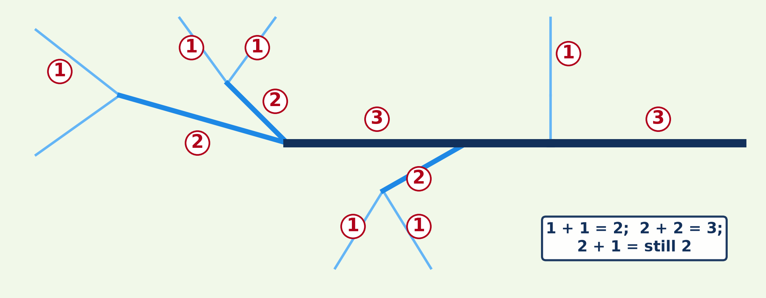
GEOGRAPHY — LOWER SIXTH ARTS
I. STREAM ORDER
Activity 1
Stream ordering by Strahler's method.
2026 / 2027
DGCAST GAROUA — GEOGRAPHY DEPARTMENT
Mr KAMDEM E. | 14
Notes:
Without the projector: draw a stream network and number it.

Slide 15
GEOGRAPHY — LOWER SIXTH ARTS
I. STREAM ORDER
Activity 1: Question
When two first-order streams meet, what order is the stream below?
2026 / 2027
DGCAST GAROUA — GEOGRAPHY DEPARTMENT
Mr KAMDEM E. | 15

Slide 16
GEOGRAPHY — LOWER SIXTH ARTS
I. STREAM ORDER
Answer
Second order.
2026 / 2027
DGCAST GAROUA — GEOGRAPHY DEPARTMENT
Mr KAMDEM E. | 16

Slide 17
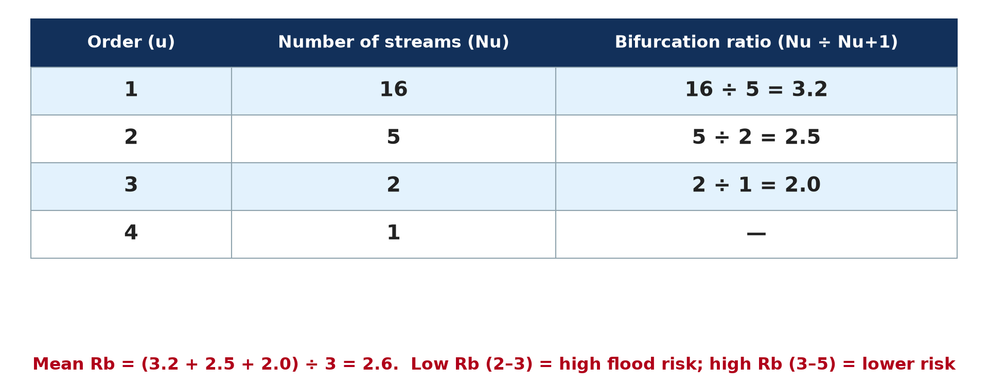
GEOGRAPHY — LOWER SIXTH ARTS
II. BIFURCATION RATIO
Activity 2
Calculating the bifurcation ratio.
2026 / 2027
DGCAST GAROUA — GEOGRAPHY DEPARTMENT
Mr KAMDEM E. | 17
Notes:
Without the projector: do the division on the board.

Slide 18
GEOGRAPHY — LOWER SIXTH ARTS
II. BIFURCATION RATIO
Activity 2: Question
What does a high bifurcation ratio suggest?
2026 / 2027
DGCAST GAROUA — GEOGRAPHY DEPARTMENT
Mr KAMDEM E. | 18

Slide 19
GEOGRAPHY — LOWER SIXTH ARTS
II. BIFURCATION RATIO
Answer
An elongated basin with a lower, slower flood peak.
2026 / 2027
DGCAST GAROUA — GEOGRAPHY DEPARTMENT
Mr KAMDEM E. | 19

Slide 20
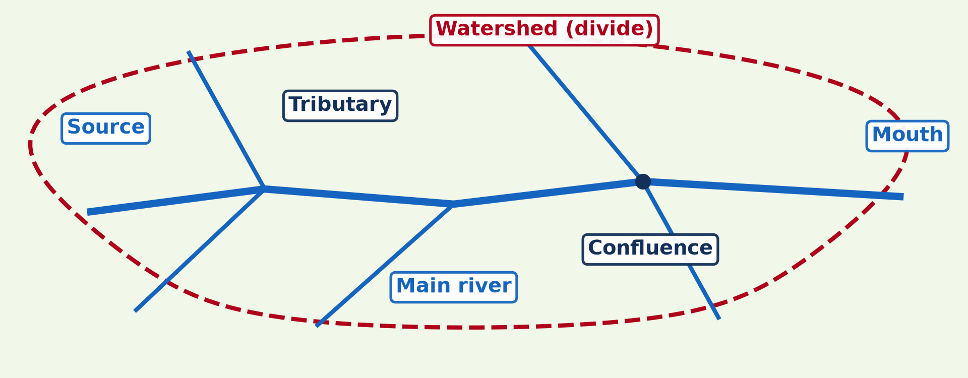
GEOGRAPHY — LOWER SIXTH ARTS
III. AREAL PROPERTIES
Activity 3
A drainage basin.
2026 / 2027
DGCAST GAROUA — GEOGRAPHY DEPARTMENT
Mr KAMDEM E. | 20
Notes:
Without the projector: do the calculation on the board.

Slide 21
GEOGRAPHY — LOWER SIXTH ARTS
III. AREAL PROPERTIES
Activity 3: Question
A basin of 50 km² has 100 km of streams. What is its drainage density?
2026 / 2027
DGCAST GAROUA — GEOGRAPHY DEPARTMENT
Mr KAMDEM E. | 21

Slide 22
GEOGRAPHY — LOWER SIXTH ARTS
III. AREAL PROPERTIES
Answer
100 ÷ 50 = 2 km per km².
2026 / 2027
DGCAST GAROUA — GEOGRAPHY DEPARTMENT
Mr KAMDEM E. | 22

Slide 23
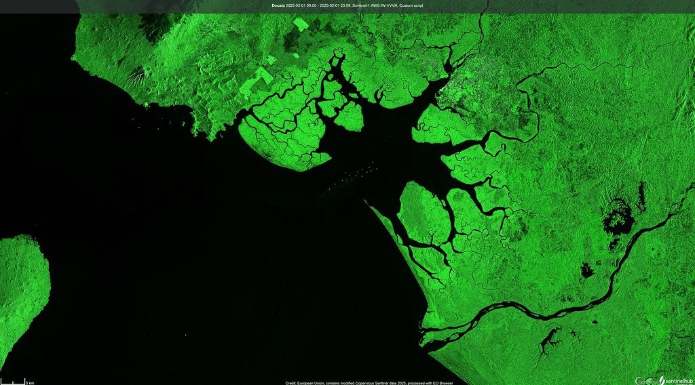
GEOGRAPHY — LOWER SIXTH ARTS
III. AREAL PROPERTIES
Activity 4
The Wouri estuary and Douala seen from a satellite.
2026 / 2027
DGCAST GAROUA — GEOGRAPHY DEPARTMENT
Mr KAMDEM E. | 23
Notes:
Without the projector: compare dense and sparse networks.

Slide 24
GEOGRAPHY — LOWER SIXTH ARTS
III. AREAL PROPERTIES
Activity 4: Question
What does a dense network of channels tell us about a basin?
2026 / 2027
DGCAST GAROUA — GEOGRAPHY DEPARTMENT
Mr KAMDEM E. | 24

Slide 25
GEOGRAPHY — LOWER SIXTH ARTS
III. AREAL PROPERTIES
Answer
Impermeable ground or heavy rain; water reaches rivers quickly.
2026 / 2027
DGCAST GAROUA — GEOGRAPHY DEPARTMENT
Mr KAMDEM E. | 25

Slide 26
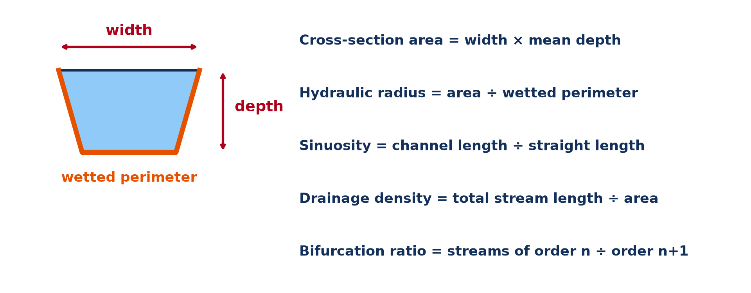
GEOGRAPHY — LOWER SIXTH ARTS
IV. LINEAR PROPERTIES
Activity 5
Channel measurements and formulas.
2026 / 2027
DGCAST GAROUA — GEOGRAPHY DEPARTMENT
Mr KAMDEM E. | 26
Notes:
Without the projector: do the calculation on the board.

Slide 27
GEOGRAPHY — LOWER SIXTH ARTS
IV. LINEAR PROPERTIES
Activity 5: Question
A channel is 8 m wide with a mean depth of 2 m and a wetted perimeter of 12 m. Find the hydraulic radius.
2026 / 2027
DGCAST GAROUA — GEOGRAPHY DEPARTMENT
Mr KAMDEM E. | 27

Slide 28
GEOGRAPHY — LOWER SIXTH ARTS
IV. LINEAR PROPERTIES
Answer
Area = 8 × 2 = 16 m²; hydraulic radius = 16 ÷ 12 ≈ 1.3 m.
2026 / 2027
DGCAST GAROUA — GEOGRAPHY DEPARTMENT
Mr KAMDEM E. | 28

Slide 29
GEOGRAPHY — LOWER SIXTH ARTS
BOARD SUMMARY
Drainage Basin Morphometry
Topic: Drainage Basin Morphometry
Sub-topic: Morphometric Analysis of Drainage Networks
Practical Work 2: Drainage Basin Morphometry
2026 / 2027
DGCAST GAROUA — GEOGRAPHY DEPARTMENT
Mr KAMDEM E. | 29
Notes:
Learners copy the board summary now. Give them enough time for each slide.

Slide 30
GEOGRAPHY — LOWER SIXTH ARTS
BOARD SUMMARY
I. Definitions (1/2)
Morphometry: It is the measurement of the shape and size of drainage basins and channels.
Stream order: It is the rank of a stream in the network.
Bifurcation ratio: It is the number of streams of one order divided by the number of the next order.
2026 / 2027
DGCAST GAROUA — GEOGRAPHY DEPARTMENT
Mr KAMDEM E. | 30

Slide 31
GEOGRAPHY — LOWER SIXTH ARTS
BOARD SUMMARY
I. Definitions (2/2)
Drainage density: It is the total length of streams divided by the basin area.
2026 / 2027
DGCAST GAROUA — GEOGRAPHY DEPARTMENT
Mr KAMDEM E. | 31

Slide 32
GEOGRAPHY — LOWER SIXTH ARTS
BOARD SUMMARY
II. Linear Properties (1/2)
A. Channel measurements: We measure length, width, depth, slope and the wetted perimeter. Cross-section area = width × mean depth.
B. Hydraulic radius: It is area ÷ wetted perimeter. A high hydraulic radius means an efficient channel with less friction.
2026 / 2027
DGCAST GAROUA — GEOGRAPHY DEPARTMENT
Mr KAMDEM E. | 32

Slide 33
GEOGRAPHY — LOWER SIXTH ARTS
BOARD SUMMARY
II. Linear Properties (2/2)
C. Sinuosity: It is channel length ÷ straight-line length. A value above 1.5 shows a meandering river.
2026 / 2027
DGCAST GAROUA — GEOGRAPHY DEPARTMENT
Mr KAMDEM E. | 33

Slide 34
GEOGRAPHY — LOWER SIXTH ARTS
BOARD SUMMARY
III. Areal Properties and Laws (1/3)
A. Stream order: In Strahler's method, sources are first order, and two streams of the same order make the next order. A lower-order stream joining does not change the order.
B. Bifurcation ratio: Most values lie between 3 and 5. Low values suggest round basins with high flood risk.
2026 / 2027
DGCAST GAROUA — GEOGRAPHY DEPARTMENT
Mr KAMDEM E. | 34

Slide 35
GEOGRAPHY — LOWER SIXTH ARTS
BOARD SUMMARY
III. Areal Properties and Laws (2/3)
C. Drainage density: It is high on impermeable rocks, steep slopes and bare land. High density means faster runoff and flashy floods.
D. Horton's laws: The number of streams decreases with order in a regular way. Their mean length increases with order.
2026 / 2027
DGCAST GAROUA — GEOGRAPHY DEPARTMENT
Mr KAMDEM E. | 35

Slide 36
GEOGRAPHY — LOWER SIXTH ARTS
BOARD SUMMARY
III. Areal Properties and Laws (3/3)
Copy the stream orders.
2026 / 2027
DGCAST GAROUA — GEOGRAPHY DEPARTMENT
Mr KAMDEM E. | 36

Slide 37
GEOGRAPHY — LOWER SIXTH ARTS
FORMATIVE EVALUATION
Formative Evaluation 1
A basin has 30 first-order and 8 second-order streams. Find the bifurcation ratio.
2026 / 2027
DGCAST GAROUA — GEOGRAPHY DEPARTMENT
Mr KAMDEM E. | 37

Slide 38
GEOGRAPHY — LOWER SIXTH ARTS
FORMATIVE EVALUATION
Expected Answer
30 ÷ 8 = 3.75.
2026 / 2027
DGCAST GAROUA — GEOGRAPHY DEPARTMENT
Mr KAMDEM E. | 38

Slide 39
GEOGRAPHY — LOWER SIXTH ARTS
FORMATIVE EVALUATION
Formative Evaluation 2
What does a high drainage density show?
2026 / 2027
DGCAST GAROUA — GEOGRAPHY DEPARTMENT
Mr KAMDEM E. | 39

Slide 40
GEOGRAPHY — LOWER SIXTH ARTS
FORMATIVE EVALUATION
Expected Answer
Impermeable ground or steep, bare slopes; fast runoff and flashy floods.
2026 / 2027
DGCAST GAROUA — GEOGRAPHY DEPARTMENT
Mr KAMDEM E. | 40

Slide 41
GEOGRAPHY — LOWER SIXTH ARTS
REMEDIATION
Remediation
Fill in the blanks:
Stream ordering uses the method of ______.
Drainage density = total stream length ÷ ______.
Hydraulic radius = area ÷ wetted ______.
2026 / 2027
DGCAST GAROUA — GEOGRAPHY DEPARTMENT
Mr KAMDEM E. | 41
Notes:
Answers: 1. Strahler 2. basin area 3. perimeter

Slide 42
GEOGRAPHY — LOWER SIXTH ARTS
HOMEWORK
Homework
On a topographic map, order the streams of a small basin and calculate its bifurcation ratio.
This ends the Hydrology branch; the next branch is Biogeography.
2026 / 2027
DGCAST GAROUA — GEOGRAPHY DEPARTMENT
Mr KAMDEM E. | 42
Notes:
This homework prepares the next lesson.

Slide 43
GEOGRAPHY — LOWER SIXTH ARTS
BILINGUAL GAME
Bilingual Game (Jeu Bilingue)
English | Français
Stream order | L'ordre des cours d'eau
Drainage density | La densité de drainage
Bifurcation ratio | Le rapport de confluence
Channel | Le chenal
Width | La largeur
Depth | La profondeur
2026 / 2027
DGCAST GAROUA — GEOGRAPHY DEPARTMENT
Mr KAMDEM E. | 43
Notes:
Say the English word; learners give the French word, then the reverse.

Slide 44
GEOGRAPHY — LOWER SIXTH ARTS
LOGBOOK
Official Logbook (1/2)
Module / Topic | Drainage Basin Morphometry
Lesson Title | Practical Work 2: Drainage Basin Morphometry
Expected Learning Outcomes | Order streams using Strahler's method. Calculate the bifurcation ratio and drainage density. Calculate channel properties (area, hydraulic radius, sinuosity) and interpret them.
Competence | Learners are able to measure and calculate the main morphometric properties of a drainage basin.
2026 / 2027
DGCAST GAROUA — GEOGRAPHY DEPARTMENT
Mr KAMDEM E. | 44

Slide 45
GEOGRAPHY — LOWER SIXTH ARTS
LOGBOOK
Official Logbook (2/2)
Matter Taught | I. Definitions: Morphometry, Stream order, Bifurcation ratio, Drainage density; II. Linear Properties: Channel measurements, Hydraulic radius, Sinuosity; III. Areal Properties and Laws: Stream order, Bifurcation ratio, Drainage density, Horton's laws.
Evaluation | Formative evaluation (3 questions) and remediation exercise.
Homework | On a topographic map, order the streams of a small basin and calculate its bifurcation ratio.
Enrolment / Present / Absent | ____ / ____ / ____
Achievement | To be completed by the teacher after the lesson.
2026 / 2027
DGCAST GAROUA — GEOGRAPHY DEPARTMENT
Mr KAMDEM E. | 45

Slide 46
GEOGRAPHY — LOWER SIXTH ARTS
TEACHER'S NOTE
Teacher's Note
Timing: Set-up, recall 8 min | Situation 8 min | 5 activities 30 min | Board summary (copying) 30 min | Evaluation, remediation 10 min | Homework, logbook 9 min | Spare 5 min
2026 / 2027
DGCAST GAROUA — GEOGRAPHY DEPARTMENT
Mr KAMDEM E. | 46

Slide 47
GEOGRAPHY — LOWER SIXTH ARTS
REFERENCES
References
National Geography Syllabus, Sixth Forms (Lower & Upper Sixth), MINESEC/IGE/IP-SS, August 2019 — Module 1 (Meteorology, Climatology & Hydrology).
Photo, Activity 4: “Duala, Camerún (Douala, Cameroon)” by migmasat, Public domain 1.0, via Flickr (https://www.flickr.com/photos/197415759@N06/54386998088)
Diagrams and animations: drawn for this lesson (DGCAST Geography Department).
2026 / 2027
DGCAST GAROUA — GEOGRAPHY DEPARTMENT
Mr KAMDEM E. | 47

