Slide 1
FORM 3
GEOGRAPHY
Lesson 10
Plate Tectonics
Notes:
Good morning, class, and welcome to our geography lesson. I am your geography teacher, Madam Che. Today we are starting Lesson 10: Plate Tectonics.

Slide 2
CLASS INFO
Class, Chapter and Duration
Class | Form 3
Chapter | The Structure of the Earth: Building Processes and Impacts on Man — Structure of the Earth
Duration | 50 minutes
Notes:
This lesson is for Form 3. It belongs to The Structure of the Earth: Building Processes and Impacts on Man — Structure of the Earth. We shall need 50 minutes to cover it.

Slide 3
IDENTIFICATION
Lesson Identification
Topic | The Structure of the Earth: Building Processes and Impacts on Man
Sub-topic | Structure of the Earth
Lesson | Lesson 10: Plate Tectonics
Notions / Concepts | Plate tectonics, plate, plate margin, convection current, subduction.
Syllabus focus | Definition; main ideas (geometric and kinetic); the plates; the plate margins (constructive, destructive and conservative) and their main landforms.
Competence | Learners are able to explain why earthquakes and volcanoes happen in some regions of the world, using a map of plates.
Notes:
Our topic is The Structure of the Earth: Building Processes and Impacts on Man, and the sub-topic is Structure of the Earth. The key notions we shall use today are: plate tectonics, plate, plate margin, convection current, subduction. At the end, you should be able to do this: learners are able to explain why earthquakes and volcanoes happen in some regions of the world, using a map of plates.

Slide 4

HOMEWORK CORRECTION
Correction of the Homework
Question (Lesson 9: The Theories of the Earth's Structure: Continental Drift):
Name the plate on which Cameroon lies.
Notes:
Before we start the new lesson, let us correct the homework I gave you at the end of Lesson 9: The Theories of the Earth's Structure: Continental Drift. The question was: Name the plate on which Cameroon lies. Take out your exercise books.

Slide 5
HOMEWORK CORRECTION
Correction: Possible Answer
The African Plate.
Notes:
Here is a good answer. The African Plate. Compare it with your own answer and correct your work in red.

Slide 6
LESSON PLAN
Lesson Plan
Correction of the homework
Objectives and recall
Real-life situation and action to take
Learning activities
Board summary
Evaluation, remediation and homework
Notes:
Here is the plan of our lesson today. First, we shall correct the homework. Then we shall look at the objectives and recall what you already know. After that, we shall study a situation from real life and the action to take, and do the learning activities. Finally, we shall copy the board summary, do the evaluation and the remediation, and I will give you the homework.

Slide 7
OBJECTIVES
Objectives
By the end of this lesson, you should be able to:
Define plate tectonics.
Explain the geometric and kinetic ideas of the theory.
Notes:
Take your time to copy this part; we will continue together.

Slide 8
OBJECTIVES
Objectives (continued)
Name the major plates and locate the African Plate.
Describe the three types of plate margins and their main landforms.
Notes:
By the end of this lesson, you should be able to do four things. Number 1: define plate tectonics. Number 2: explain the geometric and kinetic ideas of the theory. Number 3: name the major plates and locate the African Plate. Number 4: describe the three types of plate margins and their main landforms.

Slide 9
PREVIOUS KNOWLEDGE
Previous Knowledge
The continents were once joined in Pangaea.
The mantle is very hot rock that flows slowly.
Wegener could not explain what moves the continents.
Notes:
Let us first remember what you already know. The continents were once joined in Pangaea. The mantle is very hot rock that flows slowly. Wegener could not explain what moves the continents. Keep this in mind, because we shall build on it today.

Slide 10
REAL-LIFE SITUATION
Situation in Real Life
On television, Josiane sees an earthquake in Japan and a volcano in Italy, while the ground around her feels safe. She knows that Mount Cameroon is also an active volcano. She asks: "Why do earthquakes and volcanoes happen in some places and not in others?"
Notes:
Listen carefully to this situation from real life. On television, Josiane sees an earthquake in Japan and a volcano in Italy, while the ground around her feels safe. She knows that Mount Cameroon is also an active volcano. She asks: "Why do earthquakes and volcanoes happen in some places and not in others?" Think about it, because I am going to ask you some questions.

Slide 11
REAL-LIFE SITUATION
Situation: Question 1
What is the problem in the situation?
Notes:
Question 1: What is the problem in the situation? Think for a moment, then raise your hand to answer.

Slide 12
REAL-LIFE SITUATION
Answer
Josiane does not know why earthquakes and volcanoes happen only in some places.
Notes:
Good. Josiane does not know why earthquakes and volcanoes happen only in some places.

Slide 13
REAL-LIFE SITUATION
Situation: Question 2
Name one active volcano in Cameroon.
Notes:
Question 2: Name one active volcano in Cameroon. Think for a moment, then raise your hand to answer.

Slide 14
REAL-LIFE SITUATION
Answer
Mount Cameroon.
Notes:
Good. Mount Cameroon.

Slide 15
REAL-LIFE SITUATION
Situation: Question 3
Where do most earthquakes and volcanoes happen?
Notes:
Question 3: Where do most earthquakes and volcanoes happen? Think for a moment, then raise your hand to answer.

Slide 16
REAL-LIFE SITUATION
Possible Answer
At the edges of the plates.
Notes:
Good. At the edges of the plates.

Slide 17
ACTION TO TAKE
Action to Take
Use the theory of plate tectonics to explain earthquakes and volcanoes.
Notes:
From this situation, the action we are working towards in this lesson is the following: use the theory of plate tectonics to explain earthquakes and volcanoes.

Slide 18
JUSTIFICATION
Justification of the Lesson
This lesson helps us to know the plates of the Earth, how they move and the landforms they build.
Notes:
Why is this lesson important for you? This lesson helps us to know the plates of the Earth, how they move and the landforms they build.

Slide 19
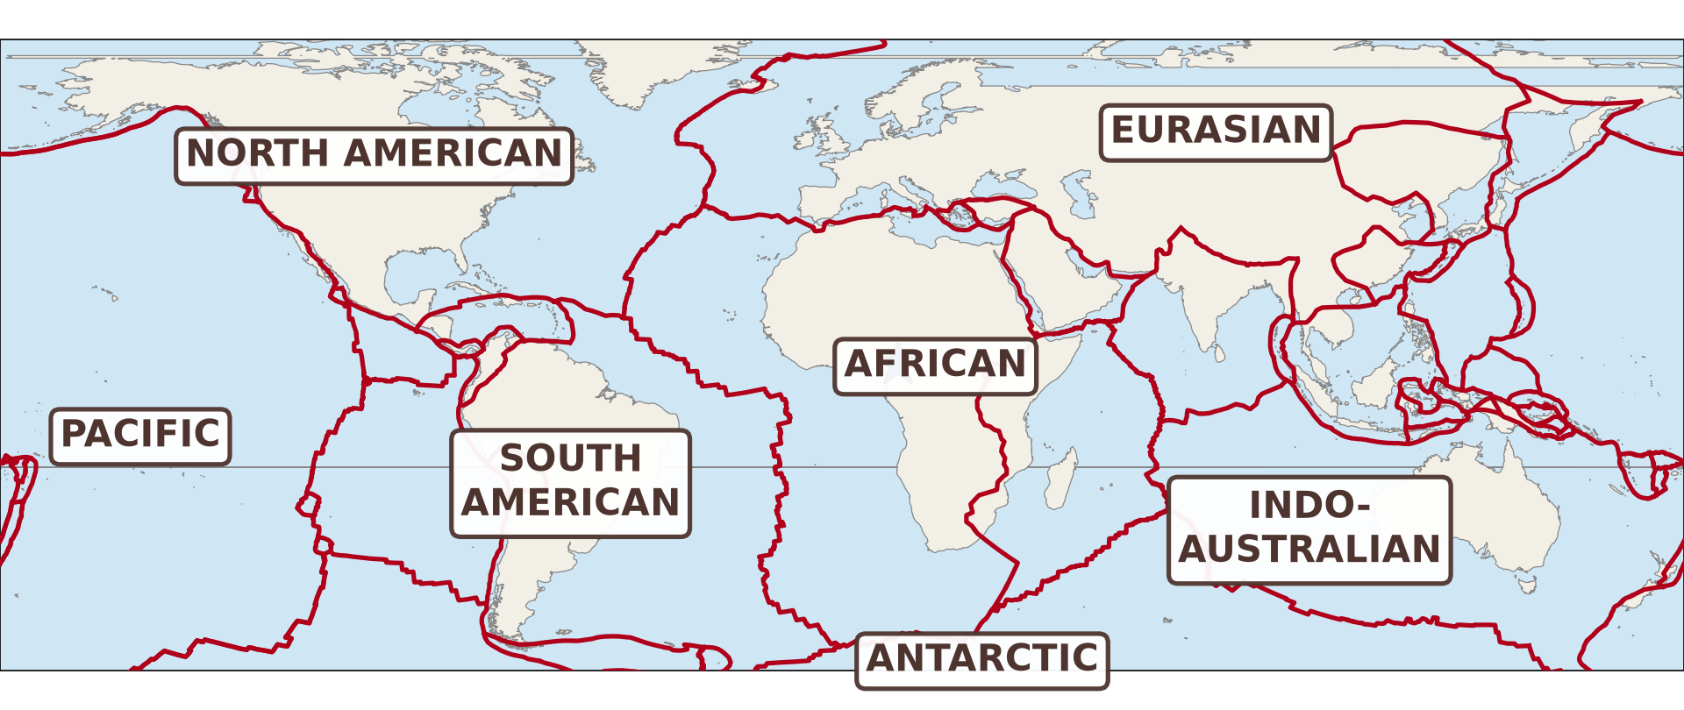
1. MAIN IDEAS
Activity 1
The main plates of the Earth.
Notes:
Activity 1. Look carefully at this diagram: the main plates of the Earth. Observe every detail before I ask the question.

Slide 20
1. MAIN IDEAS
Activity 1: Question
On which plate is Cameroon?
Notes:
Here is the question for Activity 1: On which plate is Cameroon? Take one minute to think and write your answer in your rough notebook.

Slide 21
1. MAIN IDEAS
Activity 1: Answer
On the African Plate.
Notes:
Let us check the answer together. On the African Plate.

Slide 22
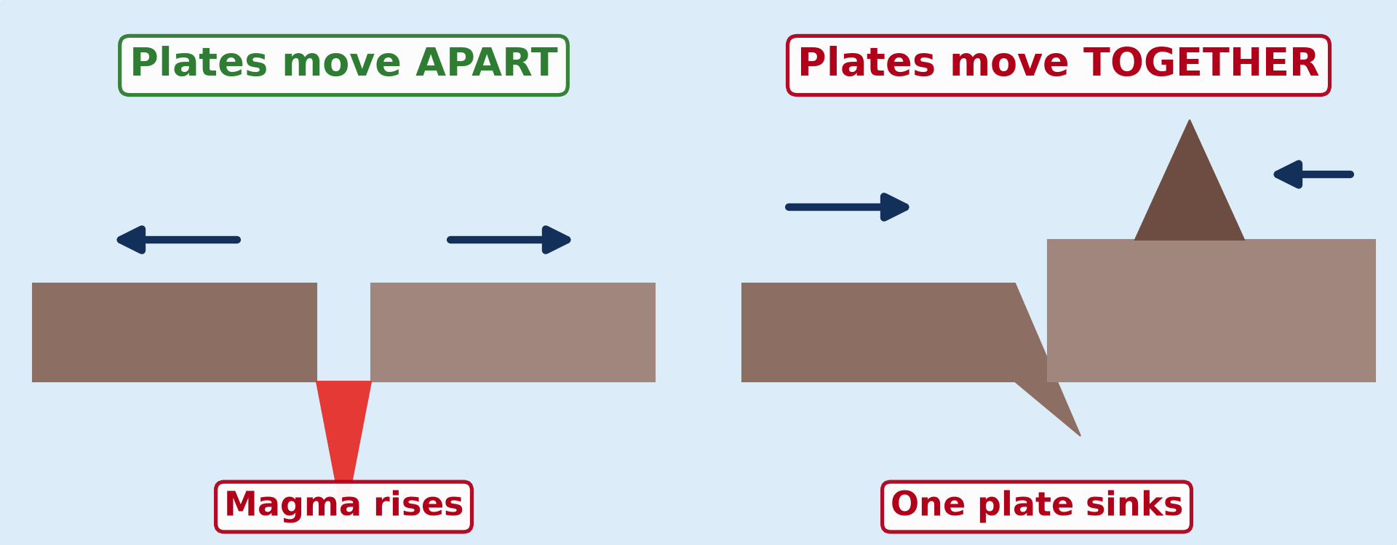
3. PLATE MARGINS AND LANDFORMS
Activity 2
Animation: plates move apart (left) and together (right).
Notes:
Activity 2. Look carefully at this animation: animation: plates move apart (left) and together (right). Watch the animation to the end; it will play again.

Slide 23
3. PLATE MARGINS AND LANDFORMS
Activity 2: Question 1
What rises when two plates move apart?
Notes:
Here is the question for Activity 2: What rises when two plates move apart? Take one minute to think and write your answer in your rough notebook.

Slide 24
3. PLATE MARGINS AND LANDFORMS
Activity 2: Answer 1
Magma rises and forms new crust.
Notes:
Let us check the answer together. Magma rises and forms new crust.

Slide 25
3. PLATE MARGINS AND LANDFORMS
Activity 2: Question 2
What happens to one plate when two plates move together?
Notes:
Here is the next question: What happens to one plate when two plates move together? Take one minute to think and write your answer in your rough notebook.

Slide 26
3. PLATE MARGINS AND LANDFORMS
Activity 2: Answer 2
It sinks under the other plate.
Notes:
Let us check the answer together. It sinks under the other plate.

Slide 27
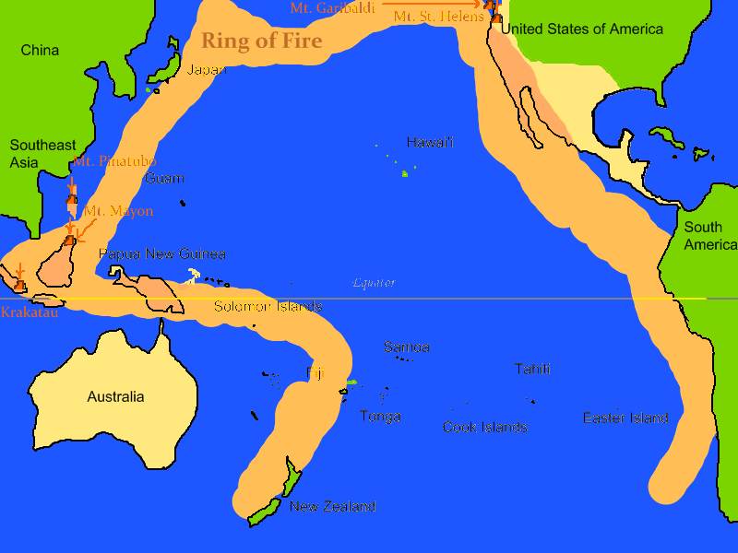
3. PLATE MARGINS AND LANDFORMS
Activity 3
Volcanoes and earthquakes around the Pacific Ocean.
Notes:
Activity 3. Look carefully at this picture: volcanoes and earthquakes around the Pacific Ocean. Observe every detail before I ask the question.

Slide 28
3. PLATE MARGINS AND LANDFORMS
Activity 3: Question
Most volcanoes and earthquakes form a belt around the Pacific Ocean. What is this belt called?
Notes:
Here is the question for Activity 3: Most volcanoes and earthquakes form a belt around the Pacific Ocean. What is this belt called? Take one minute to think and write your answer in your rough notebook.

Slide 29
3. PLATE MARGINS AND LANDFORMS
Activity 3: Answer
The Pacific Ring of Fire.
Notes:
Let us check the answer together. The Pacific Ring of Fire.

Slide 30
BOARD SUMMARY
Board Summary
Topic: The Structure of the Earth: Building Processes and Impacts on Man
Sub-topic: Structure of the Earth
Lesson 10: Plate Tectonics
Notes:
Now we are going to copy the board summary. Write the title and the headings neatly in your notebooks. I will give you enough time for each slide, so do not rush.

Slide 31
BOARD SUMMARY
DEFINITIONS
The key terms of this lesson are defined as follows:
Plate tectonics: It is the theory that the outer shell of the Earth is broken into rigid plates that move slowly.
Plate: It is a large, rigid piece of the crust and the upper mantle.
Notes:
Let us copy the definitions. The key terms of this lesson are defined as follows. On this slide we have Plate tectonics and Plate. Write each point on a new line, with the key term first, and explain it in your own words when we revise. When you finish, we go to the next slide.

Slide 32
BOARD SUMMARY
DEFINITIONS (continued)
Plate margin: It is the edge where two plates meet.
Convection current: It is the slow circular movement of hot rock in the mantle.
Subduction: It is the sinking of one plate under another plate.
Notes:
We continue with the definitions. On this slide we have Plate margin, Convection current and Subduction. Write each point on a new line, with the key term first, and explain it in your own words when we revise.

Slide 33
BOARD SUMMARY
1. Main Ideas of the Theory
The theory of plate tectonics has two main ideas:
The geometric idea: The outer shell of the Earth is divided into seven major plates and many smaller ones that fit together like a puzzle.
Notes:
Let us copy Main Ideas of the Theory. The theory of plate tectonics has two main ideas. Copy the point on The geometric idea. The figure is on the next slide.

Slide 34
BOARD SUMMARY
1. Main Ideas of the Theory
Figure 1: The major plates
Notes:
Now draw Figure 1 in your notebook: the major plates. Give it a title and label it clearly.

Slide 35
BOARD SUMMARY
1. Main Ideas of the Theory
The kinetic idea: The plates move 2 to 10 centimetres a year, pushed by convection currents in the mantle.
Notes:
We continue with Main Ideas of the Theory. On this slide we have The kinetic idea. Write each point on a new line, with the key term first, and explain it in your own words when we revise.

Slide 36
BOARD SUMMARY
2. The Plates
The major plates of the Earth are the following:
The African Plate: It carries Africa, including Cameroon.
The Eurasian Plate: It carries Europe and most of Asia.
Notes:
Let us copy The Plates. The major plates of the Earth are the following. On this slide we have The African Plate and The Eurasian Plate. Write each point on a new line, with the key term first, and explain it in your own words when we revise. When you finish, we go to the next slide.

Slide 37
BOARD SUMMARY
2. The Plates (continued)
The American Plates: The North American and South American Plates carry the Americas.
The Pacific Plate: It is the largest plate and lies under the Pacific Ocean.
The Indo-Australian and Antarctic Plates: They carry India, Australia and Antarctica.
Notes:
We continue with The Plates. On this slide we have The American Plates, The Pacific Plate and The Indo-Australian and Antarctic Plates. Write each point on a new line, with the key term first, and explain it in your own words when we revise. When you finish, we go to the next slide.

Slide 38
BOARD SUMMARY
2. The Plates (continued)
The smaller plates: They include the Nazca, Cocos, Caribbean, Arabian and Philippine Plates.
Notes:
We continue with The Plates. On this slide we have The smaller plates. Write each point on a new line, with the key term first, and explain it in your own words when we revise.

Slide 39
BOARD SUMMARY
3. Plate Margins and Main Landforms
A) Constructive (Divergent) Margins
At a constructive margin, two plates move apart:
What happens: Magma rises through the gap and cools to form new crust, so the sea floor spreads.
Notes:
Let us copy Constructive (Divergent) Margins. At a constructive margin, two plates move apart. Copy the point on What happens. The figure is on the next slide.

Slide 40
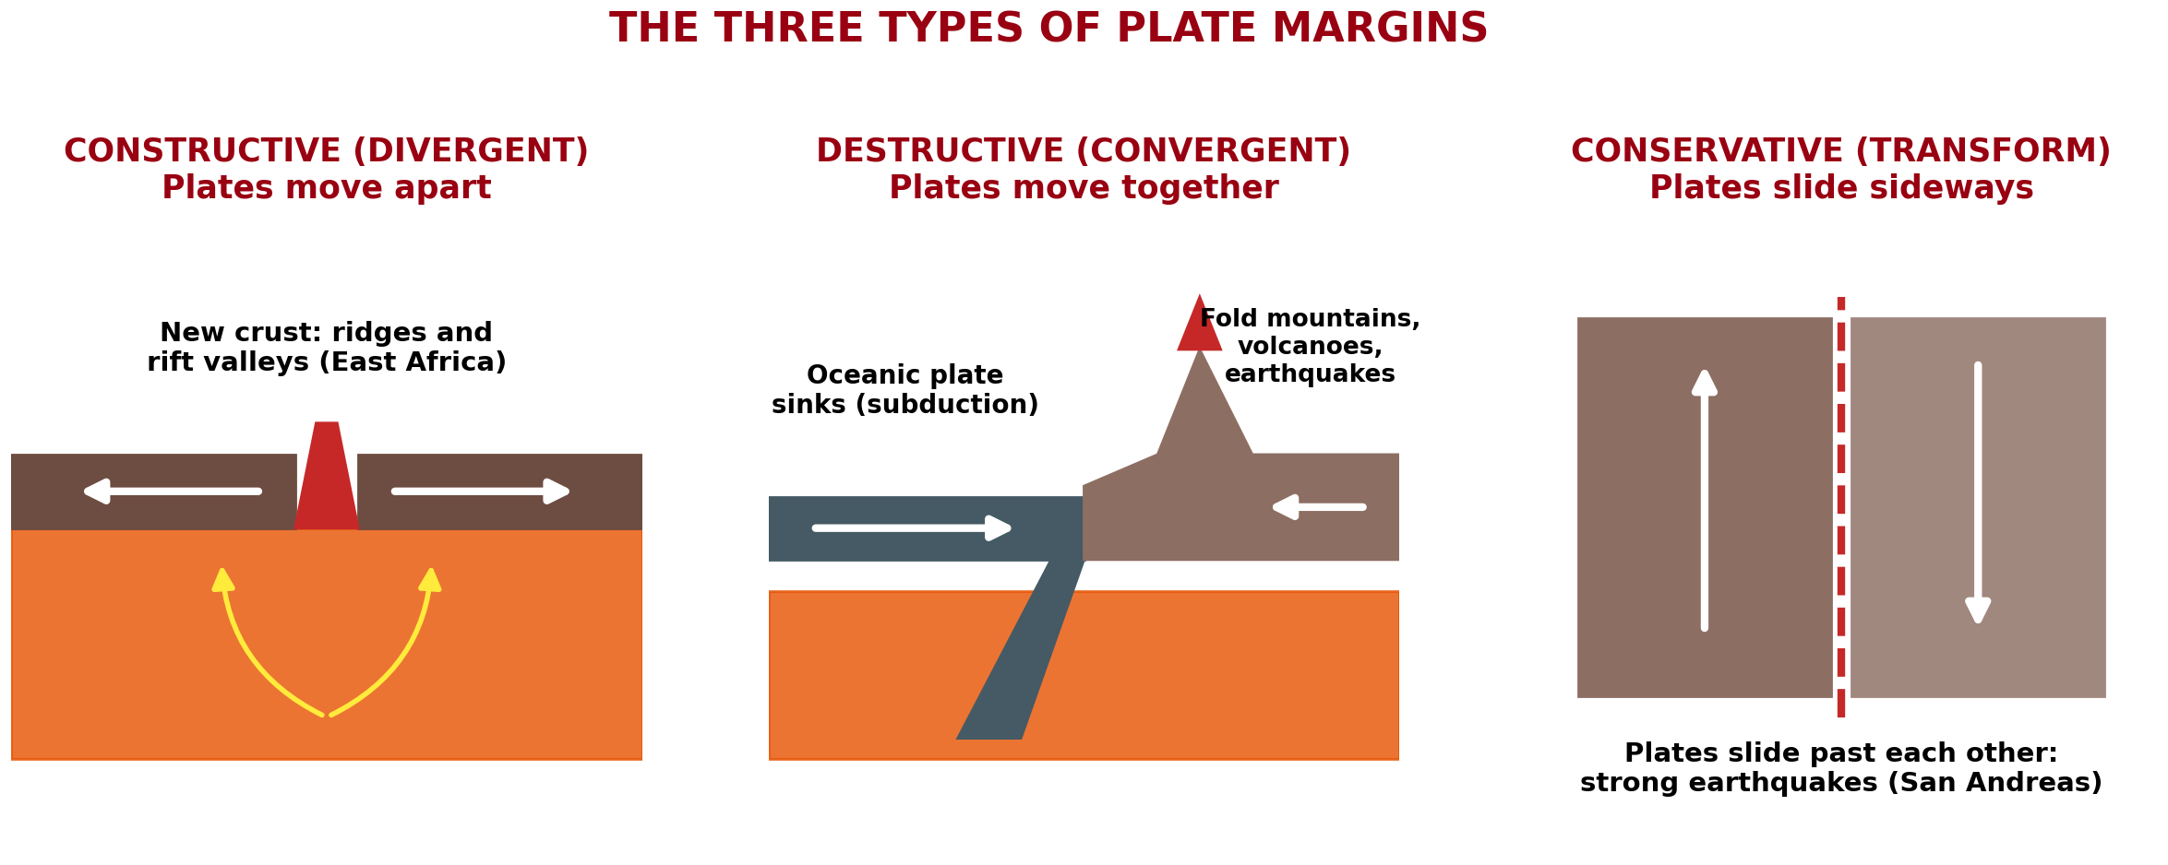
BOARD SUMMARY
3. Plate Margins and Main Landforms
A) Constructive (Divergent) Margins
Figure 2: The three types of plate margins
Notes:
Now draw Figure 2 in your notebook: the three types of plate margins. Give it a title and label it clearly.

Slide 41
BOARD SUMMARY
3. Plate Margins and Main Landforms
A) Constructive (Divergent) Margins
Mid-ocean ridges: They are long underwater mountain chains, like the Mid-Atlantic Ridge.
Rift valleys: On land, a block of crust sinks between two faults and forms a long valley, like the East African Rift Valley.
Notes:
We continue with Constructive (Divergent) Margins. On this slide we have Mid-ocean ridges and Rift valleys. Write each point on a new line, with the key term first, and explain it in your own words when we revise. When you finish, we go to the next slide.

Slide 42
BOARD SUMMARY
3. Plate Margins and Main Landforms
A) Constructive (Divergent) Margins (continued)
Volcanoes and earthquakes: Quiet volcanoes and weak earthquakes occur, as in Iceland.
Notes:
We continue with Constructive (Divergent) Margins. On this slide we have Volcanoes and earthquakes. Write each point on a new line, with the key term first, and explain it in your own words when we revise.

Slide 43
BOARD SUMMARY
3. Plate Margins and Main Landforms
B) Destructive (Convergent) Margins
At a destructive margin, two plates move together:
What happens: The heavier plate sinks under the other plate: this is subduction. The sinking plate melts and magma rises.
Notes:
Let us copy Destructive (Convergent) Margins. At a destructive margin, two plates move together. Copy the point on What happens. The figure is on the next slide.

Slide 44
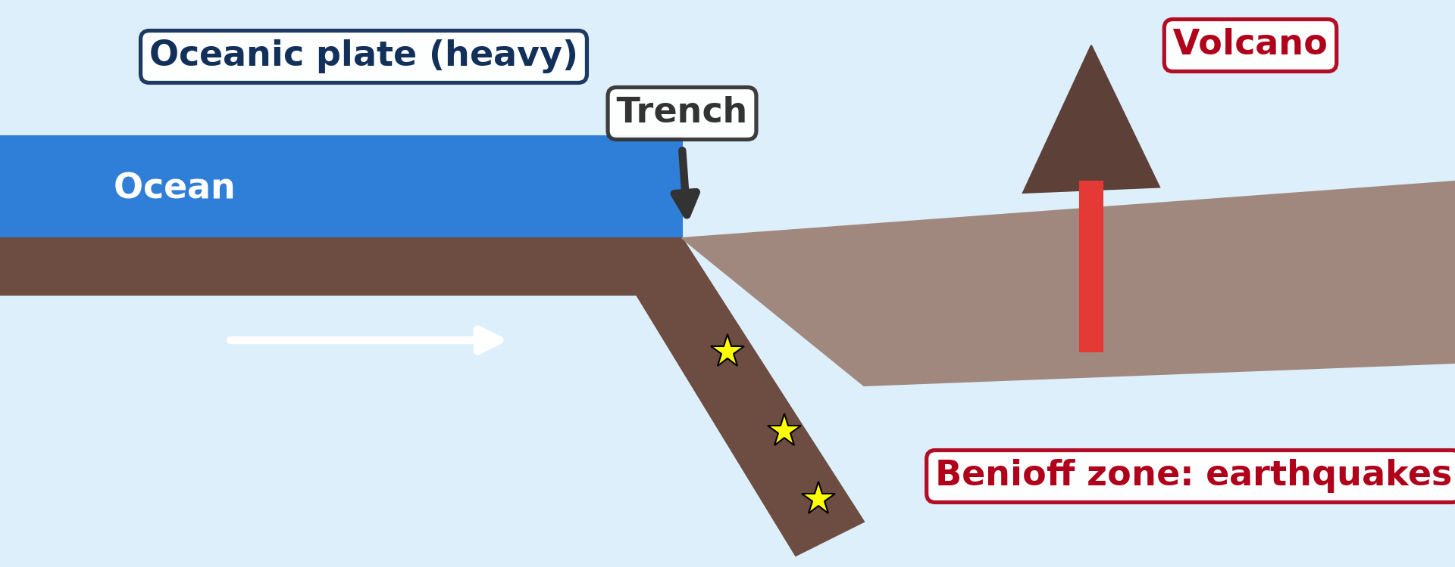
BOARD SUMMARY
3. Plate Margins and Main Landforms
B) Destructive (Convergent) Margins
Figure 3: Subduction at a destructive margin
Notes:
Now draw Figure 3 in your notebook: subduction at a destructive margin. Give it a title and label it clearly.

Slide 45
BOARD SUMMARY
3. Plate Margins and Main Landforms
B) Destructive (Convergent) Margins
Ocean plate and continental plate: An ocean trench forms, and fold mountains and volcanoes rise on the continent, like the Andes.
Notes:
We continue with Destructive (Convergent) Margins. On this slide we have Ocean plate and continental plate. Write each point on a new line, with the key term first, and explain it in your own words when we revise. When you finish, we go to the next slide.

Slide 46
BOARD SUMMARY
3. Plate Margins and Main Landforms
B) Destructive (Convergent) Margins (continued)
Ocean plate and ocean plate: An ocean trench forms and an arc of volcanic islands rises, like Japan and the Philippines.
Notes:
We continue with Destructive (Convergent) Margins. On this slide we have Ocean plate and ocean plate. Write each point on a new line, with the key term first, and explain it in your own words when we revise. When you finish, we go to the next slide.

Slide 47
BOARD SUMMARY
3. Plate Margins and Main Landforms
B) Destructive (Convergent) Margins (continued)
Continental plate and continental plate: Neither plate sinks easily, so the rocks are folded into very high fold mountains, like the Himalayas.
Notes:
We continue with Destructive (Convergent) Margins. On this slide we have Continental plate and continental plate. Write each point on a new line, with the key term first, and explain it in your own words when we revise.

Slide 48
BOARD SUMMARY
3. Plate Margins and Main Landforms
B) Destructive (Convergent) Margins
Volcanoes and earthquakes: Strong earthquakes and violent volcanoes occur, as around the Pacific Ring of Fire.
Notes:
Copy the point on Volcanoes and earthquakes. The figure is on the next slide.

Slide 49
BOARD SUMMARY
3. Plate Margins and Main Landforms
B) Destructive (Convergent) Margins
Figure 4: The Pacific Ring of Fire
Notes:
Now draw Figure 4 in your notebook: the Pacific Ring of Fire. Give it a title and label it clearly.

Slide 50
BOARD SUMMARY
3. Plate Margins and Main Landforms
C) Conservative (Transform) Margins
At a conservative margin, two plates slide past each other:
What happens: No crust is made or destroyed, but the plates rub and crack the crust along faults.
Notes:
Let us copy Conservative (Transform) Margins. At a conservative margin, two plates slide past each other. On this slide we have What happens. Write each point on a new line, with the key term first, and explain it in your own words when we revise. When you finish, we go to the next slide.

Slide 51
BOARD SUMMARY
3. Plate Margins and Main Landforms
C) Conservative (Transform) Margins (continued)
Faults and earthquakes: Strong, shallow earthquakes occur, as along the San Andreas Fault in California.
Notes:
We continue with Conservative (Transform) Margins. On this slide we have Faults and earthquakes. Write each point on a new line, with the key term first, and explain it in your own words when we revise.

Slide 52
FORMATIVE EVALUATION
Evaluation 1
What is plate tectonics?
Notes:
Now let us check what you have understood. Question 1: What is plate tectonics? Answer in your exercise book.

Slide 53
FORMATIVE EVALUATION
Expected Answer
It is the theory that the outer shell of the Earth is broken into rigid plates that move slowly.
Notes:
The expected answer is: it is the theory that the outer shell of the Earth is broken into rigid plates that move slowly. If you got it right, well done.

Slide 54
FORMATIVE EVALUATION
Evaluation 2
Name the three types of plate margins.
Notes:
Now let us check what you have understood. Question 2: Name the three types of plate margins. Answer in your exercise book.

Slide 55
FORMATIVE EVALUATION
Expected Answer
Constructive (divergent), destructive (convergent) and conservative (transform).
Notes:
The expected answer is: constructive (divergent), destructive (convergent) and conservative (transform). If you got it right, well done.

Slide 56
FORMATIVE EVALUATION
Evaluation 3
Which landforms form where an ocean plate sinks under a continent?
Notes:
Now let us check what you have understood. Question 3: Which landforms form where an ocean plate sinks under a continent? Answer in your exercise book.

Slide 57
FORMATIVE EVALUATION
Expected Answer
An ocean trench, fold mountains and volcanoes.
Notes:
The expected answer is: an ocean trench, fold mountains and volcanoes. If you got it right, well done.

Slide 58
REMEDIATION
Remediation
Fill in the blanks:
Cameroon is on the ______ Plate.
At a constructive margin, plates move ______.
The sinking of one plate under another is called ______.
Notes:
Take your time to copy this part; we will continue together.

Slide 59
REMEDIATION
Remediation (continued)
At a conservative margin, plates slide ______ each other.
The Himalayas are ______ mountains.
Notes:
For those who need more practice, fill in the blanks in your exercise book. The answers are: number 1, African; number 2, apart; number 3, subduction; number 4, past; number 5, fold.

Slide 60
HOMEWORK
Homework
Name one active volcano of Cameroon.
Notes:
For your homework: Name one active volcano of Cameroon. We shall correct it at the beginning of our next lesson.

Slide 61
NEXT LESSON
Next Lesson
Our next lesson will be on:
Lesson 11 (Part 1): Volcanoes
Notes:
Our next lesson will be on Lesson 11 (Part 1): Volcanoes. Thank you for your attention, and see you next time.

Slide 62
BILINGUAL GAME
Bilingual Game (Jeu Bilingue)
English | Français
Plate | La plaque
Plate margin | La limite de plaques
Subduction | La subduction
Ridge | La dorsale
Rift valley | La vallée du rift
Fold mountains | Les montagnes plissées
Trench | La fosse océanique
Fault | La faille
Notes:
Let us play the bilingual game. I say a word in English, and you give me the French word. Then we do the reverse.

Slide 63
LOGBOOK
Official Logbook (1/2)
Module / Topic | The Structure of the Earth: Building Processes and Impacts on Man
Lesson Title | Lesson 10: Plate Tectonics
Expected Learning Outcomes | Define plate tectonics. Explain the geometric and kinetic ideas of the theory. Name the major plates and locate the African Plate. Describe the three types of plate margins and their main landforms.
Competence | Learners are able to explain why earthquakes and volcanoes happen in some regions of the world, using a map of plates.
Notes:
I record this information in the official logbook of the class after the lesson.

Slide 64
LOGBOOK
Official Logbook (2/2)
Matter Taught | DEFINITIONS; Main Ideas of the Theory; The Plates; Constructive (Divergent) Margins; Destructive (Convergent) Margins; Conservative (Transform) Margins.
Evaluation | Formative evaluation and remediation exercise.
Homework | Name one active volcano of Cameroon.
Enrolment / Present / Absent | ____ / ____ / ____
Achievement | To be completed after the lesson.
Notes:
I complete the second page of the logbook: the matter taught, the evaluation, the homework and the attendance.

Slide 65
TEACHER'S NOTE
Teacher's Note
Timing: Homework correction, plan, objectives 4 min | Recall, situation, action 6 min | 3 activities 12 min | Board summary (copying) 15 min | Evaluation, remediation 5 min | Homework, next lesson 3 min | Logbook 5 min
Activity 2 is an animation (GIF): it plays automatically in slide-show mode.
Without the projector (Activity 1): break a biscuit into pieces: the pieces are like the plates.
Without the projector (Activity 2): move two books apart, then push them together.
Without the projector (Activity 3): draw the Pacific Ocean and mark Japan, Chile and California.
Notes:
This slide is for me, the teacher: it gives the timing of the lesson and what to do if the projector is not available.

Slide 66
REFERENCES
References
National Geography Syllabus (MINESEC), Form 3 — The Structure of the Earth: Building Processes and Impacts on Man.
Teacher's lesson notes (Form 3), checked and corrected where necessary.
Plate boundaries: Bird (2003), PB2002 model.
Photo, Activity 3: Pacific Ring of Fire volcanoes.png — BlueCaper, CC BY-SA 3.0, via Wikimedia Commons (https://commons.wikimedia.org/wiki/File:Pacific_Ring_of_Fire_volcanoes.png)
Diagrams and animations: drawn for this lesson (Geography Department).
Notes:
These are the references and picture credits used to prepare this lesson.

