Slide 1
FORM 2 TECHNICAL
GEOGRAPHY
Lesson 2 (Part 2)
The Tropical Grassland Region: Characteristics (Soils and Vegetation)
Notes:
Good morning, class, and welcome to our geography lesson. I am your geography teacher, Mr Kamdem. Today we are starting Lesson 2 (Part 2): The Tropical Grassland Region: Characteristics (Soils and Vegetation).

Slide 2
CLASS INFO
Class, Chapter and Duration
Class | Form 2 Technical
Chapter | Economic Geography — Natural Regions: 2. The Tropical Grassland Region
Duration | 2 periods (2 × 50 minutes)
Notes:
This lesson is for Form 2 Technical. It belongs to Economic Geography — Natural Regions: 2. The Tropical Grassland Region. We shall need 2 periods to cover it.

Slide 3
IDENTIFICATION
Lesson Identification
Topic | Man in His Environment
Sub-topic | Natural Regions
Lesson | Lesson 2 (Part 2): The Tropical Grassland Region: Characteristics (Soils and Vegetation)
Notions / Concepts | Savanna, deciduous, xerophyte, ferruginous soil, laterite, black cotton soil.
Syllabus focus | Characteristics of the soils and vegetation of the Tropical Grassland region.
Competence | Learners are able to recognise the trees and soils of the savanna around them and explain why some trees lose their leaves in the dry season.
Notes:
Our topic is Man in His Environment, and the sub-topic is Natural Regions. The key notions we shall use today are: savanna, deciduous, xerophyte, ferruginous soil, laterite, black cotton soil. At the end, you should be able to do this: learners are able to recognise the trees and soils of the savanna around them and explain why some trees lose their leaves in the dry season.

Slide 4

HOMEWORK CORRECTION
Correction of the Homework
Question (Lesson 2: The Tropical Grassland Region: Location and Characteristics (Climate)):
Notes:
Take your time to copy this part; we will continue together.

Slide 5
HOMEWORK CORRECTION
Correction of the Homework (continued)
Look at the trees and grass around your home. Which trees keep their leaves in the dry season, and which lose them? Is the grass green or dry now? Write your observations.
Notes:
Before we start the new lesson, let us correct the homework I gave you at the end of Lesson 2: The Tropical Grassland Region: Location and Characteristics (Climate). The question was: Look at the trees and grass around your home. Which trees keep their leaves in the dry season, and which lose them? Is the grass green or dry now? Write your observations. Take out your exercise books.

Slide 6
HOMEWORK CORRECTION
Correction: Possible Answer
Answers vary. Trees like the mango and the neem keep their leaves, while many trees such as the shea tree and acacias lose them. In the dry season the grass is yellow and dry.
Notes:
Here is a good answer. Answers vary. Trees like the mango and the neem keep their leaves, while many trees such as the shea tree and acacias lose them. In the dry season the grass is yellow and dry. Compare it with your own answer and correct your work in red.

Slide 7
LESSON PLAN
Lesson Plan
Correction of the homework
Objectives and recall
Real-life situation and action to take
Learning activities
Board summary
Evaluation, remediation and homework
Notes:
Here is the plan of our lesson today. First, we shall correct the homework. Then we shall look at the objectives and recall what you already know. After that, we shall study a situation from real life and the action to take, and do the learning activities. Finally, we shall copy the board summary, do the evaluation and the remediation, and I will give you the homework.

Slide 8
OBJECTIVES
Objectives
By the end of this lesson, you should be able to:
Describe the vegetation of the Tropical Grassland region.
Explain how savanna plants are adapted to the dry season and to bush fires.
Notes:
Take your time to copy this part; we will continue together.

Slide 9
OBJECTIVES
Objectives (continued)
Describe the main soils of the Tropical Grassland region.
Notes:
By the end of this lesson, you should be able to do three things. Number 1: describe the vegetation of the Tropical Grassland region. Number 2: explain how savanna plants are adapted to the dry season and to bush fires. Number 3: describe the main soils of the Tropical Grassland region.

Slide 10
PREVIOUS KNOWLEDGE
Previous Knowledge
The Tropical Grassland lies between 5° and 15° north and south of the Equator.
It has a wet season and a dry season, with 500 to 1,500 mm of rain.
Garoua has a dry season from November to March.
Notes:
Let us first remember what you already know. The Tropical Grassland lies between 5° and 15° north and south of the Equator. It has a wet season and a dry season, with 500 to 1,500 mm of rain. Garoua has a dry season from November to March. Keep this in mind, because we shall build on it today.

Slide 11
REAL-LIFE SITUATION
Situation in Real Life
In January, Hawa travels from Garoua to Ngaoundéré. The grass is dry and yellow, and many trees have no leaves. But one big tree, the shea tree, still has leaves, and its bark is not burnt.
Notes:
Listen carefully to this situation from real life. In January, Hawa travels from Garoua to Ngaoundéré. The grass is dry and yellow, and many trees have no leaves. But one big tree, the shea tree, still has leaves, and its bark is not burnt. Think about it, because I am going to ask you some questions.

Slide 12
REAL-LIFE SITUATION
Situation: Question 1
What is the problem in the situation?
Notes:
Question 1: What is the problem in the situation? Think for a moment, then raise your hand to answer.

Slide 13
REAL-LIFE SITUATION
Answer
Hawa does not know how savanna plants survive the dry season.
Notes:
Good. Hawa does not know how savanna plants survive the dry season.

Slide 14
REAL-LIFE SITUATION
Situation: Question 2
What did Hawa see?
Notes:
Question 2: What did Hawa see? Think for a moment, then raise your hand to answer.

Slide 15
REAL-LIFE SITUATION
Answer
Dry grass and trees without leaves.
Notes:
Good. Dry grass and trees without leaves.

Slide 16
REAL-LIFE SITUATION
Situation: Question 3
How can we protect the trees from fire?
Notes:
Question 3: How can we protect the trees from fire? Think for a moment, then raise your hand to answer.

Slide 17
REAL-LIFE SITUATION
Possible Answer
We can avoid bush fires and make firebreaks.
Notes:
Good. We can avoid bush fires and make firebreaks.

Slide 18
ACTION TO TAKE
Action to Take
Avoid bush fires, which destroy plants and the humus of the soil.
Notes:
From this situation, the action we are working towards in this lesson is the following: avoid bush fires, which destroy plants and the humus of the soil.

Slide 19
JUSTIFICATION
Justification of the Lesson
This lesson helps us to know the plants and soils around us.
Notes:
Why is this lesson important for you? This lesson helps us to know the plants and soils around us.

Slide 20
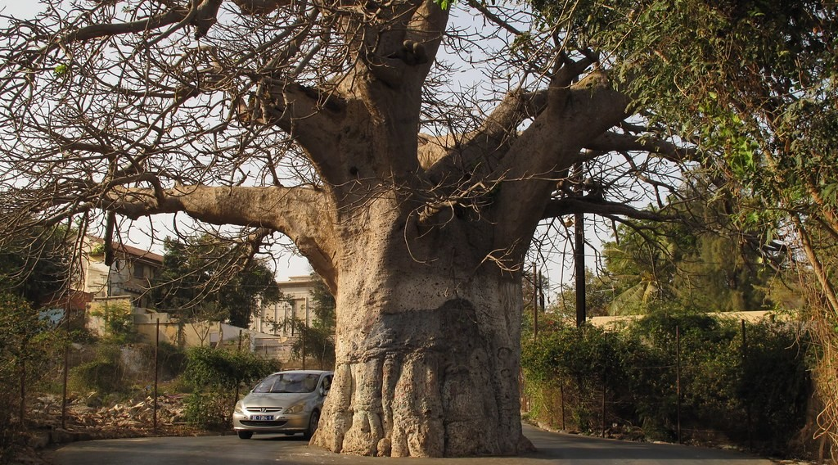
1. VEGETATION
Activity 1
A baobab tree.
Notes:
Activity 1. Look carefully at this picture: a baobab tree. Observe every detail before I ask the question.

Slide 21
1. VEGETATION
Activity 1: Question
Look at the trunk of the baobab. How does it help the tree in the dry season?
Notes:
Here is the question for Activity 1: Look at the trunk of the baobab. How does it help the tree in the dry season? Take one minute to think and write your answer in your rough notebook.

Slide 22
1. VEGETATION
Activity 1: Answer
The big trunk keeps water for the dry season.
Notes:
Let us check the answer together. The big trunk keeps water for the dry season.

Slide 23
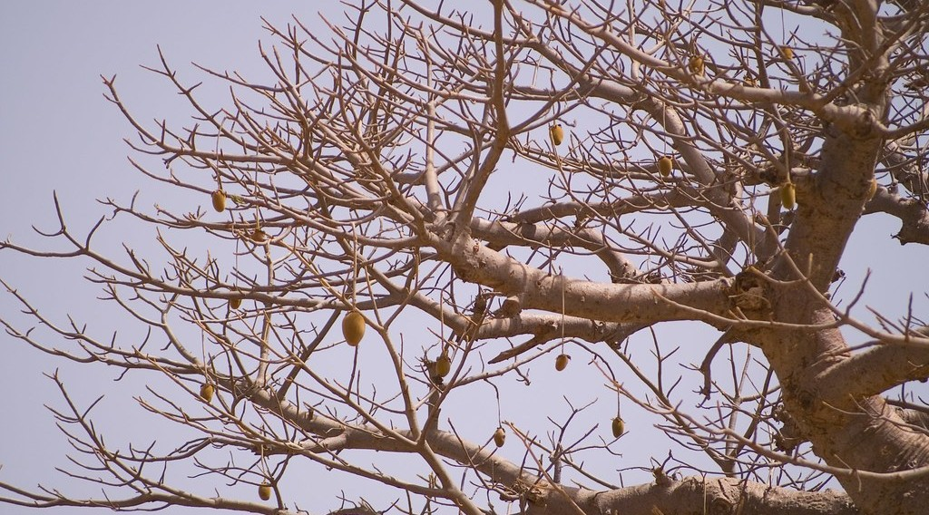
1. VEGETATION
Activity 2
A tree without leaves in the dry season.
Notes:
Activity 2. Look carefully at this picture: a tree without leaves in the dry season. Observe every detail before I ask the question.

Slide 24
1. VEGETATION
Activity 2: Question
Why do many savanna trees lose their leaves in the dry season?
Notes:
Here is the question for Activity 2: Why do many savanna trees lose their leaves in the dry season? Take one minute to think and write your answer in your rough notebook.

Slide 25
1. VEGETATION
Activity 2: Answer
To lose less water when there is no rain.
Notes:
Let us check the answer together. To lose less water when there is no rain.

Slide 26

1. VEGETATION
Activity 3
A shea tree (karité).
Notes:
Activity 3. Look carefully at this picture: a shea tree (karité). Observe every detail before I ask the question.

Slide 27
1. VEGETATION
Activity 3: Question
The shea tree has a thick bark. How does it help the tree?
Notes:
Here is the question for Activity 3: The shea tree has a thick bark. How does it help the tree? Take one minute to think and write your answer in your rough notebook.

Slide 28
1. VEGETATION
Activity 3: Answer
The thick bark protects the tree from bush fires.
Notes:
Let us check the answer together. The thick bark protects the tree from bush fires.

Slide 29

2. SOILS
Activity 4
Bricks cut from red laterite.
Notes:
Activity 4. Look carefully at this picture: bricks cut from red laterite. Observe every detail before I ask the question.

Slide 30
2. SOILS
Activity 4: Question
This red soil becomes very hard when it dries. What is it called? What do we use it for?
Notes:
Here is the question for Activity 4: This red soil becomes very hard when it dries. What is it called? What do we use it for? Take one minute to think and write your answer in your rough notebook.

Slide 31
2. SOILS
Activity 4: Answer
It is laterite. We use it for roads and bricks.
Notes:
Let us check the answer together. It is laterite. We use it for roads and bricks.

Slide 32

2. SOILS
Activity 5
Clay soil with big cracks in the dry season.
Notes:
Activity 5. Look carefully at this picture: clay soil with big cracks in the dry season. Observe every detail before I ask the question.

Slide 33
2. SOILS
Activity 5: Question
Black cotton soils are clay soils that crack when dry. Why do farmers like them?
Notes:
Here is the question for Activity 5: Black cotton soils are clay soils that crack when dry. Why do farmers like them? Take one minute to think and write your answer in your rough notebook.

Slide 34
2. SOILS
Activity 5: Answer
It is fertile and keeps water. It is good for cotton and sorghum.
Notes:
Let us check the answer together. It is fertile and keeps water. It is good for cotton and sorghum.

Slide 35
BOARD SUMMARY
Board Summary
Topic: Man in His Environment
Sub-topic: Natural Regions
Lesson 2 (Part 2): The Tropical Grassland Region: Characteristics (Soils and Vegetation)
Notes:
Now we are going to copy the board summary. Write the title and the headings neatly in your notebooks. I will give you enough time for each slide, so do not rush.

Slide 36
BOARD SUMMARY
DEFINITIONS
The key terms of this lesson are defined as follows:
Deciduous tree: It is a tree that loses its leaves in the dry season.
Laterite: It is a hard, red layer in the soil.
Notes:
Let us copy the definitions. The key terms of this lesson are defined as follows. On this slide we have Deciduous tree and Laterite. Write each point on a new line, with the key term first, and explain it in your own words when we revise. When you finish, we go to the next slide.

Slide 37
BOARD SUMMARY
DEFINITIONS (continued)
Leaching: It is the washing of plant food deep into the soil by rain.
Notes:
We continue with the definitions. On this slide we have Leaching. Write each point on a new line, with the key term first, and explain it in your own words when we revise.

Slide 38
BOARD SUMMARY
1. Vegetation
The vegetation of the savanna has the following characteristics:
Grass: Tall grass grows up to 3 metres high in the wet season.
Trees: Trees such as the baobab, the acacia and the shea tree grow far apart.
Notes:
Let us copy Vegetation. The vegetation of the savanna has the following characteristics. On this slide we have Grass and Trees. Write each point on a new line, with the key term first, and explain it in your own words when we revise. When you finish, we go to the next slide.

Slide 39
BOARD SUMMARY
1. Vegetation (continued)
Deciduous trees: Many trees lose their leaves in the dry season to save water.
Thick bark: Thick bark protects trees from bush fires.
Notes:
We continue with Vegetation. On this slide we have Deciduous trees and Thick bark. Write each point on a new line, with the key term first, and explain it in your own words when we revise.

Slide 40
BOARD SUMMARY
2. Soils
The soils of the savanna have the following characteristics:
Red soils: They are red because of iron and are only fairly fertile.
Laterite: It is a hard layer used to make roads and bricks.
Notes:
Let us copy Soils. The soils of the savanna have the following characteristics. On this slide we have Red soils and Laterite. Write each point on a new line, with the key term first, and explain it in your own words when we revise. When you finish, we go to the next slide.

Slide 41
BOARD SUMMARY
2. Soils (continued)
Black cotton soils: They are fertile clay soils that keep water well.
Little humus: The soils have little humus because bush fires burn the dead plants.
Notes:
We continue with Soils. On this slide we have Black cotton soils and Little humus. Write each point on a new line, with the key term first, and explain it in your own words when we revise.

Slide 42
FORMATIVE EVALUATION
Evaluation 1
Give two ways savanna trees survive the dry season.
Notes:
Now let us check what you have understood. Question 1: Give two ways savanna trees survive the dry season. Answer in your exercise book.

Slide 43
FORMATIVE EVALUATION
Expected Answer
They lose their leaves; the baobab keeps water in its trunk.
Notes:
The expected answer is: they lose their leaves; the baobab keeps water in its trunk. If you got it right, well done.

Slide 44
FORMATIVE EVALUATION
Evaluation 2
What is laterite used for?
Notes:
Now let us check what you have understood. Question 2: What is laterite used for? Answer in your exercise book.

Slide 45
FORMATIVE EVALUATION
Expected Answer
For roads and bricks.
Notes:
The expected answer is: for roads and bricks. If you got it right, well done.

Slide 46
REMEDIATION
Remediation
Fill in the blanks:
Trees that lose their leaves are ______ trees.
The tree that keeps water in its trunk is the ______.
The hard red layer in the soil is ______.
Notes:
For those who need more practice, fill in the blanks in your exercise book. The answers are: number 1, deciduous; number 2, baobab; number 3, laterite.

Slide 47
HOMEWORK
Homework
List three things that people in your family get from the savanna around Garoua, for example food, wood or animals.
Notes:
For your homework: List three things that people in your family get from the savanna around Garoua, for example food, wood or animals. We shall correct it at the beginning of our next lesson.

Slide 48
NEXT LESSON
Next Lesson
Our next lesson will be on:
Lesson 2 (Part 3): The Tropical Grassland Region: Types of Resources and Methods of Exploitation
Notes:
Our next lesson will be on Lesson 2 (Part 3): The Tropical Grassland Region: Types of Resources and Methods of Exploitation. Thank you for your attention, and see you next time.

Slide 49
BILINGUAL GAME
Bilingual Game (Jeu Bilingue)
English | Français
Savanna | La savane
Grass | L'herbe
Deciduous tree | L'arbre à feuilles caduques
Bush fire | Le feu de brousse
Shea tree | Le karité
Baobab | Le baobab
Laterite | La latérite
Leaching | Le lessivage
Notes:
Let us play the bilingual game. I say a word in English, and you give me the French word. Then we do the reverse.

Slide 50
LOGBOOK
Official Logbook (1/2)
Module / Topic | Man in His Environment
Lesson Title | Lesson 2 (Part 2): The Tropical Grassland Region: Characteristics (Soils and Vegetation)
Expected Learning Outcomes | Describe the vegetation of the Tropical Grassland region. Explain how savanna plants are adapted to the dry season and to bush fires. Describe the main soils of the Tropical Grassland region.
Competence | Learners are able to recognise the trees and soils of the savanna around them and explain why some trees lose their leaves in the dry season.
Notes:
I record this information in the official logbook of the class after the lesson.

Slide 51
LOGBOOK
Official Logbook (2/2)
Matter Taught | DEFINITIONS; Vegetation; Soils.
Evaluation | Formative evaluation and remediation exercise.
Homework | List three things that people in your family get from the savanna around Garoua, for example food, wood or animals.
Enrolment / Present / Absent | ____ / ____ / ____
Achievement | To be completed after the lesson.
Notes:
I complete the second page of the logbook: the matter taught, the evaluation, the homework and the attendance.

Slide 52
TEACHER'S NOTE
Teacher's Note
Timing: Homework correction, plan, objectives 8 min | Recall, situation, action 10 min | 5 activities 30 min | Board summary (copying) 30 min | Evaluation, remediation 10 min | Homework, next lesson 5 min | Logbook 7 min
Without the projector (Activity 1): ask learners where they have seen a baobab.
Without the projector (Activity 2): ask learners which trees near their home lose their leaves.
Without the projector (Activity 3): bring a piece of shea bark or shea butter to class.
Without the projector (Activity 4): ask learners the colour of the soil of the school yard.
Without the projector (Activity 5): describe the black soils (karal) of the Far North.
Notes:
This slide is for me, the teacher: it gives the timing of the lesson and what to do if the projector is not available.

Slide 53
REFERENCES
References
Harmonised Progression Sheet, Economic Geography (5051), Form 2.
Class textbook: The major biomes of the world (tropical grassland).
Photo, Activity 1: “What happens if you let weeds grow in centre of road, Dakar, Senegal” by ambabheg, CC BY 2.0, via Flickr (https://www.flickr.com/photos/31518985@N04/5627872663)
Photo, Activity 2: “'Pain de singe' (monkey's bread) in a baobab, Senegal” by Milamber's portfolio, CC BY-NC-ND 2.0, via Flickr (https://www.flickr.com/photos/90956808@N00/420120264)
Photo, Activity 3: “Female shea tree (Vitellaria paradoxa) in full flower” by Joel Abroad, CC BY-NC-SA 2.0, via Flickr (https://www.flickr.com/photos/40295335@N00/5603751456)
Photo, Activity 4: “Laterite soil bricks in Richard Rebello's farm” by India Water Portal, CC BY-NC-SA 2.0, via Flickr (https://www.flickr.com/photos/21623815@N03/10720461943)
Photo, Activity 5: “Cracked Earth” by Aleatoric Consonance, CC BY 2.0, via Flickr (https://www.flickr.com/photos/93921318@N00/3772011444)
Diagrams and animations: drawn for this lesson (Geography Department).
Notes:
These are the references and picture credits used to prepare this lesson.

