Slide 1
FORM 2 TECHNICAL
GEOGRAPHY
Lesson 4 (Part 3)
The Temperate Region: Human Activities (Farming)
Notes:
Good morning, class, and welcome to our geography lesson. I am your geography teacher, Mr Kamdem. Today we are starting Lesson 4 (Part 3): The Temperate Region: Human Activities (Farming).

Slide 2
CLASS INFO
Class, Chapter and Duration
Class | Form 2 Technical
Chapter | Economic Geography — Natural Regions: 4. The Temperate Region
Duration | 2 periods (2 × 50 minutes)
Notes:
This lesson is for Form 2 Technical. It belongs to Economic Geography — Natural Regions: 4. The Temperate Region. We shall need 2 periods to cover it.

Slide 3
IDENTIFICATION
Lesson Identification
Topic | Man in His Environment
Sub-topic | Natural Regions
Lesson | Lesson 4 (Part 3): The Temperate Region: Human Activities (Farming)
Notions / Concepts | Mixed farming, dairy farming, extensive grain farming, ranching, Mediterranean farming, mechanisation.
Syllabus focus | Farming in the temperate region.
Competence | Learners are able to explain where the imported flour, milk and meat sold in Garoua come from, and how they are produced.
Notes:
Our topic is Man in His Environment, and the sub-topic is Natural Regions. The key notions we shall use today are: mixed farming, dairy farming, extensive grain farming, ranching, Mediterranean farming, mechanisation. At the end, you should be able to do this: learners are able to explain where the imported flour, milk and meat sold in Garoua come from, and how they are produced.

Slide 4

HOMEWORK CORRECTION
Correction of the Homework
Question (Lesson 4 (Part 2): The Temperate Region: Characteristics (Soils and Vegetation)):
Find the names of three food products imported into Cameroon from temperate countries (for example wheat flour, milk or apples).
Notes:
Before we start the new lesson, let us correct the homework I gave you at the end of Lesson 4 (Part 2): The Temperate Region: Characteristics (Soils and Vegetation). The question was: Find the names of three food products imported into Cameroon from temperate countries (for example wheat flour, milk or apples). Take out your exercise books.

Slide 5
HOMEWORK CORRECTION
Correction: Possible Answer
Examples: wheat flour (from France or Canada), powdered milk (from Europe), apples (from France or South Africa), frozen chicken and onions (from Europe).
Notes:
Here is a good answer. Examples: wheat flour (from France or Canada), powdered milk (from Europe), apples (from France or South Africa), frozen chicken and onions (from Europe). Compare it with your own answer and correct your work in red.

Slide 6
LESSON PLAN
Lesson Plan
Correction of the homework
Objectives and recall
Real-life situation and action to take
Learning activities
Board summary
Evaluation, remediation and homework
Notes:
Here is the plan of our lesson today. First, we shall correct the homework. Then we shall look at the objectives and recall what you already know. After that, we shall study a situation from real life and the action to take, and do the learning activities. Finally, we shall copy the board summary, do the evaluation and the remediation, and I will give you the homework.

Slide 7
OBJECTIVES
Objectives
By the end of this lesson, you should be able to:
Describe the main types of farming in the temperate region.
Give examples of countries for each type of farming.
Notes:
Take your time to copy this part; we will continue together.

Slide 8
OBJECTIVES
Objectives (continued)
Explain why temperate farming is very productive.
Notes:
By the end of this lesson, you should be able to do three things. Number 1: describe the main types of farming in the temperate region. Number 2: give examples of countries for each type of farming. Number 3: explain why temperate farming is very productive.

Slide 9
PREVIOUS KNOWLEDGE
Previous Knowledge
The temperate region has deciduous forests, coniferous forests, Mediterranean vegetation and grasslands.
Its brown forest soils and chernozems are very fertile.
Notes:
Let us first remember what you already know. The temperate region has deciduous forests, coniferous forests, Mediterranean vegetation and grasslands. Its brown forest soils and chernozems are very fertile. Keep this in mind, because we shall build on it today.

Slide 10
REAL-LIFE SITUATION
Situation in Real Life
In a shop in Garoua, Blaise sees wheat flour from France, milk powder from the Netherlands and olive oil from Spain. He wonders how these countries produce so much food.
Notes:
Listen carefully to this situation from real life. In a shop in Garoua, Blaise sees wheat flour from France, milk powder from the Netherlands and olive oil from Spain. He wonders how these countries produce so much food. Think about it, because I am going to ask you some questions.

Slide 11
REAL-LIFE SITUATION
Situation: Question 1
What is the problem in the situation?
Notes:
Question 1: What is the problem in the situation? Think for a moment, then raise your hand to answer.

Slide 12
REAL-LIFE SITUATION
Answer
Blaise does not know how these countries produce so much food.
Notes:
Good. Blaise does not know how these countries produce so much food.

Slide 13
REAL-LIFE SITUATION
Situation: Question 2
Name the three products and their countries.
Notes:
Question 2: Name the three products and their countries. Think for a moment, then raise your hand to answer.

Slide 14
REAL-LIFE SITUATION
Answer
Flour (France), milk (Netherlands), olive oil (Spain).
Notes:
Good. Flour (France), milk (Netherlands), olive oil (Spain).

Slide 15
REAL-LIFE SITUATION
Situation: Question 3
What helps these farmers to produce a lot?
Notes:
Question 3: What helps these farmers to produce a lot? Think for a moment, then raise your hand to answer.

Slide 16
REAL-LIFE SITUATION
Possible Answer
Machines, good seeds and fertilisers.
Notes:
Good. Machines, good seeds and fertilisers.

Slide 17
ACTION TO TAKE
Action to Take
Learn from modern farming methods to improve our own farms.
Notes:
From this situation, the action we are working towards in this lesson is the following: learn from modern farming methods to improve our own farms.

Slide 18
JUSTIFICATION
Justification of the Lesson
This lesson helps us to know how farmers work in the temperate region.
Notes:
Why is this lesson important for you? This lesson helps us to know how farmers work in the temperate region.

Slide 19

1. MIXED FARMING
Activity 1
Cows on a farm with fields.
Notes:
Activity 1. Look carefully at this picture: cows on a farm with fields. Observe every detail before I ask the question.

Slide 20
1. MIXED FARMING
Activity 1: Question
This farmer grows crops and rears animals on the same farm. What is this type of farming?
Notes:
Here is the question for Activity 1: This farmer grows crops and rears animals on the same farm. What is this type of farming? Take one minute to think and write your answer in your rough notebook.

Slide 21
1. MIXED FARMING
Activity 1: Answer
Mixed farming.
Notes:
Let us check the answer together. Mixed farming.

Slide 22
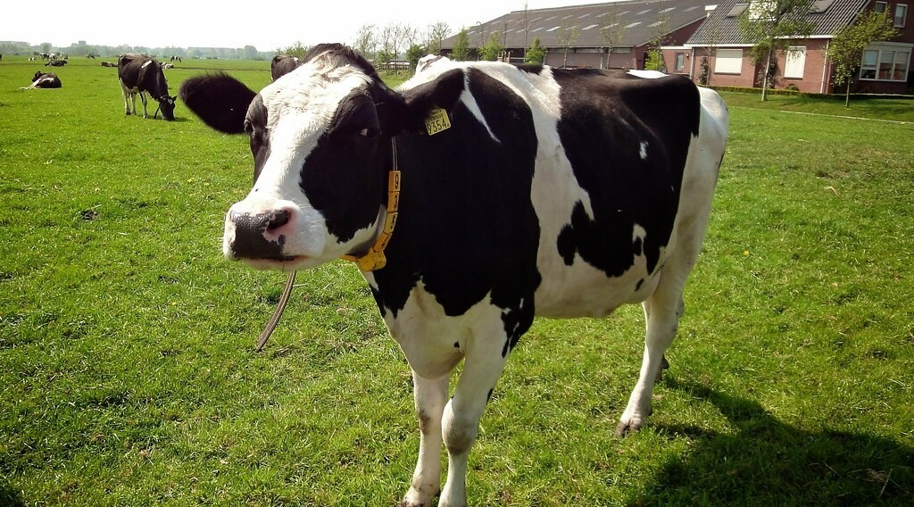
1. DAIRY FARMING
Activity 2
Cows on a farm in the Netherlands.
Notes:
Activity 2. Look carefully at this picture: cows on a farm in the Netherlands. Observe every detail before I ask the question.

Slide 23
1. DAIRY FARMING
Activity 2: Question
These cows are reared for milk, butter and cheese. What is this type of farming?
Notes:
Here is the question for Activity 2: These cows are reared for milk, butter and cheese. What is this type of farming? Take one minute to think and write your answer in your rough notebook.

Slide 24
1. DAIRY FARMING
Activity 2: Answer
Dairy farming.
Notes:
Let us check the answer together. Dairy farming.

Slide 25

1. GRAIN FARMING
Activity 3
A big machine harvests wheat.
Notes:
Activity 3. Look carefully at this picture: a big machine harvests wheat. Observe every detail before I ask the question.

Slide 26
1. GRAIN FARMING
Activity 3: Question
Why can one farmer in Canada grow so much wheat?
Notes:
Here is the question for Activity 3: Why can one farmer in Canada grow so much wheat? Take one minute to think and write your answer in your rough notebook.

Slide 27
1. GRAIN FARMING
Activity 3: Answer
He uses big machines on a huge farm.
Notes:
Let us check the answer together. He uses big machines on a huge farm.

Slide 28
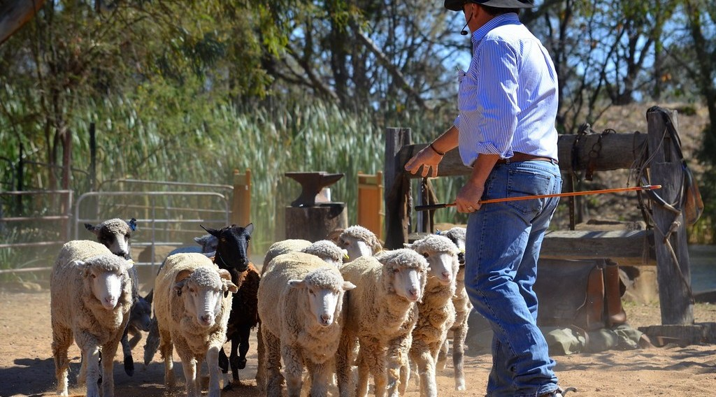
1. RANCHING
Activity 4
A farmer with his sheep.
Notes:
Activity 4. Look carefully at this picture: a farmer with his sheep. Observe every detail before I ask the question.

Slide 29
1. RANCHING
Activity 4: Question
In Australia, sheep are reared on huge farms. What are these farms called?
Notes:
Here is the question for Activity 4: In Australia, sheep are reared on huge farms. What are these farms called? Take one minute to think and write your answer in your rough notebook.

Slide 30
1. RANCHING
Activity 4: Answer
Ranches.
Notes:
Let us check the answer together. Ranches.

Slide 31
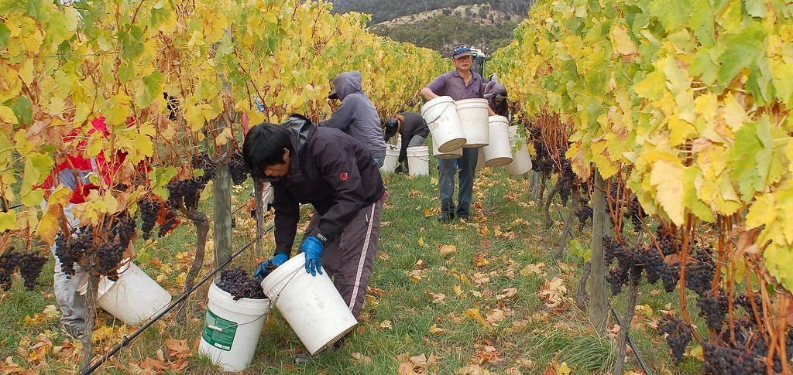
1. MEDITERRANEAN FARMING
Activity 5
Picking grapes in France.
Notes:
Activity 5. Look carefully at this picture: picking grapes in France. Observe every detail before I ask the question.

Slide 32
1. MEDITERRANEAN FARMING
Activity 5: Question
Name two crops of Mediterranean farming.
Notes:
Here is the question for Activity 5: Name two crops of Mediterranean farming. Take one minute to think and write your answer in your rough notebook.

Slide 33
1. MEDITERRANEAN FARMING
Activity 5: Answer
Grapes and olives (also oranges and wheat).
Notes:
Let us check the answer together. Grapes and olives (also oranges and wheat).

Slide 34
BOARD SUMMARY
Board Summary
Topic: Man in His Environment
Sub-topic: Natural Regions
Lesson 4 (Part 3): The Temperate Region: Human Activities (Farming)
Notes:
Now we are going to copy the board summary. Write the title and the headings neatly in your notebooks. I will give you enough time for each slide, so do not rush.

Slide 35
BOARD SUMMARY
1. Types of Farming
The main types of farming in the temperate region are the following:
Mixed farming: Farmers grow crops and rear animals on the same farm, as in England and France.
Notes:
Let us copy Types of Farming. The main types of farming in the temperate region are the following. On this slide we have Mixed farming. Write each point on a new line, with the key term first, and explain it in your own words when we revise. When you finish, we go to the next slide.

Slide 36
BOARD SUMMARY
1. Types of Farming (continued)
Dairy farming: Farmers rear cows for milk, butter and cheese, as in the Netherlands and Denmark.
Grain farming: Farmers grow wheat on very large farms, as on the Prairies of Canada.
Notes:
We continue with Types of Farming. On this slide we have Dairy farming and Grain farming. Write each point on a new line, with the key term first, and explain it in your own words when we revise. When you finish, we go to the next slide.

Slide 37
BOARD SUMMARY
1. Types of Farming (continued)
Ranching: Cattle and sheep are reared on very large farms, as in Argentina and Australia.
Mediterranean farming: Farmers grow olives, grapes and oranges.
Notes:
We continue with Types of Farming. On this slide we have Ranching and Mediterranean farming. Write each point on a new line, with the key term first, and explain it in your own words when we revise.

Slide 38
BOARD SUMMARY
2. Characteristics of Temperate Farming
Farming in the temperate region has the following characteristics:
Machines: Farmers use machines, so few workers produce a lot.
Science: Farmers use good seeds, fertilisers and modern methods.
Notes:
Let us copy Characteristics of Temperate Farming. Farming in the temperate region has the following characteristics. On this slide we have Machines and Science. Write each point on a new line, with the key term first, and explain it in your own words when we revise. When you finish, we go to the next slide.

Slide 39
BOARD SUMMARY
2. Characteristics of Temperate Farming (continued)
Trade: Most farm products are sold in markets at home and abroad.
Notes:
We continue with Characteristics of Temperate Farming. On this slide we have Trade. Write each point on a new line, with the key term first, and explain it in your own words when we revise.

Slide 40
FORMATIVE EVALUATION
Evaluation 1
What is mixed farming?
Notes:
Now let us check what you have understood. Question 1: What is mixed farming? Answer in your exercise book.

Slide 41
FORMATIVE EVALUATION
Expected Answer
Growing crops and rearing animals on the same farm.
Notes:
The expected answer is: growing crops and rearing animals on the same farm. If you got it right, well done.

Slide 42
FORMATIVE EVALUATION
Evaluation 2
Why do temperate farmers produce a lot?
Notes:
Now let us check what you have understood. Question 2: Why do temperate farmers produce a lot? Answer in your exercise book.

Slide 43
FORMATIVE EVALUATION
Expected Answer
They use machines, good seeds and fertilisers.
Notes:
The expected answer is: they use machines, good seeds and fertilisers. If you got it right, well done.

Slide 44
REMEDIATION
Remediation
Fill in the blanks:
Rearing cows for milk is ______ farming.
A very large farm for animals is a ______.
Wheat is harvested by a big ______.
Notes:
For those who need more practice, fill in the blanks in your exercise book. The answers are: number 1, dairy; number 2, ranch; number 3, machine (combine harvester).

Slide 45
HOMEWORK
Homework
Ask an adult who has lived or travelled in Europe what difficulties people face in winter. Write down two of them.
Notes:
For your homework: Ask an adult who has lived or travelled in Europe what difficulties people face in winter. Write down two of them. We shall correct it at the beginning of our next lesson.

Slide 46
NEXT LESSON
Next Lesson
Our next lesson will be on:
Lesson 4 (Part 4): The Temperate Region: Problems Faced and Adaptations
Notes:
Our next lesson will be on Lesson 4 (Part 4): The Temperate Region: Problems Faced and Adaptations. Thank you for your attention, and see you next time.

Slide 47
BILINGUAL GAME
Bilingual Game (Jeu Bilingue)
English | Français
Mixed farming | La polyculture-élevage
Dairy farming | L'élevage laitier
Wheat | Le blé
Ranch | Le ranch
Tractor | Le tracteur
Cooperative | La coopérative
Fertiliser | L'engrais
Grape | Le raisin
Notes:
Let us play the bilingual game. I say a word in English, and you give me the French word. Then we do the reverse.

Slide 48
LOGBOOK
Official Logbook (1/2)
Module / Topic | Man in His Environment
Lesson Title | Lesson 4 (Part 3): The Temperate Region: Human Activities (Farming)
Expected Learning Outcomes | Describe the main types of farming in the temperate region. Give examples of countries for each type of farming. Explain why temperate farming is very productive.
Competence | Learners are able to explain where the imported flour, milk and meat sold in Garoua come from, and how they are produced.
Notes:
I record this information in the official logbook of the class after the lesson.

Slide 49
LOGBOOK
Official Logbook (2/2)
Matter Taught | Types of Farming; Characteristics of Temperate Farming.
Evaluation | Formative evaluation and remediation exercise.
Homework | Ask an adult who has lived or travelled in Europe what difficulties people face in winter. Write down two of them.
Enrolment / Present / Absent | ____ / ____ / ____
Achievement | To be completed after the lesson.
Notes:
I complete the second page of the logbook: the matter taught, the evaluation, the homework and the attendance.

Slide 50
TEACHER'S NOTE
Teacher's Note
Timing: Homework correction, plan, objectives 8 min | Recall, situation, action 10 min | 5 activities 30 min | Board summary (copying) 30 min | Evaluation, remediation 10 min | Homework, next lesson 5 min | Logbook 7 min
Without the projector (Activity 1): ask learners if their family grows crops and keeps animals too.
Without the projector (Activity 2): show a tin of powdered milk.
Without the projector (Activity 3): compare with a farmer who harvests sorghum by hand.
Without the projector (Activity 4): compare with the ranches of the Adamawa plateau.
Without the projector (Activity 5): ask learners where oranges in the market come from.
Notes:
This slide is for me, the teacher: it gives the timing of the lesson and what to do if the projector is not available.

Slide 51
REFERENCES
References
Harmonised Progression Sheet, Economic Geography (5051), Form 2.
Class textbook: The major biomes of the world (temperate regions).
Photo, Activity 1: “Timid” by tricky (rick harrison), CC BY-NC-SA 2.0, via Flickr (https://www.flickr.com/photos/81851211@N00/205287304)
Photo, Activity 2: “Koe 9354” by ednl, CC BY 2.0, via Flickr (https://www.flickr.com/photos/31392863@N04/5640329871)
Photo, Activity 3: “John Deere Combine” by SnoShuu, CC BY-NC-ND 2.0, via Flickr (https://www.flickr.com/photos/85888233@N00/2776467094)
Photo, Activity 4: “The Flock” by seefit, CC BY 2.0, via Flickr (https://www.flickr.com/photos/76574551@N00/20928299362)
Photo, Activity 5: “Stefano Lubiana Wines Tasmania harvest panorama” by stefano lubiana wines, CC BY 2.0, via Flickr (https://www.flickr.com/photos/50979249@N06/4688372740)
Diagrams and animations: drawn for this lesson (Geography Department).
Notes:
These are the references and picture credits used to prepare this lesson.

