Slide 1
FORM 2 TECHNICAL
GEOGRAPHY
Lesson 5 (Part 1)
The Sectors of the Economy: Introduction, Definitions and Key Concepts
Notes:
Good morning, class, and welcome to our geography lesson. I am your geography teacher, Mr Kamdem. Today we are starting Lesson 5 (Part 1): The Sectors of the Economy: Introduction, Definitions and Key Concepts.

Slide 2
CLASS INFO
Class, Chapter and Duration
Class | Form 2 Technical
Chapter | Economic Geography — Sectors of the Economy
Duration | 2 periods (2 × 50 minutes)
Notes:
This lesson is for Form 2 Technical. It belongs to Economic Geography — Sectors of the Economy. We shall need 2 periods to cover it.

Slide 3
IDENTIFICATION
Lesson Identification
Topic | Economic Activities
Sub-topic | Sectors of the Economy
Lesson | Lesson 5 (Part 1): The Sectors of the Economy: Introduction, Definitions and Key Concepts
Notions / Concepts | Economy, economic activity, goods, services, raw material, production, sector of the economy.
Syllabus focus | Introduction to the sectors of the economy; definitions of terms; key concepts (activities and examples).
Competence | Learners are able to classify the jobs of people around them into the four sectors of the economy.
Notes:
Our topic is Economic Activities, and the sub-topic is Sectors of the Economy. The key notions we shall use today are: economy, economic activity, goods, services, raw material, production, sector of the economy. At the end, you should be able to do this: learners are able to classify the jobs of people around them into the four sectors of the economy.

Slide 4

HOMEWORK CORRECTION
Correction of the Homework
Question (Lesson 4 (Part 4): The Temperate Region: Problems Faced and Adaptations):
List five jobs done by people in your family or neighbourhood (for example farmer, trader, teacher, mechanic, tailor).
Notes:
Before we start the new lesson, let us correct the homework I gave you at the end of Lesson 4 (Part 4): The Temperate Region: Problems Faced and Adaptations. The question was: List five jobs done by people in your family or neighbourhood (for example farmer, trader, teacher, mechanic, tailor). Take out your exercise books.

Slide 5
HOMEWORK CORRECTION
Correction: Possible Answer
Examples: farmer, trader, teacher, mechanic, tailor, moto-taxi driver, nurse, carpenter.
Notes:
Here is a good answer. Examples: farmer, trader, teacher, mechanic, tailor, moto-taxi driver, nurse, carpenter. Compare it with your own answer and correct your work in red.

Slide 6
LESSON PLAN
Lesson Plan
Correction of the homework
Objectives and recall
Real-life situation and action to take
Learning activities
Board summary
Evaluation, remediation and homework
Notes:
Here is the plan of our lesson today. First, we shall correct the homework. Then we shall look at the objectives and recall what you already know. After that, we shall study a situation from real life and the action to take, and do the learning activities. Finally, we shall copy the board summary, do the evaluation and the remediation, and I will give you the homework.

Slide 7
OBJECTIVES
Objectives
By the end of this lesson, you should be able to:
Define economy, economic activity, goods and services.
Define a sector of the economy.
Notes:
Take your time to copy this part; we will continue together.

Slide 8
OBJECTIVES
Objectives (continued)
Name the four sectors of the economy and give an example of each.
Notes:
By the end of this lesson, you should be able to do three things. Number 1: define economy, economic activity, goods and services. Number 2: define a sector of the economy. Number 3: name the four sectors of the economy and give an example of each.

Slide 9
PREVIOUS KNOWLEDGE
Previous Knowledge
In Lessons 1 to 4, we studied the natural regions of the world.
In each region, people carry out activities such as farming, rearing, mining and tourism.
These activities help them to earn a living.
Notes:
Let us first remember what you already know. In Lessons 1 to 4, we studied the natural regions of the world. In each region, people carry out activities such as farming, rearing, mining and tourism. These activities help them to earn a living. Keep this in mind, because we shall build on it today.

Slide 10
REAL-LIFE SITUATION
Situation in Real Life
Ahmadou's father grows cotton near Garoua. His uncle works in the CICAM factory, where cotton becomes cloth. His aunt sells cloth in the market. His cousin looks for better cotton seeds in a research centre.
Notes:
Listen carefully to this situation from real life. Ahmadou's father grows cotton near Garoua. His uncle works in the CICAM factory, where cotton becomes cloth. His aunt sells cloth in the market. His cousin looks for better cotton seeds in a research centre. Think about it, because I am going to ask you some questions.

Slide 11
REAL-LIFE SITUATION
Situation: Question 1
What is the problem in the situation?
Notes:
Question 1: What is the problem in the situation? Think for a moment, then raise your hand to answer.

Slide 12
REAL-LIFE SITUATION
Answer
Ahmadou does not know how to group the jobs of his family.
Notes:
Good. Ahmadou does not know how to group the jobs of his family.

Slide 13
REAL-LIFE SITUATION
Situation: Question 2
Who works with cotton first?
Notes:
Question 2: Who works with cotton first? Think for a moment, then raise your hand to answer.

Slide 14
REAL-LIFE SITUATION
Answer
His father, who grows it.
Notes:
Good. His father, who grows it.

Slide 15
REAL-LIFE SITUATION
Situation: Question 3
What links all these jobs?
Notes:
Question 3: What links all these jobs? Think for a moment, then raise your hand to answer.

Slide 16
REAL-LIFE SITUATION
Possible Answer
They all work with cotton, one after the other.
Notes:
Good. They all work with cotton, one after the other.

Slide 17
ACTION TO TAKE
Action to Take
Value every job, because each sector depends on the others.
Notes:
From this situation, the action we are working towards in this lesson is the following: value every job, because each sector depends on the others.

Slide 18
JUSTIFICATION
Justification of the Lesson
This lesson helps us to know the main groups of jobs in a country.
Notes:
Why is this lesson important for you? This lesson helps us to know the main groups of jobs in a country.

Slide 19
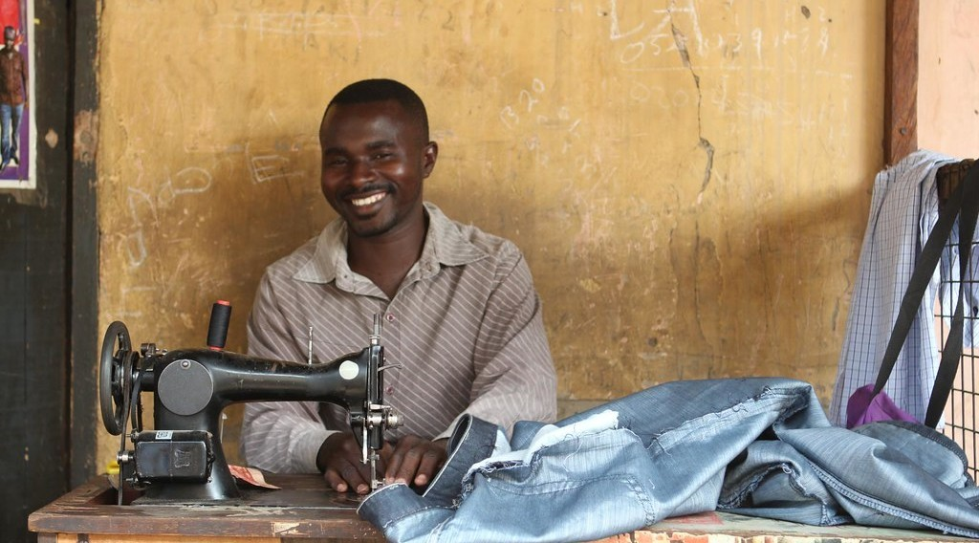
DEFINITIONS
Activity 1
A tailor at work.
Notes:
Activity 1. Look carefully at this picture: a tailor at work. Observe every detail before I ask the question.

Slide 20
DEFINITIONS
Activity 1: Question
The tailor makes a dress. Can we touch it? Is it a good or a service?
Notes:
Here is the question for Activity 1: The tailor makes a dress. Can we touch it? Is it a good or a service? Take one minute to think and write your answer in your rough notebook.

Slide 21
DEFINITIONS
Activity 1: Answer
Yes, we can touch it. It is a good.
Notes:
Let us check the answer together. Yes, we can touch it. It is a good.

Slide 22

DEFINITIONS
Activity 2
A health worker with a patient.
Notes:
Activity 2. Look carefully at this picture: a health worker with a patient. Observe every detail before I ask the question.

Slide 23
DEFINITIONS
Activity 2: Question
The doctor treats a patient. Is this a good or a service?
Notes:
Here is the question for Activity 2: The doctor treats a patient. Is this a good or a service? Take one minute to think and write your answer in your rough notebook.

Slide 24
DEFINITIONS
Activity 2: Answer
A service: work done for other people.
Notes:
Let us check the answer together. A service: work done for other people.

Slide 25
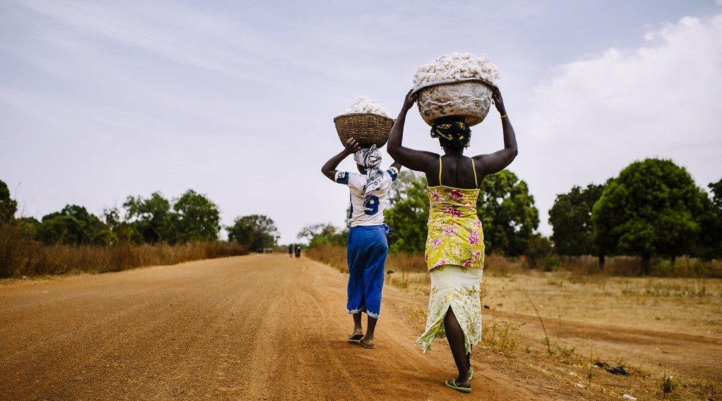
DEFINITIONS
Activity 3
Raw cotton after the harvest.
Notes:
Activity 3. Look carefully at this picture: raw cotton after the harvest. Observe every detail before I ask the question.

Slide 26
DEFINITIONS
Activity 3: Question
Cotton is used to make cloth. What do we call it?
Notes:
Here is the question for Activity 3: Cotton is used to make cloth. What do we call it? Take one minute to think and write your answer in your rough notebook.

Slide 27
DEFINITIONS
Activity 3: Answer
A raw material.
Notes:
Let us check the answer together. A raw material.

Slide 28
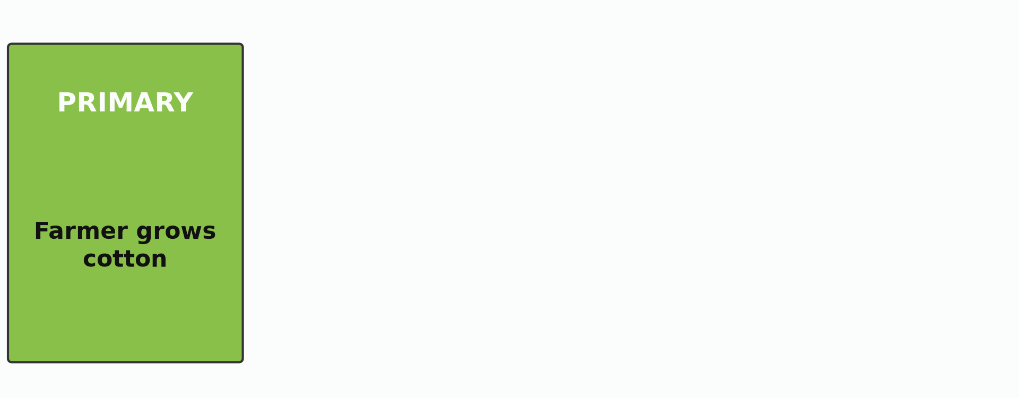
1. THE FOUR SECTORS
Activity 4
Animation: the journey of cotton.
Notes:
Activity 4. Look carefully at this animation: animation: the journey of cotton. Watch the animation to the end; it will play again.

Slide 29
1. THE FOUR SECTORS
Activity 4: Question
Name the four sectors in the order of the journey of cotton.
Notes:
Here is the question for Activity 4: Name the four sectors in the order of the journey of cotton. Take one minute to think and write your answer in your rough notebook.

Slide 30
1. THE FOUR SECTORS
Activity 4: Answer
Primary, secondary, tertiary and quaternary.
Notes:
Let us check the answer together. Primary, secondary, tertiary and quaternary.

Slide 31
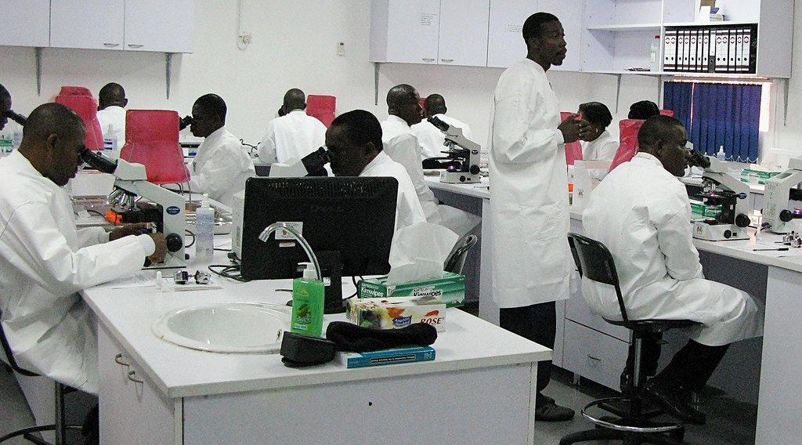
1. THE FOUR SECTORS
Activity 5
A scientist in a laboratory.
Notes:
Activity 5. Look carefully at this picture: a scientist in a laboratory. Observe every detail before I ask the question.

Slide 32
1. THE FOUR SECTORS
Activity 5: Question
Ahmadou's cousin looks for better seeds. In which sector does she work?
Notes:
Here is the question for Activity 5: Ahmadou's cousin looks for better seeds. In which sector does she work? Take one minute to think and write your answer in your rough notebook.

Slide 33
1. THE FOUR SECTORS
Activity 5: Answer
In the quaternary sector.
Notes:
Let us check the answer together. In the quaternary sector.

Slide 34
BOARD SUMMARY
Board Summary
Topic: Economic Activities
Sub-topic: Sectors of the Economy
Lesson 5 (Part 1): The Sectors of the Economy: Introduction, Definitions and Key Concepts
Notes:
Now we are going to copy the board summary. Write the title and the headings neatly in your notebooks. I will give you enough time for each slide, so do not rush.

Slide 35
BOARD SUMMARY
DEFINITIONS
The key terms of this lesson are defined as follows:
Economy: It is all the work people do to produce, sell and buy goods and services.
Goods: They are things we can touch, such as food and clothes.
Notes:
Let us copy the definitions. The key terms of this lesson are defined as follows. On this slide we have Economy and Goods. Write each point on a new line, with the key term first, and explain it in your own words when we revise. When you finish, we go to the next slide.

Slide 36
BOARD SUMMARY
DEFINITIONS (continued)
Services: They are work done for other people, such as teaching and transport.
Raw material: It is a natural product used to make goods, such as cotton.
Sector: It is a group of jobs of the same kind.
Notes:
We continue with the definitions. On this slide we have Services, Raw material and Sector. Write each point on a new line, with the key term first, and explain it in your own words when we revise.

Slide 37
BOARD SUMMARY
1. The Four Sectors of the Economy
The economy is divided into four sectors:
Primary sector: It takes products from nature, such as cotton from the farm.
Secondary sector: It turns raw materials into goods, such as cloth made from cotton.
Notes:
Let us copy The Four Sectors of the Economy. The economy is divided into four sectors. On this slide we have Primary sector and Secondary sector. Write each point on a new line, with the key term first, and explain it in your own words when we revise. When you finish, we go to the next slide.

Slide 38
BOARD SUMMARY
1. The Four Sectors of the Economy (continued)
Tertiary sector: It gives services, such as selling and transporting the cloth.
Quaternary sector: It creates knowledge, such as research on better cotton seeds.
Notes:
We continue with The Four Sectors of the Economy. On this slide we have Tertiary sector and Quaternary sector. Write each point on a new line, with the key term first, and explain it in your own words when we revise.

Slide 39
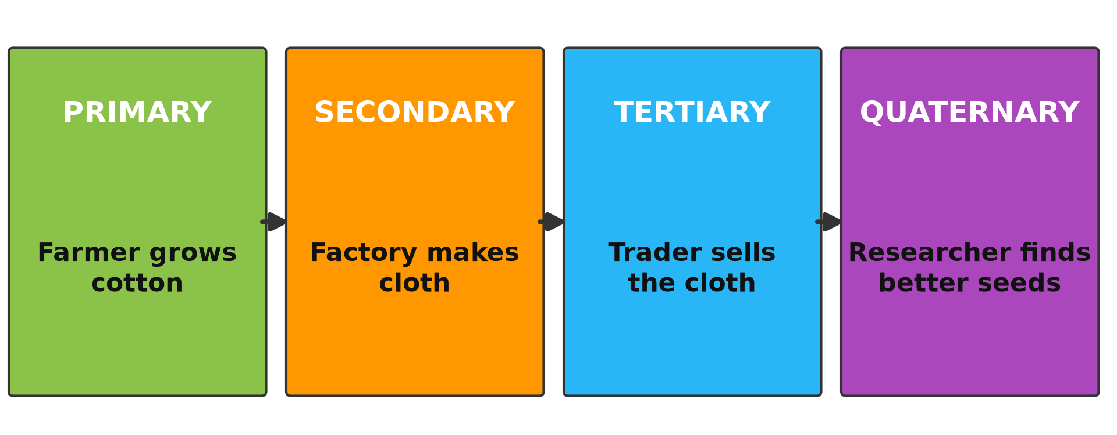
BOARD SUMMARY
1. The Four Sectors of the Economy
Illustration: the journey of cotton through the sectors
Notes:
Now draw this illustration in your notebook: the journey of cotton through the sectors. Give it a title and label it clearly.

Slide 40
FORMATIVE EVALUATION
Evaluation 1
What is the difference between a good and a service?
Notes:
Now let us check what you have understood. Question 1: What is the difference between a good and a service? Answer in your exercise book.

Slide 41
FORMATIVE EVALUATION
Expected Answer
A good can be touched; a service is work done for others.
Notes:
The expected answer is: a good can be touched; a service is work done for others. If you got it right, well done.

Slide 42
FORMATIVE EVALUATION
Evaluation 2
Name the four sectors of the economy.
Notes:
Now let us check what you have understood. Question 2: Name the four sectors of the economy. Answer in your exercise book.

Slide 43
FORMATIVE EVALUATION
Expected Answer
Primary, secondary, tertiary and quaternary.
Notes:
The expected answer is: primary, secondary, tertiary and quaternary. If you got it right, well done.

Slide 44
REMEDIATION
Remediation
Fill in the blanks:
Things that we can touch are ______.
A natural product used to make goods is a ______ material.
The sector that makes goods in factories is the ______ sector.
Notes:
For those who need more practice, fill in the blanks in your exercise book. The answers are: number 1, goods; number 2, raw; number 3, secondary.

Slide 45
HOMEWORK
Homework
Observe two workers in your area: one who works for a registered company and one who works alone in the street (for example a moto-taxi driver). Write one difference between them.
Notes:
For your homework: Observe two workers in your area: one who works for a registered company and one who works alone in the street (for example a moto-taxi driver). Write one difference between them. We shall correct it at the beginning of our next lesson.

Slide 46
NEXT LESSON
Next Lesson
Our next lesson will be on:
Lesson 5 (Part 2): The Sectors of the Economy: Formal and Informal Sectors of the Economy
Notes:
Our next lesson will be on Lesson 5 (Part 2): The Sectors of the Economy: Formal and Informal Sectors of the Economy. Thank you for your attention, and see you next time.

Slide 47
BILINGUAL GAME
Bilingual Game (Jeu Bilingue)
English | Français
Economy | L'économie
Goods | Les biens
Services | Les services
Raw material | La matière première
Primary sector | Le secteur primaire
Secondary sector | Le secteur secondaire
Tertiary sector | Le secteur tertiaire
Quaternary sector | Le secteur quaternaire
Notes:
Let us play the bilingual game. I say a word in English, and you give me the French word. Then we do the reverse.

Slide 48
LOGBOOK
Official Logbook (1/2)
Module / Topic | Economic Activities
Lesson Title | Lesson 5 (Part 1): The Sectors of the Economy: Introduction, Definitions and Key Concepts
Expected Learning Outcomes | Define economy, economic activity, goods and services. Define a sector of the economy. Name the four sectors of the economy and give an example of each.
Competence | Learners are able to classify the jobs of people around them into the four sectors of the economy.
Notes:
I record this information in the official logbook of the class after the lesson.

Slide 49
LOGBOOK
Official Logbook (2/2)
Matter Taught | DEFINITIONS; The Four Sectors of the Economy.
Evaluation | Formative evaluation and remediation exercise.
Homework | Observe two workers in your area: one who works for a registered company and one who works alone in the street (for example a moto-taxi driver). Write one difference between them.
Enrolment / Present / Absent | ____ / ____ / ____
Achievement | To be completed after the lesson.
Notes:
I complete the second page of the logbook: the matter taught, the evaluation, the homework and the attendance.

Slide 50
TEACHER'S NOTE
Teacher's Note
Timing: Homework correction, plan, objectives 8 min | Recall, situation, action 10 min | 5 activities 30 min | Board summary (copying) 30 min | Evaluation, remediation 10 min | Homework, next lesson 5 min | Logbook 7 min
CICAM (Cotonnière Industrielle du Cameroun) spins and weaves cotton in Garoua.
Activity 4 is an animation (GIF): it plays automatically in slide-show mode.
Without the projector (Activity 1): show a piece of cloth or a pen: things we can touch are goods.
Without the projector (Activity 2): ask learners to name people who give services in Garoua.
Without the projector (Activity 3): bring raw cotton and a piece of cloth.
Without the projector (Activity 4): draw four boxes on the board: farmer, factory, trader, researcher.
Notes:
Take your time to copy this part; we will continue together.

Slide 51
TEACHER'S NOTE
Teacher's Note (continued)
Without the projector (Activity 5): ask learners what a researcher does.
Notes:
This slide is for me, the teacher: it gives the timing of the lesson and what to do if the projector is not available.

Slide 52
REFERENCES
References
Harmonised Progression Sheet, Economic Geography (5051), Form 2.
Photo, Activity 1: “A tailor of Wa” by 10b travelling / Carsten ten Brink, CC BY-NC-ND 2.0, via Flickr (https://www.flickr.com/photos/77334245@N00/8154947468)
Photo, Activity 2: “Medical Readiness and Training Exercise 15-3” by US Army Africa, CC BY 2.0, via Flickr (https://www.flickr.com/photos/36281822@N08/16958932197)
Photo, Activity 3: “Women carrying cotton” by CIFOR, CC BY-NC-ND 2.0, via Flickr (https://www.flickr.com/photos/45423546@N07/35706852432)
Photo, Activity 5: “USAMRUK Malaria Diagnostics and Control Center of Excellence microscop” by US Army Africa, CC BY 2.0, via Flickr (https://www.flickr.com/photos/36281822@N08/4077018383)
Diagrams and animations: drawn for this lesson (Geography Department).
Notes:
These are the references and picture credits used to prepare this lesson.

