Slide 1
FORM 2 TECHNICAL
GEOGRAPHY
Lesson 5 (Part 6)
The Sectors of the Economy: The Quaternary Sector (Definition and Examples)
Notes:
Good morning, class, and welcome to our geography lesson. I am your geography teacher, Mr Kamdem. Today we are starting Lesson 5 (Part 6): The Sectors of the Economy: The Quaternary Sector (Definition and Examples).

Slide 2
CLASS INFO
Class, Chapter and Duration
Class | Form 2 Technical
Chapter | Economic Geography — Sectors of the Economy
Duration | 2 periods (2 × 50 minutes)
Notes:
This lesson is for Form 2 Technical. It belongs to Economic Geography — Sectors of the Economy. We shall need 2 periods to cover it.

Slide 3
IDENTIFICATION
Lesson Identification
Topic | Economic Activities
Sub-topic | Sectors of the Economy
Lesson | Lesson 5 (Part 6): The Sectors of the Economy: The Quaternary Sector (Definition and Examples)
Notions / Concepts | Quaternary sector, research, information and communication technology (ICT), knowledge economy.
Syllabus focus | Definition and examples of the quaternary sector.
Competence | Learners are able to explain how research and digital tools improve daily life and farming, and to use them responsibly.
Notes:
Our topic is Economic Activities, and the sub-topic is Sectors of the Economy. The key notions we shall use today are: quaternary sector, research, information and communication technology (ICT), knowledge economy. At the end, you should be able to do this: learners are able to explain how research and digital tools improve daily life and farming, and to use them responsibly.

Slide 4

HOMEWORK CORRECTION
Correction of the Homework
Question (Lesson 5 (Part 5): The Sectors of the Economy: The Tertiary Sector (Definition and Examples)):
Find out what a research centre does. Ask an adult or read about IRAD (Institute of Agricultural Research for Development).
Notes:
Before we start the new lesson, let us correct the homework I gave you at the end of Lesson 5 (Part 5): The Sectors of the Economy: The Tertiary Sector (Definition and Examples). The question was: Find out what a research centre does. Ask an adult or read about IRAD (Institute of Agricultural Research for Development). Take out your exercise books.

Slide 5
HOMEWORK CORRECTION
Correction: Possible Answer
IRAD carries out research to produce better seeds and animal breeds and gives advice to farmers; for example it has developed improved maize and sorghum varieties.
Notes:
Here is a good answer. IRAD carries out research to produce better seeds and animal breeds and gives advice to farmers; for example it has developed improved maize and sorghum varieties. Compare it with your own answer and correct your work in red.

Slide 6
LESSON PLAN
Lesson Plan
Correction of the homework
Objectives and recall
Real-life situation and action to take
Learning activities
Board summary
Evaluation, remediation and homework
Notes:
Here is the plan of our lesson today. First, we shall correct the homework. Then we shall look at the objectives and recall what you already know. After that, we shall study a situation from real life and the action to take, and do the learning activities. Finally, we shall copy the board summary, do the evaluation and the remediation, and I will give you the homework.

Slide 7
OBJECTIVES
Objectives
By the end of this lesson, you should be able to:
Define the quaternary sector.
Name the main quaternary activities.
Explain the importance of the quaternary sector for development.
Notes:
By the end of this lesson, you should be able to do three things. Number 1: define the quaternary sector. Number 2: name the main quaternary activities. Number 3: explain the importance of the quaternary sector for development.

Slide 8
PREVIOUS KNOWLEDGE
Previous Knowledge
The tertiary sector provides services: trade, transport, banking, social services and tourism.
Services link producers to consumers.
Notes:
Let us first remember what you already know. The tertiary sector provides services: trade, transport, banking, social services and tourism. Services link producers to consumers. Keep this in mind, because we shall build on it today.

Slide 9
REAL-LIFE SITUATION
Situation in Real Life
For many years, drought destroyed the maize of farmers near Garoua. Then researchers created a new maize that grows fast and needs less water. Now the harvests are better.
Notes:
Listen carefully to this situation from real life. For many years, drought destroyed the maize of farmers near Garoua. Then researchers created a new maize that grows fast and needs less water. Now the harvests are better. Think about it, because I am going to ask you some questions.

Slide 10
REAL-LIFE SITUATION
Situation: Question 1
What was the problem in the situation?
Notes:
Question 1: What was the problem in the situation? Think for a moment, then raise your hand to answer.

Slide 11
REAL-LIFE SITUATION
Answer
Drought destroyed the maize.
Notes:
Good. Drought destroyed the maize.

Slide 12
REAL-LIFE SITUATION
Situation: Question 2
Who solved the problem?
Notes:
Question 2: Who solved the problem? Think for a moment, then raise your hand to answer.

Slide 13
REAL-LIFE SITUATION
Answer
Researchers, with a new maize.
Notes:
Good. Researchers, with a new maize.

Slide 14
REAL-LIFE SITUATION
Situation: Question 3
Which sector do researchers belong to?
Notes:
Question 3: Which sector do researchers belong to? Think for a moment, then raise your hand to answer.

Slide 15
REAL-LIFE SITUATION
Possible Answer
The quaternary sector.
Notes:
Good. The quaternary sector.

Slide 16
ACTION TO TAKE
Action to Take
Study hard and use ICT to create new knowledge.
Notes:
From this situation, the action we are working towards in this lesson is the following: study hard and use ICT to create new knowledge.

Slide 17
JUSTIFICATION
Justification of the Lesson
This lesson helps us to know the jobs of knowledge and research.
Notes:
Why is this lesson important for you? This lesson helps us to know the jobs of knowledge and research.

Slide 18
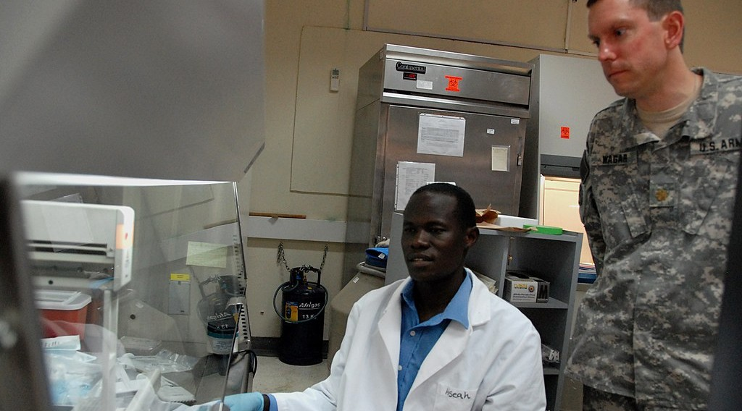
1. MEANING
Activity 1
Researchers at work.
Notes:
Activity 1. Look carefully at this picture: researchers at work. Observe every detail before I ask the question.

Slide 19
1. MEANING
Activity 1: Question
Researchers create new knowledge. Which sector is this?
Notes:
Here is the question for Activity 1: Researchers create new knowledge. Which sector is this? Take one minute to think and write your answer in your rough notebook.

Slide 20
1. MEANING
Activity 1: Answer
The quaternary sector.
Notes:
Let us check the answer together. The quaternary sector.

Slide 21

2. EXAMPLES
Activity 2
Researchers test new plants in a field.
Notes:
Activity 2. Look carefully at this picture: researchers test new plants in a field. Observe every detail before I ask the question.

Slide 22
2. EXAMPLES
Activity 2: Question
Give one research centre in Cameroon.
Notes:
Here is the question for Activity 2: Give one research centre in Cameroon. Take one minute to think and write your answer in your rough notebook.

Slide 23
2. EXAMPLES
Activity 2: Answer
IRAD (research for farming). Also the universities.
Notes:
Let us check the answer together. IRAD (research for farming). Also the universities.

Slide 24

2. EXAMPLES
Activity 3
A farmer uses a mobile phone.
Notes:
Activity 3. Look carefully at this picture: a farmer uses a mobile phone. Observe every detail before I ask the question.

Slide 25
2. EXAMPLES
Activity 3: Question
How does the phone help farmers and traders?
Notes:
Here is the question for Activity 3: How does the phone help farmers and traders? Take one minute to think and write your answer in your rough notebook.

Slide 26
2. EXAMPLES
Activity 3: Answer
They get prices and weather news, and send money.
Notes:
Let us check the answer together. They get prices and weather news, and send money.

Slide 27
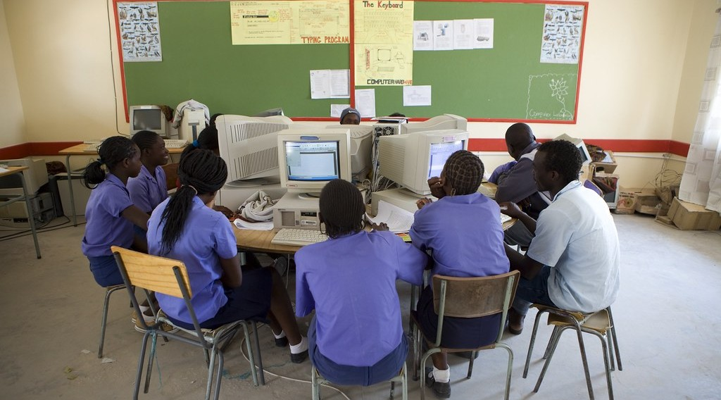
2. EXAMPLES
Activity 4
Students learn with computers.
Notes:
Activity 4. Look carefully at this picture: students learn with computers. Observe every detail before I ask the question.

Slide 28
2. EXAMPLES
Activity 4: Question
Name one job of information technology.
Notes:
Here is the question for Activity 4: Name one job of information technology. Take one minute to think and write your answer in your rough notebook.

Slide 29
2. EXAMPLES
Activity 4: Answer
Making software, websites or phone apps.
Notes:
Let us check the answer together. Making software, websites or phone apps.

Slide 30
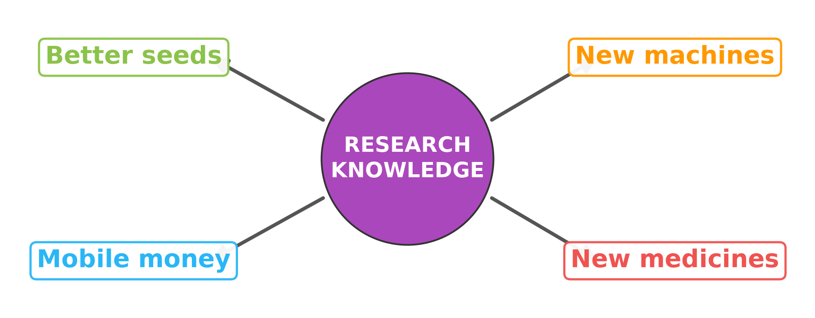
3. IMPORTANCE
Activity 5
Research helps all the other sectors.
Notes:
Activity 5. Look carefully at this diagram: research helps all the other sectors. Observe every detail before I ask the question.

Slide 31
3. IMPORTANCE
Activity 5: Question
How does research help the other sectors?
Notes:
Here is the question for Activity 5: How does research help the other sectors? Take one minute to think and write your answer in your rough notebook.

Slide 32
3. IMPORTANCE
Activity 5: Answer
Better seeds, new machines, new medicines and mobile money.
Notes:
Let us check the answer together. Better seeds, new machines, new medicines and mobile money.

Slide 33
BOARD SUMMARY
Board Summary
Topic: Economic Activities
Sub-topic: Sectors of the Economy
Lesson 5 (Part 6): The Sectors of the Economy: The Quaternary Sector (Definition and Examples)
Notes:
Now we are going to copy the board summary. Write the title and the headings neatly in your notebooks. I will give you enough time for each slide, so do not rush.

Slide 34
BOARD SUMMARY
1. Meaning of the Quaternary Sector
The quaternary sector is defined as follows:
Quaternary sector: It is the sector of knowledge, research and information.
ICT: It is information and communication technology: computers, phones and the internet.
Notes:
Let us copy Meaning of the Quaternary Sector. The quaternary sector is defined as follows. On this slide we have Quaternary sector and ICT. Write each point on a new line, with the key term first, and explain it in your own words when we revise.

Slide 35
BOARD SUMMARY
2. Examples of the Quaternary Sector
The quaternary sector includes the following activities:
Research: IRAD and the universities carry out research.
ICT: Specialists create software, websites and phone applications.
Notes:
Let us copy Examples of the Quaternary Sector. The quaternary sector includes the following activities. On this slide we have Research and ICT. Write each point on a new line, with the key term first, and explain it in your own words when we revise. When you finish, we go to the next slide.

Slide 36
BOARD SUMMARY
2. Examples of the Quaternary Sector (continued)
Advice: Experts give advice to the government and companies.
Notes:
We continue with Examples of the Quaternary Sector. On this slide we have Advice. Write each point on a new line, with the key term first, and explain it in your own words when we revise.

Slide 37
BOARD SUMMARY
3. Importance of the Quaternary Sector
The quaternary sector is important for the following reasons:
Farming: Research produces better seeds and methods.
Industry: New machines and techniques improve production.
Notes:
Let us copy Importance of the Quaternary Sector. The quaternary sector is important for the following reasons. On this slide we have Farming and Industry. Write each point on a new line, with the key term first, and explain it in your own words when we revise. When you finish, we go to the next slide.

Slide 38
BOARD SUMMARY
3. Importance of the Quaternary Sector (continued)
Services: It creates new services such as mobile money and new medicines.
Notes:
We continue with Importance of the Quaternary Sector. On this slide we have Services. Write each point on a new line, with the key term first, and explain it in your own words when we revise.

Slide 39
BOARD SUMMARY
3. Importance of the Quaternary Sector
Illustration: importance of the quaternary sector
Notes:
Now draw this illustration in your notebook: importance of the quaternary sector. Give it a title and label it clearly.

Slide 40
FORMATIVE EVALUATION
Evaluation 1
What is the quaternary sector?
Notes:
Now let us check what you have understood. Question 1: What is the quaternary sector? Answer in your exercise book.

Slide 41
FORMATIVE EVALUATION
Expected Answer
The sector of knowledge and research.
Notes:
The expected answer is: the sector of knowledge and research. If you got it right, well done.

Slide 42
FORMATIVE EVALUATION
Evaluation 2
Give one example of how research helps farmers.
Notes:
Now let us check what you have understood. Question 2: Give one example of how research helps farmers. Answer in your exercise book.

Slide 43
FORMATIVE EVALUATION
Expected Answer
It gives better seeds that resist drought.
Notes:
The expected answer is: it gives better seeds that resist drought. If you got it right, well done.

Slide 44
REMEDIATION
Remediation
Fill in the blanks:
The sector of knowledge and research is the ______ sector.
The research centre for farming in Cameroon is ______.
Notes:
Take your time to copy this part; we will continue together.

Slide 45
REMEDIATION
Remediation (continued)
Computers, phones and the internet are called ______.
Notes:
For those who need more practice, fill in the blanks in your exercise book. The answers are: number 1, quaternary; number 2, IRAD; number 3, ICT.

Slide 46
HOMEWORK
Homework
On a map of Africa in your atlas, find Cameroon and name the four oceans and seas that surround Africa.
Notes:
For your homework: On a map of Africa in your atlas, find Cameroon and name the four oceans and seas that surround Africa. We shall correct it at the beginning of our next lesson.

Slide 47
NEXT LESSON
Next Lesson
Our next lesson will be on:
Lesson 6 (Part 1): Africa: Introduction (Location and Physical Characteristics)
Notes:
Our next lesson will be on Lesson 6 (Part 1): Africa: Introduction (Location and Physical Characteristics). Thank you for your attention, and see you next time.

Slide 48
BILINGUAL GAME
Bilingual Game (Jeu Bilingue)
English | Français
Research | La recherche
Researcher | Le chercheur
Knowledge | La connaissance
Information | L'information
Software | Le logiciel
Internet | L'internet
Expert | L'expert
Innovation | L'innovation
Notes:
Let us play the bilingual game. I say a word in English, and you give me the French word. Then we do the reverse.

Slide 49
LOGBOOK
Official Logbook (1/2)
Module / Topic | Economic Activities
Lesson Title | Lesson 5 (Part 6): The Sectors of the Economy: The Quaternary Sector (Definition and Examples)
Expected Learning Outcomes | Define the quaternary sector. Name the main quaternary activities. Explain the importance of the quaternary sector for development.
Competence | Learners are able to explain how research and digital tools improve daily life and farming, and to use them responsibly.
Notes:
I record this information in the official logbook of the class after the lesson.

Slide 50
LOGBOOK
Official Logbook (2/2)
Matter Taught | Meaning of the Quaternary Sector; Examples of the Quaternary Sector; Importance of the Quaternary Sector.
Evaluation | Formative evaluation and remediation exercise.
Homework | On a map of Africa in your atlas, find Cameroon and name the four oceans and seas that surround Africa.
Enrolment / Present / Absent | ____ / ____ / ____
Achievement | To be completed after the lesson.
Notes:
I complete the second page of the logbook: the matter taught, the evaluation, the homework and the attendance.

Slide 51
TEACHER'S NOTE
Teacher's Note
Timing: Homework correction, plan, objectives 8 min | Recall, situation, action 10 min | 5 activities 30 min | Board summary (copying) 30 min | Evaluation, remediation 10 min | Homework, next lesson 5 min | Logbook 7 min
IRAD: Institut de Recherche Agricole pour le Développement, with a regional centre at Garoua.
Without the projector (Activity 1): use the situation of the new maize.
Without the projector (Activity 2): mention the IRAD station at Garoua.
Without the projector (Activity 3): ask learners how their parents use phones for work.
Without the projector (Activity 4): ask learners who uses a computer at home or at school.
Without the projector (Activity 5): draw a circle with four arrows on the board.
Notes:
This slide is for me, the teacher: it gives the timing of the lesson and what to do if the projector is not available.

Slide 52
REFERENCES
References
Harmonised Progression Sheet, Economic Geography (5051), Form 2.
IRAD: Institut de Recherche Agricole pour le Développement (Cameroon).
Photo, Activity 1: “U.S. Army research unit marks four decades in Kenya, Africa - USAMRU-K” by US Army Africa, CC BY 2.0, via Flickr (https://www.flickr.com/photos/36281822@N08/4074611177)
Photo, Activity 2: “CIMMYT international wheat nurseries growing in Ecuador” by CIMMYT, CC BY-NC-SA 2.0, via Flickr (https://www.flickr.com/photos/44760652@N05/5958068839)
Photo, Activity 3: “Using mobile technology to give feedback about the crop trials” by Bioversity International, CC BY-NC-ND 2.0, via Flickr (https://www.flickr.com/photos/50383637@N07/15019002626)
Photo, Activity 4: “The Oneputa Combined School goes from Grade 1 through to Grade 10” by World Bank Photo Collection, CC BY-NC-ND 2.0, via Flickr (https://www.flickr.com/photos/10816734@N03/5321464442)
Diagrams and animations: drawn for this lesson (Geography Department).
Notes:
These are the references and picture credits used to prepare this lesson.

