Slide 1
FORM 4
GEOGRAPHY
Lesson 1
Our Planet, the Earth: Size, Shape and Proofs
Notes:
Good morning, class, and welcome to our geography lesson. I am your geography teacher, Mr Kamdem. Today we are starting Lesson 1: Our Planet, the Earth: Size, Shape and Proofs.

Slide 2
CLASS INFO
Class, Chapter and Duration
Class | Form 4
Chapter | The Earth as a Planet in the Solar System — The Earth as a Planet of the Solar System
Duration | 50 minutes
Notes:
This lesson is for Form 4. It belongs to The Earth as a Planet in the Solar System — The Earth as a Planet of the Solar System. We shall need 50 minutes to cover it.

Slide 3
IDENTIFICATION
Lesson Identification
Topic | The Earth as a Planet in the Solar System
Sub-topic | The Earth as a Planet of the Solar System
Lesson | Lesson 1: Our Planet, the Earth: Size, Shape and Proofs
Notions / Concepts | Sphere, oblate spheroid, circumference, diameter, horizon.
Syllabus focus | Size of the Earth; shape of the Earth; proofs of the shape of the Earth.
Competence | Learners are able to explain, with everyday observations, why the Earth is round and to give its main measurements.
Notes:
Our topic is The Earth as a Planet in the Solar System, and the sub-topic is The Earth as a Planet of the Solar System. The key notions we shall use today are: sphere, oblate spheroid, circumference, diameter, horizon. At the end, you should be able to do this: learners are able to explain, with everyday observations, why the Earth is round and to give its main measurements.

Slide 4

LESSON PLAN
Lesson Plan
Objectives and recall
Real-life situation and action to take
Learning activities
Board summary
Evaluation, remediation and homework
Notes:
Here is the plan of our lesson today. First, we shall look at the objectives and recall what you already know. After that, we shall study a situation from real life and the action to take, and do the learning activities. Finally, we shall copy the board summary, do the evaluation and the remediation, and I will give you the homework.

Slide 5
OBJECTIVES
Objectives
By the end of this lesson, you should be able to:
Give the size of the Earth: its circumferences and diameters.
Describe the true shape of the Earth (an oblate spheroid).
Notes:
Take your time to copy this part; we will continue together.

Slide 6
OBJECTIVES
Objectives (continued)
Explain at least four proofs that the Earth is round.
Notes:
By the end of this lesson, you should be able to do three things. Number 1: give the size of the Earth: its circumferences and diameters. Number 2: describe the true shape of the Earth (an oblate spheroid). Number 3: explain at least four proofs that the Earth is round.

Slide 7
PREVIOUS KNOWLEDGE
Previous Knowledge
The Earth is one of the eight planets of the solar system.
The Earth moves around the Sun.
We live on the surface of the Earth, which is made of land and water.
Notes:
Let us first remember what you already know. The Earth is one of the eight planets of the solar system. The Earth moves around the Sun. We live on the surface of the Earth, which is made of land and water. Keep this in mind, because we shall build on it today.

Slide 8
REAL-LIFE SITUATION
Situation in Real Life
On a long, straight road, Aïcha sees a lorry coming from far away. First, she sees only the top of the lorry. Then she sees the whole lorry. Her brother says, "The Earth is flat."
Notes:
Listen carefully to this situation from real life. On a long, straight road, Aïcha sees a lorry coming from far away. First, she sees only the top of the lorry. Then she sees the whole lorry. Her brother says, "The Earth is flat." Think about it, because I am going to ask you some questions.

Slide 9
REAL-LIFE SITUATION
Situation: Question 1
What is the problem in the situation?
Notes:
Question 1: What is the problem in the situation? Think for a moment, then raise your hand to answer.

Slide 10
REAL-LIFE SITUATION
Answer
Aïcha cannot explain why she saw the top of the lorry first.
Notes:
Good. Aïcha cannot explain why she saw the top of the lorry first.

Slide 11
REAL-LIFE SITUATION
Situation: Question 2
Which part of the lorry did she see first?
Notes:
Question 2: Which part of the lorry did she see first? Think for a moment, then raise your hand to answer.

Slide 12
REAL-LIFE SITUATION
Answer
She saw the top of the lorry first.
Notes:
Good. She saw the top of the lorry first.

Slide 13
REAL-LIFE SITUATION
Situation: Question 3
How can she show her brother that the Earth is round?
Notes:
Question 3: How can she show her brother that the Earth is round? Think for a moment, then raise your hand to answer.

Slide 14
REAL-LIFE SITUATION
Possible Answer
She can show him a globe and photos of the Earth from space.
Notes:
Good. She can show him a globe and photos of the Earth from space.

Slide 15
ACTION TO TAKE
Action to Take
Use everyday observations to show that the Earth is round.
Notes:
From this situation, the action we are working towards in this lesson is the following: use everyday observations to show that the Earth is round.

Slide 16
JUSTIFICATION
Justification of the Lesson
This lesson helps us to know the size and the shape of our planet.
Notes:
Why is this lesson important for you? This lesson helps us to know the size and the shape of our planet.

Slide 17

2. SHAPE OF THE EARTH
Activity 1
The Earth seen from space.
Notes:
Activity 1. Look carefully at this picture: the Earth seen from space. Observe every detail before I ask the question.

Slide 18
2. SHAPE OF THE EARTH
Activity 1: Question
Look at the photo. What is the shape of the Earth?
Notes:
Here is the question for Activity 1: Look at the photo. What is the shape of the Earth? Take one minute to think and write your answer in your rough notebook.

Slide 19
2. SHAPE OF THE EARTH
Activity 1: Answer
The Earth is round, like a ball.
Notes:
Let us check the answer together. The Earth is round, like a ball.

Slide 20
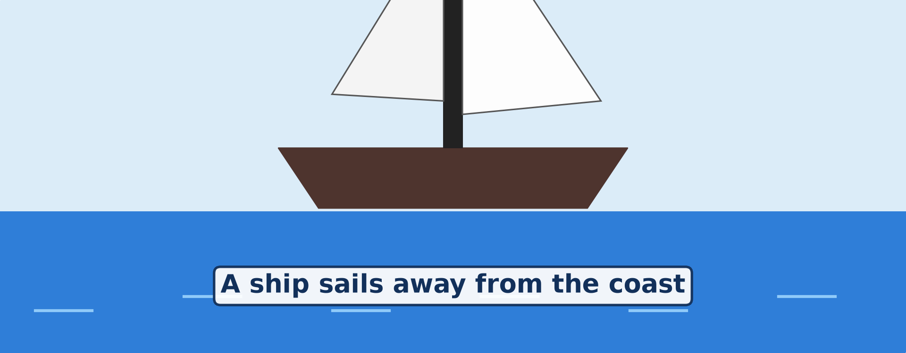
3. PROOFS OF THE SHAPE
Activity 2
Animation: a ship sails away from the coast.
Notes:
Activity 2. Look carefully at this animation: animation: a ship sails away from the coast. Watch the animation to the end; it will play again.

Slide 21
3. PROOFS OF THE SHAPE
Activity 2: Question
Which part of the ship disappears first? Why?
Notes:
Here is the question for Activity 2: Which part of the ship disappears first? Why? Take one minute to think and write your answer in your rough notebook.

Slide 22
3. PROOFS OF THE SHAPE
Activity 2: Answer
The bottom of the ship disappears first, because the ship goes over the curve of the Earth.
Notes:
Let us check the answer together. The bottom of the ship disappears first, because the ship goes over the curve of the Earth.

Slide 23
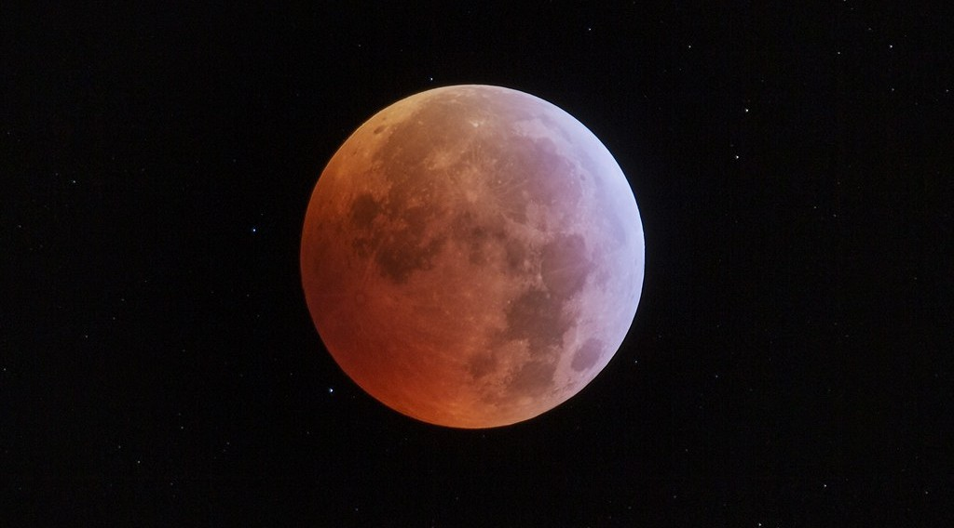
3. PROOFS OF THE SHAPE
Activity 3
An eclipse of the Moon: the Moon is inside the shadow of the Earth.
Notes:
Activity 3. Look carefully at this picture: an eclipse of the Moon: the Moon is inside the shadow of the Earth. Observe every detail before I ask the question.

Slide 24
3. PROOFS OF THE SHAPE
Activity 3: Question
During an eclipse, the edge of the shadow of the Earth on the Moon is always curved. What does this prove?
Notes:
Here is the question for Activity 3: During an eclipse, the edge of the shadow of the Earth on the Moon is always curved. What does this prove? Take one minute to think and write your answer in your rough notebook.

Slide 25
3. PROOFS OF THE SHAPE
Activity 3: Answer
The Earth is round. Only a round object gives a round shadow.
Notes:
Let us check the answer together. The Earth is round. Only a round object gives a round shadow.

Slide 26
BOARD SUMMARY
Board Summary
Topic: The Earth as a Planet in the Solar System
Sub-topic: The Earth as a Planet of the Solar System
Lesson 1: Our Planet, the Earth: Size, Shape and Proofs
Notes:
Now we are going to copy the board summary. Write the title and the headings neatly in your notebooks. I will give you enough time for each slide, so do not rush.

Slide 27
BOARD SUMMARY
DEFINITIONS
The key terms of this lesson are defined as follows:
Planet: It is a large body that moves around the Sun.
Oblate spheroid: It is a ball that is flat at the poles and wider at the Equator.
Notes:
Let us copy the definitions. The key terms of this lesson are defined as follows. On this slide we have Planet and Oblate spheroid. Write each point on a new line, with the key term first, and explain it in your own words when we revise.

Slide 28
BOARD SUMMARY
1. Size of the Earth
The main measurements of the Earth are the following:
Equatorial circumference: It is the distance around the Equator, which is about 40,075 km.
Notes:
Let us copy Size of the Earth. The main measurements of the Earth are the following. On this slide we have Equatorial circumference. Write each point on a new line, with the key term first, and explain it in your own words when we revise. When you finish, we go to the next slide.

Slide 29
BOARD SUMMARY
1. Size of the Earth (continued)
Polar circumference: It is the distance around the Earth through the poles, which is about 40,008 km.
Equatorial diameter: It is the distance through the centre of the Earth at the Equator, which is about 12,756 km.
Notes:
We continue with Size of the Earth. On this slide we have Polar circumference and Equatorial diameter. Write each point on a new line, with the key term first, and explain it in your own words when we revise.

Slide 30
BOARD SUMMARY
2. Shape of the Earth
The true shape of the Earth is described as follows:
Oblate spheroid: The Earth is round, slightly flattened at the poles and bulging at the Equator.
Notes:
Let us copy Shape of the Earth. The true shape of the Earth is described as follows. On this slide we have Oblate spheroid. Write each point on a new line, with the key term first, and explain it in your own words when we revise.

Slide 31
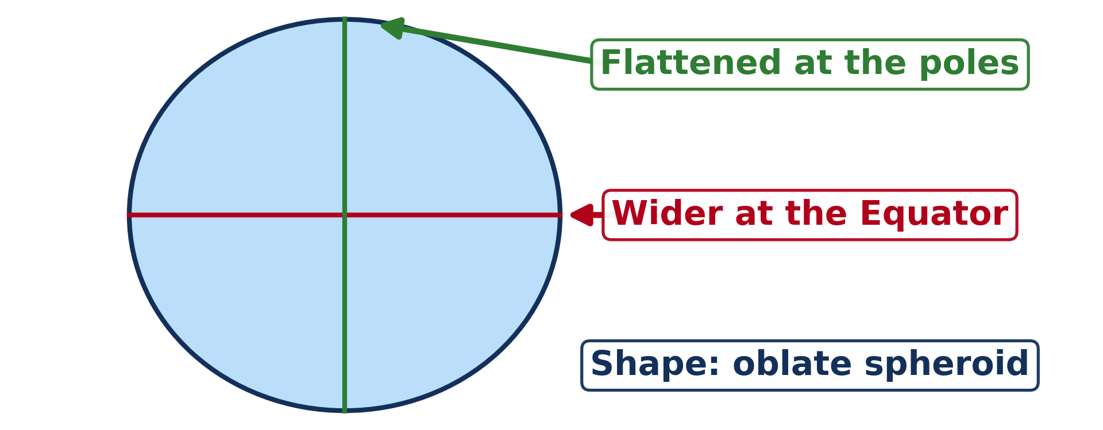
BOARD SUMMARY
2. Shape of the Earth
Illustration: the shape of the Earth
Notes:
Now draw this illustration in your notebook: the shape of the Earth. Give it a title and label it clearly.

Slide 32
BOARD SUMMARY
3. Proofs of the Shape of the Earth
The following observations prove that the Earth is round:
The ship at sea: When a ship sails away, its bottom disappears first and its top last.
The eclipse of the Moon: The shadow of the Earth on the Moon is always curved.
Notes:
Let us copy Proofs of the Shape of the Earth. The following observations prove that the Earth is round. On this slide we have The ship at sea and The eclipse of the Moon. Write each point on a new line, with the key term first, and explain it in your own words when we revise. When you finish, we go to the next slide.

Slide 33
BOARD SUMMARY
3. Proofs of the Shape of the Earth (continued)
Photos from space: Photos taken from space show that the Earth is round.
Travel around the world: A traveller who goes always in one direction comes back to the starting point.
Notes:
We continue with Proofs of the Shape of the Earth. On this slide we have Photos from space and Travel around the world. Write each point on a new line, with the key term first, and explain it in your own words when we revise.

Slide 34
FORMATIVE EVALUATION
Evaluation 1
What is the shape of the Earth?
Notes:
Now let us check what you have understood. Question 1: What is the shape of the Earth? Answer in your exercise book.

Slide 35
FORMATIVE EVALUATION
Expected Answer
It is an oblate spheroid.
Notes:
The expected answer is: it is an oblate spheroid. If you got it right, well done.

Slide 36
FORMATIVE EVALUATION
Evaluation 2
Give two proofs that the Earth is round.
Notes:
Now let us check what you have understood. Question 2: Give two proofs that the Earth is round. Answer in your exercise book.

Slide 37
FORMATIVE EVALUATION
Expected Answer
The ship at sea and the round shadow of the Earth on the Moon.
Notes:
The expected answer is: the ship at sea and the round shadow of the Earth on the Moon. If you got it right, well done.

Slide 38
REMEDIATION
Remediation
Fill in the blanks:
The Earth is flat at the ______.
The Earth is wider at the ______.
The shadow of the Earth on the Moon is ______.
Notes:
For those who need more practice, fill in the blanks in your exercise book. The answers are: number 1, poles; number 2, Equator; number 3, round.

Slide 39
HOMEWORK
Homework
Look at the Moon on three different evenings this week. Draw its shape each time and write the date under each drawing.
Notes:
For your homework: Look at the Moon on three different evenings this week. Draw its shape each time and write the date under each drawing. We shall correct it at the beginning of our next lesson.

Slide 40
NEXT LESSON
Next Lesson
Our next lesson will be on:
Further Study 1: The Universe and the Moon
Notes:
Our next lesson will be on Further Study 1: The Universe and the Moon. Thank you for your attention, and see you next time.

Slide 41
BILINGUAL GAME
Bilingual Game (Jeu Bilingue)
English | Français
Planet | La planète
Shape | La forme
Size | La taille
Sphere | La sphère
Circumference | La circonférence
Diameter | Le diamètre
Horizon | L'horizon
Proof | La preuve
Notes:
Let us play the bilingual game. I say a word in English, and you give me the French word. Then we do the reverse.

Slide 42
LOGBOOK
Official Logbook (1/2)
Module / Topic | The Earth as a Planet in the Solar System
Lesson Title | Lesson 1: Our Planet, the Earth: Size, Shape and Proofs
Expected Learning Outcomes | Give the size of the Earth: its circumferences and diameters. Describe the true shape of the Earth (an oblate spheroid). Explain at least four proofs that the Earth is round.
Competence | Learners are able to explain, with everyday observations, why the Earth is round and to give its main measurements.
Notes:
I record this information in the official logbook of the class after the lesson.

Slide 43
LOGBOOK
Official Logbook (2/2)
Matter Taught | DEFINITIONS; Size of the Earth; Shape of the Earth; Proofs of the Shape of the Earth.
Evaluation | Formative evaluation and remediation exercise.
Homework | Look at the Moon on three different evenings this week. Draw its shape each time and write the date under each drawing.
Enrolment / Present / Absent | ____ / ____ / ____
Achievement | To be completed after the lesson.
Notes:
I complete the second page of the logbook: the matter taught, the evaluation, the homework and the attendance.

Slide 44
TEACHER'S NOTE
Teacher's Note
Timing: Homework correction, plan, objectives 4 min | Recall, situation, action 6 min | 3 activities 12 min | Board summary (copying) 15 min | Evaluation, remediation 5 min | Homework, next lesson 3 min | Logbook 5 min
Figures: equatorial circumference 40,075 km; polar 40,008 km; equatorial diameter 12,756 km; polar 12,714 km.
Activity 2 is an animation (GIF): it plays automatically in slide-show mode.
Without the projector (Activity 1): show a globe or a ball.
Without the projector (Activity 2): draw three ships going down behind a curved line and ask the question.
Without the projector (Activity 3): hold a ball in front of a torch: its shadow on the wall is round.
Notes:
This slide is for me, the teacher: it gives the timing of the lesson and what to do if the projector is not available.

Slide 45
REFERENCES
References
National Geography Syllabus (MINESEC), Form 4 — The Earth as a Planet in the Solar System.
Teacher's lesson notes (Form 4), checked and corrected where necessary.
Photo, Activity 1: “Blue Marble, Eastern Hemisphere March 2014” by NASA Goddard Photo and Video, CC BY 2.0, via nasa (https://www.flickr.com/photos/24662369@N07/14990033062)
Photo, Activity 3: “Medio de la totalidad eclipse Luna 21 enero 2019” by StarryEarth, CC BY-NC 2.0, via Flickr (https://www.flickr.com/photos/65131760@N06/46777562672)
Diagrams and animations: drawn for this lesson (Geography Department).
Notes:
These are the references and picture credits used to prepare this lesson.

