Slide 1
FORM 4
GEOGRAPHY
Further Study 1
The Universe and the Moon
Notes:
Good morning, class, and welcome to our geography lesson. I am your geography teacher, Mr Kamdem. Today we are starting Further Study 1: The Universe and the Moon.

Slide 2
CLASS INFO
Class, Chapter and Duration
Class | Form 4
Chapter | The Earth as a Planet in the Solar System — The Earth as a Planet of the Solar System
Duration | 50 minutes
Notes:
This lesson is for Form 4. It belongs to The Earth as a Planet in the Solar System — The Earth as a Planet of the Solar System. We shall need 50 minutes to cover it.

Slide 3
IDENTIFICATION
Lesson Identification
Topic | The Earth as a Planet in the Solar System
Sub-topic | The Earth as a Planet of the Solar System
Lesson | Further Study 1: The Universe and the Moon
Notions / Concepts | Universe, galaxy, star, satellite, phases of the Moon, tides.
Syllabus focus | Meaning and composition of the universe; links with planet Earth; the Moon: phases and impacts on the natural environment and on human activities.
Competence | Learners are able to recognise the phases of the Moon and to explain how the Moon affects tides, calendars and daily activities.
Notes:
Our topic is The Earth as a Planet in the Solar System, and the sub-topic is The Earth as a Planet of the Solar System. The key notions we shall use today are: universe, galaxy, star, satellite, phases of the Moon, tides. At the end, you should be able to do this: learners are able to recognise the phases of the Moon and to explain how the Moon affects tides, calendars and daily activities.

Slide 4

HOMEWORK CORRECTION
Correction of the Homework
Question (Lesson 1: Our Planet, the Earth: Size, Shape and Proofs):
Look at the Moon on three different evenings this week. Draw its shape each time and write the date under each drawing.
Notes:
Before we start the new lesson, let us correct the homework I gave you at the end of Lesson 1: Our Planet, the Earth: Size, Shape and Proofs. The question was: Look at the Moon on three different evenings this week. Draw its shape each time and write the date under each drawing. Take out your exercise books.

Slide 5
HOMEWORK CORRECTION
Correction: Possible Answer
The drawings should show the Moon changing shape: for example a thin crescent, then a half Moon, then a nearly full Moon, each with its date.
Notes:
Here is a good answer. The drawings should show the Moon changing shape: for example a thin crescent, then a half Moon, then a nearly full Moon, each with its date. Compare it with your own answer and correct your work in red.

Slide 6
LESSON PLAN
Lesson Plan
Correction of the homework
Objectives and recall
Real-life situation and action to take
Learning activities
Board summary
Evaluation, remediation and homework
Notes:
Here is the plan of our lesson today. First, we shall correct the homework. Then we shall look at the objectives and recall what you already know. After that, we shall study a situation from real life and the action to take, and do the learning activities. Finally, we shall copy the board summary, do the evaluation and the remediation, and I will give you the homework.

Slide 7
OBJECTIVES
Objectives
By the end of this lesson, you should be able to:
Define the universe and a galaxy, and describe the place of the Earth in the universe.
Describe the phases of the Moon.
Notes:
Take your time to copy this part; we will continue together.

Slide 8
OBJECTIVES
Objectives (continued)
Explain the impacts of the Moon on the natural environment and on human activities.
Notes:
By the end of this lesson, you should be able to do three things. Number 1: define the universe and a galaxy, and describe the place of the Earth in the universe. Number 2: describe the phases of the Moon. Number 3: explain the impacts of the Moon on the natural environment and on human activities.

Slide 9
PREVIOUS KNOWLEDGE
Previous Knowledge
The Earth is an oblate spheroid.
Many proofs show that the Earth is round, such as the round shadow of the Earth on the Moon.
The Earth is one of the eight planets that move around the Sun.
Notes:
Let us first remember what you already know. The Earth is an oblate spheroid. Many proofs show that the Earth is round, such as the round shadow of the Earth on the Moon. The Earth is one of the eight planets that move around the Sun. Keep this in mind, because we shall build on it today.

Slide 10
REAL-LIFE SITUATION
Situation in Real Life
One evening, Hawaou sits outside with her grandmother. The full Moon lights up the compound. Grandmother says that people used to plant some crops according to the shape of the Moon. Hawaou wonders why the Moon changes its shape.
Notes:
Listen carefully to this situation from real life. One evening, Hawaou sits outside with her grandmother. The full Moon lights up the compound. Grandmother says that people used to plant some crops according to the shape of the Moon. Hawaou wonders why the Moon changes its shape. Think about it, because I am going to ask you some questions.

Slide 11
REAL-LIFE SITUATION
Situation: Question 1
What is the problem in the situation?
Notes:
Question 1: What is the problem in the situation? Think for a moment, then raise your hand to answer.

Slide 12
REAL-LIFE SITUATION
Answer
Hawaou does not know why the Moon changes its shape.
Notes:
Good. Hawaou does not know why the Moon changes its shape.

Slide 13
REAL-LIFE SITUATION
Situation: Question 2
What lights up the compound?
Notes:
Question 2: What lights up the compound? Think for a moment, then raise your hand to answer.

Slide 14
REAL-LIFE SITUATION
Answer
The full Moon.
Notes:
Good. The full Moon.

Slide 15
REAL-LIFE SITUATION
Situation: Question 3
Where does the light of the Moon come from?
Notes:
Question 3: Where does the light of the Moon come from? Think for a moment, then raise your hand to answer.

Slide 16
REAL-LIFE SITUATION
Possible Answer
From the Sun. The Moon has no light of its own.
Notes:
Good. From the Sun. The Moon has no light of its own.

Slide 17
ACTION TO TAKE
Action to Take
Observe the sky and the Moon regularly and use the tides and the phases safely.
Notes:
From this situation, the action we are working towards in this lesson is the following: observe the sky and the Moon regularly and use the tides and the phases safely.

Slide 18
JUSTIFICATION
Justification of the Lesson
This lesson helps us to know the universe, the Moon and its effects on our life.
Notes:
Why is this lesson important for you? This lesson helps us to know the universe, the Moon and its effects on our life.

Slide 19
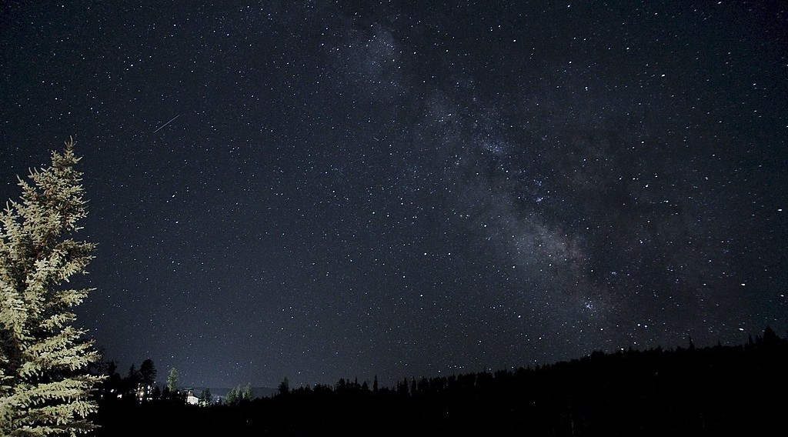
1. THE UNIVERSE
Activity 1
The Milky Way at night.
Notes:
Activity 1. Look carefully at this picture: the Milky Way at night. Observe every detail before I ask the question.

Slide 20
1. THE UNIVERSE
Activity 1: Question
This band of light is made of billions of stars. What is it called?
Notes:
Here is the question for Activity 1: This band of light is made of billions of stars. What is it called? Take one minute to think and write your answer in your rough notebook.

Slide 21
1. THE UNIVERSE
Activity 1: Answer
The Milky Way, our galaxy.
Notes:
Let us check the answer together. The Milky Way, our galaxy.

Slide 22
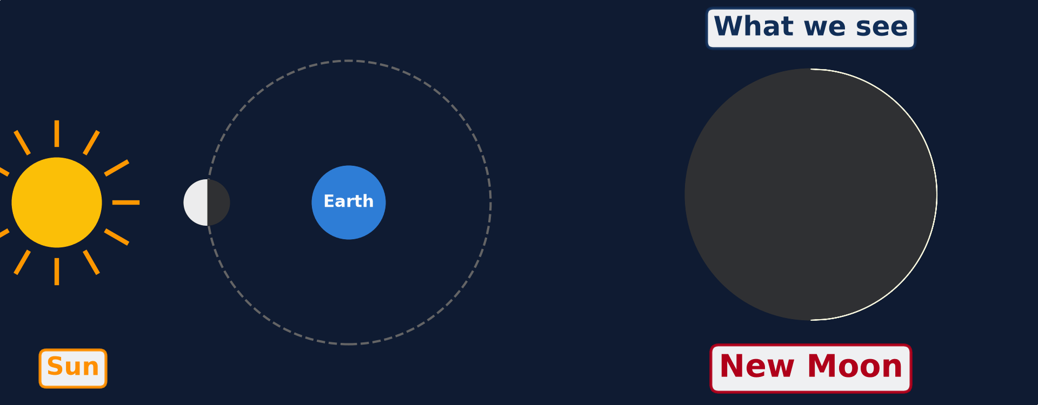
2. THE PHASES OF THE MOON
Activity 2
Animation: the Moon moves around the Earth.
Notes:
Activity 2. Look carefully at this animation: animation: the Moon moves around the Earth. Watch the animation to the end; it will play again.

Slide 23
2. THE PHASES OF THE MOON
Activity 2: Question
Why does the shape of the Moon seem to change?
Notes:
Here is the question for Activity 2: Why does the shape of the Moon seem to change? Take one minute to think and write your answer in your rough notebook.

Slide 24
2. THE PHASES OF THE MOON
Activity 2: Answer
The Sun lights half of the Moon. We see a different part of this lit half as the Moon moves.
Notes:
Let us check the answer together. The Sun lights half of the Moon. We see a different part of this lit half as the Moon moves.

Slide 25
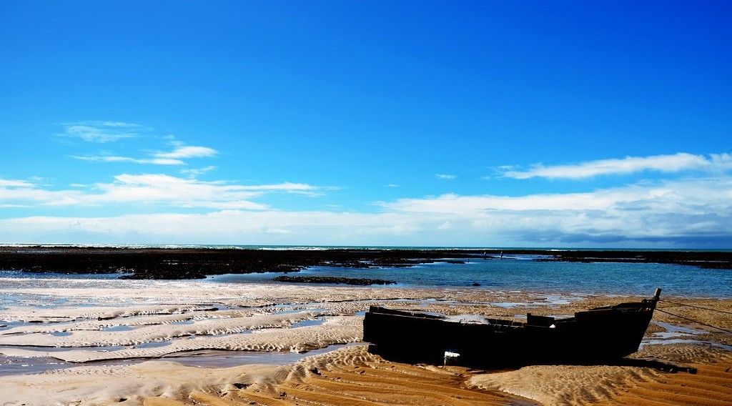
3. IMPACTS OF THE MOON
Activity 3
Boats on the sand when the sea is low.
Notes:
Activity 3. Look carefully at this picture: boats on the sand when the sea is low. Observe every detail before I ask the question.

Slide 26
3. IMPACTS OF THE MOON
Activity 3: Question
The sea goes down and comes back twice a day. What causes this?
Notes:
Here is the question for Activity 3: The sea goes down and comes back twice a day. What causes this? Take one minute to think and write your answer in your rough notebook.

Slide 27
3. IMPACTS OF THE MOON
Activity 3: Answer
The pull (gravity) of the Moon. This is the tide.
Notes:
Let us check the answer together. The pull (gravity) of the Moon. This is the tide.

Slide 28
BOARD SUMMARY
Board Summary
Topic: The Earth as a Planet in the Solar System
Sub-topic: The Earth as a Planet of the Solar System
Further Study 1: The Universe and the Moon
Notes:
Now we are going to copy the board summary. Write the title and the headings neatly in your notebooks. I will give you enough time for each slide, so do not rush.

Slide 29
BOARD SUMMARY
1. The Universe
A) Meaning
The universe can be defined as follows:
Universe: It is all of space and everything in it: stars, planets, gases and dust.
Notes:
Let us copy Meaning. The universe can be defined as follows. On this slide we have Universe. Write each point on a new line, with the key term first, and explain it in your own words when we revise.

Slide 30
BOARD SUMMARY
1. The Universe
B) Composition
The universe is made up of the following elements:
Galaxies: They are huge groups of stars, and our galaxy is called the Milky Way.
The Sun: It is the star of our solar system and it gives light and heat to the Earth.
Notes:
Let us copy Composition. The universe is made up of the following elements. On this slide we have Galaxies and The Sun. Write each point on a new line, with the key term first, and explain it in your own words when we revise. When you finish, we go to the next slide.

Slide 31
BOARD SUMMARY
1. The Universe
B) Composition (continued)
The Moon: It is the natural satellite of the Earth, and it moves around the Earth in about 29½ days.
Notes:
We continue with Composition. On this slide we have The Moon. Write each point on a new line, with the key term first, and explain it in your own words when we revise.

Slide 32
BOARD SUMMARY
2. The Phases of the Moon
The Moon shows the following phases during a month:
New Moon: The lit side of the Moon faces away from the Earth, so we do not see it.
First quarter: We see the right half of the Moon lit by the Sun.
Notes:
Let us copy The Phases of the Moon. The Moon shows the following phases during a month. On this slide we have New Moon and First quarter. Write each point on a new line, with the key term first, and explain it in your own words when we revise. When you finish, we go to the next slide.

Slide 33
BOARD SUMMARY
2. The Phases of the Moon (continued)
Full Moon: We see the whole lit face of the Moon.
Last quarter: We see the left half of the Moon lit by the Sun.
Notes:
We continue with The Phases of the Moon. On this slide we have Full Moon and Last quarter. Write each point on a new line, with the key term first, and explain it in your own words when we revise.

Slide 34
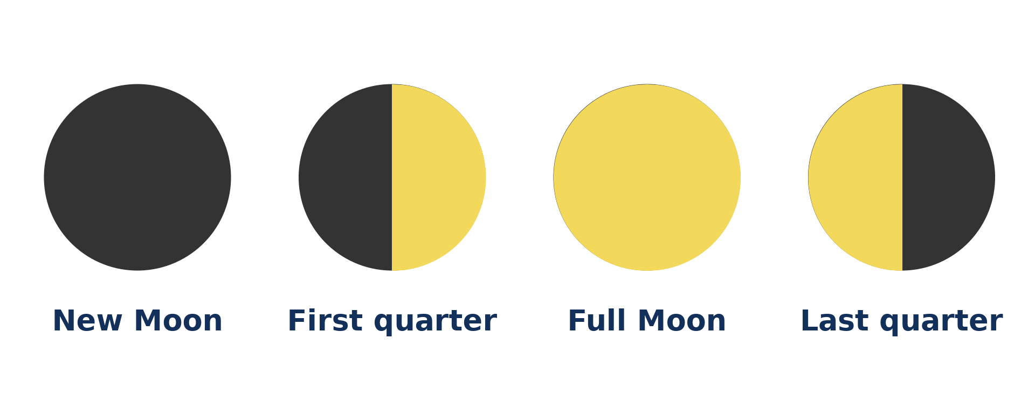
BOARD SUMMARY
2. The Phases of the Moon
Illustration: the phases of the Moon
Notes:
Now draw this illustration in your notebook: the phases of the Moon. Give it a title and label it clearly.

Slide 35
BOARD SUMMARY
3. Impacts of the Moon
The Moon affects the environment and human activities as follows:
Tides: The pull of the Moon makes the sea rise and fall twice a day.
Fishing and navigation: Fishermen and sailors use the times of the tides to go out and come back.
Notes:
Let us copy Impacts of the Moon. The Moon affects the environment and human activities as follows. On this slide we have Tides and Fishing and navigation. Write each point on a new line, with the key term first, and explain it in your own words when we revise. When you finish, we go to the next slide.

Slide 36
BOARD SUMMARY
3. Impacts of the Moon (continued)
Calendar and culture: Some calendars and feasts, such as Ramadan, follow the phases of the Moon.
Notes:
We continue with Impacts of the Moon. On this slide we have Calendar and culture. Write each point on a new line, with the key term first, and explain it in your own words when we revise.

Slide 37
FORMATIVE EVALUATION
Evaluation 1
What is a galaxy? Name our galaxy.
Notes:
Now let us check what you have understood. Question 1: What is a galaxy? Name our galaxy. Answer in your exercise book.

Slide 38
FORMATIVE EVALUATION
Expected Answer
A huge group of stars. Ours is the Milky Way.
Notes:
The expected answer is: a huge group of stars. Ours is the Milky Way. If you got it right, well done.

Slide 39
FORMATIVE EVALUATION
Evaluation 2
What causes the tides?
Notes:
Now let us check what you have understood. Question 2: What causes the tides? Answer in your exercise book.

Slide 40
FORMATIVE EVALUATION
Expected Answer
The pull (gravity) of the Moon.
Notes:
The expected answer is: the pull (gravity) of the Moon. If you got it right, well done.

Slide 41
REMEDIATION
Remediation
Fill in the blanks:
Our galaxy is called the ______ Way.
When we see the whole Moon, it is the ______ Moon.
The rise and fall of the sea are called ______.
Notes:
For those who need more practice, fill in the blanks in your exercise book. The answers are: number 1, Milky; number 2, Full; number 3, tides.

Slide 42
HOMEWORK
Homework
Look at a map of Cameroon in your atlas. Find the numbers written on the edges of the map and copy the numbers written near Garoua.
Notes:
For your homework: Look at a map of Cameroon in your atlas. Find the numbers written on the edges of the map and copy the numbers written near Garoua. We shall correct it at the beginning of our next lesson.

Slide 43
NEXT LESSON
Next Lesson
Our next lesson will be on:
Lesson 2: Earth Divisions: Latitudes and Longitudes
Notes:
Our next lesson will be on Lesson 2: Earth Divisions: Latitudes and Longitudes. Thank you for your attention, and see you next time.

Slide 44
BILINGUAL GAME
Bilingual Game (Jeu Bilingue)
English | Français
Universe | L'univers
Galaxy | La galaxie
Star | L'étoile
Satellite | Le satellite
Full Moon | La pleine lune
New Moon | La nouvelle lune
Tide | La marée
Gravity | La gravité
Notes:
Let us play the bilingual game. I say a word in English, and you give me the French word. Then we do the reverse.

Slide 45
LOGBOOK
Official Logbook (1/2)
Module / Topic | The Earth as a Planet in the Solar System
Lesson Title | Further Study 1: The Universe and the Moon
Expected Learning Outcomes | Define the universe and a galaxy, and describe the place of the Earth in the universe. Describe the phases of the Moon. Explain the impacts of the Moon on the natural environment and on human activities.
Competence | Learners are able to recognise the phases of the Moon and to explain how the Moon affects tides, calendars and daily activities.
Notes:
I record this information in the official logbook of the class after the lesson.

Slide 46
LOGBOOK
Official Logbook (2/2)
Matter Taught | Meaning; Composition; The Phases of the Moon; Impacts of the Moon.
Evaluation | Formative evaluation and remediation exercise.
Homework | Look at a map of Cameroon in your atlas. Find the numbers written on the edges of the map and copy the numbers written near Garoua.
Enrolment / Present / Absent | ____ / ____ / ____
Achievement | To be completed after the lesson.
Notes:
I complete the second page of the logbook: the matter taught, the evaluation, the homework and the attendance.

Slide 47
TEACHER'S NOTE
Teacher's Note
Timing: Homework correction, plan, objectives 4 min | Recall, situation, action 6 min | 3 activities 12 min | Board summary (copying) 15 min | Evaluation, remediation 5 min | Homework, next lesson 3 min | Logbook 5 min
Activity 2 is an animation (GIF): it plays automatically in slide-show mode.
Without the projector (Activity 1): ask learners to look at the night sky far from town lights.
Without the projector (Activity 2): use a ball and a torch: move the ball around a learner's head.
Without the projector (Activity 3): describe the beach at Kribi in the morning and in the evening.
Notes:
This slide is for me, the teacher: it gives the timing of the lesson and what to do if the projector is not available.

Slide 48
REFERENCES
References
National Geography Syllabus (MINESEC), Form 4 — The Earth as a Planet in the Solar System.
Teacher's lesson notes (Form 4), checked and corrected where necessary.
Photo, Activity 1: “Telluride Milky Way Night Sky With Satellite Streak” by wienotfilms, CC BY-NC 2.0, via Flickr (https://www.flickr.com/photos/76583523@N05/14781116206)
Photo, Activity 3: “Praia de Itapororoca” by Rodrigo_Soldon, CC BY-ND 2.0, via Flickr (https://www.flickr.com/photos/8865243@N02/10838180494)
Diagrams and animations: drawn for this lesson (Geography Department).
Notes:
These are the references and picture credits used to prepare this lesson.

