Slide 1
FORM 4
GEOGRAPHY
Lesson 4
Local Time, Standard Time and Time Zones
Notes:
Good morning, class, and welcome to our geography lesson. I am your geography teacher, Mr Kamdem. Today we are starting Lesson 4: Local Time, Standard Time and Time Zones.

Slide 2
CLASS INFO
Class, Chapter and Duration
Class | Form 4
Chapter | The Earth as a Planet in the Solar System — Location and Time
Duration | 50 minutes
Notes:
This lesson is for Form 4. It belongs to The Earth as a Planet in the Solar System — Location and Time. We shall need 50 minutes to cover it.

Slide 3
IDENTIFICATION
Lesson Identification
Topic | The Earth as a Planet in the Solar System
Sub-topic | Location and Time
Lesson | Lesson 4: Local Time, Standard Time and Time Zones
Notions / Concepts | Local time, standard time, time zone, Greenwich Mean Time (GMT).
Syllabus focus | Local time, standard time and time zones: meaning, illustrations, reasons for time zones; why some countries have many time zones.
Competence | Learners are able to explain why the time is different in other countries, and to find the time of a match or a call abroad.
Notes:
Our topic is The Earth as a Planet in the Solar System, and the sub-topic is Location and Time. The key notions we shall use today are: local time, standard time, time zone, Greenwich Mean Time (GMT). At the end, you should be able to do this: learners are able to explain why the time is different in other countries, and to find the time of a match or a call abroad.

Slide 4

HOMEWORK CORRECTION
Correction of the Homework
Question (Practical Work 1: Locate a Place on a Map):
Look at the time on a phone set to Cameroon time and on a phone or television showing the time in another country (for example Dubai or Brazil). Write both times and the difference.
Notes:
Before we start the new lesson, let us correct the homework I gave you at the end of Practical Work 1: Locate a Place on a Map. The question was: Look at the time on a phone set to Cameroon time and on a phone or television showing the time in another country (for example Dubai or Brazil). Write both times and the difference. Take out your exercise books.

Slide 5
HOMEWORK CORRECTION
Correction: Possible Answer
Example: Cameroon 12:00, Dubai 15:00 (difference 3 hours ahead); Brazil (Brasília) 08:00 (4 hours behind). Places to the east are ahead in time.
Notes:
Here is a good answer. Example: Cameroon 12:00, Dubai 15:00 (difference 3 hours ahead); Brazil (Brasília) 08:00 (4 hours behind). Places to the east are ahead in time. Compare it with your own answer and correct your work in red.

Slide 6
LESSON PLAN
Lesson Plan
Correction of the homework
Objectives and recall
Real-life situation and action to take
Learning activities
Board summary
Evaluation, remediation and homework
Notes:
Here is the plan of our lesson today. First, we shall correct the homework. Then we shall look at the objectives and recall what you already know. After that, we shall study a situation from real life and the action to take, and do the learning activities. Finally, we shall copy the board summary, do the evaluation and the remediation, and I will give you the homework.

Slide 7
OBJECTIVES
Objectives
By the end of this lesson, you should be able to:
Define local time and standard time.
Explain the meaning of time zones and why they exist.
Notes:
Take your time to copy this part; we will continue together.

Slide 8
OBJECTIVES
Objectives (continued)
Explain why some countries have many time zones.
Notes:
By the end of this lesson, you should be able to do three things. Number 1: define local time and standard time. Number 2: explain the meaning of time zones and why they exist. Number 3: explain why some countries have many time zones.

Slide 9
PREVIOUS KNOWLEDGE
Previous Knowledge
Longitudes measure the distance east or west of the Prime Meridian.
The Earth turns from west to east.
Garoua is at about 13° E.
Notes:
Let us first remember what you already know. Longitudes measure the distance east or west of the Prime Meridian. The Earth turns from west to east. Garoua is at about 13° E. Keep this in mind, because we shall build on it today.

Slide 10
REAL-LIFE SITUATION
Situation in Real Life
The Indomitable Lions play a match in Brazil. The match starts at 3 p.m. in Brazil, but in Garoua we watch it at 7 p.m. Alima wonders why the time is not the same everywhere.
Notes:
Listen carefully to this situation from real life. The Indomitable Lions play a match in Brazil. The match starts at 3 p.m. in Brazil, but in Garoua we watch it at 7 p.m. Alima wonders why the time is not the same everywhere. Think about it, because I am going to ask you some questions.

Slide 11
REAL-LIFE SITUATION
Situation: Question 1
What is the problem in the situation?
Notes:
Question 1: What is the problem in the situation? Think for a moment, then raise your hand to answer.

Slide 12
REAL-LIFE SITUATION
Answer
Alima does not know why Brazil and Garoua have different times.
Notes:
Good. Alima does not know why Brazil and Garoua have different times.

Slide 13
REAL-LIFE SITUATION
Situation: Question 2
What is the time difference?
Notes:
Question 2: What is the time difference? Think for a moment, then raise your hand to answer.

Slide 14
REAL-LIFE SITUATION
Answer
4 hours.
Notes:
Good. 4 hours.

Slide 15
REAL-LIFE SITUATION
Situation: Question 3
Why is it later in Garoua?
Notes:
Question 3: Why is it later in Garoua? Think for a moment, then raise your hand to answer.

Slide 16
REAL-LIFE SITUATION
Possible Answer
Garoua is east of Brazil. The Sun rises there first.
Notes:
Good. Garoua is east of Brazil. The Sun rises there first.

Slide 17
ACTION TO TAKE
Action to Take
Always check the local time of a place before calling or travelling.
Notes:
From this situation, the action we are working towards in this lesson is the following: always check the local time of a place before calling or travelling.

Slide 18
JUSTIFICATION
Justification of the Lesson
This lesson helps us to understand why time changes from place to place.
Notes:
Why is this lesson important for you? This lesson helps us to understand why time changes from place to place.

Slide 19

1. LOCAL TIME
Activity 1
15° of longitude = 1 hour.
Notes:
Activity 1. Look carefully at this diagram: 15° of longitude = 1 hour. Observe every detail before I ask the question.

Slide 20
1. LOCAL TIME
Activity 1: Question
It is 12:00 at 0°. What time is it at 15° E and at 15° W?
Notes:
Here is the question for Activity 1: It is 12:00 at 0°. What time is it at 15° E and at 15° W? Take one minute to think and write your answer in your rough notebook.

Slide 21
1. LOCAL TIME
Activity 1: Answer
13:00 at 15° E, 11:00 at 15° W.
Notes:
Let us check the answer together. 13:00 at 15° E, 11:00 at 15° W.

Slide 22

2. TIME ZONES
Activity 2
The time zones of the world.
Notes:
Activity 2. Look carefully at this diagram: the time zones of the world. Observe every detail before I ask the question.

Slide 23
2. TIME ZONES
Activity 2: Question
How many time zones are there? In which one is Cameroon?
Notes:
Here is the question for Activity 2: How many time zones are there? In which one is Cameroon? Take one minute to think and write your answer in your rough notebook.

Slide 24
2. TIME ZONES
Activity 2: Answer
24 time zones. Cameroon is in GMT + 1.
Notes:
Let us check the answer together. 24 time zones. Cameroon is in GMT + 1.

Slide 25
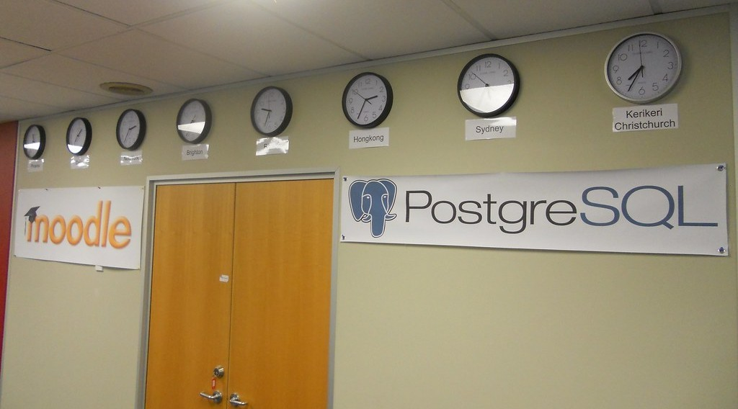
2. TIME ZONES
Activity 3
Clocks showing the time in different cities.
Notes:
Activity 3. Look carefully at this picture: clocks showing the time in different cities. Observe every detail before I ask the question.

Slide 26
2. TIME ZONES
Activity 3: Question
Why do these clocks show different times?
Notes:
Here is the question for Activity 3: Why do these clocks show different times? Take one minute to think and write your answer in your rough notebook.

Slide 27
2. TIME ZONES
Activity 3: Answer
Each city is in a different time zone.
Notes:
Let us check the answer together. Each city is in a different time zone.

Slide 28
BOARD SUMMARY
Board Summary
Topic: The Earth as a Planet in the Solar System
Sub-topic: Location and Time
Lesson 4: Local Time, Standard Time and Time Zones
Notes:
Now we are going to copy the board summary. Write the title and the headings neatly in your notebooks. I will give you enough time for each slide, so do not rush.

Slide 29
BOARD SUMMARY
DEFINITIONS
The key terms of this lesson are defined as follows:
Local time: It is the time given by the position of the Sun in a place.
Standard time: It is the official time used by a whole country or zone.
Notes:
Let us copy the definitions. The key terms of this lesson are defined as follows. On this slide we have Local time and Standard time. Write each point on a new line, with the key term first, and explain it in your own words when we revise.

Slide 30
BOARD SUMMARY
1. Local and Standard Time
Local and standard time follow these rules:
The rule: The Earth turns 15° in one hour, so 1° of longitude equals 4 minutes of time.
East and west: Places to the east are ahead in time and places to the west are behind.
Notes:
Let us copy Local and Standard Time. Local and standard time follow these rules. On this slide we have The rule and East and west. Write each point on a new line, with the key term first, and explain it in your own words when we revise. When you finish, we go to the next slide.

Slide 31
BOARD SUMMARY
1. Local and Standard Time (continued)
Cameroon: Cameroon uses West Africa Time, which is GMT + 1.
Notes:
We continue with Local and Standard Time. On this slide we have Cameroon. Write each point on a new line, with the key term first, and explain it in your own words when we revise.

Slide 32
BOARD SUMMARY
1. Local and Standard Time
Illustration: time and longitude
Notes:
Now draw this illustration in your notebook: time and longitude. Give it a title and label it clearly.

Slide 33
BOARD SUMMARY
2. Time Zones
Time zones are explained as follows:
Time zone: It is an area where people use the same standard time.
Number and width: There are 24 main time zones, each about 15° of longitude wide.
Notes:
Let us copy Time Zones. Time zones are explained as follows. On this slide we have Time zone and Number and width. Write each point on a new line, with the key term first, and explain it in your own words when we revise. When you finish, we go to the next slide.

Slide 34
BOARD SUMMARY
2. Time Zones (continued)
Reason: Time zones avoid having a different time in every town.
Countries with many zones: Wide countries from east to west, like Russia with 11 zones, have many time zones.
Notes:
We continue with Time Zones. On this slide we have Reason and Countries with many zones. Write each point on a new line, with the key term first, and explain it in your own words when we revise.

Slide 35
FORMATIVE EVALUATION
Evaluation 1
How many degrees does the Earth turn in one hour?
Notes:
Now let us check what you have understood. Question 1: How many degrees does the Earth turn in one hour? Answer in your exercise book.

Slide 36
FORMATIVE EVALUATION
Expected Answer
15°.
Notes:
The expected answer is: 15°. If you got it right, well done.

Slide 37
FORMATIVE EVALUATION
Evaluation 2
What is the standard time of Cameroon?
Notes:
Now let us check what you have understood. Question 2: What is the standard time of Cameroon? Answer in your exercise book.

Slide 38
FORMATIVE EVALUATION
Expected Answer
West Africa Time, GMT + 1.
Notes:
The expected answer is: west Africa Time, GMT + 1. If you got it right, well done.

Slide 39
REMEDIATION
Remediation
Fill in the blanks:
The Earth turns ______ ° in one hour.
There are ______ main time zones.
Places to the east have a time that is ______.
Notes:
For those who need more practice, fill in the blanks in your exercise book. The answers are: number 1, 15; number 2, 24; number 3, ahead.

Slide 40
HOMEWORK
Homework
Find the time in Garoua when it is 12 noon in London in winter (GMT). Then try: what time is it in a town at 45° E when it is 12 noon at 0°?
Notes:
For your homework: Find the time in Garoua when it is 12 noon in London in winter (GMT). Then try: what time is it in a town at 45° E when it is 12 noon at 0°? We shall correct it at the beginning of our next lesson.

Slide 41
NEXT LESSON
Next Lesson
Our next lesson will be on:
Practical Work 2: Calculation of Time and Date
Notes:
Our next lesson will be on Practical Work 2: Calculation of Time and Date. Thank you for your attention, and see you next time.

Slide 42
BILINGUAL GAME
Bilingual Game (Jeu Bilingue)
English | Français
Local time | L'heure locale
Standard time | L'heure légale
Time zone | Le fuseau horaire
Clock | L'horloge
Noon | Midi
Midnight | Minuit
Ahead | En avance
Behind | En retard
Notes:
Let us play the bilingual game. I say a word in English, and you give me the French word. Then we do the reverse.

Slide 43
LOGBOOK
Official Logbook (1/2)
Module / Topic | The Earth as a Planet in the Solar System
Lesson Title | Lesson 4: Local Time, Standard Time and Time Zones
Expected Learning Outcomes | Define local time and standard time. Explain the meaning of time zones and why they exist. Explain why some countries have many time zones.
Competence | Learners are able to explain why the time is different in other countries, and to find the time of a match or a call abroad.
Notes:
I record this information in the official logbook of the class after the lesson.

Slide 44
LOGBOOK
Official Logbook (2/2)
Matter Taught | DEFINITIONS; Local and Standard Time; Time Zones.
Evaluation | Formative evaluation and remediation exercise.
Homework | Find the time in Garoua when it is 12 noon in London in winter (GMT). Then try: what time is it in a town at 45° E when it is 12 noon at 0°?
Enrolment / Present / Absent | ____ / ____ / ____
Achievement | To be completed after the lesson.
Notes:
I complete the second page of the logbook: the matter taught, the evaluation, the homework and the attendance.

Slide 45
TEACHER'S NOTE
Teacher's Note
Timing: Homework correction, plan, objectives 4 min | Recall, situation, action 6 min | 3 activities 12 min | Board summary (copying) 15 min | Evaluation, remediation 5 min | Homework, next lesson 3 min | Logbook 5 min
Without the projector (Activity 1): draw the time line on the board.
Without the projector (Activity 2): draw 24 strips on the board.
Without the projector (Activity 3): ask learners to compare the time on a phone set to another country.
Notes:
This slide is for me, the teacher: it gives the timing of the lesson and what to do if the projector is not available.

Slide 46
REFERENCES
References
National Geography Syllabus (MINESEC), Form 4 — The Earth as a Planet in the Solar System.
Teacher's lesson notes (Form 4), checked and corrected where necessary.
Photo, Activity 3: “The world in our office - 2012-03-28” by 4nitsirk, CC BY-SA 2.0, via Flickr (https://www.flickr.com/photos/26223114@N02/7023309809)
Diagrams and animations: drawn for this lesson (Geography Department).
Notes:
These are the references and picture credits used to prepare this lesson.

