Slide 1
FORM 4
GEOGRAPHY
Lesson 9
The Theory of Continental Drift
Notes:
Good morning, class, and welcome to our geography lesson. I am your geography teacher, Mr Kamdem. Today we are starting Lesson 9: The Theory of Continental Drift.

Slide 2
CLASS INFO
Class, Chapter and Duration
Class | Form 4
Chapter | The Structure of the Earth: Building Processes and Impacts on Man — Internal Structure of the Earth
Duration | 50 minutes
Notes:
This lesson is for Form 4. It belongs to The Structure of the Earth: Building Processes and Impacts on Man — Internal Structure of the Earth. We shall need 50 minutes to cover it.

Slide 3
IDENTIFICATION
Lesson Identification
Topic | The Structure of the Earth: Building Processes and Impacts on Man
Sub-topic | Internal Structure of the Earth
Lesson | Lesson 9: The Theory of Continental Drift
Notions / Concepts | Continental drift, Pangaea, Laurasia, Gondwanaland.
Syllabus focus | The theory of continental drift: main idea, illustration and evidence.
Competence | Learners are able to explain, with map evidence, that the continents have moved, and to read the shape of the continents on a world map.
Notes:
Our topic is The Structure of the Earth: Building Processes and Impacts on Man, and the sub-topic is Internal Structure of the Earth. The key notions we shall use today are: continental drift, Pangaea, Laurasia, Gondwanaland. At the end, you should be able to do this: learners are able to explain, with map evidence, that the continents have moved, and to read the shape of the continents on a world map.

Slide 4

HOMEWORK CORRECTION
Correction of the Homework
Question (Lesson 8: Rocks):
Look at a map of the world. Cut out, or trace, Africa and South America and try to fit their coasts together. Write what you notice.
Notes:
Before we start the new lesson, let us correct the homework I gave you at the end of Lesson 8: Rocks. The question was: Look at a map of the world. Cut out, or trace, Africa and South America and try to fit their coasts together. Write what you notice. Take out your exercise books.

Slide 5
HOMEWORK CORRECTION
Correction: Possible Answer
The east coast of South America fits into the west coast of Africa like pieces of a jigsaw puzzle: the two continents were once joined.
Notes:
Here is a good answer. The east coast of South America fits into the west coast of Africa like pieces of a jigsaw puzzle: the two continents were once joined. Compare it with your own answer and correct your work in red.

Slide 6
LESSON PLAN
Lesson Plan
Correction of the homework
Objectives and recall
Real-life situation and action to take
Learning activities
Board summary
Evaluation, remediation and homework
Notes:
Here is the plan of our lesson today. First, we shall correct the homework. Then we shall look at the objectives and recall what you already know. After that, we shall study a situation from real life and the action to take, and do the learning activities. Finally, we shall copy the board summary, do the evaluation and the remediation, and I will give you the homework.

Slide 7
OBJECTIVES
Objectives
By the end of this lesson, you should be able to:
State the theory of continental drift.
Describe the break-up of Pangaea.
Explain the evidence for continental drift.
Notes:
By the end of this lesson, you should be able to do three things. Number 1: state the theory of continental drift. Number 2: describe the break-up of Pangaea. Number 3: explain the evidence for continental drift.

Slide 8
PREVIOUS KNOWLEDGE
Previous Knowledge
The crust is broken and lies on the very hot mantle.
The mantle flows very slowly.
Fossils are found mainly in sedimentary rocks.
Notes:
Let us first remember what you already know. The crust is broken and lies on the very hot mantle. The mantle flows very slowly. Fossils are found mainly in sedimentary rocks. Keep this in mind, because we shall build on it today.

Slide 9
REAL-LIFE SITUATION
Situation in Real Life
Djibrilla looks at a map. The coast of Africa and the coast of South America look like two pieces of a puzzle. He wonders if they were once joined.
Notes:
Listen carefully to this situation from real life. Djibrilla looks at a map. The coast of Africa and the coast of South America look like two pieces of a puzzle. He wonders if they were once joined. Think about it, because I am going to ask you some questions.

Slide 10
REAL-LIFE SITUATION
Situation: Question 1
What is the problem in the situation?
Notes:
Question 1: What is the problem in the situation? Think for a moment, then raise your hand to answer.

Slide 11
REAL-LIFE SITUATION
Answer
Djibrilla wonders if Africa and South America were once joined.
Notes:
Good. Djibrilla wonders if Africa and South America were once joined.

Slide 12
REAL-LIFE SITUATION
Situation: Question 2
What does he notice?
Notes:
Question 2: What does he notice? Think for a moment, then raise your hand to answer.

Slide 13
REAL-LIFE SITUATION
Answer
The two coasts fit like a puzzle.
Notes:
Good. The two coasts fit like a puzzle.

Slide 14
REAL-LIFE SITUATION
Situation: Question 3
Who first explained this?
Notes:
Question 3: Who first explained this? Think for a moment, then raise your hand to answer.

Slide 15
REAL-LIFE SITUATION
Possible Answer
Alfred Wegener, in 1912.
Notes:
Good. Alfred Wegener, in 1912.

Slide 16
ACTION TO TAKE
Action to Take
Use maps and evidence to explain how the continents moved.
Notes:
From this situation, the action we are working towards in this lesson is the following: use maps and evidence to explain how the continents moved.

Slide 17
JUSTIFICATION
Justification of the Lesson
This lesson helps us to understand that the continents move.
Notes:
Why is this lesson important for you? This lesson helps us to understand that the continents move.

Slide 18

1. THE THEORY
Activity 1
Animation: closing the Atlantic Ocean.
Notes:
Activity 1. Look carefully at this animation: animation: closing the Atlantic Ocean. Watch the animation to the end; it will play again.

Slide 19
1. THE THEORY
Activity 1: Question
What happens when we bring South America near Africa?
Notes:
Here is the question for Activity 1: What happens when we bring South America near Africa? Take one minute to think and write your answer in your rough notebook.

Slide 20
1. THE THEORY
Activity 1: Answer
The two coasts fit together like a puzzle.
Notes:
Let us check the answer together. The two coasts fit together like a puzzle.

Slide 21
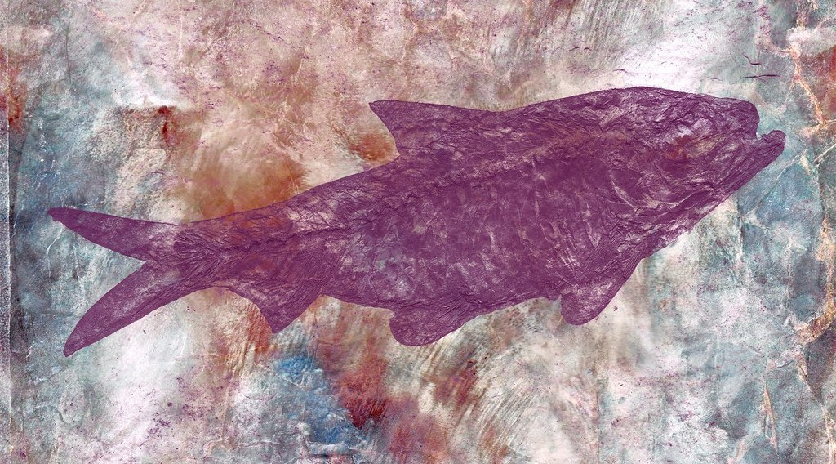
2. EVIDENCE
Activity 2
A fossil of a fish in rock.
Notes:
Activity 2. Look carefully at this picture: a fossil of a fish in rock. Observe every detail before I ask the question.

Slide 22
2. EVIDENCE
Activity 2: Question
The fossils of the same small reptile (Mesosaurus) are found in Brazil and in southern Africa. What does it prove?
Notes:
Here is the question for Activity 2: The fossils of the same small reptile (Mesosaurus) are found in Brazil and in southern Africa. What does it prove? Take one minute to think and write your answer in your rough notebook.

Slide 23
2. EVIDENCE
Activity 2: Answer
The two continents were once joined.
Notes:
Let us check the answer together. The two continents were once joined.

Slide 24

2. EVIDENCE
Activity 3
A crack in the ground in Iceland, where two plates move apart.
Notes:
Activity 3. Look carefully at this picture: a crack in the ground in Iceland, where two plates move apart. Observe every detail before I ask the question.

Slide 25
2. EVIDENCE
Activity 3: Question
The ground here opens a little every year. What does it show?
Notes:
Here is the question for Activity 3: The ground here opens a little every year. What does it show? Take one minute to think and write your answer in your rough notebook.

Slide 26
2. EVIDENCE
Activity 3: Answer
The land (the continents) is moving.
Notes:
Let us check the answer together. The land (the continents) is moving.

Slide 27
BOARD SUMMARY
Board Summary
Topic: The Structure of the Earth: Building Processes and Impacts on Man
Sub-topic: Internal Structure of the Earth
Lesson 9: The Theory of Continental Drift
Notes:
Now we are going to copy the board summary. Write the title and the headings neatly in your notebooks. I will give you enough time for each slide, so do not rush.

Slide 28
BOARD SUMMARY
1. The Theory of Continental Drift
The main idea of the theory is the following:
Continental drift: It is the slow movement of the continents over millions of years.
Author: The theory was proposed by Alfred Wegener in 1912.
Notes:
Let us copy The Theory of Continental Drift. The main idea of the theory is the following. On this slide we have Continental drift and Author. Write each point on a new line, with the key term first, and explain it in your own words when we revise. When you finish, we go to the next slide.

Slide 29
BOARD SUMMARY
1. The Theory of Continental Drift (continued)
Pangaea: All the continents were once joined in one big continent called Pangaea.
Break-up: Pangaea broke into pieces which slowly moved apart to form today's continents.
Notes:
We continue with The Theory of Continental Drift. On this slide we have Pangaea and Break-up. Write each point on a new line, with the key term first, and explain it in your own words when we revise.

Slide 30
BOARD SUMMARY
2. Evidence of Continental Drift
The following evidence supports the theory:
Jigsaw fit: The coasts of Africa and South America fit together like a puzzle.
Fossils: The same fossils of plants and animals are found on both sides of the Atlantic.
Notes:
Let us copy Evidence of Continental Drift. The following evidence supports the theory. On this slide we have Jigsaw fit and Fossils. Write each point on a new line, with the key term first, and explain it in your own words when we revise. When you finish, we go to the next slide.

Slide 31
BOARD SUMMARY
2. Evidence of Continental Drift (continued)
Rocks: The same types and ages of rocks are found on continents now far apart.
Old ice marks: Marks of ancient glaciers are found in hot lands such as Africa and India.
Notes:
We continue with Evidence of Continental Drift. On this slide we have Rocks and Old ice marks. Write each point on a new line, with the key term first, and explain it in your own words when we revise.

Slide 32
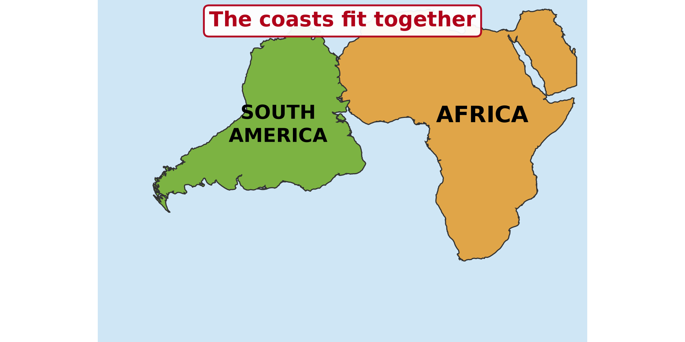
BOARD SUMMARY
2. Evidence of Continental Drift
Illustration: the jigsaw fit of the continents
Notes:
Now draw this illustration in your notebook: the jigsaw fit of the continents. Give it a title and label it clearly.

Slide 33
FORMATIVE EVALUATION
Evaluation 1
What is Pangaea?
Notes:
Now let us check what you have understood. Question 1: What is Pangaea? Answer in your exercise book.

Slide 34
FORMATIVE EVALUATION
Expected Answer
The single big continent of long ago.
Notes:
The expected answer is: the single big continent of long ago. If you got it right, well done.

Slide 35
FORMATIVE EVALUATION
Evaluation 2
Give two pieces of evidence for continental drift.
Notes:
Now let us check what you have understood. Question 2: Give two pieces of evidence for continental drift. Answer in your exercise book.

Slide 36
FORMATIVE EVALUATION
Expected Answer
The jigsaw fit and the same fossils on both continents.
Notes:
The expected answer is: the jigsaw fit and the same fossils on both continents. If you got it right, well done.

Slide 37
REMEDIATION
Remediation
Fill in the blanks:
The theory of continental drift was given by ______.
The single big continent was called ______.
Notes:
Take your time to copy this part; we will continue together.

Slide 38
REMEDIATION
Remediation (continued)
Africa and South America fit like a ______.
Notes:
For those who need more practice, fill in the blanks in your exercise book. The answers are: number 1, Wegener; number 2, Pangaea; number 3, puzzle (jigsaw).

Slide 39
HOMEWORK
Homework
Listen to the news or ask an adult about a recent earthquake or volcanic eruption in the world. Write the name of the country and what happened.
Notes:
For your homework: Listen to the news or ask an adult about a recent earthquake or volcanic eruption in the world. Write the name of the country and what happened. We shall correct it at the beginning of our next lesson.

Slide 40
NEXT LESSON
Next Lesson
Our next lesson will be on:
Lesson 10: The Theory of Plate Tectonics
Notes:
Our next lesson will be on Lesson 10: The Theory of Plate Tectonics. Thank you for your attention, and see you next time.

Slide 41
BILINGUAL GAME
Bilingual Game (Jeu Bilingue)
English | Français
Continental drift | La dérive des continents
Continent | Le continent
Evidence | La preuve
Fossil | Le fossile
Coast | La côte
Ice sheet | L'inlandsis / la calotte glaciaire
Puzzle | Le puzzle
To move apart | S'éloigner
Notes:
Let us play the bilingual game. I say a word in English, and you give me the French word. Then we do the reverse.

Slide 42
LOGBOOK
Official Logbook (1/2)
Module / Topic | The Structure of the Earth: Building Processes and Impacts on Man
Lesson Title | Lesson 9: The Theory of Continental Drift
Expected Learning Outcomes | State the theory of continental drift. Describe the break-up of Pangaea. Explain the evidence for continental drift.
Competence | Learners are able to explain, with map evidence, that the continents have moved, and to read the shape of the continents on a world map.
Notes:
I record this information in the official logbook of the class after the lesson.

Slide 43
LOGBOOK
Official Logbook (2/2)
Matter Taught | The Theory of Continental Drift; Evidence of Continental Drift.
Evaluation | Formative evaluation and remediation exercise.
Homework | Listen to the news or ask an adult about a recent earthquake or volcanic eruption in the world. Write the name of the country and what happened.
Enrolment / Present / Absent | ____ / ____ / ____
Achievement | To be completed after the lesson.
Notes:
I complete the second page of the logbook: the matter taught, the evaluation, the homework and the attendance.

Slide 44
TEACHER'S NOTE
Teacher's Note
Timing: Homework correction, plan, objectives 4 min | Recall, situation, action 6 min | 3 activities 12 min | Board summary (copying) 15 min | Evaluation, remediation 5 min | Homework, next lesson 3 min | Logbook 5 min
Activity 1 is an animation (GIF): it plays automatically in slide-show mode.
Without the projector (Activity 1): cut a paper map of the two continents and fit them.
Without the projector (Activity 2): explain: this small animal could not swim across the ocean.
Without the projector (Activity 3): push two books apart slowly on the table.
Notes:
This slide is for me, the teacher: it gives the timing of the lesson and what to do if the projector is not available.

Slide 45
REFERENCES
References
National Geography Syllabus (MINESEC), Form 4 — The Structure of the Earth: Building Processes and Impacts on Man.
Teacher's lesson notes (Form 4), checked and corrected where necessary.
Photo, Activity 2: “Marble Skin Fish Fossil” by Bold Frontiers, CC BY 2.0, via Flickr (https://www.flickr.com/photos/82955120@N05/14091612527)
Photo, Activity 3: “Silfra Fissure” by Daveography.ca, CC BY-NC-SA 2.0, via Flickr (https://www.flickr.com/photos/71482738@N00/32857247053)
Diagrams and animations: drawn for this lesson (Geography Department).
Notes:
These are the references and picture credits used to prepare this lesson.

