Slide 1
FORM 4
GEOGRAPHY
Lesson 13
Earthquakes
Notes:
Good morning, class, and welcome to our geography lesson. I am your geography teacher, Mr Kamdem. Today we are starting Lesson 13: Earthquakes.

Slide 2
CLASS INFO
Class, Chapter and Duration
Class | Form 4
Chapter | The Structure of the Earth: Building Processes and Impacts on Man — Seismic Activities and Man
Duration | 50 minutes
Notes:
This lesson is for Form 4. It belongs to The Structure of the Earth: Building Processes and Impacts on Man — Seismic Activities and Man. We shall need 50 minutes to cover it.

Slide 3
IDENTIFICATION
Lesson Identification
Topic | The Structure of the Earth: Building Processes and Impacts on Man
Sub-topic | Seismic Activities and Man
Lesson | Lesson 13: Earthquakes
Notions / Concepts | Seismicity, focus, epicentre, magnitude, resources, hazards.
Syllabus focus | Definition; causes; manifestation; impact on man; adaptation and mitigation.
Competence | Learners are able to explain what causes earthquakes and to apply safety rules (drop, cover and hold on) during an earthquake.
Notes:
Our topic is The Structure of the Earth: Building Processes and Impacts on Man, and the sub-topic is Seismic Activities and Man. The key notions we shall use today are: seismicity, focus, epicentre, magnitude, resources, hazards. At the end, you should be able to do this: learners are able to explain what causes earthquakes and to apply safety rules (drop, cover and hold on) during an earthquake.

Slide 4

HOMEWORK CORRECTION
Correction of the Homework
Question (Lesson 12: The Impact of Volcanicity on Man):
Ask your parents if they have ever felt the ground shake. Write where and when it happened, and what they felt.
Notes:
Before we start the new lesson, let us correct the homework I gave you at the end of Lesson 12: The Impact of Volcanicity on Man. The question was: Ask your parents if they have ever felt the ground shake. Write where and when it happened, and what they felt. Take out your exercise books.

Slide 5
HOMEWORK CORRECTION
Correction: Possible Answer
Answers vary. Example: in Buea, people felt the ground shake for a few seconds during the eruption of 1999; windows rattled and people ran outside.
Notes:
Here is a good answer. Answers vary. Example: in Buea, people felt the ground shake for a few seconds during the eruption of 1999; windows rattled and people ran outside. Compare it with your own answer and correct your work in red.

Slide 6
LESSON PLAN
Lesson Plan
Correction of the homework
Objectives and recall
Real-life situation and action to take
Learning activities
Board summary
Evaluation, remediation and homework
Notes:
Here is the plan of our lesson today. First, we shall correct the homework. Then we shall look at the objectives and recall what you already know. After that, we shall study a situation from real life and the action to take, and do the learning activities. Finally, we shall copy the board summary, do the evaluation and the remediation, and I will give you the homework.

Slide 7
OBJECTIVES
Objectives
By the end of this lesson, you should be able to:
Define an earthquake, its focus and its epicentre.
Explain the causes of earthquakes.
Notes:
Take your time to copy this part; we will continue together.

Slide 8
OBJECTIVES
Objectives (continued)
Describe how earthquakes are measured and how they appear.
Explain their impact on man and suggest adaptation and mitigation measures.
Notes:
By the end of this lesson, you should be able to do three things. Number 1: define an earthquake, its focus and its epicentre. Number 2: explain the causes of earthquakes. Number 3: describe how earthquakes are measured and how they appear. Number 4: explain their impact on man and suggest adaptation and mitigation measures.

Slide 9
PREVIOUS KNOWLEDGE
Previous Knowledge
The plates move against each other at their margins.
Volcanic eruptions can cause the ground to shake.
Conservative margins have strong earthquakes.
Notes:
Let us first remember what you already know. The plates move against each other at their margins. Volcanic eruptions can cause the ground to shake. Conservative margins have strong earthquakes. Keep this in mind, because we shall build on it today.

Slide 10
REAL-LIFE SITUATION
Situation in Real Life
On the news, Ismaïla sees that an earthquake in Morocco in September 2023 destroyed many villages. Thousands of people died. He wonders what makes the ground shake.
Notes:
Listen carefully to this situation from real life. On the news, Ismaïla sees that an earthquake in Morocco in September 2023 destroyed many villages. Thousands of people died. He wonders what makes the ground shake. Think about it, because I am going to ask you some questions.

Slide 11
REAL-LIFE SITUATION
Situation: Question 1
What is the problem in the situation?
Notes:
Question 1: What is the problem in the situation? Think for a moment, then raise your hand to answer.

Slide 12
REAL-LIFE SITUATION
Answer
Ismaïla does not know what makes the ground shake.
Notes:
Good. Ismaïla does not know what makes the ground shake.

Slide 13
REAL-LIFE SITUATION
Situation: Question 2
What did the earthquake destroy?
Notes:
Question 2: What did the earthquake destroy? Think for a moment, then raise your hand to answer.

Slide 14
REAL-LIFE SITUATION
Answer
Villages and houses.
Notes:
Good. Villages and houses.

Slide 15
REAL-LIFE SITUATION
Situation: Question 3
Why do so many people die?
Notes:
Question 3: Why do so many people die? Think for a moment, then raise your hand to answer.

Slide 16
REAL-LIFE SITUATION
Possible Answer
Their houses fall on them.
Notes:
Good. Their houses fall on them.

Slide 17
ACTION TO TAKE
Action to Take
Know what to do during an earthquake: take cover, protect your head and stay away from walls.
Notes:
From this situation, the action we are working towards in this lesson is the following: know what to do during an earthquake: take cover, protect your head and stay away from walls.

Slide 18
JUSTIFICATION
Justification of the Lesson
This lesson helps us to know earthquakes and how to reduce their damage.
Notes:
Why is this lesson important for you? This lesson helps us to know earthquakes and how to reduce their damage.

Slide 19
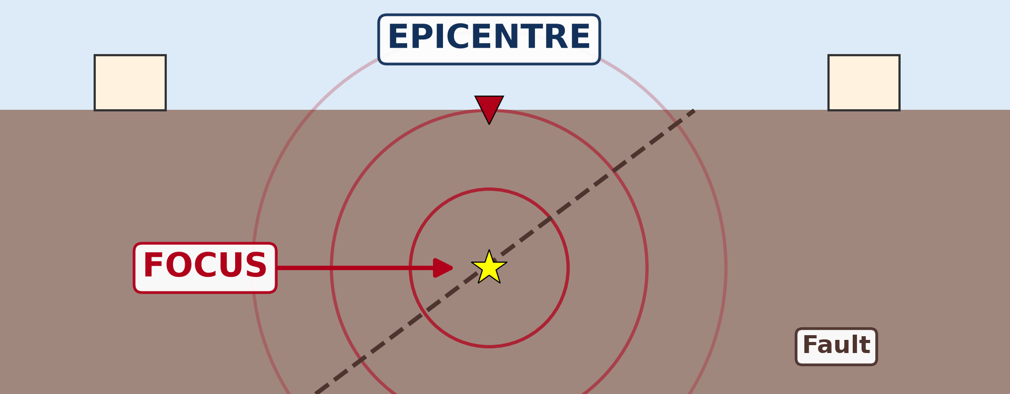
1. MEANING AND CAUSES
Activity 1
Animation: the waves of an earthquake.
Notes:
Activity 1. Look carefully at this animation: animation: the waves of an earthquake. Watch the animation to the end; it will play again.

Slide 20
1. MEANING AND CAUSES
Activity 1: Question
Where does the earthquake start? What is the point just above it?
Notes:
Here is the question for Activity 1: Where does the earthquake start? What is the point just above it? Take one minute to think and write your answer in your rough notebook.

Slide 21
1. MEANING AND CAUSES
Activity 1: Answer
It starts at the focus. The point above is the epicentre.
Notes:
Let us check the answer together. It starts at the focus. The point above is the epicentre.

Slide 22
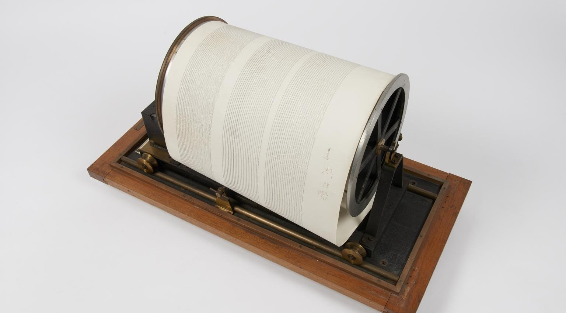
2. MANIFESTATION
Activity 2
A seismograph.
Notes:
Activity 2. Look carefully at this picture: a seismograph. Observe every detail before I ask the question.

Slide 23
2. MANIFESTATION
Activity 2: Question
What does this instrument do?
Notes:
Here is the question for Activity 2: What does this instrument do? Take one minute to think and write your answer in your rough notebook.

Slide 24
2. MANIFESTATION
Activity 2: Answer
It records the shaking of the ground.
Notes:
Let us check the answer together. It records the shaking of the ground.

Slide 25

3. IMPACT ON MAN
Activity 3
Houses destroyed by an earthquake.
Notes:
Activity 3. Look carefully at this picture: houses destroyed by an earthquake. Observe every detail before I ask the question.

Slide 26
3. IMPACT ON MAN
Activity 3: Question
What is the main cause of death during an earthquake?
Notes:
Here is the question for Activity 3: What is the main cause of death during an earthquake? Take one minute to think and write your answer in your rough notebook.

Slide 27
3. IMPACT ON MAN
Activity 3: Answer
Buildings fall on people.
Notes:
Let us check the answer together. Buildings fall on people.

Slide 28
BOARD SUMMARY
Board Summary
Topic: The Structure of the Earth: Building Processes and Impacts on Man
Sub-topic: Seismic Activities and Man
Lesson 13: Earthquakes
Notes:
Now we are going to copy the board summary. Write the title and the headings neatly in your notebooks. I will give you enough time for each slide, so do not rush.

Slide 29
BOARD SUMMARY
DEFINITIONS
The key terms of this lesson are defined as follows:
Earthquake: It is a sudden shaking of the ground.
Focus: It is the point under the ground where the earthquake starts.
Notes:
Let us copy the definitions. The key terms of this lesson are defined as follows. On this slide we have Earthquake and Focus. Write each point on a new line, with the key term first, and explain it in your own words when we revise. When you finish, we go to the next slide.

Slide 30
BOARD SUMMARY
DEFINITIONS (continued)
Epicentre: It is the point on the surface directly above the focus.
Notes:
We continue with the definitions. On this slide we have Epicentre. Write each point on a new line, with the key term first, and explain it in your own words when we revise.

Slide 31
BOARD SUMMARY
1. Causes of Earthquakes
Earthquakes have the following causes:
Plate movements: The sudden movement of plates along faults is the main cause of earthquakes.
Volcanic eruptions: Eruptions shake the ground around volcanoes.
Notes:
Let us copy Causes of Earthquakes. Earthquakes have the following causes. On this slide we have Plate movements and Volcanic eruptions. Write each point on a new line, with the key term first, and explain it in your own words when we revise. When you finish, we go to the next slide.

Slide 32
BOARD SUMMARY
1. Causes of Earthquakes (continued)
Human activities: Mining, explosions and big dams can cause small earthquakes.
Notes:
We continue with Causes of Earthquakes. On this slide we have Human activities. Write each point on a new line, with the key term first, and explain it in your own words when we revise.

Slide 33
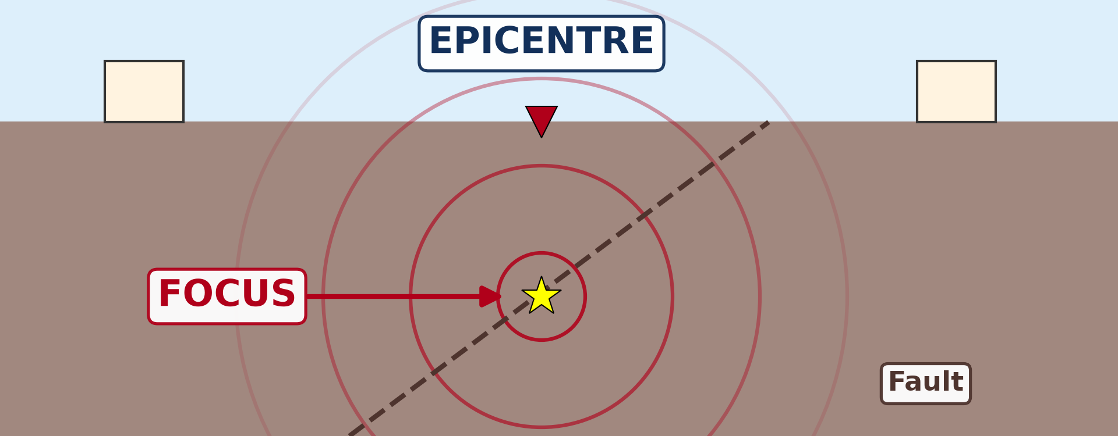
BOARD SUMMARY
1. Causes of Earthquakes
Illustration: focus and epicentre
Notes:
Now draw this illustration in your notebook: focus and epicentre. Give it a title and label it clearly.

Slide 34
BOARD SUMMARY
2. Manifestation and Measurement
Earthquakes are recorded and measured as follows:
Seismograph: It is an instrument that records the shock waves of an earthquake.
Richter scale: It is the scale that measures the strength (magnitude) of an earthquake.
Notes:
Let us copy Manifestation and Measurement. Earthquakes are recorded and measured as follows. On this slide we have Seismograph and Richter scale. Write each point on a new line, with the key term first, and explain it in your own words when we revise.

Slide 35
BOARD SUMMARY
3. Impact and Protection
Earthquakes affect people and are managed as follows:
Impact on man: Earthquakes kill people and destroy houses, roads and bridges.
Strong buildings: Buildings designed to resist shaking reduce deaths.
Notes:
Let us copy Impact and Protection. Earthquakes affect people and are managed as follows. On this slide we have Impact on man and Strong buildings. Write each point on a new line, with the key term first, and explain it in your own words when we revise. When you finish, we go to the next slide.

Slide 36
BOARD SUMMARY
3. Impact and Protection (continued)
Education: People who learn safety drills know what to do during an earthquake.
Notes:
We continue with Impact and Protection. On this slide we have Education. Write each point on a new line, with the key term first, and explain it in your own words when we revise.

Slide 37
FORMATIVE EVALUATION
Evaluation 1
What is the epicentre?
Notes:
Now let us check what you have understood. Question 1: What is the epicentre? Answer in your exercise book.

Slide 38
FORMATIVE EVALUATION
Expected Answer
The point on the surface above the focus.
Notes:
The expected answer is: the point on the surface above the focus. If you got it right, well done.

Slide 39
FORMATIVE EVALUATION
Evaluation 2
How do countries like Japan reduce the damage?
Notes:
Now let us check what you have understood. Question 2: How do countries like Japan reduce the damage? Answer in your exercise book.

Slide 40
FORMATIVE EVALUATION
Expected Answer
They build houses that resist earthquakes.
Notes:
The expected answer is: they build houses that resist earthquakes. If you got it right, well done.

Slide 41
REMEDIATION
Remediation
Fill in the blanks:
A sudden shaking of the ground is an ______.
The instrument that records earthquakes is the ______.
Notes:
Take your time to copy this part; we will continue together.

Slide 42
REMEDIATION
Remediation (continued)
The point under the ground where it starts is the ______.
Notes:
For those who need more practice, fill in the blanks in your exercise book. The answers are: number 1, earthquake; number 2, seismograph; number 3, focus.

Slide 43
HOMEWORK
Homework
After the next rain, look at the side of a road or a slope. Write what the running water did to the soil, and where the soil went.
Notes:
For your homework: After the next rain, look at the side of a road or a slope. Write what the running water did to the soil, and where the soil went. We shall correct it at the beginning of our next lesson.

Slide 44
NEXT LESSON
Next Lesson
Our next lesson will be on:
Lesson 14: Denudation
Notes:
Our next lesson will be on Lesson 14: Denudation. Thank you for your attention, and see you next time.

Slide 45
BILINGUAL GAME
Bilingual Game (Jeu Bilingue)
English | Français
Earthquake | Le séisme / le tremblement de terre
Focus | Le foyer / hypocentre
Epicentre | L'épicentre
Seismograph | Le sismographe
Magnitude | La magnitude
Tsunami | Le tsunami
Fault | La faille
Collapse | L'effondrement
Notes:
Let us play the bilingual game. I say a word in English, and you give me the French word. Then we do the reverse.

Slide 46
LOGBOOK
Official Logbook (1/2)
Module / Topic | The Structure of the Earth: Building Processes and Impacts on Man
Lesson Title | Lesson 13: Earthquakes
Expected Learning Outcomes | Define an earthquake, its focus and its epicentre. Explain the causes of earthquakes. Describe how earthquakes are measured and how they appear. Explain their impact on man and suggest adaptation and mitigation measures.
Competence | Learners are able to explain what causes earthquakes and to apply safety rules (drop, cover and hold on) during an earthquake.
Notes:
I record this information in the official logbook of the class after the lesson.

Slide 47
LOGBOOK
Official Logbook (2/2)
Matter Taught | DEFINITIONS; Causes of Earthquakes; Manifestation and Measurement; Impact and Protection.
Evaluation | Formative evaluation and remediation exercise.
Homework | After the next rain, look at the side of a road or a slope. Write what the running water did to the soil, and where the soil went.
Enrolment / Present / Absent | ____ / ____ / ____
Achievement | To be completed after the lesson.
Notes:
I complete the second page of the logbook: the matter taught, the evaluation, the homework and the attendance.

Slide 48
TEACHER'S NOTE
Teacher's Note
Timing: Homework correction, plan, objectives 4 min | Recall, situation, action 6 min | 3 activities 12 min | Board summary (copying) 15 min | Evaluation, remediation 5 min | Homework, next lesson 3 min | Logbook 5 min
Activity 1 is an animation (GIF): it plays automatically in slide-show mode.
Without the projector (Activity 1): drop a stone in water: the waves spread in circles.
Without the projector (Activity 2): draw a zigzag line on the board.
Without the projector (Activity 3): ask learners how houses could be made stronger.
Notes:
This slide is for me, the teacher: it gives the timing of the lesson and what to do if the projector is not available.

Slide 49
REFERENCES
References
National Geography Syllabus (MINESEC), Form 4 — The Structure of the Earth: Building Processes and Impacts on Man.
Teacher's lesson notes (Form 4), checked and corrected where necessary.
USGS Earthquake Hazards Program: magnitude and intensity.
Photo, Activity 2: “Recording drum from Golitsyn seismograph” by Galitzin, Boris; Masing, Hugo, CC BY-NC-SA 4.0, via sciencemuseum (https://collection.sciencemuseumgroup.org.uk/objects/co8647018/recording-drum-from-golitsyn-seismograph)
Photo, Activity 3: “Collapsed buildings in earthquake-hit Chautara, Nepal” by DFID - UK Department for International Development, CC BY 2.0, via Flickr (https://www.flickr.com/photos/14214150@N02/16693413433)
Diagrams and animations: drawn for this lesson (Geography Department).
Notes:
These are the references and picture credits used to prepare this lesson.

