Slide 1
FORM 4
GEOGRAPHY
Lesson 15
Weathering
Notes:
Good morning, class, and welcome to our geography lesson. I am your geography teacher, Mr Kamdem. Today we are starting Lesson 15: Weathering.

Slide 2
CLASS INFO
Class, Chapter and Duration
Class | Form 4
Chapter | Denudation Processes, Landforms and Impacts on Man — Weathering Processes and Impacts on Man
Duration | 50 minutes
Notes:
This lesson is for Form 4. It belongs to Denudation Processes, Landforms and Impacts on Man — Weathering Processes and Impacts on Man. We shall need 50 minutes to cover it.

Slide 3
IDENTIFICATION
Lesson Identification
Topic | Denudation Processes, Landforms and Impacts on Man
Sub-topic | Weathering Processes and Impacts on Man
Lesson | Lesson 15: Weathering
Notions / Concepts | Weathering, in situ, physical weathering, chemical weathering.
Syllabus focus | Definition; types (physical and chemical); general factors of weathering in brief (climate, rock characteristics, vegetation, time, human activities).
Competence | Learners are able to explain why rocks, walls and buildings slowly break down, and to choose materials and actions that slow this down.
Notes:
Our topic is Denudation Processes, Landforms and Impacts on Man, and the sub-topic is Weathering Processes and Impacts on Man. The key notions we shall use today are: weathering, in situ, physical weathering, chemical weathering. At the end, you should be able to do this: learners are able to explain why rocks, walls and buildings slowly break down, and to choose materials and actions that slow this down.

Slide 4

HOMEWORK CORRECTION
Correction of the Homework
Question (Lesson 14: Denudation):
Compare an old wall and a new wall in your area. Write three differences you see, and suggest what damaged the old wall.
Notes:
Before we start the new lesson, let us correct the homework I gave you at the end of Lesson 14: Denudation. The question was: Compare an old wall and a new wall in your area. Write three differences you see, and suggest what damaged the old wall. Take out your exercise books.

Slide 5
HOMEWORK CORRECTION
Correction: Possible Answer
The old wall has cracks, peeling paint and crumbling or dark patches, while the new wall is smooth and clean. It was damaged by rain, sun and heat, plants and time: this is weathering.
Notes:
Here is a good answer. The old wall has cracks, peeling paint and crumbling or dark patches, while the new wall is smooth and clean. It was damaged by rain, sun and heat, plants and time: this is weathering. Compare it with your own answer and correct your work in red.

Slide 6
LESSON PLAN
Lesson Plan
Correction of the homework
Objectives and recall
Real-life situation and action to take
Learning activities
Board summary
Evaluation, remediation and homework
Notes:
Here is the plan of our lesson today. First, we shall correct the homework. Then we shall look at the objectives and recall what you already know. After that, we shall study a situation from real life and the action to take, and do the learning activities. Finally, we shall copy the board summary, do the evaluation and the remediation, and I will give you the homework.

Slide 7
OBJECTIVES
Objectives
By the end of this lesson, you should be able to:
Define weathering.
Distinguish physical and chemical weathering.
Explain briefly the factors of weathering.
Notes:
By the end of this lesson, you should be able to do three things. Number 1: define weathering. Number 2: distinguish physical and chemical weathering. Number 3: explain briefly the factors of weathering.

Slide 8
PREVIOUS KNOWLEDGE
Previous Knowledge
Denudation includes weathering, erosion and transportation.
Weathering happens in place, without movement.
The main agents are running water, wind and waves.
Notes:
Let us first remember what you already know. Denudation includes weathering, erosion and transportation. Weathering happens in place, without movement. The main agents are running water, wind and waves. Keep this in mind, because we shall build on it today.

Slide 9
REAL-LIFE SITUATION
Situation in Real Life
In Sadou's compound, an old wall is cracked. Its stones break into sandy pieces at the bottom. A new wall with the same stones still looks strong.
Notes:
Listen carefully to this situation from real life. In Sadou's compound, an old wall is cracked. Its stones break into sandy pieces at the bottom. A new wall with the same stones still looks strong. Think about it, because I am going to ask you some questions.

Slide 10
REAL-LIFE SITUATION
Situation: Question 1
What is the problem in the situation?
Notes:
Question 1: What is the problem in the situation? Think for a moment, then raise your hand to answer.

Slide 11
REAL-LIFE SITUATION
Answer
The old wall breaks into pieces.
Notes:
Good. The old wall breaks into pieces.

Slide 12
REAL-LIFE SITUATION
Situation: Question 2
Why is the old wall weaker than the new one?
Notes:
Question 2: Why is the old wall weaker than the new one? Think for a moment, then raise your hand to answer.

Slide 13
REAL-LIFE SITUATION
Answer
It has been in the sun and rain for many years.
Notes:
Good. It has been in the sun and rain for many years.

Slide 14
REAL-LIFE SITUATION
Situation: Question 3
What do we call this slow breaking of rock?
Notes:
Question 3: What do we call this slow breaking of rock? Think for a moment, then raise your hand to answer.

Slide 15
REAL-LIFE SITUATION
Possible Answer
Weathering.
Notes:
Good. Weathering.

Slide 16
ACTION TO TAKE
Action to Take
Observe weathering around you and protect buildings from its effects.
Notes:
From this situation, the action we are working towards in this lesson is the following: observe weathering around you and protect buildings from its effects.

Slide 17
JUSTIFICATION
Justification of the Lesson
This lesson helps us to know how rocks break down.
Notes:
Why is this lesson important for you? This lesson helps us to know how rocks break down.

Slide 18
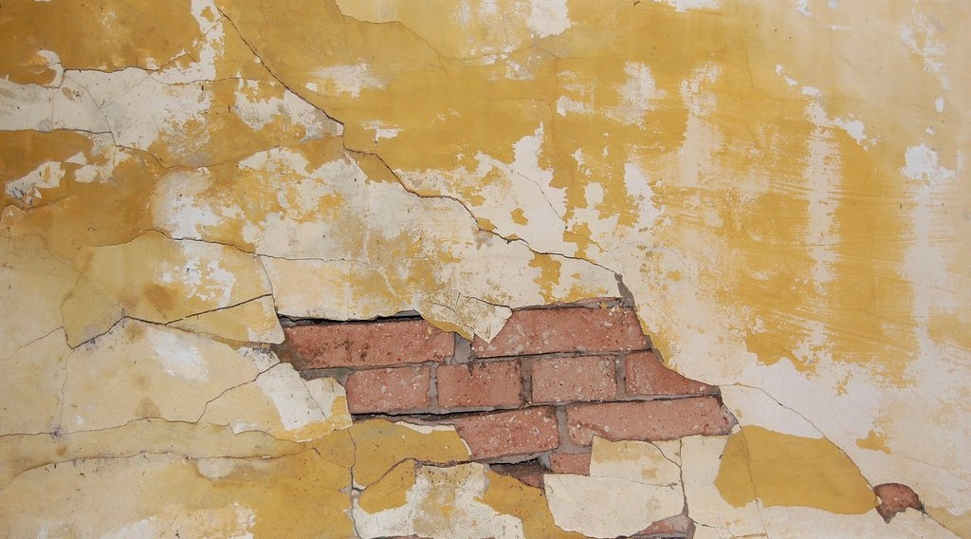
1. MEANING OF WEATHERING
Activity 1
An old wall that is breaking.
Notes:
Activity 1. Look carefully at this picture: an old wall that is breaking. Observe every detail before I ask the question.

Slide 19
1. MEANING OF WEATHERING
Activity 1: Question
What makes this old wall break slowly?
Notes:
Here is the question for Activity 1: What makes this old wall break slowly? Take one minute to think and write your answer in your rough notebook.

Slide 20
1. MEANING OF WEATHERING
Activity 1: Answer
Sun, rain and air: weathering.
Notes:
Let us check the answer together. Sun, rain and air: weathering.

Slide 21

2. TYPES OF WEATHERING
Activity 2
A rusty piece of metal.
Notes:
Activity 2. Look carefully at this picture: a rusty piece of metal. Observe every detail before I ask the question.

Slide 22
2. TYPES OF WEATHERING
Activity 2: Question
Rain and air make iron red and weak. Which type of weathering is similar?
Notes:
Here is the question for Activity 2: Rain and air make iron red and weak. Which type of weathering is similar? Take one minute to think and write your answer in your rough notebook.

Slide 23
2. TYPES OF WEATHERING
Activity 2: Answer
Chemical weathering.
Notes:
Let us check the answer together. Chemical weathering.

Slide 24

3. FACTORS OF WEATHERING
Activity 3
Tree roots break a rock.
Notes:
Activity 3. Look carefully at this picture: tree roots break a rock. Observe every detail before I ask the question.

Slide 25
3. FACTORS OF WEATHERING
Activity 3: Question
How can plants break rocks?
Notes:
Here is the question for Activity 3: How can plants break rocks? Take one minute to think and write your answer in your rough notebook.

Slide 26
3. FACTORS OF WEATHERING
Activity 3: Answer
Their roots grow in cracks and open them.
Notes:
Let us check the answer together. Their roots grow in cracks and open them.

Slide 27
BOARD SUMMARY
Board Summary
Topic: Denudation Processes, Landforms and Impacts on Man
Sub-topic: Weathering Processes and Impacts on Man
Lesson 15: Weathering
Notes:
Now we are going to copy the board summary. Write the title and the headings neatly in your notebooks. I will give you enough time for each slide, so do not rush.

Slide 28
BOARD SUMMARY
1. Meaning of Weathering
Weathering is defined as follows:
Weathering: It is the breaking down of rocks in their place by the weather, plants and animals.
Notes:
Let us copy Meaning of Weathering. Weathering is defined as follows. On this slide we have Weathering. Write each point on a new line, with the key term first, and explain it in your own words when we revise.

Slide 29
BOARD SUMMARY
2. Types of Weathering
There are two main types of weathering:
Physical weathering: Rocks break into smaller pieces without any change in their minerals.
Chemical weathering: The minerals of the rock are changed by water and air, so the rock rots.
Notes:
Let us copy Types of Weathering. There are two main types of weathering. On this slide we have Physical weathering and Chemical weathering. Write each point on a new line, with the key term first, and explain it in your own words when we revise.

Slide 30
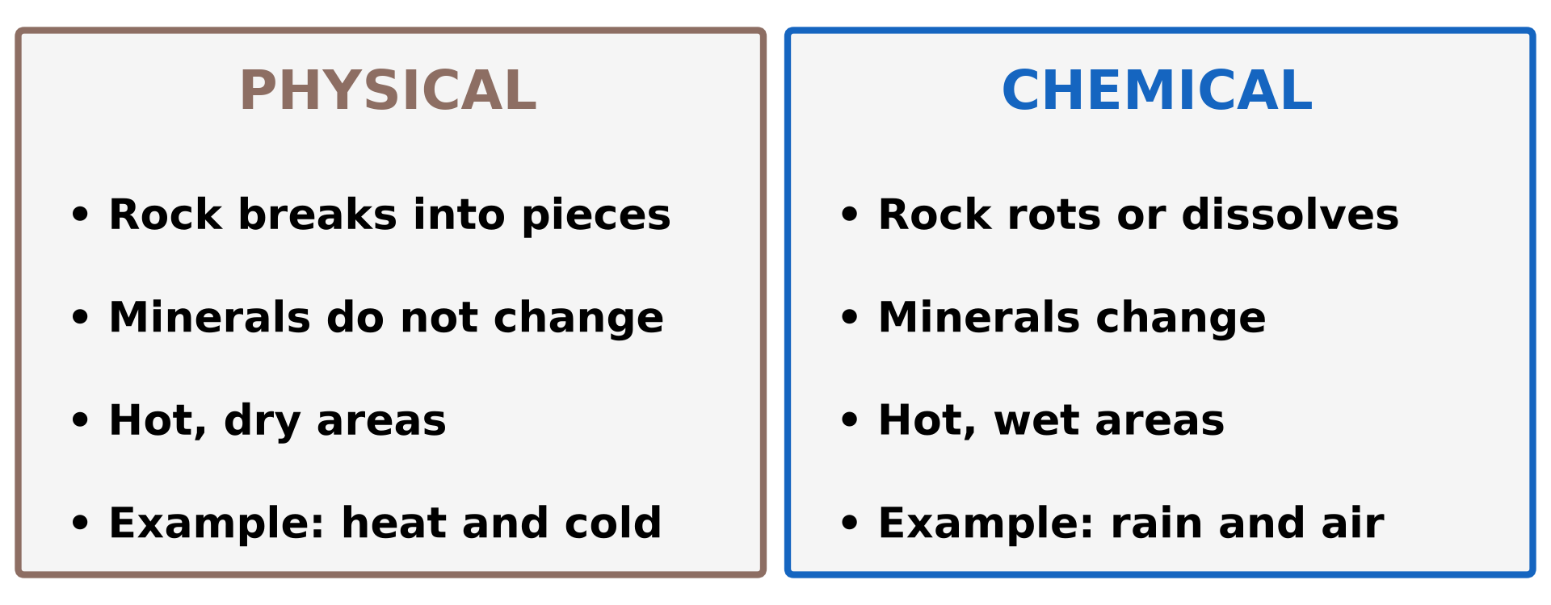
BOARD SUMMARY
2. Types of Weathering
Illustration: types of weathering
Notes:
Now draw this illustration in your notebook: types of weathering. Give it a title and label it clearly.

Slide 31
BOARD SUMMARY
3. Factors of Weathering
Weathering depends on the following factors:
Climate: Hot and wet climates favour chemical weathering, while hot deserts favour physical weathering.
Rock characteristics: Soft rocks and rocks with many joints break faster.
Notes:
Let us copy Factors of Weathering. Weathering depends on the following factors. On this slide we have Climate and Rock characteristics. Write each point on a new line, with the key term first, and explain it in your own words when we revise. When you finish, we go to the next slide.

Slide 32
BOARD SUMMARY
3. Factors of Weathering (continued)
Vegetation: Roots open cracks, and rotting plants produce acids that attack rocks.
Time: The longer rocks are exposed, the more they are weathered.
Human activities: Roads, quarries and farming expose rocks to weathering.
Notes:
We continue with Factors of Weathering. On this slide we have Vegetation, Time and Human activities. Write each point on a new line, with the key term first, and explain it in your own words when we revise.

Slide 33
FORMATIVE EVALUATION
Evaluation 1
What is weathering?
Notes:
Now let us check what you have understood. Question 1: What is weathering? Answer in your exercise book.

Slide 34
FORMATIVE EVALUATION
Expected Answer
The breaking down of rocks in their place.
Notes:
The expected answer is: the breaking down of rocks in their place. If you got it right, well done.

Slide 35
FORMATIVE EVALUATION
Evaluation 2
Give the two types of weathering.
Notes:
Now let us check what you have understood. Question 2: Give the two types of weathering. Answer in your exercise book.

Slide 36
FORMATIVE EVALUATION
Expected Answer
Physical and chemical weathering.
Notes:
The expected answer is: physical and chemical weathering. If you got it right, well done.

Slide 37
REMEDIATION
Remediation
Fill in the blanks:
Rocks breaking into pieces without changing is ______ weathering.
Rain and air change the minerals: ______ weathering.
Tree ______ can break rocks.
Notes:
For those who need more practice, fill in the blanks in your exercise book. The answers are: number 1, physical; number 2, chemical; number 3, roots.

Slide 38
HOMEWORK
Homework
Touch a big rock or a cement wall at 1 p.m. and again at 7 p.m. Write what you feel, and why this could break the rock after many years.
Notes:
For your homework: Touch a big rock or a cement wall at 1 p.m. and again at 7 p.m. Write what you feel, and why this could break the rock after many years. We shall correct it at the beginning of our next lesson.

Slide 39
NEXT LESSON
Next Lesson
Our next lesson will be on:
Lesson 16: Physical Weathering Processes and Products
Notes:
Our next lesson will be on Lesson 16: Physical Weathering Processes and Products. Thank you for your attention, and see you next time.

Slide 40
BILINGUAL GAME
Bilingual Game (Jeu Bilingue)
English | Français
Weathering | L'altération
Physical weathering | L'altération physique / mécanique
Chemical weathering | L'altération chimique
Joint | La diaclase / fissure
Climate | Le climat
Vegetation | La végétation
In situ | Sur place
To crumble | S'effriter
Notes:
Let us play the bilingual game. I say a word in English, and you give me the French word. Then we do the reverse.

Slide 41
LOGBOOK
Official Logbook (1/2)
Module / Topic | Denudation Processes, Landforms and Impacts on Man
Lesson Title | Lesson 15: Weathering
Expected Learning Outcomes | Define weathering. Distinguish physical and chemical weathering. Explain briefly the factors of weathering.
Competence | Learners are able to explain why rocks, walls and buildings slowly break down, and to choose materials and actions that slow this down.
Notes:
I record this information in the official logbook of the class after the lesson.

Slide 42
LOGBOOK
Official Logbook (2/2)
Matter Taught | Meaning of Weathering; Types of Weathering; Factors of Weathering.
Evaluation | Formative evaluation and remediation exercise.
Homework | Touch a big rock or a cement wall at 1 p.m. and again at 7 p.m. Write what you feel, and why this could break the rock after many years.
Enrolment / Present / Absent | ____ / ____ / ____
Achievement | To be completed after the lesson.
Notes:
I complete the second page of the logbook: the matter taught, the evaluation, the homework and the attendance.

Slide 43
TEACHER'S NOTE
Teacher's Note
Timing: Homework correction, plan, objectives 4 min | Recall, situation, action 6 min | 3 activities 12 min | Board summary (copying) 15 min | Evaluation, remediation 5 min | Homework, next lesson 3 min | Logbook 5 min
Without the projector (Activity 1): show an old wall of the school.
Without the projector (Activity 2): show a rusty nail.
Without the projector (Activity 3): show a tree root in a cracked wall or road.
Notes:
This slide is for me, the teacher: it gives the timing of the lesson and what to do if the projector is not available.

Slide 44
REFERENCES
References
National Geography Syllabus (MINESEC), Form 4 — Denudation Processes, Landforms and Impacts on Man.
Teacher's lesson notes (Form 4), checked and corrected where necessary.
Photo, Activity 1: “Cracked wall” by árticotropical, CC BY 2.0, via Flickr (https://www.flickr.com/photos/8581973@N02/521943309)
Photo, Activity 2: “Lock down!” by ViNo Gv, CC BY 2.0, via Flickr (https://www.flickr.com/photos/38217093@N03/20143584561)
Photo, Activity 3: “Stones 'n' Roots” by erix!, CC BY 2.0, via Flickr (https://www.flickr.com/photos/68387408@N00/55692423)
Diagrams and animations: drawn for this lesson (Geography Department).
Notes:
These are the references and picture credits used to prepare this lesson.

