Slide 1
FORM 4
GEOGRAPHY
Lesson 27
Semi-Arid and Desert Landscapes
Notes:
Good morning, class, and welcome to our geography lesson. I am your geography teacher, Mr Kamdem. Today we are starting Lesson 27: Semi-Arid and Desert Landscapes.

Slide 2
CLASS INFO
Class, Chapter and Duration
Class | Form 4
Chapter | Denudation Processes, Landforms and Impacts on Man — Hot Desert Landscapes: Wind Action and Human Adaptation
Duration | 50 minutes
Notes:
This lesson is for Form 4. It belongs to Denudation Processes, Landforms and Impacts on Man — Hot Desert Landscapes: Wind Action and Human Adaptation. We shall need 50 minutes to cover it.

Slide 3
IDENTIFICATION
Lesson Identification
Topic | Denudation Processes, Landforms and Impacts on Man
Sub-topic | Hot Desert Landscapes: Wind Action and Human Adaptation
Lesson | Lesson 27: Semi-Arid and Desert Landscapes
Notions / Concepts | Rock pedestal, zeugen, yardangs, inselbergs.
Syllabus focus | Location of semi-arid areas and hot deserts in Africa; main erosional processes of wind; erosional features.
Competence | Learners are able to locate the hot deserts of Africa on a map and recognise rocks and walls worn by the wind.
Notes:
Our topic is Denudation Processes, Landforms and Impacts on Man, and the sub-topic is Hot Desert Landscapes: Wind Action and Human Adaptation. The key notions we shall use today are: rock pedestal, zeugen, yardangs, inselbergs. At the end, you should be able to do this: learners are able to locate the hot deserts of Africa on a map and recognise rocks and walls worn by the wind.

Slide 4

HOMEWORK CORRECTION
Correction of the Homework
Question (Lesson 26: Impact of Wave Action on Human Development along Coastal Areas):
On a map of Africa in your atlas, find the Sahara, the Sahel and the Kalahari. Write in which part of Africa each one is located.
Notes:
Before we start the new lesson, let us correct the homework I gave you at the end of Lesson 26: Impact of Wave Action on Human Development along Coastal Areas. The question was: On a map of Africa in your atlas, find the Sahara, the Sahel and the Kalahari. Write in which part of Africa each one is located. Take out your exercise books.

Slide 5
HOMEWORK CORRECTION
Correction: Possible Answer
The Sahara is in North Africa; the Sahel is a belt south of the Sahara, from Senegal to Sudan (including the Far North of Cameroon); the Kalahari is in Southern Africa (Botswana).
Notes:
Here is a good answer. The Sahara is in North Africa; the Sahel is a belt south of the Sahara, from Senegal to Sudan (including the Far North of Cameroon); the Kalahari is in Southern Africa (Botswana). Compare it with your own answer and correct your work in red.

Slide 6
LESSON PLAN
Lesson Plan
Correction of the homework
Objectives and recall
Real-life situation and action to take
Learning activities
Board summary
Evaluation, remediation and homework
Notes:
Here is the plan of our lesson today. First, we shall correct the homework. Then we shall look at the objectives and recall what you already know. After that, we shall study a situation from real life and the action to take, and do the learning activities. Finally, we shall copy the board summary, do the evaluation and the remediation, and I will give you the homework.

Slide 7
OBJECTIVES
Objectives
By the end of this lesson, you should be able to:
Locate the main hot deserts and the semi-arid Sahel on a map of Africa.
Describe the three processes of wind erosion: deflation, abrasion and attrition.
Notes:
Take your time to copy this part; we will continue together.

Slide 8
OBJECTIVES
Objectives (continued)
Explain the formation of rock pedestals, zeugen, yardangs and inselbergs.
Notes:
By the end of this lesson, you should be able to do three things. Number 1: locate the main hot deserts and the semi-arid Sahel on a map of Africa. Number 2: describe the three processes of wind erosion: deflation, abrasion and attrition. Number 3: explain the formation of rock pedestals, zeugen, yardangs and inselbergs.

Slide 9
PREVIOUS KNOWLEDGE
Previous Knowledge
Rivers and waves are agents of erosion: they wear away, transport and deposit material.
Waves erode the coast and form cliffs, caves, arches and stacks.
Today, we study another agent of erosion: the wind, in dry areas.
Notes:
Let us first remember what you already know. Rivers and waves are agents of erosion: they wear away, transport and deposit material. Waves erode the coast and form cliffs, caves, arches and stacks. Today, we study another agent of erosion: the wind, in dry areas. Keep this in mind, because we shall build on it today.

Slide 10
REAL-LIFE SITUATION
Situation in Real Life
During the Harmattan, Moussa sees that the old wall of his compound is worn near the ground, but the top is still smooth. The worn side faces the north-east, where the Harmattan comes from.
Notes:
Listen carefully to this situation from real life. During the Harmattan, Moussa sees that the old wall of his compound is worn near the ground, but the top is still smooth. The worn side faces the north-east, where the Harmattan comes from. Think about it, because I am going to ask you some questions.

Slide 11
REAL-LIFE SITUATION
Situation: Question 1
What is the problem in the situation?
Notes:
Question 1: What is the problem in the situation? Think for a moment, then raise your hand to answer.

Slide 12
REAL-LIFE SITUATION
Answer
Moussa does not know how the wind wore away the wall.
Notes:
Good. Moussa does not know how the wind wore away the wall.

Slide 13
REAL-LIFE SITUATION
Situation: Question 2
Which part of the wall is worn?
Notes:
Question 2: Which part of the wall is worn? Think for a moment, then raise your hand to answer.

Slide 14
REAL-LIFE SITUATION
Answer
The bottom, facing the north-east.
Notes:
Good. The bottom, facing the north-east.

Slide 15
REAL-LIFE SITUATION
Situation: Question 3
What can protect the wall?
Notes:
Question 3: What can protect the wall? Think for a moment, then raise your hand to answer.

Slide 16
REAL-LIFE SITUATION
Possible Answer
A hedge or trees that stop the wind.
Notes:
Good. A hedge or trees that stop the wind.

Slide 17
ACTION TO TAKE
Action to Take
Protect dry lands from wind erosion by planting trees.
Notes:
From this situation, the action we are working towards in this lesson is the following: protect dry lands from wind erosion by planting trees.

Slide 18
JUSTIFICATION
Justification of the Lesson
This lesson helps us to understand how wind shapes rocks in dry areas.
Notes:
Why is this lesson important for you? This lesson helps us to understand how wind shapes rocks in dry areas.

Slide 19

1. LOCATION
Activity 1
The hot deserts of the world.
Notes:
Activity 1. Look carefully at this diagram: the hot deserts of the world. Observe every detail before I ask the question.

Slide 20
1. LOCATION
Activity 1: Question
Name the largest hot desert. Which dry belt lies south of it?
Notes:
Here is the question for Activity 1: Name the largest hot desert. Which dry belt lies south of it? Take one minute to think and write your answer in your rough notebook.

Slide 21
1. LOCATION
Activity 1: Answer
The Sahara. The Sahel lies south of it.
Notes:
Let us check the answer together. The Sahara. The Sahel lies south of it.

Slide 22
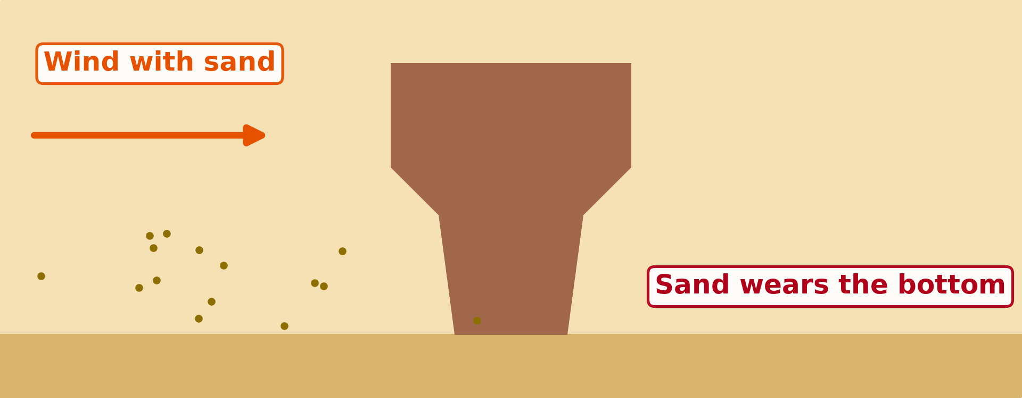
2. WIND EROSION
Activity 2
Animation: the wind throws sand against a rock.
Notes:
Activity 2. Look carefully at this animation: animation: the wind throws sand against a rock. Watch the animation to the end; it will play again.

Slide 23
2. WIND EROSION
Activity 2: Question
Why is the rock worn more at the bottom?
Notes:
Here is the question for Activity 2: Why is the rock worn more at the bottom? Take one minute to think and write your answer in your rough notebook.

Slide 24
2. WIND EROSION
Activity 2: Answer
The wind carries most sand near the ground.
Notes:
Let us check the answer together. The wind carries most sand near the ground.

Slide 25
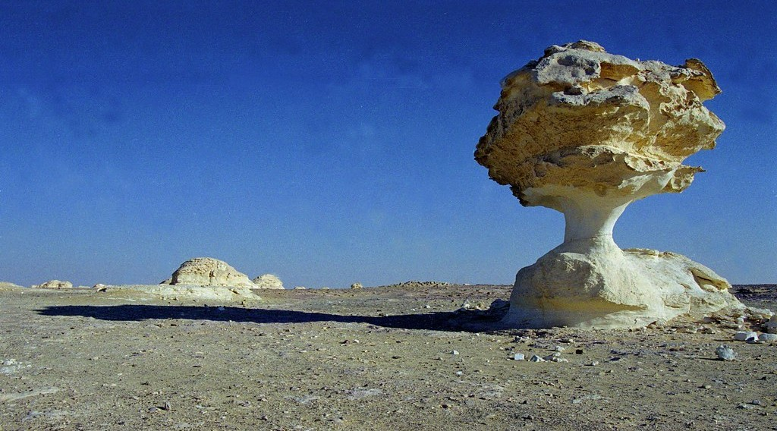
3. EROSIONAL FEATURES
Activity 3
A rock worn by the wind.
Notes:
Activity 3. Look carefully at this picture: a rock worn by the wind. Observe every detail before I ask the question.

Slide 26
3. EROSIONAL FEATURES
Activity 3: Question
This rock is narrow at the bottom and wide at the top. What is it called?
Notes:
Here is the question for Activity 3: This rock is narrow at the bottom and wide at the top. What is it called? Take one minute to think and write your answer in your rough notebook.

Slide 27
3. EROSIONAL FEATURES
Activity 3: Answer
A rock pedestal (mushroom rock).
Notes:
Let us check the answer together. A rock pedestal (mushroom rock).

Slide 28
BOARD SUMMARY
Board Summary
Topic: Denudation Processes, Landforms and Impacts on Man
Sub-topic: Hot Desert Landscapes: Wind Action and Human Adaptation
Lesson 27: Semi-Arid and Desert Landscapes
Notes:
Now we are going to copy the board summary. Write the title and the headings neatly in your notebooks. I will give you enough time for each slide, so do not rush.

Slide 29
BOARD SUMMARY
1. Location of Semi-arid Areas and Hot Deserts in Africa
Dry lands in Africa are located as follows:
Semi-arid region: It is a region that receives 250 to 500 mm of rain per year.
The Sahara: It is the largest hot desert in the world, in North Africa.
Notes:
Let us copy Location of Semi-arid Areas and Hot Deserts in Africa. Dry lands in Africa are located as follows. On this slide we have Semi-arid region and The Sahara. Write each point on a new line, with the key term first, and explain it in your own words when we revise. When you finish, we go to the next slide.

Slide 30
BOARD SUMMARY
1. Location of Semi-arid Areas and Hot Deserts in Africa (continued)
The Kalahari and the Namib: They are hot deserts in Southern Africa.
The Sahel: It is a semi-arid belt south of the Sahara that includes the Far North of Cameroon.
Notes:
We continue with Location of Semi-arid Areas and Hot Deserts in Africa. On this slide we have The Kalahari and the Namib and The Sahel. Write each point on a new line, with the key term first, and explain it in your own words when we revise.

Slide 31
BOARD SUMMARY
1. Location of Semi-arid Areas and Hot Deserts in Africa
Illustration: hot deserts
Notes:
Now draw this illustration in your notebook: hot deserts. Give it a title and label it clearly.

Slide 32
BOARD SUMMARY
2. Erosional Processes of Wind
Wind erodes the land through the following processes:
Deflation: It is the removal of loose sand and dust by the wind.
Abrasion: It is the wearing of rocks by sand thrown by the wind near the ground.
Notes:
Let us copy Erosional Processes of Wind. Wind erodes the land through the following processes. On this slide we have Deflation and Abrasion. Write each point on a new line, with the key term first, and explain it in your own words when we revise. When you finish, we go to the next slide.

Slide 33
BOARD SUMMARY
2. Erosional Processes of Wind (continued)
Attrition: It is the wearing of sand grains as they hit each other.
Notes:
We continue with Erosional Processes of Wind. On this slide we have Attrition. Write each point on a new line, with the key term first, and explain it in your own words when we revise.

Slide 34
BOARD SUMMARY
3. Erosional Features
Wind erosion forms the following features:
Rock pedestal: It is a mushroom-shaped rock worn at its base by abrasion.
Zeugen: They are tabular ridges of hard rock resting on soft rock.
Notes:
Let us copy Erosional Features. Wind erosion forms the following features. On this slide we have Rock pedestal and Zeugen. Write each point on a new line, with the key term first, and explain it in your own words when we revise. When you finish, we go to the next slide.

Slide 35
BOARD SUMMARY
3. Erosional Features (continued)
Yardangs: They are long ridges of rock lying in the direction of the wind.
Inselberg: It is an isolated steep hill rising from a flat plain.
Notes:
We continue with Erosional Features. On this slide we have Yardangs and Inselberg. Write each point on a new line, with the key term first, and explain it in your own words when we revise.

Slide 36
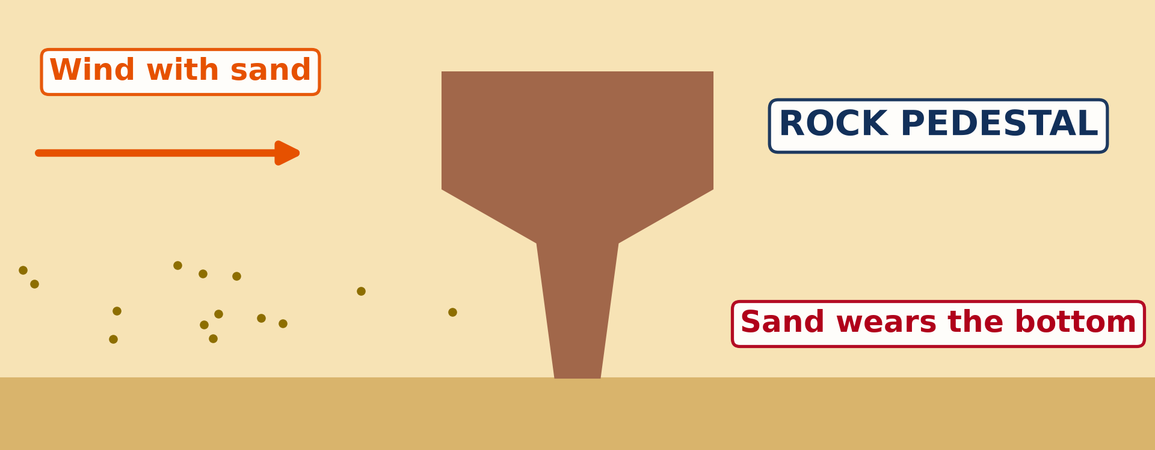
BOARD SUMMARY
3. Erosional Features
Illustration: a rock pedestal
Notes:
Now draw this illustration in your notebook: a rock pedestal. Give it a title and label it clearly.

Slide 37
FORMATIVE EVALUATION
Evaluation 1
What is abrasion?
Notes:
Now let us check what you have understood. Question 1: What is abrasion? Answer in your exercise book.

Slide 38
FORMATIVE EVALUATION
Expected Answer
The wearing of rocks by sand thrown by the wind.
Notes:
The expected answer is: the wearing of rocks by sand thrown by the wind. If you got it right, well done.

Slide 39
FORMATIVE EVALUATION
Evaluation 2
Why is a rock pedestal narrow at the bottom?
Notes:
Now let us check what you have understood. Question 2: Why is a rock pedestal narrow at the bottom? Answer in your exercise book.

Slide 40
FORMATIVE EVALUATION
Expected Answer
The wind throws most sand near the ground.
Notes:
The expected answer is: the wind throws most sand near the ground. If you got it right, well done.

Slide 41
REMEDIATION
Remediation
Fill in the blanks:
The removal of loose sand by wind is ______.
A mushroom-shaped rock is a rock ______.
A lonely hill on a flat plain is an ______.
Notes:
For those who need more practice, fill in the blanks in your exercise book. The answers are: number 1, deflation; number 2, pedestal; number 3, inselberg.

Slide 42
HOMEWORK
Homework
After the next windy day, look around your compound. Find a place where sand or dust has piled up, for example behind a wall, a stone or a bush, and write down why you think it collected there.
Notes:
For your homework: After the next windy day, look around your compound. Find a place where sand or dust has piled up, for example behind a wall, a stone or a bush, and write down why you think it collected there. We shall correct it at the beginning of our next lesson.

Slide 43
NEXT LESSON
Next Lesson
Our next lesson will be on:
Lesson 28: Depositional Features of Wind Action
Notes:
Our next lesson will be on Lesson 28: Depositional Features of Wind Action. Thank you for your attention, and see you next time.

Slide 44
BILINGUAL GAME
Bilingual Game (Jeu Bilingue)
English | Français
Desert | Le désert
Semi-arid | Semi-aride
Wind erosion | L'érosion éolienne
Deflation | La déflation
Abrasion | La corrasion
Rock pedestal | Le rocher-champignon
Inselberg | L'inselberg
Ridge | La crête
Notes:
Let us play the bilingual game. I say a word in English, and you give me the French word. Then we do the reverse.

Slide 45
LOGBOOK
Official Logbook (1/2)
Module / Topic | Denudation Processes, Landforms and Impacts on Man
Lesson Title | Lesson 27: Semi-Arid and Desert Landscapes
Expected Learning Outcomes | Locate the main hot deserts and the semi-arid Sahel on a map of Africa. Describe the three processes of wind erosion: deflation, abrasion and attrition. Explain the formation of rock pedestals, zeugen, yardangs and inselbergs.
Competence | Learners are able to locate the hot deserts of Africa on a map and recognise rocks and walls worn by the wind.
Notes:
I record this information in the official logbook of the class after the lesson.

Slide 46
LOGBOOK
Official Logbook (2/2)
Matter Taught | Location of Semi-arid Areas and Hot Deserts in Africa; Erosional Processes of Wind; Erosional Features.
Evaluation | Formative evaluation and remediation exercise.
Homework | After the next windy day, look around your compound. Find a place where sand or dust has piled up, for example behind a wall, a stone or a bush, and write down why you think it collected there.
Enrolment / Present / Absent | ____ / ____ / ____
Achievement | To be completed after the lesson.
Notes:
I complete the second page of the logbook: the matter taught, the evaluation, the homework and the attendance.

Slide 47
TEACHER'S NOTE
Teacher's Note
Timing: Homework correction, plan, objectives 4 min | Recall, situation, action 6 min | 3 activities 12 min | Board summary (copying) 15 min | Evaluation, remediation 5 min | Homework, next lesson 3 min | Logbook 5 min
Activity 2 is an animation (GIF): it plays automatically in slide-show mode.
Without the projector (Activity 1): draw Africa with the Sahara and the Sahel.
Without the projector (Activity 2): use the example of Moussa's wall.
Without the projector (Activity 3): draw a mushroom-shaped rock.
Notes:
This slide is for me, the teacher: it gives the timing of the lesson and what to do if the projector is not available.

Slide 48
REFERENCES
References
National Geography Syllabus (MINESEC), Form 4 — Denudation processes, landforms and impacts on man — Lesson 27.
Teacher's lesson notes, Lesson 27 (f4.docx).
Climate data for Garoua: Weather Spark; Mont Tinguelin: Wikipédia (fr).
Photo, Activity 3: “Stone Mushroom in White Desert. Qasr. Al-Farafra. Egypt. Free Stock Ph” by SkilledAdventurer, CC BY 2.0, via Flickr (https://www.flickr.com/photos/140589650@N06/26810236588)
Diagrams and animations: drawn for this lesson (Geography Department).
Notes:
These are the references and picture credits used to prepare this lesson.

