Slide 1
FORM 4
GEOGRAPHY
Lesson 31
Weather and Climate
Notes:
Good morning, class, and welcome to our geography lesson. I am your geography teacher, Mr Kamdem. Today we are starting Lesson 31: Weather and Climate.

Slide 2
CLASS INFO
Class, Chapter and Duration
Class | Form 4
Chapter | Module 3: Weather and Climate — Adaptation to Climatic Excesses
Duration | 50 minutes
Notes:
This lesson is for Form 4. It belongs to Module 3: Weather and Climate — Adaptation to Climatic Excesses. We shall need 50 minutes to cover it.

Slide 3
IDENTIFICATION
Lesson Identification
Topic | The Earth-Atmosphere System
Sub-topic | Measurement of Weather Elements
Lesson | Lesson 31: Weather and Climate
Notions / Concepts | Weather, weather instruments.
Syllabus focus | Definition of weather and climate; definition of a weather station; classification of weather elements, instruments and measurements; their isolines.
Competence | Learners are able to read a simple weather forecast and use it to plan daily activities such as farming or travel.
Notes:
Our topic is The Earth-Atmosphere System, and the sub-topic is Measurement of Weather Elements. The key notions we shall use today are: weather, weather instruments. At the end, you should be able to do this: learners are able to read a simple weather forecast and use it to plan daily activities such as farming or travel.

Slide 4

HOMEWORK CORRECTION
Correction of the Homework
Question (Lesson 30: The Atmosphere):
Watch or listen to a weather forecast on television or radio. Write down two pieces of information it gives (for example temperature, rain or wind).
Notes:
Before we start the new lesson, let us correct the homework I gave you at the end of Lesson 30: The Atmosphere. The question was: Watch or listen to a weather forecast on television or radio. Write down two pieces of information it gives (for example temperature, rain or wind). Take out your exercise books.

Slide 5
HOMEWORK CORRECTION
Correction: Possible Answer
Examples: the forecast gave the temperature (maximum 36 °C in Garoua), the chance of rain (storms in the evening) and the wind (dust-laden Harmattan).
Notes:
Here is a good answer. Examples: the forecast gave the temperature (maximum 36 °C in Garoua), the chance of rain (storms in the evening) and the wind (dust-laden Harmattan). Compare it with your own answer and correct your work in red.

Slide 6
LESSON PLAN
Lesson Plan
Correction of the homework
Objectives and recall
Real-life situation and action to take
Learning activities
Board summary
Evaluation, remediation and homework
Notes:
Here is the plan of our lesson today. First, we shall correct the homework. Then we shall look at the objectives and recall what you already know. After that, we shall study a situation from real life and the action to take, and do the learning activities. Finally, we shall copy the board summary, do the evaluation and the remediation, and I will give you the homework.

Slide 7
OBJECTIVES
Objectives
By the end of this lesson, you should be able to:
Define weather and climate and distinguish between them.
Define a weather station.
Notes:
Take your time to copy this part; we will continue together.

Slide 8
OBJECTIVES
Objectives (continued)
Name the weather elements with their instruments, units and isolines.
Notes:
By the end of this lesson, you should be able to do three things. Number 1: define weather and climate and distinguish between them. Number 2: define a weather station. Number 3: name the weather elements with their instruments, units and isolines.

Slide 9
PREVIOUS KNOWLEDGE
Previous Knowledge
The atmosphere has four layers; weather takes place in the troposphere.
Temperature falls with height in the troposphere.
The ozone layer protects us from ultraviolet rays.
Notes:
Let us first remember what you already know. The atmosphere has four layers; weather takes place in the troposphere. Temperature falls with height in the troposphere. The ozone layer protects us from ultraviolet rays. Keep this in mind, because we shall build on it today.

Slide 10
REAL-LIFE SITUATION
Situation in Real Life
On Monday morning, it rains in Garoua, so Idrissa takes an umbrella. His cousin in Paris says: "But Garoua has a hot climate. Why do you need an umbrella?"
Notes:
Listen carefully to this situation from real life. On Monday morning, it rains in Garoua, so Idrissa takes an umbrella. His cousin in Paris says: "But Garoua has a hot climate. Why do you need an umbrella?" Think about it, because I am going to ask you some questions.

Slide 11
REAL-LIFE SITUATION
Situation: Question 1
What is the problem in the situation?
Notes:
Question 1: What is the problem in the situation? Think for a moment, then raise your hand to answer.

Slide 12
REAL-LIFE SITUATION
Answer
The cousin mixes up weather and climate.
Notes:
Good. The cousin mixes up weather and climate.

Slide 13
REAL-LIFE SITUATION
Situation: Question 2
What is the weather in Garoua on Monday?
Notes:
Question 2: What is the weather in Garoua on Monday? Think for a moment, then raise your hand to answer.

Slide 14
REAL-LIFE SITUATION
Answer
Cloudy and rainy.
Notes:
Good. Cloudy and rainy.

Slide 15
REAL-LIFE SITUATION
Situation: Question 3
What is the climate of Garoua?
Notes:
Question 3: What is the climate of Garoua? Think for a moment, then raise your hand to answer.

Slide 16
REAL-LIFE SITUATION
Possible Answer
Hot, with a wet and a dry season.
Notes:
Good. Hot, with a wet and a dry season.

Slide 17
ACTION TO TAKE
Action to Take
Follow weather forecasts to plan our activities.
Notes:
From this situation, the action we are working towards in this lesson is the following: follow weather forecasts to plan our activities.

Slide 18
JUSTIFICATION
Justification of the Lesson
This lesson helps us to know the difference between weather and climate.
Notes:
Why is this lesson important for you? This lesson helps us to know the difference between weather and climate.

Slide 19

1. WEATHER AND CLIMATE
Activity 1
A rainy afternoon.
Notes:
Activity 1. Look carefully at this picture: a rainy afternoon. Observe every detail before I ask the question.

Slide 20
1. WEATHER AND CLIMATE
Activity 1: Question
The condition of the air today is rainy. Is this the weather or the climate?
Notes:
Here is the question for Activity 1: The condition of the air today is rainy. Is this the weather or the climate? Take one minute to think and write your answer in your rough notebook.

Slide 21
1. WEATHER AND CLIMATE
Activity 1: Answer
The weather.
Notes:
Let us check the answer together. The weather.

Slide 22

2. THE WEATHER STATION
Activity 2
A weather station.
Notes:
Activity 2. Look carefully at this picture: a weather station. Observe every detail before I ask the question.

Slide 23
2. THE WEATHER STATION
Activity 2: Question
What do people do in this place?
Notes:
Here is the question for Activity 2: What do people do in this place? Take one minute to think and write your answer in your rough notebook.

Slide 24
2. THE WEATHER STATION
Activity 2: Answer
They measure the weather every day.
Notes:
Let us check the answer together. They measure the weather every day.

Slide 25
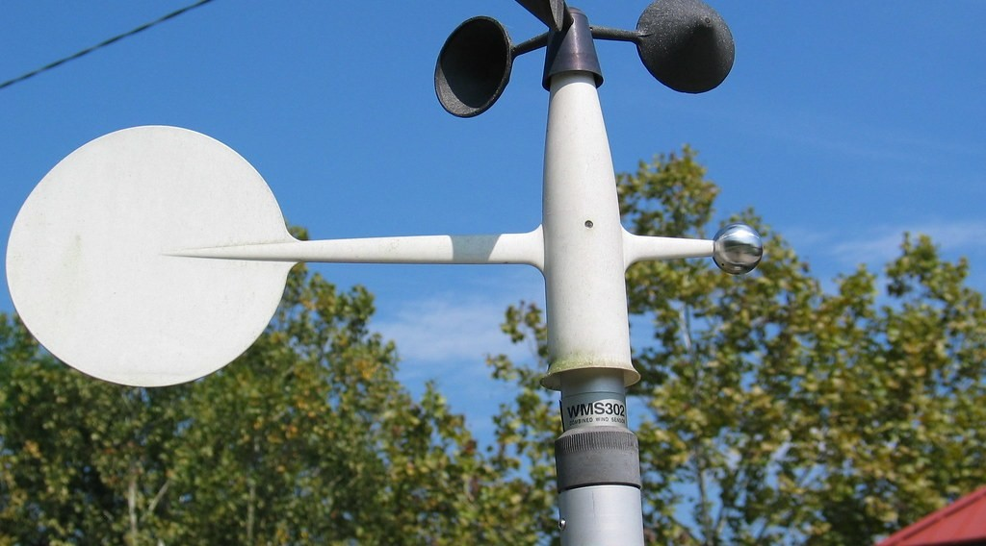
3. WEATHER ELEMENTS AND INSTRUMENTS
Activity 3
Instruments that measure the wind.
Notes:
Activity 3. Look carefully at this picture: instruments that measure the wind. Observe every detail before I ask the question.

Slide 26
3. WEATHER ELEMENTS AND INSTRUMENTS
Activity 3: Question
Which instrument measures wind speed? Which one shows wind direction?
Notes:
Here is the question for Activity 3: Which instrument measures wind speed? Which one shows wind direction? Take one minute to think and write your answer in your rough notebook.

Slide 27
3. WEATHER ELEMENTS AND INSTRUMENTS
Activity 3: Answer
The anemometer (speed); the wind vane (direction).
Notes:
Let us check the answer together. The anemometer (speed); the wind vane (direction).

Slide 28
BOARD SUMMARY
Board Summary
Topic: The Earth-Atmosphere System
Sub-topic: Measurement of Weather Elements
Lesson 31: Weather and Climate
Notes:
Now we are going to copy the board summary. Write the title and the headings neatly in your notebooks. I will give you enough time for each slide, so do not rush.

Slide 29
BOARD SUMMARY
1. Weather and Climate
Weather and climate are defined as follows:
Weather: It is the condition of the atmosphere at a place at a given time.
Climate: It is the average weather of a place over a long period of about 30 years.
Notes:
Let us copy Weather and Climate. Weather and climate are defined as follows. On this slide we have Weather and Climate. Write each point on a new line, with the key term first, and explain it in your own words when we revise.

Slide 30
BOARD SUMMARY
2. The Weather Station
The weather station is defined as follows:
Weather station: It is a place where weather elements are measured and recorded with instruments.
Notes:
Let us copy The Weather Station. The weather station is defined as follows. On this slide we have Weather station. Write each point on a new line, with the key term first, and explain it in your own words when we revise.

Slide 31
BOARD SUMMARY
3. Weather Elements, Instruments and Isolines
Weather elements are measured and shown as follows:
Temperature: It is measured with a thermometer in °C and shown by isotherms.
Rainfall: It is measured with a rain gauge in mm and shown by isohyets.
Notes:
Let us copy Weather Elements, Instruments and Isolines. Weather elements are measured and shown as follows. On this slide we have Temperature and Rainfall. Write each point on a new line, with the key term first, and explain it in your own words when we revise. When you finish, we go to the next slide.

Slide 32
BOARD SUMMARY
3. Weather Elements, Instruments and Isolines (continued)
Wind: Its direction is shown by a wind vane and its speed is measured with an anemometer.
Air pressure: It is measured with a barometer in millibars and shown by isobars.
Notes:
We continue with Weather Elements, Instruments and Isolines. On this slide we have Wind and Air pressure. Write each point on a new line, with the key term first, and explain it in your own words when we revise.

Slide 33

BOARD SUMMARY
3. Weather Elements, Instruments and Isolines
Illustration: weather instruments
Notes:
Now draw this illustration in your notebook: weather instruments. Give it a title and label it clearly.

Slide 34
FORMATIVE EVALUATION
Evaluation 1
What is the difference between weather and climate?
Notes:
Now let us check what you have understood. Question 1: What is the difference between weather and climate? Answer in your exercise book.

Slide 35
FORMATIVE EVALUATION
Expected Answer
Weather is today; climate is the average over about 30 years.
Notes:
The expected answer is: weather is today; climate is the average over about 30 years. If you got it right, well done.

Slide 36
FORMATIVE EVALUATION
Evaluation 2
Which instrument measures rainfall?
Notes:
Now let us check what you have understood. Question 2: Which instrument measures rainfall? Answer in your exercise book.

Slide 37
FORMATIVE EVALUATION
Expected Answer
The rain gauge.
Notes:
The expected answer is: the rain gauge. If you got it right, well done.

Slide 38
REMEDIATION
Remediation
Fill in the blanks:
The condition of the air today is the ______.
The average weather over 30 years is the ______.
Wind speed is measured with an ______.
Notes:
For those who need more practice, fill in the blanks in your exercise book. The answers are: number 1, weather; number 2, climate; number 3, anemometer.

Slide 39
HOMEWORK
Homework
Put one bottle of water in the sun and another in the shade for one hour. Touch both and write down which is hotter and why.
Notes:
For your homework: Put one bottle of water in the sun and another in the shade for one hour. Touch both and write down which is hotter and why. We shall correct it at the beginning of our next lesson.

Slide 40
NEXT LESSON
Next Lesson
Our next lesson will be on:
Lesson 32: Weather Elements: Atmospheric Temperatures
Notes:
Our next lesson will be on Lesson 32: Weather Elements: Atmospheric Temperatures. Thank you for your attention, and see you next time.

Slide 41
BILINGUAL GAME
Bilingual Game (Jeu Bilingue)
English | Français
Weather | Le temps
Climate | Le climat
Weather station | La station météorologique
Thermometer | Le thermomètre
Rain gauge | Le pluviomètre
Anemometer | L'anémomètre
Wind vane | La girouette
Barometer | Le baromètre
Notes:
Let us play the bilingual game. I say a word in English, and you give me the French word. Then we do the reverse.

Slide 42
LOGBOOK
Official Logbook (1/2)
Module / Topic | The Earth-Atmosphere System
Lesson Title | Lesson 31: Weather and Climate
Expected Learning Outcomes | Define weather and climate and distinguish between them. Define a weather station. Name the weather elements with their instruments, units and isolines.
Competence | Learners are able to read a simple weather forecast and use it to plan daily activities such as farming or travel.
Notes:
I record this information in the official logbook of the class after the lesson.

Slide 43
LOGBOOK
Official Logbook (2/2)
Matter Taught | Weather and Climate; The Weather Station; Weather Elements, Instruments and Isolines.
Evaluation | Formative evaluation and remediation exercise.
Homework | Put one bottle of water in the sun and another in the shade for one hour. Touch both and write down which is hotter and why.
Enrolment / Present / Absent | ____ / ____ / ____
Achievement | To be completed after the lesson.
Notes:
I complete the second page of the logbook: the matter taught, the evaluation, the homework and the attendance.

Slide 44
TEACHER'S NOTE
Teacher's Note
Timing: Homework correction, plan, objectives 4 min | Recall, situation, action 6 min | 3 activities 12 min | Board summary (copying) 15 min | Evaluation, remediation 5 min | Homework, next lesson 3 min | Logbook 5 min
Without the projector (Activity 1): ask learners to describe the weather today.
Without the projector (Activity 2): mention the weather station at Garoua airport.
Without the projector (Activity 3): make a paper wind vane.
Notes:
This slide is for me, the teacher: it gives the timing of the lesson and what to do if the projector is not available.

Slide 45
REFERENCES
References
National Geography Syllabus (MINESEC), Form 4 — Module 3: Weather and Climate.
Teacher's lesson notes (f4.docx), checked and corrected where necessary.
Photo, Activity 1: “When it rains in Africa!” by Martin_Heigan, CC BY-NC-ND 2.0, via Flickr (https://www.flickr.com/photos/97303475@N00/31286250004)
Photo, Activity 2: “Adelaide. Urrbrae. The weather station at the Waite campus of the Univ” by denisbin, CC BY-ND 2.0, via Flickr (https://www.flickr.com/photos/82134796@N03/49865994827)
Photo, Activity 3: “3-cup anemometer installed at Thomas More College measures horizontal ” by FondriestEnv, CC BY-NC 2.0, via Flickr (https://www.flickr.com/photos/67593579@N07/6334536635)
Diagrams and animations: drawn for this lesson (Geography Department).
Notes:
These are the references and picture credits used to prepare this lesson.

